Slide 1
Modern Javascript

Slide 2

Frontend Engineer
& Free software enthusiast

Slide 3
Goals
ES5
Versioning in Javascript
  The dilemma
  One Javascript
TC39 process
New features
  ES2015
  ES2016
  ES2017
  ES2018

Slide 4
Versioning in Javascript

Slide 5
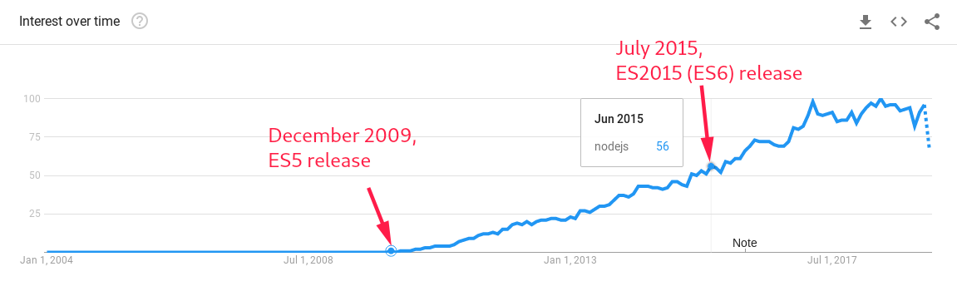
NodeJS explodes

Slide 6
Early Javascript
Javascript was very loosely typed
Error prone
Not reliable for mission-critical projects

Slide 7
5th Edition Of Javascript
Attempt clean up the language
Introduced Strict mode
Breaking changes

Slide 8
NodeJS explodes

Slide 9
The Dilemma
Incompatible release
  The web is HUGE
  “Don’t break the internet”
  Fractured ecosystem
  Hard to maintain, refactor & migrate
  Developers are people

Slide 10
One Javascript
Evolution without versioning
Backward compatible release
Concept by David Herman
Progressively enhance the language
Make existing features more powerful

Slide 11
TC39 Process

Slide 12
TC39 Process
TC39 committee responsible for improving the ECMAScript language specification
Open for everyone to participate!
Maturity based system

Slide 13
Features!

Slide 14
ES2015
Constants
Block scoped variables & functions
Arrow functions
Default, rest & spread parameters
Enhanced object properties
Array & Object destructing
Class syntax
Symbols
Generators
Map, Set, WeakMap, Weakset
Promises

Slide 15
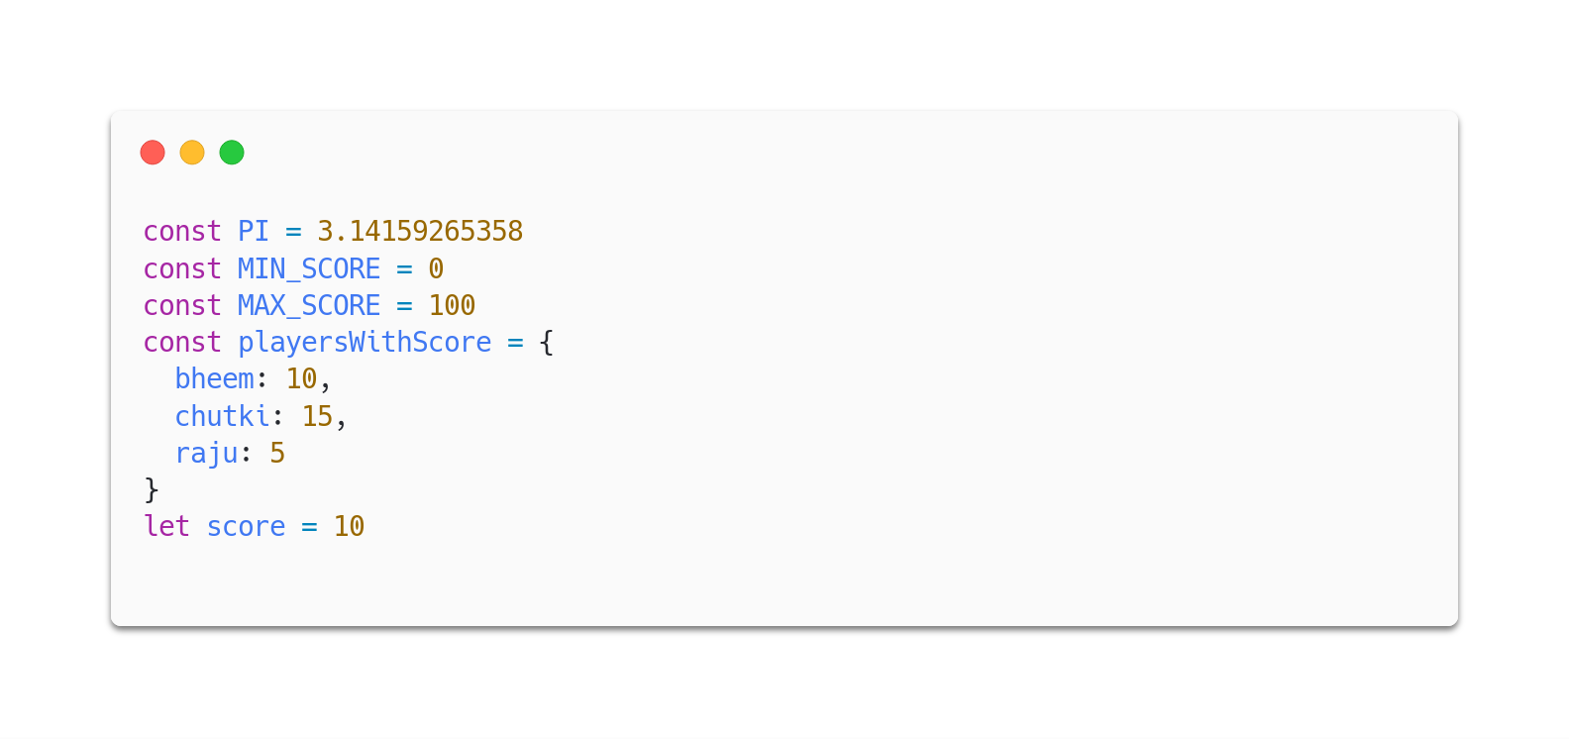
Constants

Slide 16
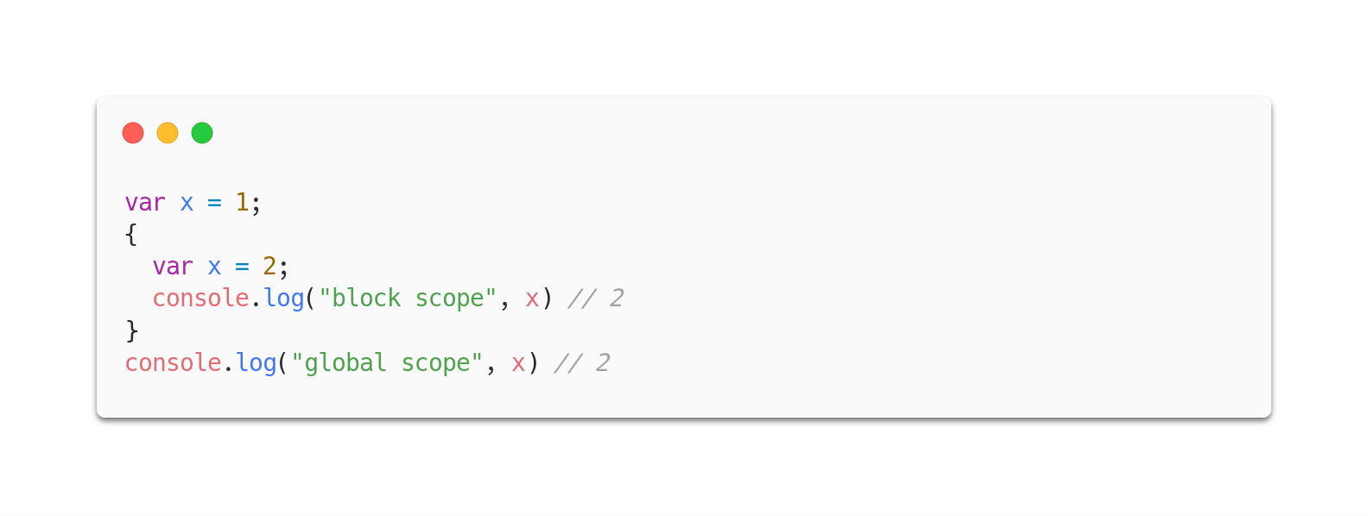
Block scoped variables & functions

Slide 17
ES2016
Array.prototype.includes
Exponentiation Operator

Slide 18
ES2017
Async functions
Object.values & Object.entries
Object.getOwnPropertyDescriptors

Slide 19
ES2018
Async functions
Rest / Spread properties
RegExp named capture groups
RegExp lookbehind assertions
Promise.prototype.finally

