Slide 1

Applied statistical analysis Replication Final project
Burak Ozuer
18302382
BEHAVIORAL ADDICTION TO TECHNOLOGY

Slide 2
Behavioural Functions Associated With Wanting to Reduce Internet Use
Elizabeth G. E. Kyonka, February 22, 2023

Slide 3

About the article
The article explores the development of self-report scales for assessing problematic internet use and emphasizes the importance of studying the motivations behind internet usage.
Hypothesis : The desire to reduce internet use is associated with problematic internet use as measured by the Young Diagnostic Questionnaire (YDQ; Young, 1998). The so-called problematic internet users may be less likely to want to reduce internet use than nonproblematic internet users simply because they value internet use more.

Slide 4

GOAL OF THE REPLICATION STUDY
The article and supporting documents have been found in the OSF knowledge base.
The supporting documents include the raw survey data, the structure of the survey questions (including the type of answers and their meanings), and additional data analysis results that help reach a conclusion for this study.
Since the coding steps were not shared, one of the most challenging steps of the replication study was to generate the same results as reported using R coding.
OSF Page: https://osf.io/kwf4e/

Slide 5
Data Manipulation
Data manipulation steps were applied to replicate the results of the descriptive analysis, which were shared as a supplementary document in the OSF knowledge base.
Scaling Survey Answers
Findings
Before applying the data transformation steps, I analysed the survey questions and created a data dictionary, which proved to be very helpful in understanding the data.
For the YDQ* analysis, questions were grouped, and the answer scale was adjusted to 1-2, with "no" answers replaced by 0.
The YDQ bin model attribute was calculated based on participants answering 5 or more YDQ questions as 'Yes'.
The analysis included data transformation steps, but they were not explained well in the article. Replicating the results from a descriptive analysis perspective was challenging due to unclear explanations of data mapping and transformation.
YDQ* : Young Diagnostic Questionnaire.

Slide 6
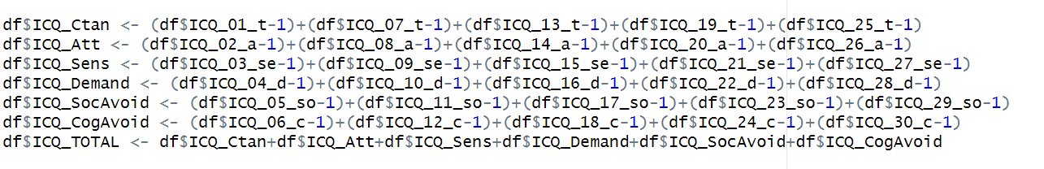
Data dictionary
Survey Questions
Attribute Name | Question
IU_W2R | Do you wish you spent less time on the internet?
ICQ_01_t | I go online to make money.
ICQ_02_a | I like the community aspects of using the internet.
ICQ_03_se | I like visual and auditory aspects of using the internet.
ICQ_04_d | I use the internet to get a break from work or other difficult tasks.
ICQ_05_so | I find it is better to confront someone over the internet rather than doing it face to face.
ICQ_06_c | I use the internet when I can’t stop thinking about something.
ICQ_07_t | I earn money when I use the internet.
ICQ_08_a | I go online to connect with my friends.
ICQ_09_se | I feel more alive when I am using the internet than when I am doing other types of activities.
ICQ_10_d | I use the internet to procrastinate.
ICQ_11_so | I use the internet after being in an argument or fight.
ICQ_12_c | I use the internet when I am feeling depressed or sad.
ICQ_13_t | I enjoy shopping online.
ICQ_14_a | I like interacting with other people on the internet.
ICQ_15_se | I feel a rush and get excited when I use the internet.
ICQ_16_d | I use the internet to avoid work or other things I need to do.
ICQ_17_so | I use the internet when I am not getting enough support from the people in my life.
ICQ_18_c | I go online when I feel stressed or anxious.
ICQ_19_t | I use coupons and discounts I learn about online.
ICQ_20_a | I enjoy getting attention from people on the internet.
ICQ_21_se | I go online when there is nothing else going on or I have nothing better to do.
ICQ_22_d | I use the internet when I have a work project or class assignment that is due soon.
ICQ_23_so | I use the internet as a buffer between other people and me.
ICQ_24_c | I use the internet when I am worried.
ICQ_25_t | When I use the internet, people offer me gifts, money, or other items.
ICQ_26_a | I enjoy meeting new people online.
ICQ_27_se | When I use the internet, I get immersed in what’s on the screen rather than my physical surroundings.
ICQ_28_d | If I must do something boring, difficult, or unpleasant, I use the internet first to psych myself up.
ICQ_29_so | I use the internet when people give me a hard time.
ICQ_30_c | I use the internet as a way of keeping my mind off my problems.
YDQ.1 | Do you feel preoccupied with the internet (think about previous online activity or anticipate next online session)?
YDQ.2 | Do you feel the need to use the internet with increasing amounts of time in order to achieve satisfaction?
YDQ.3 | Have you repeatedly made unsuccessful efforts to control, cut back, or stop internet use?
YDQ.4 | Do you feel restless, moody, depressed or irritable when attempting to cut down or stop internet use?
YDQ.5 | Do you stay online longer than originally intended?
YDQ.6 | Have you jeopardized or risked the loss of a significant relationship, job, educational, or career opportunity because of the internet?
YDQ.7 | Have you lied to family members, a therapist, or others to conceal the extent of involvement with the internet?
YDQ.8 | Do you use the internet as a way of escaping from problems or of relieving a dysphoric mood (e.g. feelings
The ICQ-P also assesses three negative
reinforcement functions: (a) demand (escape from or avoidance of the demands of work, school, or other responsibilities), (b) social escape/avoidance (i.e., escape from or avoidance of social conflict or awkwardness), and (c) cognitive escape/avoidance (i.e., escape from or avoidance of one’s own thoughts or feelings).

Slide 7
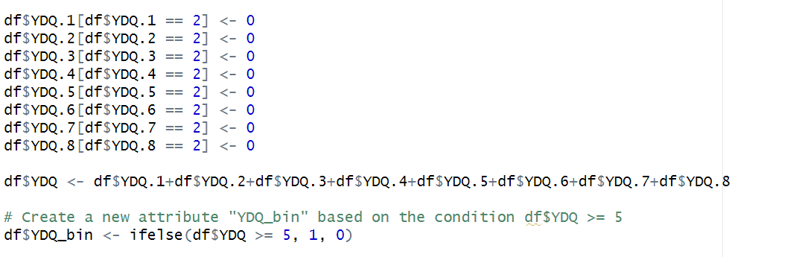
YDQ : Young Diagnostic Questionnaire.
Survey questions and answer scale
YDQ.1 | Do you feel preoccupied with the internet (think about previous online activity or anticipate next online session)?
YDQ.2 | Do you feel the need to use the internet with increasing amounts of time in order to achieve satisfaction?
YDQ.3 | Have you repeatedly made unsuccessful efforts to control, cut back, or stop internet use?
YDQ.4 | Do you feel restless, moody, depressed or irritable when attempting to cut down or stop internet use?
YDQ.5 | Do you stay online longer than originally intended?
YDQ.6 | Have you jeopardized or risked the loss of a significant relationship, job, educational, or career opportunity because of the internet?
YDQ.7 | Have you lied to family members, a therapist, or others to conceal the extent of involvement with the internet?
YDQ.8 | Do you use the internet as a way of escaping from problems or of relieving a dysphoric mood (e.g. feelings

Slide 8
Descriptive analysis – bar charts
Based on the “Do you wish you spent less time on the internet?” question answer, participants are more likely willing to reduce the time spent on internet according to the descriptive analysis below
819 respondents completed the survey, 351 of them wanted to spend less time on the internet, 468 of them answered the question above as “No”

Slide 9
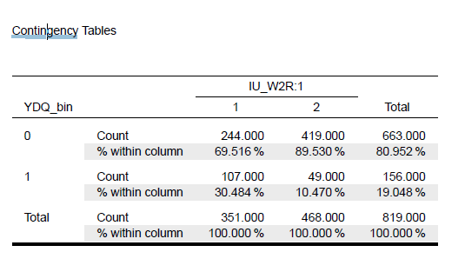
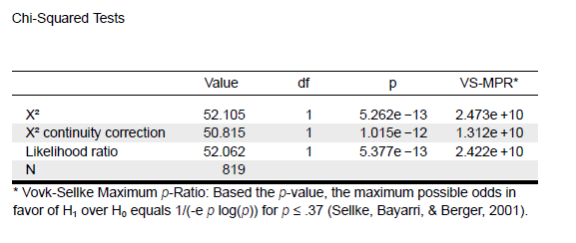
CHI-SQUARED TEST
Chi-Squared Test Outputs
Findings
The Chi-square test of independence is a statistical hypothesis test used to determine whether two categorical or nominal variables are likely to be related or not.
The chi-square test statistic (Χ²) is 52.105, with 1 degree of freedom (df) and a p-value of 5.262e-13. This indicates a significant association between the variables IU_W2R and YDQ_bin.
Conclusion: In support of Hypothesis, wanting to reduce internet use was linked to problematic internet habits. Those scoring ≥5 on the YDQ were more likely to express this desire compared to those with lower scores.

Slide 10
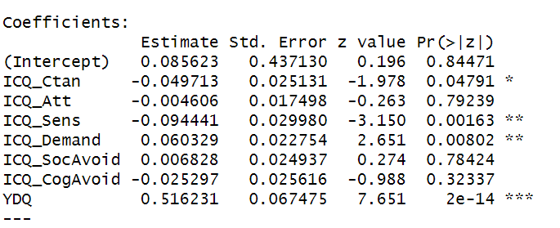
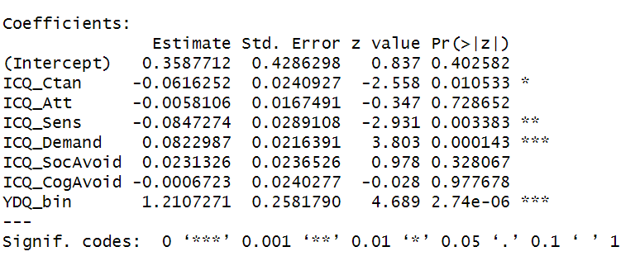
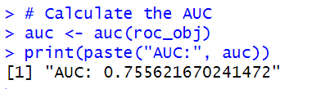
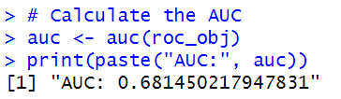
Alternative Study
GLM Model: As an alternative analysis, I wanted to generate a logistic regression model to see the impact of all the other variables on wanted the reduce internet use(YDQ and YDQ_bin)
Coefficients
Findings
As an alternative analysis, I wanted to generate a binary regression model to see the impact of all the other variables on wanted the reduce internet use
In the first model, YDQ is treated as a continuous variable. A significant coefficient for YDQ (0.001, denoted as '**' in the output) suggests that as YDQ scores increase, the likelihood of experiencing the outcome of interest (IU_W2R) significantly changes.
In the second model, YDQ_bin represents a binary version of YDQ, likely indicating division into two groups (e.g., low vs. high). The highly significant coefficient for YDQ_bin (2.74e-06, denoted as '***' in the output) indicates that this binary representation strongly predicts the likelihood of experiencing the outcome of interest (IU_W2R).

Slide 11

THANK YOU
Burak Ozuer
ozuerb@tcd.ie

