Slide 1
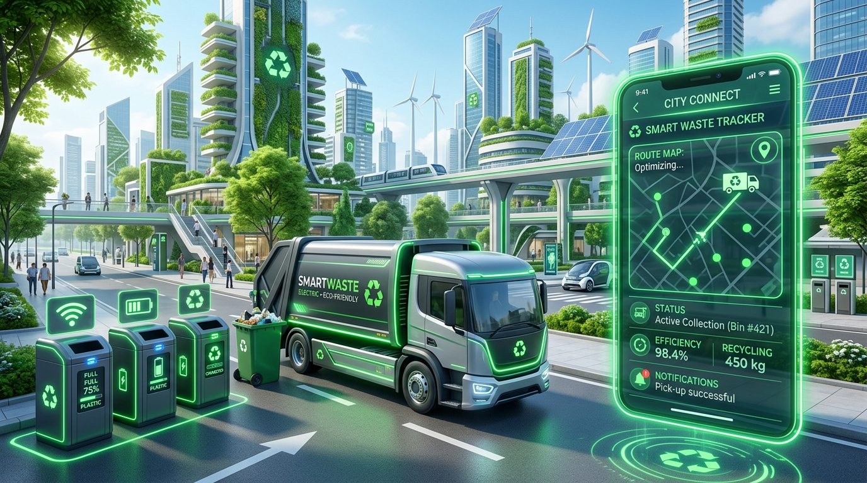
BENADIR UNIVERSITY
Faculty of Computer Science & IT
SMART WASTE COLLECTION MANAGEMENT SYSTEM
Bachelor Thesis Final Project Defense
STUDENTS (GROUP SEVEN):
1. Yahye Abdi Mohamud
2. MahmedAmin Abbdisalan Ali
3. Abdirsaq Isse Mahamed
4. Abdimalik Nuur Ali
5. Nuur Ahmed Osble
6. Sahid Hussein Isse
7. Nafiso Abdullahi Abdirahman
8. Maryan Mahamed Duale
SUPERVISOR: Eng. Isse Mahamed Abdi
ACADEMIC YEAR: 2025/2026
Notes:
Honorable members of the examination committee, supervisor Eng. Isse Mahamed Abdi, and respected faculty members, welcome to our final-year project defense. We are Group Seven, presenting our project: Smart Waste Collection Management System developed for Mogadishu municipal waste operations.

Slide 2
BENADIR UNIVERSITY | THESIS DEFENSE
Introduction & Project Background
Urban Waste Management Context
• Urban Sanitation Challenge: Mogadishu generates over 2,500 tons of solid waste daily due to rapid urbanization.
• Public Health & Environment: Improper waste disposal leads to roadside accumulation, waterborne disease vectors (cholera, typhoid), and clogged drainage.
• Operational Inefficiencies: Traditional waste collection relies heavily on manual paper logs, unannounced truck visits, and verbal dispatch.
• Computerized Intervention: Need for a centralized web-based system connecting Residents, Administrators, and Drivers in real-time.
Smart Waste Collection Management System (SWCMS) | Benadir University - 2025/2026
Notes:
Waste management is a vital urban service. In Mogadishu, rapid population growth has overwhelmed traditional garbage collection. Without digital coordination, trucks operate blindly and waste accumulates on streets, threatening public health. Our project introduces a computerized web framework to solve this problem.

Slide 3
BENADIR UNIVERSITY | THESIS DEFENSE
Problem Statement
⚠️ Manual Dispatch & Verbal Communication
Sanitation firms rely on non-digitized paper logs and verbal instructions, leading to delayed truck dispatch and missed pickups.
⚠️ Information Gap & Passive Residents
Residents have no digital portal to request pickups on demand or track when trucks will arrive, resulting in roadside dumping.
⚠️ Driver Tracking 'Digital Black Hole'
Once drivers leave central depots, management lacks real-time visibility into their active location, job progress, or status.
⚠️ Financial Opacity & Revenue Leakage
Reliance on door-to-door physical cash collection causes unrecorded transactions, payment disputes, and financial losses.
Smart Waste Collection Management System (SWCMS) | Benadir University - 2025/2026
Notes:
The core problem identified in our research is fourfold: manual dispatching, communication breakdown between residents and collectors, lack of field tracking for drivers, and financial leakage from cash collections. Our system directly addresses each of these four pain points.

Slide 4
BENADIR UNIVERSITY | THESIS DEFENSE
Aim of the Project
🎯 PRIMARY GENERAL OBJECTIVE
To design, develop, and implement an integrated web-based Waste Collection Management System (WCMS) utilizing a PHP and MySQL framework to bridge the communication and operational gap between residents, administrators, and field drivers in Mogadishu.
Key Expected Outcome: Transforming municipal waste management from a reactive manual process into an automated, data-driven, and transparent digital utility.
Smart Waste Collection Management System (SWCMS) | Benadir University - 2025/2026
Notes:
The primary aim of our project, as stated in Chapter 1 of our thesis, is to design and develop a web-based Waste Collection Management System using PHP and MySQL. This system connects residents, administrators, and drivers into a single synchronized digital workflow.

Slide 5
BENADIR UNIVERSITY | THESIS DEFENSE
Specific Research & Technical Objectives
📌 Objective 1: Workflow Analysis
Analyze operational workflows and limitations of existing manual waste practices in Mogadishu, specifically focusing on dispatch challenges faced by service providers like Ifiye Waste Management Co.
📌 Objective 2: Multi-Portal Design
Design a multi-portal system architecture establishing a seamless, real-time communication loop between residents (citizens), administrators, and field drivers to eliminate coordination gaps.
📌 Objective 3: PHP/MySQL Backend Engine
Develop backend engine using PHP 8.x and MySQL relational database to fully automate request logs, 1-to-1 district driver auto-dispatch, task assignments, and digital payment tracking.
Smart Waste Collection Management System (SWCMS) | Benadir University - 2025/2026
Notes:
To achieve our main aim, we defined three specific objectives: analyzing existing manual workflows in local firms like Ifiye Co., designing a multi-portal architecture for three user roles, and engineering a PHP/MySQL backend with automated 1-to-1 district driver dispatch.

Slide 6
BENADIR UNIVERSITY | THESIS DEFENSE
Research Questions
❓ Research Question 1
How can manual waste collection workflows and truck dispatching in Mogadishu be digitized to improve operational response times and eliminate uncollected roadside waste?
❓ Research Question 2
How can a multi-portal web system architecture effectively connect residents, municipal administrators, and field drivers in a synchronized real-time loop?
❓ Research Question 3
How can digital payment verification (EVC Plus mobile money integration) eliminate revenue leakage and improve financial transparency for sanitation service providers?
Smart Waste Collection Management System (SWCMS) | Benadir University - 2025/2026
Notes:
Our research was guided by three key questions focused on digitizing manual workflows, establishing real-time communication across three user portals, and eliminating cash revenue leakage through digital mobile money verification.

Slide 7
BENADIR UNIVERSITY | THESIS DEFENSE
Significance of the Study
🏡 Residents (Citizens)
On-demand request initiation, live pickup tracking, transparent mobile receipts, and clean neighborhood environments.
🏢 Waste Collection Companies
Optimized truck logistics, reduced fuel waste, zero cash revenue leakage, and automated driver dispatch.
🚚 Field Drivers
Direct mobile job queue, clear district routing, emergency SOS alerts, and structured completed work logs.
👑 Administrators
Centralized operational command, dynamic analytics, historical audit trails, and automated 1-to-1 district routing.
🌱 Community & Environment
Prevention of waterborne/airborne disease vectors (cholera, typhoid), clean urban streets, and restored city aesthetics.
Smart Waste Collection Management System (SWCMS) | Benadir University - 2025/2026
Notes:
The study provides practical benefits for five key stakeholder groups: residents gain service transparency, waste companies prevent revenue leakage, drivers receive clear district routing, admins gain full control, and the community benefits from public health improvements.

Slide 8
BENADIR UNIVERSITY | THESIS DEFENSE
Scope and Limitations
✅ IN SCOPE (Implemented Features)
• 18 Mogadishu Districts Selection (`Wadajir`, `Hodan`, `Waberi`, `Deyniile`, `Karaan`, etc.).
• Automated 1-to-1 District Driver Auto-Dispatch algorithm.
• Simulated EVC Plus Mobile Money Payment & PIN verification modal.
• Three specialized portals: Resident, Admin Dashboard, and Driver Portal.
• Threaded Quoted Messaging (`Re: ...`) and notification feeds.
• Client PDF Statement generation & Admin report printing.
🛑 OUT OF SCOPE (Thesis Constraints)
• Native App Store Packages: System operates as a mobile-responsive web application (not published on iOS/Android stores).
• Direct Commercial Telecom USSD Gateway: EVC Plus uses reference confirmation & simulated PIN modal (due to telecom sandbox restrictions).
• Physical Hardware Sensors: Waste volume relies on resident plan selection rather than physical IoT load-cell weight sensors on trucks.
Smart Waste Collection Management System (SWCMS) | Benadir University - 2025/2026
Notes:
It is crucial to clarify our scope. In scope are all features implemented in our system across Mogadishu's 18 districts. Out of scope, as documented in Chapter 5 of our thesis, are native app store binaries, direct commercial telecom USSD API sandbox access, and physical IoT truck sensors.

Slide 9
BENADIR UNIVERSITY | THESIS DEFENSE
Literature Review & Research Gap
Operational Feature | Traditional (Manual / Offline) | Modern (Our SWCMS System)
Logistics & Dispatch | Static pre-planned routes; verbal / paper dispatch | Automated 1-to-1 District Driver Auto-Dispatch
Communication | No direct link with citizens; roadside waiting | Multi-portal synchronized loop & threaded messaging
Payment Verification | Cash-based door-to-door, revenue leakage | Simulated EVC Plus Mobile Money & digital ledger
Audit Trails & Data | No historical records or service logs | Timestamped Request Logs & PDF statement exports
💡 IDENTIFIED RESEARCH GAP IN SOMALIA
While international systems utilize IoT and cloud fleet platforms, local operations in Mogadishu suffer from a complete absence of a unified triple-portal ecosystem connecting citizens, administration, and field drivers simultaneously in real-time. Our project fills this critical gap.
Smart Waste Collection Management System (SWCMS) | Benadir University - 2025/2026
Notes:
Chapter 2 reviewed existing literature. Traditional systems operate on static routes and cash payments. Our research gap in Somalia is the lack of an integrated triple-portal platform that connects citizens, management, and field drivers simultaneously.

Slide 10
BENADIR UNIVERSITY | THESIS DEFENSE
Development Methodology: Agile Scrum Framework
1. Planning & Backlog
Requirement gathering from Ifiye Co. managers & resident surveys.
2. Architecture & Design
UML modeling, ERD database design, multi-portal wireframes.
3. Sprint 1 (Backend & DB)
MySQL 3NF database schema & PHP 8.x REST API core engine.
4. Sprint 2 (Portals & Routing)
Responsive HTML/CSS/JS interfaces & 1-to-1 district auto-dispatch.
5. Sprint 3 (Payment & Security)
EVC Plus payment tracking, Bcrypt security, buffer purging.
6. Testing & Deployment
Unit testing, constraint validation, UAT, and final deployment.
Smart Waste Collection Management System (SWCMS) | Benadir University - 2025/2026
Notes:
Chapter 3 detailed our research methodology. We adopted the Agile Scrum framework across three iterative sprints. This allowed continuous testing and refinement of backend PHP REST APIs and frontend responsive portals.

Slide 11
BENADIR UNIVERSITY | THESIS DEFENSE
System Functional & Non-Functional Requirements
⚙️ FUNCTIONAL REQUIREMENTS
• FR-1: User Registration & Role Login (Bcrypt auth).
• FR-2: Resident Pickup Scheduling (Plan selection & address).
• FR-3: Automated 1-to-1 District Driver Auto-Dispatch.
• FR-4: Simulated EVC Plus Payment & PIN verification.
• FR-5: Driver Duty Toggle (On Duty / Off Duty) & Job Queue.
• FR-6: Threaded Quoted Messaging (`Re: ...`) & PDF Statement Exports.
🛡️ NON-FUNCTIONAL REQUIREMENTS
• NFR-1 (Security): Passwords hashed with Bcrypt, PDO Prepared Statements, role-based authorization middleware.
• NFR-2 (Reliability): Output Buffer purging (`ob_start()`, `ob_clean()`) ensuring zero JSON syntax errors.
• NFR-3 (Usability): Responsive Bootstrap 5 interfaces optimized for desktop & mobile devices.
• NFR-4 (Performance): Sub-second API response times and dynamic DOM updates without full page reloads.
Smart Waste Collection Management System (SWCMS) | Benadir University - 2025/2026
Notes:
Our requirements were divided into Functional requirements—such as auto-dispatch, EVC payment, and messaging—and Non-Functional requirements covering Bcrypt security, responsive UI usability, and output buffer safety.

Slide 12
BENADIR UNIVERSITY | THESIS DEFENSE
Technology Stack & Development Tools
PHP 8.x Backend
Native RESTful API endpoints handling business logic (`api/*.php`).
MySQL 8.x Database
Normalized relational database (`smart_waste_db`) in 3rd Normal Form.
HTML5 & CSS3
Semantic structure, responsive styling, and custom dark mode themes.
JavaScript (ES6+)
Dynamic DOM updates, fetch API calls, and real-time interface logic.
Bootstrap 5.3
Responsive grid layout, modern card components, and modal dialogues.
Leaflet.js Mapping
OpenStreetMap integration for driver route navigation & location pins.
jsPDF & AutoTable
Client-side PDF generation for receipts and billing statements.
XAMPP & Apache
Local web server environment for PHP execution and MySQL testing.
Smart Waste Collection Management System (SWCMS) | Benadir University - 2025/2026
Notes:
Every technology listed here is actively used in our system: PHP 8.x for backend REST APIs, MySQL for relational storage, HTML5/CSS3/JS/Bootstrap 5 for frontend interfaces, Leaflet.js for maps, and jsPDF for PDF statement exports.

Slide 13
BENADIR UNIVERSITY | THESIS DEFENSE
3-Tier System Architecture Design
1. Presentation Layer (Frontend)
Responsive Web Portals built with HTML5, CSS3, Bootstrap 5.3, and ES6+ JS. Includes Chart.js for analytics, Leaflet.js for interactive route maps, and jsPDF for client-side invoice rendering.
2. Application Layer (PHP REST Backend)
PHP 8.x RESTful APIs (`api/admin.php`, `api/resident.php`, `api/driver.php`, `api/auth.php`). Handles authentication, 1-to-1 district auto-dispatch, threaded messaging, and buffer output purging (`ob_clean()`).
3. Database Layer (MySQL Storage)
MySQL 8.x relational database (`smart_waste_db`). Stores normalized records for users, drivers, residents, pickup requests, payments, activity logs, and notifications with foreign key constraints.
Smart Waste Collection Management System (SWCMS) | Benadir University - 2025/2026
Notes:
Our system follows a classic 3-Tier Architecture: Presentation Layer for user interfaces, Application Layer powered by PHP REST APIs handling auto-dispatch logic, and Database Layer with MySQL for relational storage.

Slide 14
BENADIR UNIVERSITY | THESIS DEFENSE
Core System Portals & Modules
🏡 RESIDENT PORTAL
• Account Registration & Login
• Schedule Waste Pickup ($5/$15/$45)
• EVC Plus Mobile Payment & PIN
• Live Request Status & Timeline Logs
• Download Personal Statement (PDF)
👑 ADMIN DASHBOARD
• System Overview & Analytics Charts
• Manage Requests & Payment Status
• Driver Onboarding & District Allocation
• Automated 1-to-1 District Auto-Dispatch
• Support Messaging & Audit Reports
🚚 DRIVER PORTAL
• Duty Status Toggle (On Duty/Off Duty)
• Active District Pickup Job Cards
• Interactive Route Map & Street Directions
• Job Status Updates (Accepted -> Done)
• One-Tap Emergency SOS Trigger
Smart Waste Collection Management System (SWCMS) | Benadir University - 2025/2026
Notes:
The system consists of three dedicated portals: Resident Portal for scheduling and payments, Admin Dashboard for central logistics and driver onboarding, and Driver Portal for outdoor field job execution.

Slide 15
BENADIR UNIVERSITY | THESIS DEFENSE
Use Case Diagram & System Actors
👤 Resident Actor
Registers account, selects district, submits pickup request, enters EVC PIN for payment, tracks request lifecycle, views statement PDF, sends support inquiries.
👨‍💼 Admin Actor
Logs in, monitors dashboard analytics, registers new drivers, sets 1-to-1 district binding, reviews payments, replies to user reports with quoted context, exports system logs.
🚚 Driver Actor
Logs in, toggles duty status (On Duty / On Break / Off Duty), views assigned district jobs, accepts job, launches map navigation, updates job status to Completed, triggers emergency SOS.
Smart Waste Collection Management System (SWCMS) | Benadir University - 2025/2026
Notes:
The Use Case diagram highlights three primary actors: Resident initiating requests and payments, Admin managing driver onboarding and system monitoring, and Driver executing field collection tasks.

Slide 16
BENADIR UNIVERSITY | THESIS DEFENSE
Entity-Relationship Diagram (Relational Database Schema)
🗄️ Table: users
Fields: user_id (PK), name, email, password (Bcrypt), phone, role ('admin','resident','driver'), created_at
🗄️ Table: residents
Fields: id (PK), user_id (FK), address, district, phone, subscription_plan, profile_picture
🗄️ Table: drivers
Fields: driver_id (PK), user_id (FK), license_no, truck_plate, assigned_district, duty_status ('On Duty','Off Duty')
🗄️ Table: requests
Fields: request_id (PK), resident_id (FK), driver_id (FK), status ('Pending','Assigned','Accepted','In Progress','Completed'), plan, amount, waste_type, request_time
🗄️ Table: payments
Fields: payment_id (PK), request_id (FK), resident_id (FK), amount, method ('Mobile Money','Credit Card'), status ('Paid','Completed'), paid_at
🗄️ Table: notifications
Fields: id (PK), user_id (FK), title, message, is_read, created_at
Smart Waste Collection Management System (SWCMS) | Benadir University - 2025/2026
Notes:
Our database schema `smart_waste_db` is normalized in 3rd Normal Form. Primary keys and Foreign keys connect users, residents, drivers, requests, payments, and notifications, ensuring data integrity.

Slide 17
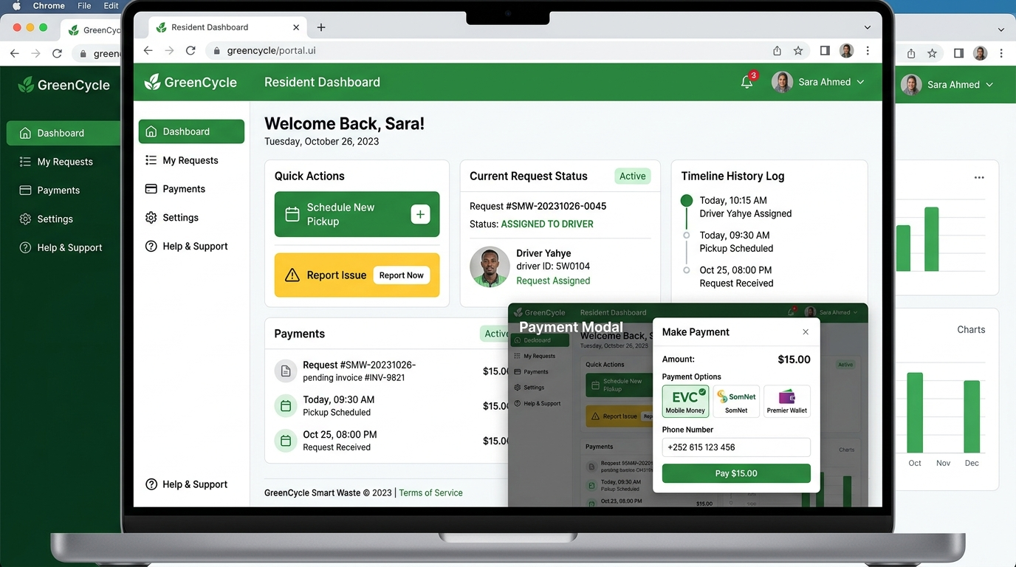
BENADIR UNIVERSITY | THESIS DEFENSE
Resident Portal Implementation (Live System Screenshots)
Resident Portal Implementation
• 18 Mogadishu Districts Registration: Captures home district, address, and contact details.
• Schedule Pickup Modal: Allows selection of service plan ($5 Pay Per Pickup, $15 Monthly, $45 Commercial).
• EVC Plus Mobile Payment: Prompts USSD PIN confirmation and logs payment reference.
• Request Timeline Feed: Real-time status logs displaying driver assignment and pickup progress.
Smart Waste Collection Management System (SWCMS) | Benadir University - 2025/2026
Notes:
This slide displays live system screenshots from our Resident Portal. Residents select their Mogadishu district during registration, schedule pickups, settle fees via EVC Plus, and view chronological request status logs.

Slide 18
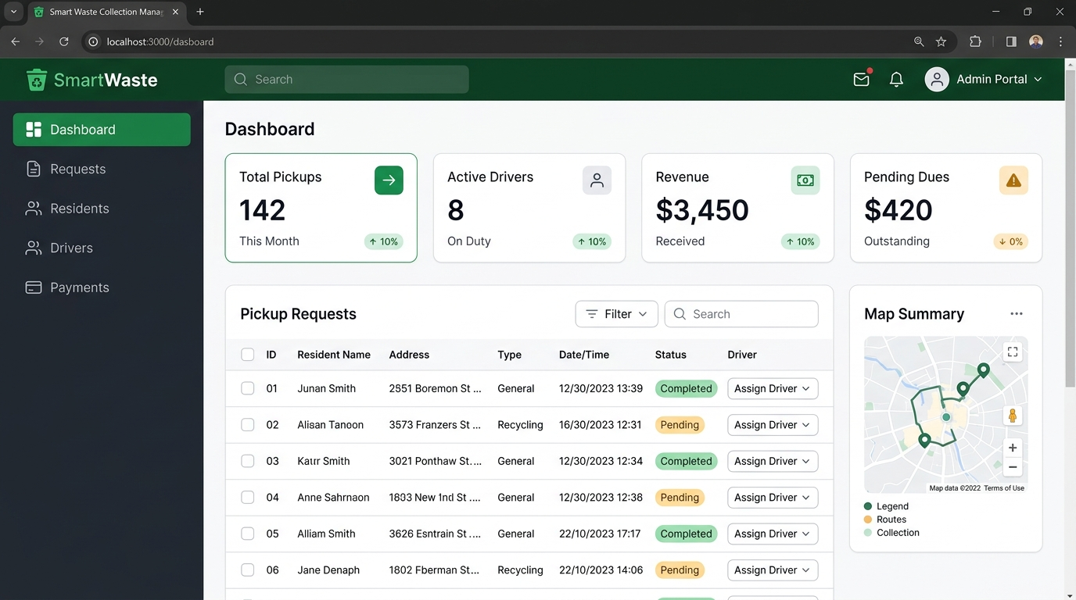
BENADIR UNIVERSITY | THESIS DEFENSE
Admin Control Dashboard (Live System Screenshots)
Admin Management Capabilities
• Real-Time Metrics Panel: Displays total waste requests, completed pickups, active drivers, and total revenue ($65.00).
• Driver Onboarding: Registers drivers with unique license numbers, truck plates, and allocates 1-to-1 district binding.
• Request Supervision: Views live request tables, payment statuses, and manual driver reassignment controls.
• Threaded Messaging: Replies to user reports with embedded quote cards (`Re: ...`).
Smart Waste Collection Management System (SWCMS) | Benadir University - 2025/2026
Notes:
Here is a screenshot of the Admin Dashboard. Administrators can monitor real-time system metrics, onboard fleet drivers to dedicated districts, track incoming pickup requests, and review payment statuses.

Slide 19
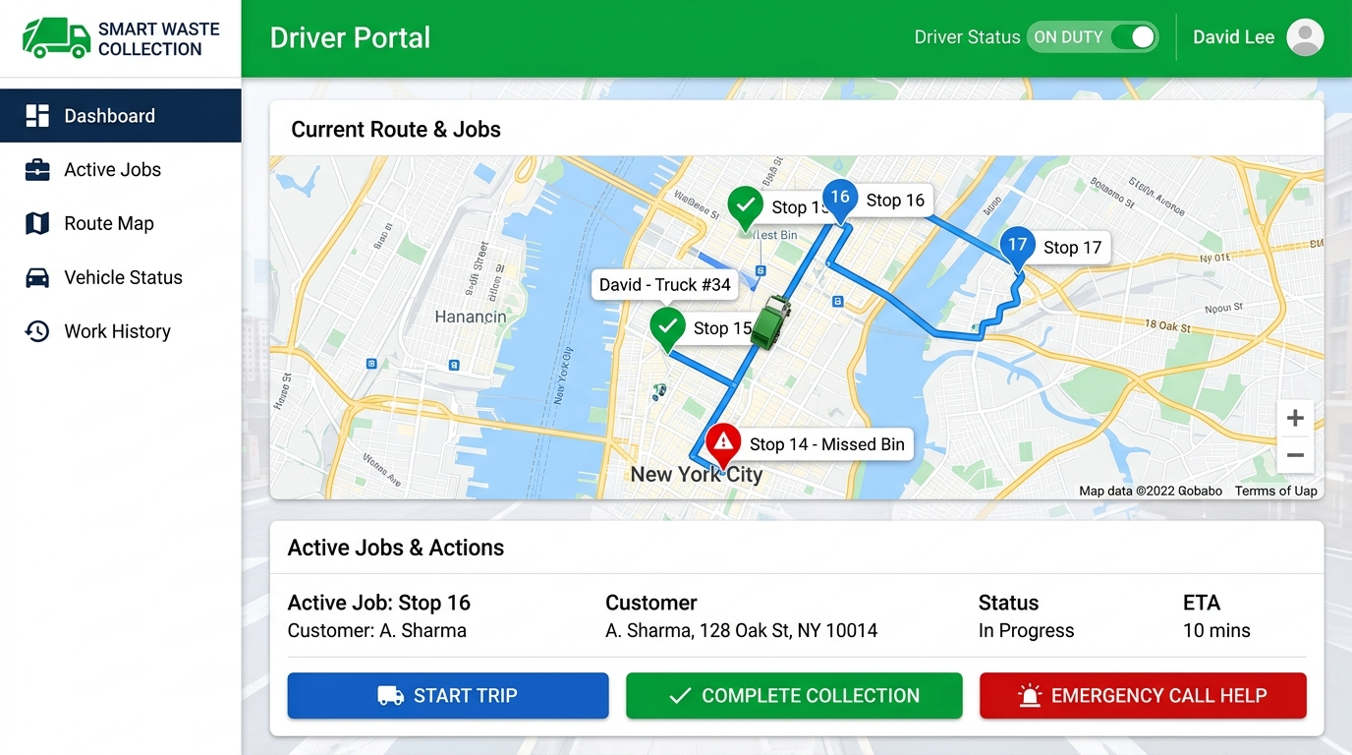
BENADIR UNIVERSITY | THESIS DEFENSE
Driver Portal Implementation (Live System Screenshots)
Driver Field Operations
• Duty Status Toggle: Drivers set status to 'On Duty', 'On Break', or 'Off Duty'.
• Active Job Queue: Displays assigned district job cards with resident name, street address, and waste type.
• Job Lifecycle Execution: Buttons to 'Accept Job', 'Start Trip' (In Progress), and 'Complete Collection'.
• Work History Log: Keeps sequential records of completed collection jobs (#1, #2, etc.).
Smart Waste Collection Management System (SWCMS) | Benadir University - 2025/2026
Notes:
This slide shows the Driver Portal interface. Drivers toggle their duty status, view assigned collection jobs in their district, launch route maps, update status to Completed, and review their work history.

Slide 20
BENADIR UNIVERSITY | THESIS DEFENSE
End-to-End System Workflow Diagram
1. Request & Pay
Resident submits pickup request & settles $5 fee via EVC Plus PIN.
2. Auto-Dispatch
Backend auto-assigns request to dedicated district truck driver.
3. Admin Audit
Request appears on Admin Dashboard in 'Assigned' status.
4. Driver Accept
Driver receives job notification, switches to On Duty, and accepts job.
5. Start Trip
Driver clicks Start Trip; status transitions to 'In Progress'.
6. Complete Job
Driver empties bin, marks 'Completed', and audit log is saved.
Smart Waste Collection Management System (SWCMS) | Benadir University - 2025/2026
Notes:
This diagram details the complete operational workflow from resident request submission to automated driver dispatch, driver acceptance, trip execution, and final status completion.

Slide 21
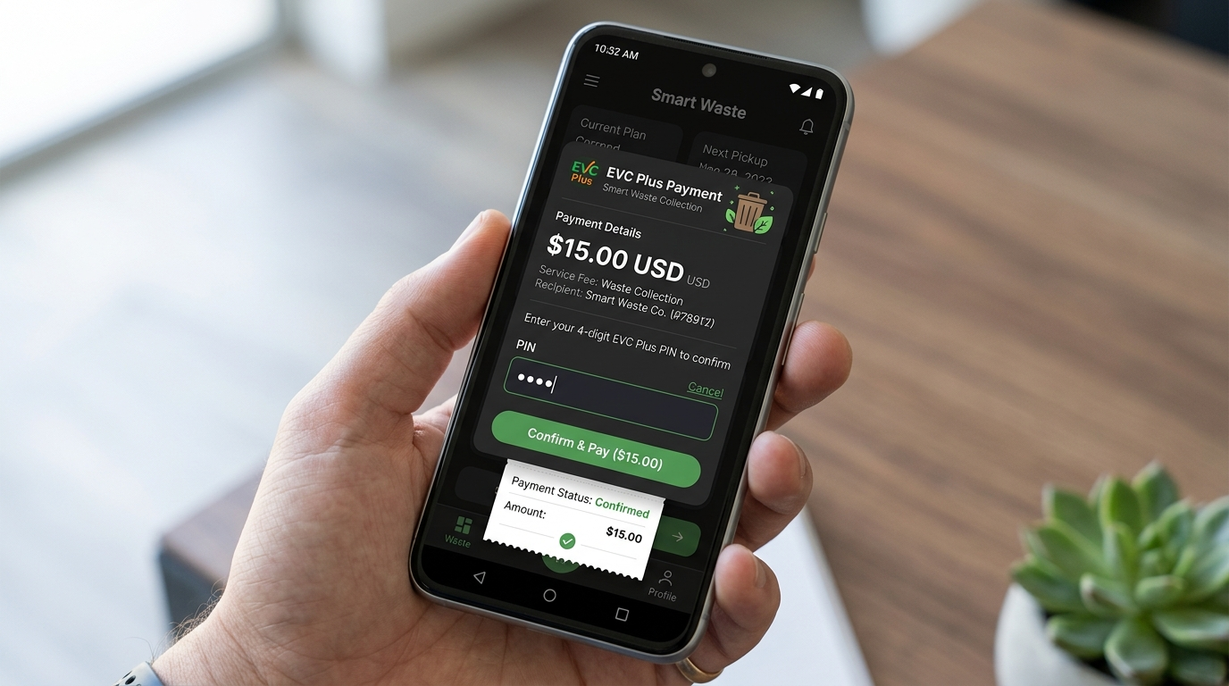
BENADIR UNIVERSITY | THESIS DEFENSE
Digital Payment Process (EVC Plus Integration)
Payment Verification Workflow
1. Plan Rate Locking: System automatically locks fee based on selected plan ($5.00 Pay Per Pickup, $15 Monthly, $45 Commercial).
2. USSD PIN Modal: Displays authentic mobile money security prompt requesting 4-digit PIN confirmation.
3. Simulated Gateway: Verifies PIN input, generates transaction reference, and updates payment ledger.
4. Status Update: Payment status marks 'Paid', enabling immediate administrative processing and driver dispatch.
Smart Waste Collection Management System (SWCMS) | Benadir University - 2025/2026
Notes:
Our payment module simulates EVC Plus mobile money transactions. The system automatically locks the service plan fee, displays a 4-digit USSD PIN modal, verifies payment, and logs transactions directly into the database.

Slide 22
BENADIR UNIVERSITY | THESIS DEFENSE
System Testing & Validation Matrix
Test ID | Module Tested | Test Scenario & Execution | Status
TC-01 | Registration & Auth | Submit credentials (phone, district, password). Verifies Bcrypt hash & session token. | PASS
TC-02 | 1-to-1 Auto-Dispatch | Resident in Hodan district submits pickup request. System auto-assigns Hodan driver. | PASS
TC-03 | Driver Job Management | Assigned driver switches to On Duty & accepts job. Status updates to In Progress. | PASS
TC-04 | Payment & Ledger | Resident completes $5.00 EVC Plus checkout form. Payment registered as Paid. | PASS
TC-05 | Threaded Messaging | Admin replies to resident report with embedded quote text (`Re: ...`). Rendered in feed. | PASS
TC-06 | Buffer Output Safety | API responses executed across endpoints. Purges buffers (`ob_clean`), zero JSON error. | PASS
Smart Waste Collection Management System (SWCMS) | Benadir University - 2025/2026
Notes:
As documented in Appendix C of our thesis, comprehensive User Acceptance Testing was performed across all six core modules. All test cases, including auto-dispatch, payment verification, and buffer safety, passed successfully.

Slide 23
BENADIR UNIVERSITY | THESIS DEFENSE
Results & Key Achievements
🏆 Digitized 18 Mogadishu Districts
Eliminated manual paper logs and static routing across all 18 municipal districts with automated 1-to-1 driver auto-dispatch.
🏆 Eliminated Revenue Leakage
Replaced cash collections with transparent digital EVC Plus payment tracking and immutable database ledgers.
🏆 End-to-End Request Transparency
Achieved 100% request visibility across the full lifecycle: Pending -> Assigned -> Accepted -> In Progress -> Completed.
🏆 Automated PDF Reporting
Implemented one-click client PDF statement generation and administrative printable audit reports.
Smart Waste Collection Management System (SWCMS) | Benadir University - 2025/2026
Notes:
The system achieved significant results: complete digitization of Mogadishu's 18 districts, elimination of cash revenue leakage, 100% request tracking transparency, and automated PDF statement reporting.

Slide 24
BENADIR UNIVERSITY | THESIS DEFENSE
System Strengths & Technical Contribution
⭐ Modular 3-Tier Architecture
Decoupled frontend JavaScript modules and PHP RESTful API endpoints (`api/*.php`) ensuring high maintainability.
⭐ Automated 1-to-1 District Routing
Intelligent binding between municipal districts and dedicated waste trucks, eliminating manual dispatch delays.
⭐ Output Buffer Reliability Safety
Integrated `ob_start()` and `ob_clean()` buffer purging inside API response handlers, guaranteeing zero JSON syntax errors.
⭐ Role-Based Security (RBAC)
Bcrypt password hashing, HTTP-only session verification with session auto-healing, and 100% Prepared Statements.
Smart Waste Collection Management System (SWCMS) | Benadir University - 2025/2026
Notes:
Our technical contributions include a modular 3-tier architecture, automated 1-to-1 district auto-dispatch algorithm, output buffer safety purging preventing JSON errors, and robust Bcrypt/RBAC security.

Slide 25
BENADIR UNIVERSITY | THESIS DEFENSE
System Limitations & Future Enhancements
⚠️ CURRENT LIMITATIONS
• Mobile-Responsive Web App: Runs in mobile web browsers; native app store binaries are not published.
• Simulated USSD Gateway: EVC Plus operates via PIN modal reference (direct telecom API requires commercial sandbox).
• No Physical Hardware Sensors: Waste volume relies on plan classification rather than physical IoT truck weight load cells.
🚀 FUTURE WORK (Planned Roadmap)
• Native Android/iOS Mobile Apps: Publishing native mobile applications with push notifications.
• IoT Smart Bin Sensors: Solar-powered Ultrasonic sensors triggering auto-requests at 85% capacity.
• AI Route Optimization: Machine learning algorithms optimizing truck routing to cut fuel waste by 30%.
• Direct Telecom API Integration: Connecting live Hormuud / Somnet USSD payment gateways.
Smart Waste Collection Management System (SWCMS) | Benadir University - 2025/2026
Notes:
In accordance with Chapter 5, current limitations are clearly separated from future work. Future enhancements include IoT smart bin fill-level sensors, AI route optimization algorithms, and native mobile apps.

Slide 26
BENADIR UNIVERSITY | THESIS DEFENSE
Conclusion
🎓 FINAL CONCLUSION
• Problem Solved: The Waste Collection Management System (WCMS) successfully digitizes solid waste logistics in Mogadishu, replacing manual paper logs and static truck routes.
• Unified Multi-Portal System: Seamlessly synchronizes Residents, Administrators, and Field Drivers in a real-time authenticated communication loop.
• Financial & Logistical Accountability: Automated 1-to-1 district auto-dispatch and EVC Plus digital payment tracking eliminate cash revenue leakage and roadside trash delays.
• Foundation for Governance: Lays a robust technical foundation for digital municipal governance and urban sanitation in Somalia.
Smart Waste Collection Management System (SWCMS) | Benadir University - 2025/2026
Notes:
In conclusion, the Waste Collection Management System successfully addresses urban sanitation challenges in Mogadishu by providing a secure, synchronized web platform connecting citizens, administrators, and drivers.

Slide 27
BENADIR UNIVERSITY | THESIS DEFENSE
Recommendations
1. Municipal Adoption
Recommend local sanitation authorities and private collection firms in Mogadishu officially adopt the WCMS digital portal to replace paper logs.
2. Driver Digital Orientation
Conduct structured digital literacy workshops for waste truck drivers to familiarize them with mobile portal job acceptance and duty status toggling.
3. Telecom SMS Gateway Partnership
Form formal partnerships with local telecommunications providers (Hormuud/Somnet) for direct USSD API sandbox integration and SMS alerts.
Smart Waste Collection Management System (SWCMS) | Benadir University - 2025/2026
Notes:
We recommend municipal adoption by local waste firms, digital training for truck drivers, and strategic partnerships with local telecom providers for commercial USSD API access.

Slide 28
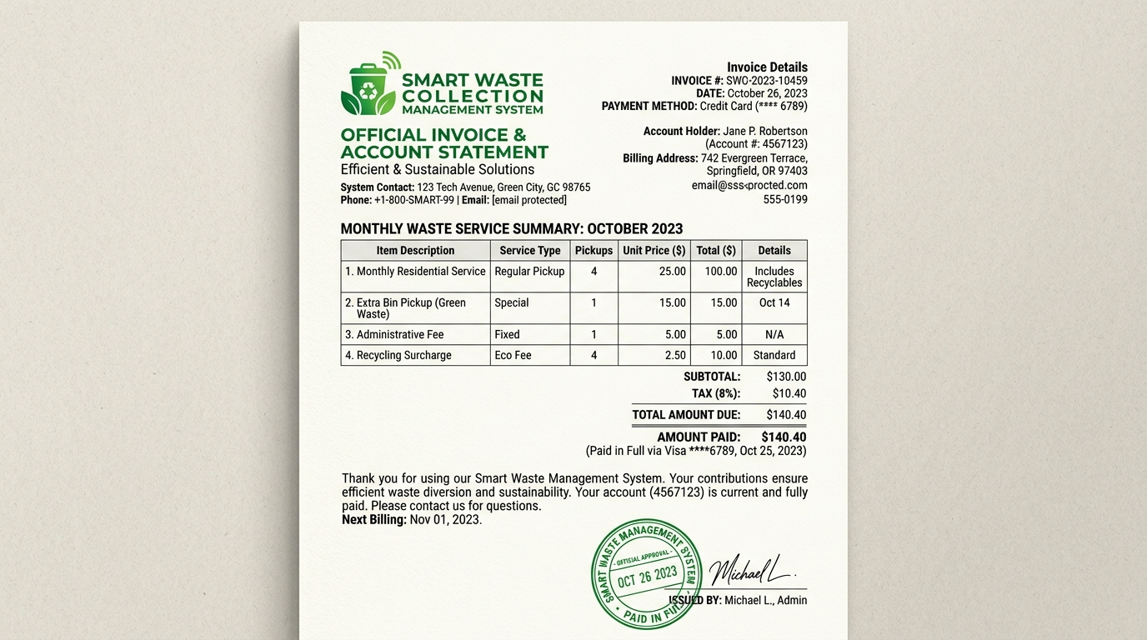
BENADIR UNIVERSITY | THESIS DEFENSE
System Operational Demonstration Flow
🔄 COMPLETE SYSTEM FLOW RECAP
1. RESIDENT: Submits pickup request & completes $5 EVC PIN payment.
2. SYSTEM: Auto-dispatches request to assigned 1-to-1 district driver.
3. ADMIN: Monitors live request on dashboard analytics panel.
4. DRIVER: Receives job, toggles On Duty, accepts job & starts trip.
5. COLLECTION: Driver completes collection & updates status to Done.
6. AUDIT & PDF: Timestamped log archived & client PDF statement generated.
Smart Waste Collection Management System (SWCMS) | Benadir University - 2025/2026
Notes:
This summary flow demonstrates the live operational loop from resident request and payment to admin monitoring, driver execution, and final PDF statement generation.

Slide 29
THANK YOU!
Questions & Academic Discussion
Group Seven - Benadir University
Faculty of Computer Science & Information Technology
Academic Session 2025/2026
Notes:
Thank you honorable supervisors and examiners for your attention. We are now ready to answer any questions and receive your valued feedback on our Smart Waste Collection Management System.

