Slide 1
Understanding the Feline Social System
Notes from Sarah Heath BVSc MRCVS

Slide 2
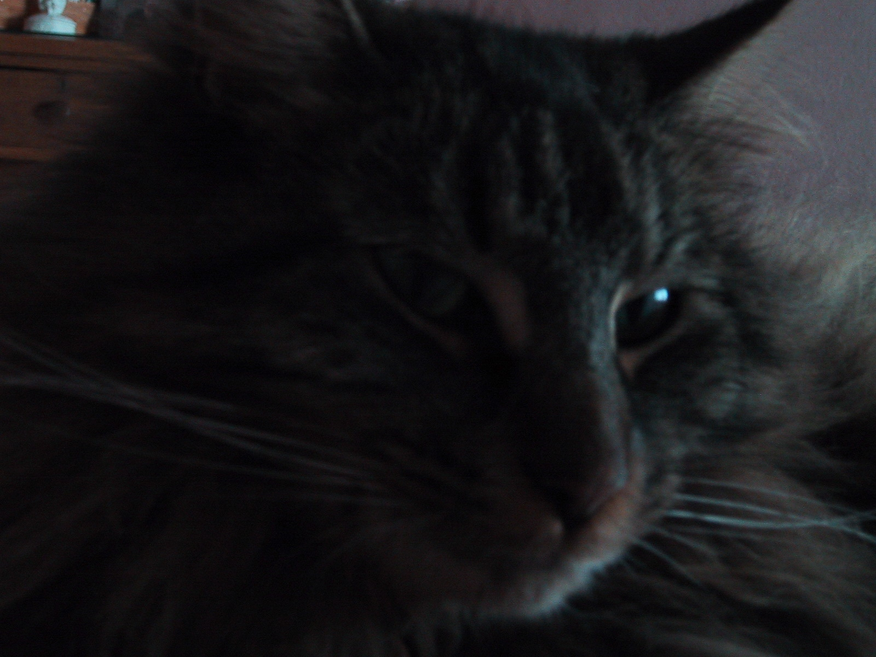
Feline Behavior
New Subject and Questions are arising
Lagging behind canine behavior
Cats are not dogs
Distinct species, ethological identity, and behavioral patterns
Not truly domesticated?
Increasing popularity

Slide 3
Misunderstandings
Many of the problems encountered by cat owners relate to normal feline behaviors which are displayed in inappropriate circumstances!
Lack of understanding of feline social systems
Involves misinterpretation of feline communication.

Slide 4
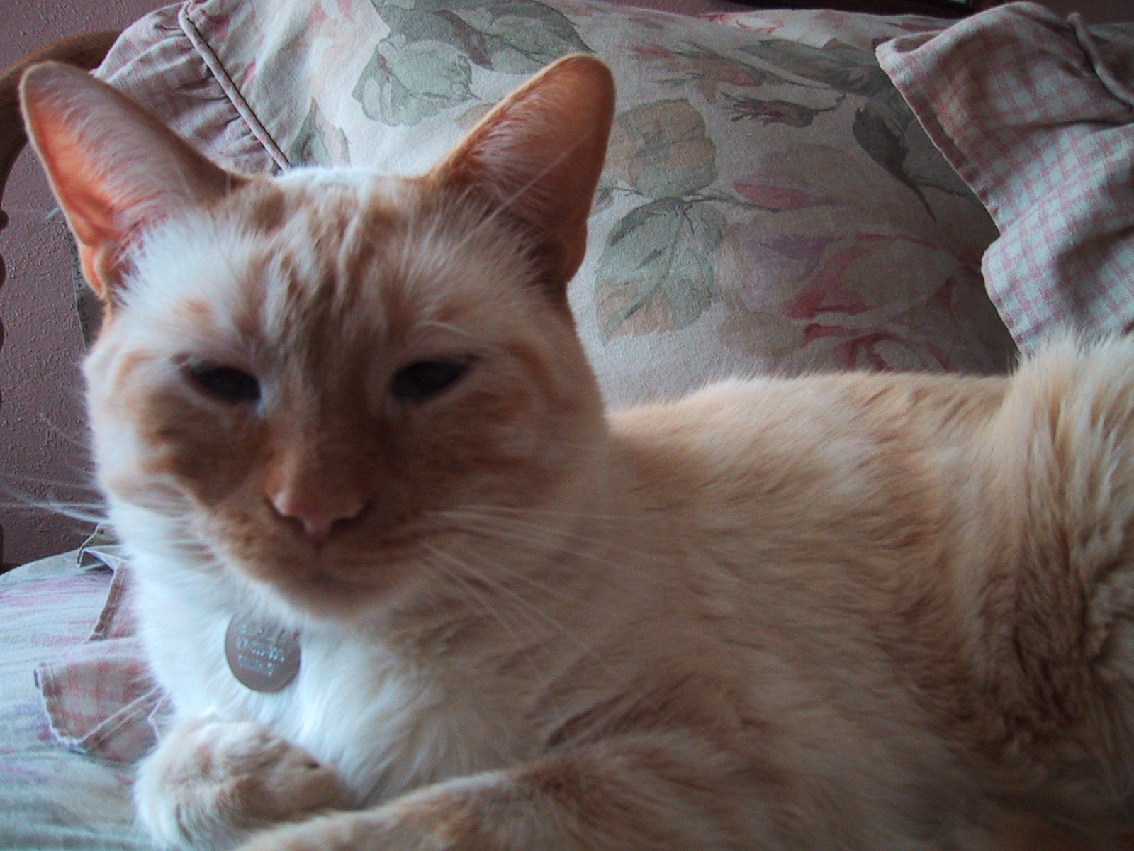
Social Behavior
Lack of need for social interaction
Solitary hunter
Solitary survivor
Asocial? Not true
Now known that the feline society is based on social co-operation between related females
Cats do best with minimal requirement for social interaction
Cats can come to appreciate social interaction through learning

Slide 5
Social Behavior
Natural (semi-feral) groups consist mostly of female cats and their offspring
One adult tom breeds the majority of females in his territory
Other males are generally not tolerated

Slide 6
Social Behavior
Communal dens for kittens
Communal nursing
Communal defense
Aggression is displayed to male and female outsiders
Communication is vital
Mutual grooming and rubbing

Slide 7
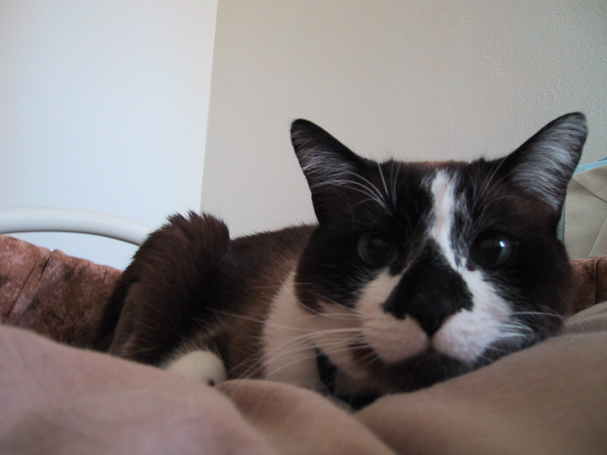
Social Behavior
Rubbing and grooming are acceptable forms of communication
Rubbing has taken on an importance in human-cat relationship
Conditioning plays a role in the rubbing behavior and it is commonly misinterpreted
Mutual grooming is a reciprocal behavior
The grooming behavior is often seen post conflict as a reconciling behavior

Slide 8
Territorial Behavior
Male cats have a larger home range than female cats
Overlapping territories are used on a “time share” basis
“Time sharing” is possible due the use of signaling through the olfactory system

Slide 9
Aggressive Behavior
Behaviors which are designed to keep strangers away include olfactory, vocal, and visual communication
Aggressive signals are designed to avoid physical contact
Aggression within social groups is rare and mild
Aggression to outsiders can be intense

Slide 10
Effects of Neutering
Less aggression in neutered colonies
Other behaviors remain intact
Neutering enables people to keep unrelated cats in a social group
For the pet cat social grouping also includes people and other domesticated species

Slide 11
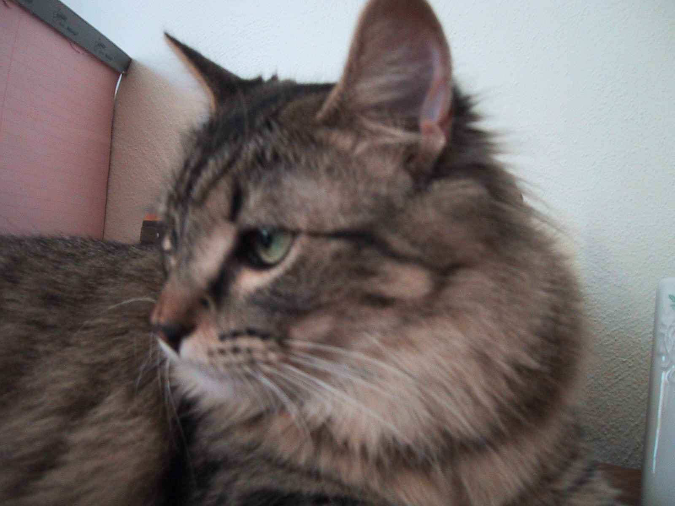
Feline Communication
Appease - very limited
Freeze-vulnerable
Flight-preferred
Fight-last resort

Slide 12
Feline Communication
The majority of feline signals are designed to increase or maintain distance between individuals
Vocal signals are the exception and these include greeting signals and signals associated with mating
Each of the communication channels has a slightly different role to play in feline behavior
A combination of each of the channels gives the beat chance of unambiguous signaling and of avoidance of out and out conflict

Slide 13
Olfactory Signaling
Very important in feline society
Effective across time
No need for sender and receiver to come into contact
Open to large amount of misinterpretation
Signal needs to be accurate and is therefore often factual

Slide 14
Olfactory Signaling
This is a long range form of communication
It is not directional-dependent of wind, etc
Source location is very indirect, don’t know the individual
It takes a lone time to switch the signal off and it cannot be easily modified

Slide 15
Olfactory Signaling
Very effective as a distancing signal
Important in spacing of cats within a highly populated area
Effective as a means of avoiding unnecessary confrontation
Useful at night or in situations of dense vegetation

Slide 16
Examples of Olfactory Signaling
Rubbing
Scratching - glands on feet
Middening- feces and will not cover up
Urine spraying - more common

Slide 17
Olfactory Signaling
Hidden messages that the human nose cannot detect
Flehmen response
Very important in sexual behavior
Also plays a central role in social communication

Slide 18
Visual Signaling
Medium range of communication
Source location is direct
Signal is very directional
Changes can be made rapidly and messages can be modified
It necessitates proximity
Limited use in dense vegetation or in low light levels

Slide 19
Visual Signaling
Primarily geared toward increasing distance between individuals
Combination of postural and facial signals
Body posture gives first impression
Facial expression allows for fine tuning
Body postures demonstrate level of fear and aggression
Body posture and tail position are important indicators of emotional status

Slide 20
Visual Signaling
Much debate over whether cats show signals of dominance and submission
In young kittens submissive signals can be identified
In male cats there may be a hierarchical structure
Female society is based on co-operation rather than hierarchy

Slide 21
Examples of Body Posturing
Arched back - increase physical stature
Crouched body posture
Social roll - invitation for social interaction
Tail up - greeting behavior

Slide 22
Facial Signaling
Ears
Eyes
Whiskers
All signals can be altered very rapidly
If in doubt about a cat’s intentions ALWAYS watch the face!

Slide 23
Ear Positions
Erect and facing forward - happy
Flattened to the head - frightened
Rotated backwards and erect - action will be taken shortly
Rotated backwards and flattened - action will be taken shortly

Slide 24
Vocal Signaling
Long range of communication
Source location is indirect
The signal is omnidirectional
Changes can be made relatively easily and message can be modified
Ease of detection can be altered by altering frequency

Slide 25
Vocal Signaling
Three classes of vocal signals in cats:
Those made with mouth closed - purr and trill/chirrup
Those made with mouth open and gradually closing - Miaow, long miaow (separation), Female call, male miaow (deep)
Those made while the mouth is held open on a fixed position by tension within the facial muscles - growl, yowl, snarl, hiss, spit, pain shriek

Slide 26
Vocal Signaling
Used extensively in cat to human communication
Open to conditioning
Often find certain vocal signals that are unique to one cat

Slide 27
Conclusions
Cats are not small dogs!
Distinct species, distinct ethological identity, distinct behavioral patterns
Understanding normal feline behavior is a major factor in improving the cat-human relationship

