Slide 1
A Real-Time Juturna Pipeline for Live Audio
Summarization and Keyword Extraction
STREAMIND — Streaming Transcription and Real-Time Extraction for AI Meeting INtelligence Distillation
Mervegul Parlak · Burak Kara · Alperen F. Zengin · Ali C. Begen
Ozyegin University, Istanbul, Turkiye · Rennes, France
IEEE MMSP 2026 Grand Challenge
Notes:
Introduce the team and frame this as a Grand Challenge submission, not a general research talk — the whole design is shaped by one external scoring function, which the next few slides will make concrete.

Slide 2
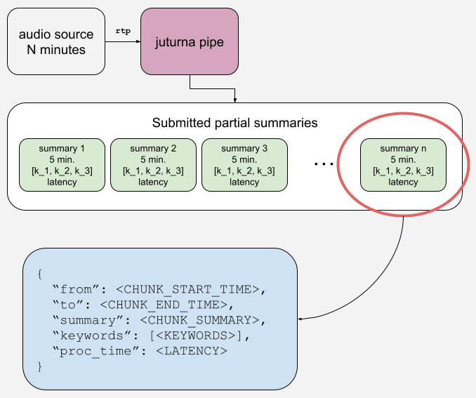
The Challenge — Problem & Goal
▸ Goal: live audio in → structured summary + 3 keywords out, in real time
▸ Reference pipeline: WebRTC/RTP reception → incremental ASR → novel-chunk extraction → 300s window aggregation → summarization → transmission
▸ Evaluation datasets: Rev16 (30 podcast episodes) and IETF125 (8 live conference sessions)
STREAMIND — IEEE MMSP 2026 Grand Challenge
2
Notes:
The challenge bridges live audio reception and structured LLM inference — bring your own pipeline that ingests a live RTP stream and progressively emits summaries, not a batch transcription tool. 300-second windows on a 30-minute recording yield 6 progressive summary chunks, which is the unit everything downstream gets scored on.

Slide 3
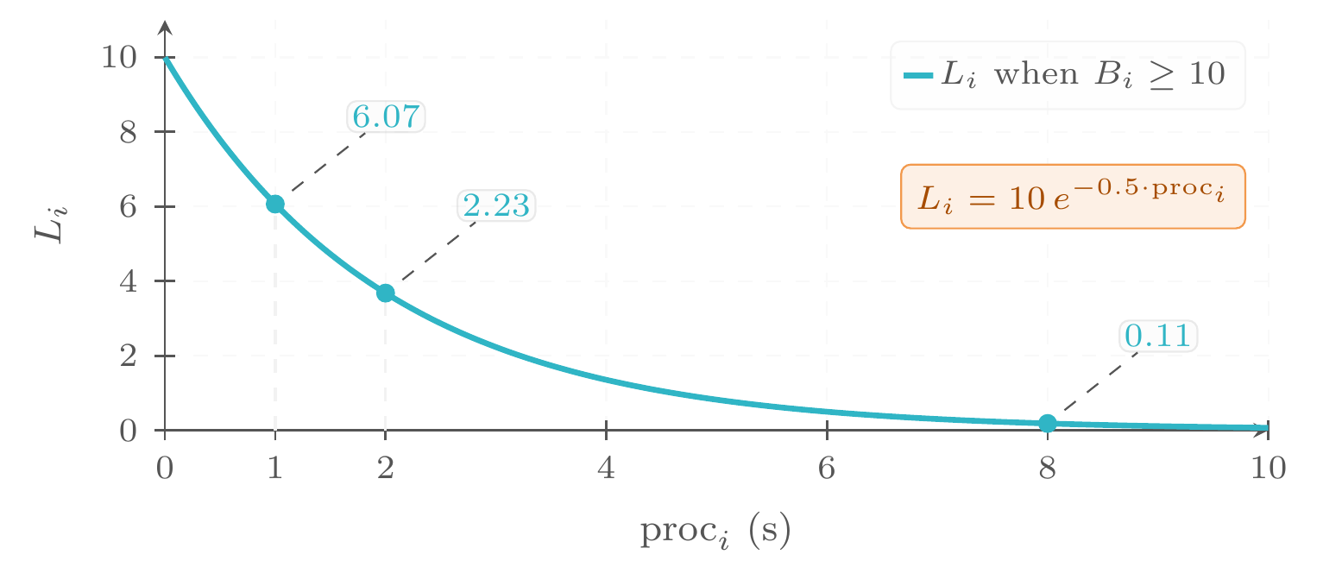
The Challenge — Scoring Contract
▸ C_i = B_i + K_i + L_i per chunk
▸ B_i ∈ [5,25] — 5-dimension LLM-judged quality (factual consistency, relevance, coherence, fluency, conciseness)
▸ K_i = 2(N_rel − N_irrel) ∈ [-6,6] — keyword relevance
▸ L_i = 10·e^(−0.5·proc_i), only if B_i ≥ 10
▸ Janus WebRTC bonus: flat +4
▸ Final score = average chunk score per source, then min-max normalized across submissions
STREAMIND — IEEE MMSP 2026 Grand Challenge
3
Notes:
The latency term is gated on a quality floor — you cannot game speed by emitting garbage instantly. This single design choice shapes every architectural decision in the rest of the talk: quality first, then squeeze latency.

Slide 4
Why This Is Hard
▸ Streaming, not batch: overlapping ASR chunks need deduplication before they reach the summarizer
▸ Fixed 300s windows required to produce progressive (not just final) output
▸ Single-GPU ceiling: RTX Pro 4500, 32GB, at eval time — ASR + LLM must co-reside
▸ Juturna itself is a young framework (1.0-beta) — this challenge also stress-tests the tool
STREAMIND — IEEE MMSP 2026 Grand Challenge
4
Notes:
Two separate hard constraints stack here — a systems constraint (real-time, overlapping, GPU-bounded) and a tooling constraint (building on a beta framework). Worth naming both since it explains some of the defensive engineering choices later (fallback paths, guarantees).

Slide 5
Background — Juturna Framework
▸ Meetecho's open-source real-time AI pipeline library
▸ Node-based, message-driven, async/threaded architecture
▸ Three node roles sharing one abstraction: source / proc / sink
▸ Each node: a typed message transformer with a defined lifecycle (configure → warmup → start → stop → destroy)
STREAMIND — IEEE MMSP 2026 Grand Challenge
5
Notes:
Juturna's node graph maps directly onto the challenge's staged pipeline description — that's essentially why the reference implementation and every submission looks like a chain of nodes. It's a fairly thin abstraction, which is part of why it works for fast prototyping under a deadline.

Slide 6
Background — Janus WebRTC Gateway
▸ Real WebRTC ingestion (ICE/DTLS/SRTP negotiation, live conferencing audio)
▸ Contrast: challenge baseline uses ffmpeg-simulated RTP (a file replayed over UDP, no real negotiation)
▸ Janus's RTP-forward capability feeds Juturna's audio_rtp source node directly
▸ This is why adopting Janus earns the challenge's +4 bonus
STREAMIND — IEEE MMSP 2026 Grand Challenge
6
Notes:
The bonus exists because Janus demonstrates the real version of audio reception — actual WebRTC negotiation from a live client, not a toy pipe. Both Janus and Juturna come from Meetecho, so this also showcases their intended combined stack.

Slide 7
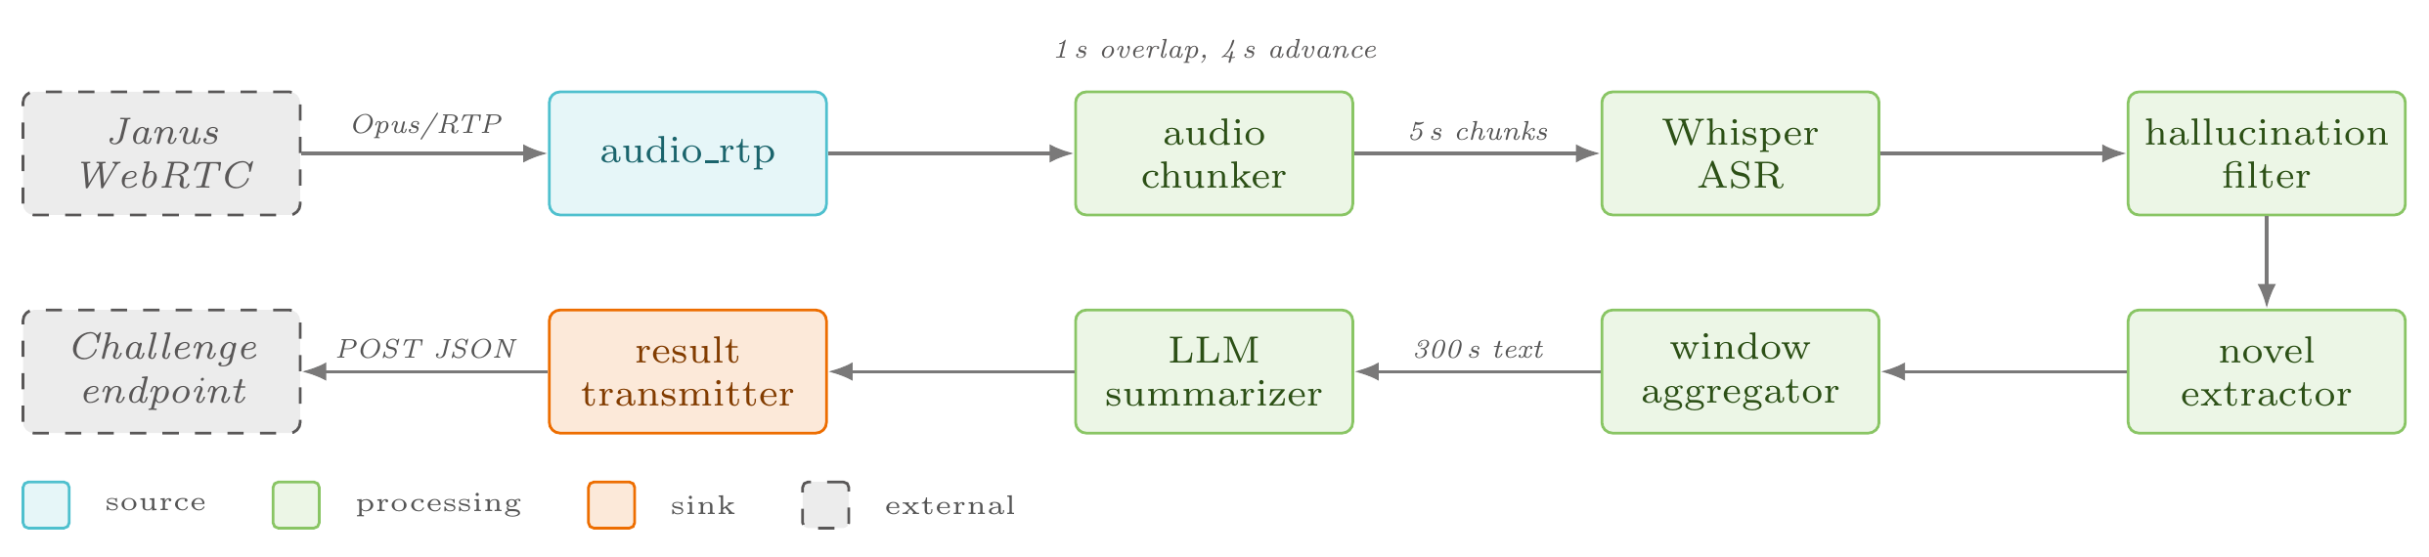
Solution — Architecture Overview
▸ 8-node Juturna pipeline, one node per stage
▸ audio_rtp → audio_chunker → transcriber_whisper → hallucination_filter → novel_extractor → window_aggregator → summarizer_vllm → result_transmitter
STREAMIND — IEEE MMSP 2026 Grand Challenge
7
Notes:
This is the centerpiece diagram of the talk — walk left to right, naming each node's job in one clause. ASR/hallucination-filter/novel-extractor protect B_i, keyword logic inside the summarizer targets K_i, and the summarizer's prompt/quantization choices target L_i.

Slide 8
Solution — Streaming Chunk Deduplication
▸ Problem: 5s audio chunks with 1s overlap → duplicated transcript text
▸ Greedy suffix-prefix match, 10 words down to 1, first exact match wins
▸ SequenceMatcher fallback (similarity ≥ 0.8) to absorb ASR variation across the overlap
▸ Removes ~20% redundant text per 300s window
STREAMIND — IEEE MMSP 2026 Grand Challenge
8
Notes:
Without this, roughly a fifth of every context window handed to the summarizer would just be repeated speech — directly hurting conciseness and coherence, both B_i sub-scores.

Slide 9
Solution — Keyword Guarantee
▸ Problem: challenge requires exactly 3 keywords; raw LLM output is inconsistent
▸ Strip banned generic terms → dedupe (case-insensitive) → backfill from transcript token frequency → fallback terms as last resort
▸ Guarantees the 3-keyword format — does not guarantee positive K_i
STREAMIND — IEEE MMSP 2026 Grand Challenge
9
Notes:
Be explicit about the limit here — this is a format guarantee, not a quality guarantee. Under a weak summarizer (Llama-3.1-8B) two windows still scored K_i = -6 because the fallback keywords inherited low relevance from an already-poor summary. Worth stating plainly since it's an honest constraint, not a flaw to hide.

Slide 10
Solution — Quality-Gated Latency Optimization
▸ Prompt engineering + enable_thinking=False (thinking-mode suppression) + int4-AWQ quantization
▸ Result: B_i held above 23/25 while average processing time is 0.76s
▸ Directly targets the challenge's exponential latency bonus L_i = 10·e^(−0.5·proc_i)
STREAMIND — IEEE MMSP 2026 Grand Challenge
10
Notes:
This is the punchline of the solution section — quality didn't have to be traded for speed here; the three contributions compound so that a sub-second pipeline still scores near-ceiling on quality. Segue into results.

Slide 11
Evaluation Methodology — LLM-as-a-Judge
▸ B_i and K_i are LLM-judged — no ground-truth reference summary exists, so scoring follows the G-Eval LLM-as-judge paradigm
▸ Cross-family judge panel: Mistral-Small-24B-Instruct, Phi-4, Gemma-3-27B-IT (all int4-AWQ) — deliberately excludes the Qwen family (the summarizer's own family) to avoid self-evaluation bias
▸ Each judge scores every summary against the same 5 Likert criteria the challenge defines for B_i, plus a per-keyword boolean relevance flag for K_i
▸ Judges run sequentially, isolated subprocesses, VRAM reclaimed between loads — single 24GB dev GPU can't host all three at once
▸ Every configuration run ≥3 times to absorb judge non-determinism; reported numbers are means ± standard deviation across runs
▸ Panel consensus = mean ± std across the 3 judges too — low dispersion → confidence, high dispersion → flags judge-specific bias, treated with caution
STREAMIND — IEEE MMSP 2026 Grand Challenge
11
Notes:
Since B_i and K_i come from an LLM judge, not a fixed reference metric, the methodology itself needs to be defensible — this is the guardrail section before the numbers. Two independent sources of noise are controlled separately: within-judge stochasticity (handled by ≥3 pipeline runs per config) and between-judge bias (handled by scoring with three model families unrelated to the summarizer, then reporting their spread, not just their mean). Be upfront in Q&A: this panel is a proxy for the hidden challenge judge — where all three agree, scores are more trustworthy, but they remain directional, not absolute.

Slide 12
Results — Headline Number
▸ Cross-episode mean final score: 40.14 ± 0.85 / 45 (Rev16, submission config)
▸ Per-window breakdown (episode 27, 5 windows): avg B_i = 24.4, K_i = 6.0 (ceiling), L_i = 6.65, avg proc = 0.82s
▸ With Janus +4 bonus: 41.09 for this episode
STREAMIND — IEEE MMSP 2026 Grand Challenge
12
Notes:
Lead with this number, then immediately show it's not a one-off by pointing at the per-window table — quality and keyword score stay essentially flat across the whole 25-minute episode.

Slide 13
Results — Cross-Domain Validation
▸ IETF125 technical meeting sessions (out-of-domain from the podcast-tuned pipeline): mean score 40.22
▸ Closely tracks the Rev16 podcast mean (40.14)
STREAMIND — IEEE MMSP 2026 Grand Challenge
13
Notes:
The pipeline and prompt were developed against podcast audio; this is the evidence that it generalizes to a genuinely different domain (structured technical meetings) without retuning.

Slide 14
Results — Does ASR Accuracy Matter?
▸ small.en: WER 0.259 → final score 40.44
▸ large-v3-turbo: WER 0.252 → final score 40.14
▸ The lower-WER model scores marginally lower overall
STREAMIND — IEEE MMSP 2026 Grand Challenge
14
Notes:
Counterintuitive finding worth pausing on — at 300-second summarization granularity, transcription accuracy isn't the bottleneck; small ASR errors get smoothed out by the summarizer. Submission still ships large-v3-turbo for non-English robustness, which this two-episode English-only comparison doesn't test.

Slide 15
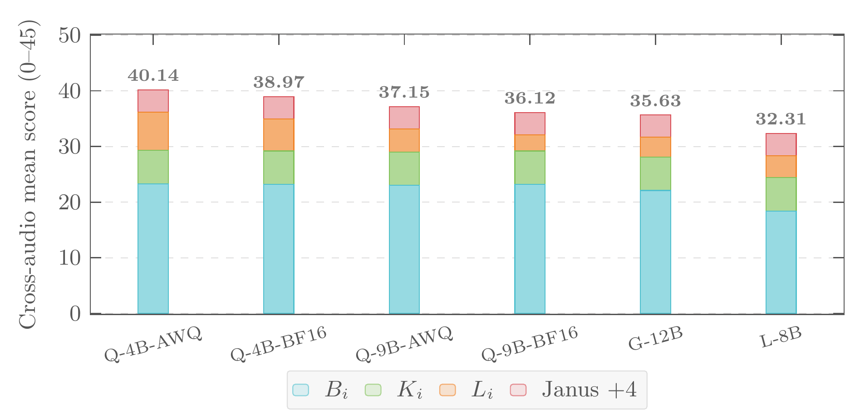
Results — Model-Size & Cross-Family Sweep
▸ AWQ int4 cuts latency ~35% at 4B with essentially flat B_i + K_i
▸ K_i sits at ceiling (6.0) for every configuration — the keyword guarantee holds regardless of summarizer
Model | B_i (/25) | K_i (/6) | L_i (/10) | proc_i (s) | Janus | Total (/45)
Qwen3.5-4B-AWQ (submission) | 23.3 | 6.0 | 6.84 | 0.76 | +4.0 | 40.14 ± 0.85
Qwen3.5-4B-BF16 | 23.2 | 6.0 | 5.77 | ~1.10† | +4.0 | 38.97 ± 0.91
Qwen3.5-9B-AWQ | 23.0 | 6.0 | 4.15 | ~1.76† | +4.0 | 37.15 ± 1.53
Qwen3.5-9B-BF16 | 23.2 | 6.0 | 2.92 | 2.51 | +4.0 | 36.12 ± 1.42
Gemma-3-12B-IT-AWQ | 22.1 | 6.0 | 3.55 | 2.07 | +4.0 | 35.63 ± 1.06
Llama-3.1-8B-Instruct | 18.4 | 6.0 | 3.92 | ~1.87† | +4.0 | 32.31 ± 4.59
† proc_i not stated directly in the paper's prose for this row — derived by inverting L_i = 10·e^(−0.5·proc_i) against the reported L_i.
STREAMIND — IEEE MMSP 2026 Grand Challenge
15
Notes:
Bigger models don't win under this scoring function — quality plateaus quickly across the Qwen family while latency keeps climbing, so the reward curve favors the smallest model that still clears the quality floor. Llama-3.1-8B's large variance (episode-to-episode B_i swinging 13→24) is a robustness gap in that model, not in the pipeline.

Slide 16
Honest Limitations
▸ Ablations are qualitative, not isolated toggle-off experiments — can't cleanly separate the contribution of dedup vs. keyword-guarantee vs. prompt engineering individually (flagged by both reviewers)
▸ Hallucination filter is a fixed 22-pattern list — blind to novel or semantic hallucinations outside it
▸ Novel-extractor's exact-match approach can misalign under heavy disfluency or noisy overlap
STREAMIND — IEEE MMSP 2026 Grand Challenge
16
Notes:
State these plainly and don't soften them — they're exactly what both reviewers flagged, and the paper already commits to them as future work (threats to validity). Owning this directly builds more credibility in Q&A than skipping past it.

Slide 17
Thank You
Real-time, quality-gated, sub-second summarization pipeline
40.14/45 cross-episode mean · generalizes to a second domain (IETF125: 40.22)
Open source: github.com/streaming-university/streamind
Questions?
Notes:
Close on the generalization result, not just the headline score — it's the strongest signal that this isn't overfit to one dataset. Open the floor for questions.

