Slide 1


WorLd Tree’s GuardIan
Aydın Burak Kuyumcu
Mehmet Emin Ayaz
Canberk Balcı

Slide 2
Introductıon
World Tree's Guardian is an action-RPG game.
Objective: Save all oba people .
Motivation:
Introduce Turkish mythology to a global audience.
Present mythology in an entertaining way.

Slide 3
Problem
Few games in the industry representing Turkish mythology.
Aim:
Educate players about Turkish mythology.
Provide an engaging RPG experience.

Slide 4
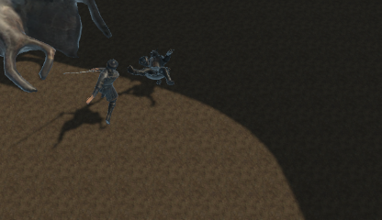
Initial Design Idea
Players manage resources to save oba citizens.
Setting: Turkish village.
Players explore, battle enemies, and strategize character development.
Storyline:
Obtain Ülgen’s mystical ring by defeating itbaraks.
Use the ring to confront giants threatening the tribe.

Slide 5
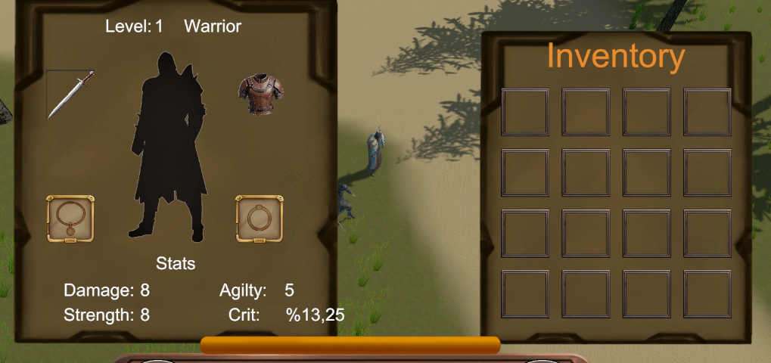
FInal DesIgn Idea
Features:
NPC interaction, item collection, and combat.
Character development system.
Skill and equipment management.
Goal: Save the village by defeating all enemies.

Slide 6
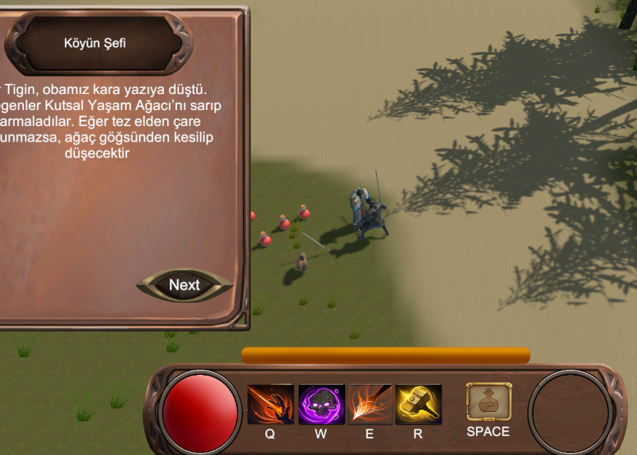
ImplementatIon
Game Flow:
Players explore the village, fight enemies, and collect items.
Equipment and health potions help enhance stats.
Game ends when all enemies are defeated.

Slide 7
EvaluatIon
Testing Process:
Tested with two perspectives:
Players: For enjoyment and usability.
Game Designers/Engineers: For technical and design feedback.
Ran the game in debug mode to gather feedback.
Results:
Strengths: Successful aspects in gameplay and concept.
Weaknesses: Identified problems with mechanics, story, and game time.

Slide 8
RecommendatIons & ConclusIons
Recommendations:
Extend game duration.
Improve mechanics and expand the story.
Add a boss system to enhance challenge.
Conclusion:
Learning Outcomes:
Gained knowledge about RPG development and Turkish mythology.
Overcame challenges in mechanics, assets, and resources.
Github : https://github.com/burak-kuyumcu/WorldTreesGuardian
Trailer Video: https://www.youtube.com/watch?v=rEwKDedHqOc

