Slide 1
Bank Tele-marketing Analysis COMP-550X Online Data Science Program Fall- 2020
Advisor: Mehmet Sezgin
Group Members:
Hilal Atalan
Burak Özbek
Bilge Bilgili Buğanli

Slide 2

Agenda
Introduction
Problem Definition
Dataset
Data Cleaning
Data Analysis
Data Visualization
Model Implementation Process
Conclusion

Slide 3

Problem Definition
With the technological developments in banks, the importance of digital channels is considerably increasing.
Digital channels are used as sales channels in addition to performing banking transactions.
In this project, it is aimed to analyze and classify the campaign calls to the customers so that they can turn into real sales.
Our main goal is to increase call efficiency by determining customers who can accept the offer.
There is information about whether the customer accepts the offer or not that is in the customer calls made in banks.

Slide 4
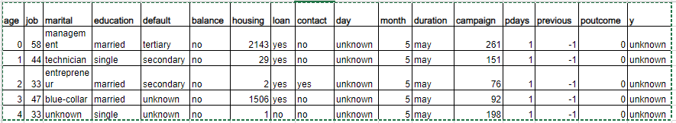

Dataset
There are 41,188 observations in this dataset. Each represents an existing customer that the bank reached via phone calls.
For each observation, the dataset records 16 input variables that stand for both qualitative and quantitative attributes of the customer, such as age, job, housing and personal loan status, account balance, and the number of contacts.
There is a single binary output variable that denotes “yes” or “no” revealing the outcomes of the phone calls.
This dataset is about the direct phone call marketing campaigns, which aim to promote term deposits among existing customers, by a Portuguese banking institution from May 2008 to November 2010. It is publicly available in the UCI Machine learning Repository, which can be retrieved from http://archive.ics.uci.edu/ml/datasets/Bank+Marketing#.

Slide 5
Data Cleaning
We checked if there is any missing value in data set and we observed that there no NaN values. So there is no need to fill missing value methods or etc
We know some values are like “unknown”, and “others” from sample data set (data head table.), so we checked number of unique values in data set.
For poutcome; “other” does not mean anything. Therefore, rows which column poutcome contains “other” will be deleted.
For contact; there are “unknown” values. We believed that contact is not related variable to the problem. So, it will be deleted.
For Unknown values in job and education columns will be replaced with “other” for reporting purposes.

Slide 6
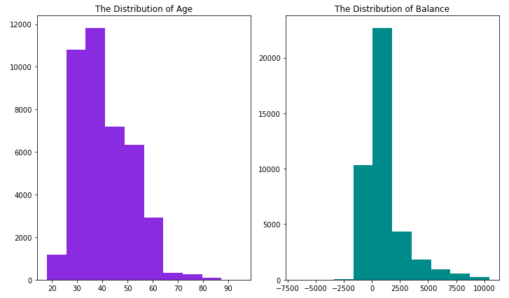
Data Analysis
The distribution of age: In its telemarketing campaigns, clients called by the bank have an extensive age range, from 18 to 95 years old. However, a majority of customers called is in the age of 30s and 40s (33 to 48 years old fall within the 25th to 75th percentiles). The distribution of customer age is fairly normal with a small standard deviation.
The distribution of balance: After dropping outliers in balance, the range of balance is still massive, from a minimum of -6847 to a maximum of 10443 euros, giving a range of 17290 euros. The distribution of balance has a huge standard deviation relative to the mean, suggesting large variabilities in customers' balance levels.

Slide 7
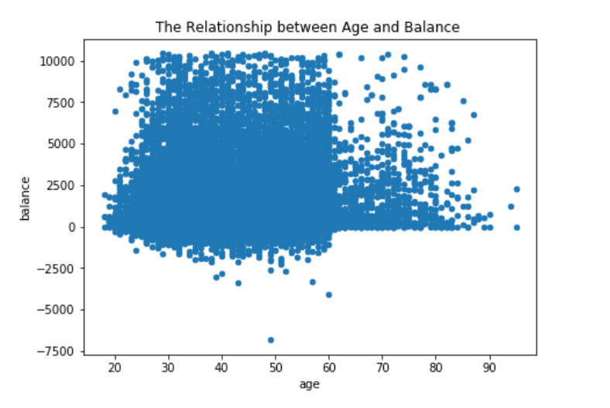
Data Analysis
Based on this scatter plot, there is no clear relationship between client’s age and balance level.
Nevertheless, over the age of 60, clients tend to have a significantly lower balance, mostly under 5,000 euros. This is due to the fact that most people retire after 60 and no longer have a reliable income source.

Slide 8
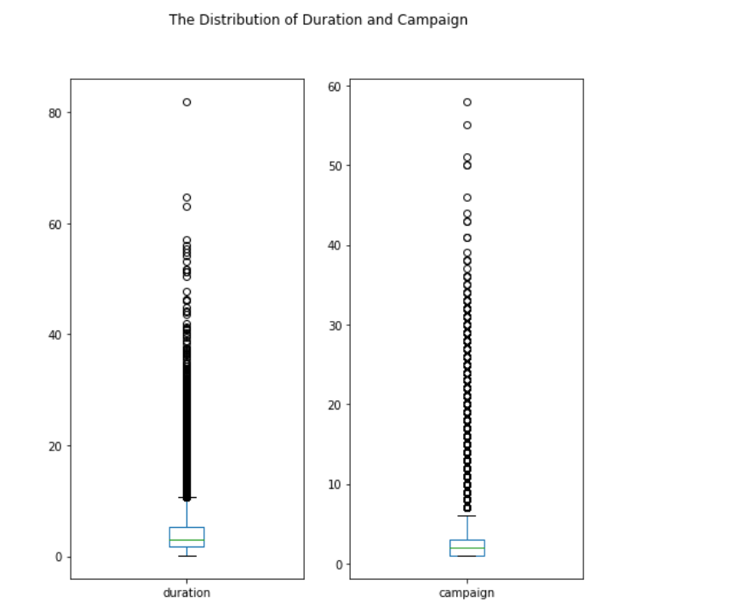
Data Analysis
The distribution of duration: As observed from the box plot, the duration of contact has a median of 3 minutes, with an interquartile range of 1.73 minutes to 5.3 minutes. The left-skewed boxplot indicates that most calls are relatively short. Also, there is a large number of outliers ranging from 10 minutes to 40 minutes, which are worth further study.
The distribution of campagin: About half of the clients have been contacted by the bank for the second time, while 25% was first introduced to the term deposit. Most clients have been reached by the bank for one to three times, which is reasonable. However, some clients have been contacted by as high as 58 times, which is not normal. These clients may have some special needs that require frequent contact.

Slide 9
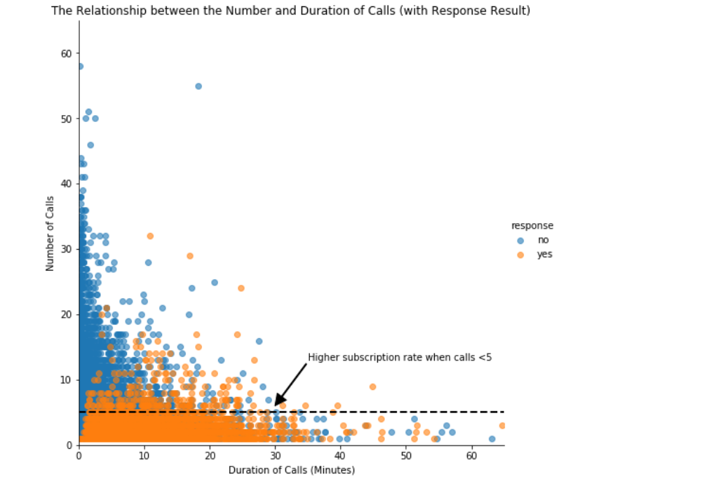
Data Analysis
Clients subscribed to term deposits are denoted as "yes" while those did not are denoted as "no".
“yes” clients and “no” clients are forming two relatively separate clusters. Compared to “no” clients”, “yes” clients were contacted by fewer times and had longer call duration.
After five campaign calls, clients are more likely to reject the term deposit unless the duration is high. Most “yes” clients were approached by less than 10 times.
This suggests that the bank should resist calling a client for more than five times, which can be disturbing and increase dissatisfaction.

Slide 10
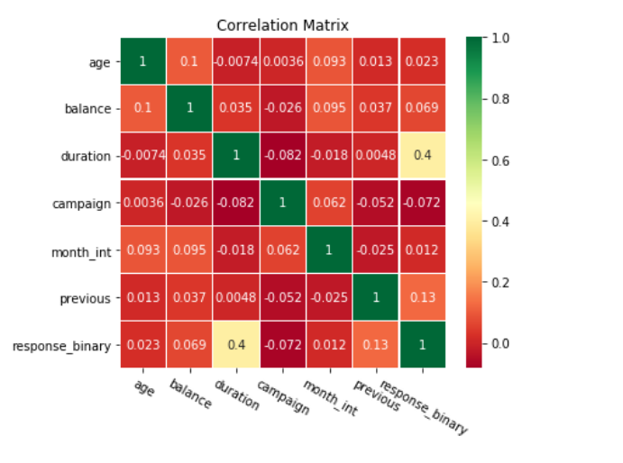
Data Analysis
The scatter matrix does not reveal any clear relationship among age, balance, duration and campaign.
To investigate more about correlation, a correlation matrix was plotted with all qualitative variables.
“campaign outcome” has a strong correlation with “duration”, a moderate correlation with “previous contacts”, and mild correlations between “balance”, “month of contact” and “number of campaign”. Their influences on campaign outcome will be investigated further in the machine learning part.

Slide 11
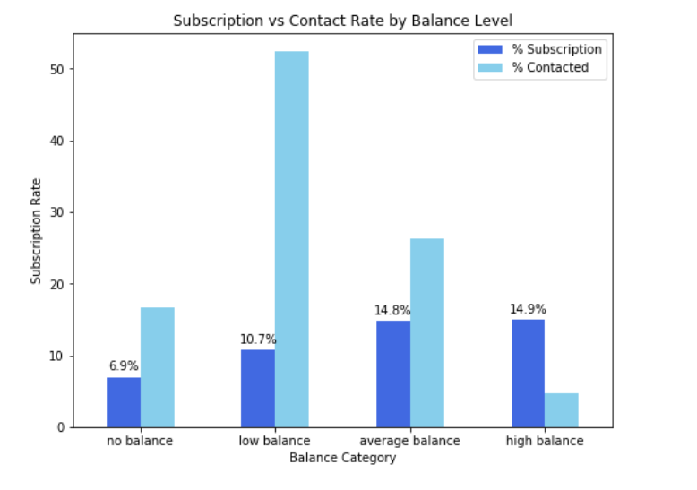
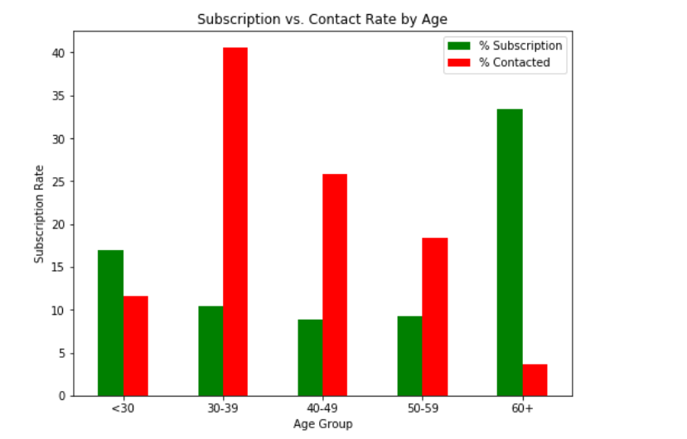
Data Visualization
Green vertical bars rate. About 17% of the subscriptions came from the clients aged between 18 to 29. More than 50% of the subscriptions are contributed by the youngest and the eldest clients.
Red vertical bars show that the bank focused its marketing efforts on the middle-aged group, which returned lower subscription rates than the younger and older groups.
No Balance: clients with a negative balance.
Low Balance: clients with a balance between 0 and 1000 euros
Average Balance: clients with a balance between 1000 and 5000 euros.
High Balance: clients with a balance greater than 5000 euros.
Notes:
It is not surprising to see such a pattern because the main investment objective of older people is saving for retirement while the middle-aged group tend to be more aggressive with a main objective of generating high investment income. Term deposits, as the least risky investment tool, are more preferable to the eldest.
The youngest may not have enough money or professional knowledge to engage in sophisticated investments, such as stocks and mutual funds. Term deposits provide liquidity and generate interest incomes that are higher than the regular saving account, so term deposits are ideal investments for students.

Slide 12
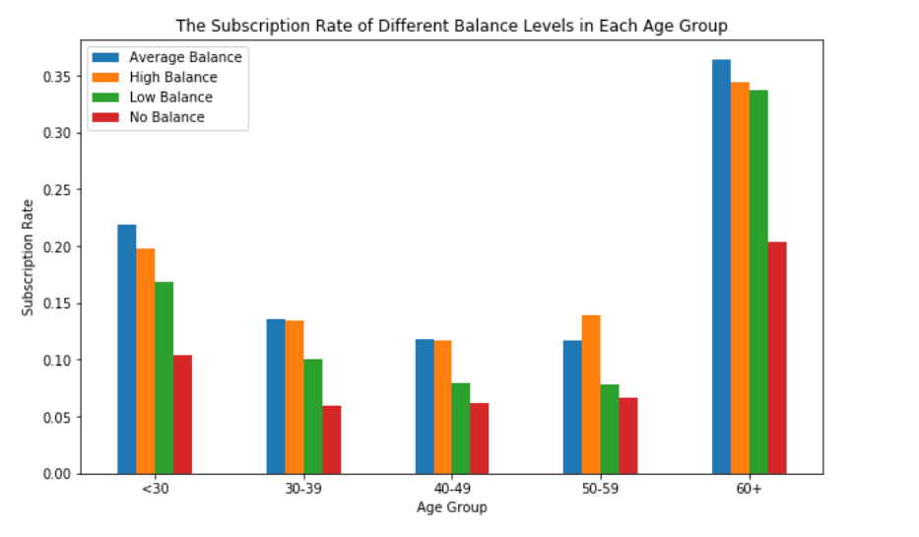
Data Visualization
The willingness to subscribe is exceptionally high for people aged above 60 and younger people aged below 30 also have a distinguishable higher subscription rate than those of other age groups.
The effect of balance levels on subscription decision is applicable to each individual age group: every age group shares a common trend that the percentage of subscription increases with balance.
In sum, the bank should prioritize its telemarketing to clients who are above 60 years old and have positive balances, because they have the highest acceptance rate of about 35%. The next group the bank should focus on is young clients with positive balances, who showed high subscription rates between 15% and 20%.

Slide 13
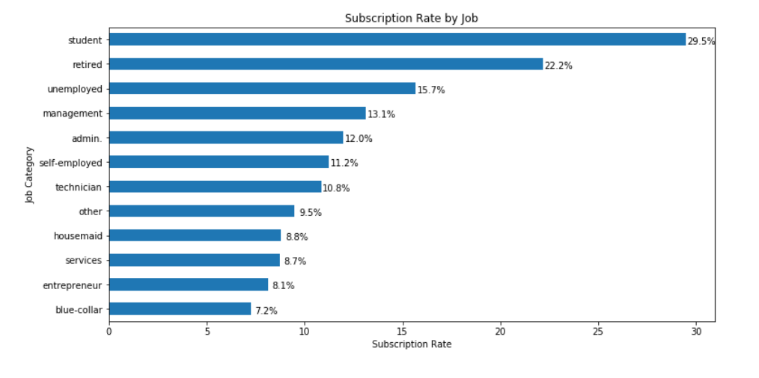
Data Visualization
The horizontal bar chart, students and retired clients account for more than 50% of subscription, which is consistent with the previous finding of higher subscription rates among the younger and older.

Slide 14
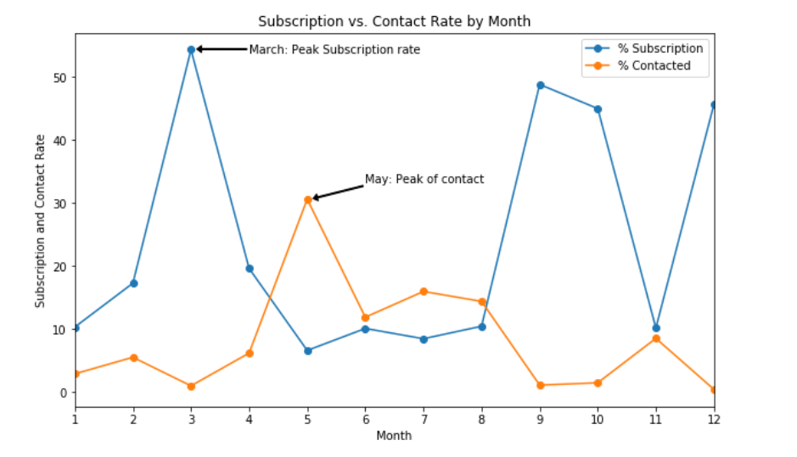
Data Visualization
This line chart displays the bank’s contact rate in each month as well as clients’ response rate in each month.
The bank contacted most clients between May and August. The highest contact rate is around 30%, which happened in May, while the contact rate is closer to 0 in March, September, October, and December.
The highest subscription rate occurred in March, which is over 50%, and all subscription rates in September, October, and December are over 40%.

Slide 15
Model Implementation Process
Model Type | Accuracy
Logistic Regression - LR | 0.885284
KNeighborsClassifier (default parameter from scikit learn, neighbour=5) - KNN | 0.874938
Classification and Regression Trees (default parameter from scikit learn, maximum depth “none”) - CART | 0.833251
Naive Bayes - NB | 0.823855
KNeighborsClassifier (default parameter from scikit learn, neighbour=7) – KNN2 | 0.880386
Classification and Regression Trees (default parameter from scikit learn, criterion Gini) – CART2 | 0.831598
Classification and Regression Trees (default parameter from scikit learn, max leaf nodes=3, “none”) – CART3 | 0.885284
Classification and Regression Trees (default parameter from scikit learn, max _depth=7,) – CART4 | 0.884059
MLP – (default parameters: activation= relu, hidden_layer_sizes=100, solver='adam‘, max_iter=300) | 0.885345
MLP2 – (activation= logistic, hidden_layer_sizes=150, solver=sgd‘, max_iter=300) | 0.885284

Slide 16
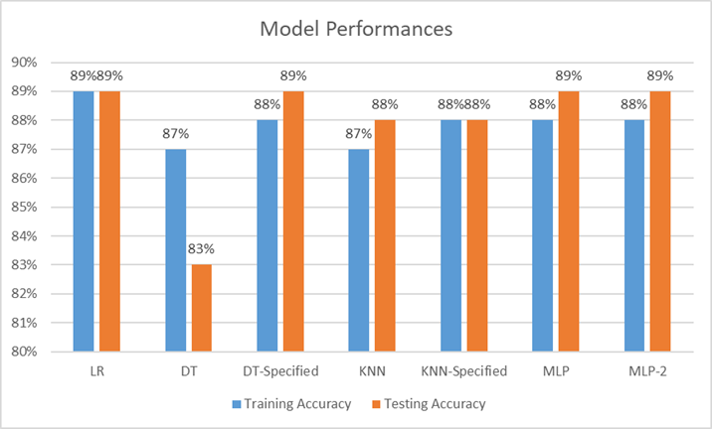
Model Implementation Process
Base Model is Logistic Regression
Benchmark Model 1: Decision Tree
Benchmark Model 2: KNN
Benchmark Model 3: MLP

Slide 17
Conclusion
The most responsive customers possess these features:
Feature 1: age < 30 or age > 60
Feature 2: students or retired people
Feature 3: a balance of more than 5000 euros
By applying logistic regression, KNN, Decision Tree and MLP algorithms, classification and estimation model were successfully built.
By using Logistic regression algorithm, the bank will be able to predict a customer's response to its telemarketing campaign before calling this customer.

Slide 18
Thank You

