Slide 1

AUTO GRADING OF ANSWERS FOR TEXT-BASED OPEN-ENDED
QUESTIONS USING NATURAL LANGUAGE PROCESSING
Burak keskin

Slide 2
Objectıve
In text-based exams with open-ended questions, it takes a long time to read and evaluate the answers.
In this study, the objective is to read and successfully evaluate these exams in computer environment using natural language processing methods.

Slide 3
Overvıew
What is CBA?
What is NLP?
Literature Review.
Which methods are suitable for sentence analysis in NLP?
What are the results achieved in this study?

Slide 4
Computer based assessment
Computer Based Assessment(CBA) is the technique that is used to assess the students with the help of computer environment.
Usually used for multiple choice exams but rarely used for open-ended exams.
It is not easy to use in exams with math content.
On the other hand, it can be used for text-only exams.
Worldwide known exams like TOEFL, GMAT, GRE are examples of CBA.

Slide 5
Advantages of cba
Immediate score reporting: According to the study Daniels and Gierl 2017, anxiety of the students are dramatically reduced when they learn their grades immediately after the exam is finished.
Time efficiency: Compared to reading answer sheets manually, CBA saves huge amount of time by quickly assessing the sheets.
Storage space: CBA systems do not require large physical space in the real world like paper based assessment.
Feedback: It is easier to analyze the results and give feedback to provide students the room for improvement.

Slide 6
Dısadvantages of cba
Cost: CBA requires computers, smart phones, tablets etc. to be able to make and assess the exam. Which is considered expensive in both hardware and deployment of the required software compared to the paper based exams.
User Interaction: Although it is common knowledge to interact with tech devices in present, there may be bugs, issues, incompatibilities in the system that limits the performance.
Availability: Each student should have access to the CBA environment and in rare cases this may become a problem.

Slide 7
Natural language processIng
Natural language processing(NLP) is a field of computer science to understand the interaction between human and computers.
Content extraction, text summarization, question answering, next sentence prediction, word-sentence similarity detection are possible by the libraries provided with NLP.

Slide 8
Lıterature RevIew
Objective is accurate evaluation of sentence similarity.
TF-IDF, T5, BERT, USE are the most popular methods to be used for this objective.
In order to measure sentence similarity, three aspects have been used in different studies.
These aspects are Word based, Structure Based, Vector Based.

Slide 9
Aspects of sentence Sımılarıty
Word Based: Compare the word similarity between the student's answer and the solution.
Structure Based: Compare the structure of the student's answer to solution.
Vector Based: Transform both student's answer and the solution into vectors and compare the similarity of the vectors.

Slide 10
Word based
Word based assessment process is not optimal because the solutions of the questions asked in the exam differs in number of words.
An irrelevant answer containing the required words may have high grade which is not the desired result.
‘This is a pencil.’ and ‘This is.’ results in %89 similarity when word based methods are used.
TF-IDF is one of the popular techniques used in word based assessment.

Slide 11
Structure based
Structure based assessment process is also not optimal because there are many grammar errors, misspelling, use of other languages.
There are models that pre-trained for multilingual assessment of the sentences but performance is poor.
Results change due to the order of words in the answers which may lead to false evaluations.
T5(Text to text transformer model (Haller 2020)) is a popular technique used in structure based assessment.

Slide 12
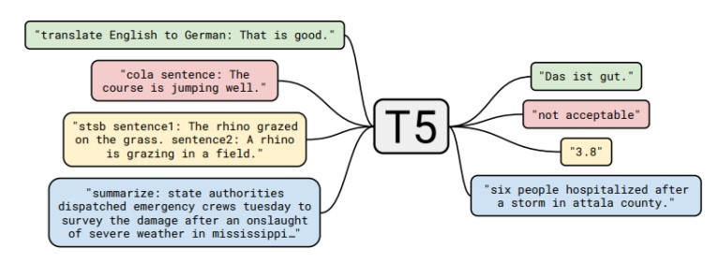
T5
Aim of this approach is to have an all-in-one model for all the natural language processing tasks.
It has state of art performance in generic datasets like SciEntsBank (Haller 2020).

Slide 13
Vector based
Vector based assessment is found more suitable for assessment technique. Process of the vector based assessment can be summarized as:
Take the sentences and transform them into high dimensional vectors that can be used for semantic similarity, text classification and other natural language tasks.
Compare the vectors of student's answer and the solution to find similarity between them.

Slide 14
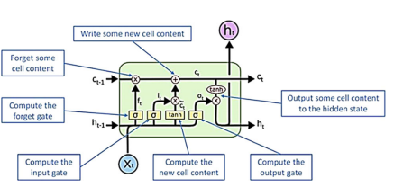
LSTM
LSTM(Long-Short Term Memory) is special kind of RNN(recurrent neural network) that is capable of learning long term dependencies in data.
Suffers from the vanishing gradient problem in small sized data.
Widely used in handwriting recognition, speech recognition and video games.
Takes long time to train and are easy to overfit.
Not suitable for sentence similarity because compared to the widely used areas, sentences weights are much smaller and causes vanishing gradient problem.

Slide 15
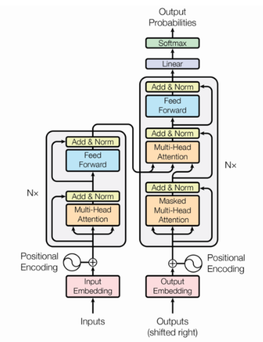
Transformers
Transformers are the deep learning models that proposed in the paper (Vaswani et al. 2017) developed to solve the problems encountered in previous approaches like LSTM.
An attention mechanism is used to process all input at once which makes parallelization possible. Popular models are:
BERT(Bidirectional Transformer Encoder Representation)
GPT(Generative Pre-Trained Transformer)
USE(Universal Sentence Encoder).

Slide 16
Methods

Slide 17
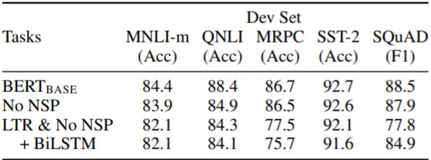
BERT
BERT was created by Jacob Devlin and his colleagues in 2018.
Unlike previous models, BERT use bidirectional encoding mechanism hence provides better results compared to the previous models in well known datasets as seen in the figure.

Slide 18
USE
The Universal Sentence Encoder(USE) is proposed in (Cer et al. 2018) and is used for encoding sentences into vectors to be analyzed for NLP tasks.
There are currently two different versions of USE which differs in accuracy and performance.
Transformer based and DAN(Deep Averaging Network) based.

Slide 19
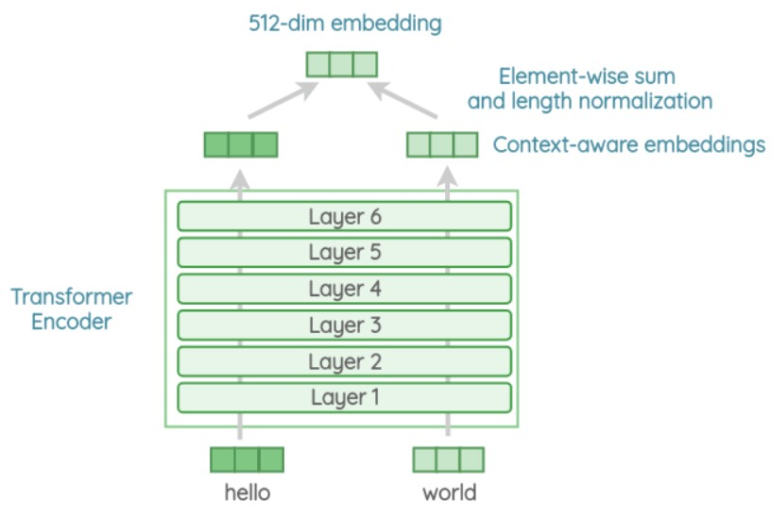
Transformer based use
Transformer based model of USE is composed of 6 stacked transformer layer with each layer having a self-attention module that provides an output of a 512-dimensional vector as sentence embedding.
This version requires more resources for computation but for large datasets performance is better.

Slide 20
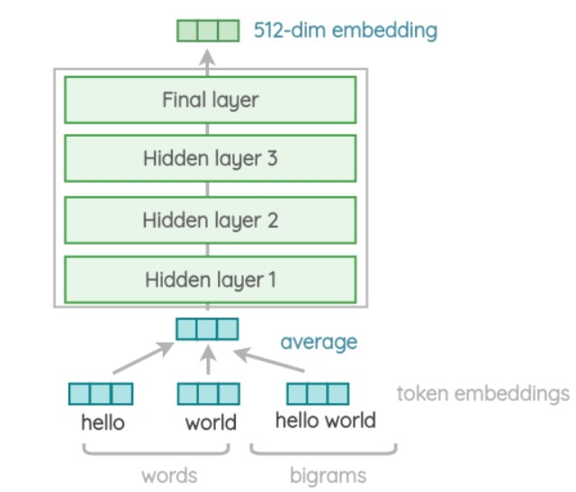
DAN based use
DAN based model of USE is composed of 4 stacked layers with feed forwarding mechanism that provides an output of a 512-dimensional vector as sentence embedding.
This version requires less resources for computation and performs better in small sized datasets similar to the one used in this study.

Slide 21
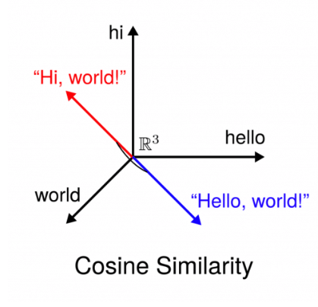
Cosıne sımılarıty
Vector based assessment is selected in the scope of this study.
Cosine similarity is the technique to calculate the similarity between vectors.

Slide 22
Dataset
For this study, dataset from the Natural Science course was used which includes the answers of 88 students for five different questions.
There are questions with direct answer and also questions with open-ended answers in the dataset.
For the questions with direct answers, grades given were similar to the original grades.
For the questions with open-ended answers, grades given were lower compared to the original grades.

Slide 23
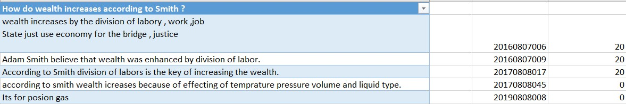
Dataset
Example of a question with a direct answer is shown in the figure below.
Answer in the solution manual for this question was : ‘According to Smith wealth increases by division of labor’.
As seen in the figure, instructor gave full scores to the answers containing ‘division of labor’.

Slide 24
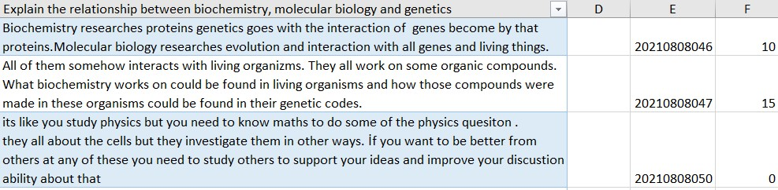
Dataset
Example of a question with open-ended answer is shown in the figure below.
Answer given by ChatGPT was : ‘Biochemistry isolates the protein of the functional organ and studies the chemical composition of the puree. Genetics study the population and observe how traits are being transmitted from parents to offspring through genes. Molecular Biology isolates the gene (DNA) and arrives at the protein form for biochemistry.’.
As seen in the figure, instructor gave scores depending on the content of the answer.

Slide 25
Results and dıscussıon
BERT-Base, RoBERTa-Large and DAN based USE have been used.
Results for each model are explained in the following slides.
Original grades given by the instructor are used for comparison of the models.
In all models, results were divided into three parts as Failed, Successfull and High Success as researchers did in the literature.

Slide 26
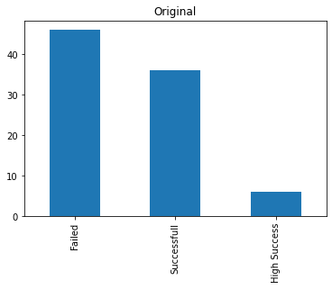
Orıgınal
Original distribution of the grades is shown in the figure.
In the original scores given, 46 students have Failed, 42 students were Successfull and 6 of the passed students performed High Success.

Slide 27
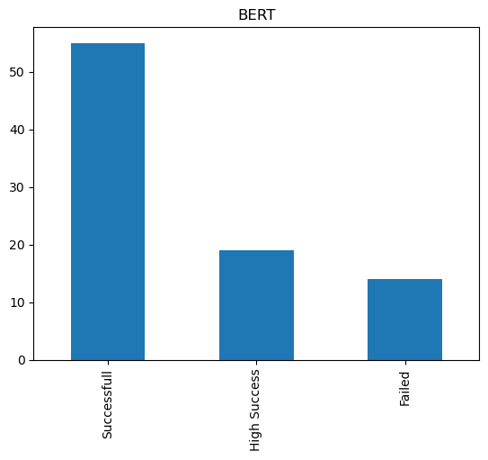
Bert-base
Distribution of the grades assessed with BERT-Base model is shown in the figure.
In this model, 14 students have Failed and 19 students performed high success.
This result is not viable because there are students that gave irrelevant answers to each question and should have failed the course.

Slide 28
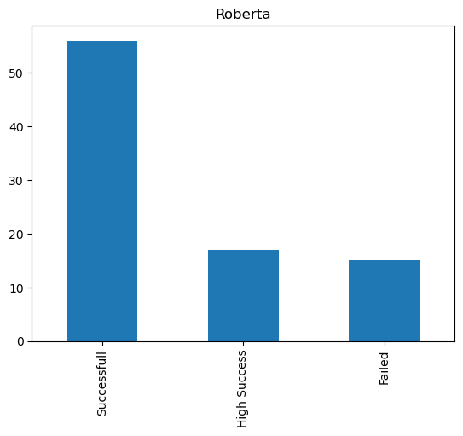
Roberta-large
Distribution of the grades assessed with RoBERTa-Large model is shown in the figure.
In this model, 15 students have Failed and 73 students were Successfull. 17 students that perform high success.
This result is better than BERT-Base model but students with High Success in the original scores were given lower scores.

Slide 29
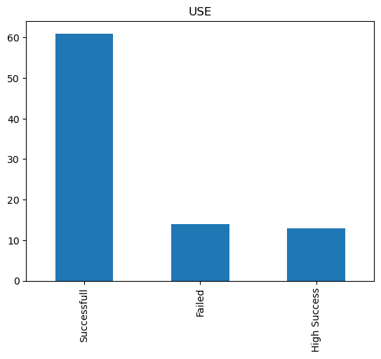
Dan Based USE
Distribution of the grades assessed with DAN Based USE model is shown in the figure.
In this model, 14 students have Failed and 74 students were Successfull. 19 of the passed students performed High Success.
This result is closest to the original scores given but students performed High Success in original assessment had lower scores.

Slide 30
Z-score
After the results were analyzed, it is clear that RoBERTa model is the best performing model overall.
To observe the accuracy between models and original grades, Z-Score is applied on all results.

Slide 31
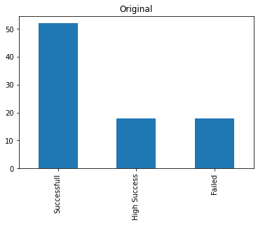
Zscore of Orıgınal
After Z-Score is applied to the original grades, 18 students have Failed, 70 students were Successfull and 18 of the passed students performed High Success.

Slide 32
Zscore of BERT
After Z-Score is applied to the BERT grades, 14 students have Failed, 74 students were Successfull and 19 of the passed students performed High Success.

Slide 33
Z-Score results
By analyzing the data of Z-Score, it is observed that 61 of the students were labeled same in original and RoBERTa grades.
From 88 students, 61 of the students were assessed similar to the instructor’s assessment, meaning %70 accuracy is achieved by using the RoBERTa model in this study.

Slide 34
Conclusıon
In literature, evaluation of university level exams with custom datasets were missing. Each study is done on the popular large sized datasets.
%70 accuracy is achieved with RoBERTa model.
In this study, it is shown that using vector based models for evaluating the similarity of sentences in custom datasets with small size can be considered as a viable option.
RoBERTa model outperformed other models used in this study in terms of comparison with the original grades and is suggested as the evaluation method for small sample size cases similar to this study.

Slide 35
Thank you for listening

