Slide 1
Named Entity Recognition in Tweets
Group 48
Estelle MAUDET
Burak MANDIRA

Slide 2
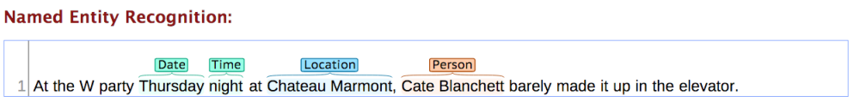
1) Introduction
Aim: Designing and implementing a system to extract and classify named entities in tweets.

Slide 3
2) Process
We used Stanford NER
4 different classes with B/I- prefix:
PER
LOC
ORG
MISC
Various properties and features are examined to increase the performance of the system.
For test and training, provided CoNLL file that contains tweets and gold answers is used.
At the end, properties and features that give the best result are applied to cross-validation with k = 2 and k = 10

Slide 4
3) Adjusting the system
In the evaluations, basic properties in austen.prop⁽¹⁾ are used as base case.
During the evaluations, the system is trained on the first half and tested on the second half of the whole file due to the time-efficiency.
Precision | Recall | F1
0.7308 | 0.3680 | 0.4895
⁽¹⁾ https://nlp.stanford.edu/software/crf-faq.shtml#a

Slide 5
3.1) Trials of Various Properties
Different properties are examined by changing the property file(.prop) for performance enhancement:
 | Precision | Recall | F1
Base Case | 0.7308 | 0.3680 | 0.4895
useWordPairs | 0.7296 | 0.3577 | 0.4801
normalizeTerms & normalizeTimex | 0.7316 | 0.3662 | 0.4881
useOccurrencePatterns | 0.7277 | 0.3753 | 0.4952
useTitle | 0.7321 | 0.3705 | 0.492
mergeTags | 0.7157 | 0.3565 | 0.476

Slide 6
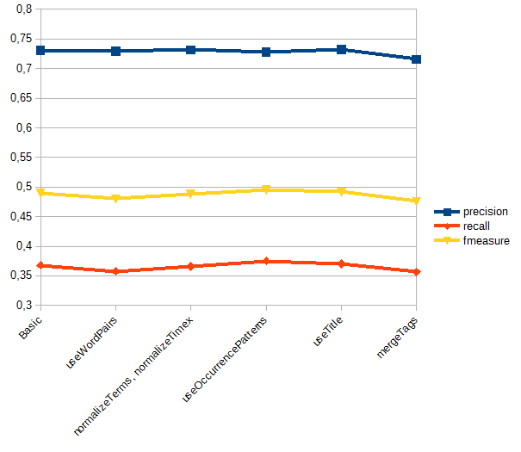
3.1) Trials of Various Properties (cont.)
A considerable list of other properties have also been tried, without having any change on the performance.

Slide 7
3.2) Gazettes
A gazette file is a list(dictionary) of entities.
A cursory glance to gazette files:
PER James
ORG Apple
LOC Alabama
MISC Tour de France
sloppyGazette vs. cleanGazette

Slide 8
3.2) Gazettes (cont.)
Results of progressive improvements via gazettes:
 | Precision | Recall | F1
Base Case (w/o gazettes) | 0.7308 | 0.368 | 0.4895
PER | 0.7452 | 0.3771 | 0.5008
PER + LOC | 0.7642 | 0.4062 | 0.5304
PER + LOC + ORG (cleanGazettes) | 0.7731 | 0.4413 | 0.5618
PER + LOC + ORG + MISC (cleanGazettes) | 0.7714 | 0.4413 | 0.5614

Slide 9
3.3) POS tags
An example of POS tagging of a tweet would be:
`The/NNP truth/NN will/MD always/RB win/VB’ - Julian/NNP Assange/NNP
writes/VBZ #FakeHashtag/HT.
Helps to enhance the performance of NER⁽¹⁾.
Used 3 different POS taggers:
Stanford CoreNLP tagger⁽²⁾
GATE tweetie tagger⁽³⁾
CMU Noah’s ARK Twitter tagger⁽⁴⁾
⁽¹⁾ Named Entity Recognition in Tweets, [Ritter, A., Clark, S., & Etzioni, O. (2011, July). Named entity recognition in tweets: an experimental study. In Proceedings of the Conference on Empirical Methods in Natural Language Processing (pp. 1524-1534). Association for Computational Linguistics.]
⁽²⁾ https://stanfordnlp.github.io/CoreNLP/pos.html
⁽³⁾ https://gate.ac.uk/wiki/twitter-postagger.html
⁽⁴⁾ http://www.cs.cmu.edu/~ark/TweetNLP/

Slide 10
3.3) POS tags (cont.)
Original tweets are tagged with those 3 POS taggers and tags are added to the CoNLL file as a new column, so that the classifier could learn on the tags as well. The results are as follows:
 | Precision | Recall | F1
Base Case | 0.7308 | 0.368 | 0.4895
useTags (stanford) | 0.7138 | 0.4062 | 0.5177
useTags (tweetie-tagger) | 0.6701 | 0.4389 | 0.5304
useTags (ark-tagger) | 0.6645 | 0.4352 | 0.526

Slide 11
3.4) Lemmatization
The process of grouping together the inflected forms of a word so they can be analysed as a single item, identified by the word's lemma, or dictionary form⁽¹⁾.
Simplifies the learning process⁽²⁾ and eliminates inflected forms (e.g. past, past perfect, plural etc.) of words.
“I’ve been studying my notes” -> “I have be study I note”
⁽¹⁾ https://en.wikipedia.org/wiki/Lemmatisation
⁽²⁾ A survey of named entity recognition and classification, David Nadeau, Satoshi Sekine, National Research Council, Canada/New York University

Slide 12
3.4) Lemmatization (cont.)
Used Stanford CoreNLP Lemmatizer⁽¹⁾ and the results are as follows:
 | Precision | Recall | F1
Base Case | 0.7308 | 0.368 | 0.4895
with Lemmas | 0.7424 | 0.3717 | 0.4954
⁽¹⁾ https://stanfordnlp.github.io/CoreNLP/

Slide 13
4) Combining all features
 | Precision | Recall | F1
Base Case | 0.7308 | 0.368 | 0.4895
Gazette | 0.7714 | 0.4413 | 0.5614
Tag | 0.6701 | 0.4389 | 0.5304
Lemma | 0.7424 | 0.3717 | 0.4954
Tag + Gazette | 0.7333 | 0.4861 | 0.5846
Tag + Gazette + Lemma | 0.7444 | 0.5061 | 0.6025
1.36% precision difference
13.81% recall difference
11.3% F1 score difference

Slide 14
5) Combining all properties
Henceforth, the base to compare with will be the combined model of Gazettes, Lemmas and POS tags.
 | Precision | Recall | F1
Gazette + Lemma + Tag | 0.7444 | 0.5061 | 0.6025
useOccurrencePatterns, useTitle2 | 0.7484 | 0.5097 | 0.6064
change from PER to B-PER (in firstnames gazette file) | 0.7487 | 0.5103 | 0.6069
useOccurrencePatterns, useTitle2, PER to B-PER | 0.7478 | 0.5115 | 0.6075
useOccurrencePatterns, useTitle2, PER to B-PER, recommended properties⁽¹⁾ | 0.7442 | 0.5266 | 0.6168
⁽¹⁾ wordShape=dan2useLC, disjunctionWidth=4, sigma = 20, useLastRealWord=true, useNextRealWord=true

Slide 15
6) Cross validation
After having decided the optimal properties and features, the system is evaluated with cross-validation for k=2 and k=10:
 | Precision | Recall | F1
k = 2 | 0.7535 | 0.5597 | 0.6419
k = 10 | 0.7816 | 0.6362 | 0.7005

Slide 16
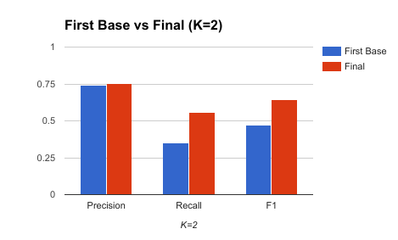
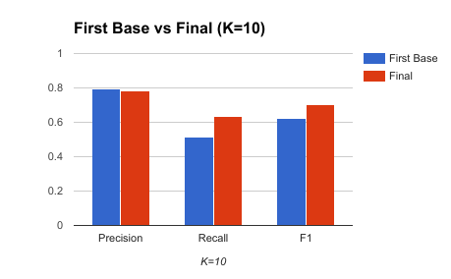
6) Cross validation (cont.)
The following graphs shows our final cross-validation results compared to first base case:

Slide 17
7) Bonus
Study of the results from the test file.
We extracted the Named Entity classified by PER and listed them by frequencies:
Julian Fantino
Obama
Sarah Palin
...
Who is Julian Fantino? And why is he first?

Slide 18
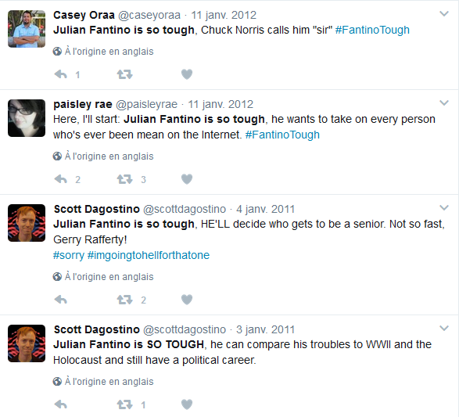
7) Bonus (cont.)

Slide 19
Any questions?
Thank you for your attention

