Slide 1





Slide 2
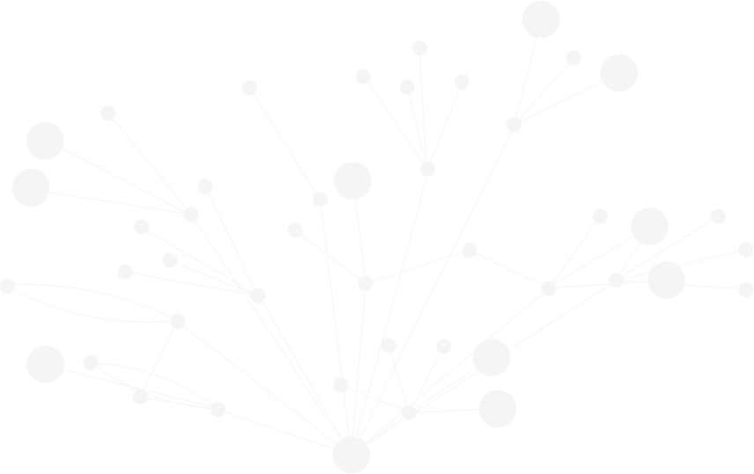

10:05 - 10:50 - Graphs in Government
Jim Webber, Chief Scientist, Neo4j
10:50 - 11:35 - POLE Investigations (Persons, Objects, Locations, and Events) for Governments
Tom Geudens, Senior Presales Consultant, Neo4j
11:35 - 12:10 - Intelligence Use Cases for Graph Data
Michal Bachman, CEO, GraphAware
12:10 - 12:20 - Q&A Session

Slide 3
- neo4j.com/webinars
360' View of Everything - How to Unlock the Power of Your Master Data using Graphs
https://data-analytics-live-eu.coriniumintelligence.com/#DALIVEAGENDA
Graphs in Government - neo4j.com/connections

