Slide 1
Graph Data Modeling
Tips and Tricks

Slide 2
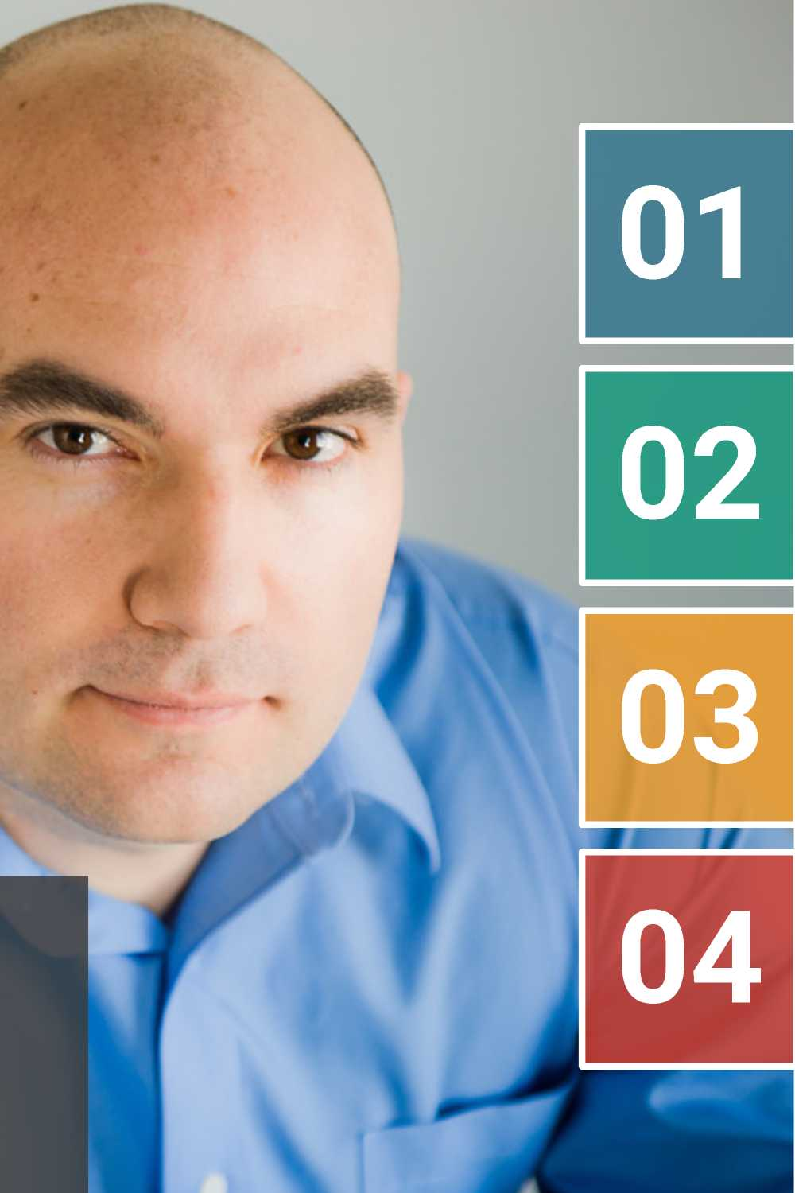
Max De Marzi
Neo4j Field Engineer
maxdemarzi.com
About 160 blog posts
@maxdemarzi
github.com/maxdemarzi
About 200 public repositories
About Me !

Slide 3
Agenda
• Property Graph Data Model
• The most important Slide about Neo4j you will ever see
• Basics of Modeling
• Modeling Acting
• Modeling Flights
• Modeling Twitter
• Modeling Forms
• Modeling Chains
neozj

Slide 4
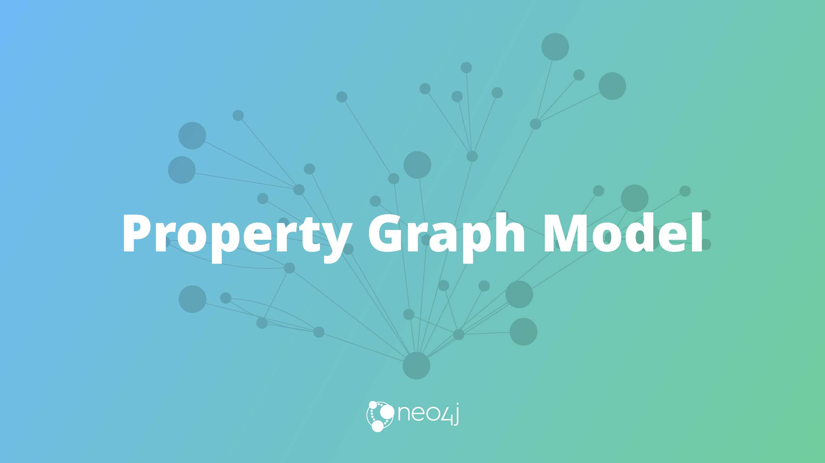

Slide 5
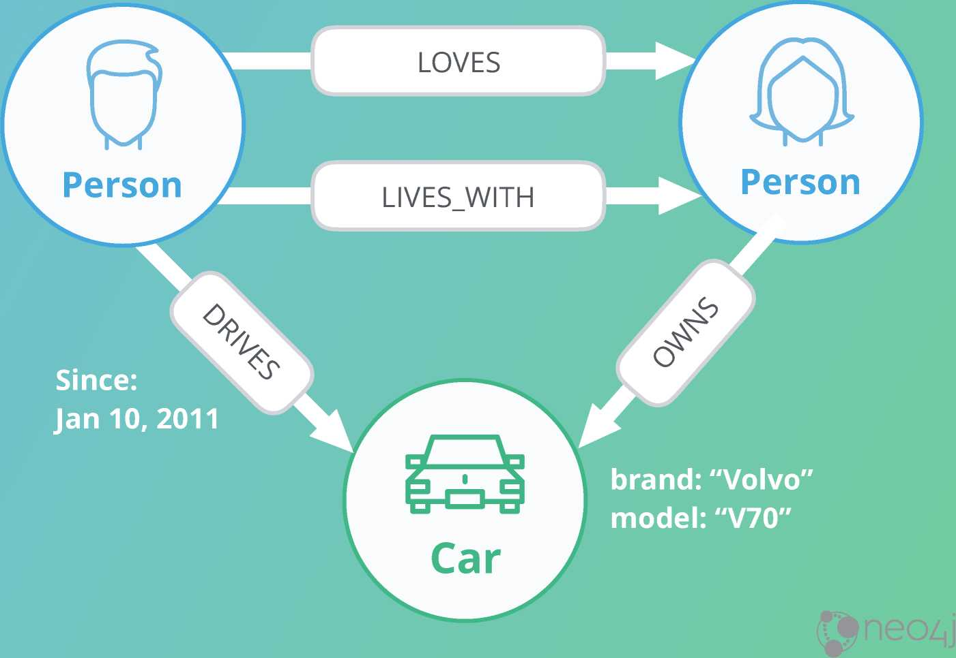
Property Graph Model Components
name:"Dan"
born: May 29, 1970 name:"Ann"
twitter:"@dan" born: Dec 5, 1975
Nodes
• Can have Labels
• Can have Properties
Relationships
• Relate nodes by type and direction
• Can have Properties

Slide 6
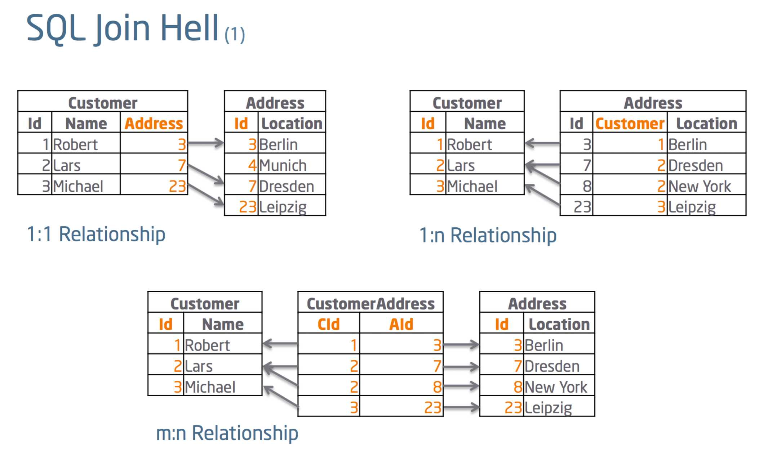
What you (probably) already know:

Slide 7
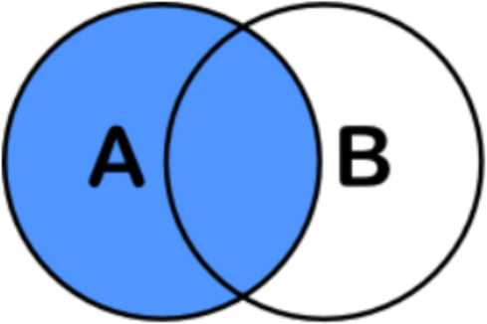
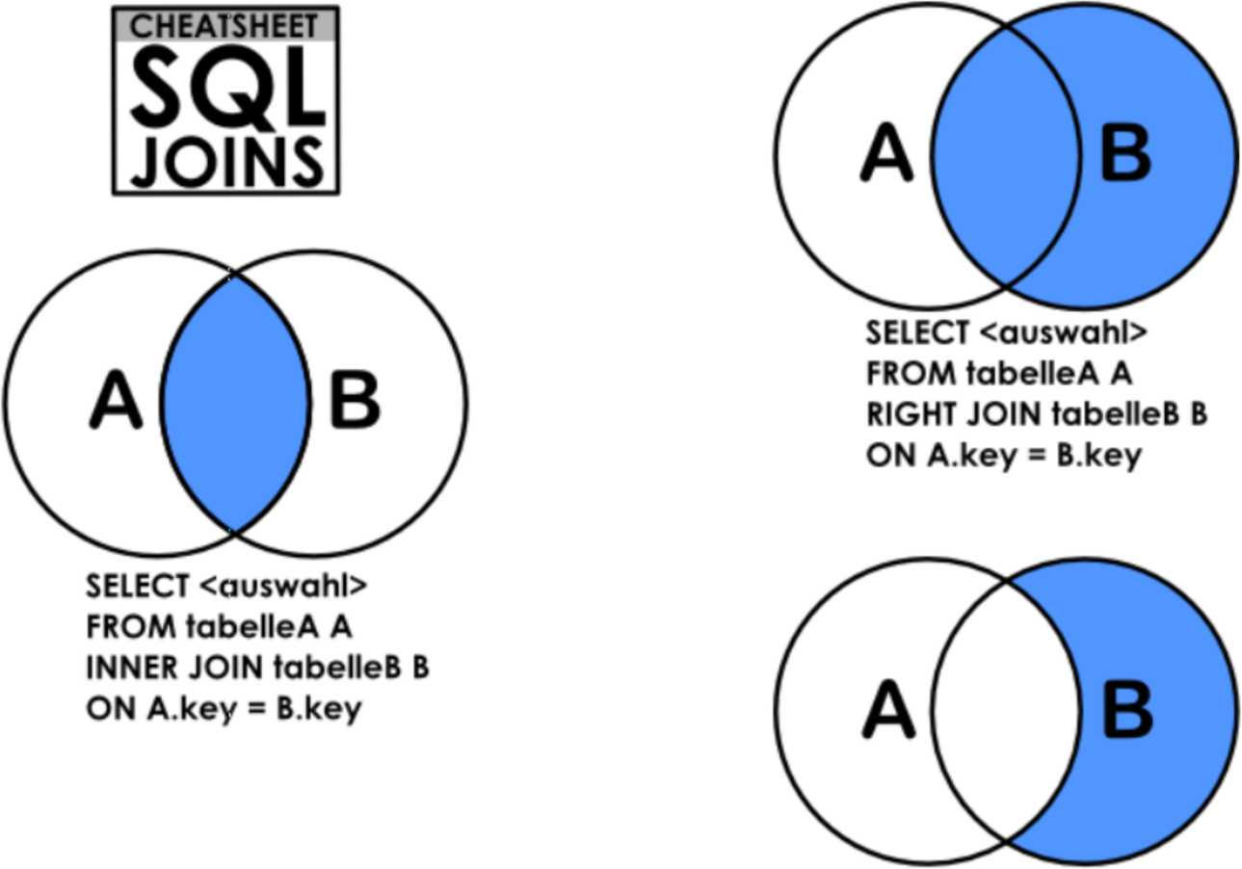
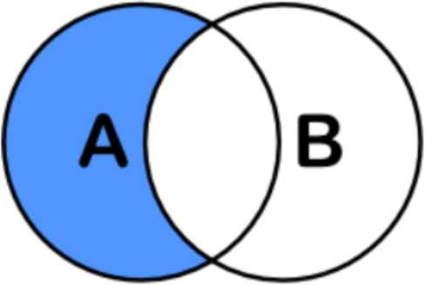
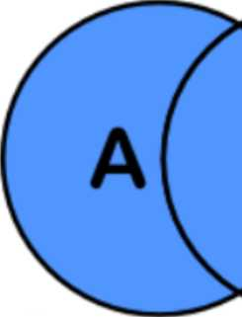
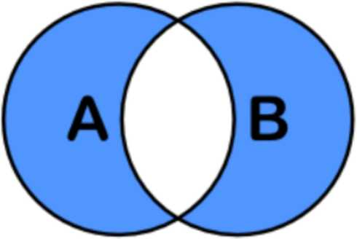
SELECT <auswahl> FROM tabelleA A
LEFT JOIN tabelleB B ON A.key = B.key
SELECT <auswahl>
SELECT <auswahl>
FROM tabelleA A LEFT JOIN tabelleB B ON A.key = B.key WHERE B.key IS NULL
FROM tabelleA A RIGHT JOIN tabelleB B ON A.key = B.key WHERE A.key IS NULL
SELECT <auswahl>
FROM tabelleA A
SELECT <auswahl>
FROM tabelleA A
FULL OUTER JOIN tabelleB B
FULL OUTER JOIN tabelleB B
ON A.key = B.key
ON A.key = B.key WHERE A.key IS NULL OR B.key IS NULL

Slide 8
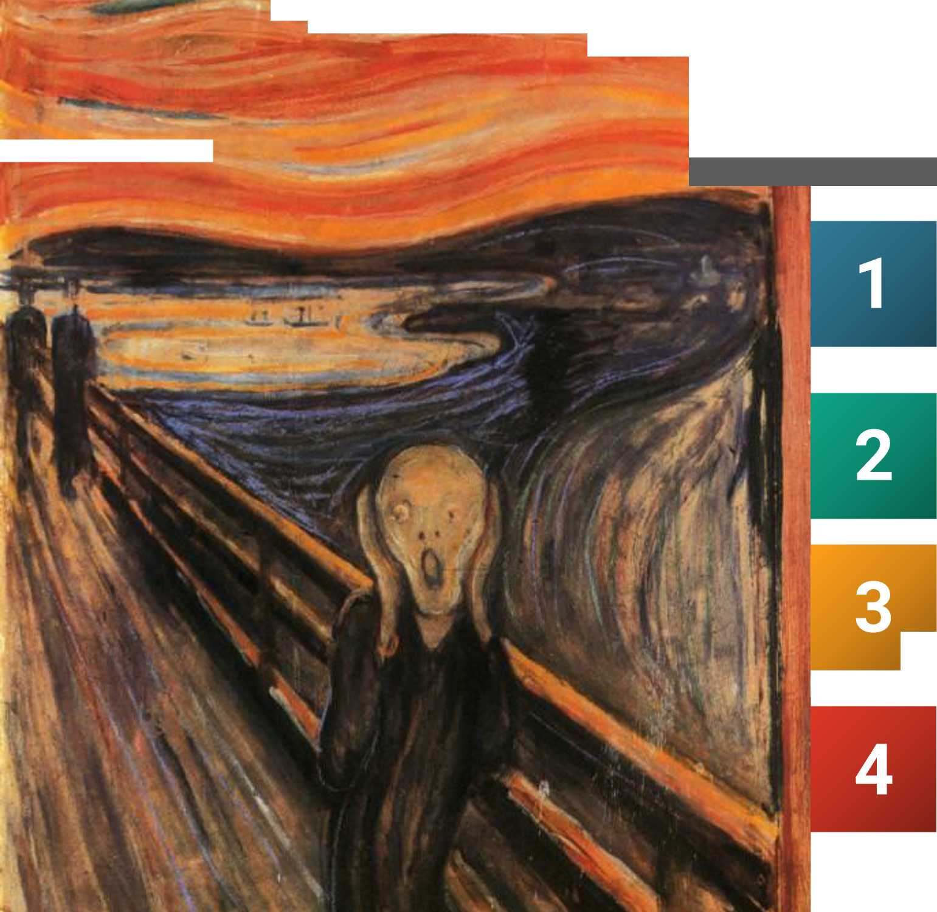



___^ _
— -a)
The Problem
Joins are executed every time you query the relationship
Executing a Join means to search for a key
B-Tree Index: O(log(n))
Your data grows by 10x, your time
I goes up by one step on each Join
More Data = More Searches Slower Performance

Slide 9
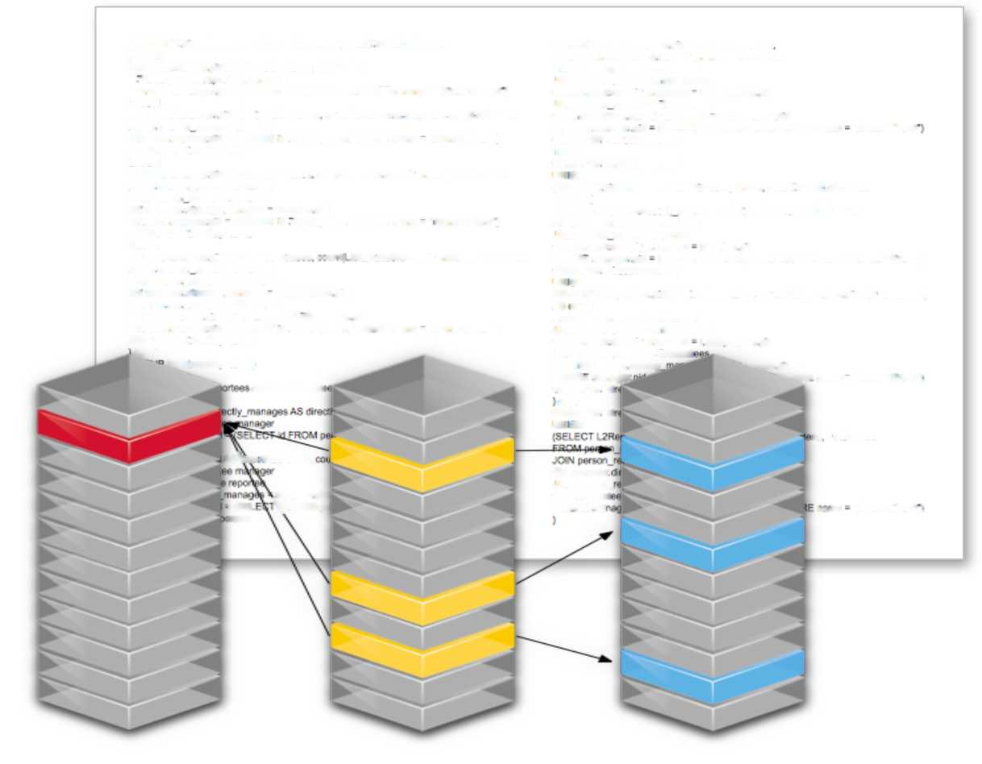
Relational Databases can't handle Relationships
1 Wrong Model
They cannot model or store relationships without complexity
2 Degraded Performance
Speed plummets as data grows and as the number of joins grows
3 Wrong Language
SQL was built with Set Theory in mind, not Graph Theory
4 Not Flexible
New types of data and relationships require schema redesign
(SELECT T dneclReporreee AS drec:Reportees. *um(T ooum) AS coum
SELECT dep«M Repodew.pd AS direeNeportees
FROM •:
oouni(deptr2Repcnee$ direcfly.manages) as coon:
SELECT manager pd AS dreciRepunees. 0 AS count
FROM person.reponee manager
-ROM person, mconee manager
.Cxn person.reponee l * Reporiees
WHERE manager pid * (SELECT id FROM person WHwE name * TName IName l
ON managerdrecdy.manages - HReporree* pd
UNION
.OiN person repo nee L/Reporlee*
SELECT manage' p«d AS dreclReporree* counl(maneger di'ecrty.menagee; AS oouni
ON L* Reporlee* dire:dy_m*nage* - L2Rei*rteespd
FROM person reportea manage
WHERE manage' p*d
(SELECT id FROM parson WHERE romp
TName I Name
WHERE manager pd ^ (SEL ECT d from person WHERE naira - tNome Naira* i
CROUP H^{v} cirafRepixiees
croup by orectReportees
: ast
UNION
CROUP B^{v} diretfReportees)
SELECT manager pd AS drectReiXine** ccud(repor1ea dree: y .manage*) AS count
UN ON
from pemoo_rapotea manager
(SELECT T dircofteporless AS d/eclReponee* sumfrcour; AS count
JOIN pemon repyiee reprrtee
FROM!
ON manage' d-mcdy. manage* - reponee pid
SELECT reponee dir^dy manage* AS drectReporree*. 0 AS oount
WHFRE manager pd - (SELECT d -ROM person WHERE naira - “Name Naira* I
from person_raponee manager
CROUP BY dreclReoorae*
,o«si person reponee reponee
UNION
ON manager dree: y .manages
reponee Pd
SELECT manager pd AS dredRepin^ci ■ j »ri! ?Rep fte»<a d reefy .manages) AS count
WHERr manage' p*d
(SELECT id FROM p*mon WHFRF rome ^ *TName INama*(
from pemorrepridee manager
CROUP B^{v} diwfReporlee*
JOIN person.repodee UReponeas
JN on
ON manage' d>'ecfly_manage* - li Reporiees pd
SELECT LZReponee* p»d AS dreclReporree*. oounii\?Repoirees dmcP,.manages)
JOIN pe'son.repodee L2Reponees
AS »<ni
ON URepoiteesdrecPf.manages = L/Reponee* pid
from person.reponee manager
WHERE manager pd = (SELECT d from person whfrf naira - TName Naira*)
»OfN person.reponee L* Reponee*
GROUP BY drec!R*<»onees
ON manager dree: y.manages
11 R^xmee* Pd
AST
UOfN person.reponee L/Report
BY
dreclReoonees!
ON L * Reporter di reedy
'-mteespd
AS dreeReporti
WHERr manager
•***HERF name - “TName iNama",
CROUP B^{v} di
AST
CROUP B^{v} di
UN o N
e* r. AS count
A-S\re*-'R*( <rtees.
ON manager
reporlee fid I \) FROM 09
-0<N person.
‘(SEL
irees
ON r Report
WHFRF ma
i., m
TName INama ;

Slide 10
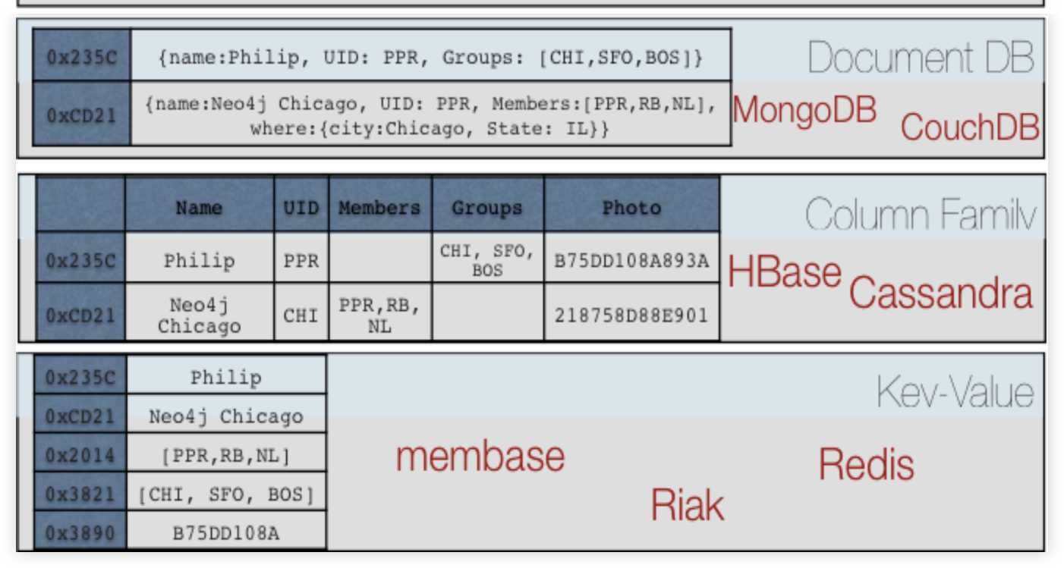
NoSQL Databases can't handle Relationships
1 Wrong Model
They cannot model or store relationships without complexity
2 Degraded Performance
Speed plummets as you try to join data together in the application
3 Wrong Languages
Lots of wacky "almost sql" languages terrible at "joins"
4 Not ACID
Eventually Consistent means Eventually Corrupt

Slide 11
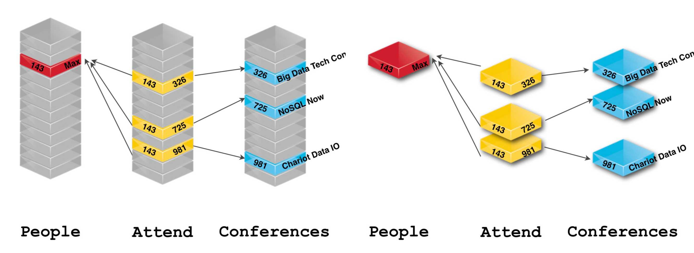
Same Data, Different Layout
No more Tables, no more Foreign Keys, no more Joins

Slide 12
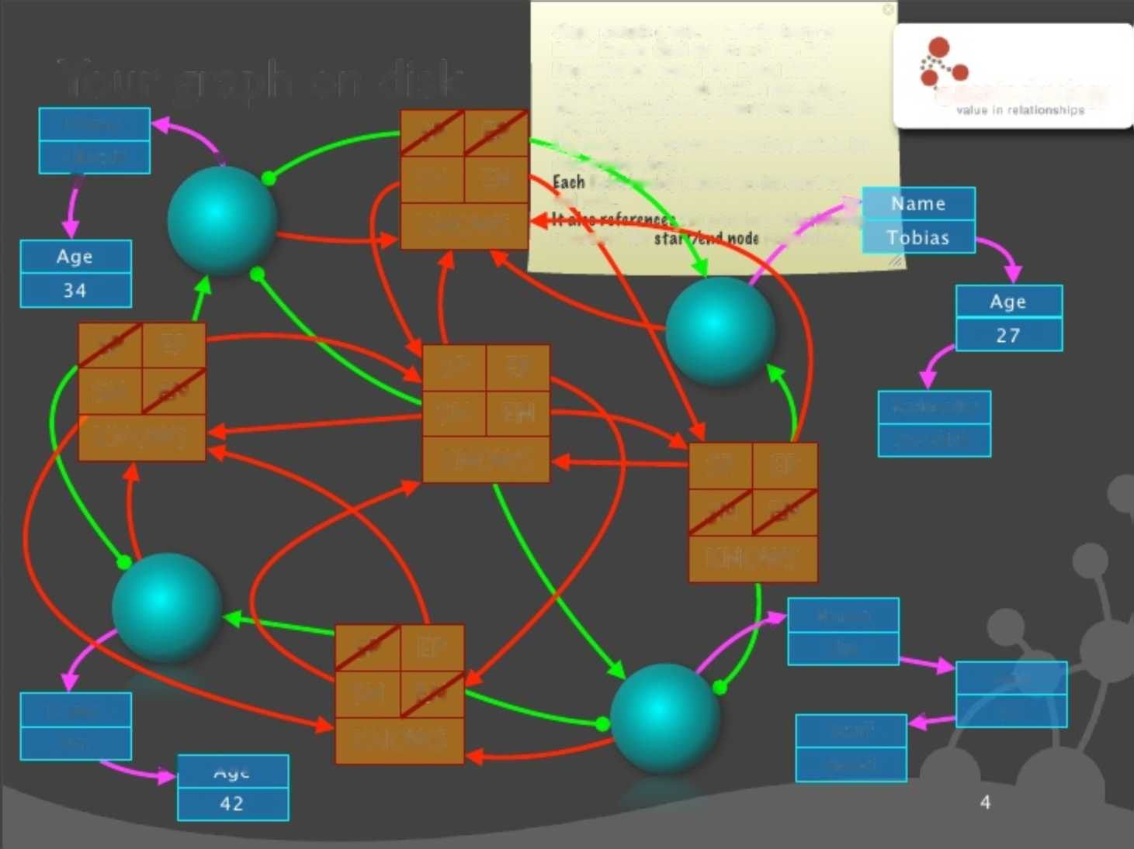
Double Linked List Relationship Layout
Simple sample graph. It all boils down to linked lists of fixed size records on disk. Properties are stored as a linked list of property records, each holding key+value. Each node/relationship references its first property record.
Your graph on disk
•neo technology
Name Cp
C ^{r}j | W-r.
V | '■Li'
SN | EN
KNOWS
-i^Nodes also reference the first node in its relationship chain.
Alistair \
f SN
Relationship references its start and
KNC
eW node. recorAfor the
_the prev/next relationship : respectively
IQI | EP
SN | FN
KNOWS
SP | EP
SN | EN
KNOWS
Nationality
Swedish
SP EP Q FN KNOWS
Name |  | SP SN | EP FN
Ian | ^ 1 Ana | KNOWS
Name
^{w} 'V
Jim
Stuff
good
 | Age
i — | 37

Slide 13
Neo4j Storage Record Layout
Node( 15 Bytes)
InUse Next Relationship ID Next Property ID Labels Extra
15 9 14
Relationship (34 Bytes)
InUse First Node ID Second Node ID Relationship Type First Node Prev Rel ID First Node Next Rel ID Second Node Prev Rel ID Second Node Next Rel ID ^
1 5 9 13 17 21 RelationshipGroup (25 Bytes) Type InUse HighBits Next RelationshipGroup Out Chain In Chain Loop Chain Owning Node |  |  |  |  |  |  |  | 25 2
2 3 5 9 13 17 21 Property Record (41 Bytes) Bits Next Property Record Previous Property Record Payload
1 | 5 | 9
Dynamic Record
InUse Size | Next Block | Payload
1
4
8

Slide 14
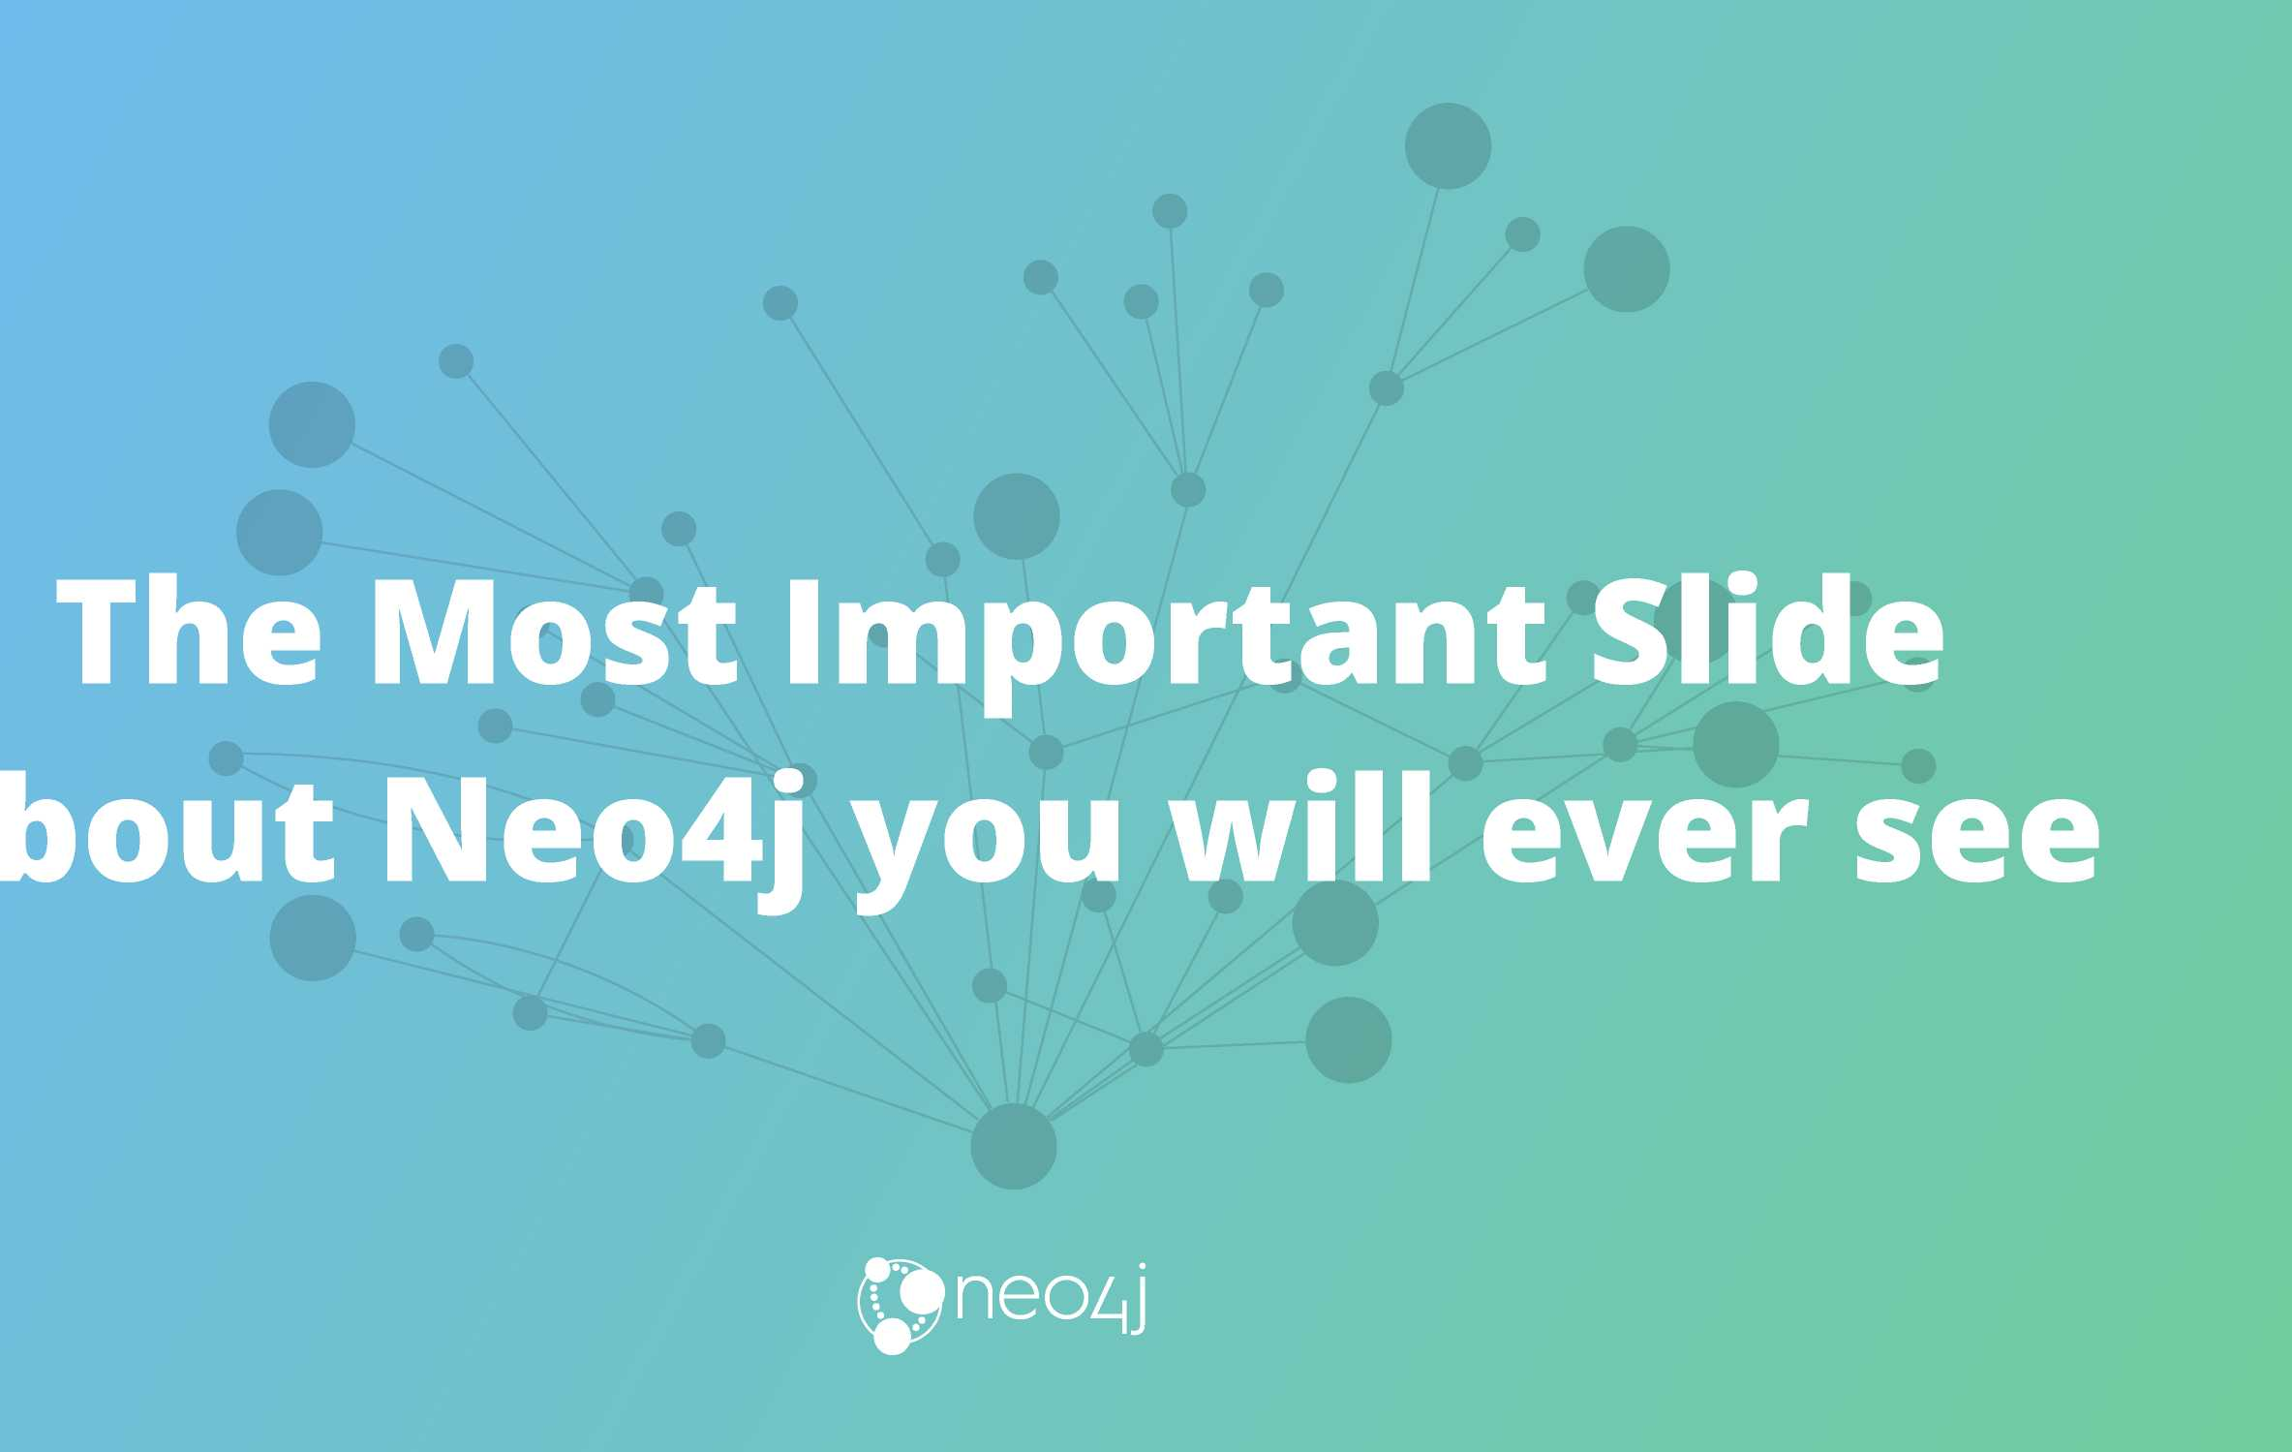

Slide 15


What we put in cache
ID Relationship ID refs
in: R 1 | R 2 | • • • | R n
" o ar r i | R 2 | • • • | R n
it}:*, R 1 | R 2 | R 3 | • • •
R 1 | • • • | R n
R n
/Node
(grouped by type)
i f I I I
* * * *
i 4 i /
Key 1 | Key 2 | ■ ■ ■ | Key n
' '
. * '
* I •
» I *
Val n
\: :• w 1
* % * | id'’ | \ start * |  | end type
Relationship
 | Key 1 |  | Key 2 |  | Key n
 |  | < |  | < |  | <

Slide 16

Pointers instead of Lookups
Fixed Sized Records
"Joins" on Creation
4 Spin Spin Spin through this data structure

Slide 17


Slide 18
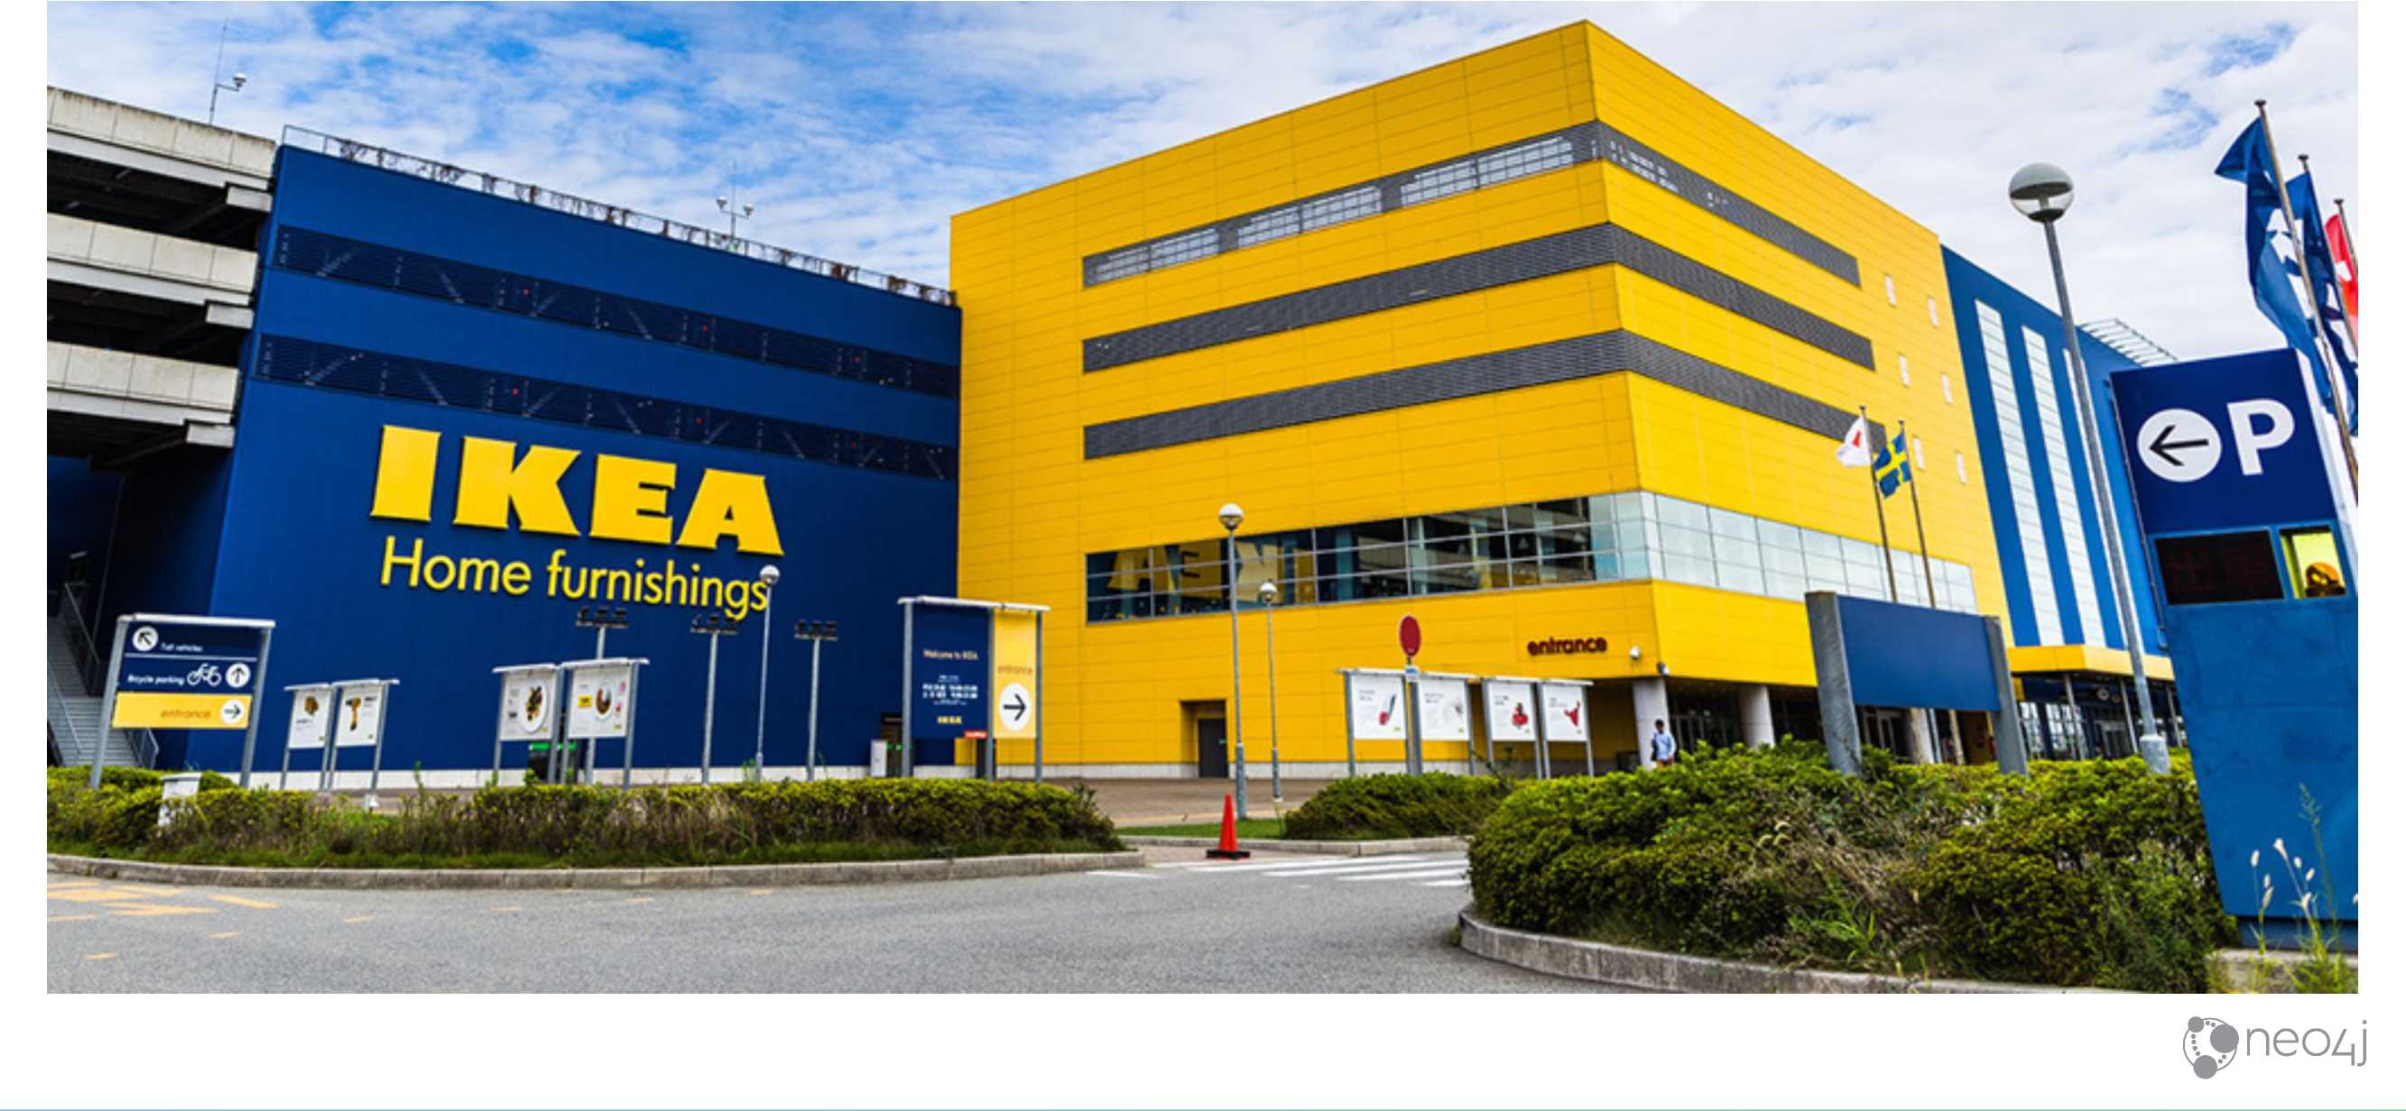
Swedes

Slide 19

Partitions
Each Node’s relationships are partitioned by
type and direction.

Slide 20
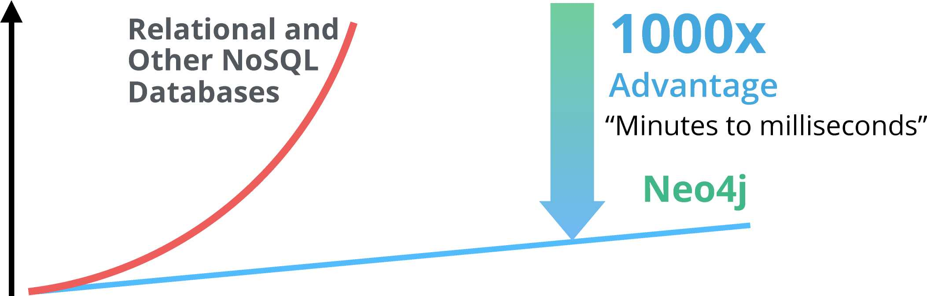

Real-Time Query Performance
Response Time
0 to 2 hops 5+ hops
0 to 3 degrees 3+ degrees
Few connections Thousands of connections
-►
Connectedness and Size of Data Set
neo/|j

Slide 21
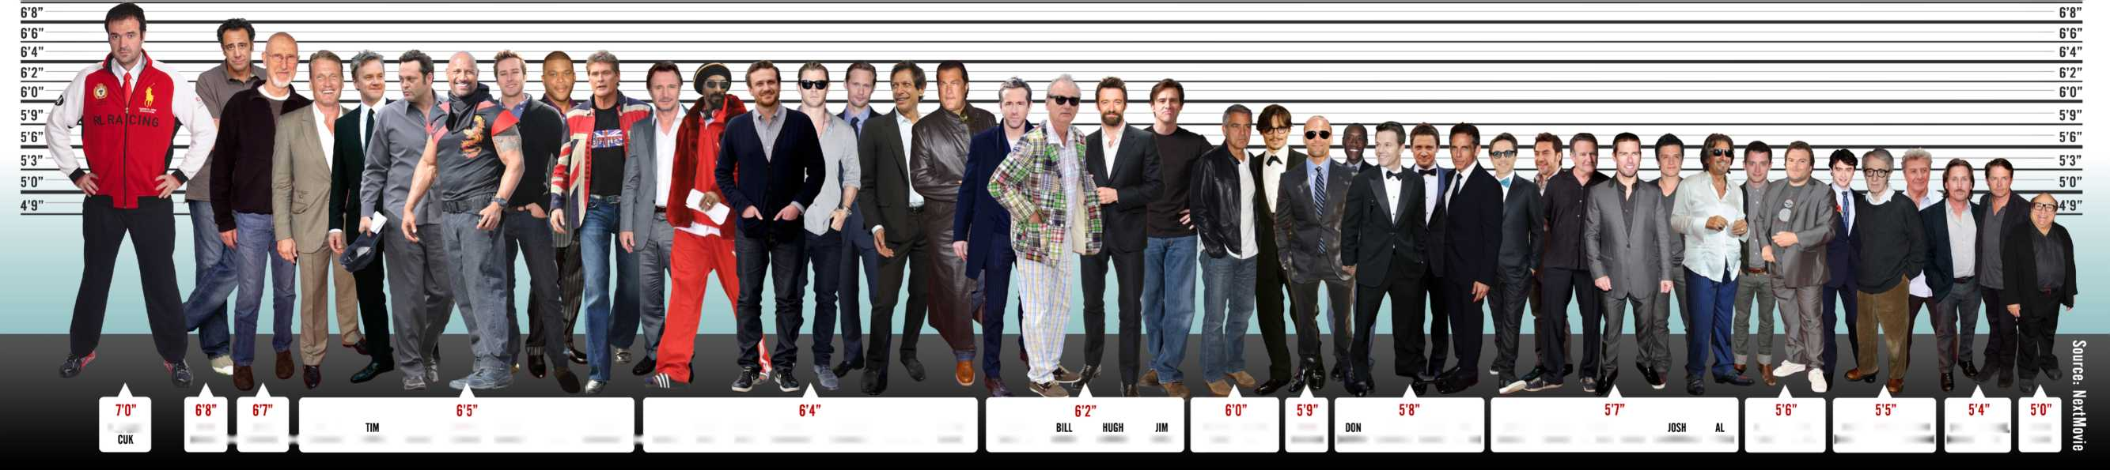
But not for every query
I don't know the average height of all hollywood actors, but I do know the Six Degrees of Kevin Bacon
TALLEST ACTOR IN HOLLYWOOD
7’0”
7’0”
VLADIMIR
BRAD
IAMES
DOLPH
VINCE DWAYNE ARMIE TYLER
DAVID
LIAM SNOOP JASON CHRIS ALEXANDAR JEFF
STEVEN
RYAN
GEORGE JOHNNY CLOONEY DEPP
JASON
STATHAM
MARK
JEREMY
BEN
ROBERT
JAVIER
ROBIN
TOM
ELIJAH
JACK
DANIEL
WOODY DUSTIN
EMILIO MICHAEL
DANNY
GARRETT ■ CROMWELL ■ LUNDGREN ROBBINS VAUGHN JOHNSON HAMMER PERRY HASSELHOFF ■ NEESON DOGG SEGEL HEMSWORTH SKARSGARD GOLDBLUM SEAGAL
REYNOLDS
MURRAY
IACKMAN
CARREY
CHEADLE WAHLBERG RENNER STILLER
DOWNEY JR BARDEM WILLIAMS CRUISE HUTCHERSON PACINO
WOOD
BLACK
RADCLIFFE ALLEN HOFFMAN
ESTEVEZ
J FOX
DEVITO

Slide 22
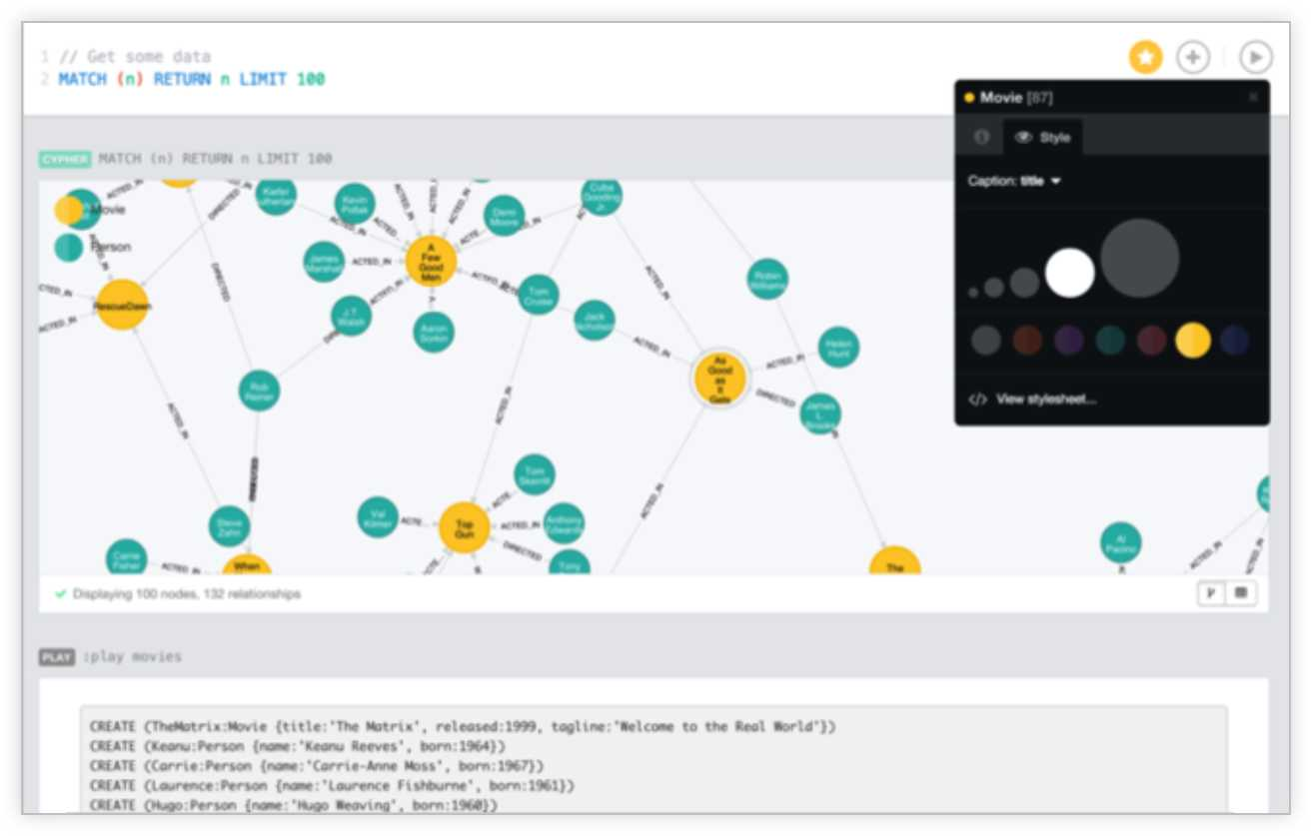
Reimagine your Data as a Graph
1 Right Model
Graphs simplify how you think
2 Better Performance
Query relationships in real time
3 Right Language
Cypher was purpose built for Graphs
4 Flexible and Consistent
Evolve your schema seamlessly while keeping transactions
Agile, High Performance and Scalable without Sacrifice

Slide 23
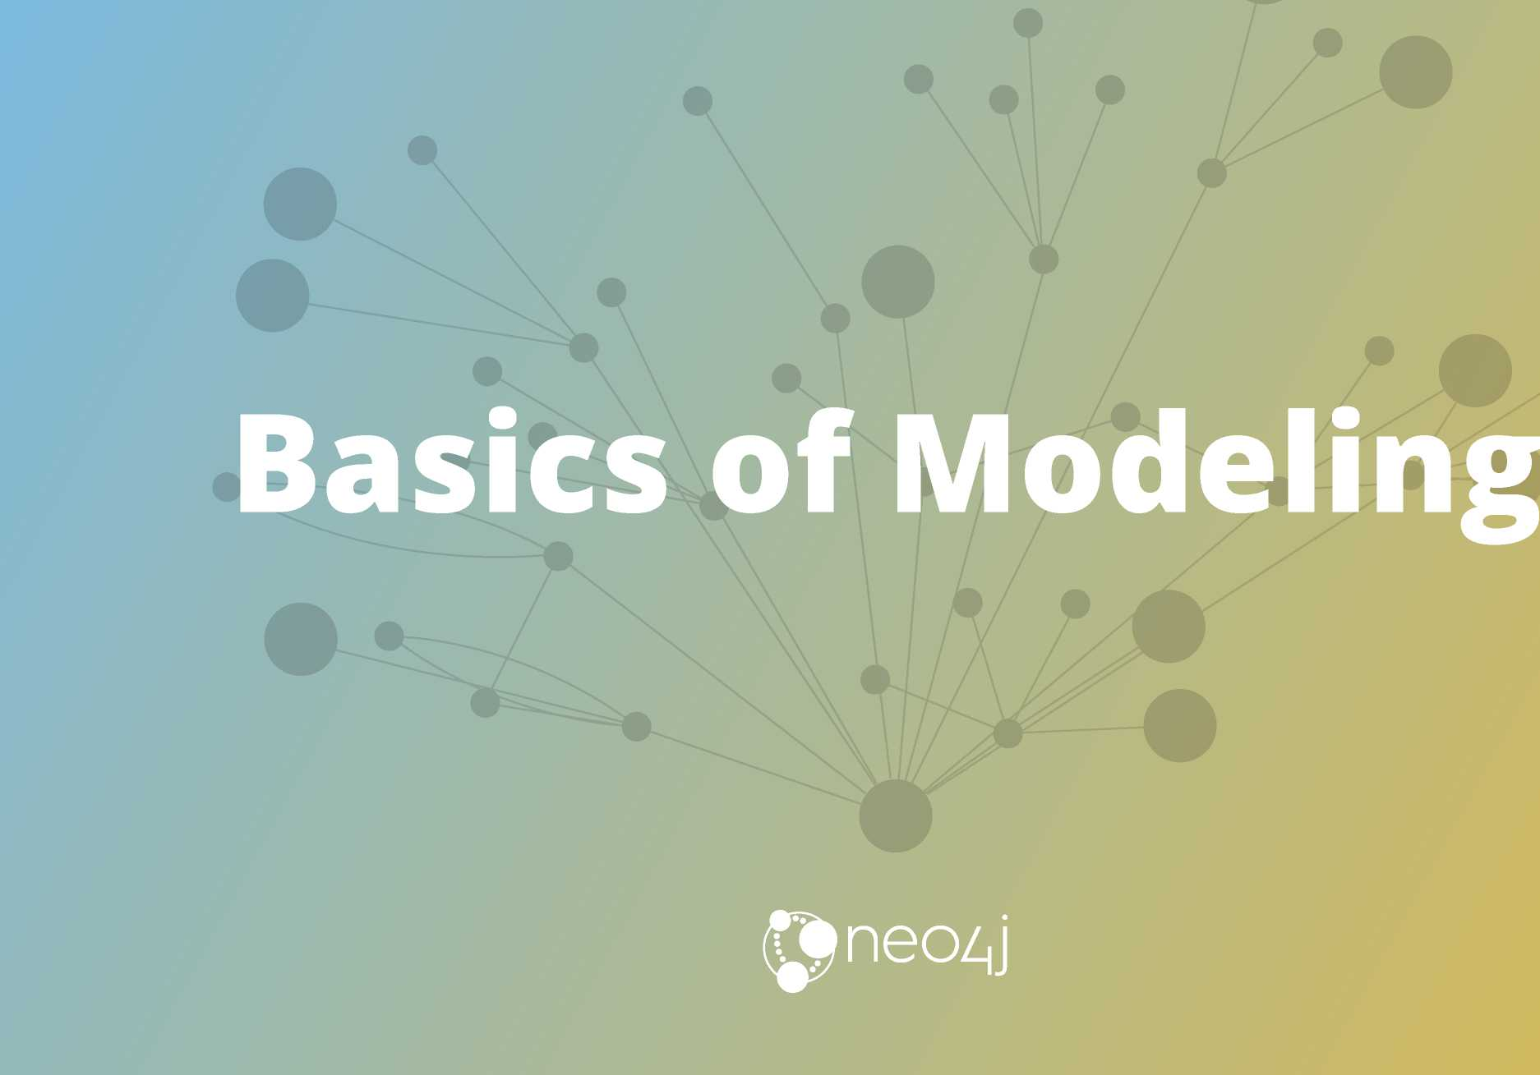

Slide 24
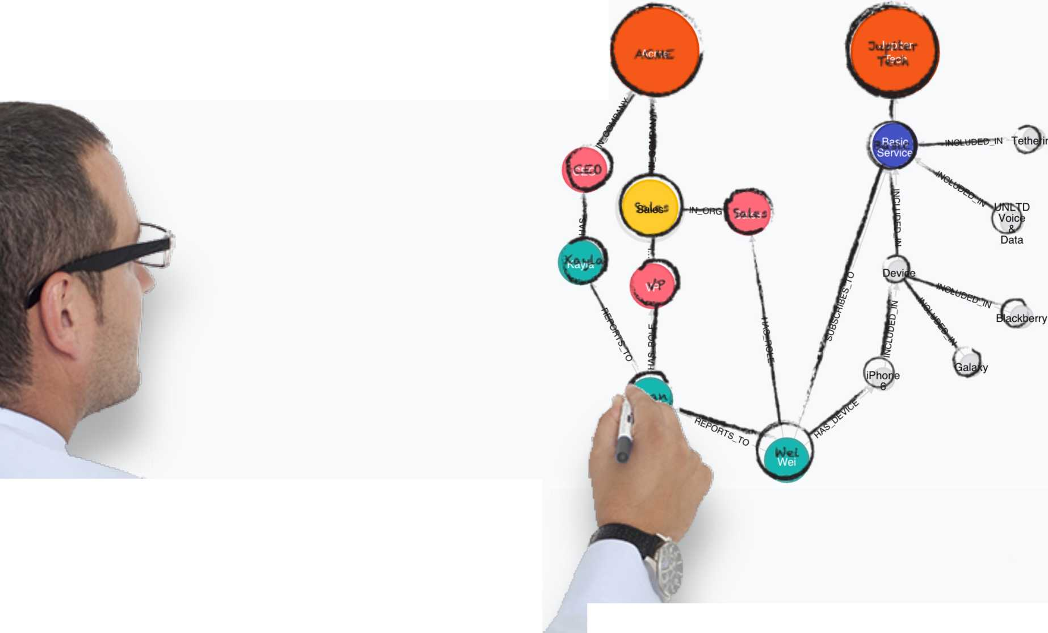

Neo4j Property Graph
The Whiteboard Model is the Physical Model
A unified view for ultimate agility
• Easily understood
• Easily evolved
• Easy collaboration between business and IT
neo/|j

Slide 25
Arrows
http://www.apcjones .com/arrows/#
It’s simple, it’s fast, it doesn’t run out of ink.
neo/|j

Slide 26
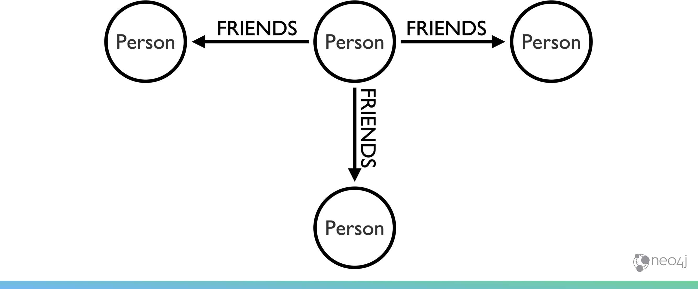
Nodes can have many relationships

Slide 27



Two Nodes can be related by more than one relationship type
neo/|j

Slide 28


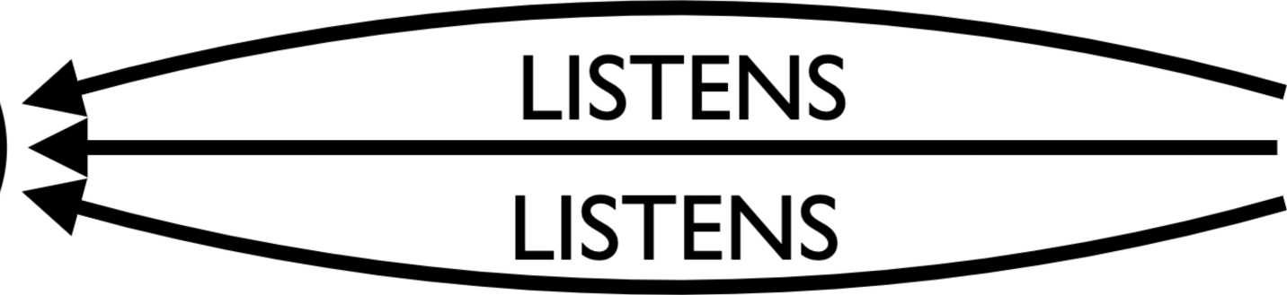
Two Nodes can be related by the same relationship type more than once
LISTENS
neo/|j

Slide 29
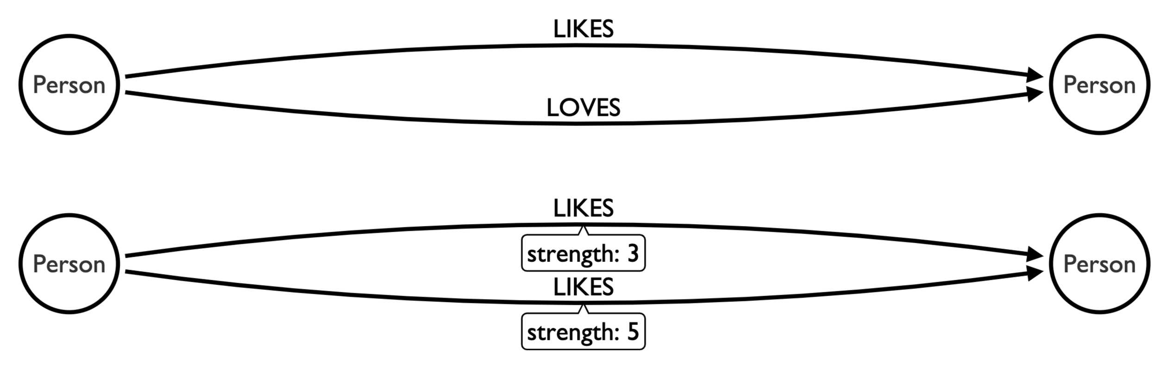
Relationships can have properties
up
neozj

Slide 30

Don't overcomplicate your model
^Address^
•►^ddres^
LIVES AT
WORKS AT
HAS ADDRESS /T A HAS ADDRESS ^ \
4 ~ a ■— I Person I ~ a -► I Address I
type: Home y type: Work V J
$neozJ

Slide 31
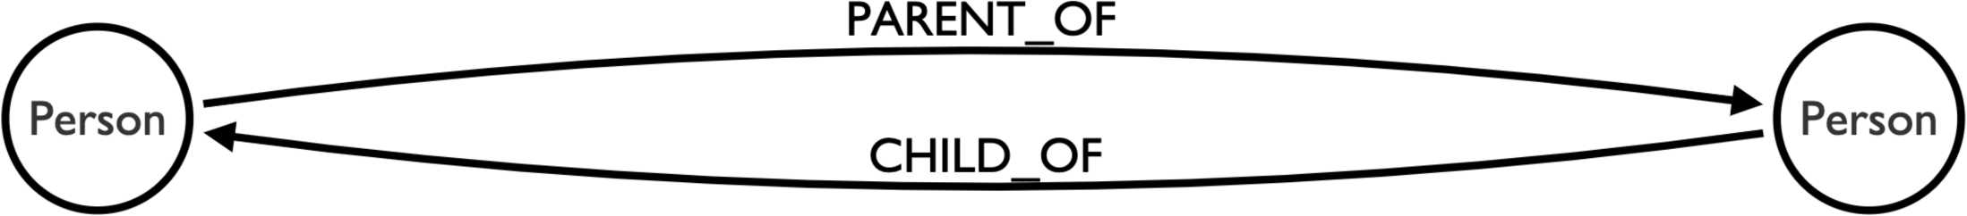
Pick one or the other, not both
neo/|j

Slide 32

...but this is fine:
neo/|j

Slide 33

Modeling Acting

Slide 34

Graphs are Whiteboard Friendly
Just draw stuff and "walla" there is your data model
FoROH Ac
<s&®&
n ^ S.FIR6WM.L
i ' r¹
KJ6TwOgl<
6
S3
hicroGlow 5orikL WSlilA
ZI3
CflAtc
CMAT PtcTU^f
o<=*Vt* FARtl
COMPANY
Snj
• •
I WTrtt. M6T ■ HtfA^c^ttreW
G^^{w}J^{H}
> mfAtfCH
i
*1
oOO,
-
Co
wPA*¹ 7
tV t: i A
5, —
IOcA
C*U£«. ^ ^ V
iTXusT'CS
5«o»—
L_A^r VfAR. THIS VfAR
qoalhy
STKbT€G1 /
T»ne
4r
>
c50CC£5S*
SUilNfcSS
^ _{(WPJ}
©v/ATiO
QOAL’'y
0k
floured
® \S
>00 A V-
(V-r^oRK

Slide 35
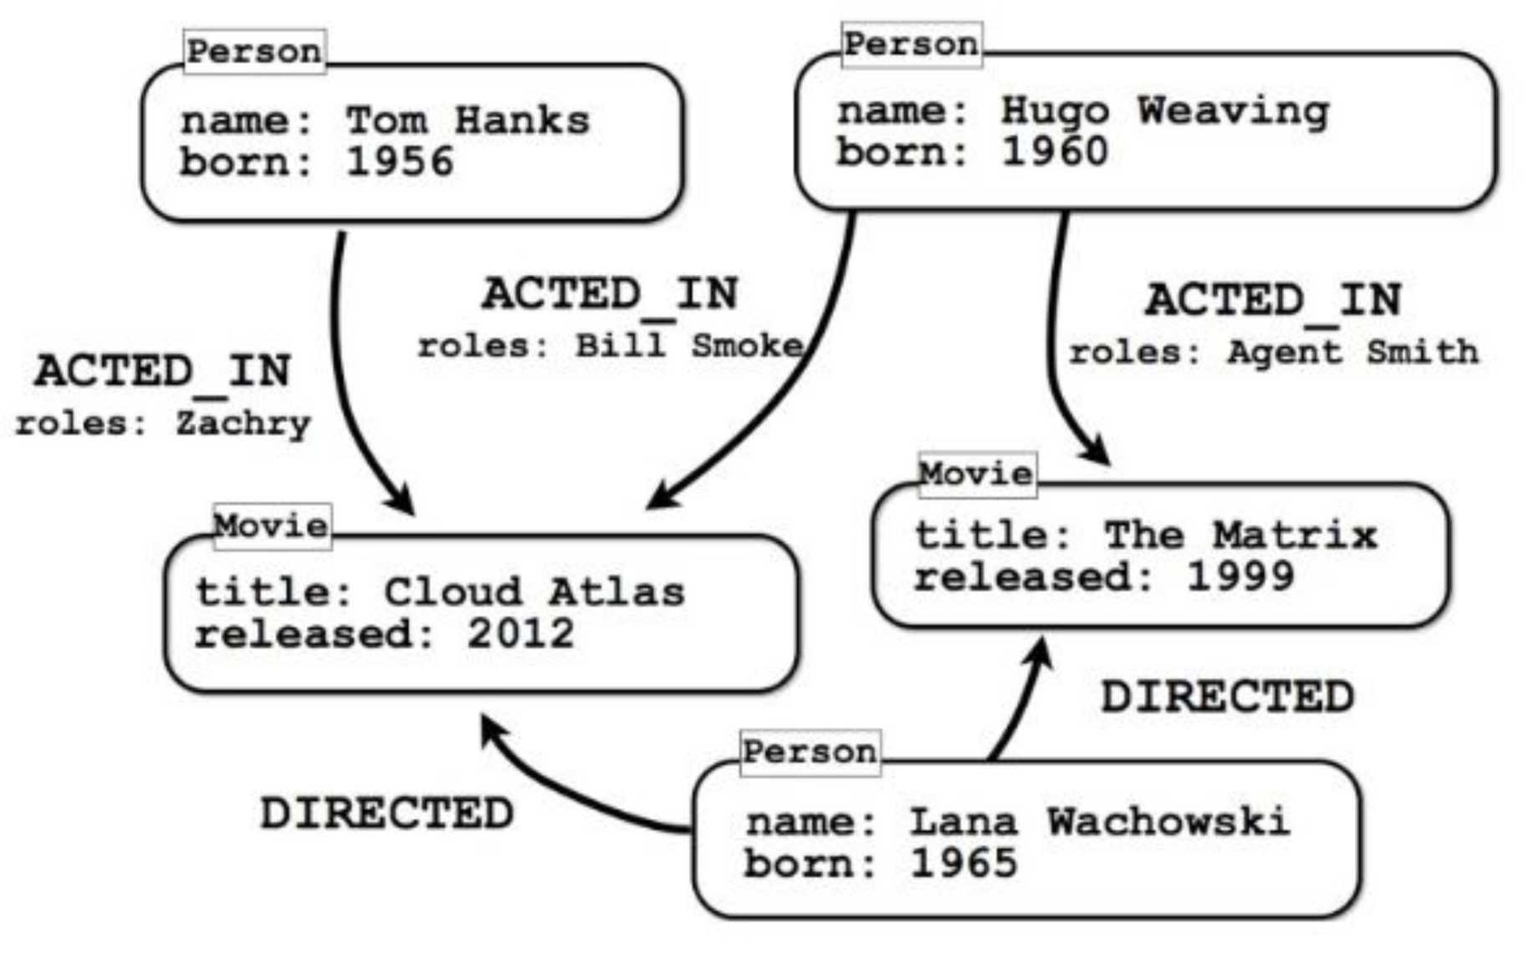
Some Models are Easy
Movie Property Graph

Slide 36


Slide 37
Some Models are Easy but not for all Questions
Should Roles be their own Node?

Slide 38


Slide 39
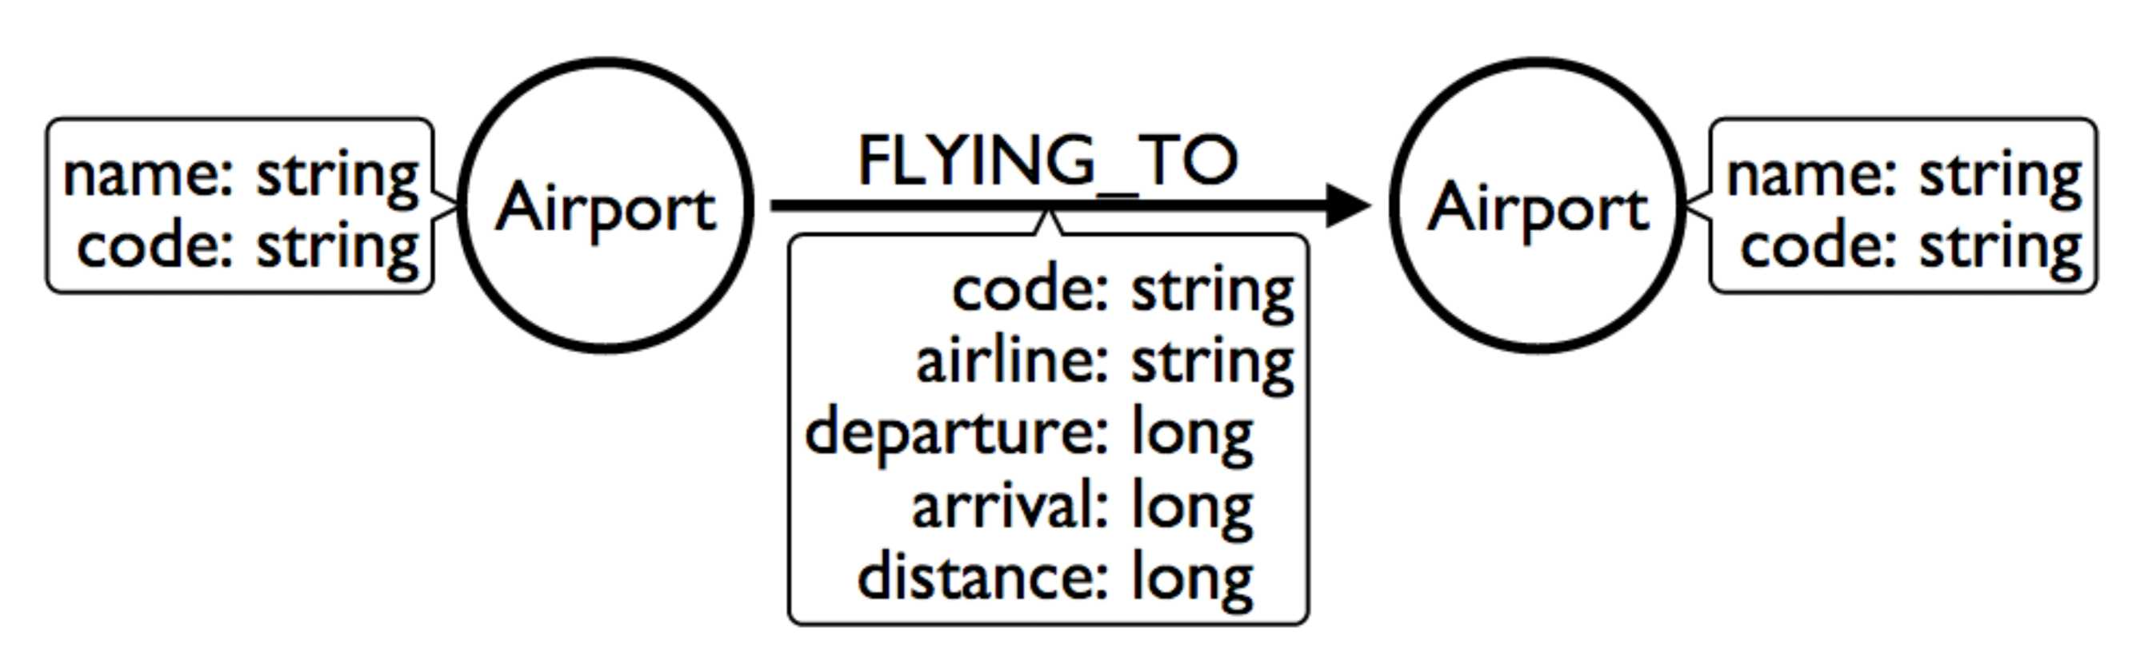
How do you model Flight Data?
Airports Nodes with Flying To Relationships

Slide 40
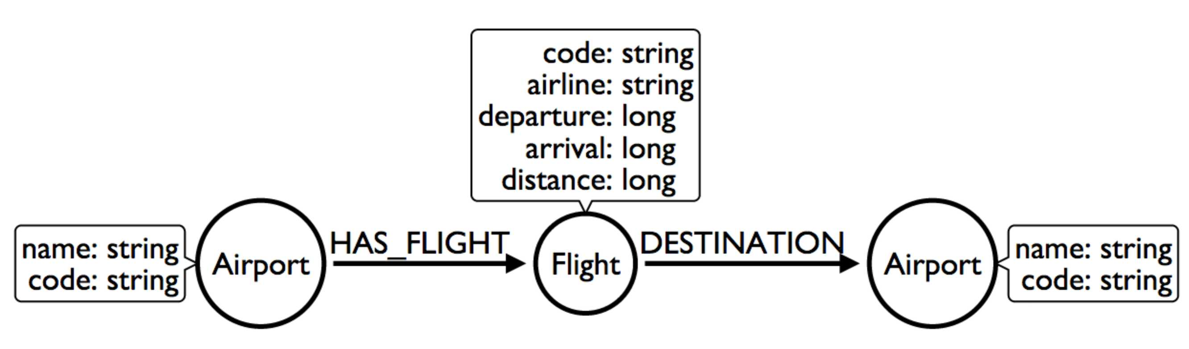
How do you model Flight Data?
Maybe Flight should be its own Node?

Slide 41
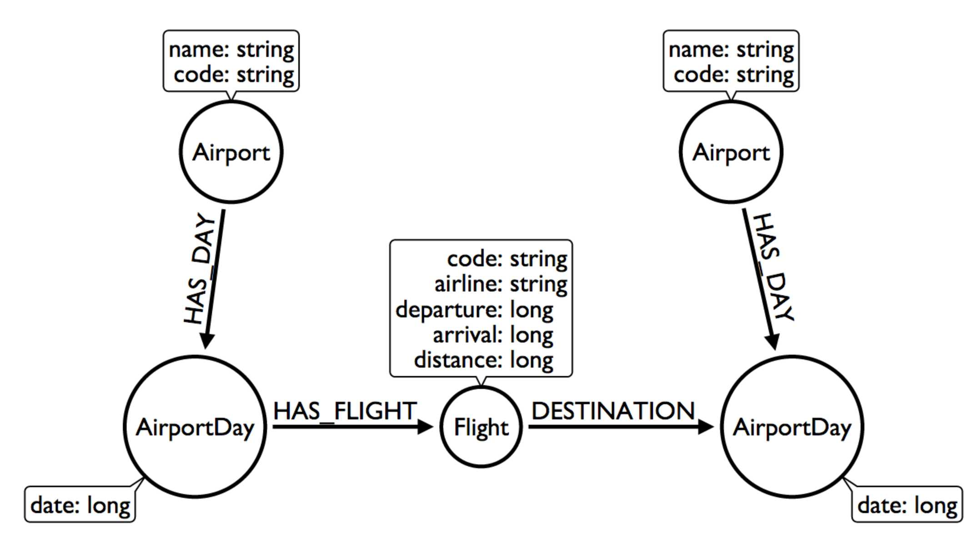
How do you model Flight Data?
Don't we care about Flights only on particular Days?

Slide 42
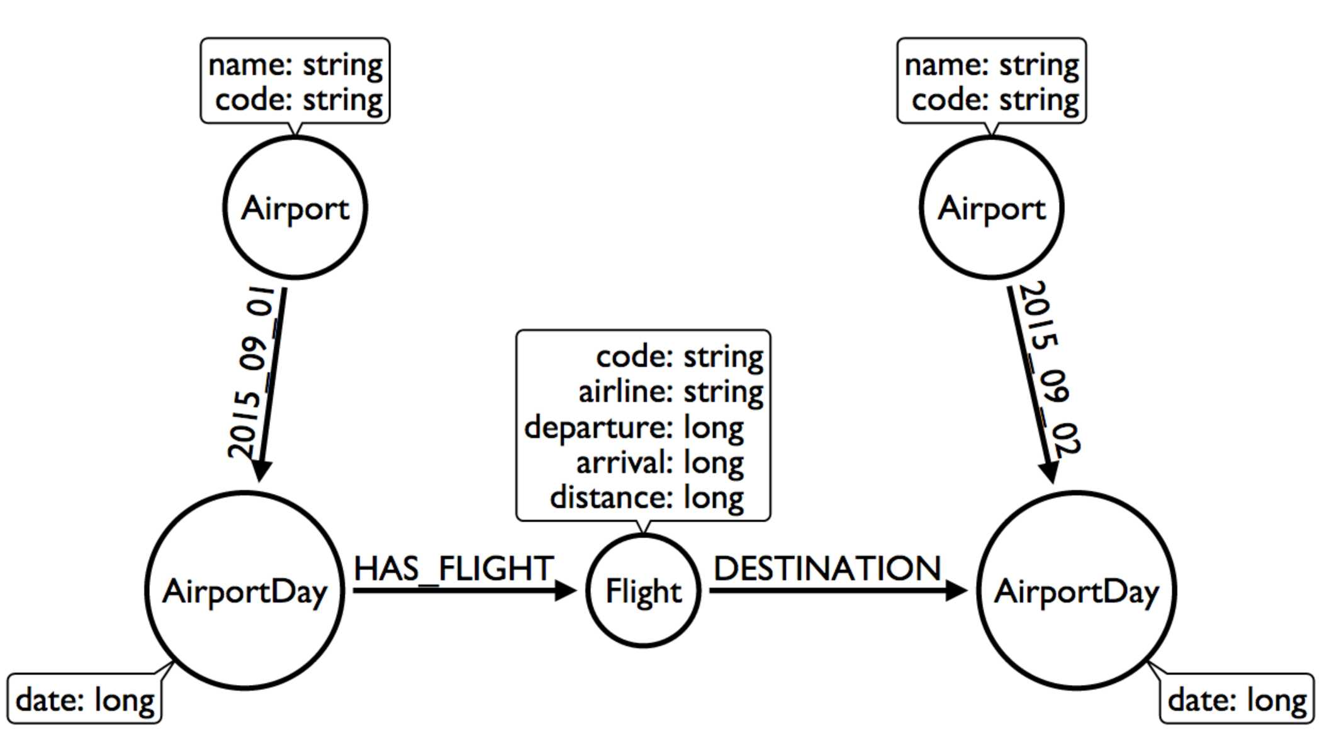
How do you model Flight Data?
What is this trick with the date in the relationship type?

Slide 43
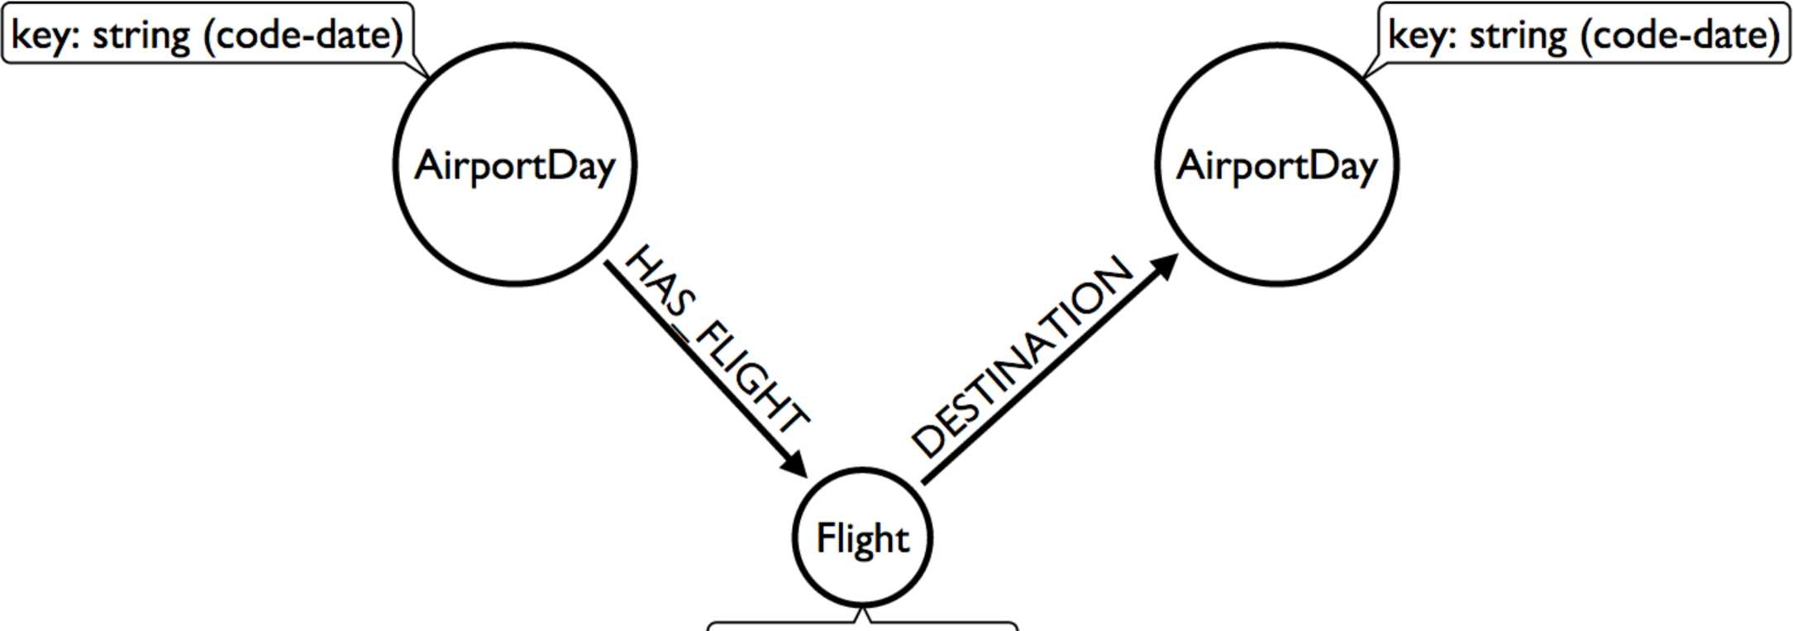
How do you model Flight Data?
We don't need Airports if we model this way!
code: string airline: string departure: long arrival: long distance: long

Slide 44


Slide 45
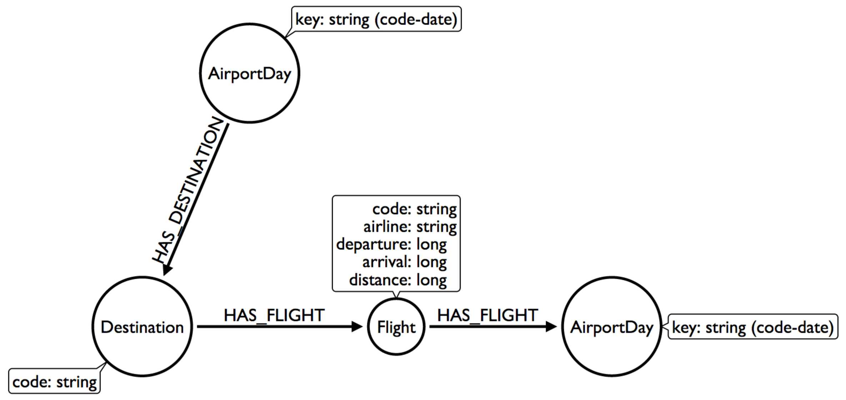
How do you model Flight Data?
Group Destinations together!

Slide 46
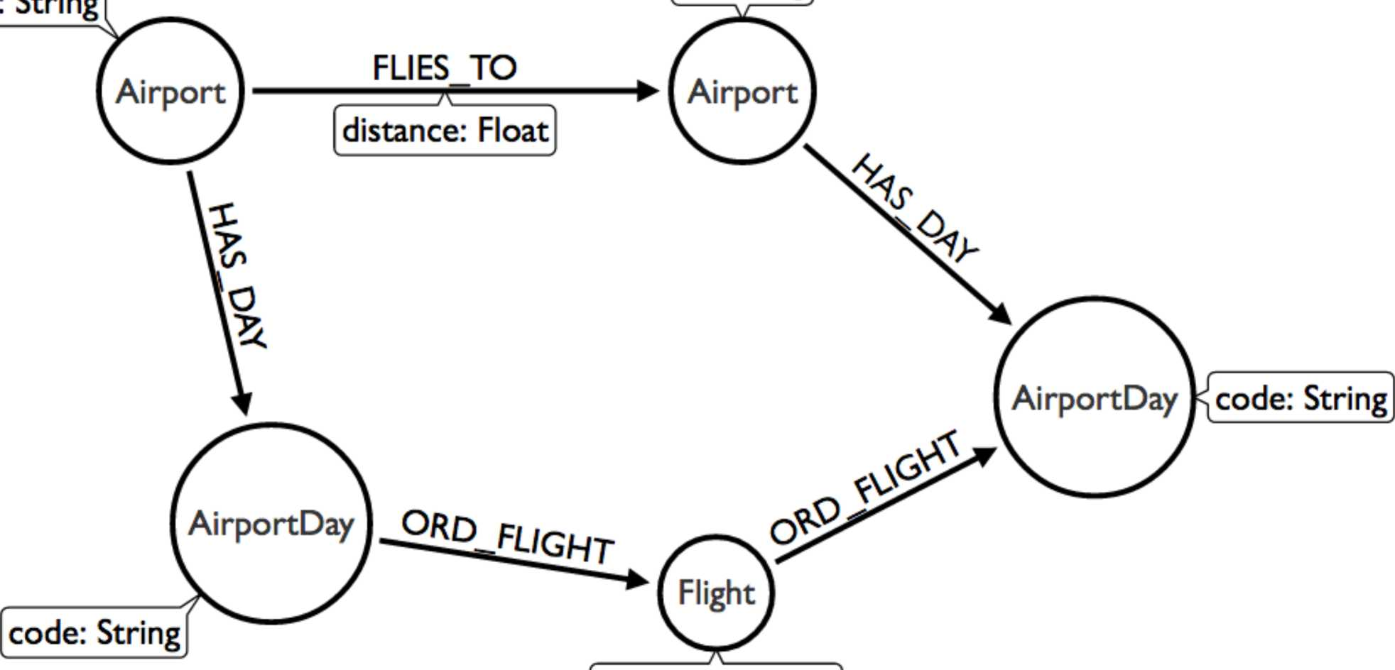
How do you model Flight Data?
OMG WAT! _
id: String
code: String departs: Long arrives: Long distance: Integer

Slide 47

Do not try and bend the data. That's impossible.

Slide 48

Modeling Twitter

Slide 49
Building a News Feed
Cloning Twitter
9:00 am
@hipster
This is what I had for breakfast! <Insert Image of squirrel food>
@neo4j
Automated tweet telling me about Graph Connect 2020 in NYC on Apr 20-22
8:30 am
@ex-coworker
Stuff I no longer care about.
8:12 am
@someguy
Inspirational Quote of the Day
8:03 am

Slide 50
Cloning Twitter
How do others do it?
“After we create a post and we obtain the post ID, we need to LPUSH the ID in the timeline of every user that is following the author of the post” from Tutorial: Design and implementation of a simple Twitter clone using PHP and the Redis key-value store
1
2
3
foreach($followers as $fid) {
$r->lpush("posts:$fid",$postid);
}
Another example using the document store Firebase instead uses the same approach: “When a new spark is posted, we’ll [put] it in the global list, and then put its ID in the feed of every user that is following the author.” from An open source Twitter clone built with Firebase
1
2
3
4
5
6 7
// Add spank ID to the feed of everyone following this user. currentllser.child("followers").once("value", function(list) { list.forEach(function(follower) { var childRef = firebase.child("users").child(follower.name()); childRef.child("feed").child(sparkRefld).set(true);
});
});

Slide 51
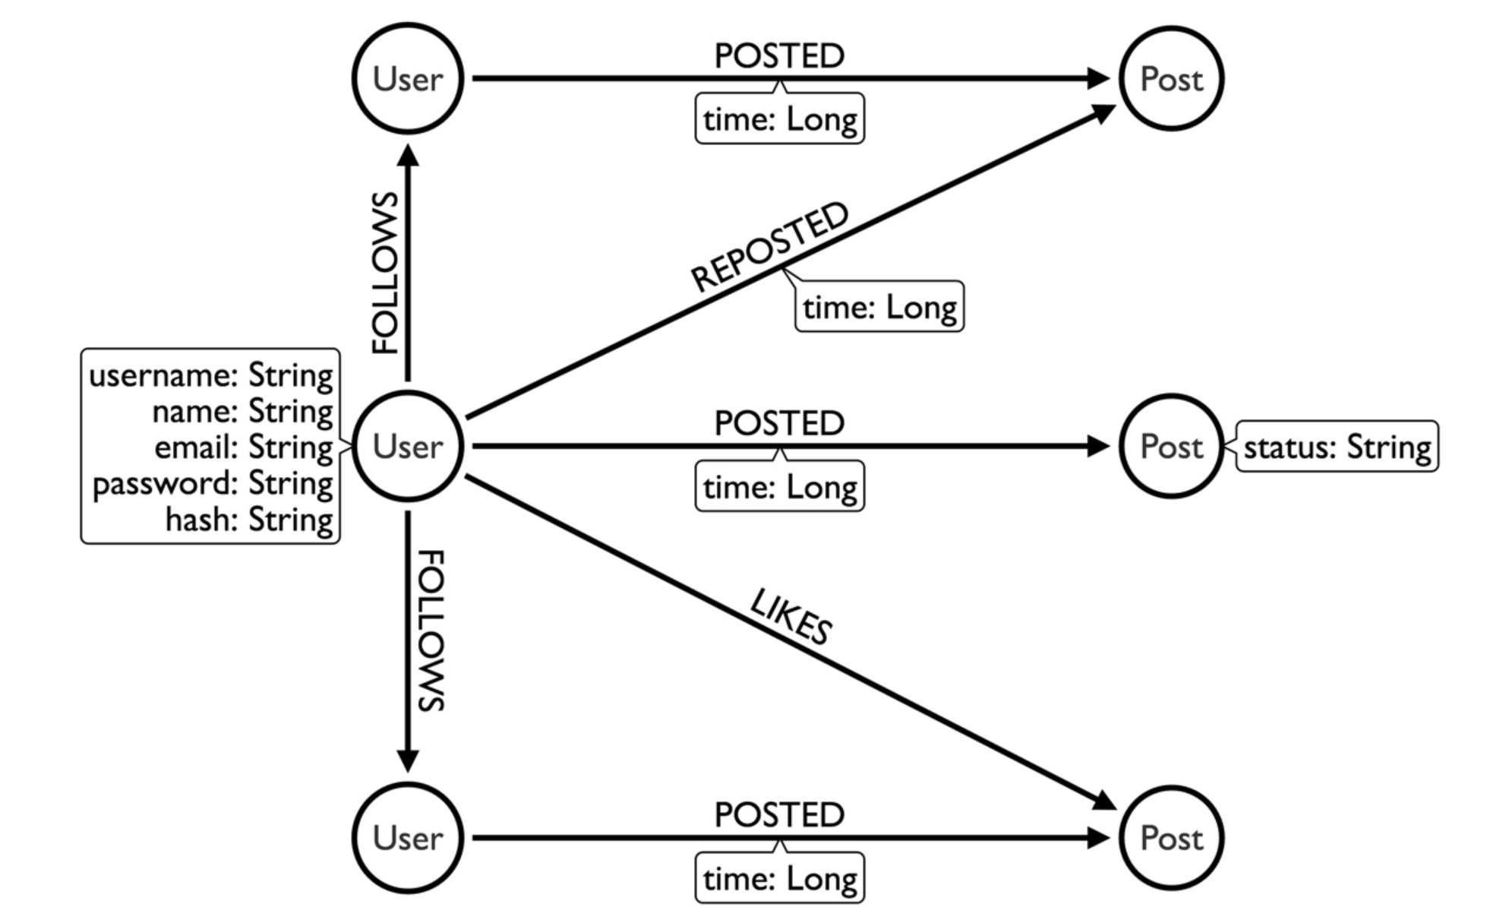
Modeling a Twitter Feed
The Wrong Way

Slide 52
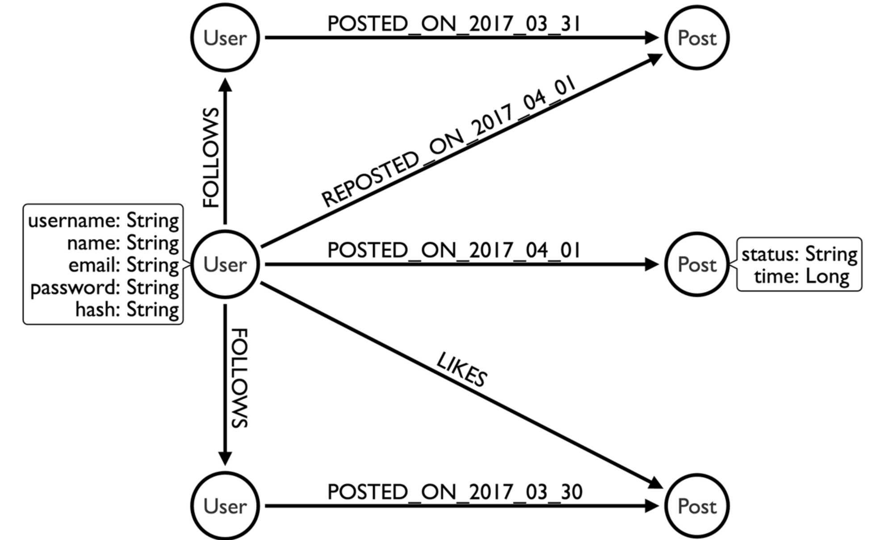
Modeling a Twitter Feed
A Better Way

Slide 53
What we put in cache
Neo4j Secret Sauce Yet Again
Relationship ID refs
1
2
3
4
Pointers instead of Lookups
in: R 1 | R 2 | • • • | R n
" oJr R 1 | R 2 | • • • | R n
ig:*, R 1 | R 2 | R 3 | • • •
ogu R 1 | • • • | R n
R n
/Node
(grouped by type)
Fixed Sized Records
*
*
*
' / ' /
/ * i /
# /
# /
I *
Key 1 Key 2
Key n
■ • • \ • • ⁴ , It \ W V \ |  | Val 1 |  | Val 2 |  | Val n
* % * | id' | start , ***_ |  | end type II
Relationship
 | Key 1 |  | Key 2 |  | ... Key n
 |  | Val 1 |  | Val 2 |  | Val n
"Joins" on Creation
Spin Spin Spin through this data structure

Slide 54

Make the Queries Scale
.. .and the database scales with them.
. .and that’s why we don’t make any money.
neozj

Slide 55
SCALING OUT IS IN FASHION
But when your model and your query match you don’t have to.

Slide 56


Slide 57


Modeling Forms

Slide 58
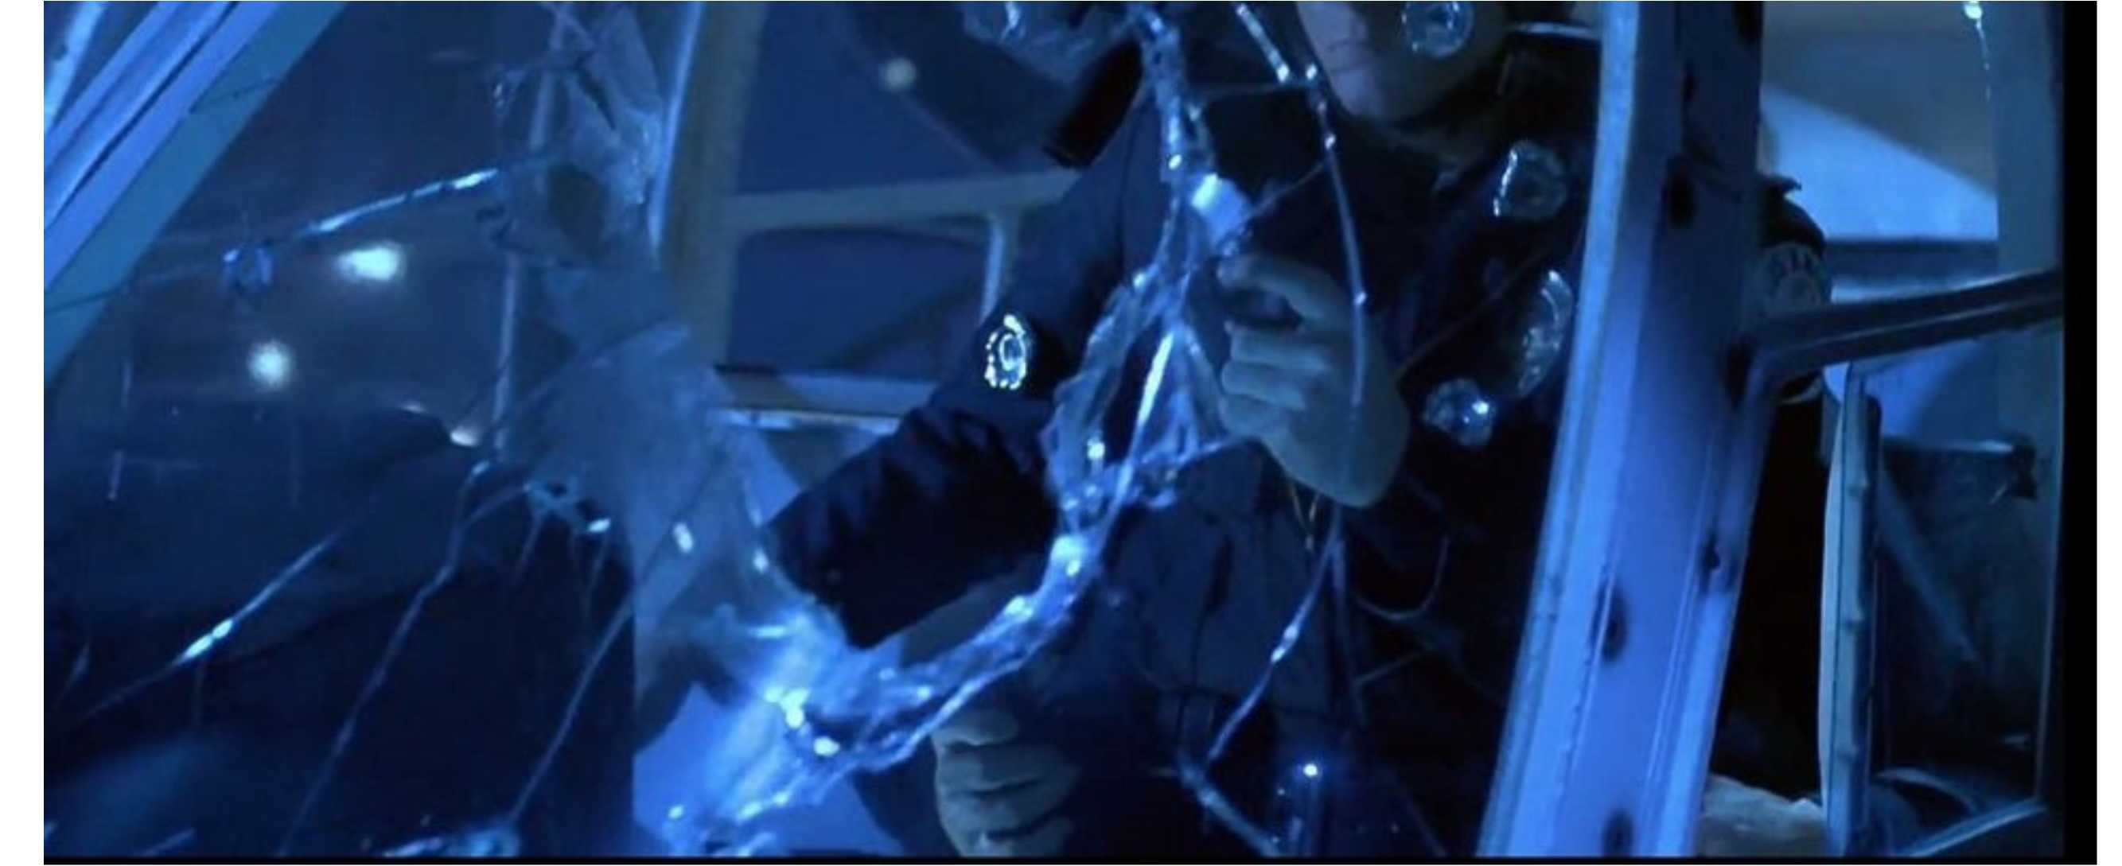
Fluid Schema
How many arms does the T1000 have in this picture?

Slide 59
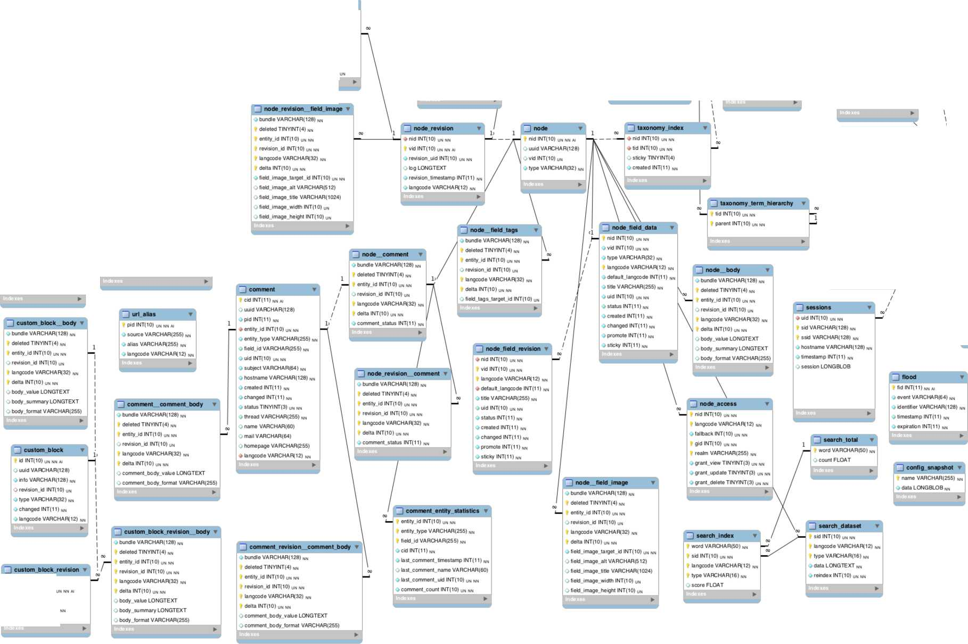
No more "Wall Sized" Schema Diagrams
menu Jinks
3I r»ode_revision__field tags ▼
^ node .revision, body t
 |  | _| taxonomy term data r
 |  | Mid INT( 10) UN NN AI
 |  | Ouuid VARCHAR(128)
_ _| file usage |  | Ovid VARCHAR(255) _{NN}
fid INT( 10) un nn | — | y langcode VARCHAR(12) _{NN}
module VARCHAR(50) _{NN} |  | y name VARCHAR(255) _{NN}
type VARCHAR(64) _{NN} |  | y description LONGTEXT
id VARCHAR(64) _{NN} |  | y format VARCHAR(255)
> count INT{10) un nn |  | y weight INT(11) _{NN}
Indexes |  | / changed INT(11) nn
I
^ file managed
_| watchdog
^ user revision, user picture ▼
^ batch
3) queue
O menu name VARCHAR(32) t ml id INT(10)_{un} nna.
V bundle VARCHAR(128) _{NN} deleted TINYINT(4) _{NN} entity_id INT(10) _{UN NN} I revision id INT(10) _{UN NN} langcode VARCHAR(32) _{NN} delta INT(10) _{UN NN} > field Jag s_target_id INT(10)
y bundle VARCHAR(128) _{NN} deleted TINYINT(4) _{NN} entity.id INT(10) _{UN NN} revision_id INT(10) _{UN NN} langcode VARCHAR(32) _{NN} delta INT(10) _{UN NN} v body value LONGTEXT y body summary LONGTEXT y body .format VARCHAR(255)
fid INT(10) _{UN} nn a. yuuid VARCHAR(128) OuidlNT(10) _{UN} NN y filename VARCHAR(255) _{h} O uri VARCHAR(255) _{NN} y langcode VARCHAR(12) _{N}i y filemime VARCHAR(255) _{N} y files ize BIGINT{20) _{UN} nn O status TINYI NT(4) _{NN} y timestamp INT(10) un nn
wid INT( 11) nn ai >uid INT(10) UN NN O type VARCHAR(64) _{NN} y message LONGTEXT _{N}n y variables LONGBLOB _{N}n y severity TINYINT(3) _{0N} nn O ink VARCHAR(255) y location TEXT _{N}n y refererTEXT
y hostname VARCHAR(128) _{N} O timestamp INT(11) _{N}n
y bundle VARCHAR(128) nn deleted TINYINT(4) _{NN} entity id INT(10) un nn revision.id INT(10) un nn langcode VARCHAR(32) _{NN} delta INT(10) un nn y user, picture .target.id INT(10) un nn y user, picture .alt VARCHAR(512)
O user, picture .title VARCHAR(1024) y user, picture width INT(10) un y user.picture.height INT(10) un
3) user..user picture
bid INT( 10) UN NN y token VARCHAR(64) _{N}i y timestamp INT(11) _{N}n O batch LONGBLOB
item.id INT(10) un nn ai y name VARCHAR(255) _{h} y data LONGBLOB y expire INT(11) _{N}n y created INT(11) _{NN}
Ouuid VARCHAR(128)
3] menu router
O bundle VARCHAR( 128) _{NN} deleted TINYINT(4) _{NN} entity.id INT(10) un nn O revision.id INT(10) _{U}n ) langcode VARCHAR(32) _{N}n delta INT(10) _{UN} nn
Oplid INT(10) _{UN NN} O link_path VARCHAR(255) _{NN} ♦ router path VARCHAR(255) _{N}, O langcode VARCHAR(12) _{NN} O link title VARCHAR(255) _{NN} O options BLOB ^ module VARCHAR(50) _{NN} O hidden SMALLINT{6) _{NN} O external SMALLINT(6) _{NN} O has children SMALLINT(6) _{NN} O expanded SMALLINT(6) _{NN} <> weight INT(11) _{NN} O depth SMALLINT(6) _{NN} O customized SMALLINT(6) _{NN} <»p1 INT(10)_{un nn} O p2 INT(10) _{UN NN} <»p3INT(10) _{UN NN} Op4INT(10)_{UN NN} Op5INT(10) _{UN NN} ^p€INT(10)_{UN nn} O p7 INT(10) un nn <»p8INT(10) _{UN NN} Op9 INT(10) _{UN NN} O updated SMALLINT(6) _{NN} O route name VARCHAR(255) O route parameters LONGBLOB
- path VARCHAR(255) _{NN} Q load Junctions BLOB _{NN} O to.arg Junctions BLOB _{NN} O access callback VARCHAR(255) _{NN} O access_arguments BLOB <* page cal back VARCHAR(255) _{NN} O page arguments BLOB OfitlNT(11)_{NN}
Ouser.ptcture.target.id INT(10) un nn Ouser.pcture alt VARCHAR(512)
^ semaphore
name VARCHAR(255) _{N} value VARCHAR(255) _{N}i expire DOUBLE _{N}n
Q number parts SMALLINT(6) _{NN} O context INT(11)_{nn} O tab_parent VARCHAR(255) _{NN} 4 tab_root VARCHAR(255) _{NN} Otitic VARCHAR(255) _{NN} O title.callback VARCHAR(255) _{NN} O title arguments VARCHAR(255) _{NN} O theme cal back VARCHAR(255) _{NN} O theme arguments VARCHAR(255) _{N} Otype INT(11) _{NN} O description TEXT _{NN} O description_calback VARCHAR(255) _{N} O descript ion.arguments VARCHAR(255) _{N} O position VARCHAR(255) _{NN} O weight INT(11) _{NN} O includeJile MEDIUMTEXT O route.name VARCHAR(255)
O user.pcture.title VARCHAR(1024) O user picture width INT(10) un Ouser.picture height INT(10) un
CZ -
__ _| users roles | ▼ ^{V}
fuid INT( 10) UN NN | -
rid VARCHAR(64) _{NN}
Indexes | ►
t.....
_J sequences ▼
\
3) users
^1
Uid INT(10) UN NN Ouuid VARCHAR(128)
value I NT(10) u
3) users data | ▼
t Uid INT(10) UN NN
module VARCHAR(50) _{NN}
name VARCHAR(128) _{N}n
0 value LONGBLOB
y serialized T1NYINT(3) _{UN}
Indexes
O name VARCHAR(60) _{NN} O langcode VARCHAR(12) _{NN} O pass VARCHAR(128) _{N}n O mail VARCHAR(254)
3) shortcut.set users
^ variable
uid INT( 10) un nn O set name VARCHAR(32) _{N}
name VARCHAR(128) i>, y value LONGBLOB _{NN}
O theme VARCHAR(50) nn O signature VARCHAR(255) _{NN} O signature.format VARCHAR(255)
O created INT(11) _{NN} y access INT(11) nn O login INT(11) nn O status TINYI NT(4) _{NN} O timezone VARCHAR(32)
3] cache
cache config
_| cache views.info
O preferred langcode VARCHAR( 12) _{N}n Opreferred.admin.langcode VARCHAR(12) _{N} O in it VARCHAR(254)
- cid VARCHAR(255) _{NN} y data LONGBLOB y expire INT(11) _{NN} y created INT(11) _{NN} y serialized SMALLINT(6) _{NN} y tags LONGTEXT y checksum invalidations INT(11) _{N} y checksum deletions INT(11) _{NN}
cid VARCHAR(255) _{NN} O data LONGBLOB y expire INT(11)_{nn} y created INT(11) _{NN} y serialized SMALLINT(6) _{NN} y tags LONGTEXT y checksum invalidations INT(11) _{N} y checksum.deletions INT(11) _{NN}
t cid VARCHAR(255) _{NN} y data LONGBLOB y expire INT(11) _{NN} y created INT(11) _{NN} y serialized SMALLINT(6) _{NN} y tags LONGTEXT y checksum invalidations INT(11) _{H} y checksum deletions INT(11) _{NN}
^ router
name VARCHAR(255) _{N}n y path VARCHAR(255) nn y pattern outline VARCHAR(255) _{N} y route.set VARCHAR(255) _{NN} Ofit INT( 11) nn O route TEXT
y number_parts SMALLINT(6) _{N}n
3] cache bootstrap
3) cache toolbar
cache i
' cid VARCHAR(255) _{m} O data LONGBLOB y expire INT(11) _{NN} y created INT(11) _{N}n y serialized SMALLINT(6) _{NN} y tags LONGTEXT y checksum invalidations INT{11) _{N} y checksum deletions INT(11) _{NN}
cid VARCHAR(255) _{NN} y data LONGBLOB y expire INT(11) _{NN} y created INT(11) _{NN} y serialized SMALLINT(6) _{NN} y tags LONGTEXT y checksum invalidations INT(11) _{N} y checksum deletions INT(11) _{NN}
cid VARCHAR{255) _{NN} O data LONGBLOB y expire INT(11) _{NN} y created INT(11) _{NN} y serialized SMALLINT(6) _{NN} > tags LONGTEXT y checksum invalidations INT(11) _{N} y checksum deletions INT(11) _{NN}
^ history
uidlNT(11) nn nid INT(11) _{NN} y timestamp INT(11) _{NN}
^ cache block
^ cache tags
cache field
cid VARCHAR(255) _{m} y data LONGBLOB y expire INT(11)_{NN} y created INT(11) _{N}n y serialized SMALLINT(6) _{NN} y tags LONGTEXT y checksum invalidations INT(11) _{N} y check sum deletions INT(11) _{NN}
tag VARCHAR(255) _{N}, y invalidations INT(11)_{n} y deletions INT(11) _{NN}
cid VARCHAR(255) _{NN} y data LONGBLOB y expire INT(11) _{NN} y created INT(11) _{NN} y serialized SMALLINT(6) _{NN} y tags LONGTEXT y check sum. invalidations INT (11) _{N} ychecksum deletions INT( 11) _{NN}
_] key value expire ▼ |  | _] key value
colection VARCHAR(128) _{NN} |  | collection VARCHAR(128) _{N}n
' name VARCHAR(128) _{N}n |  | name VARCHAR(128) _{NN}
y value LONGBLOB _{N}n |  | y value LONGBLOB _{NN}
y expire INT(11) _{NN} |  | Indexes
►
► id INT( 10) un nn revision.id INT(10) O tog LONGTEXT _{NN}
O info VARCHAR(128) Ochanged INT(11) _{NN}

Slide 60
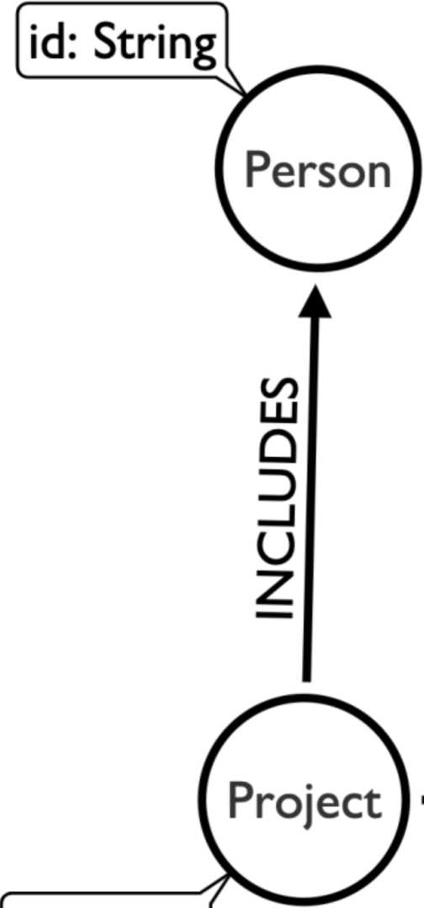
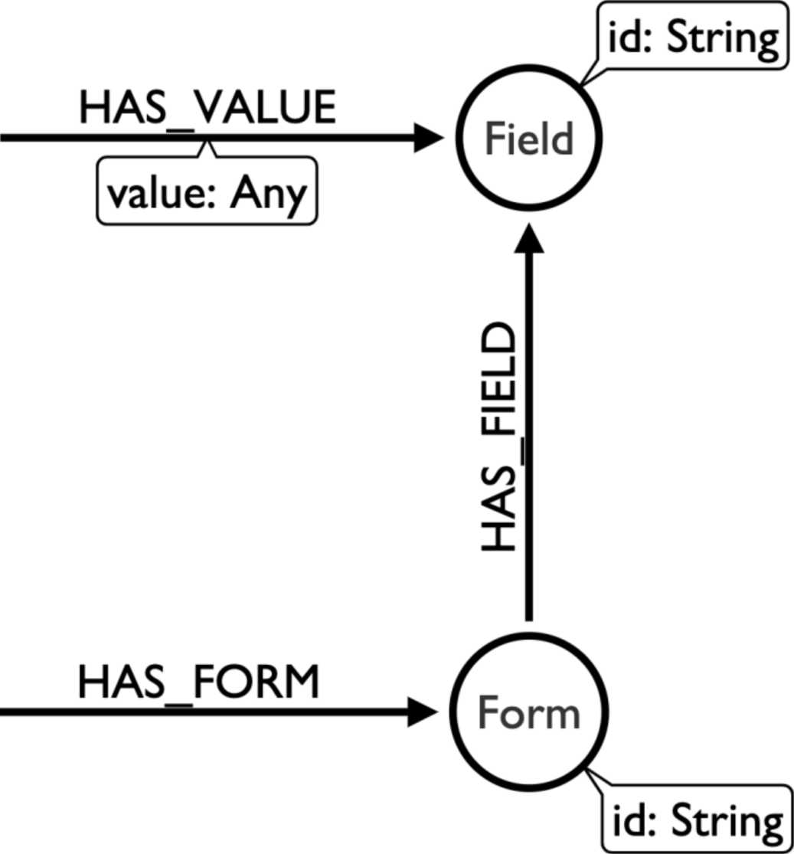
Any Form
For all forms, all fields, all values you'll ever need.
id: String

Slide 61
Wait a minute
• What if they fill out lots of forms?
• What if they respond to the same form twice?
• What if responses to forms are linked together?
• Are we missing a concept?
neo/|j

Slide 62
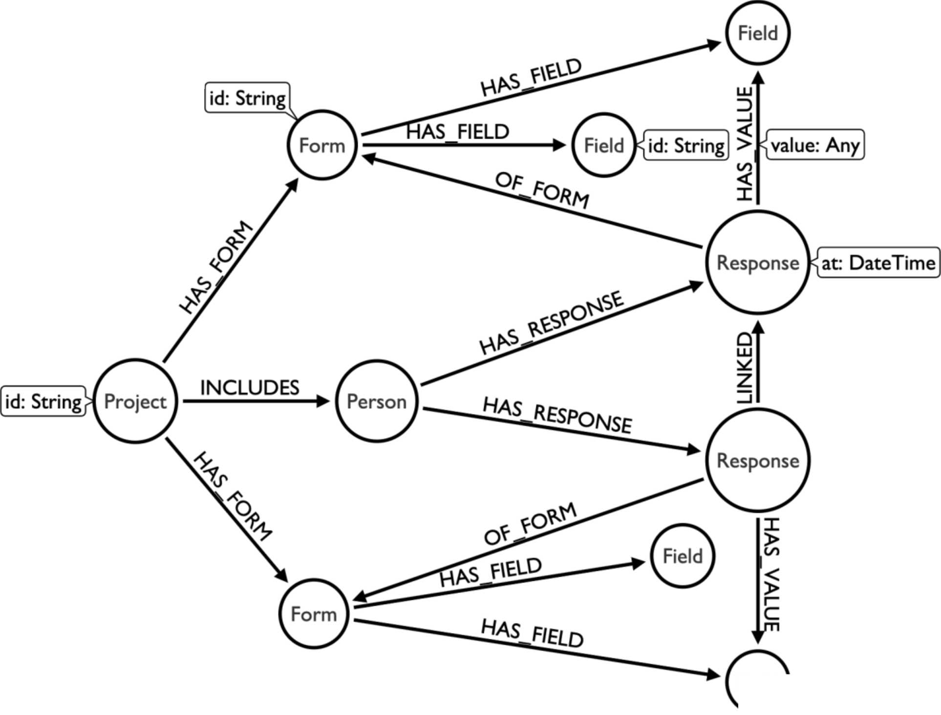
Responses to Forms
For all forms, all fields, all values you'll ever need.
Field

Slide 63


Slide 64

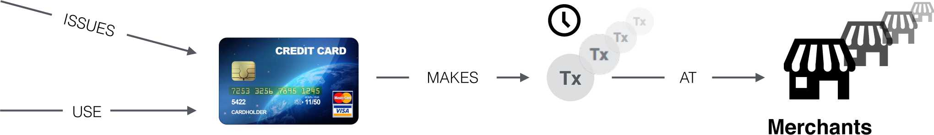

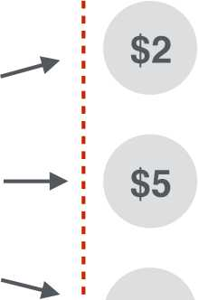

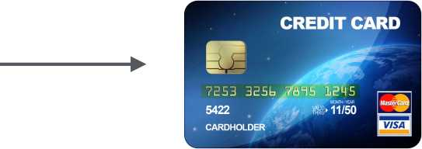

Card Issuer
&
Card Holder
t
i—
Testing
Terminal ATM- Data Breach
skimming
USE
- MAKES
MAKES
$4000
Fraudster
$10

Slide 65
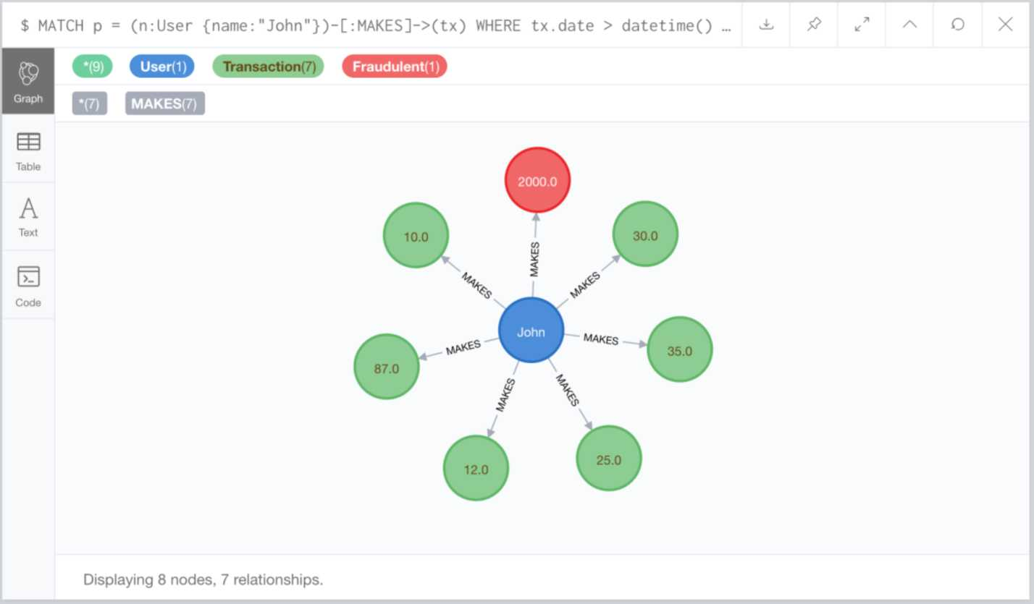
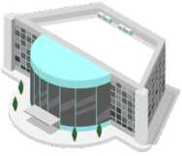

^{Tx Tx}
✓ ✓ $2000
Computer
Store
John
Tx i | Tx
✓ ✓
Tx Tx Tx Tx
✓ ✓ ✓ ✓
Tx Tx
✓ ✓
Tx
✓

Slide 66
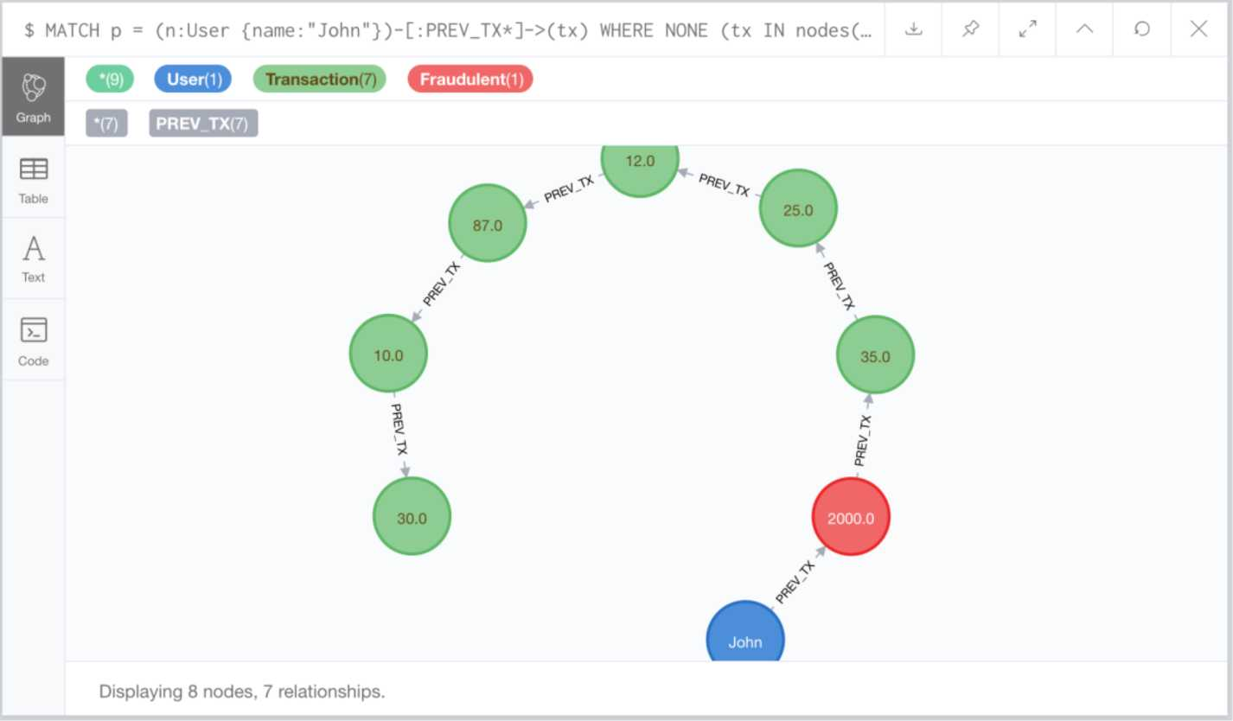

^{Tx Tx}
✓ ✓ $2000
Computer
Store
John
Tx i I Tx
✓ ✓
Tx Tx Tx Tx
✓ ✓ ✓ ✓
Tx Tx
✓ ✓
Tx
✓

Slide 67
$ MATCH p = (fraud:Fraudulent)-[:PREV_TX*]->(tx) WHERE fraud.date > datetime(... dL & ** ^ O X
Transaction(37) (SBBD
E5S1 H
 | *•)■-» <». «. ----, - | ( tkM ) | _____ - l»«V TX | ⁰
© ... | ⁽w^{:i} (-)—*(•“ ^_{i:} ;; ⁽~' "" \ / ->-# | © | - — - | e
"f.t* | .. - - © ^{w} . — - - | -•
Table
A
Text
>_
Code
Displaying 37 nodes, 34 relationships.
Tx | Tx | Tx
✓ | ✓ | ✓
^{Tx Tx}
✓ ✓ $2000
Computer
Store
John
Tx Tx
✓ ✓ ✓
Tx Tx Tx
✓ ✓ ✓

Slide 68


Slide 69

©
Karen | & | Tx | Tx | 1 ^{Tx} | X | Tx
 |  |  |  | $3 1 1 | $8
Robert | & | rx I Tx | Tx | 1 1 Tx ¹ Tx i | Tx | Tx
 |  |  | ✓ | ✓ | ✓ i | ✓ | ✓
Sheila | & | rx i Tx | Tx |  | Tx | X
 |  |  |  | $2 : i i |  | $3
John | & | rx j Tx | Tx | Tx | | Tx | Tx
 |  | / ✓ | ✓ | $4 ; y | ✓ | ✓
Gas Station

Slide 70
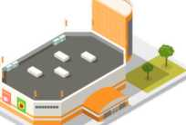
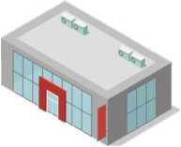
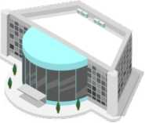
Tx | X $12 | Tx | • $1500 | Tx | Tx
Tx | Tx | Tx | Tx | Tx | Tx
✓ | ✓ | ✓ | ✓ | ✓ | ✓
Tx | Tx | • $3000 | Tx | Tx | Tx
• $10 | Tx ✓ | Tx ✓ | X $25 | Tx ✓ | • $2000
Furniture
Store
Jewelry
Store
Computer
Store

Slide 71
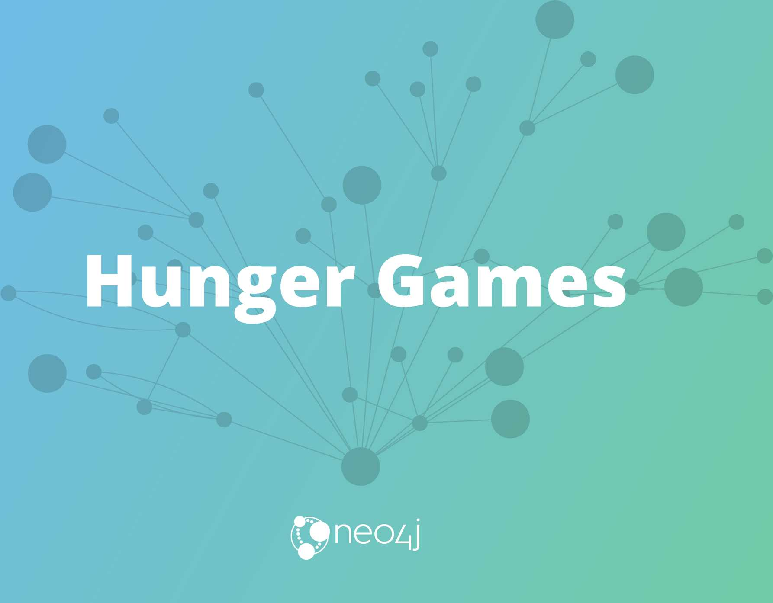

Slide 72
Questions
1. What is the Tool Max uses for Modeling?
2. Up to how many relationship types can I use?
A. 8192
B. 32768
C. 65536
3. What is the secret to Neo4j?
neo/|j

Slide 73


