Slide 1






































HOW SENTRY CAN HELP US WITH BUGS.

Slide 2





Slide 3
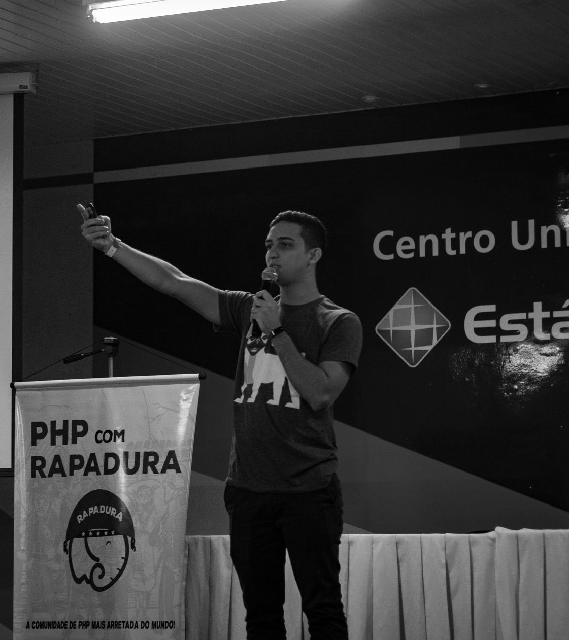












ERISON SILVA
Senior PHP Developer at Oowlish, Graduated in System analysis and development, Zend certification engineer PHP 7 and member "PHP com rapadura" community.
/ eerison

Slide 4









WHAT IS SENTRY?

Slide 5

SENTRY IS AN OPEN- SOURCE ERROR TRACKING TOOL THAT HELPS YOU
MONITOR AND FIX CRASHES IN REAL TIME

Slide 6
SENTRY WORKFLOW
ALERT TRIAGE RESOLVER

Slide 7
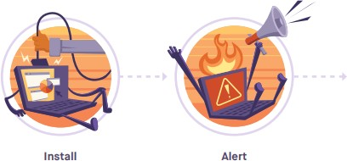
ALERT
Sentry’s notifications give immediate visibility into the impact of errors on your users and why you are being alerted.
See how many times each error occurred and how many users it affected with aggregated errors.
Sentry has SDKs that support most languages
By customizing alert rules and integrating into the tools you already use, you can receive alerts when (and if) you want them,

Slide 8
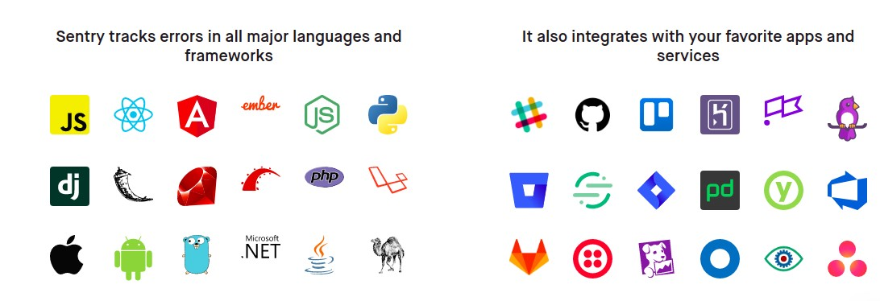

Slide 9

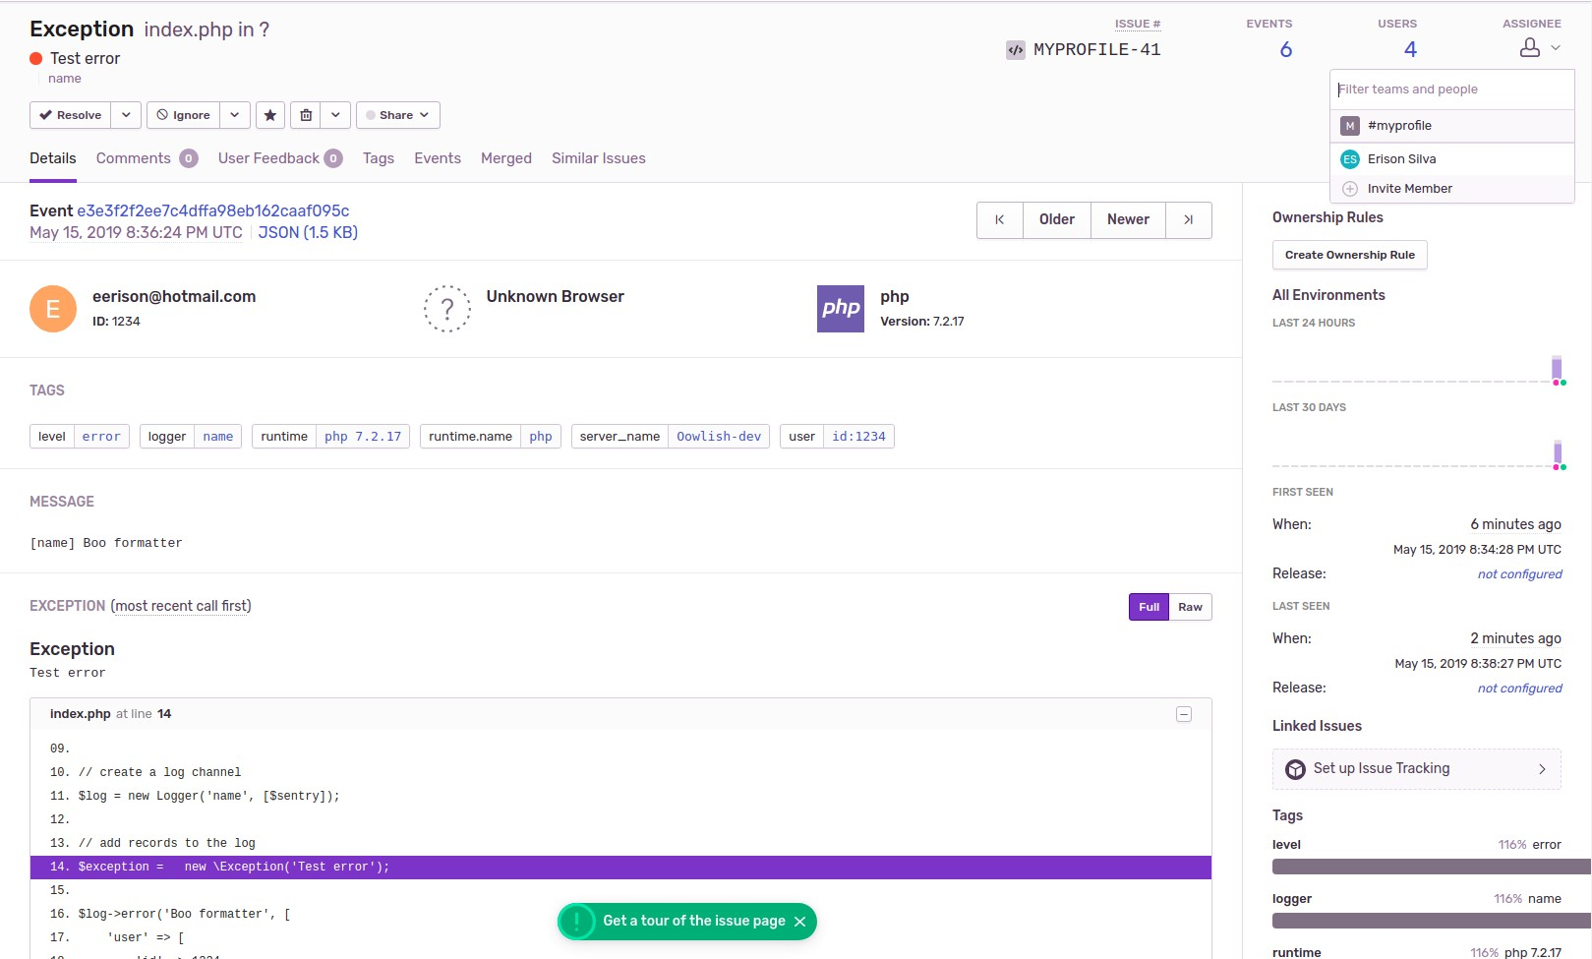

Slide 10
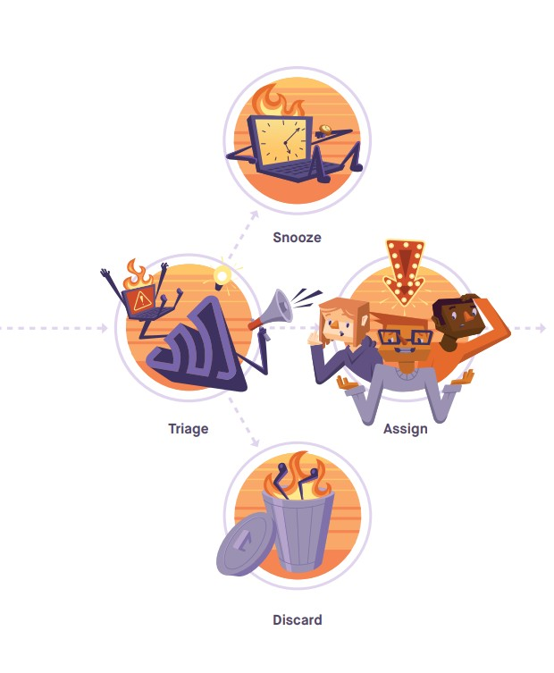
TRIAGE

Slide 11
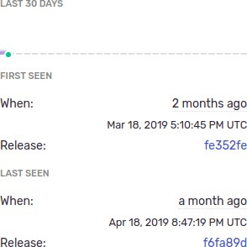
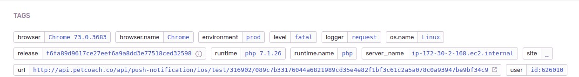
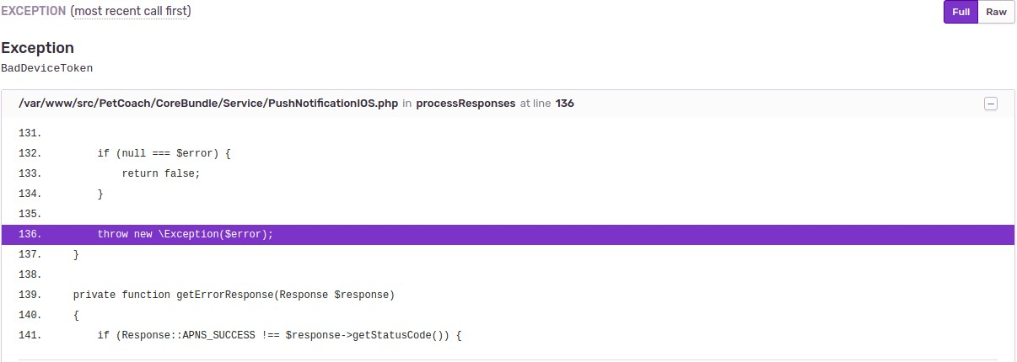

Slide 12
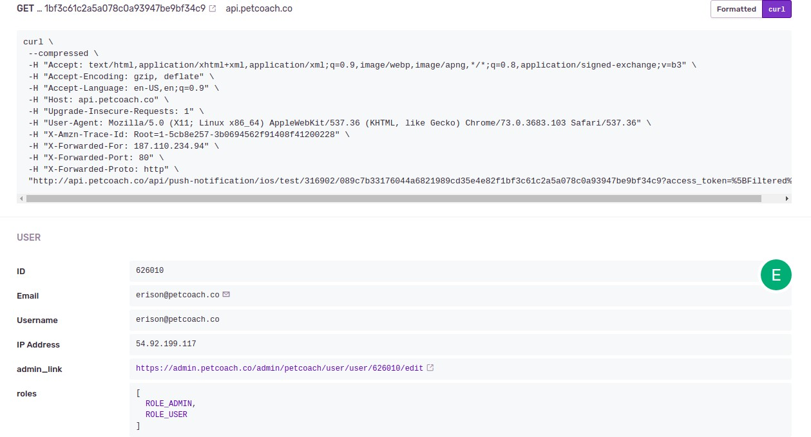

Slide 13
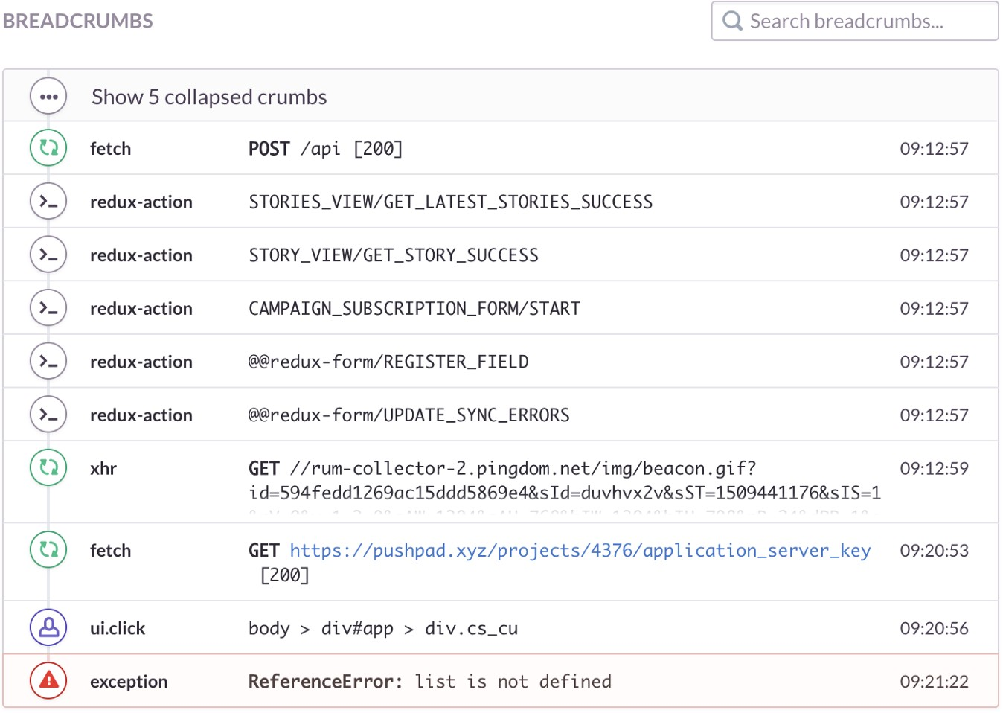
TRIAGE - BREADCRUMBS

Slide 14
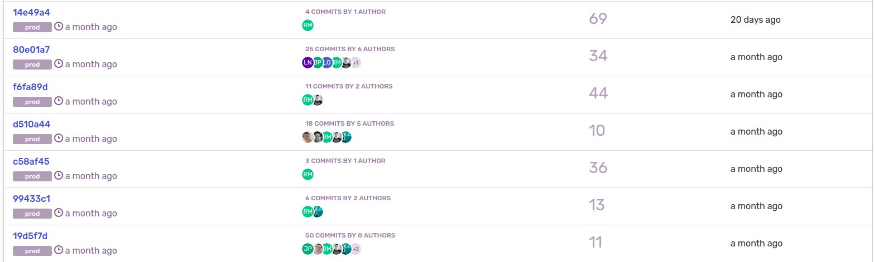
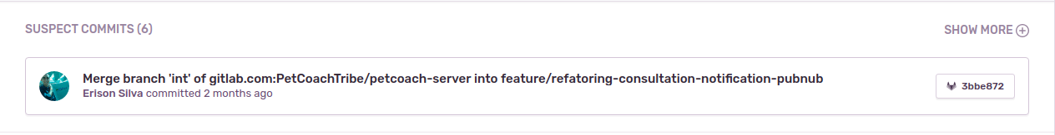
TRIAGE - RELEASE

Slide 15
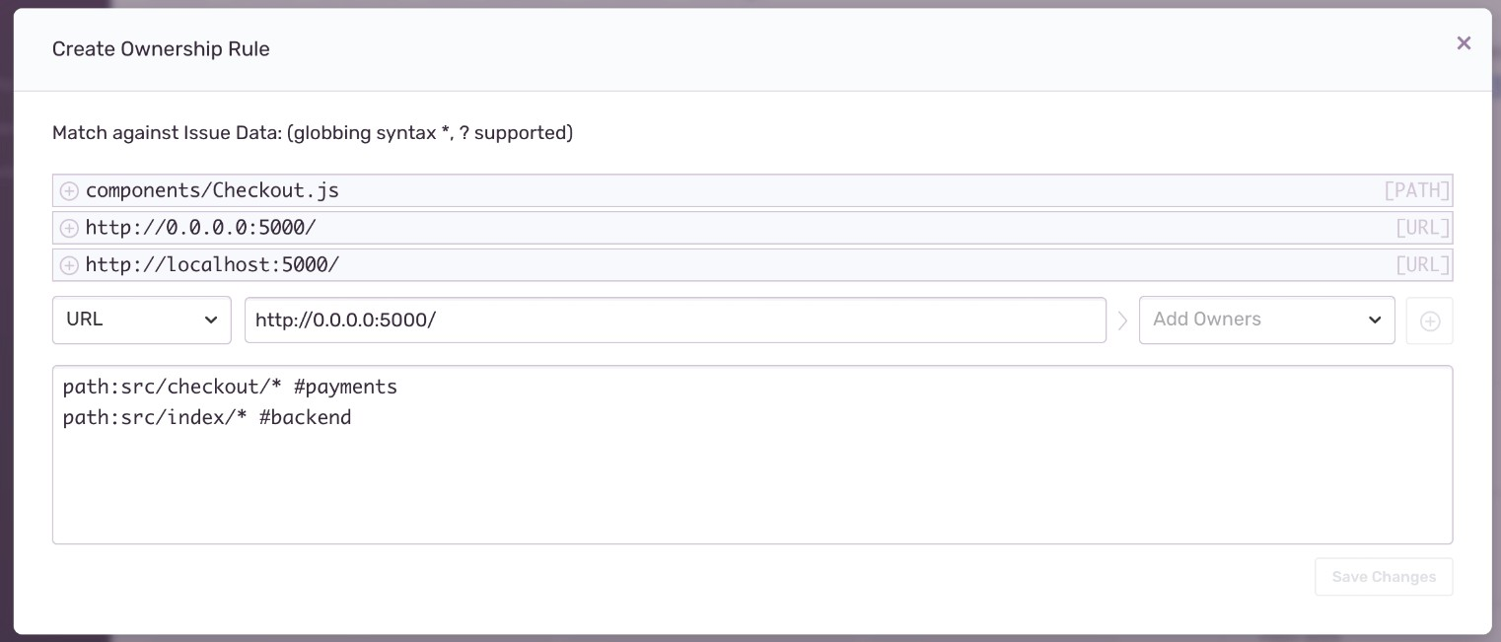
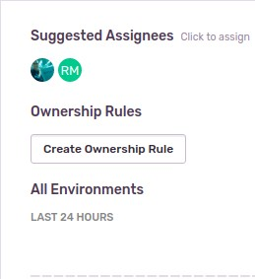
TRIAGE - OWNERSHIP

Slide 16
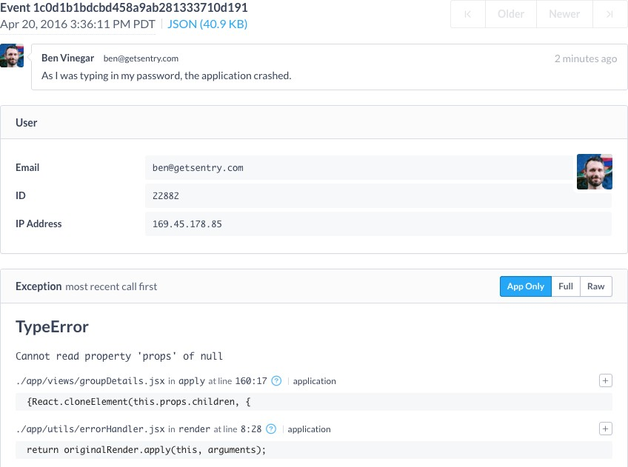
TRIAGE - USER FEEDBACK

Slide 17
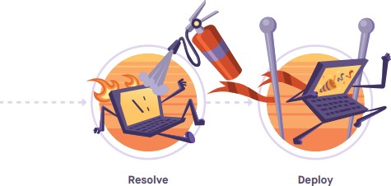
RESOLVER
The newly assigned issue owner now has the context to iterate on the code and commit the fix. Resolve via commit is a useful way for that engineer to stay organized and productive. Referencing the issue in the commit (e.g., Fixes ISSUE-ID-123) will mark it to resolve in that specific release and mute notifications for that issue before the fix deploys.
The deployment pipeline then picks up the change and deploys it. You can also configure deploy emails to send details on how many files have changed and what commits are being released once the code gets deployed.

Slide 18
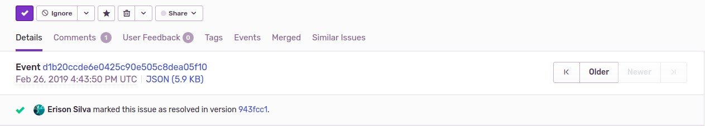
RESOLVER

Slide 19
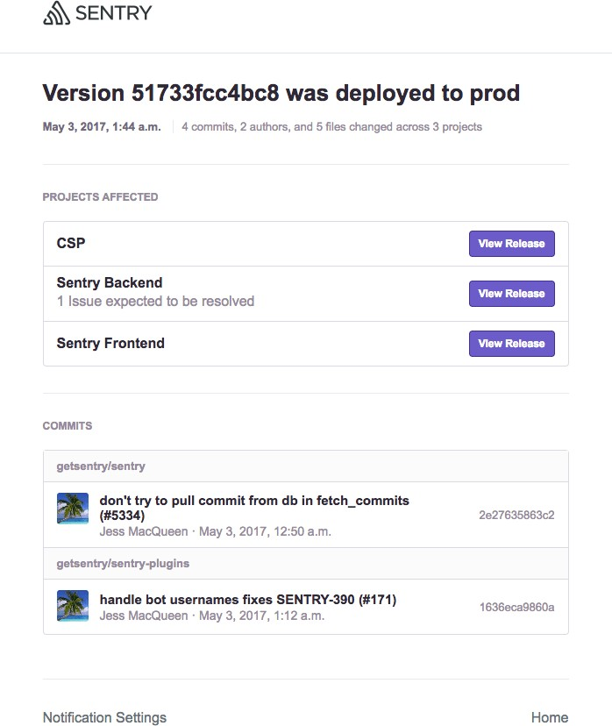
RESOLVER - DEPLOY

Slide 20
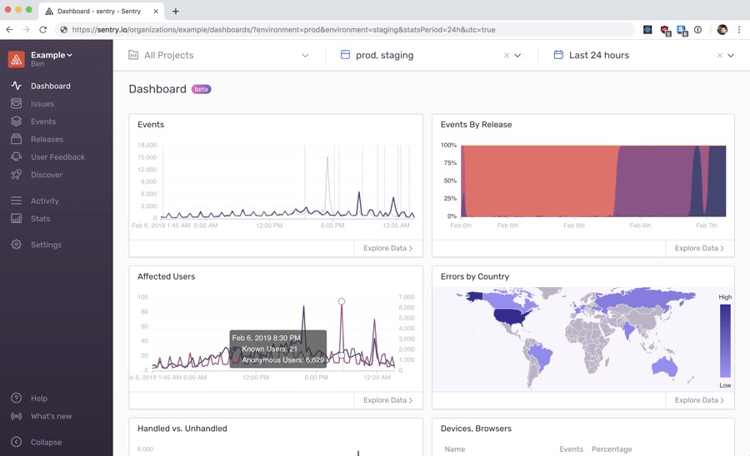
EXTRA - DASHBOARDS

Slide 21
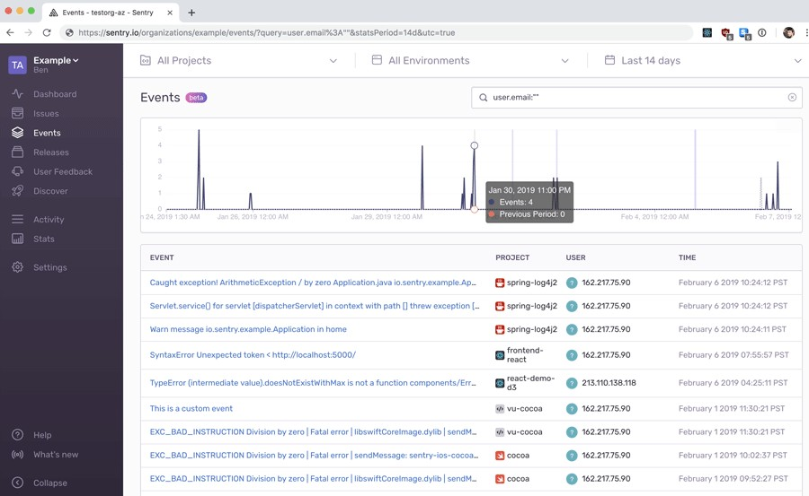
EXTRA - DASHBOARDS

Slide 22


THANK YOU

