Slide 1
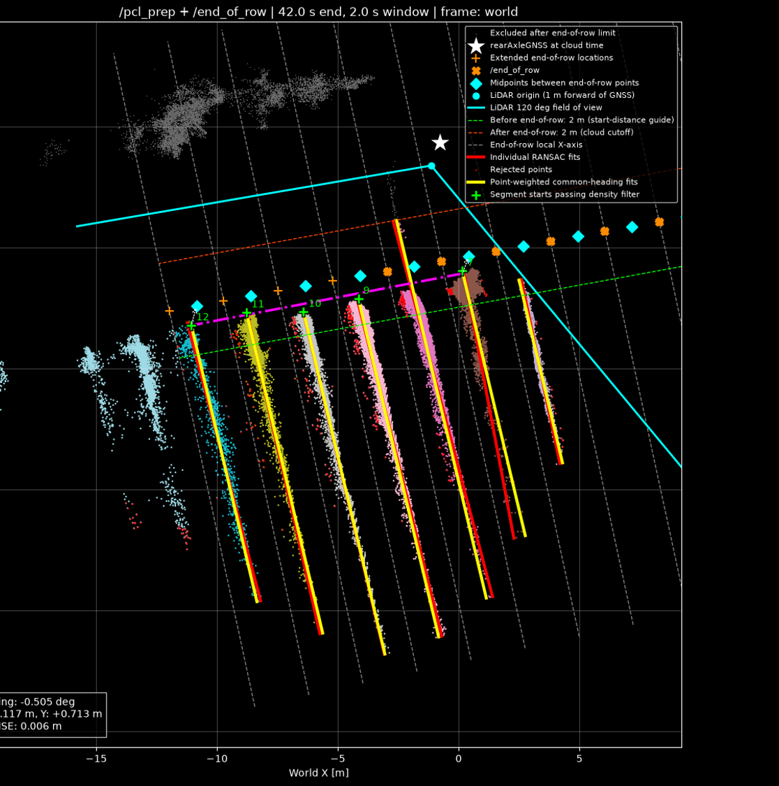
Start of Row implementation
Pernav
Edward
22nd of October 2026

Slide 2
intro
Gave the start of row algorithm a go
Developed in python
  Not yet a ROS2 node
AI developed but step-by-step

Slide 3
Processing steps

Slide 4
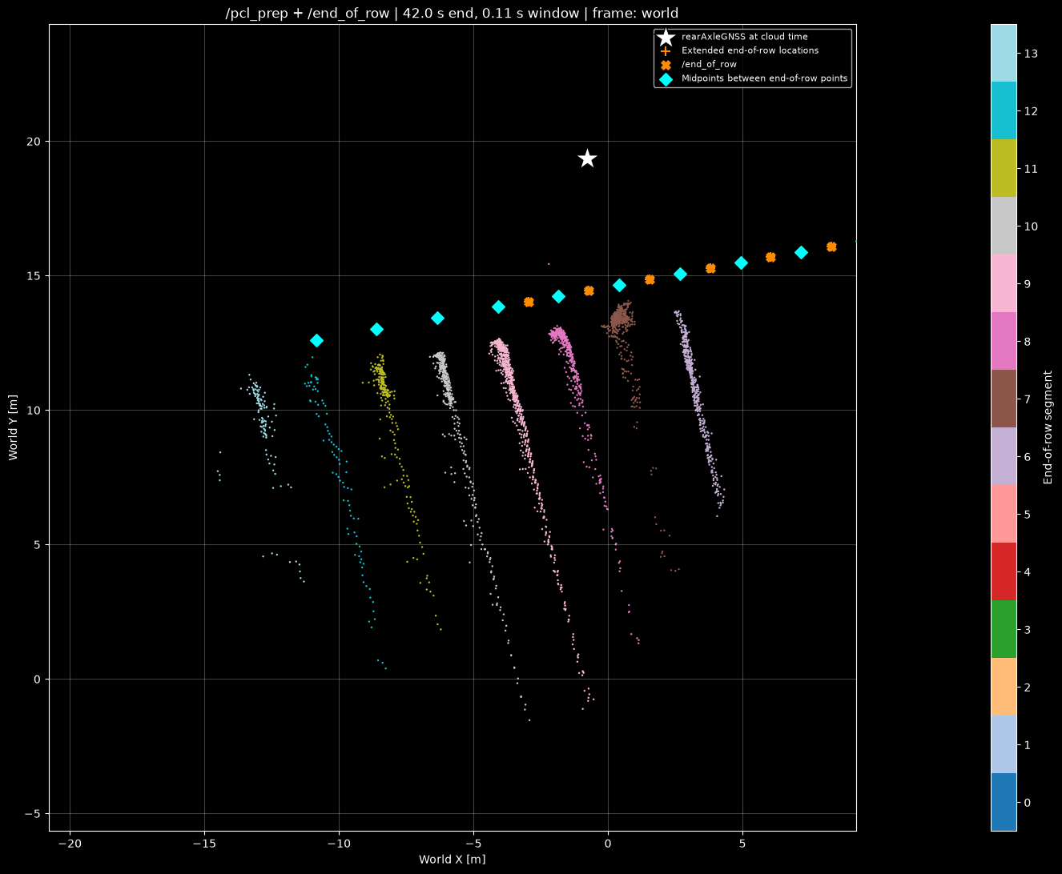
Stitch PCL’s
Single PCL
Septentrio rearAxle
EoR from Joram
Note: pcl colors are due to segmentation explained a few slides into the future

Slide 5
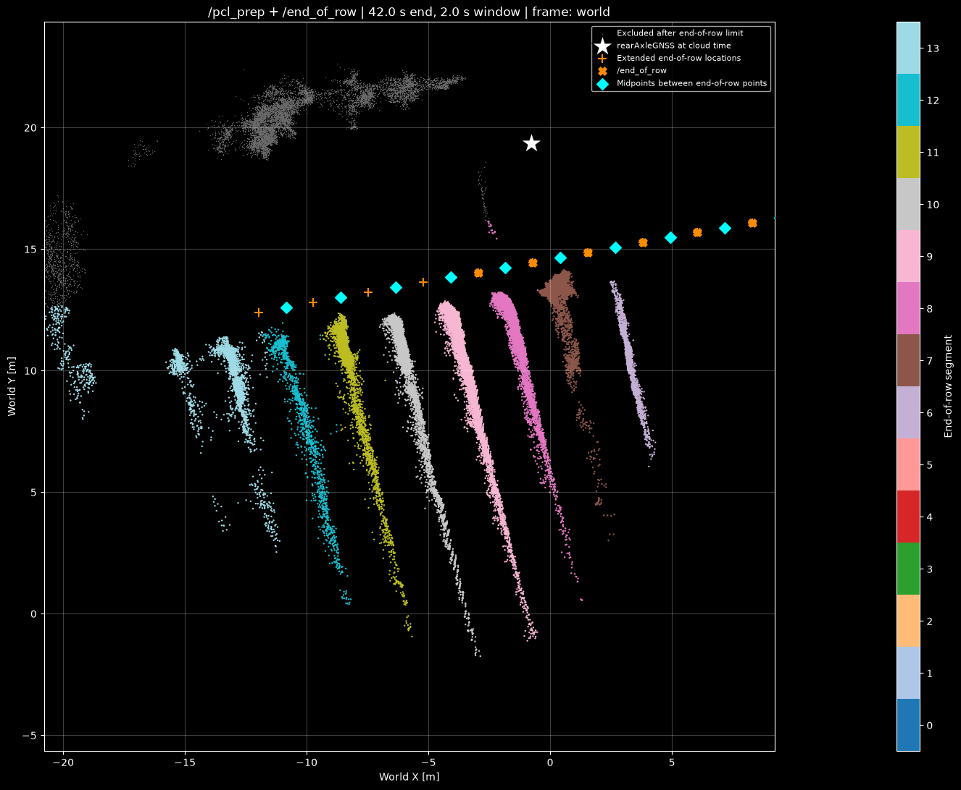
Stitch PCL’s
2s window
Extrapolate EoR to previously unseen region
  Limited to +10m

Slide 6
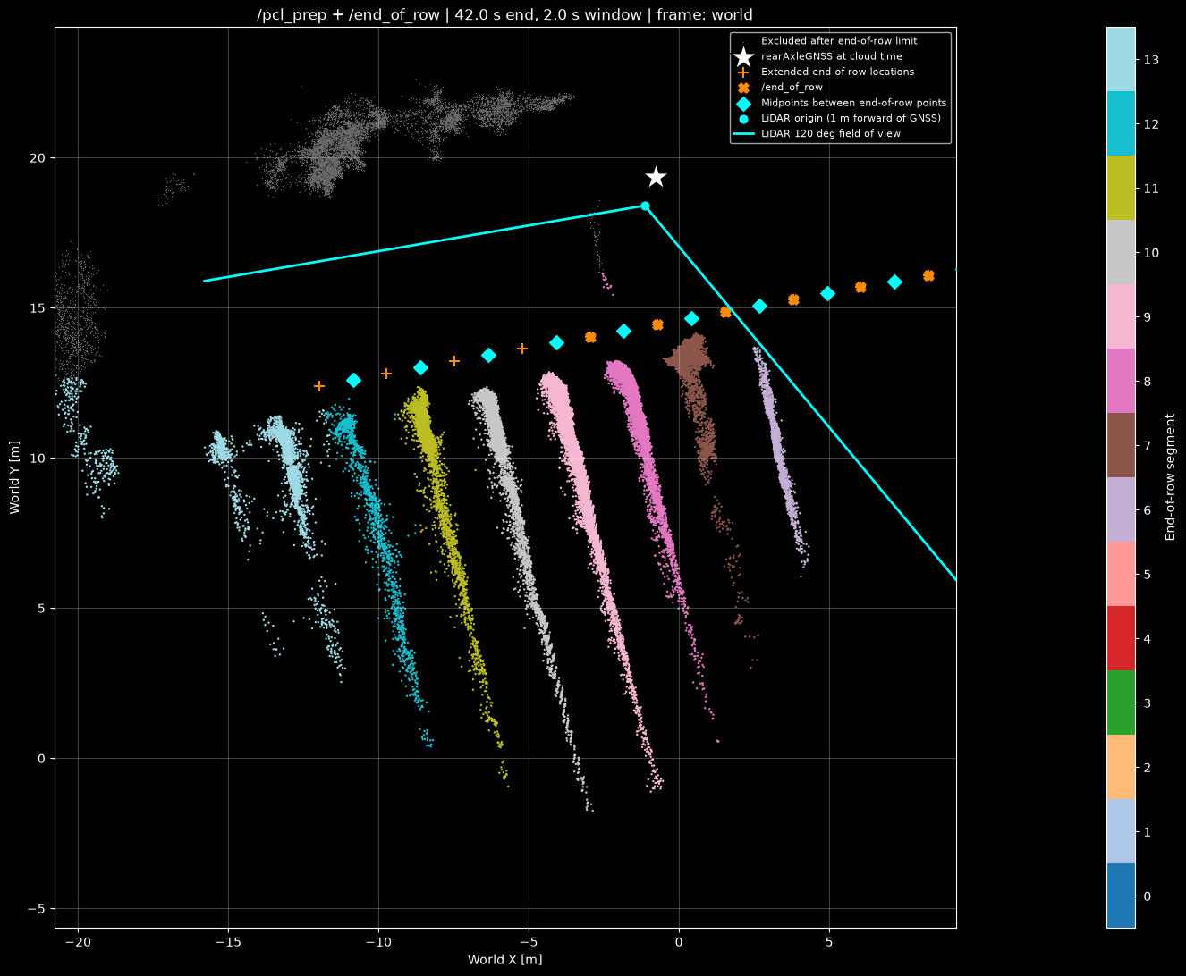
Add LIDAR FoV

Slide 7
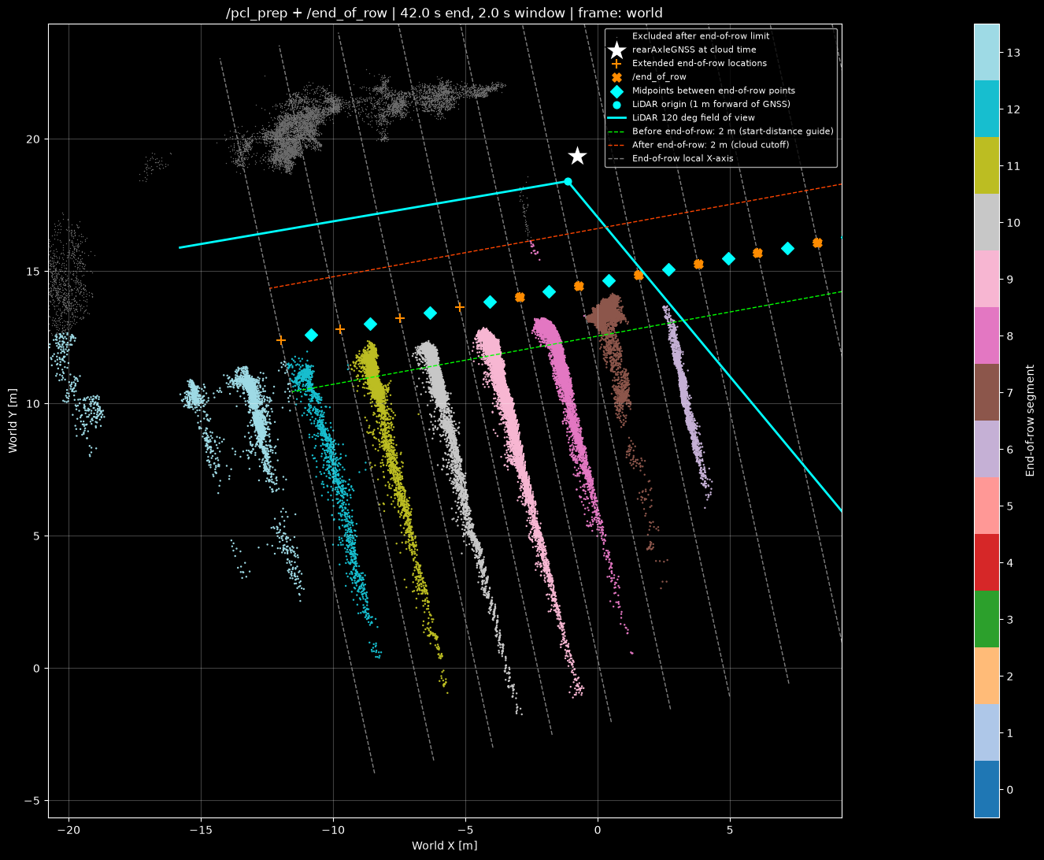
Segment pcl
Uses EoR x and y axes

Slide 8
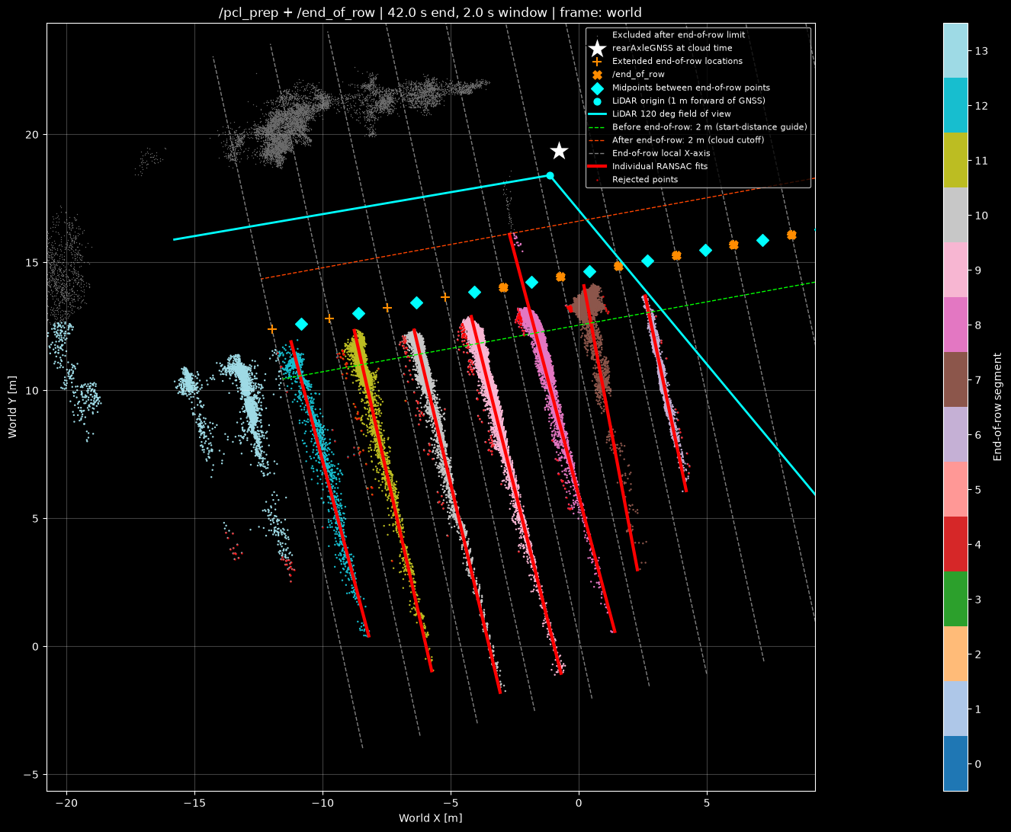
RANSAC
One per segmented PCL
  Retain 99% of points

Slide 9
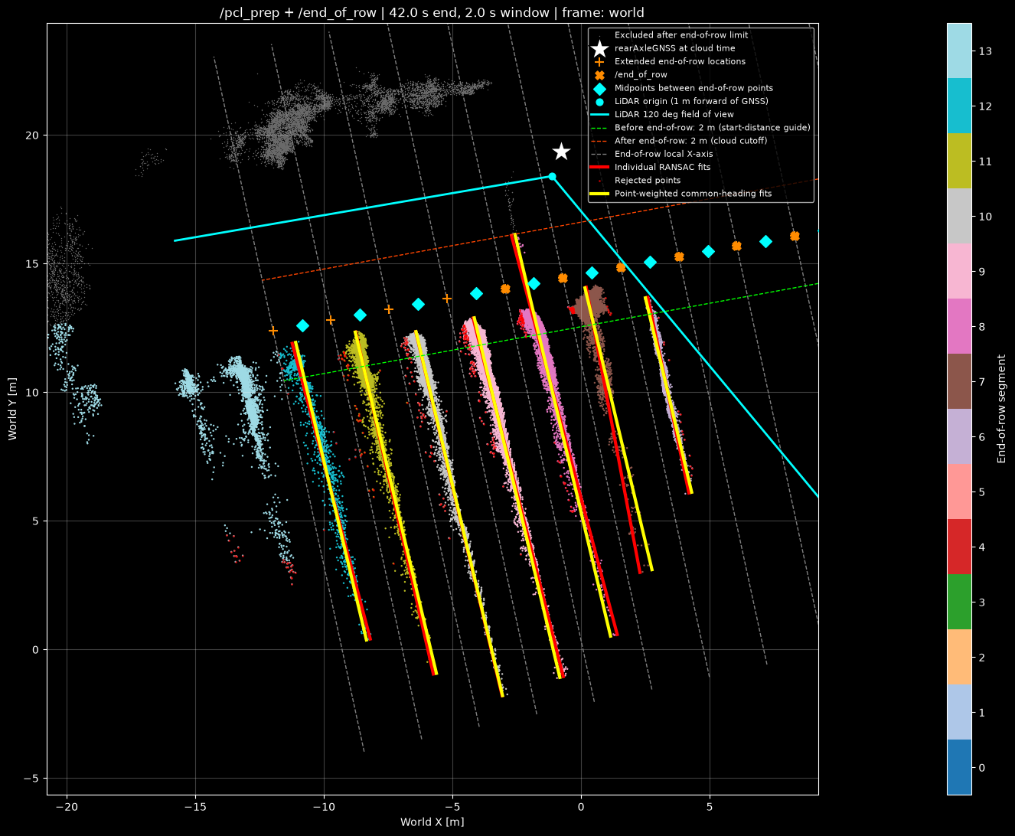
RANSAC
Common heading fit
  Computes average heading
  Weighted by no. of inliers in each pcl

Slide 10
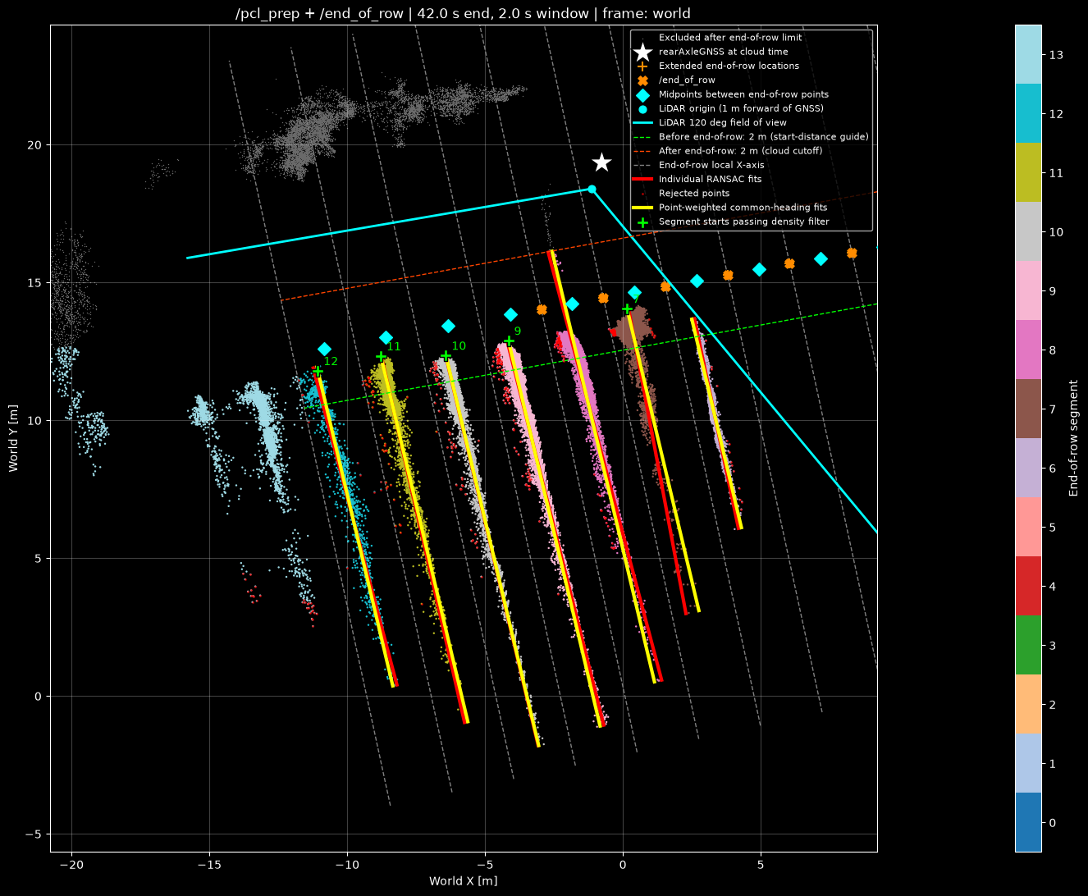
SoV
Find start of vines
  Find first point along common heading
  Remove if not in locally dense region
    5 points in 0.25m radius
  Remove if too close to LIDAR FoV boundary

Slide 11
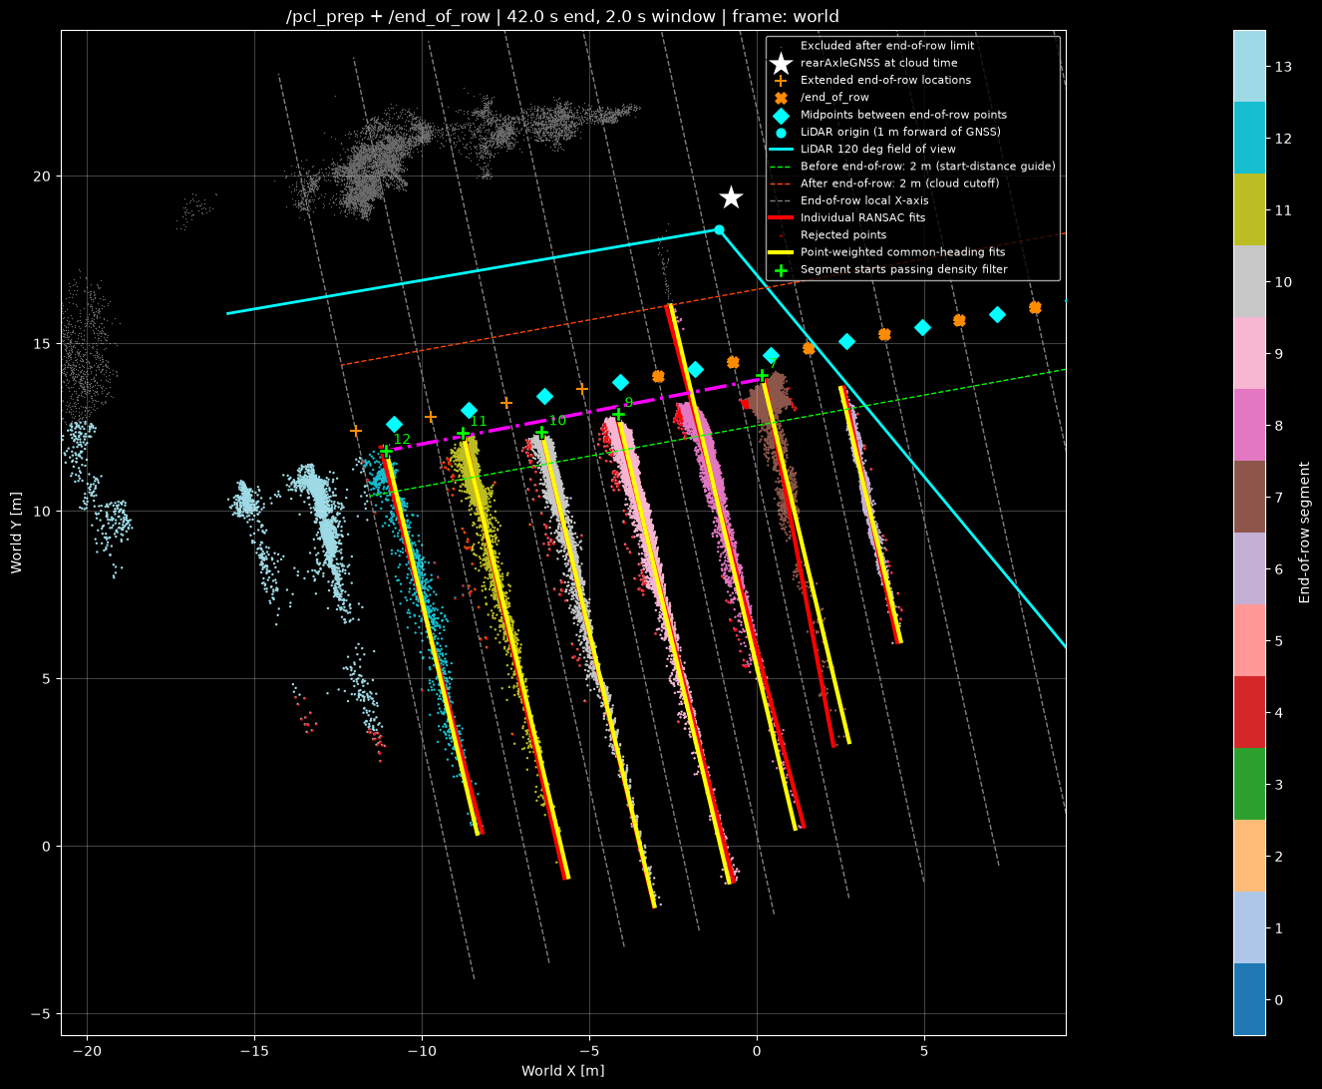
SoV Line
(Nearly) LS between all SoV
  Exclude 1 outlier IF NOT on headland side
OK like this, or can we think of something better?

Slide 12

metrics
Heading error
XY error

Slide 13
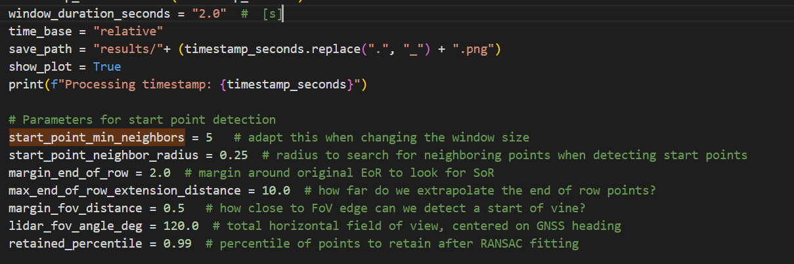
parameters
Tried to limit this

Slide 14
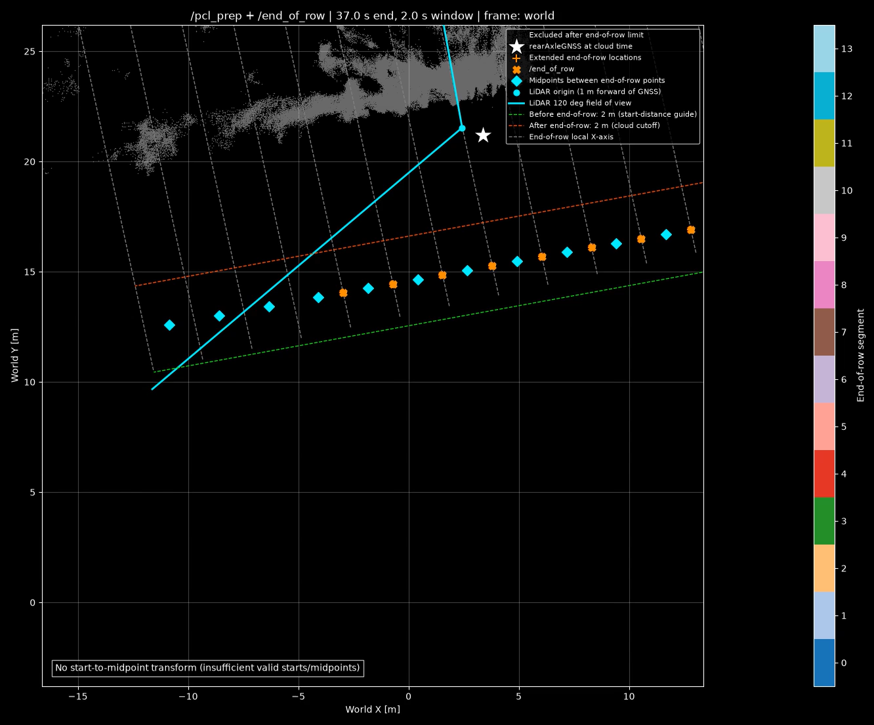
validation
Last Linden fieldtest
Compute time per pcl: [0.01 .. 2.6]s
  Linked to no. of PCL points
  Approx. linear with window

Slide 15
Next steps
SoV line fitting improvement?
Speed-up:
  Remove unnecessary computations
  Optimize RANSAC parameters
  RoI selection →
  Downsampling based on local density?
Track SoR over time?
Make node
Test on Jetson
???

Slide 16
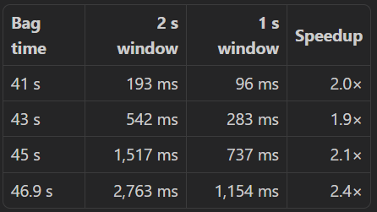
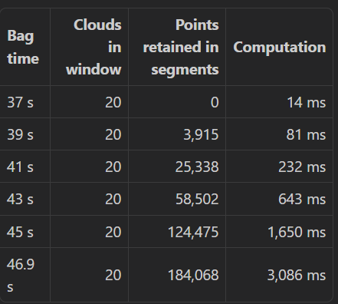
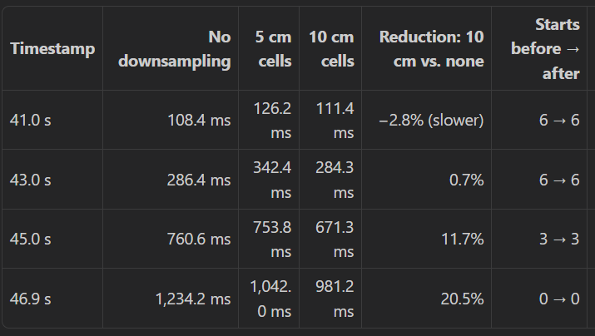
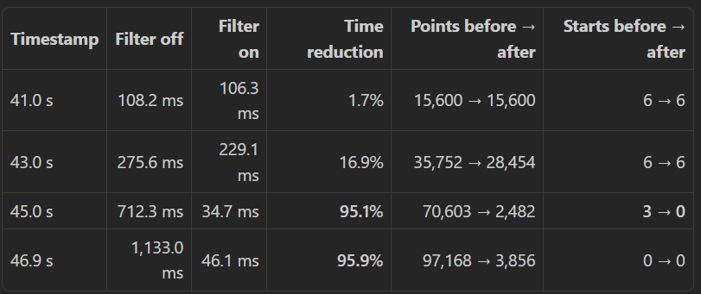
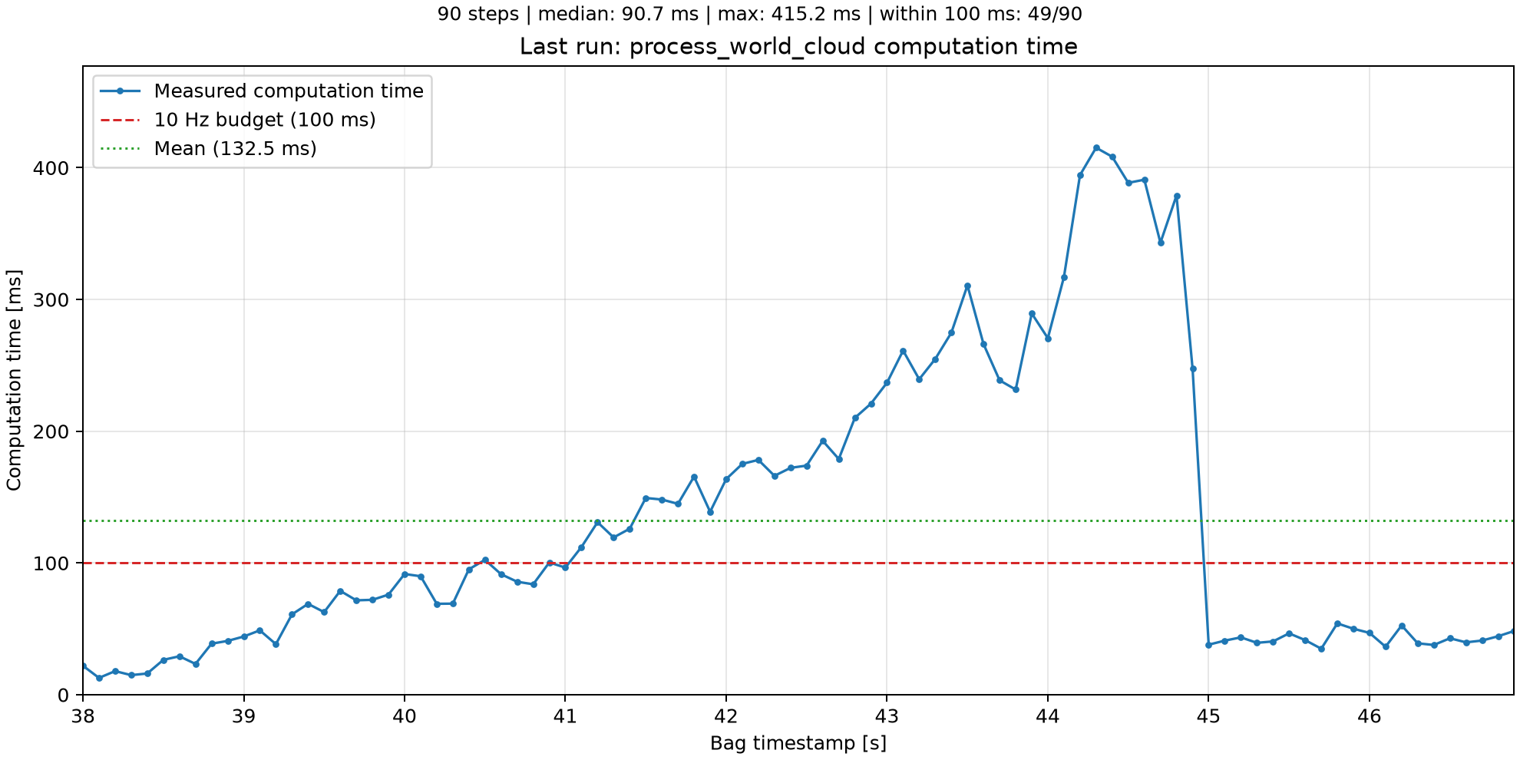
Speed-up
Reduce to 1s stitching window
Downsample dense regions for RANSAC (common) heading, use full pcl for SoVs
Remove segmented PCLs that cross the LIDAR FoV
Result
  Seems to be capped at <0.5s
  Good enough for now?

Slide 17
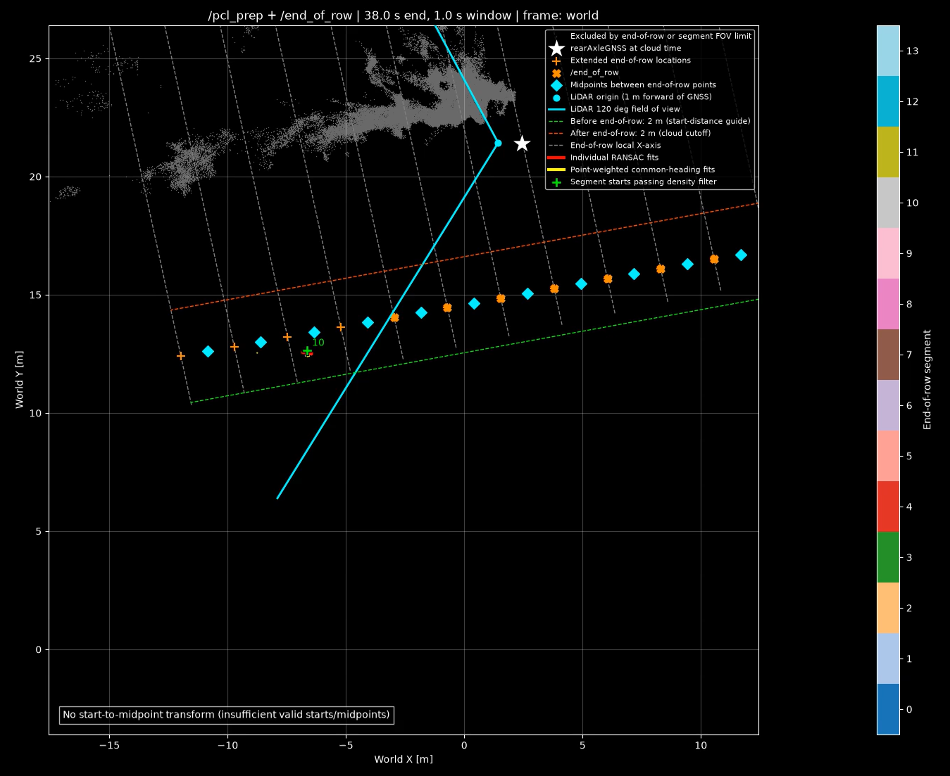
validation
Updated with speed-up improvements

Slide 18
Steps
2-step RANSAC
Rear axle validation

