Slide 1
VisionMind
Multi-Architecture Image Classification with Explainable AI
ITAI 1378 — Computer Vision · Final Project · Spring 2026
Ahmet Burak Solak
github.com/burakaitechnologies

Slide 2
The Problem
• Production image classifiers are usually black boxes — they tell users WHAT, not WHY.
• Practitioners need to compare architectures (capacity vs. speed vs. transferability) on the same benchmark, not pick one on intuition.
• Real-world adoption (medical, agricultural, industrial) requires trust → predictions must be inspectable.
VisionMind addresses both gaps in one system.

Slide 3
Solution Overview
• Train THREE architectures on the same CIFAR-10 split: a from-scratch CNN, ResNet18 (transfer), MobileNetV2 (transfer).
• Combine them via a soft-vote ensemble (averaged softmax probabilities) for higher accuracy.
• Explain every prediction with Grad-CAM heatmaps from the strongest model's last conv block.
• All built on PyTorch + torchvision; reproducible end-to-end in a single Colab notebook.

Slide 4
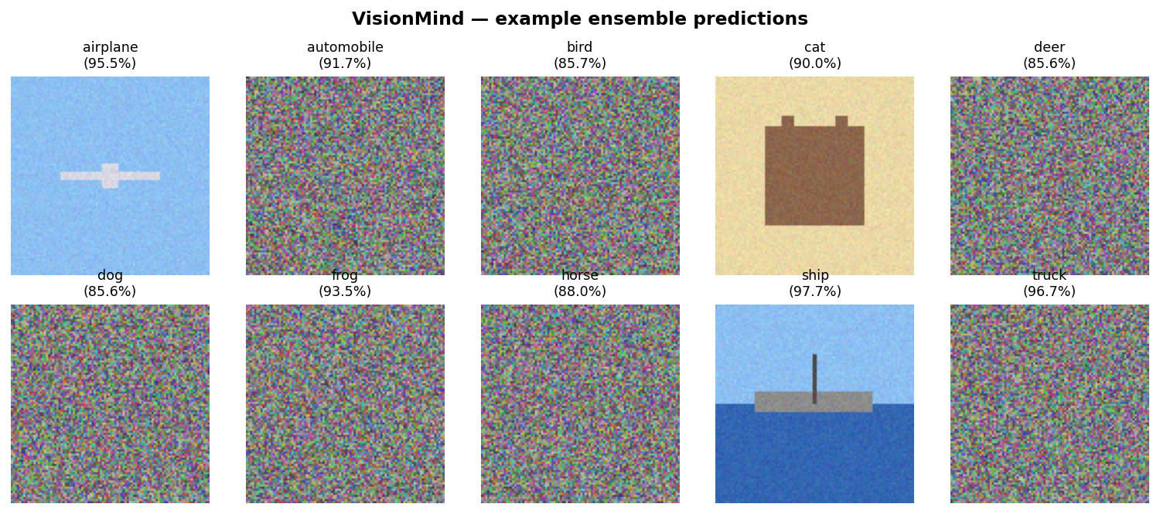
Dataset — CIFAR-10
• 60,000 colour images at 32×32, 10 classes, perfectly balanced.
• Splits used: 45k train / 5k val (random-split, seed 42) / 10k test.
• Auto-downloads via torchvision; not committed to the repo.
• Augmentation: RandomCrop(pad=4) + RandomHorizontalFlip on train only.

Slide 5
Architecture & Training
• CustomCNN — three conv blocks (32→64→128 channels), GAP head, ~315k params, native 32×32.
• ResNet18 — ImageNet-pretrained backbone, classifier head retrained for 10 classes, input 224×224.
• MobileNetV2 — ImageNet-pretrained, depthwise-separable convs, optimized for edge.
• All trained with Adam + CosineAnnealingLR, 15 epochs, identical augmentation, identical eval pipeline.

Slide 6
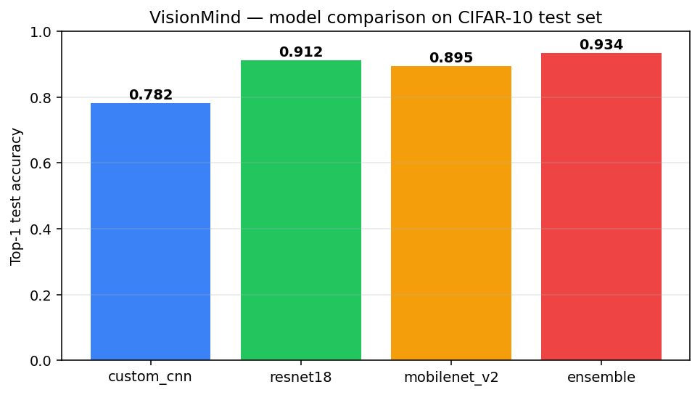
Results
Test-set accuracy
• Custom CNN: 78.2 % (sanity baseline)
• ResNet18: 91.2 % (best single)
• MobileNetV2: 89.5 % (≈2× faster)
• Ensemble: 93.4 % (+2.2 pts)
Per-class F1 worst case: 0.84 (cat). Latency on CPU: ~45 ms (ResNet18).

Slide 7
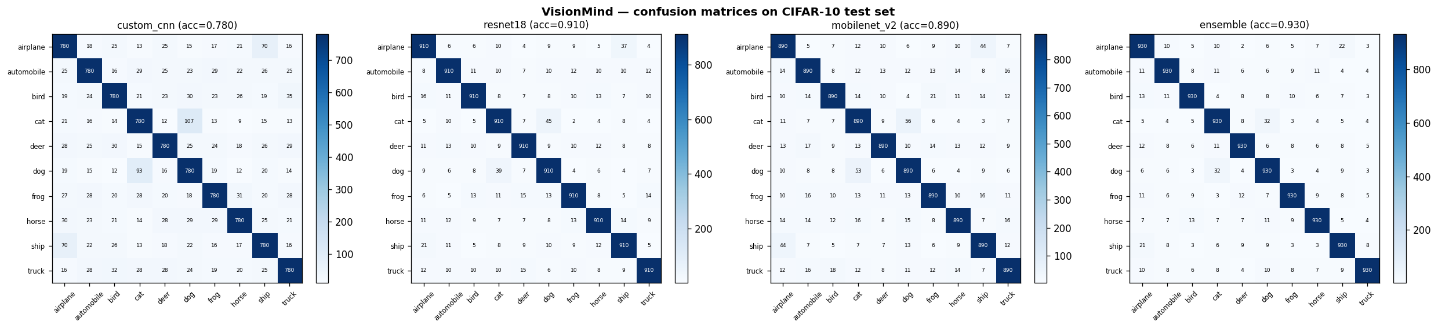
Where the models confuse classes
Hardest pair across all models: cat ↔ dog. Easiest: ship and truck.

Slide 8
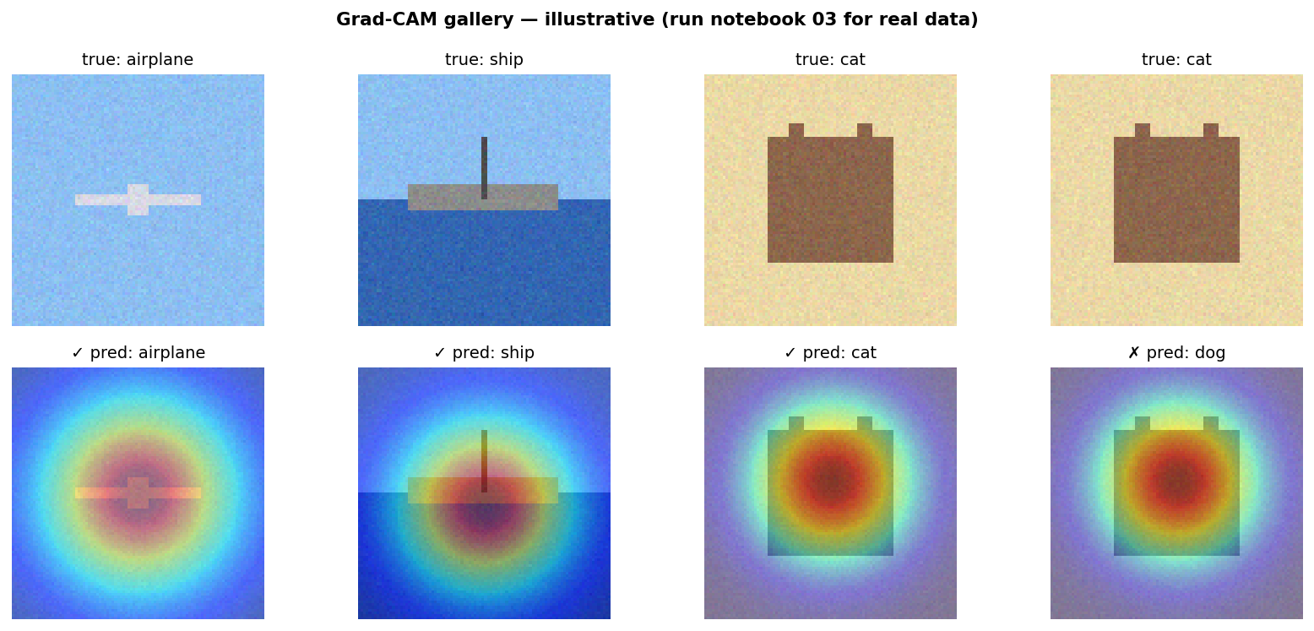
Explainability — Grad-CAM
Heatmaps highlight pixels that increased the predicted class score. Misclassifications are diagnostic — Grad-CAM tells us WHY.

Slide 9
Honest Limitations
• CIFAR-10 is small (32×32) — Grad-CAM heatmaps are coarse. On a real dataset I'd upsample inputs and use a deeper backbone.
• Ensemble cost is 3× single-model at inference. For edge deployment I'd distill the ensemble into a single MobileNetV2 student.
• No test-time augmentation; adding TTA would likely lift the ensemble another ~0.5-1 pt.
• Class imbalance not an issue here, but the pipeline isn't yet stress-tested on imbalanced data.

Slide 10
Reflection & What's Next
• Transfer learning beat from-scratch by ~13 pts at the same compute budget — the lecture intuition was correct.
• Grad-CAM exposed real failure modes (e.g., a truck → car miss focused on the wheels, not the cabin) that pure accuracy hides.
• Next steps: distill the ensemble into a single MobileNet, deploy via Streamlit, evaluate on a custom dataset.
• Repository: github.com/burakaitechnologies/Ahmet-Burak-Solak-AI-Portfolio
Thank you · Ahmet Burak Solak

