Slide 1

Credit Card Customer Analytics & Strategic Growth Model
Advanced Data Processing, Segmentation & Predictive Scenarios
Burak Canlı | 2026

Slide 2
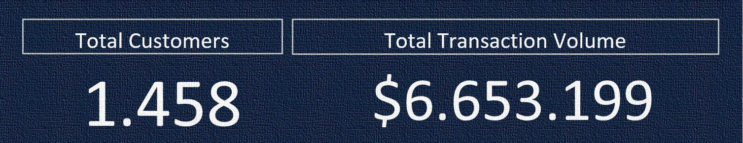
Comprehensive cleaning and algorithmic imputation of 10,000+ customer records.
Implementation of 5-Tier Strategic Customer Segmentation (VIP, Potential, Regular, At-Risk, Passive).
Data-driven financial simulation and automated C-Level dashboard architecture.
Executive Summary

Slide 3
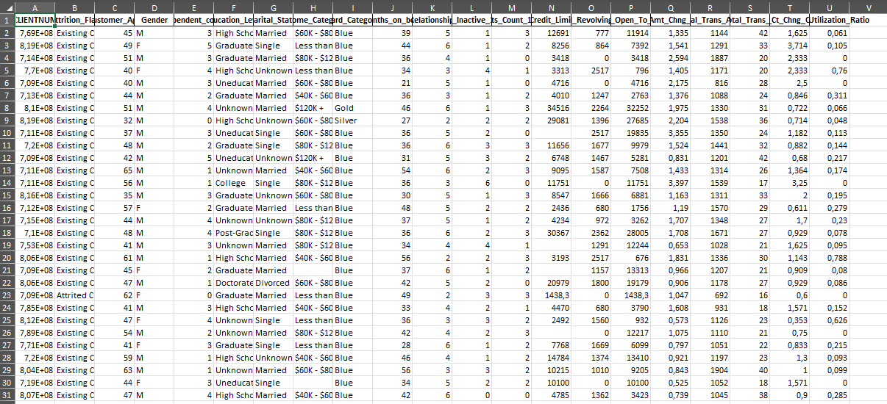
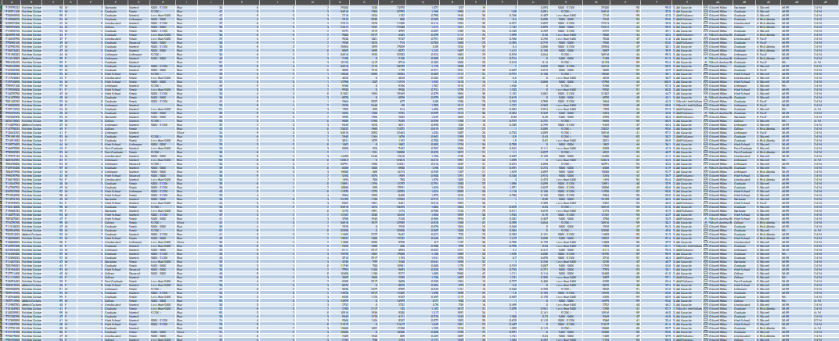
Outlier Treatment: Corrected anomalous age records (0 & 197) and negative credit limits using median imputation.
Standardization: Cleaned textual irregularities in education levels using TRIM and PROPER functions
Smart Imputation: Algorithmically resolved missing income brackets based on credit limits instead of raw deletion.
Before
After
Data Engineering & Hygiene

Slide 4
Algorithmic Hierarchy: Developed a multi-variable model combining transaction volume and frequency rather than simple spending.
VIP Identification: Successfully isolated high-value cardholders to prioritize retention campaigns.
Risk Mitigation: Grouped declining and inactive customers into targeted recovery brackets.
5-Tier Strategic Customer Segmentation

Slide 5
Age Distribution: Mapped customer density across age brackets (Age_Group).
Tenure Impact: Evaluated customer loyalty duration against churn rates
Actionable Insights: Discovered critical drop-off points in specific age tiers.
Count of CLIENTNUM | Column Labels
Row Labels | F | M | Grand Total
25-35 | 466 | 436 | 902
36-45 | 1977 | 1765 | 3742
46-55 | 2208 | 1952 | 4160
56+ | 707 | 616 | 1323
Grand Total | 5358 | 4769 | 10127
Demographics & Attrition Radar

Slide 6
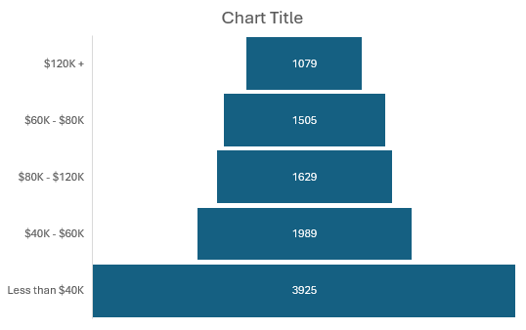
Core Driver Identification: The top 20% of card categories generate the vast majority of volume (Left Chart).
Funnel Analysis: Visualized the income bracket hierarchy to understand demographic purchasing power (Right Chart).
Pareto Revenue & Income Hiyerarchy

Slide 7
Monthly Transaction Volume
Average Credit Limit | 11111,11111
Credit Utilization Rate | 0,27
Expected Monthly Transaction Volume | 3000
Targeting: Simulated required average credit limits to achieve a baseline $3,000 monthly transaction volüme.
Mathematical Baseline: Identified $11,111 as the optimal credit limit threshold for target acquisition.
Strategic Constraint: Modeled dynamic limit adjustments for rapid executive decision-making.
Predictive Modeling: Goal Seek Simulation

Slide 8
2D Matrix Architecture: Cross-tabulated prospective credit limits against diverse utilization rates using Data Tables.
Dynamic Forecasting: Generated multiple potential revenue outcomes instantaneously without altering raw data.
Risk/Reward Balance: Provided a clear strategic roadmap for limit enhancement campaigns.
What-If Analysis: Scenario Matrix

Slide 9

One-Click Refresh: Implemented VBA macro scripting for automated end-to-end data pipeline updates.
Dynamic Interactivity: Integrated Slicers and offset parameters for real-time dashboard filtering.
Form Controls: Engineered an interactive risk-premium toggle using Checkbox and dynamic arrays.
System Architecture & VBA Automation

Slide 10

Pareto analysis shows a massive dependency on the Top 20% cardholder tier.
Launch a "Premium Concierge" program with zero-fee transactions for high-volume users.
Securing the core revenue stream and increasing lifetime value (LTV) by 15%.
%20
Strategy 1: VIP Retention & Loyalty Program

Slide 11

High attrition rate detected in the 36-45 age group (mid-tenure).
Deploy automated "We Miss You" email sequences and temporary cashback incentives for inactive segments.
Reduce the monthly churn rate by 4% within the first quarter.
Strategy 2: Proactive Churn Prevention

Slide 12

Underutilized credit limits in the "Potential" segment are bottlenecking transaction volume.
Gradually increase the average credit limit to $11,111 for targeted low-risk profiles, as simulated in Goal Seek.
Achieve the $3,000 baseline transaction volume goal and boost interest revenue.
Strategy 3: Credit Limit Optimization

