Slide 1

Massachusetts Sales Territory Analysis
EmporiUm in-store sales, 2022 – 2025
Burak Colak · Capstone 1
Notes:
Hi everyone, I'm Burak Colak. This is my Capstone 1 project: a sales territory analysis of the Massachusetts in-store territory for EmporiUm. I'll walk through each of the manager's questions, show my Excel charts, and finish with a recommendation.

Slide 2

Agenda
ROADMAP
1
My approach and how the data connects
2
Whole database and Massachusetts snapshot
3
Revenue by month and the regional comparison
In-store sales
Massachusetts
Jan 2022 – Dec 2025
4
Categories and store ranking
5
Trends, relationships and seasonality
6
Findings and recommendation
Notes:
Here's the plan. First my approach and how the database fits together. Then a snapshot of the whole database and of Massachusetts. Then revenue by month and the regional comparison, categories and stores, trends, relationships and seasonality, and finally my findings and recommendation.

Slide 3



Scenario: a bookstore chain, one territory
THE BUSINESS
Sold in stores and online
THE BUSINESS
EmporiUm sells textbooks, technology, art supplies and apparel, in stores and online.
MY TERRITORY
Split by region and sales territory
Massachusetts: 18 in-store locations in the Northeast region.
THE QUESTION
Textbooks, technology, art, apparel and more
How is the territory performing, and where should sales focus next quarter?
Notes:
EmporiUm is a growing student bookstore chain that also sells technology, art supplies and apparel, in stores and online. I was assigned Massachusetts, an in-store territory in the Northeast region.

Slide 4





My approach: five steps
METHOD
STEP 1
STEP 2
STEP 3
STEP 4
STEP 5
Explore
Query
Verify
Investigate
Chart & recommend
Learn each table and how the tables connect
One SQL script with a query per question
Every result checked against $5,733,256.27 and 42,010 transactions
Dig into the 2025 jump: price, volume or mix?
Two Excel PivotCharts, then a recommendation
Control totals used in every check: $5,733,256.27 revenue · 42,010 transactions · 18 stores
Notes:
My approach had five steps. First, I loaded the database and explored each table to see how they connect. Second, I wrote one SQL script with a query for each question. Third, I checked every result against control totals. Fourth, when I saw a big jump in 2025, I dug into why. Finally, I built PivotCharts in Excel and turned the evidence into a recommendation.

Slide 5
How the tables connect
DATA MODEL
Store_Locations
Management
StoreId, StoreLocation, State
State
State, Region,
SalesManager
Store_ID = StoreId
Store_Sales
Store_ID, Prod_Num,
Sale_Amount, Transaction_Date
Prod_Num = ProdNum
Products
Inventory_Categories
ProdNum, Product, Categoryid
Categoryid
Categoryid, Category
Every query follows one of two paths: sale → store → state → region, or sale → product → category.
Notes:
This is how the tables connect. Store sales link to store locations by store ID, which gives me the state, and the state links to the management table, which gives me the region. Store sales also link to products by product number, and products link to categories. Every query I wrote follows one of these two paths.

Slide 6
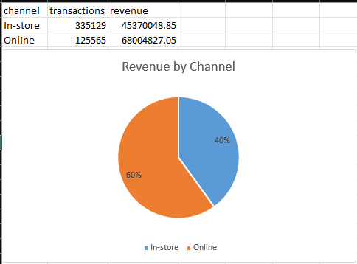

Whole database at a glance
SUMMARY STATS · WHOLE DATABASE
$113.4M
460.7K
Total revenue
Transactions
111
669
Stores in 10 states
Products, 6 categories
Notes:
Across the whole database there is about 113 million dollars in revenue, from roughly 460 thousand transactions between January 2022 and December 2025. Sixty percent of that revenue is online and forty percent is in-store, across 111 stores in 10 states. Technology and Accessories alone is about two thirds of all revenue.

Slide 7
Q1 · Massachusetts at a glance
SUMMARY STATS · TERRITORY
$5.73M
42,010
18
$136
Total revenue
Transactions
Stores
Average sale
In-store only
Jan 2022 – Dec 2025
Across Massachusetts
Per transaction
Jan 1, 2022 – Dec 31, 2025
Top store: Worcester
Lowest store: Lowell
Four full years of data
$602K, the largest of 18
$267K, ranked 18th
Notes:
Question one: total revenue. Massachusetts brought in 5.73 million dollars over the four years, from January 1st 2022 to December 31st 2025. That's 42,010 transactions across 18 stores, with an average sale of 136 dollars.

Slide 8
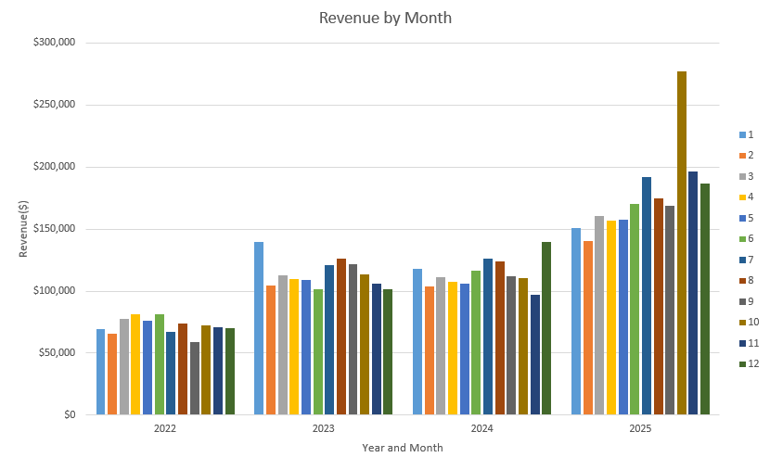
Q2 · Revenue by month: a big step up in 2025
REVENUE BY YEAR AND MONTH
$0.86M
Revenue in 2022
$1.37M
Revenue in 2023
$1.37M
Revenue in 2024
$2.13M
Revenue in 2025
Notes:
Question two: revenue by year and month. Annual revenue grew from 864 thousand dollars in 2022 to 1.37 million in 2023, stayed almost flat in 2024, then jumped to 2.13 million in 2025. Within 2025, October was the biggest month at 277 thousand dollars.

Slide 9
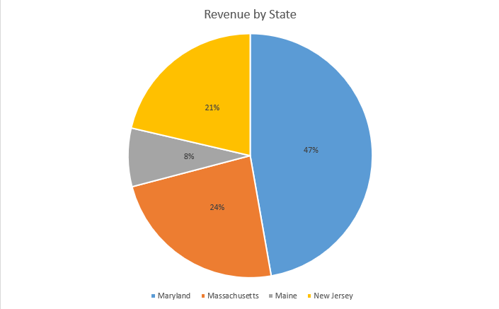
Q3 · Massachusetts is 23.65% of the Northeast
COMPARATIVE ANALYSIS
23.65%
of Northeast revenue
$5.73M
Massachusetts revenue
Northeast total: $24.24M
#2 of 4
Northeast states by revenue
Maryland leads
Notes:
Question three: the regional comparison. Massachusetts is 23.65 percent of the Northeast's 24.2 million dollars, second to Maryland, which has 47 percent from only 9 stores. Across all ten in-store states, Massachusetts ranks third, and the Northeast as a whole is 53 percent of in-store revenue.

Slide 10
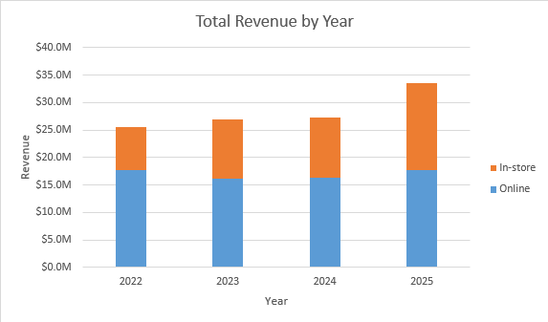

Whole database: 2025 growth came from the stores
TREND · WHOLE DATABASE
+47%
In-store revenue, 2025 vs 2024
+8%
Online revenue, 2025 vs 2024
$25.6M
$33.6M
Total revenue in 2022
Total revenue in 2025
Notes:
Company-wide, revenue grew every year, from 25.6 million dollars in 2022 to 33.6 million in 2025. The 2025 jump came from the stores, which grew 47 percent. Online sales only grew 8 percent.

Slide 11
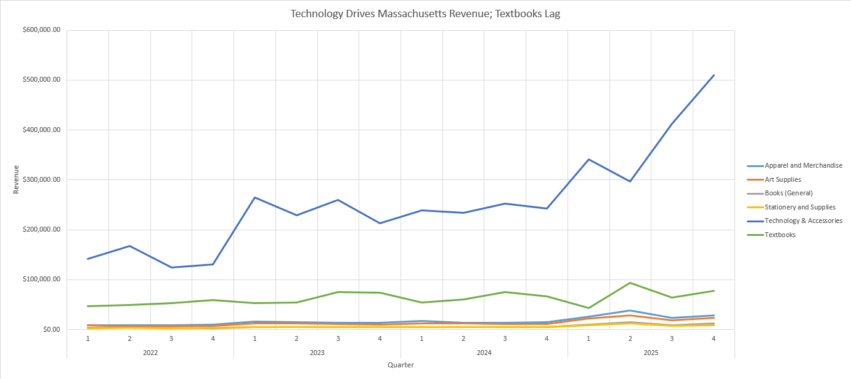
Technology surges in 2025; Textbooks stay flat
TREND · TERRITORY
Notes:
This is my PivotChart, quarterly revenue by category for Massachusetts. Technology and Accessories is the top line and surges to about 510 thousand dollars in Q4 2025, nearly double Q4 of 2024. Textbooks stay flat. The four cheaper categories sit near the bottom because each sale is small.

Slide 12
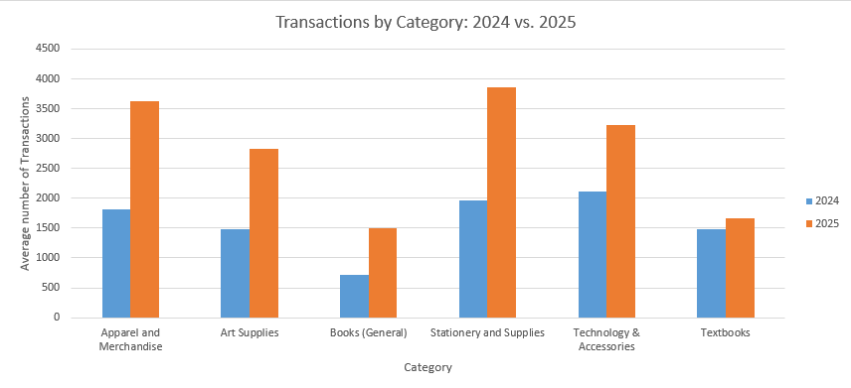
Q4 · Cheap categories doubled; Textbooks barely moved
TRANSACTIONS AND AVERAGE SALE BY CATEGORY
Notes:
Question four: transactions and average sale by category. Here's 2024 against 2025. The four cheap categories each roughly doubled their transactions, and their average prices barely changed. Technology grew 52 percent and its average sale rose to 485 dollars. Textbooks grew only 12 percent, and their average sale slipped a little.

Slide 13

Why 2025 jumped: volume and a shift to cheaper items
TREND ANALYSIS
+55.4%
Revenue
$1.37M → $2.13M
+74.1%
Transactions
9,585 → 16,683
−10.7%
Average sale
$143.09 → $127.77
Notes:
So what happened in 2025? Massachusetts revenue rose 55 percent, but the average sale fell almost 11 percent. The reason is volume: transactions grew 74 percent. Prices didn't drop. Instead, cheap categories like apparel, art supplies, books and stationery roughly doubled their transactions, which pulled the average down..

Slide 14
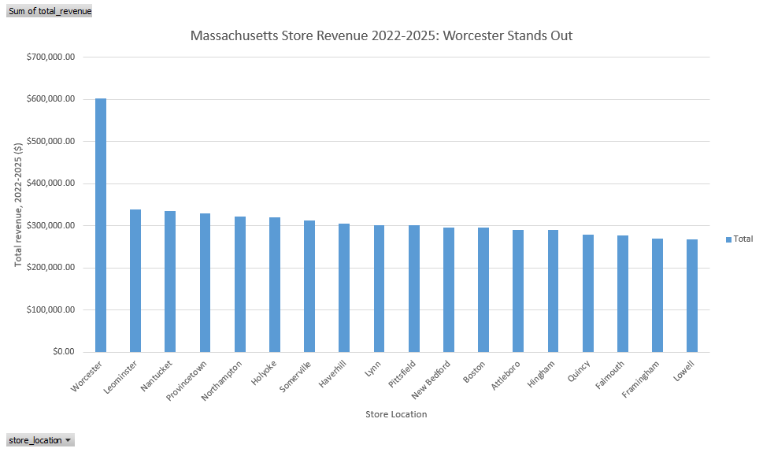
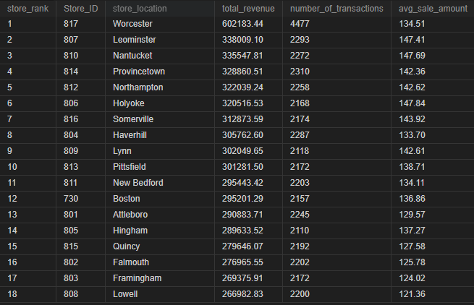
Q5 · Worcester leads; the lowest four sell smaller baskets
STORE RANKING · PIVOTCHART 2
Notes:
Question five: the store ranking. Worcester is first at 602 thousand dollars, with about twice the transactions of any other store. The rest are tightly bunched between 267 and 338 thousand. The four lowest, Lowell, Framingham, Falmouth and Quincy, have normal traffic but a lower average sale, 125 dollars compared with 140 elsewhere.

Slide 15
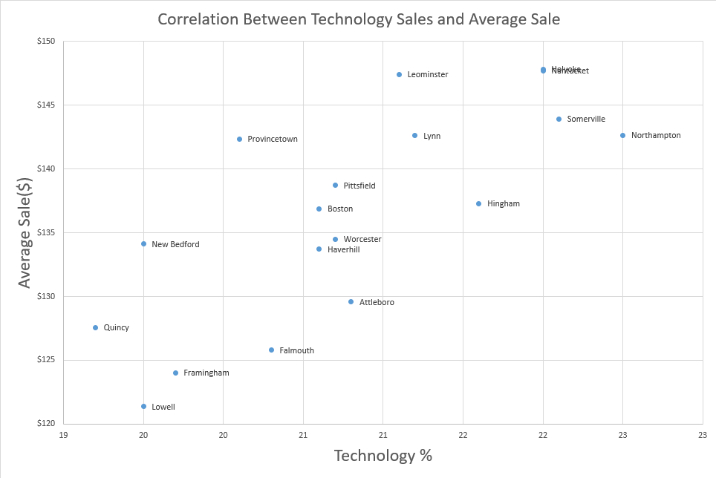
Lowest four stores: less technology, smaller baskets
RELATIONSHIP ANALYSIS
$139.58
$124.68
Lowest avg sale: Lowell
Lowest avg sale: Lowell
22.5%
Highest Technology Mix:
Northampton
19.2%
Lowest Technology Mix:
Quincy
Notes:
This chart shows the relationship between technology sales and store performance. Stores with a lower technology mix, like Quincy at 19.2%, tend to have lower average sales, while stores with a higher technology mix, like Northampton at 22.5%, generally perform better. This suggests that selling more Technology & Accessories can help increase basket size and improve revenue.

Slide 16
Textbooks are weakest in Q1 every year
SEASONALITY
−18.8%
Textbook revenue, Q1 2025 vs Q1 2024
< 25%
Q1 share of textbook revenue
in all four years
+110%
Technology revenue, Q4 2025 vs Q4 2024
$243K → $510K
Notes:
Next quarter is January to March. Textbooks are weakest in the first quarter in every year: their Q1 share of annual revenue is below 25 percent each year, and in 2025 Q1 textbook revenue fell 19 percent from the year before. Technology, on the other hand, ended 2025 with real momentum, up about 110 percent in the fourth quarter.

Slide 17



What the data says
FINDINGS
2025 revenue +55%
Driven by transaction volume (+74%), not by price changes
Technology is ~73% of revenue
Highest average sale ($485) and still accelerating
Cheap categories doubled
Four low-ticket categories add little revenue despite +92% to +110% volume
Textbooks lag
+12% transactions in 2025; Q1 is the weakest quarter every year
Lowest stores sell smaller baskets
Lowell, Framingham, Falmouth, Quincy: lower technology share, lower average sale
Notes:
Let me summarize. Massachusetts grew 55 percent in 2025, driven by volume, not price. Technology is about 73 percent of revenue and still accelerating. Textbooks lagged, with a weak first quarter every year. And the lowest stores have a lower average sale because they sell relatively less technology.

Slide 18
Recommendation: protect Technology, fix Q1 textbooks
RECOMMENDATION
1
2
3
Protect and extend Technology & Accessories
Run a textbook promotion in Q1
Lift the average sale at the lowest four stores
~73% of revenue, highest average sale, +110% in Q4 2025
Weakest category in its weakest quarter; Q1 2025 revenue fell 19%
Lowell, Framingham, Falmouth, Quincy: less technology, smaller baskets
How I reached it
Caveat
2025 jump → category mix → seasonality → stores
Data ends in Dec 2025. Recheck these trends with newer data before acting.
Each step narrowed the question until one action per level was clear.
Notes:
My recommendation: protect and extend Technology next quarter, since it's the biggest revenue driver. Second, run a textbook promotion in Q1, the weakest category in its weakest quarter. Third, focus on Lowell, Framingham, Falmouth and Quincy, where raising the average sale through technology has the most upside. I reached this by following the evidence: first the 2025 jump, then the category mix, then seasonality, then stores. The caveat is that the data ends in December 2025, so these trends should be rechecked with newer data. Thank you.

