Slide 1

Massachusetts Sales Territory Analysis
EmporiUm in-store sales, 2022 – 2025
Burak Colak · Capstone 1
Date 11/06/2026
Notes:
Hi everyone, I'm Burak Colak. Today I'll walk you through my sales territory analysis for Massachusetts.

Slide 2

Agenda
ROADMAP
Scenario and the whole database
1
Massachusetts at a glance
2
Comparing to the Northeast region
In-store sales
Massachusetts
Jan 2022 – Dec 2025
3
Trends and relationships
4
Findings and recommendation
5
Notes:
I'll start with the scenario and the whole database, then zoom in on Massachusetts, compare it to its region, look at trends and relationships, and finish with my recommendation.

Slide 3



Scenario: a bookstore chain, one territory
THE BUSINESS
Sold in stores and online
THE BUSINESS
EmporiUm sells textbooks, technology, art supplies and apparel, in stores and online.
MY TERRITORY
Split by region and sales territory
Massachusetts: 18 in-store locations in the Northeast region.
THE QUESTION
Textbooks, technology, art, apparel and more
How is the territory performing, and where should sales focus next quarter?
Notes:
EmporiUm is a student bookstore chain that sells textbooks, technology, art supplies and more, in stores and online. I'm the analyst for the Massachusetts in-store territory, part of the Northeast region. The sales manager wants to know how the territory is performing and where to focus next quarter.

Slide 4
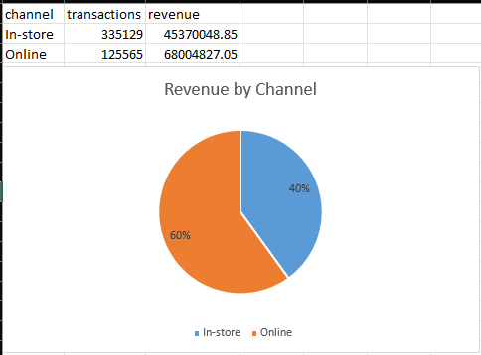

Whole database at a glance
SUMMARY STATS · WHOLE DATABASE
$113.4M
460.7K
Total revenue
Transactions
111
669
Stores in 10 states
Products, 6 categories
Notes:
Across the whole database there is about 113 million dollars in revenue, from roughly 460 thousand transactions between January 2022 and December 2025. Sixty percent of that revenue is online and forty percent is in-store, across 111 stores in 10 states.

Slide 5
Massachusetts at a glance
SUMMARY STATS · TERRITORY
$5.73M
42,010
18
$136
Total revenue
Transactions
Stores
Average sale
In-store only
Jan 2022 – Dec 2025
Across Massachusetts
Per transaction
Jan 1, 2022 – Dec 31, 2025
Top store: Worcester
Lowest store: Lowell
Four full years of data
$602K, the largest of 18
$267K, ranked 18th
Notes:
Massachusetts has 18 stores and brought in 5.73 million dollars from 42 thousand transactions, with an average sale of 136 dollars.. Worcester is the top store at 602 thousand dollars.

Slide 6
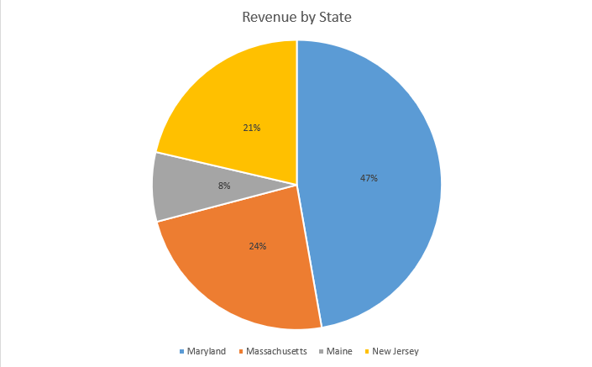
Comparison: 23.65% of the Northeast region
COMPARATIVE ANALYSIS
23.65%
of Northeast revenue
$5.73M
Massachusetts revenue
Northeast total: $24.24M
#2 of 4
Northeast states by revenue
Maryland leads
Notes:
Massachusetts is the second-largest of the four Northeast states, with 23.65 percent. Maryland leads with 47 percent.

Slide 7
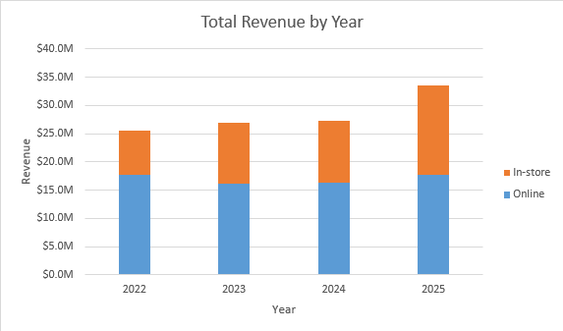

Whole database: 2025 growth came from the stores
TREND · WHOLE DATABASE
+47%
In-store revenue, 2025 vs 2024
+8%
Online revenue, 2025 vs 2024
$25.6M
$33.6M
Total revenue in 2022
Total revenue in 2025
Notes:
Company-wide, revenue grew every year, from 25.6 million dollars in 2022 to 33.6 million in 2025. The 2025 jump came from the stores, which grew 47 percent. Online sales only grew 8 percent.

Slide 8
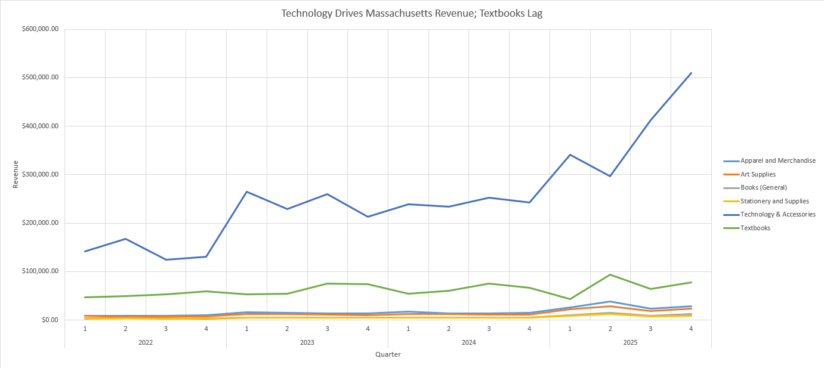
Technology surges in 2025; Textbooks stay flat
TREND · TERRITORY
Notes:
This is my PivotChart, quarterly revenue by category for Massachusetts. Technology and Accessories is the top line and surges to about 510 thousand dollars in Q4 2025, nearly double Q4 of 2024. Textbooks stay flat. The four cheaper categories sit near the bottom because each sale is small.

Slide 9
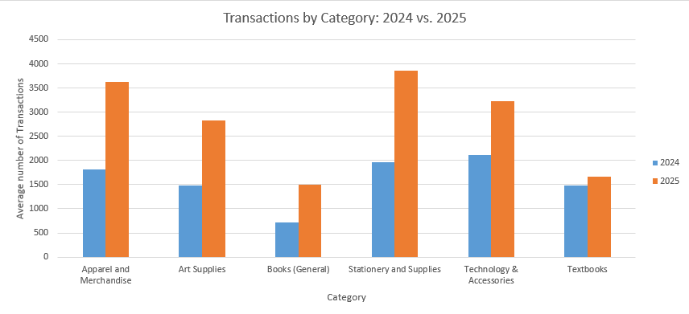

Why 2025 jumped: volume and a shift to cheaper items
TREND ANALYSIS
+55.4%
Revenue
$1.37M → $2.13M
+74.1%
Transactions
9,585 → 16,683
−10.7%
Average sale
$143.09 → $127.77
Notes:
So what happened in 2025? Massachusetts revenue rose 55 percent, but the average sale fell almost 11 percent. The reason is volume: transactions grew 74 percent. Prices didn't drop. Instead, cheap categories like apparel, art supplies, books and stationery roughly doubled their transactions, which pulled the average down. Technology grew 52 percent, and its average sale actually went up.

Slide 10
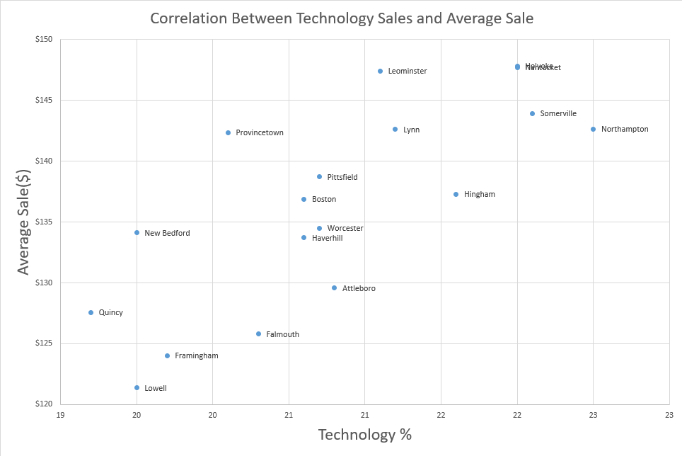
Lowest four stores: less technology, smaller baskets
RELATIONSHIP ANALYSIS
$139.58
$124.68
Lowest avg sale: Lowell
Lowest avg sale: Lowell
22.5%
Highest Technology Mix:
Northampton
19.2%
Lowest Technology Mix:
Quincy
Notes:
This chart shows the relationship between technology sales and store performance. Stores with a lower technology mix, like Quincy at 19.2%, tend to have lower average sales, while stores with a higher technology mix, like Northampton at 22.5%, generally perform better. This suggests that selling more Technology & Accessories can help improve revenue.

Slide 11
Findings and recommendation
FINDINGS & RECOMMENDATIONS
What I found
Recommendation
2025 revenue jumped 55%, driven by volume (+74%), not price
1
Protect and extend Technology & Accessories
Technology is ~73% of revenue and still accelerating
2
Run a textbook promotion in Q1
Textbooks lag: +12% transactions, weakest in Q1 every year
3
Lift the average sale at Lowell, Framingham, Falmouth and Quincy
Lowest stores sell less technology, so their average sale is lower
Notes:
My recommendation is to focus on Technology and Accessories next quarter, since it's about 73 percent of revenue and still accelerating. I'd also run a textbook promotion in Q1, because textbooks grew only 12 percent in transactions and Q1 is their weakest quarter every year. Stores like Lowell, Framingham, Falmouth and Quincy have the most room to lift their average sale. One caveat: the data ends in December 2025, so these trends should be rechecked with newer data. Thank you, I'm happy to take questions.

Slide 12
THANK YOU FOR LISTENING
EmporiUm in-store sales, 2022 – 2025
Burak Colak · Capstone 1
Date 11/06/2026
Notes:
Hi everyone, I'm Burak Colak. Today I'll walk you through my sales territory analysis for Massachusetts.

