Slide 1

MACHINE LEARNING WITH TIDY MODELS
Burak Dilber, fırat özdemir
January 21, 2020

Slide 2
OUTLINE
Introduction
The Developers of Tidymodels
Websites & Meetings & Workshops & Conferences
Tidymodels Packages
Why Should Tidymodels be Preferred?
What Makes a Model?
Application
Conclusion

Slide 3


INTRODUCTION
Reuse existing data structures
Compose simple functions with the pipe.
Embrace functional programming.
Design for humans.
Encourage empirical validation and good methodology.
Smooth out diverse interfaces.
Build highly reusable infrastructure.
Enable a wider variety of methodologies.

Slide 4
INTRODUCTION
The focus is on an R dialect called tidyverse that is designed to be a better interface for common tasks using R.
tidymodels explains how tidyverse can be used to produce high quality models.
The tools used to do this are called tidymodels packages.
Tidymodels packages have been used to promote good methodology and statistical practice.

Slide 5
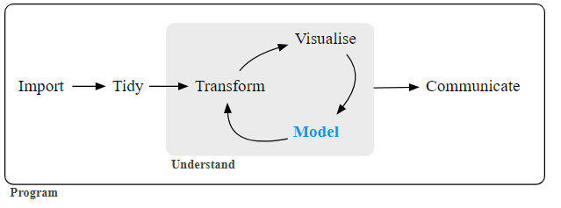
INTRODUCTION
There are two reasons that models permeate our lives today:
an abundance of software exists to create models and
it has become easier to record data and make it accessible.

Slide 6
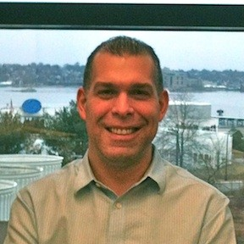


THE DEVELOPERS OF TIDYMODELS
MAX KUHN
HADLEY WICKHAM
DAVIS VAUGHAN

Slide 7
https://www.tmwr.org/
Tidy Modeling with R
MAX KUHN AND JULIA SILGE
Hello World
Basics
Tools for Creating Effective Models

Slide 8
https://github.com/tidymodels
tidymodels
tmwr
tidymodels.org

Slide 9

MEETUP
R-Ladies Columbus Monthly Meetup
LA R Users: June Meeting
Date: November 20, 2020
The tidymodels framework mentioned modeling and machine learning packages using tidyverse principles.
Speaker: Ezgi Karaesmen
Date: June 30, 2020
Title: Three reasons to use tidymodels
Speaker: Julia Silge

Slide 10
WORKSHOP
Rstudio::conf (January 27-28, 2020)
Title: Introduction to Machine Learning with the Tidyverse
This workshop provided a gentle introduction to machine learning and to tidymodels.
Speaker: Alison Hill
https://conf20-intro-ml.netlify.app/

Slide 11
RSTUDIO::CONF 2018
Fireside Chat: Tidyverse Discussion
Speakers: Jenny Bryan | Mine Çetinkaya-Rundel | Max Kuhn | Hadley Wickham | Mara Averick |
Date: March 5, 2018
https://rstudio.com/resources/rstudioconf-2018/fireside-chat-tidyverse-discussion/

Slide 12




TIDYMODELS PACKAGES
Pre – Process
Train
Validate

Slide 13

WORKFLOWS
Managing both a 'parsnip' model and a preprocessor, such as a model formula or recipe from 'recipes', can often be challenging. The goal of 'workflows' is to streamline this process by bundling the model alongside the preprocessor, all within the same object.

Slide 14

TUNE
The ability to tune models is important. 'tune' contains functions and classes to be used in conjunction with other 'tidymodels' packages for finding reasonable values of hyper-parameters in models, pre-processing methods, and post-processing steps.

Slide 15

BROOM
Tidy ()
Glance ()
Augment ()

Slide 16

DIALS
Many models contain tuning parameters (i.e. parameters that cannot be directly estimated from the data). These tools can be used to define objects for creating, simulating, or validating values for such parameters.

Slide 17
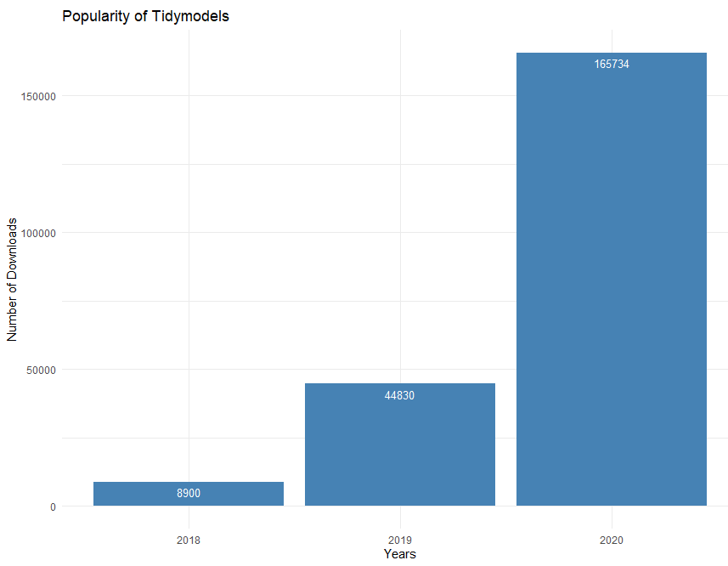
POPULARITY OF TIDYMODELS

Slide 18


WHY SHOULD TIDYMODELS BE PREFERRED?
TensorFlow™ is an open-source software library for Machine Intelligence. The R interface to TensorFlow lets you work productively using the high-level Keras and Estimator APIs and the core TensorFlow API.
Sparklyr provides bindings to Spark’s distributed machine learning library. Together with sparklyr’s dplyr interface, you can easily create and tune machine learning workflows on Spark, orchestrated entirely within R.
TENSORFLOW
SPARKLYR

Slide 19
WHY SHOULD TIDYMODELS BE PREFERRED?
keras
rstan
glmnet
C50
xgboost
rpart
kknn
ranger
randomForest
kernlab
liquidSVM

Slide 20

WHAT MAKES A MODEL?
Pick a model
Set the Mode (if needed)
Set the Engine

Slide 21

WHAT MAKES A MODEL?
Linear Regression

Slide 22

WHAT MAKES A MODEL?
Logistic Regression

Slide 23
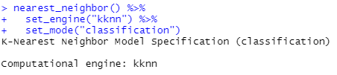
WHAT MAKES A MODEL?
K - Nearest Neighbor

Slide 24

APPLICATION - 1
Gas Turbine CO and NOx Emission Data Set
The dataset contains 36733 instances of 11 sensor measures aggregated over one hour, from a gas turbine located in Turkey for the purpose of studying flue gas emissions, namely CO and NOx.
Source:
Heysem Kaya, Department of Information and Computing Sciences, Utrecht University, 3584 CC, Utrecht, The Netherlands Pınar Tüfekçi, Çorlu Faculty of Engineering, Namık Kemal University, TR-59860 Çorlu, Tekirdağ, Turkey
https://archive.ics.uci.edu/ml/datasets/Gas+Turbine+CO+and+NOx+Emission+Data+Set

Slide 25
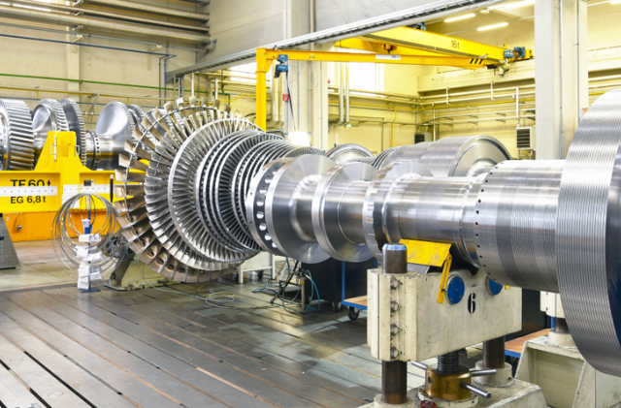
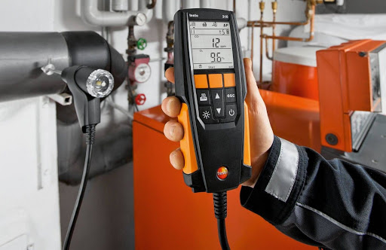
APPLICATION - 1
Gas Turbine
Emission Measuring Instrument

Slide 26
APPLICATION - 1
The data comes from the power plant used for predicting hourly net energy yield.
This data is collected in data range (01.01.2011 - 31.12.2015), includes gas turbine parameters (such as Turbine Inlet Temperature and Compressor Discharge pressure) in addition to the ambient variables.
The dataset can be well used for predicting turbine energy yield (TEY) using ambient variables as features.

Slide 27
APPLICATION - 1
The explanations of sensor measurements and their brief statistics are given below.
Ambient temperature (AT) C
Ambient pressure (AP) mbar
Ambient humidity (AH) (%)
Air filter difference pressure (AFDP) mbar
Gas turbine exhaust pressure (GTEP) mbar
Turbine inlet temperature (TIT) C
Turbine after temperature (TAT) C
Compressor discharge pressure (CDP) mbar
Turbine energy yield (TEY) MWH
Carbon monoxide (CO) mg/m3
Nitrogen oxides (NOx) mg/m3

Slide 28
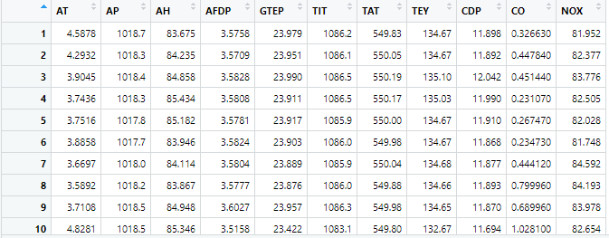

APPLICATION - 1
.
.
.

Slide 29
APPLICATION - 1
Algorithms
Linear Regression
Boosted Trees
Decision Tree
K- Nearest Neighbor
Random Forest
Support Vector Machine

Slide 30
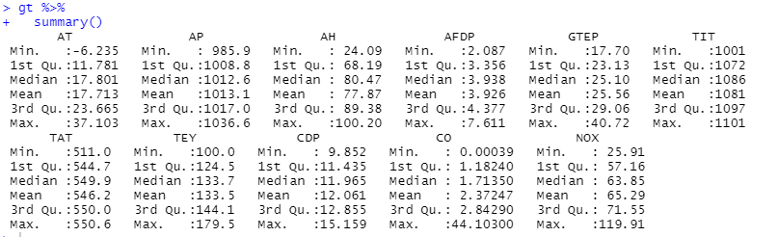
APPLICATION - 1
Summary Statistics

Slide 31
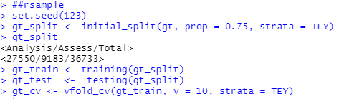
APPLICATION - 1
Training, Testing and Cross-Validation

Slide 32
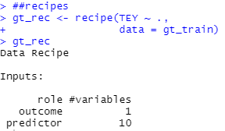
APPLICATION - 1

Slide 33
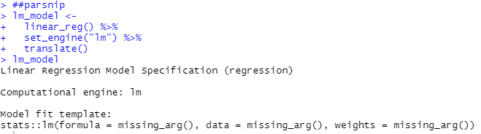
APPLICATION - 1
Linear Regression

Slide 34
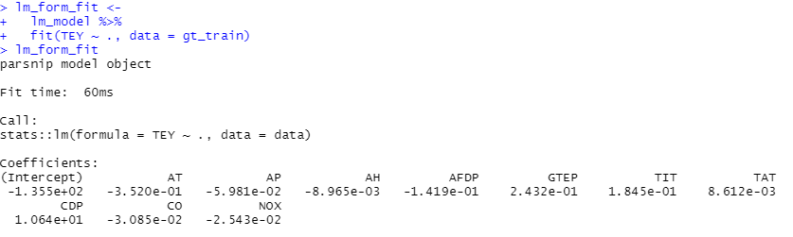
APPLICATION - 1
Linear Regression

Slide 35
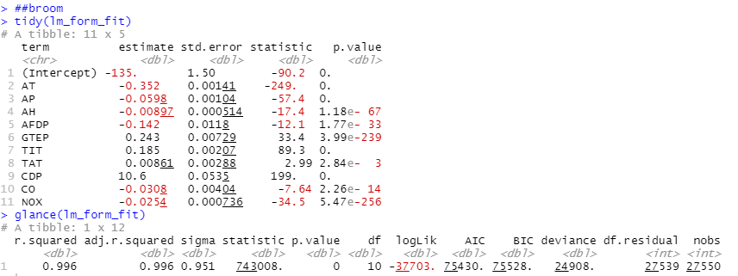
APPLICATION - 1

Slide 36
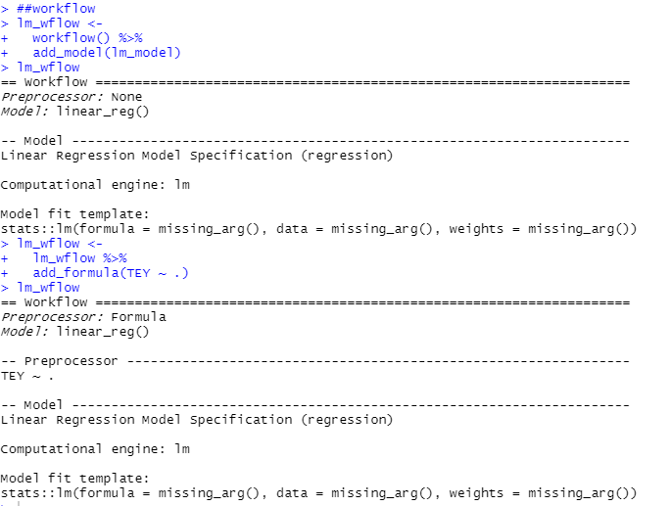
APPLICATION - 1
Workflows

Slide 37
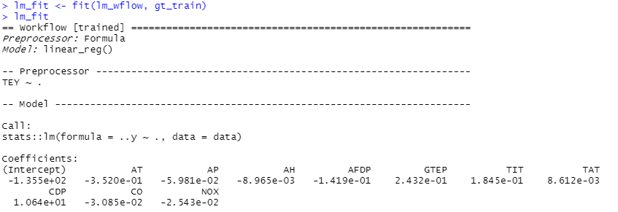
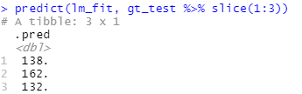
APPLICATION - 1

Slide 38
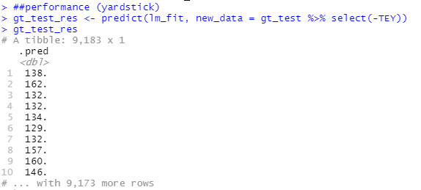
APPLICATION - 1

Slide 39
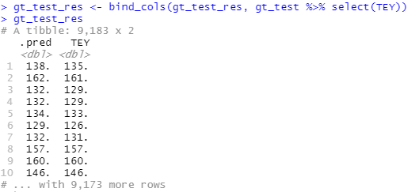
APPLICATION - 1

Slide 40
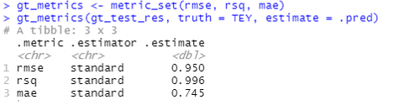
APPLICATION - 1
RMSE, R-Square, MAE

Slide 41
APPLICATION - 1
Algorithms | RMSE | R-Square | MAE | Time
Linear Regression | 0.950 | 0.996 | 0.745 | 60ms
Boosted Trees | 1.120 | 0.997 | 0.887 | 2s
Decision Tree | 3.080 | 0.961 | 2.210 | 1.3s
K – Nearest Neighbor | 1.140 | 0.995 | 0.725 | 33.8s
Random Forest | 0.621 | 0.998 | 0.436 | 3m 4.3s
Support Vector Machine | 0.958 | 0.996 | 0.758 | 3m 44.9s

Slide 42
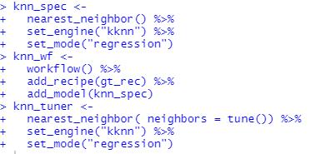
APPLICATION - 1
Tuning Parameter (K – Nearest Neighbor)

Slide 43
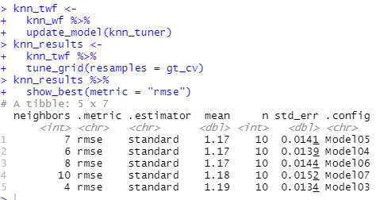
APPLICATION - 1
Tuning Parameter (K – Nearest Neighbor)

Slide 44
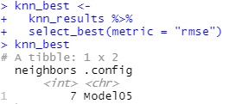
APPLICATION - 1
Tuning Parameter (K – Nearest Neighbor)

Slide 45
APPLICATION - 1
Algorithms | RMSE | R-Square | MAE | Time
Linear Regression | 0.950 | 0.996 | 0.745 | 60ms
Boosted Trees | 1.010 | 0.998 | 0.811 | 2.3s
Decision Tree | 0.990 | 0.996 | 0.717 | 3.7s
K – Nearest Neighbor | 1.090 | 0.995 | 0.716 | 22.9s
Random Forest | 0.621 | 0.998 | 0.436 | 3m 4.3s
Support Vector Machine | 0.958 | 0.996 | 0.758 | 3m 44.9s

Slide 46
APPLICATION - 2
HTRU2 Data Set
Pulsar candidates collected during the HTRU survey. Pulsars are a type of star, of considerable scientific interest. Candidates must be classified in to pulsar and non-pulsar classes to aid discovery.
Source:
Dr Robert Lyon, University of Manchester, School of Physics and Astronomy, Alan Turing Building, Manchester M13 9PL, United Kingdom, robert.lyon '@' manchester.ac.uk
https://archive.ics.uci.edu/ml/datasets/HTRU2

Slide 47
APPLICATION - 2
Pulsars are a rare type of Neutron star that produce radio emission detectable here on Earth. They are of considerable scientific interest as probes of space-time, the inter-stellar medium, and states of matter.
As pulsars rotate, their emission beam sweeps across the sky, and when this crosses our line of sight, produces a detectable pattern of broadband radio emission. As pulsars rotate rapidly, this pattern repeats periodically. Thus pulsar search involves looking for periodic radio signals with large radio telescopes.
Each pulsar produces a slightly different emission pattern, which varies slightly with each rotation. Thus a potential signal detection known as a 'candidate', is averaged over many rotations of the pulsar, as determined by the length of an observation. In the absence of additional info, each candidate could potentially describe a real pulsar. However in practice almost all detections are caused by radio frequency interference (RFI) and noise, making legitimate signals hard to find.

Slide 48
APPLICATION - 2
Each candidate is described by 8 continuous variables, and a single class variable. The first four are simple statistics obtained from the integrated pulse profile. This is an array of continuous variables that describe a longitude-resolved version of the signal that has been averaged in both time and frequency. The remaining four variables are similarly obtained from the DM-SNR curve. These are summarised below:
1. Mean of the integrated profile. 2. Standard deviation of the integrated profile. 3. Excess kurtosis of the integrated profile. 4. Skewness of the integrated profile. 5. Mean of the DM-SNR curve. 6. Standard deviation of the DM-SNR curve. 7. Excess kurtosis of the DM-SNR curve. 8. Skewness of the DM-SNR curve. 9. Class
HTRU 2 Summary 17,898 total examples. 1,639 positive examples. 16,259 negative examples.

Slide 49
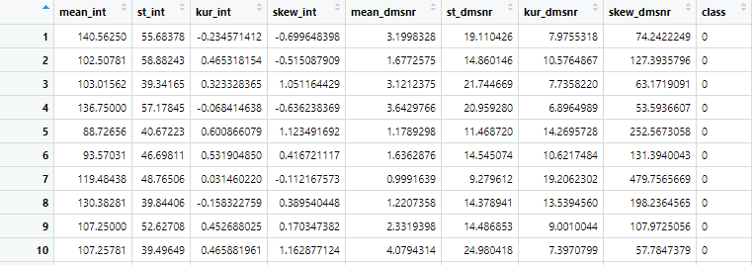
APPLICATION - 2
.
.
.

Slide 50
APPLICATION - 2
Algorithms
Logistic Regression
Boosted Trees
Decision Tree
K- Nearest Neighbor
Random Forest
Support Vector Machine
Naive Bayes Classifier
Flexible Discriminant Models
Linear Discriminant Models
Regularized Discriminant Models

Slide 51
APPLICATION - 2
Algorithms | Accuracy | Time
Logistic Regression | 0.976 | 280ms
Boosted Trees | 0.978 | 910ms
Decision Tree | 0.975 | 900ms
K – Nearest Neighbor | 0.976 | 7.9s
Random Forest | 0.978 | 20.2s
Support Vector Machine | 0.976 | 8.1s
Naive Bayes Classifier | 0.962 | 160ms
Flexible Discriminant Models | 0.976 | 1.3s
Linear Discriminant Models | 0.974 | 221ms
Regularized Discriminant Models | 0.962 | 1m 37.1s

Slide 52
APPLICATION - 2
Not a Pulsar Star
Algorithms | Precision | Recall | F1 - Score
Logistic Regression | 0.979 | 0.995 | 0.987
Boosted Trees | 0.982 | 0.994 | 0.988
Decision Tree | 0.979 | 0.994 | 0.986
K – Nearest Neighbor | 0.981 | 0.993 | 0.987
Random Forest | 0.982 | 0.994 | 0.988
Support Vector Machine | 0.979 | 0.995 | 0.987
Naive Bayes Classifier | 0.983 | 0.975 | 0.979
Flexible Discriminant Models | 0.980 | 0.993 | 0.987
Linear Discriminant Models | 0.976 | 0.996 | 0.986
Regularized Discriminant Models | 0.978 | 0.980 | 0.979

Slide 53
APPLICATION - 2
Pulsar Star
Algorithms | Precision | Recall | F1 - Score
Logistic Regression | 0.940 | 0.782 | 0.854
Boosted Trees | 0.938 | 0.801 | 0.864
Decision Tree | 0.946 | 0.816 | 0.876
K – Nearest Neighbor | 0.934 | 0.791 | 0.857
Random Forest | 0.935 | 0.813 | 0.870
Support Vector Machine | 0.940 | 0.782 | 0.854
Naive Bayes Classifier | 0.788 | 0.840 | 0.813
Flexible Discriminant Models | 0.921 | 0.800 | 0.856
Linear Discriminant Models | 0.956 | 0.751 | 0.841
Regularized Discriminant Models | 0.884 | 0.714 | 0.790

Slide 54
CONCLUSION
Provides a mechanism for chaining commands with a forward-pipe operator, %>%.
This operator will forward a value, or the result of an expression, into the next function call/expression.
There is flexible support for the type of right-hand side expressions.
The magrittr package has two aims: decrease development time and improve readability and maintainability of code.

Slide 55
CONCLUSION
The tidymodels framework is a collection of packages for modeling and machine learning using tidyverse principles.
After you are comfortable with the basics, you can learn how to go farther with tidymodels in your modeling and machine learning projects.
It is important to clarify that the group of packages that make up tidymodels do not implement statistical models themselves.
Instead, they focus on making all the tasks around fitting the model much easier.
Those tasks are data pre-processing and results validation.

Slide 56
CONCLUSION
The Parsnip package provides a common interface to allow specifying a model across different functions or computation engines without having to remember different argument names.
The discrim package contains methods for additional classification patterns for use with the 'Parsnip' package.
Additional packages: discrim, infer, textrecipes, themis

Slide 57
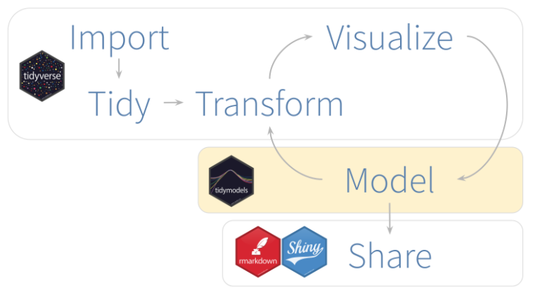
CONCLUSION

Slide 58
CONCLUSION
In this study, we created models for regression and classification data sets using tidymodels.
The number of functions, and options of such functions, were kept at a minimum for the purposes of this demonstration, but there is much more that can be done with this wonderful group of packages.
Using the syntax of tidymodels, models were created, performance measurements were obtained and algorithms were compared.

Slide 59
CONCLUSION
The random forest algorithm generally performs well.
The main limitation of random forest is that a large number of trees can make the algorithm too slow and ineffective for real-time predictions.
When comparing the criteria in the regression data set, all algorithms can be preferred.
Since the classifier data set is unbalance, accuracy is not a sufficient criterion for us.
Algorithms were compared on the basis of precision, recall and F - 1 score criteria.
Linear discriminant models show good performance in terms of precision criteria, while naive bayes algorithm can be preferred in terms of recall criteria.
Tree-based algorithms perform well in terms of F - 1 score criteria.

Slide 60
REFERENCES
https://www.tidymodels.org/
https://cran.r-project.org/web/packages/rsample/
https://cran.r-project.org/web/packages/parsnip/
https://cran.r-project.org/web/packages/recipes/
https://cran.r-project.org/web/packages/workflows/
https://cran.r-project.org/web/packages/tune/
https://cran.r-project.org/web/packages/yardstick/
https://cran.r-project.org/web/packages/broom/
https://cran.r-project.org/web/packages/dials/
https://cran.r-project.org/web/packages/themis/

Slide 61
REFERENCES
https://cran.r-project.org/web/packages/discrim/
https://cran.r-project.org/web/packages/infer/
https://cran.r-project.org/web/packages/textrecipes/
https://www.tmwr.org/
https://github.com/tidymodels
https://conf20-intro-ml.netlify.app/
https://rstudio.com/resources/rstudioconf-2018/fireside-chat-tidyverse-discussion/
https://archive.ics.uci.edu/ml/datasets/Gas+Turbine+CO+and+NOx+Emission+Data+Set
https://archive.ics.uci.edu/ml/datasets/HTRU2

Slide 62

https://github.com/burakdilber/tidymodels

Slide 63
THANK YOU FOR LISTENING

