Slide 1

Notes:
Let it run a beat too long. Canyang: 'Burak. Burak.'

Slide 2
Just kidding.
No data leakage here
Notes:
The turn. Keep it dry.

Slide 3
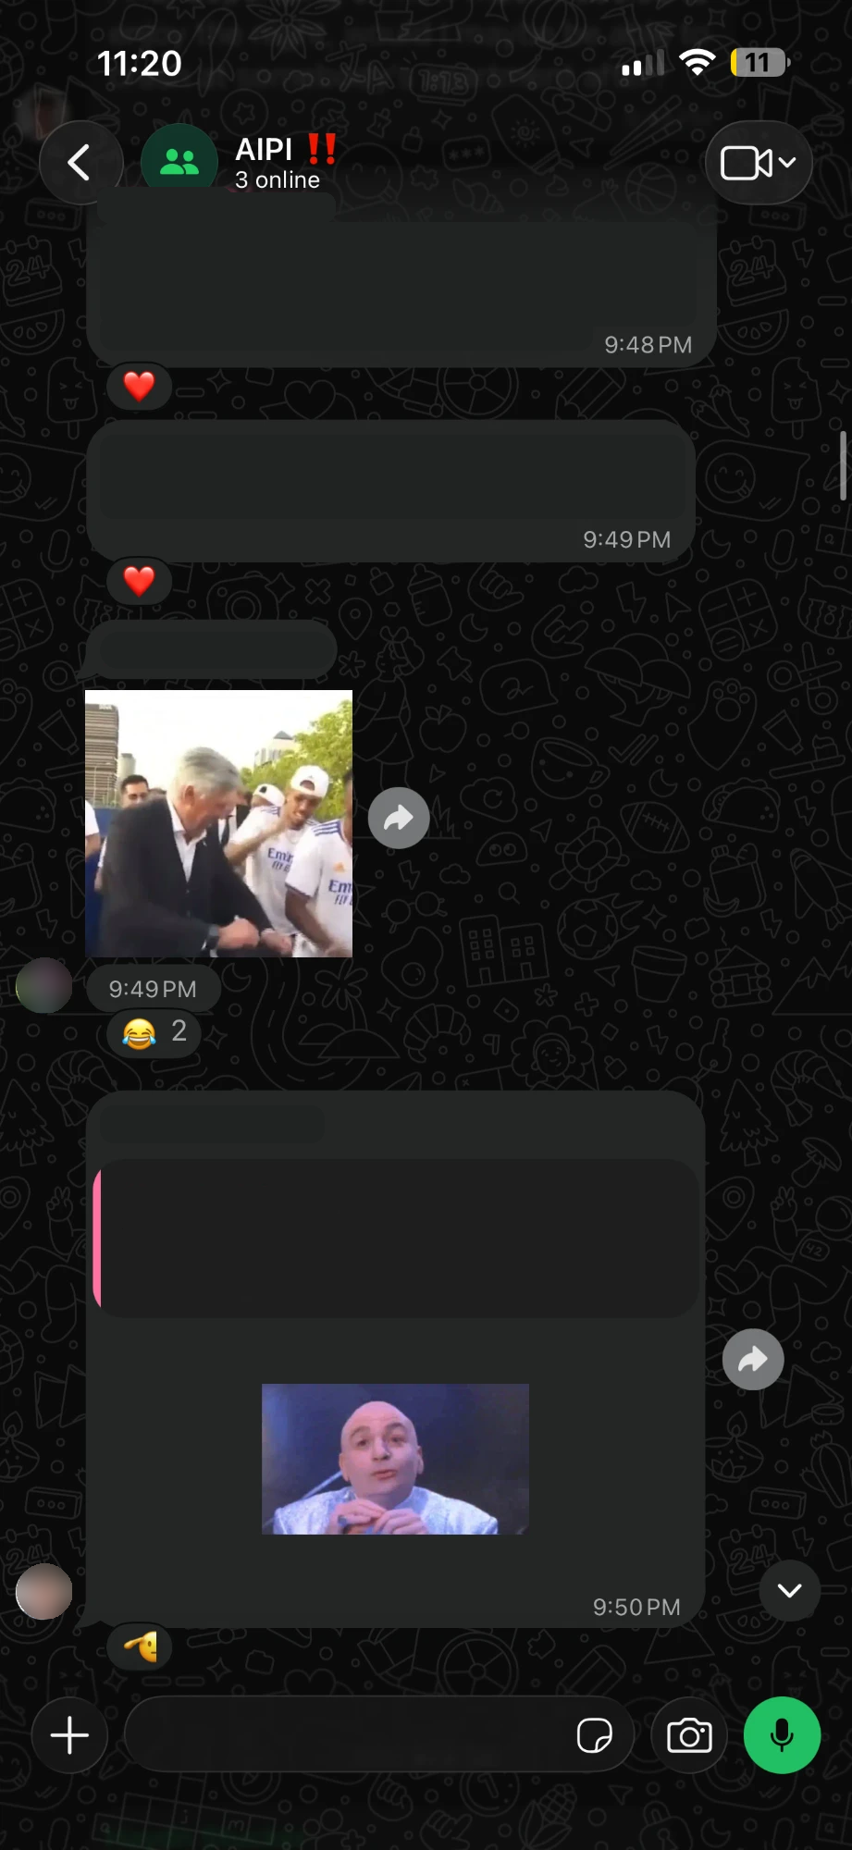

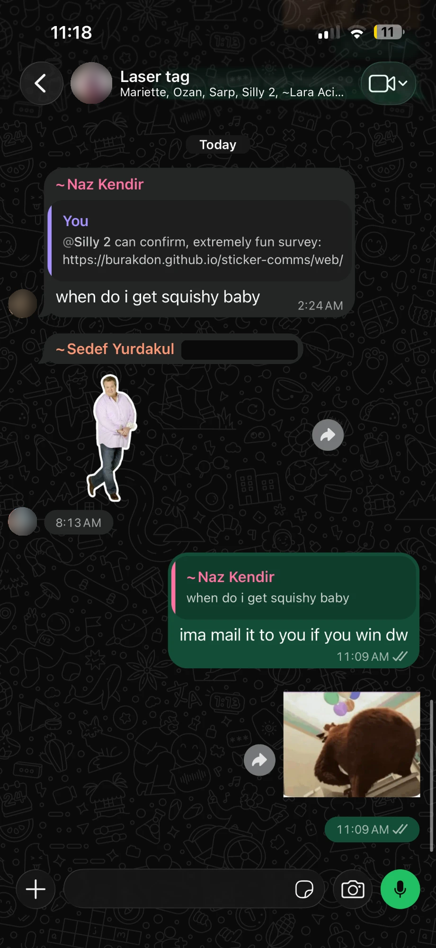

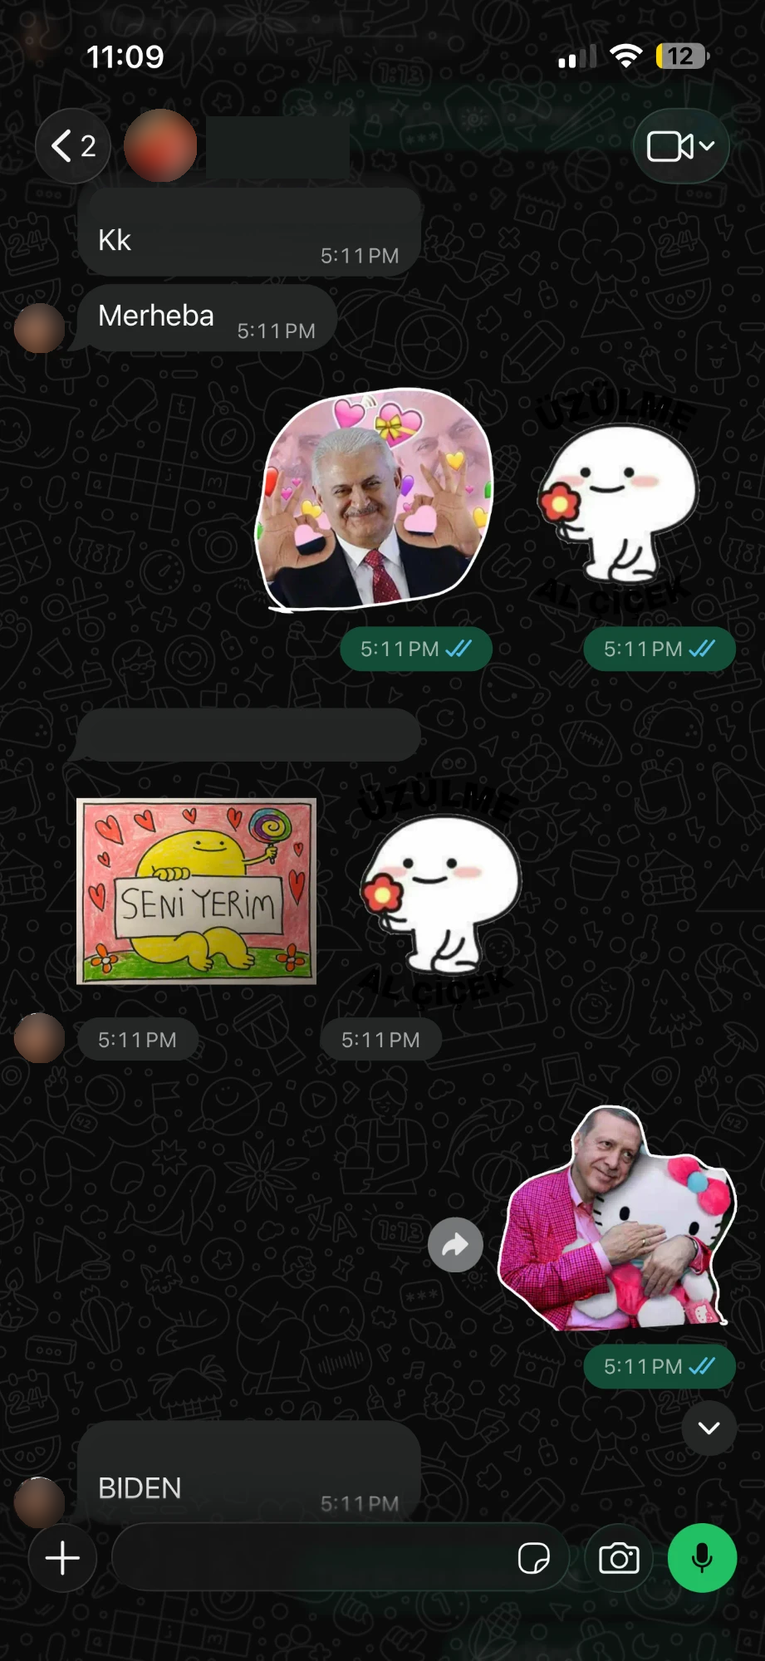
But stickers are fun; our group chats run on these
Notes:
Half the chat is Turkish. The other half laughs at Bülent Arınç crying. Do they get it, or are they being polite? Motivation in one breath.

Slide 4



Can you read a sticker from another culture?
H0
No change, stickers and gifs suck.
Null, no effect
Turkish
H1
Does seeing the sticker inside a chat help?
Chat > alone. The one we randomized.
Chinese
H2
Do natives read their own stickers better?
In-group > out-group. Measured, not randomized.
Can outsiders beat chance with no context at all?
Out-group accuracy > 1/3 on no-text stickers.
English
H4
H5
…and is it the sticker, or just the message?
Chat > message-only. The text-only control.
12 stickers per culture · 36 in total
Notes:
Name the literature in one phrase: the in-group advantage in emotion recognition (Elfenbein & Ambady 2002), but for stickers. H1 is the randomized one; H2 is measured; H4 is the chance test; H5 is the control for 'is it just the message?'.

Slide 5
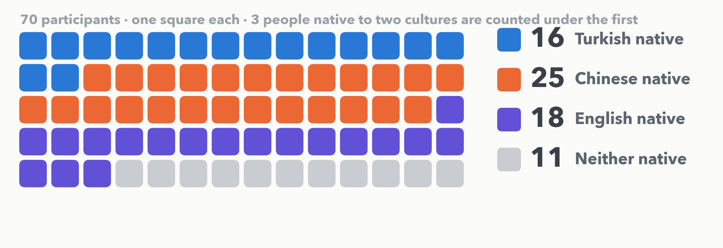
Survey Results
11 of them scanned the flyer 🧸 (Thanks XAI students and the random people in Twinnies even tho some of you were pretty mean)
Collected Oct 31 – Nov 2 on one link, WhatsApp, WeChat and a flyer.
Notes:
Callback to the olive deck for anyone who saw it. One line, move on. 70 completed; 16 Turkish, 26 Chinese, 21 American natives; 11 came in through the flyer QR code.

Slide 6
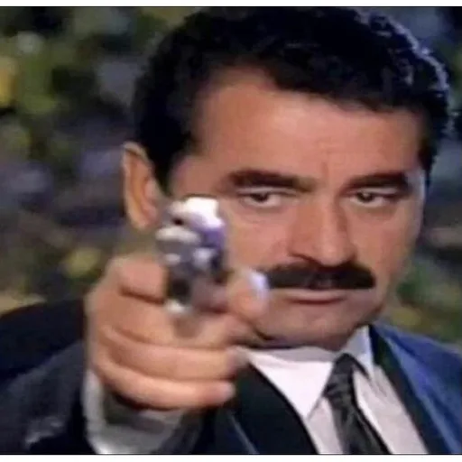
Live round 1 · What does the sender mean?
Positive
Negative
Sarcastic
Notes:
Show alone, class votes by hand. Then next slide: same sticker in chat, vote again. Sender intent: sarcastic.

Slide 7
Live round 1 · …and now inside the chat
Friend
I ate your leftover pizza
Positive
Negative
Sarcastic
Reveal: sender intent = sarcastic · outsiders got it 22% alone, 23% in chat · a Turkish singer, İbrahim Tatlıses
Notes:
Vote again, then reveal. Non-native readers: 22% correct alone, 23% in chat.

Slide 8

Live round 2 · What does the sender mean?
Positive
Negative
Sarcastic
Notes:
Show alone, class votes by hand. Then next slide: same sticker in chat, vote again. Sender intent: sarcastic.

Slide 9
Live round 2 · …and now inside the chat
Friend
How are you holding up after staying up all night?
Positive
Negative
Sarcastic
Reveal: sender intent = sarcastic · outsiders got it 21% alone, 35% in chat · “没事啊 我很好啊” — “It's fine, I'm great”
Notes:
Vote again, then reveal. Non-native readers: 21% correct alone, 35% in chat.

Slide 10
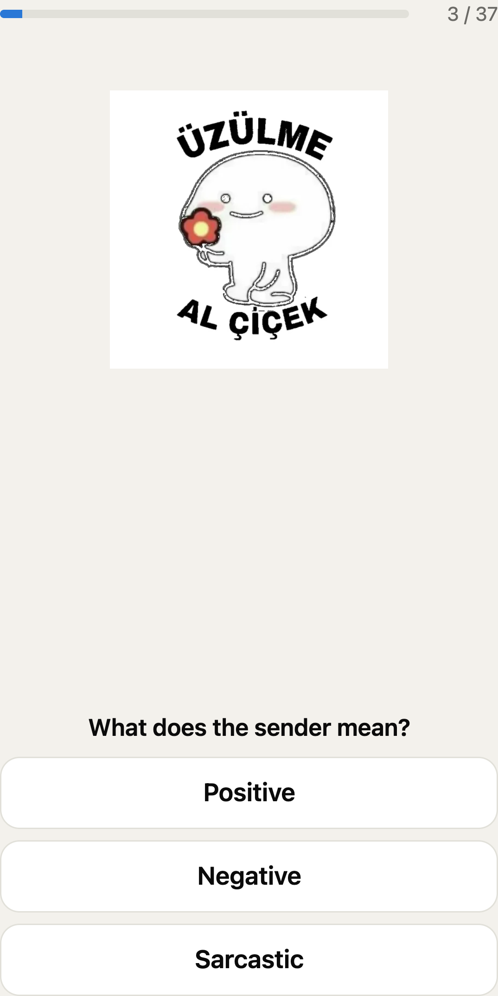
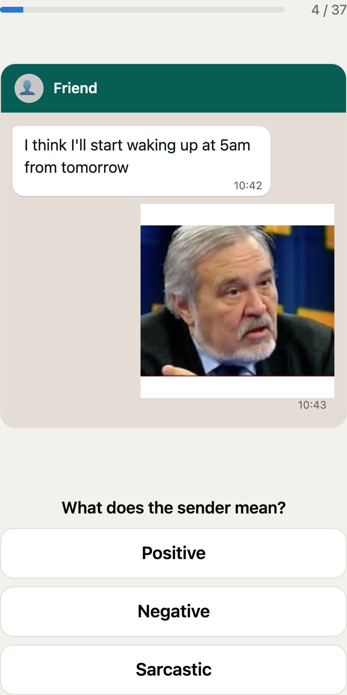
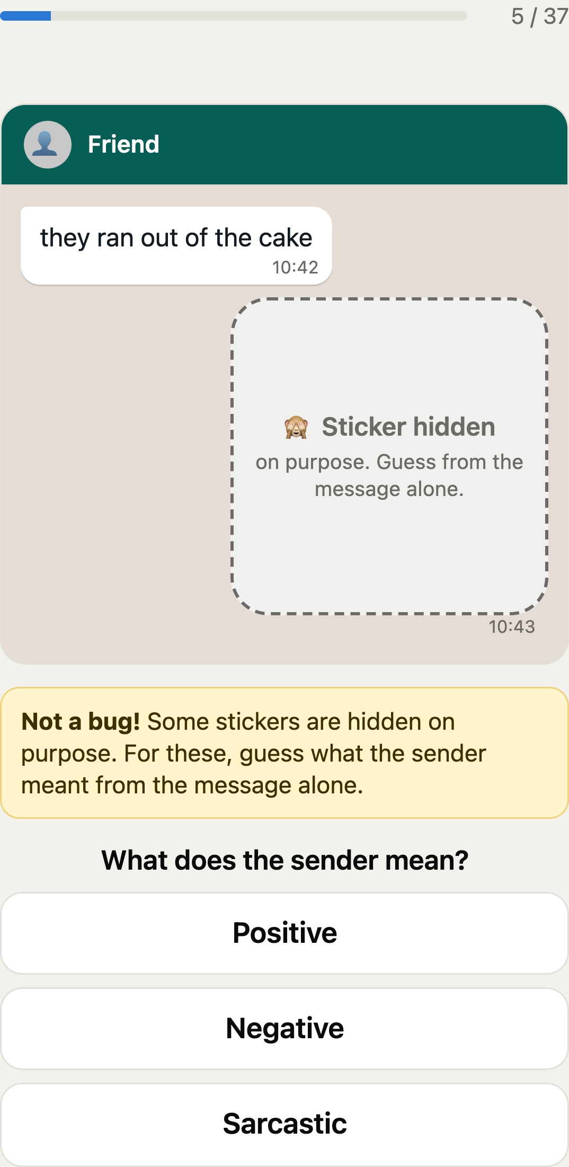
36 stickers, 3 cultures, 3 ways to see them
12 per culture
6 with text on the sticker, 6 without · 2 positive / 2 negative / 2 sarcastic in each half
Every sticker once
37 trials per person (36 + an attention check), order shuffled
Latin square
3 sets × 3 rotations, so each sticker gets each context equally often
Answer key = sender intent
the author of each culture's set labeled their own stickers; natives then checked them
Sticker alone
Sticker in chat
Message only
Notes:
Within-subject. Every participant sees every sticker exactly once, in one of three contexts. A Latin square (three sets of 12, three rotations) means every sticker appears in every context equally often across people. Context is randomized; native-or-not is measured. The answer key is sender intent: the author of each set labeled what they mean when they send it.

Slide 11
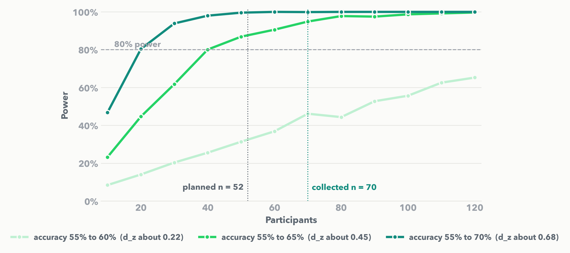
How many people did we need?
Assumptions: paired t-test on per-person accuracy · α = .05 · 80% power · medium effect d_z = 0.4 (Cohen's convention; no prior sticker study) · computed with statsmodels, checked by simulating the real 12-trials-per-condition design
52
planned · paired t, α = .05, power .80, d_z = 0.4
70
collected · 16 / 26 / 21 natives per culture
6 pts
smallest context effect we could detect with 70 (observed SD = 0.18)
Analytic: statsmodels TTestPower. Simulation: 1,000 synthetic studies per point with the real Latin-square structure. Effect size from Cohen's conventions (no prior study on stickers); pilot of 9 people used to sanity-check the SD.
Notes:
Paired t-test on per-person accuracy, alpha .05, 80% power, d_z = 0.4 (moderate) gives n = 52 with statsmodels TTestPower. We also simulated the real trial structure (12 binary trials per condition, participant and sticker random effects): a 10-point lift needs about 40 people. We collected 70; after the fact, the observed SD of the chat-minus-alone difference (0.18) means 70 people detect a 6-point lift. Natives per culture: 16, 26, 21, all above the 15 floor for the answer-key check.

Slide 12
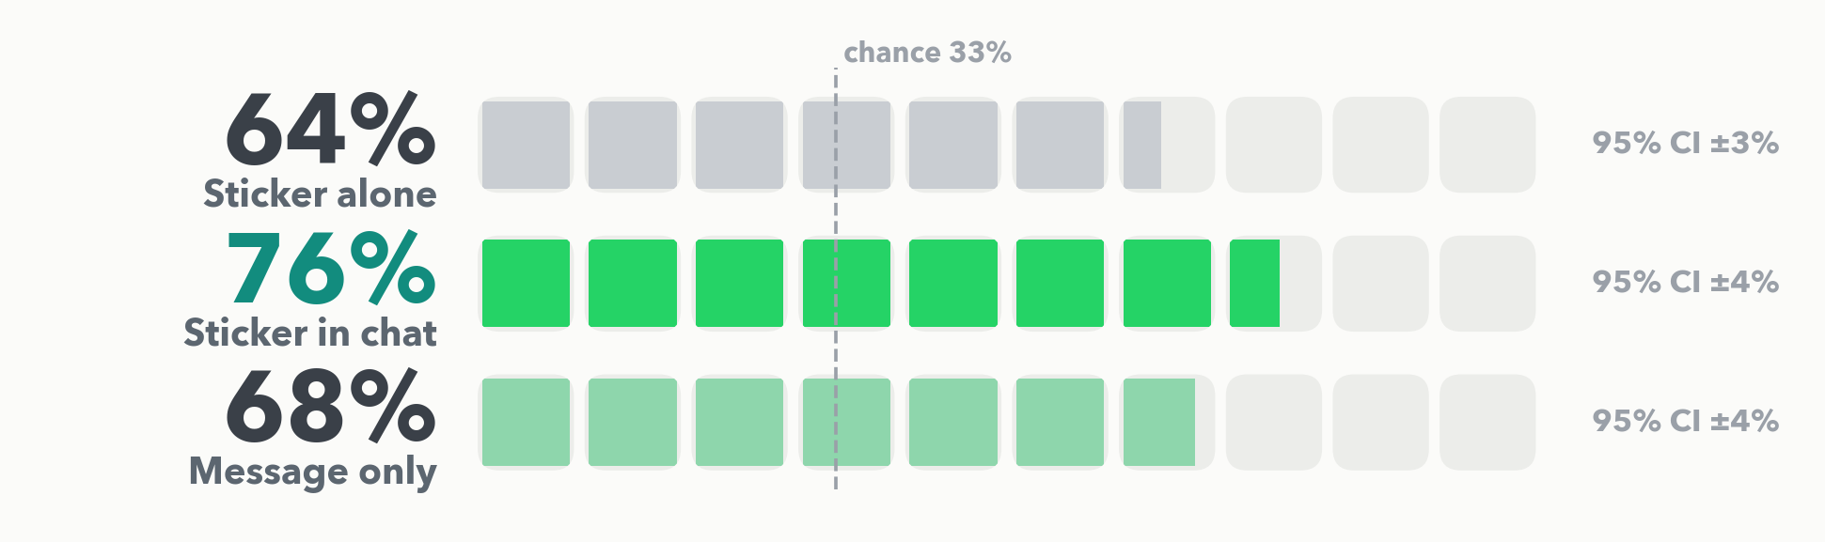
Context helps. +11 points.
Paired t-test, n = 70: chat − alone = +11.3 pts, 95% CI [6.6, 16.0], d_z = 0.58, p < .0001
Repeated-measures ANOVA across the three contexts: F = 10.8, p < .0001, η²p = .14. Holm post hocs: chat > alone (p < .0001), chat > message-only (p = .004), alone ≈ message-only (p = .17).
Each square is 10% of trials answered correctly. Error bars are 95% CIs of the per-person mean. The sticker adds +7.5 points over the message alone (H5, p = .002).
Notes:
H1 confirmed: chat > alone by 11.3 points, 95% CI 6.6 to 16.0, d_z = 0.58, t(69) = 4.82, p < .0001. Differences were normal (Shapiro p = .29); Wilcoxon agrees. H5 too: chat > message-only by 7.5 points, p = .002, so the sticker adds meaning beyond the words. RM-ANOVA over the three contexts F = 10.8, p < .0001, partial eta squared .14, sphericity fine; Holm post hocs: alone < chat, chat > message-only, alone vs message-only not significant.

Slide 13
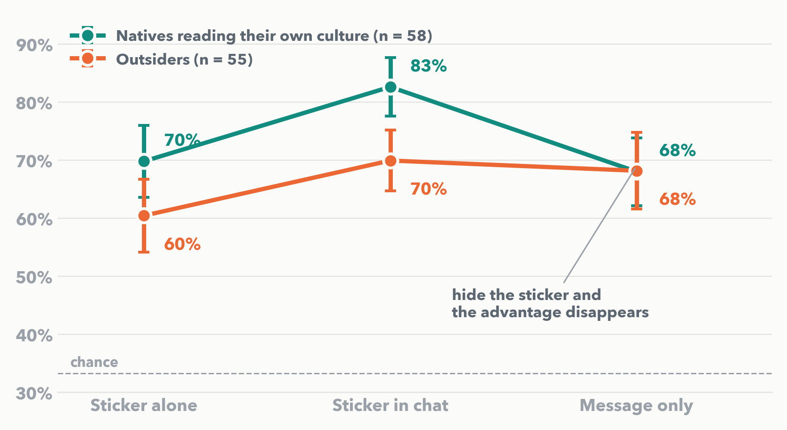
Natives win… until you hide the sticker
In-group advantage
OR 1.51 [1.26, 1.81], p < .001 · mixed logistic regression, random intercepts for participant and sticker
Context helps everyone
chat × native interaction OR 1.33 [0.92, 1.90], p = .13 · H3 not supported
Hide the sticker, lose the edge
message-only × native OR 0.65 [0.48, 0.88], p = .005
Per-person means ± 95% CI. 'Some' familiarity excluded here (pre-registered: native vs none). Sticker-to-sticker variance is 4× participant variance: which sticker matters more than who is reading.
Notes:
H2 confirmed: natives are better on their own culture's stickers, odds ratio 1.51 (95% CI 1.26 to 1.81) from a mixed logistic regression with crossed random intercepts for participant and sticker. H3 was NOT what we predicted: chat helped insiders and outsiders about equally (chat × native interaction OR 1.33, p = .13). The interaction that did show up: hide the sticker and natives lose their edge entirely (message-only × native OR 0.65, p = .005). Natives are reading the picture, not the caption.

Slide 14
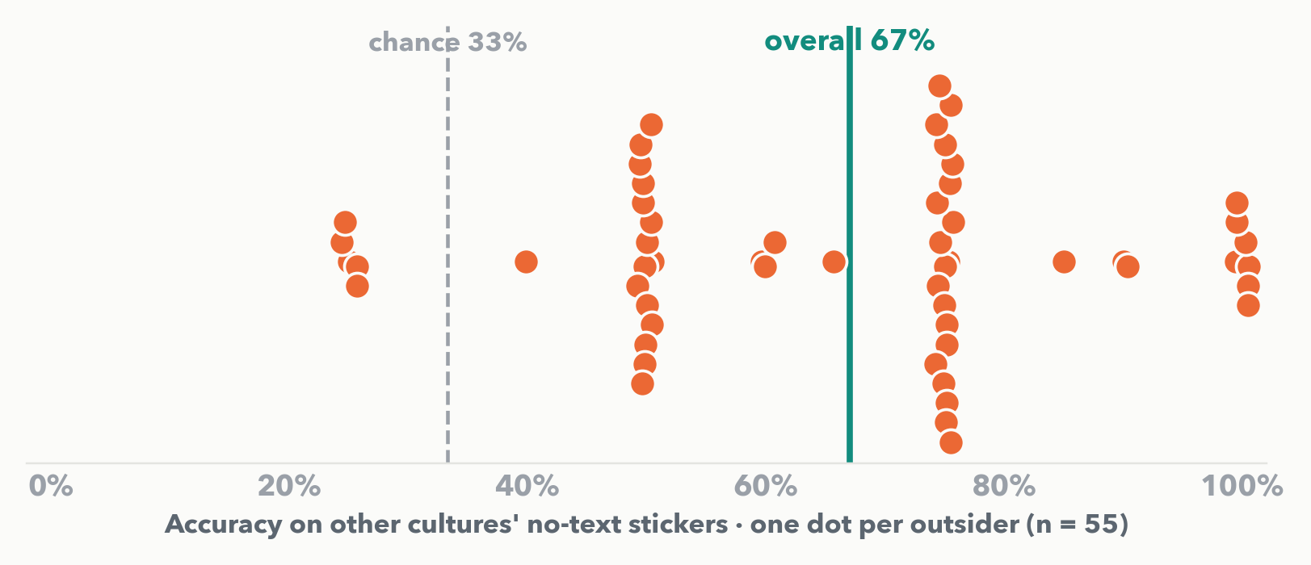
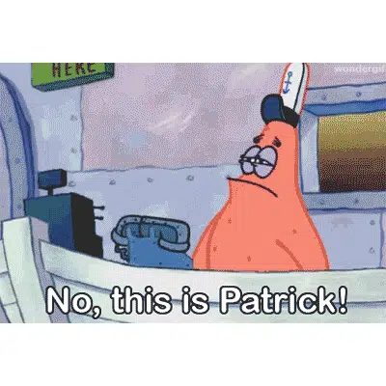
Outsiders are not guessing
67%
of outsiders' answers correct on no-text stickers with no context · chance is 33% · binomial p < .0001, h = 0.69
Hardest for outsiders
22%
a joke threat
24%
“No, this is Patrick!”
29%
“It's fine, I'm great”
Sarcastic stickers are the ones that fail: a sticker that says one thing and means another needs the culture to decode it.
Notes:
H4: on no-text stickers from other cultures, with no chat context, outsiders scored 67% against a 33% chance rate. Exact binomial p < .0001, Cohen's h = 0.69; per-person one-sample t also p < .0001. Sentiment leaks through the image. Except when a man points a gun at you as a joke.

Slide 15
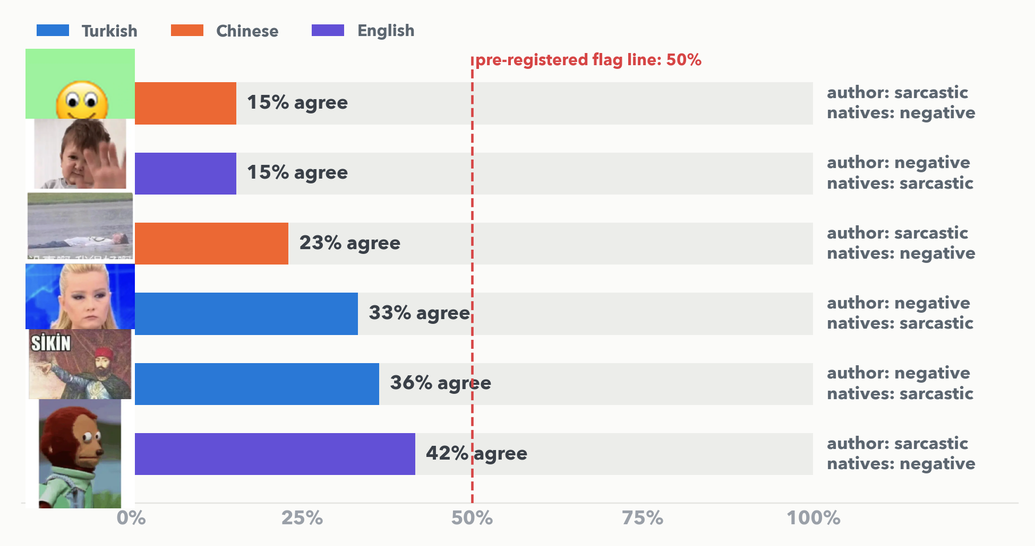
Sarcasm is where authors and natives part ways
6 of 36 stickers flagged. All six are sarcastic or negative.
Rerun without them: chat − alone = +9.7 pts, p = .0006. Nothing changes.
Rule was written before data collection: < 50% native agreement, at least 5 ratings.
Notes:
The pre-registered answer-key check: for each sticker, do natives (with the sticker visible) agree with the author's label at least 50% of the time? 6 of 36 fail, all sarcastic or negative. We wrote down what WE mean when we send these; our own communities disagreed on exactly the sarcastic ones. All conclusions hold with these six removed (H1 +9.7 points, p = .0006).

Slide 16
What the data cannot tell us
🧑‍🤝‍🧑
Convenience sample
Friends, classmates, WeChat groups. Young, online, mostly students.
🎲
Native-or-not was measured, not randomized
The context effect is causal; the in-group effect is quasi-experimental.
✍️
The answer key is one person's intent per culture
Validated by natives, but sarcasm is inherently contested, and 6 stickers show it.
🪤
Our attention check was itself ambiguous
“Select POSITIVE” vs “what does the sender mean?” 6 of 8 ‘failures’ chose sarcastic. We kept them (they behaved like everyone else); the pre-registered exclusion gives the same answers.
Notes:
Convenience sample; native-or-not measured not randomized; one author's intent per culture as the key; the attention check was ambiguous and we say how we handled it. The pre-registered exclusion gives the same conclusions.

Slide 17
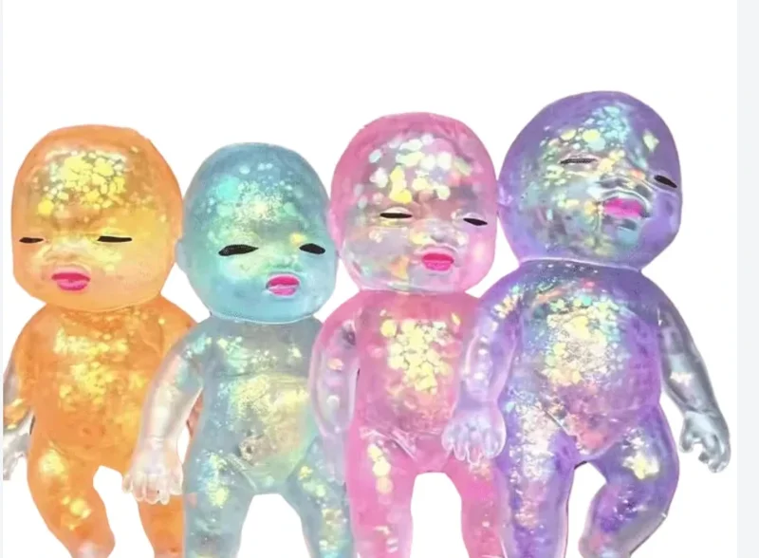
Takeaway
The sticker carries the meaning. Context helps everyone by about 11 points, but the picture is what natives are reading, and sarcasm is the part that doesn't travel.
If you want a sticker to land across cultures: no text, no sarcasm, and send it in a chat, not on its own.
Draw time 🧸
Notes:
One sentence, then the draw. Two winners: one from everyone, one reserved for AIPI students in the room.

Slide 18
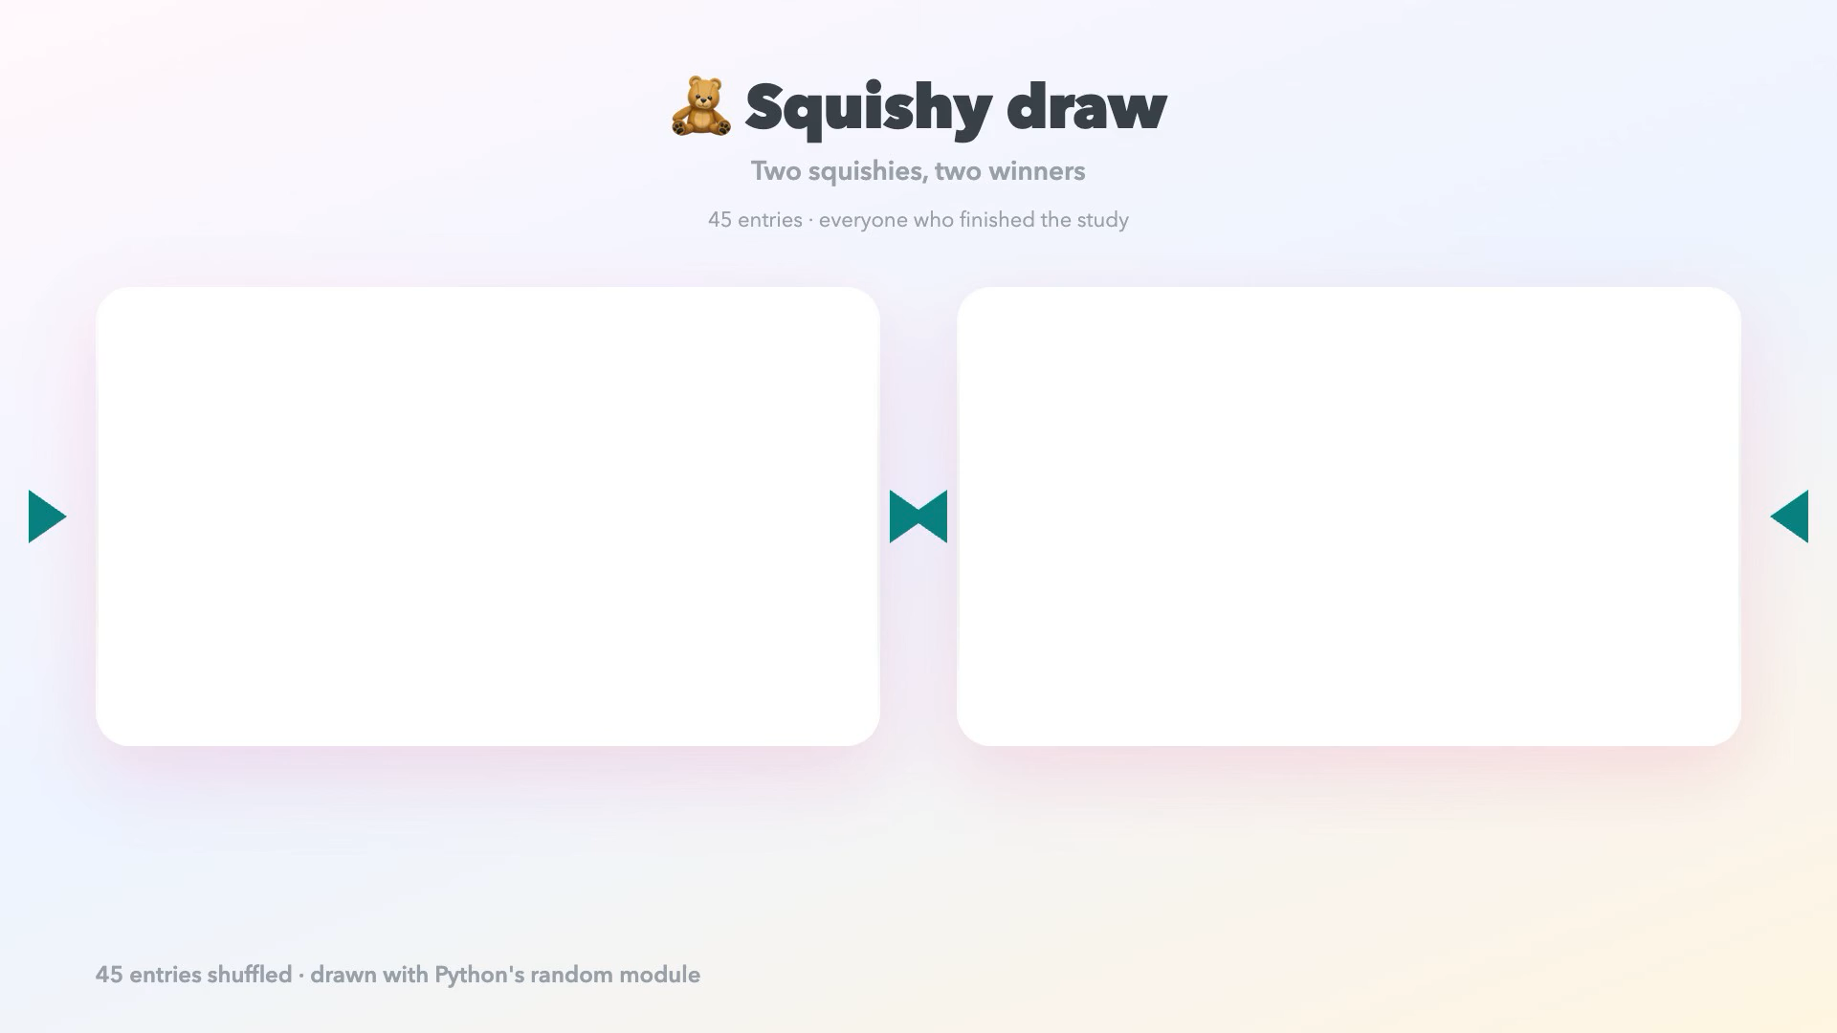

Slide 19
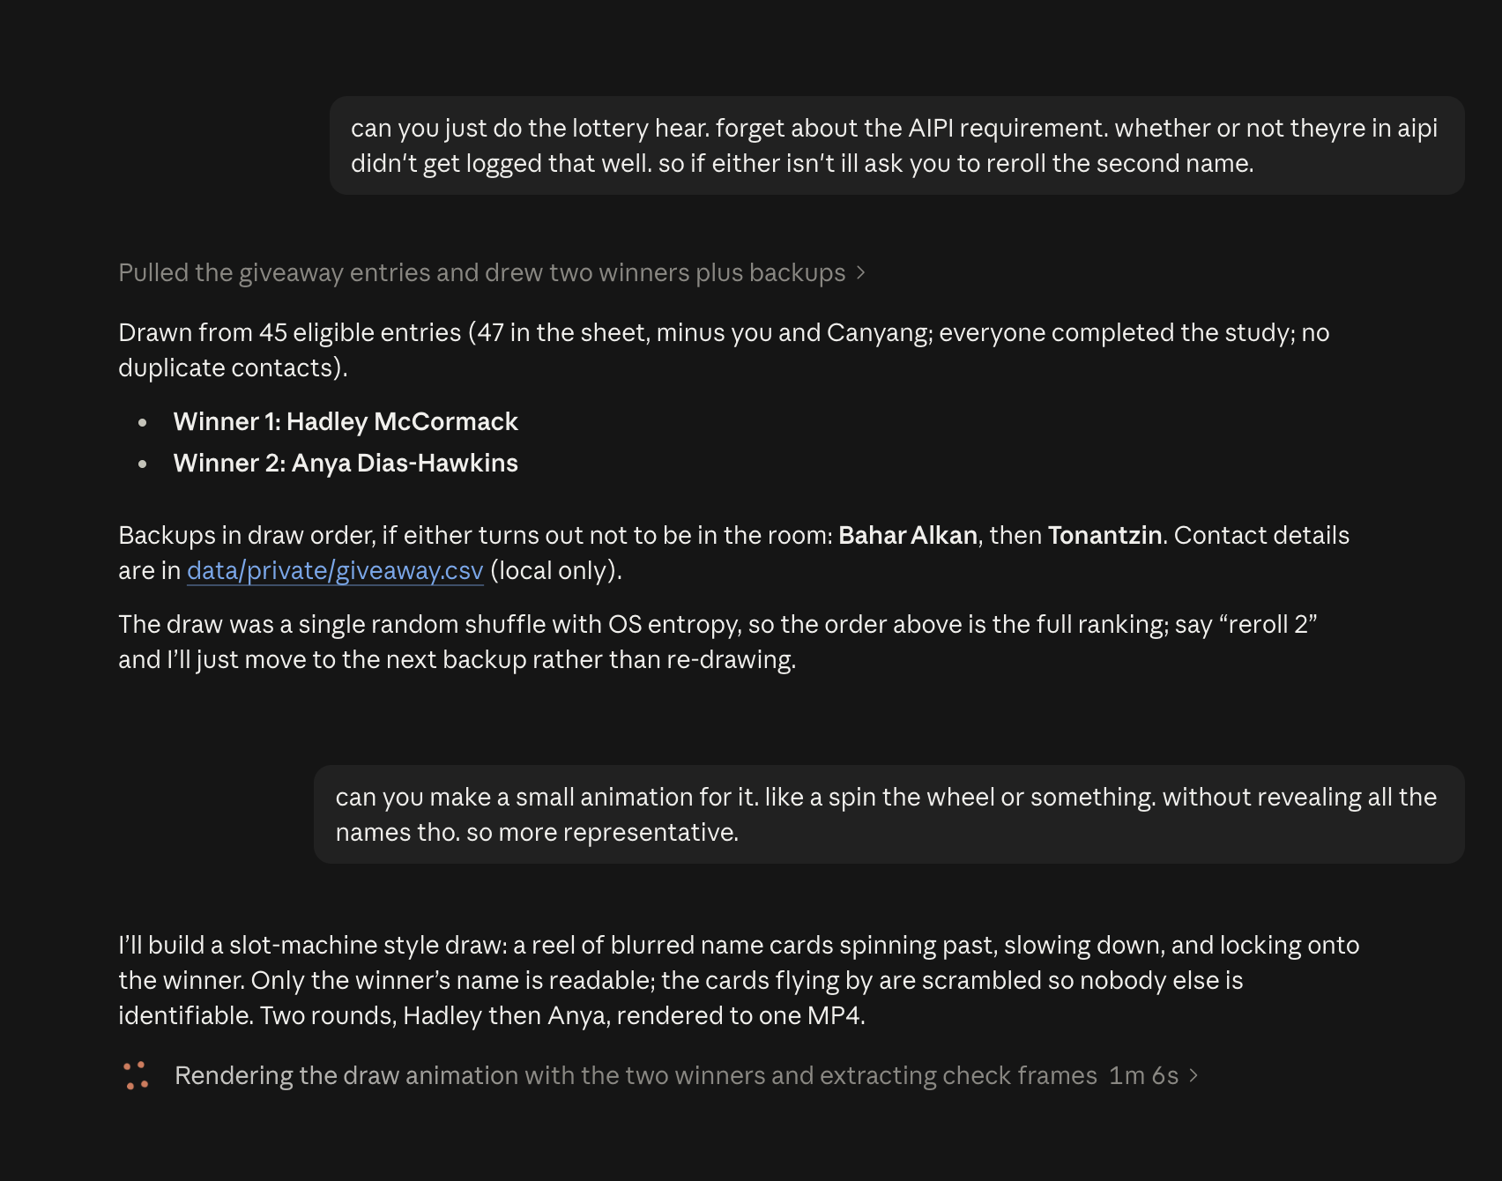
How the Giveaway was conducted
(Trust in Claude)

Slide 20
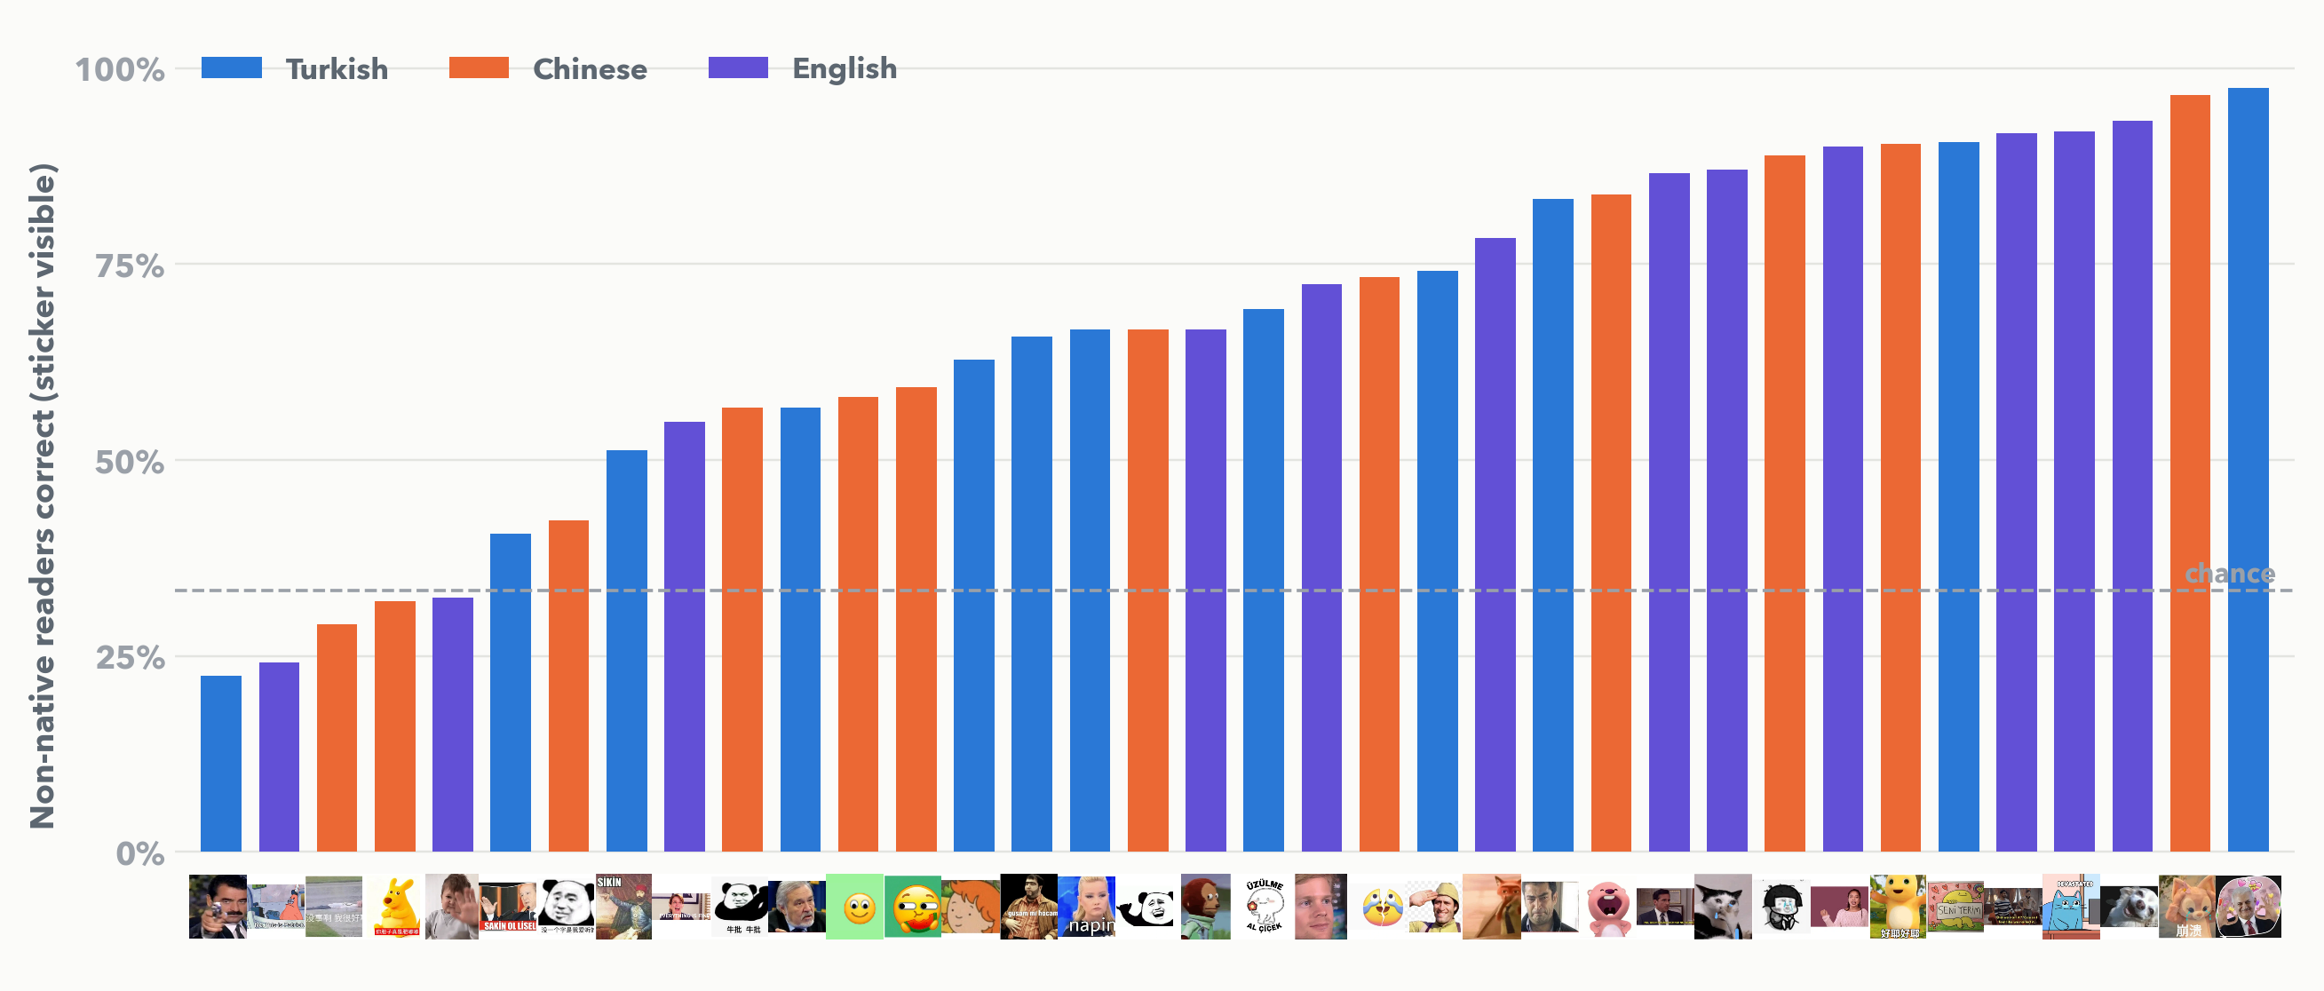
All 36 stickers, ranked by how outsiders read them
Notes:
Non-native readers, sticker visible. Bar colour is the sticker's culture.

Slide 21
The numbers
Hypothesis | Test | Result | Effect size | p
H1 chat > alone | Paired t-test on per-person accuracy (n = 70); Shapiro p = .29; Wilcoxon agrees | +11.3 pts, 95% CI [6.6, 16.0] | d_z = 0.58 | < .0001
Context (3 levels) | One-way repeated-measures ANOVA; Mauchly p = .18 (no correction needed); Friedman agrees | F = 10.8 | η²p = .14 | < .0001
Post hocs (Holm) | alone vs chat · chat vs message-only · alone vs message-only | −11.3 · +7.5 · −3.8 pts | d = −0.76 · 0.48 · −0.25 | < .0001 · .004 · .17
H5 chat > message-only | Paired t-test | +7.5 pts, 95% CI [2.9, 12.1] | d_z = 0.39 | .002
H2 in-group advantage | Mixed logistic regression, random intercepts: participant + sticker (1,543 trials) | OR 1.51 [1.26, 1.81] |  | < .001
H3 context × in-group | same model, interaction terms | chat × native OR 1.33 [0.92, 1.90]; message-only × native OR 0.65 [0.48, 0.88] |  | .13 · .005
H4 outsiders > chance | Exact binomial vs 1/3 (276 trials); per-person one-sample t (n = 55) | 67% vs 33% | h = 0.69; d = 1.54 | < .0001
Sensitivity | Pre-registered attention exclusion (n = 57); 6 flagged stickers removed | H1 +9.7 pts in both | d_z = 0.51 / 0.43 | .0003 / .0006
Notes:
Everything the report tests, on one slide.

Slide 22
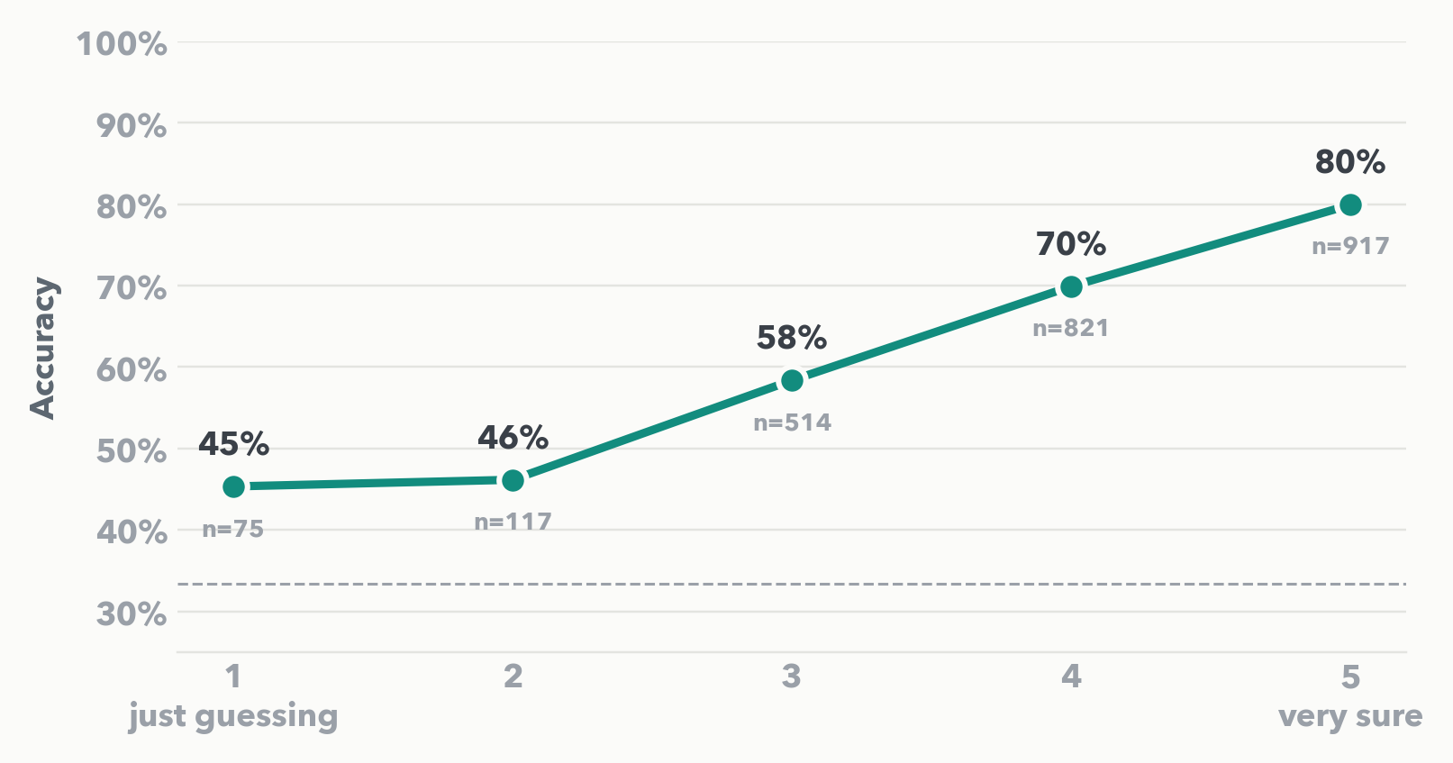
People know when they are guessing
What did NOT predict decoding other cultures' stickers: meme fluency (p = .36), daily sticker use (p = .64), being bilingual (p = .78), age (p = .16).
Reaction times: median 3.7 s per sticker; the task took about 5 minutes.
Notes:
Accuracy climbs with confidence from 45% to 80%. Meme fluency, sticker-use frequency, bilingualism and age did not predict out-group accuracy (all p > .16 in the covariate model).

