Slide 1


Slide 2
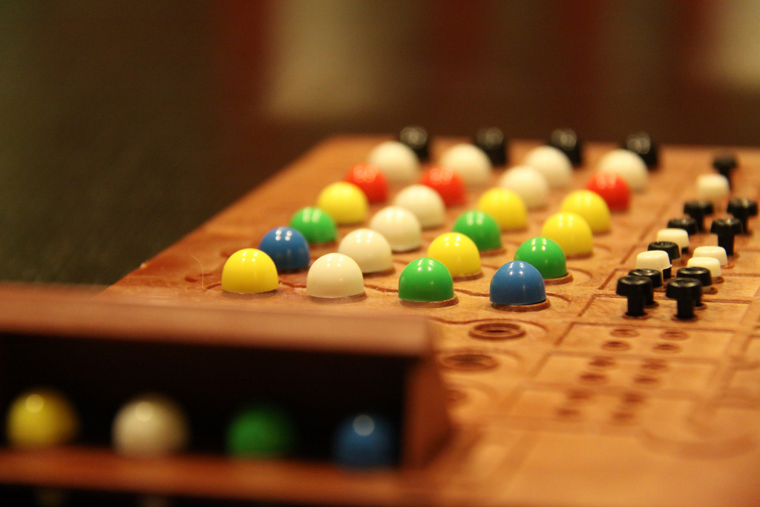
A GAME OF MINDS
Players guess the colours of ball and their positions.
After guesses, feedbacks are given.

Slide 3
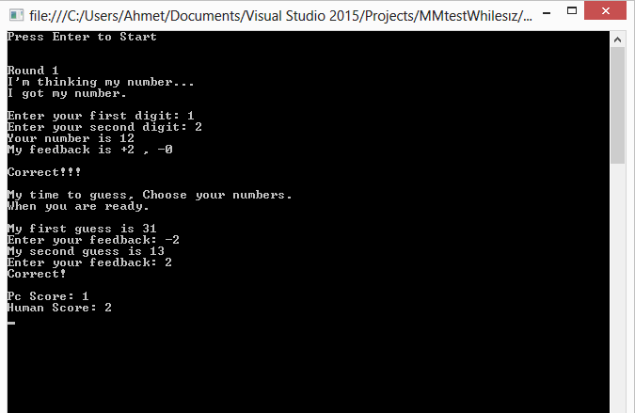
IN OUR GAME
Players guess NUMBERS instead of COLOURS, and their position.
Feedbacks will be still given.
10 Rounds based game, where every round 2 games are played.

Slide 4
MAIN PROCESS
FIRST GAME
CPU chooses his two digit number.
Human tries to find by feedback given from CPU.
No step limit
Every guess counts as one more point for CPU.
SECOND GAME
Human chooses his two digit number.
CPU tries to find by feedback given from CPU.
Step limit: 3
(CPU is able to find at maximum 3 move.)
Every guess counts as one more point for Human.

Slide 5
FEEDBACK PROCESS
CPU FEEDBACK
The every guess number’s digits are compared with every CPU’s digits.
Correct number wrong position: -1 Feedback for every digit
Correct number correct position: +1 Feedback for every digit

Slide 6
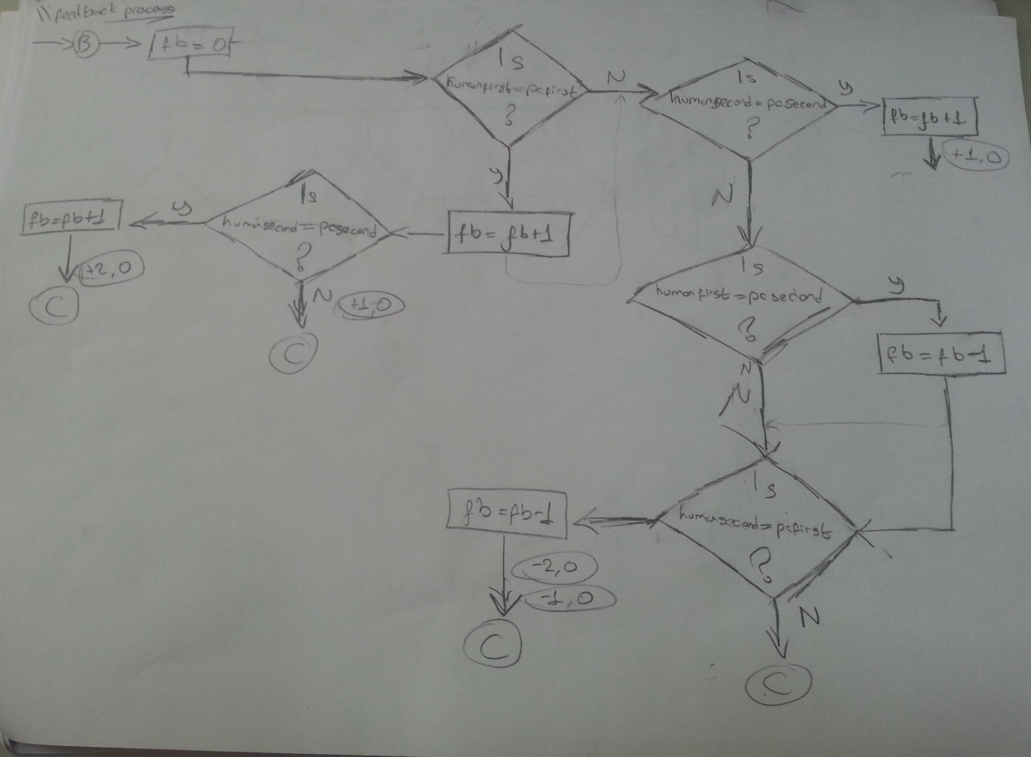
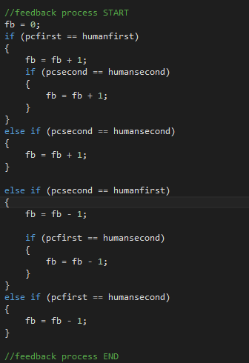
FEEDBACK PROCESS

Slide 7
FEEDBACK PROCESS (cont’d)
HUMAN FEEDBACK
Human only enter his feedback at his turn, nothing more. (If player enters his digits while computer is making his guesses, CPU can read the number at second guess automaticly.)
CPU pick his digits different from each and randomly in scale of (1,3)
After feedback, CPU changes one of his digits.
At least THREE move, CPU finds the choosen number by Hooman. If third feedback is not (+2, -0) understands you were cheating.

Slide 8
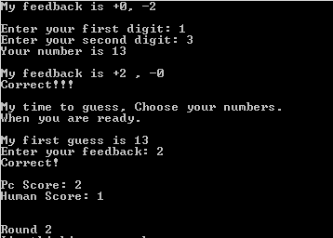
SCORES
Total number of CPU’s move is added to Human’s score.
Total number of Human’s move is added to CPU’s score.

Slide 9
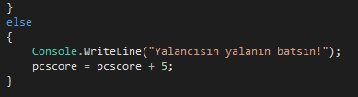
SCORES
If the wrong feedbacks are given;
Automaticly 5 points is added to CPU’s score as penalty.

Slide 10
Thanks for listening
PRESENTATION:
Abdullah Çelik
Ahmet Sait Polat
Burak Erdal

