Slide 1
Object Detection and Tracking Systems with Stereo Vision for Autonomous Driving
Burak Erdogan
Master of Science Thesis in Automotive System Management-Car Electronics Department of Hochschule Esslingen
Supervisor: Prof. Thao Dang

Slide 2
Contents
Stereo Vision
STIXEL method
CSRT
Evaluation
Conclusion
Hochschule Esslingen | 02.09.2019
Notes:
Customer Identification: to clearly identify who the company will be selling the new washing machine to. Start from smaller market and see the response
Entry point Identification: does it allow access to under served market? Is there a strong need that can be fulfilled? Are there any good existing competitors? Is the new solution strong enough to counter their resources and knowledge of the market?
Market Entry Strategy: Price your product such that there is a balance between affordability and feasibility. How do we want to be perceived by the customer?
Assemble Plan: It is detailed action plan. Includes details of all required marketing plan as well as timeline. Clearly define milestones.
Research: Identifying a well balanced cross section of the target audience by approaching them directly or via online survey
Test: Run a pilot project from time to time.
Ramping Up: Goal is to increase the market share and revenues
Exit Strategy: Plan for both success and failure

Slide 3
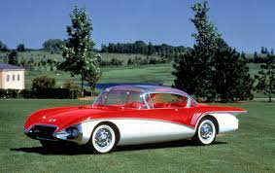
Stereo Vision
Camera
Buick Centurion of General Motors Matarama’s concept car was the first car that rear camera system was used in 1956
Driver assistance systems with camera
-Active Park Assist
-Adaptive Cruise Control
-Forward Collision Warning
-Lane-Keep Assist
Figure [1.1]
Hochschule Esslingen | 02.09.2019

Slide 4
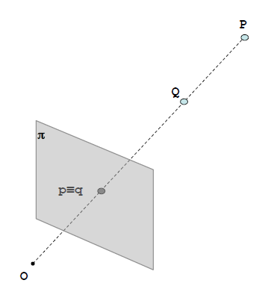
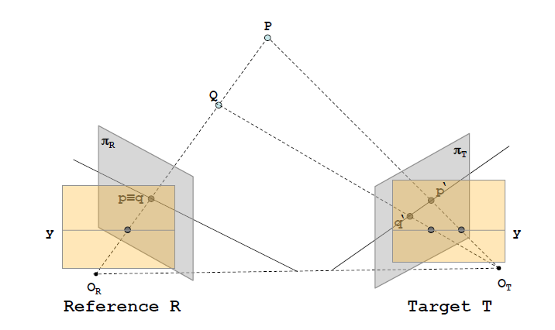
Stereo Vision
Basics of Stereo Vision
Cameras are passive sensors ( thermal camera etc.. exception)
Raw data needs to be processed
One camera is not enough to calculate depth
Figure [1.2]
o = optical center
π = image plane
P= object
p = object image in camera’s image plane
Q= object
q = object image in camera’s image plane
Figure [1.3]
Hochschule Esslingen | 02.09.2019

Slide 5
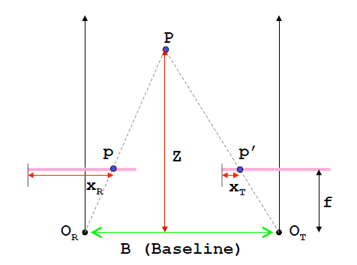
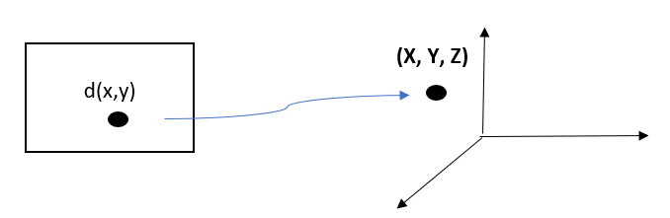




Stereo Vision
Calculation of Depth
From 2D to 3D
Figure [1.5]
Figure [1.4]
$$\frac{b}{Z}=\frac{\left(b+Xt\right)−Xr}{Z−f}$$
(1)
$$X=Z\frac{X_{R}}{f}$$
(3)
$Z=\frac{b∗f}{Xr−Xt}$
(2)
$$Y=Z\frac{Y_{R}}{f}$$
(4)
Xr-Xt = disparity map
Hochschule Esslingen | 02.09.2019

Slide 6
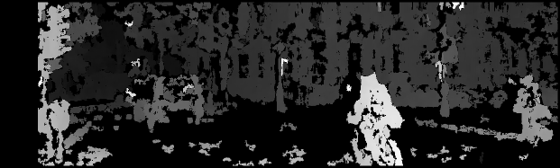
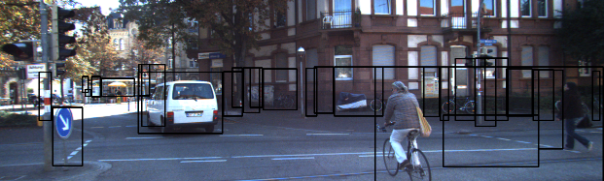
Stereo Vision
Figure [1.6] : Disparity Image
Figure [1.7]: Stereo Image
Hochschule Esslingen | 02.09.2019

Slide 7
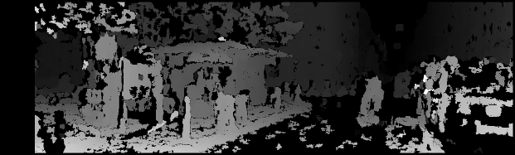
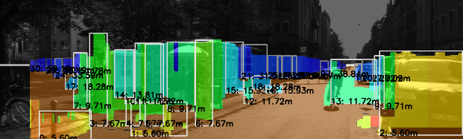
Stereo Vision
Figure [1.8] : Disparity Image
Figure [1.9] : Depth Map
Hochschule Esslingen | 02.09.2019

Slide 8
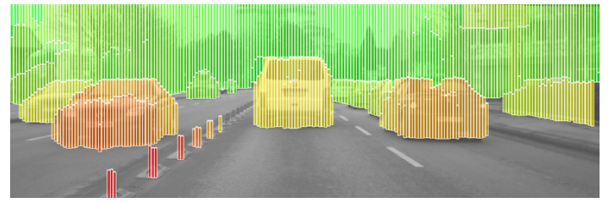
STIXEL
Stixel was invented in 2009 by D. Pfeiffer et. al.
Stixel is basically a stick made of pixels
Less number of calculation for disparity
Figure [2.1] : Stixel World
Hochschule Esslingen | 02.09.2019

Slide 9
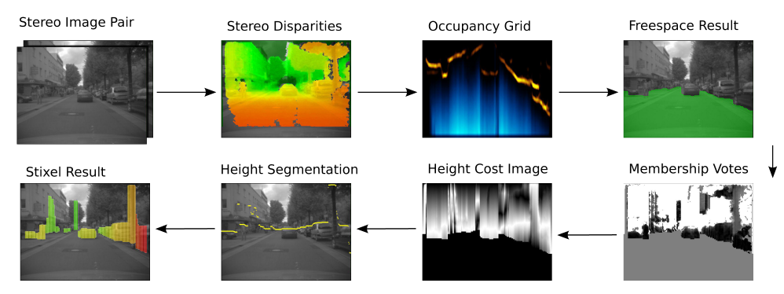
STIXEL
Figure [2.2] : Stixel Steps
-SGM provides dense stereo image
-Occupancy Grid shows the potential obstacle in the environment
-Free-space area is calculated
-In height segmentation step, upper boundaries of obstacles are obtained
Hochschule Esslingen | 02.09.2019

Slide 10
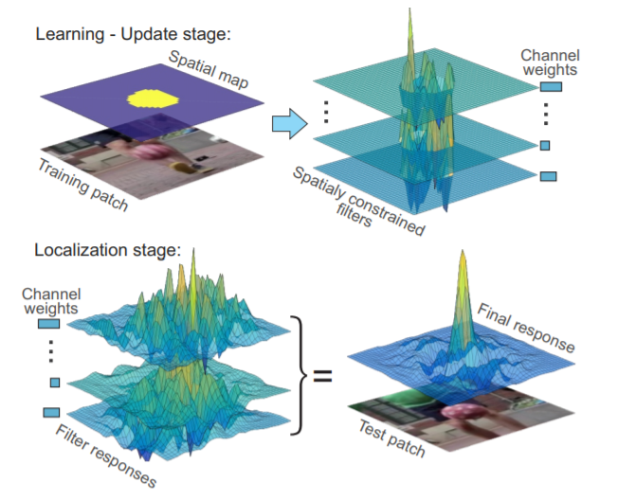
CSRT
Discriminative Correlation Filter with Channel and Spatial Reliability
Introduced by Alan Lukezic and his colleagues in 2017
Allows us to use RGB image format for tracking
Spatial reliability map adjusts the filter support to the part of the object suitable for tracking
Reliability scores reflect channel-wise quality of the learned filters and are used as feature weighting coefficients in localization
Figure [3.1] : CSRT Approach
Hochschule Esslingen | 02.09.2019

Slide 11
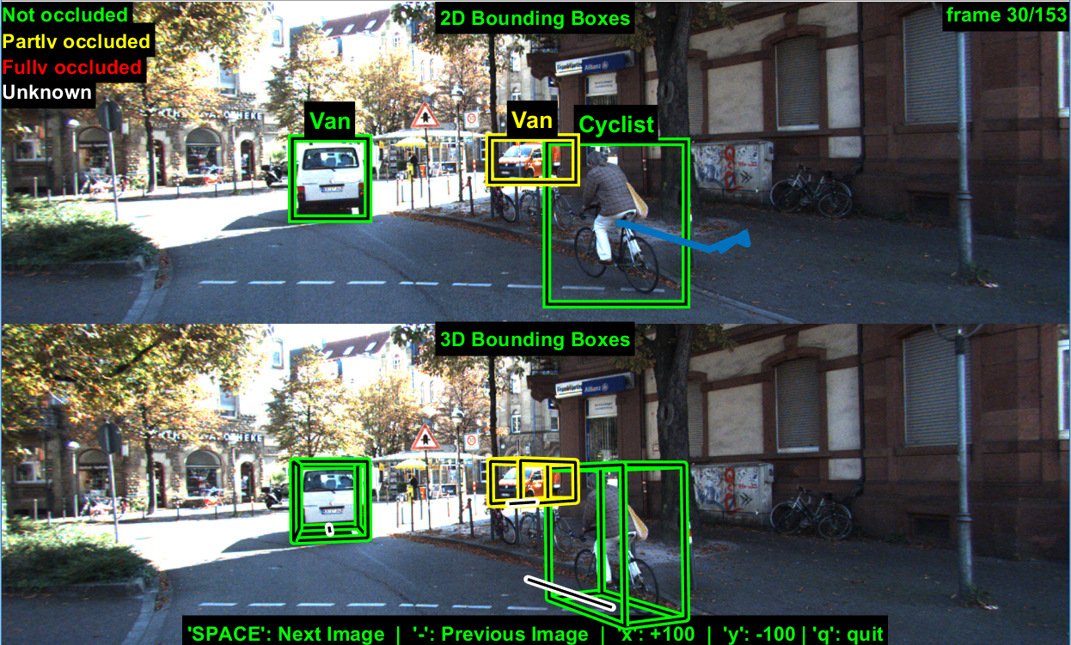
Evaluation
Dataset
KITTI Dataset ( Karlsruhe Institute of Technology
It provides tracklet data which shows objects in each frame
MATLAB was used to run tracklet.XML file
Figure [4.1] : Tracklet Image with MATLAB
Hochschule Esslingen | 02.09.2019

Slide 12
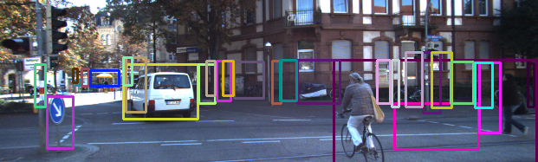
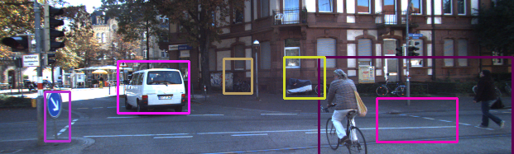
Evaluation
Object Filtering
Figure [4.2] : Unfiltered frame
Figure [4.3] : Filtered frame
Hochschule Esslingen | 02.09.2019

Slide 13
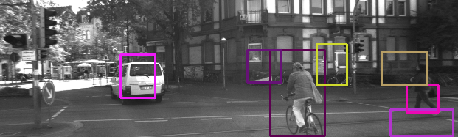
Evaluation
Tracking with Grayscale Format
Boosting, CSRT, KCF, MIL,MOSSE, TLD were selected for tracking with grayscale image
For comparison, the paths of bounding boxes were drawn
Average distance between tracklet data and our result were calculated
Figure [4.4] : Grayscale Format
Hochschule Esslingen | 02.09.2019

Slide 14
Evaluation
Figure [4.4] : MOSSE
Figure [4.5] : CSRT
Hochschule Esslingen | 02.09.2019

Slide 15
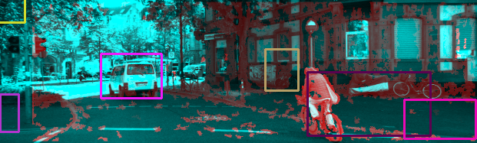
Evaluation
Tracking with RGB Format and Depth Data
Disparity Map and RBG image were merged
Red channel was changed with Disparity Map
Figure [4.6] : Disparity-GB Image
Hochschule Esslingen | 02.09.2019

Slide 16
Evaluation
Hochschule Esslingen | 02.09.2019

Slide 17
Evaluation
Distance graph is not accurate to compare results
The frame number might be taken into account for more accurate comparison
 | CSRT-RGB | CSRT-Depth
Average distance in X axis | -212,2441 | 9,0140
Average distance in Y axis | -12,6936 | 21,4357
Table [4.1] : Total average distance of CSRT-RGB and CSRT-Depth Tracking
Van1 is desired object | CSRT-Grayscale | CSRT-RGB | CSRT-Depth
Frame number | 52 | 88 | 57
Table [4.2] : The Frame numbers of trackers tracked objects successfully
Hochschule Esslingen | 02.09.2019

Slide 18
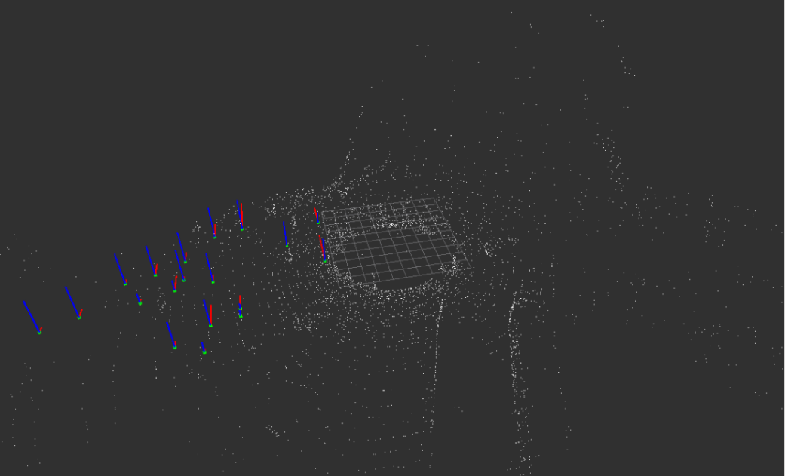
Conclusion
Depth information as 3rd channel in image format did not increase the accuracy of CSRT algorithm
It can be added as 4th channel but CSRT algorithm in Open-CV does not work with 4 channel image
The STIXEL code that was used in the project does not classify the bounding boxes. Therefore a better filtering technic is needed
ROS was used to simulate this project in 3D environment but that step could not be completed
Figure [5.1] : ROS Rviz image
Hochschule Esslingen | 02.09.2019

Slide 19


