Slide 1
METU INSTRUMENT
DC/DC CONVERTER
WITH FORWARD TOPOLOGY

Slide 2
WHY DO WE SELECT FORWARD TOPOLOGY?
ADVANTAGES:
No air gap in transformer design
Less current ripple than flyback since filtered output
Lower current ripple due to larger magnetizing inductance

Slide 3
WHY DO WE SELECT FORWARD TOPOLOGY?
DISADVANTAGES:
More components higher cost
In DCM gain changes too much
Higher voltage on mosfet and diodes

Slide 4
TOPOLOGY SELECTİON
We decide to use Reset winding to increase efficiency
Select 100kHz,
Decrease ripple voltage
Increase response of controller

Slide 5

Transformer Selection
R material has lower core loss than P material
E45959 is 2250 W core for 100kHz

Slide 6


Transformer Design
Reset windings and Primary windings same, Max D=50%
Turn ratio is 2 satisfy output gain conditions.
Minimum turn ratio should be 3 to ensure no Saturation.

Slide 7
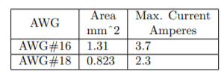
Transformer Design
Select wire according to max current;
At min. input voltage,input current is 2A
Output current is 1A.
Since system not ideal, efficiency is not 100%,

Slide 8
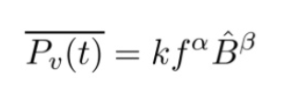

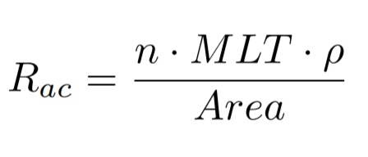
Transformer Design
Core Loss,
Copper Loss,

Slide 9
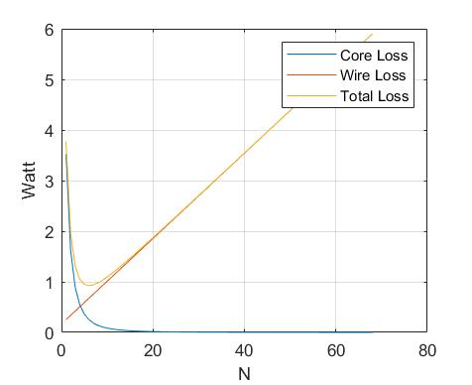
Transformer Design
Window area=550 m^2.
K_fill=0.3 litz wire.
Calculations show max N is 70.
Most efficient N=8.

Slide 10
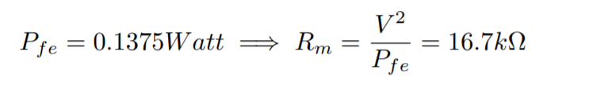
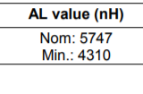

Transformer Parameters

Slide 11
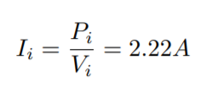
MOSFET Consideration
Voltage drop is multiple of input voltage, since Reset Winding
- Vds>100V
Aimed efficiency is 85%, so max input current,

Slide 12


Mosfet Consideration
IRF 740 N available component at lab.
R_on=0.55 ohm
t_on and t_off is much smaller than Ts

Slide 13
HeatSink
TO-220 Package
ATS-PCB1020
Rc=6.4

Slide 14
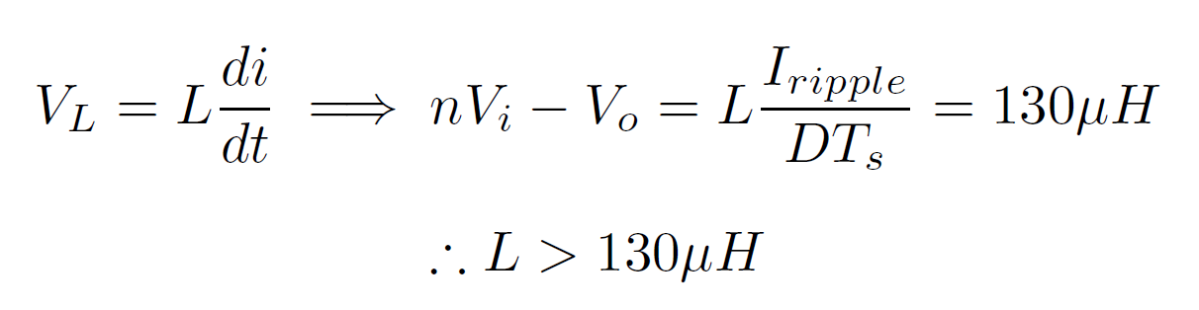
Component Selection
Output Inductor Consideration
This result is also verified by simulation, but in simulation higher value inductance are needed because of non-idealities.

Slide 15

Output Inductor Selection
CG3885-ALB 470µH inductor is chosen according to simulation results.
It has 10 A max current and 8 mΩ max DC resistance.

Slide 16

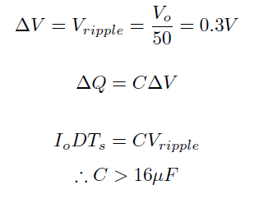
Output Capacitor Selection
This result is also verified by simulation, but in simulation higher value capacitor are needed because of non-idealities.

Slide 17
Output Capacitor Selection
860080675012 150 µF capacitor is selected.
It has 0.05 Ω ESR value and 50 V DC voltage rating

Slide 18
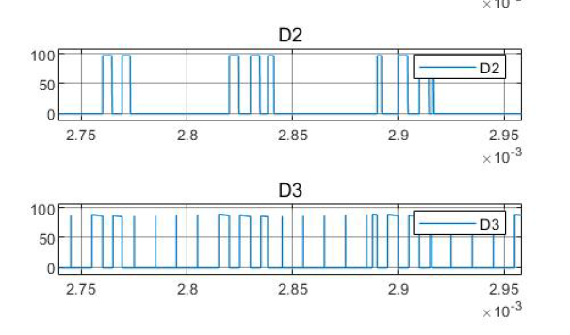
Diode Selection
Nearly 100 V has observed on diodes in simulation

Slide 19
Diode Selection
For safety, 200 V 10 A diodes are chosen (DPG10I200PM)
It has 0.98 VF and 0.1 µC recovery charge
35 ns recovery time
-> Vf*If = 0.98V *3.2A = 3.13W conduction loss
Q_{R}*V_{R}*f_{s} = 2W switching loss

Slide 20
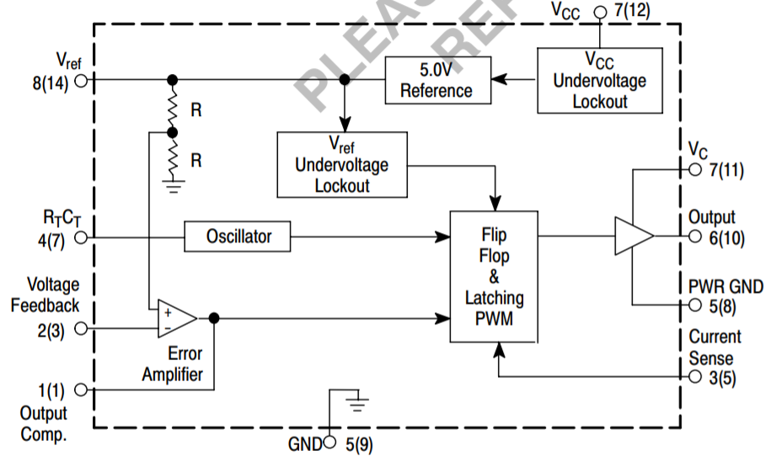
Aimed Bonuses
Analog Controller IC: UC3844

Slide 21
UC3844
Current Mode Controller
Voltage Feedback
Soft Start

Slide 22
Efficiency Bonus
As simulated at Matlab efficiency is %85.

Slide 23
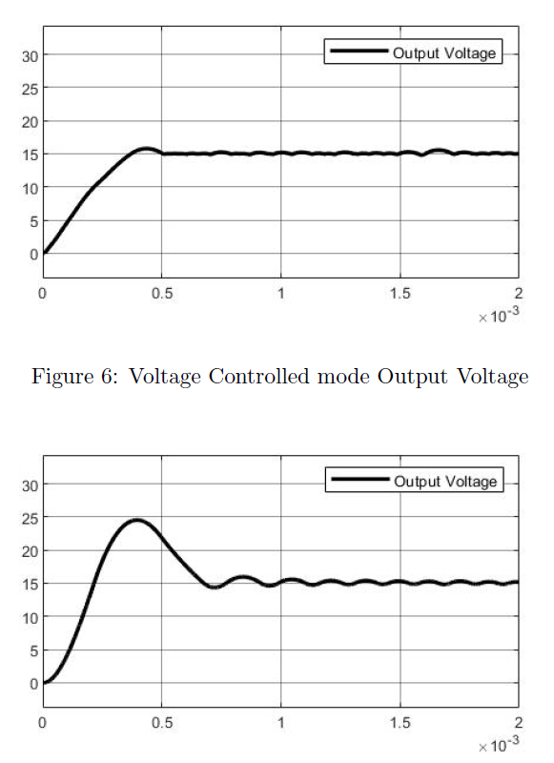
Current Mode Control
Current control Mode control decrease
oscillations and output reach steady
state faster.

Slide 24
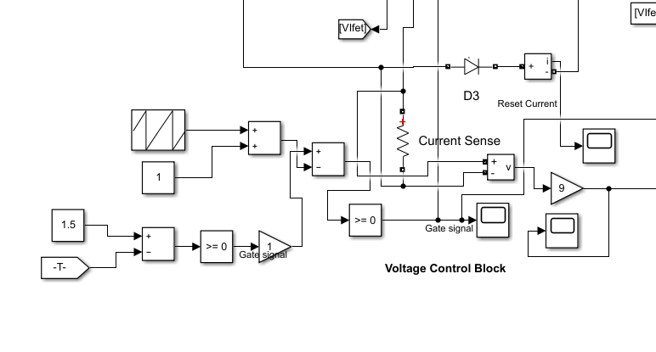
Voltage Control Block

Slide 25
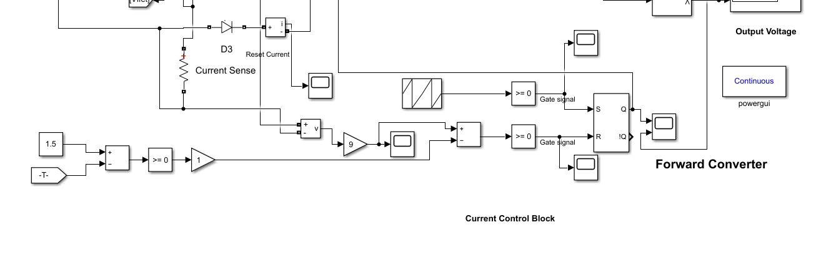
Current Control Block

Slide 26
PCB
We are planning to implement our nal circuitry on Printed Circuit Board (PCB). Because PCB has some advantages over stripboard. It is more professional than stripboard and it is less noisy. Also, after drawing proper PCB layout it is easy to implement.

Slide 27
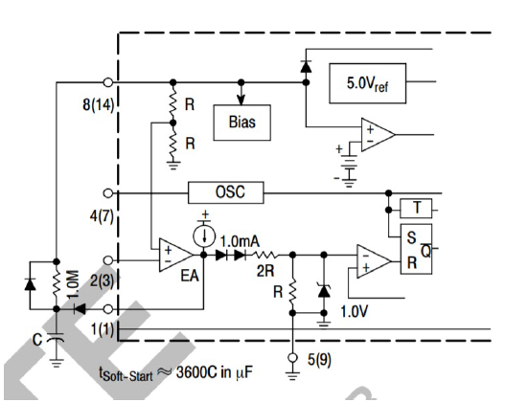
Soft Starting
Soft Starting Ciruit of UC3844

Slide 28
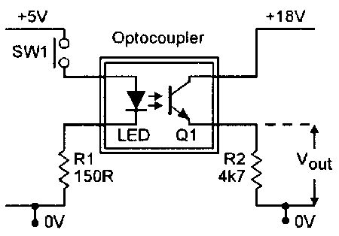
Isolation
TLP250 Optocoupler

Slide 29
