Slide 1
Unsupervised Hierarchical Learning
Burak Muammer Yıldız , Hamza Emin Hacıoğlu

Slide 2
Our Purpose
Our goal is to enable agents to autonomously discover diverse , distinguishable skills without any external reward signal. By maximizing mutual information between skills and states , the agent learns behaviors that are both varied and predictable - forming a basis for hierarchical decision making where high-level controllers can select from a repertoire of pre learned skills.

Slide 3
Our Reference Paper (Dıversıty ıs all you need)
Diversity is All You Need (DIAYN) is an unsupervised reinforcement learning method that discovers diverse skills without any external reward signal. The agent learns by maximizing mutual information between skills and states—meaning each skill should produce distinguishable behaviors that a discriminator can identify. A pseudo-reward is computed as how "surprised" the discriminator is to correctly identify the skill from the resulting state. This creates a foundation for hierarchical learning, where pre-learned skills can later be composed for complex downstream tasks. Tablo ve resim eklenecek.

Slide 4
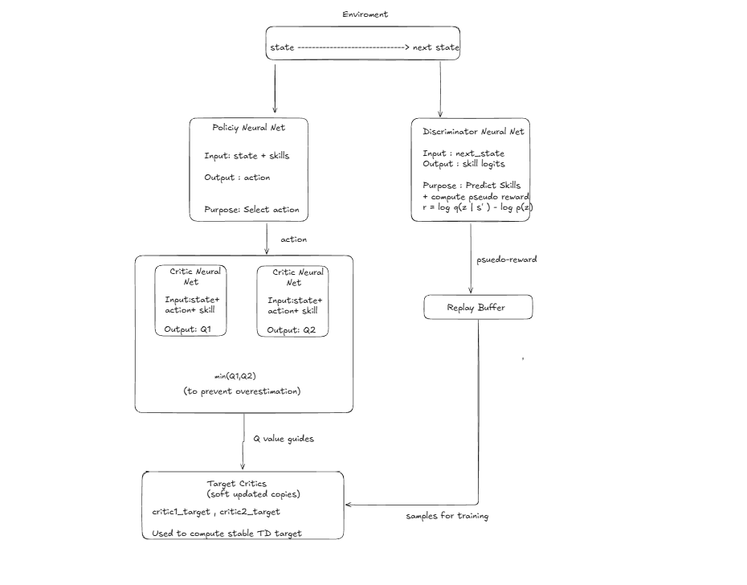
How Does Our Skıll Dıscoverıng Algorıthm Works ?

Slide 5
Our Learned Skills
I will put our skills as video.

