Slide 1
Testing

Slide 2
Ways to test:
Automated – Nunit in Xamarin
Manually – Using a checklist of written specifications

Slide 3
Pros of manual testing:
Project is only a small front end with the specifications given to us
Save time and money writing code
Lack of knowledge to write automated tests
Flexible during development

Slide 4
Functional testing
Our software must test these features
Register a student
View session
Make and cancel bookings
Search for bookings

Slide 5
Functional Requirements checklist
User can log in (username: 12345678 password: test123)
Register profile information changes when updated
A list of workshops show when selecting a category
Search results show by:
date
time
location
name and type of booking
After booking a workshop, the workshop booked displays in the “Bookings” tab
After cancelling a workshop, the workshop is removed from the booking tab
Reminders show after setting a reminder
Phone or app is notified when a reminder has passed
Able to record attendance
Be able to show status in waitlist, if booking is full

Slide 6
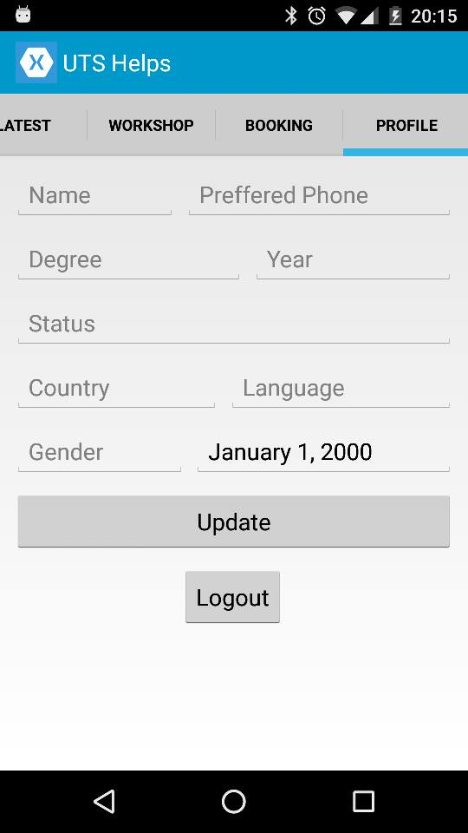
Example of register working when:
Information is displayed
Stays the same when updated

Slide 7
Non-functional requirements
Maximum 3 seconds response time when logging in
Passwords must be hidden during input
Mobile app must be skinnable
App should not crash at anytime of use
Showing information for available workshops should display in 3 seconds or less
UI must be stable on all screen sizes and devices

Slide 8
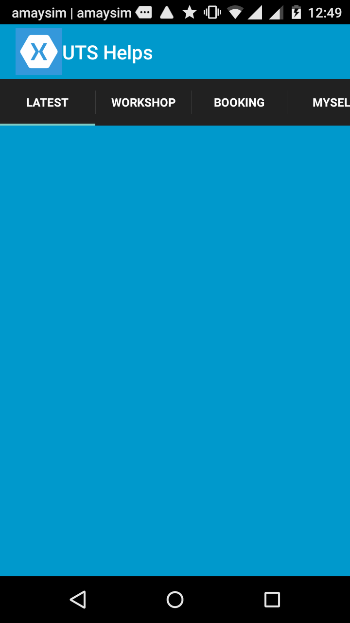
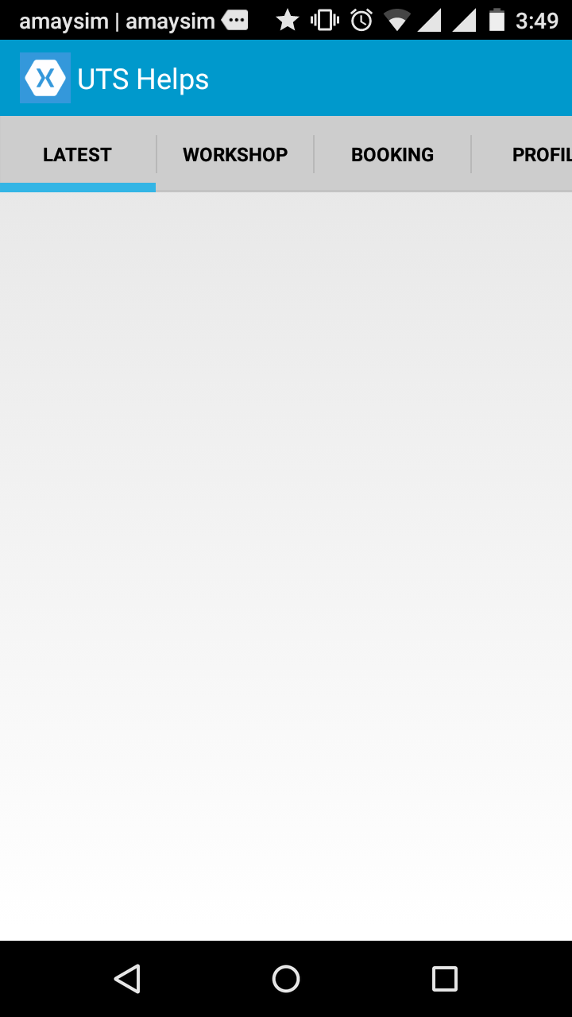
Example of skinnable
requirement
Using MVC enables us to
Easily change the layout,
Without affecting the
Functions of the app
Therefore making it
“Skinnable”

Slide 9
Defects
Defects that are found are written down on a document on google drive
The defects are logged with the commit they are found with on github
Any crashes are logged with the application output
Developers use the information to fix the bugs

Slide 10
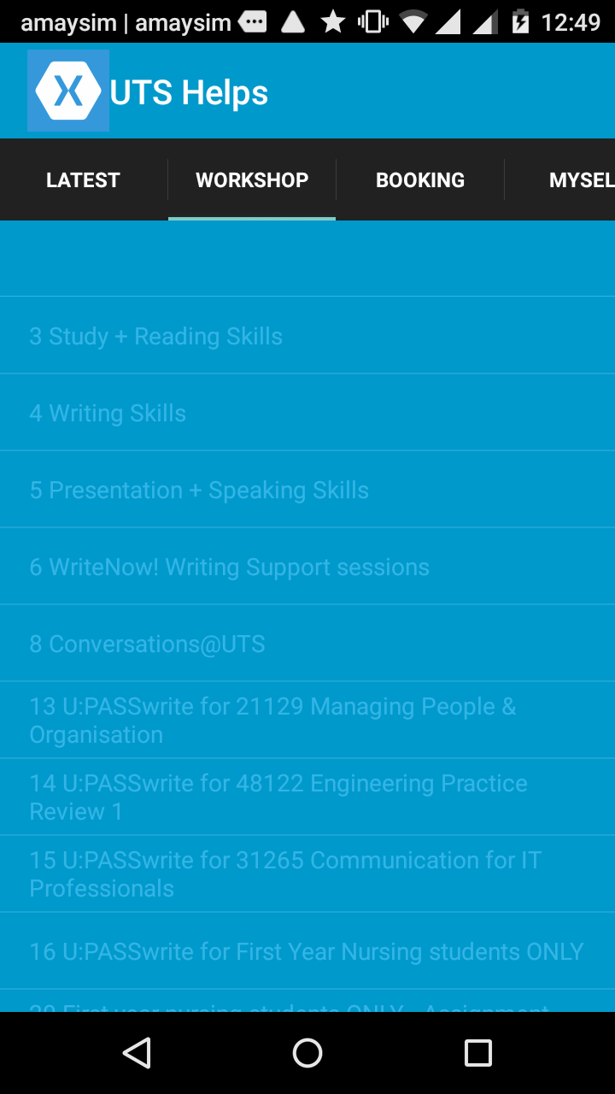
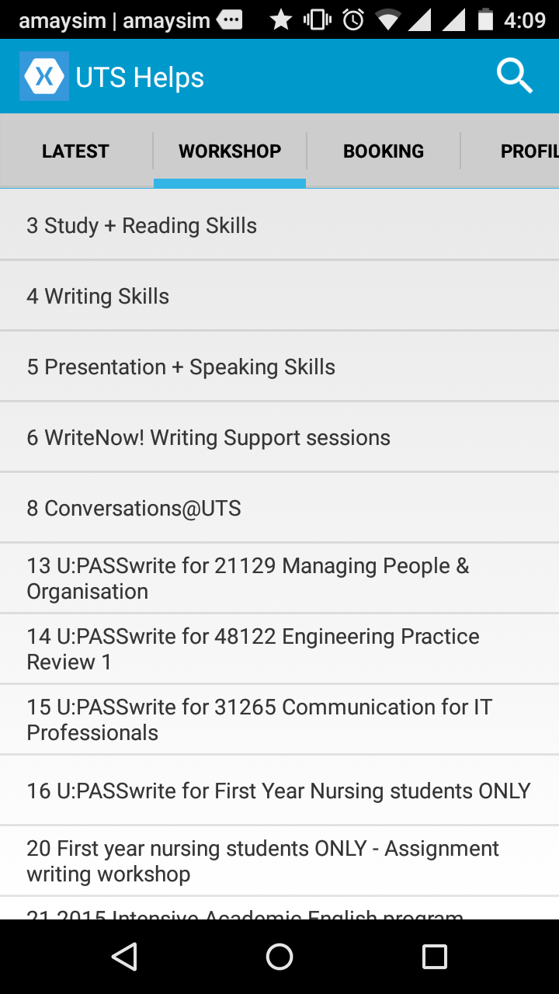
Example of a UI defect
Text was not clearly shown,
Since IOS displays differently
to android therefore causing
defects
This was fixed by changing
the android theme to
Holo Light

