Slide 1
PANZER17
Prepared by: Group 2c

Slide 2
Overview of the game
Named PANZER17, the game is based on the old TANK 1990 arcade game.The game starts with the top view of the map and tanks. Tanks will move in four directions, up, down, right and left. Tanks' first position will be generated randomly. The main purpose of this game is to protect the castle from getting destroyed by the enemies. If castle is shot by an enemy, the game ends and the enemy wins. Enemy's and user's tanks will be different in colour. The user, may move his/her tank all around the map and can shoot missiles as well. The user gains points based on enemy tanks destroyed throughout the game.If the user manages to destroy all of the enemies, stage will be cleared. The player loses the game if shot by an enemy's tank three times.

Slide 3
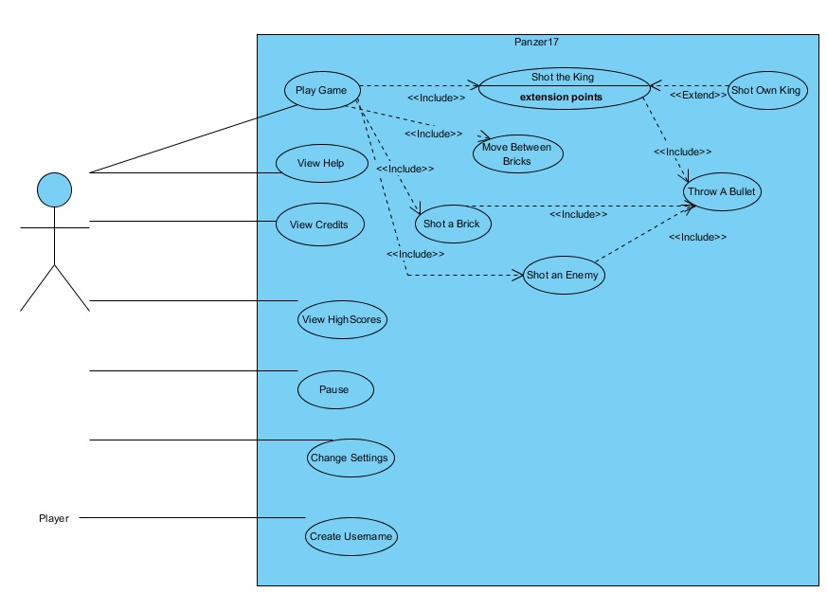
USE CASE(Expected)

Slide 4
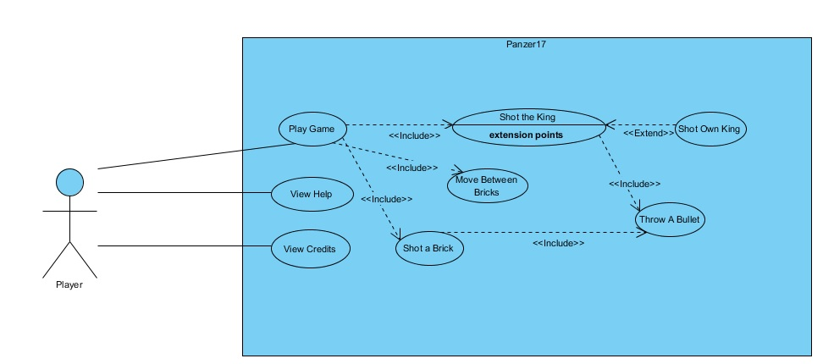
USE CASE DUE TO COMPLETION OF WORK

Slide 5
IDENTIFIED PROBLEMS AND ADDITIONS
Main Menu needed to be initialized by Main Class. So we created an additional class by Main Class.
Speed(Additional Feature):
We decided during the implementation that the speed will increase if playerTank reaches to a bonus such as the speed will increase if playerTank gets a speed bonus.
Tank Class
We divided the method moveUp() into four parts such as moveLeft(), moveRight(), moveDown() and move Up().
JavaFX
We used JavaFX to replace swing as the standard GUI library for JavaSE.
Buttons
We changed our buttons in order to implement it easily. The buttons are ‘A’ for the left direction, ‘S’ fort he down direction, ‘D’ fort he right direction and ‘W’ for the up direction.

Slide 6
TEAM WORK
We divided the implementation in four parts. The user interface subsystem belongs to
Ndriçim Rrapi, while Burak got the implementation of the Map and the classes inherit
from Map. Ferhat Serdar was responsible for the bonus implementation, which is not
done by him . Lastly, Pınar got the bullet part . During the implementation, everyone
encountered with problems and discussed these with each other. If one part could
not done by someone else, other partner did that. We should work more
synchronizely and we should manage time.

