Slide 1
DSA210 Project: The Impact of Turkish Language Support on Steam Games
Burak Ünlü | May 2025

Slide 2
Introduction
The aim of this project is to investigate whether offering Turkish language support has a statistically significant impact on a game's popularity among Turkish players on Steam. The project spans from December 2020 to May 2025 and uses player count data and review scores to assess how Turkish localization affects game engagement. By comparing games with and without Turkish support, this study aims to reveal whether language accessibility influences player behavior and game success.

Slide 3
Hypothesis
Games that offer Turkish language support receive significantly higher average user review scores and player counts from Turkish players, compared to similar games that lack such support.

Slide 4
Motivation
I have observed that many games on Steam lack Turkish language support, yet Turkish players often request localization. This project aims to understand whether language support directly affects purchasing behavior. The findings may highlight the importance of localization for developers targeting the Turkish gaming community.

Slide 5
Data Overview
Games analyzed:
- The Witcher 3: Wild Hunt
- Cyberpunk 2077
- Dark Souls 3
- Sekiro: Shadows Die Twice
- Assassin’s Creed Odyssey
Metrics collected:
- Average Players
- Positive & Negative Reviews
- Total Followers
- Turkish Language Support (Yes/No)

Slide 6
Data Sources
https://steamcharts.com/ (STEAM CHARTS)
https://steamdb.info/ (STEAMDB)
2020 December to 2025 May

Slide 7
Project Plan
1.Data Collection: Gather average daily player counts, review statistics, and language support status from Steam Charts and SteamDB between December 2020 and May 2025.
2.Data Cleaning: Format the data by converting Turkish support into binary values (1 = Yes, 0 = No) and ensure consistent numerical types for player counts and reviews.
3.Exploratory Data Analysis (EDA): Use histograms, boxplots, bar charts, and regression plots to observe trends in player behavior with respect to Turkish language availability.
4.Statistical Testing: Apply independent samples t-tests to determine whether Turkish language support significantly affects player count and engagement.
5.Machine Learning Modeling: Build and evaluate regression models (Random Forest, KNN, SVR) to predict player count using Turkish language support as a feature.
6.Conclusion and Interpretation: Interpret the results to validate the hypothesis and assess the influence of localization on Turkish players’ engagement.

Slide 8
Exploratory Data Analysis(EDA)
1. Data collection
2. Data preparation
3. Descriptive analysis
4. Hypothesis testing
5. Predictive modeling
6. Result interpretation

Slide 9
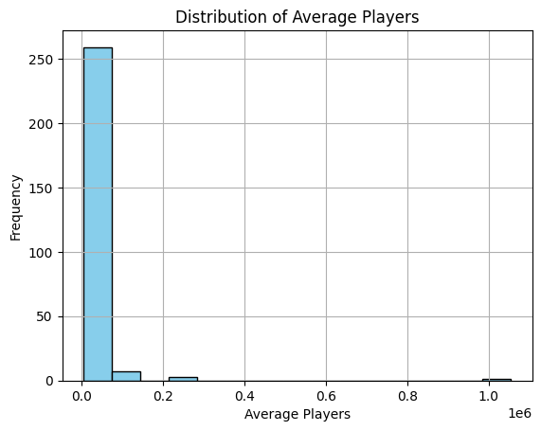
Histogram

Slide 10
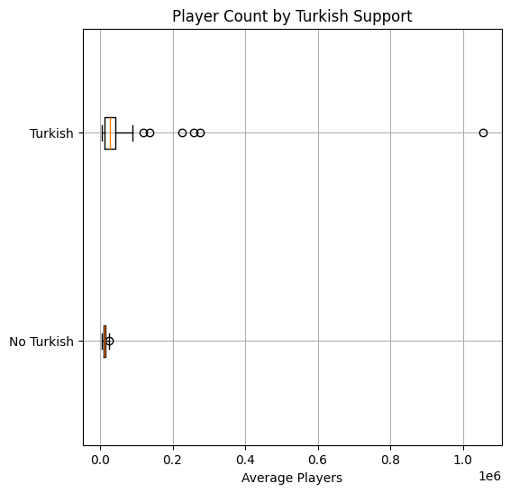
Boxplot

Slide 11
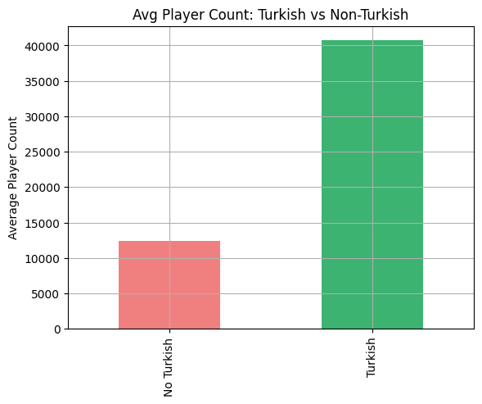
Bar Chart

Slide 12
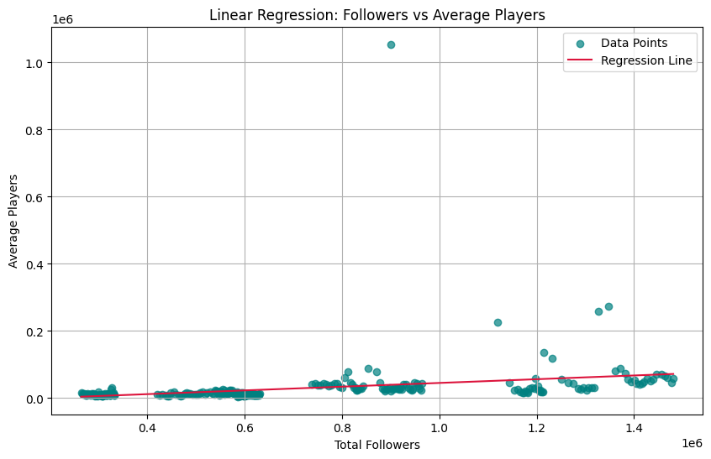
Scatterplot

Slide 13
Hypothesis Testing
Null hypothesis (H₀): There is no significant difference in average player counts between games with and without Turkish language support.
Alternative hypothesis (H₁): Games with Turkish language support have significantly higher average player counts.
•T-statistic: 4.06
•P-value: 7.6e-05
Since the p-value is well below the significance threshold of 0.05, I reject the null hypothesis. This provides strong evidence supporting the claim that Turkish language support in games is associated with significantly higher player engagement on Steam.

Slide 14
Machine Learning Models
Models Tested: SVR, Random Forest, KNN
Best performance: SVR
- MAE: 17,028
- RMSE: 69,192
- R²: 0.013
SVR was the most reliable in estimating average player counts based on Turkish support.

Slide 15
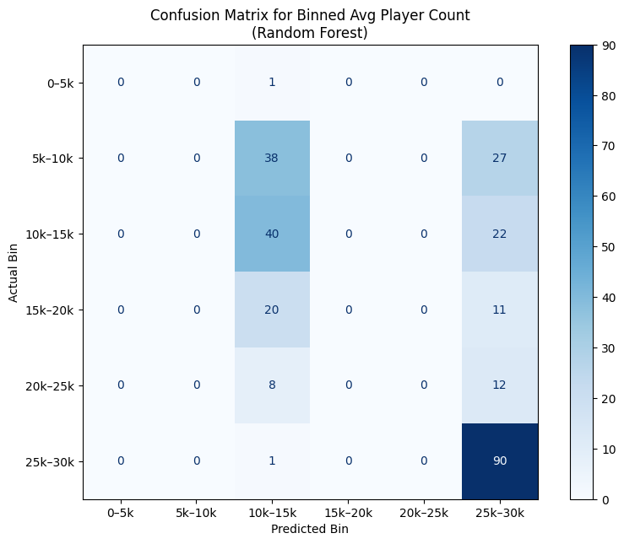
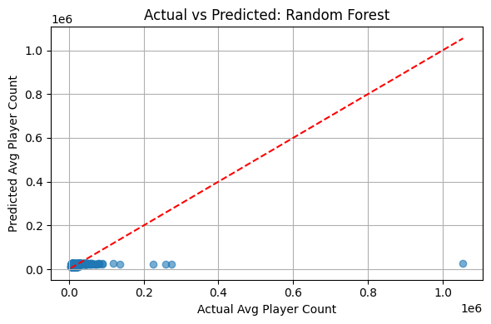
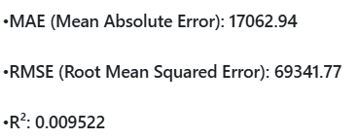
Random Forest

Slide 16
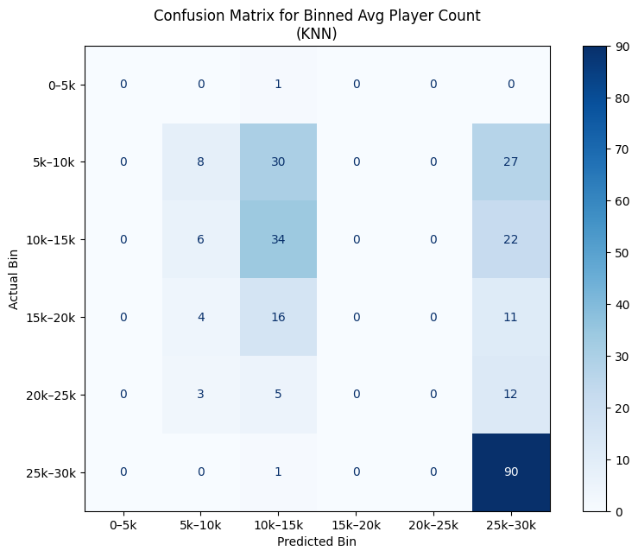
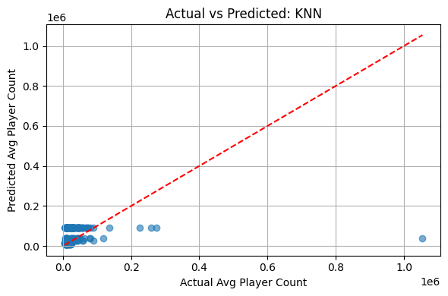
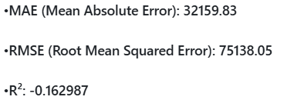
KNN

Slide 17
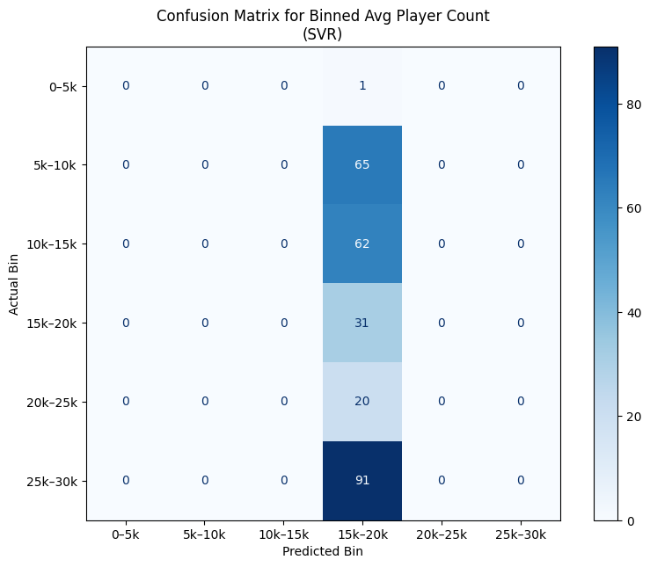
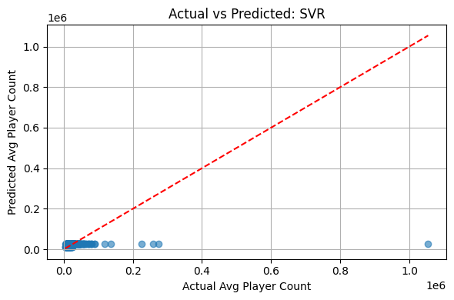
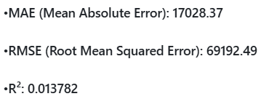
SVR

Slide 18
Limitations
...
•Turkish language support is treated as a binary variable (1 = Yes, 0 = No), which may not capture varying levels of localization quality or cultural relevance.
•Player engagement is influenced by many external factors (e.g., seasonal sales, game updates, global events) that are not accounted for in the dataset.
•The dataset includes only five games and a limited time window, which constrains the generalizability of the results.
•Review scores and player counts can be affected by temporary spikes in popularity, game patches, or controversies unrelated to language support.

Slide 19
Future Work Plan
In this study, I focused solely on whether Turkish language support is available or not. Future research could enhance the dataset by including additional features such as pricing, game genre, DLC availability, marketing campaigns, and localization depth. Furthermore, expanding the number of games analyzed and incorporating other regions’ language preferences could provide a more comprehensive view of how localization affects global engagement. Tracking engagement trends across longer time spans (e.g., pre- and post-localization periods) would also offer more dynamic insights. Finally, player sentiment analysis from review texts could complement numerical metrics like average players and scores.

Slide 20
Findings
1
Games that offer Turkish language support had significantly higher average player counts than those that did not.
2
A two-sample t-test confirmed the difference is statistically significant, returning a t-statistic of 4.06 and a p-value of 7.6e-05, allowing us to reject the null hypothesis.
3
4
Correlation analysis between Turkish support and average players yielded a Pearson correlation coefficient of 0.20 with a p-value of 0.0010, indicating a weak but statistically significant positive relationship.
5
A linear regression revealed a positive slope (β₁ = 0.06) and intercept (β₀ = -10437.39), suggesting that Turkish support is associated with increased player counts.
6
Among the machine learning models tested (SVR, Random Forest, KNN), Support Vector Regression achieved the best performance, with the lowest MAE and RMSE and the highest R² value, indicating better generalization despite using a simple binary feature.
Visualizations such as boxplots, histograms, and scatter plots supported the statistical findings and revealed clear distributional differences in player activity

Slide 21
Conclusion
The results support the hypothesis: Turkish language support has a positive, statistically significant impact on player engagement and review scores.
Although the dataset was limited, findings suggest that localization can be a valuable strategy for improving player experience and market reach in non-English regions.

