Slide 1
The Resurgance of Civil War in 2015 Turkey and JDP’s Electoral Success
PLSC 31101: Computational Tools for Social Science
Final Project
Burak Tan
Fall 2019
The University of Chicago

Slide 2
Summer 2015: Two Elections
June 7th, 2015: 40.9% 258 MPs
November 1st, 2015: 49.8% 317MPs
5 months, 5 million votes, 1 Civil War

Slide 3
Question and Hypothesis
Question: What is the relationship between the increased JDP votes and the resurgence of violence?
Hypothesis: JDP increased its votes predominantly in the districts and regions affected by the civil war

Slide 4
Data
Election results: Turkish Supreme Electoral Council
85 electoral districts
Regional classification: NUTS Data from European Union
11 geographical regions
Impact of the war: UCDP Data on Battle Related Deaths
Georeferenced Event Dataset (GED) Global version 19.1
Limited to ‘‘Government of Turkey’’ (June 7 – Nov 1)

Slide 5
Challenges
Turkish alphabet, special characters, inconsistent bureaucrats, bizarre district name coding conventions
Reading PDFs and Excel documents in R
I → ı | Ş → S | İstanbul → istanbul
İ → i | Ç → C | Iğdır → Igdir / igdir

Slide 6
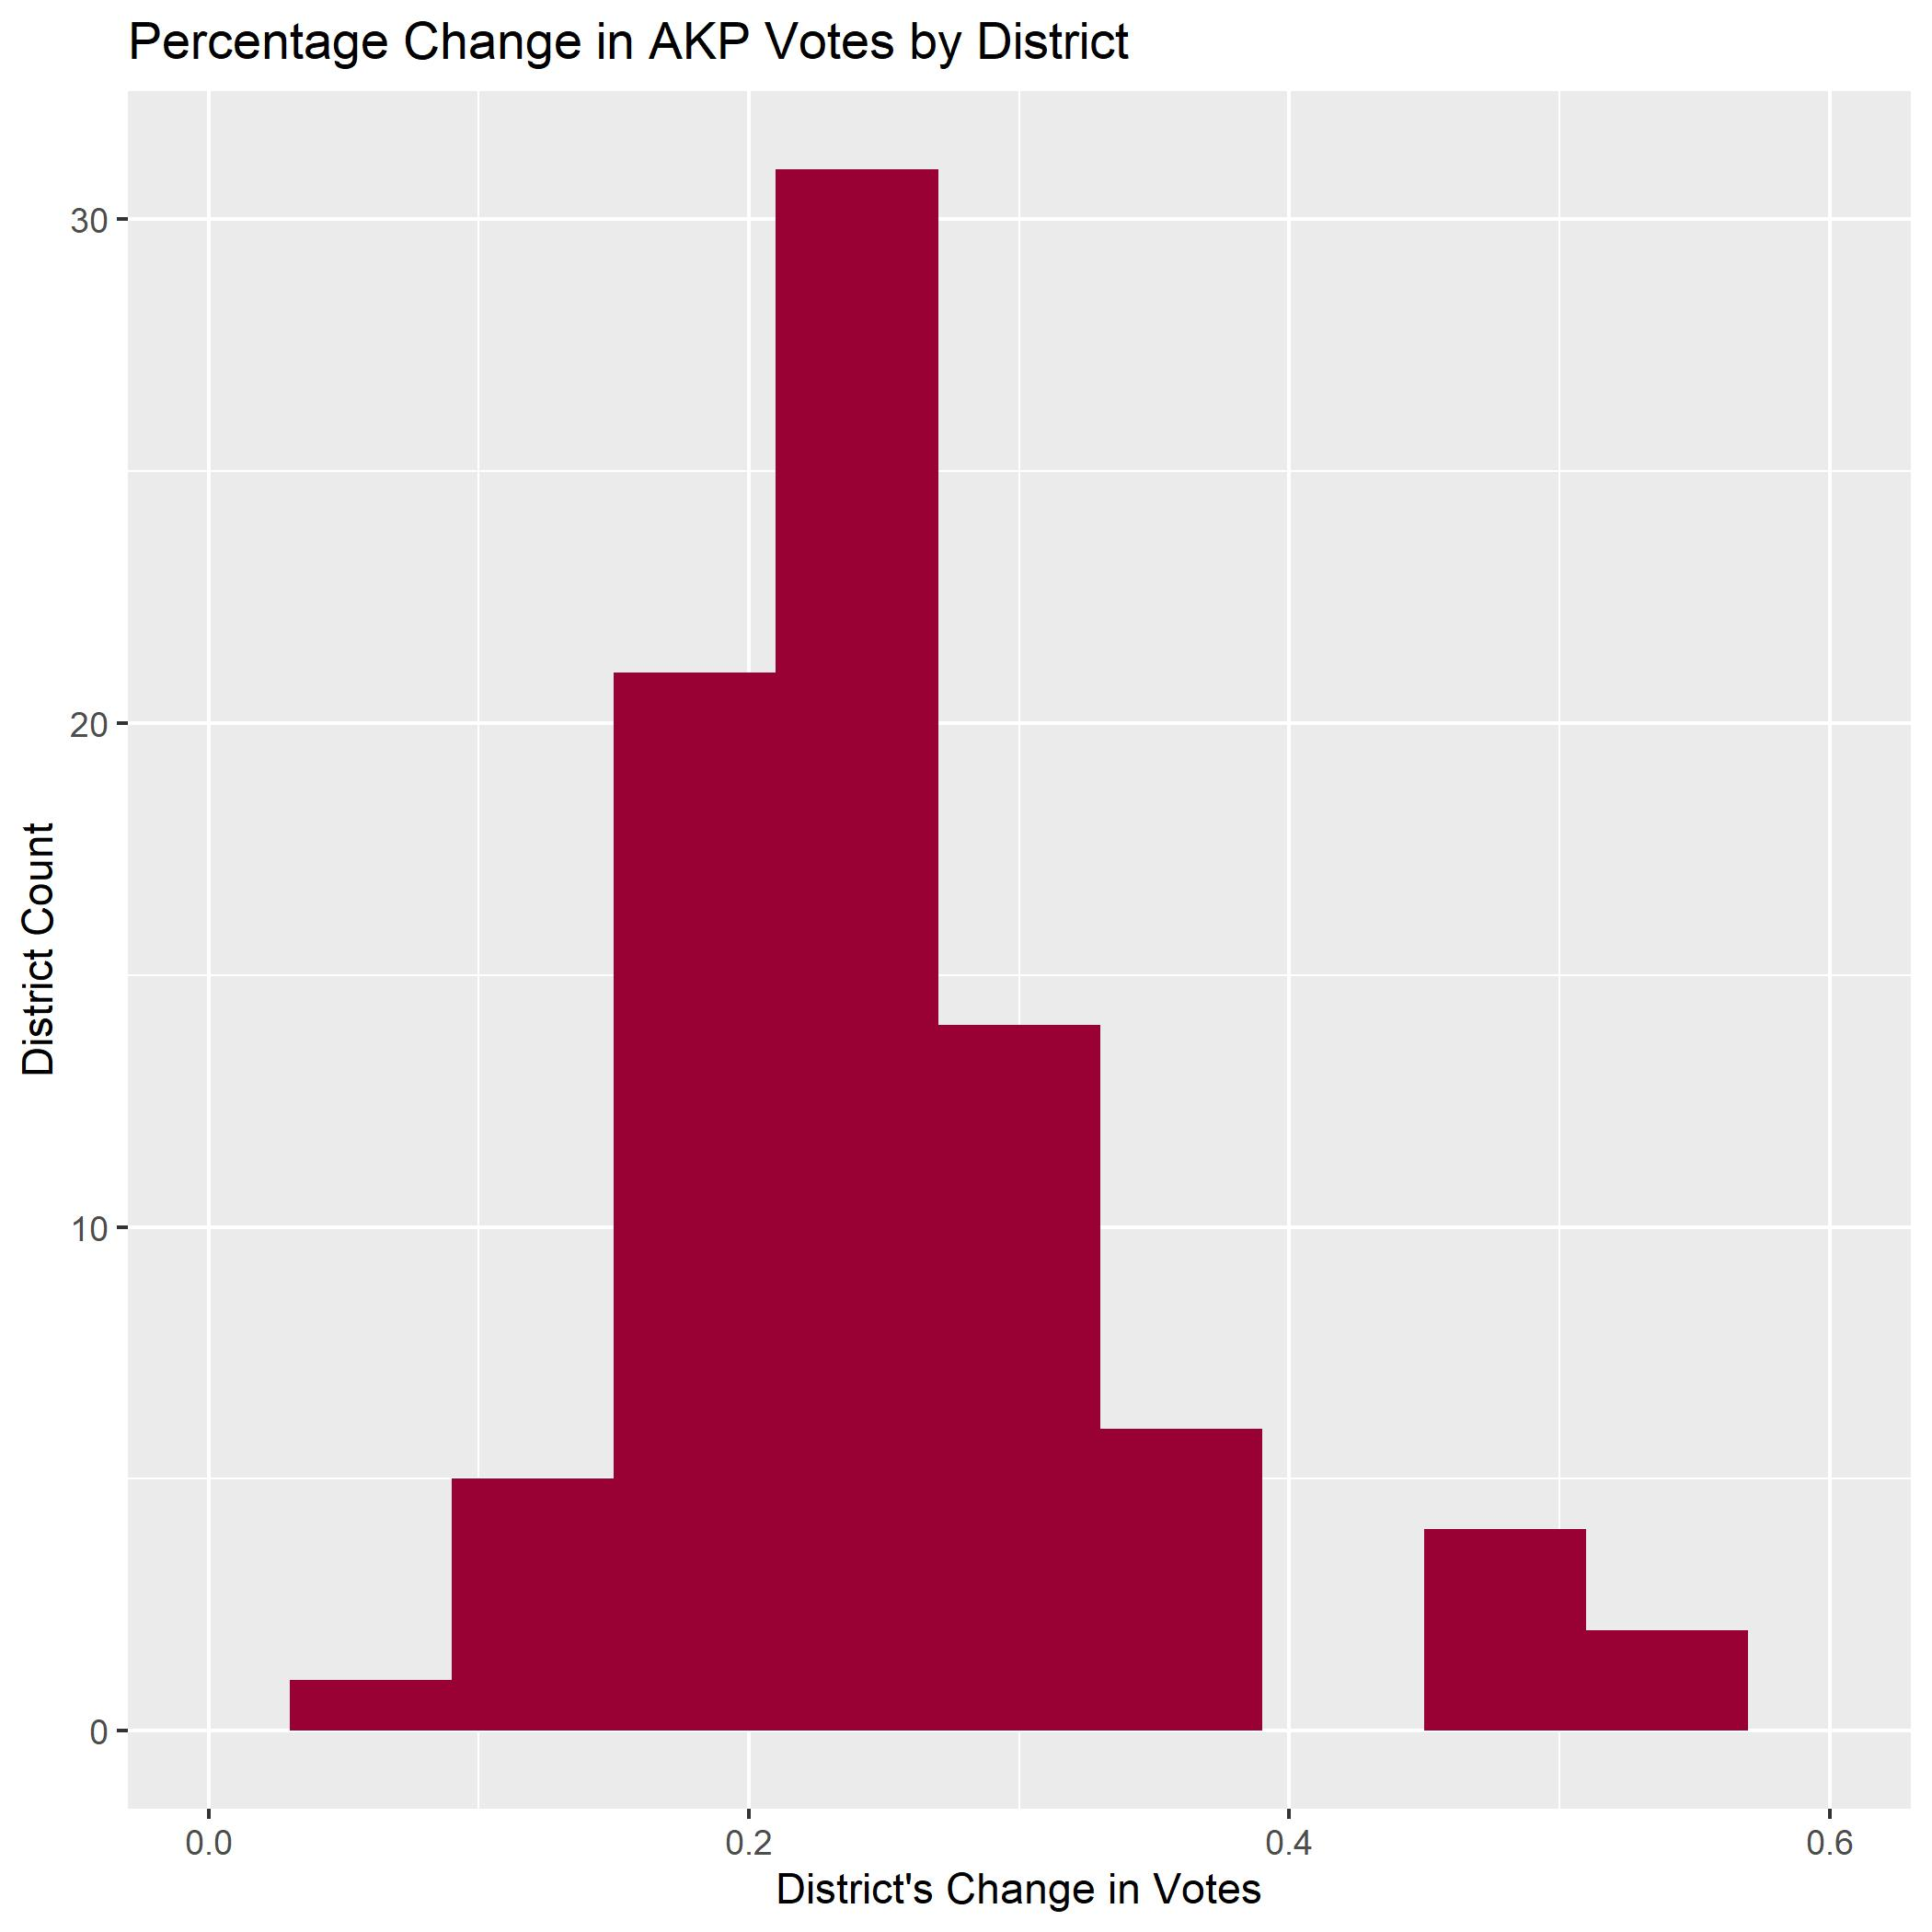
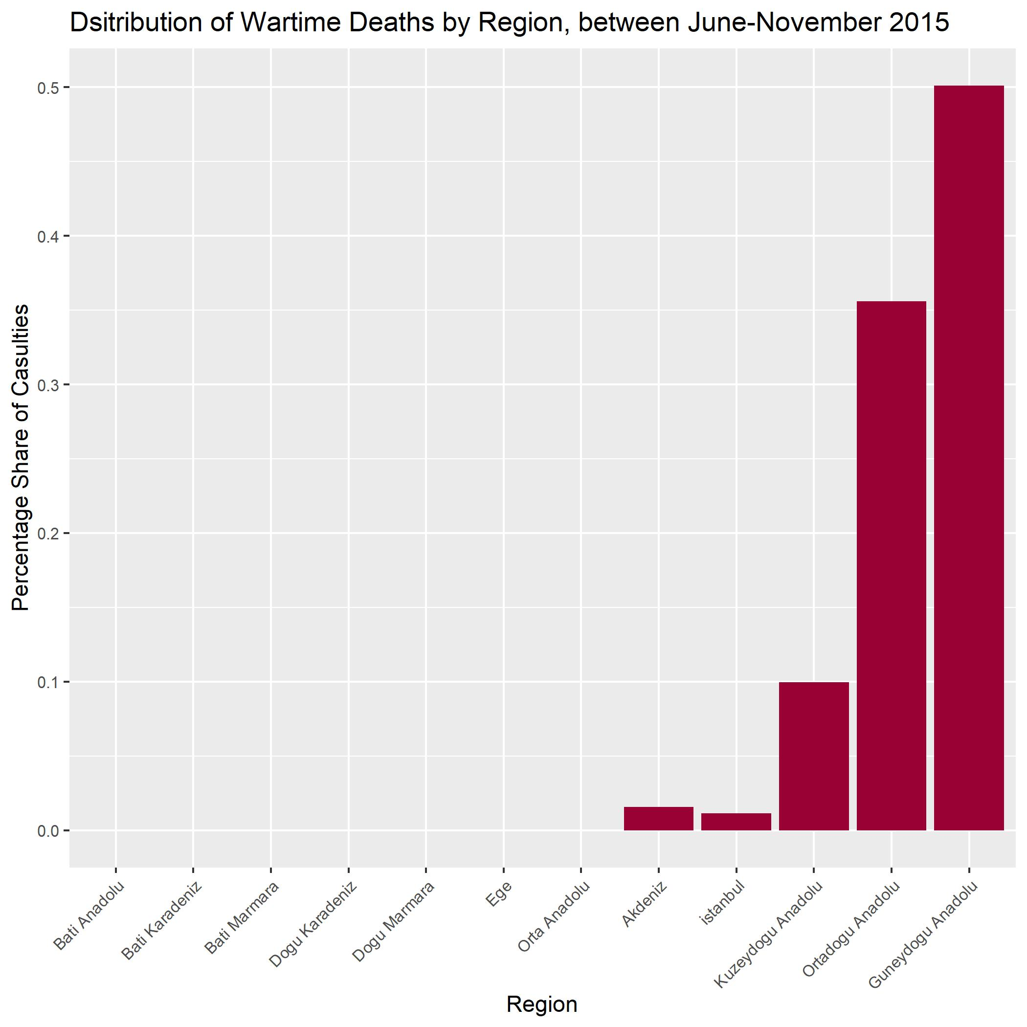
Results

Slide 7
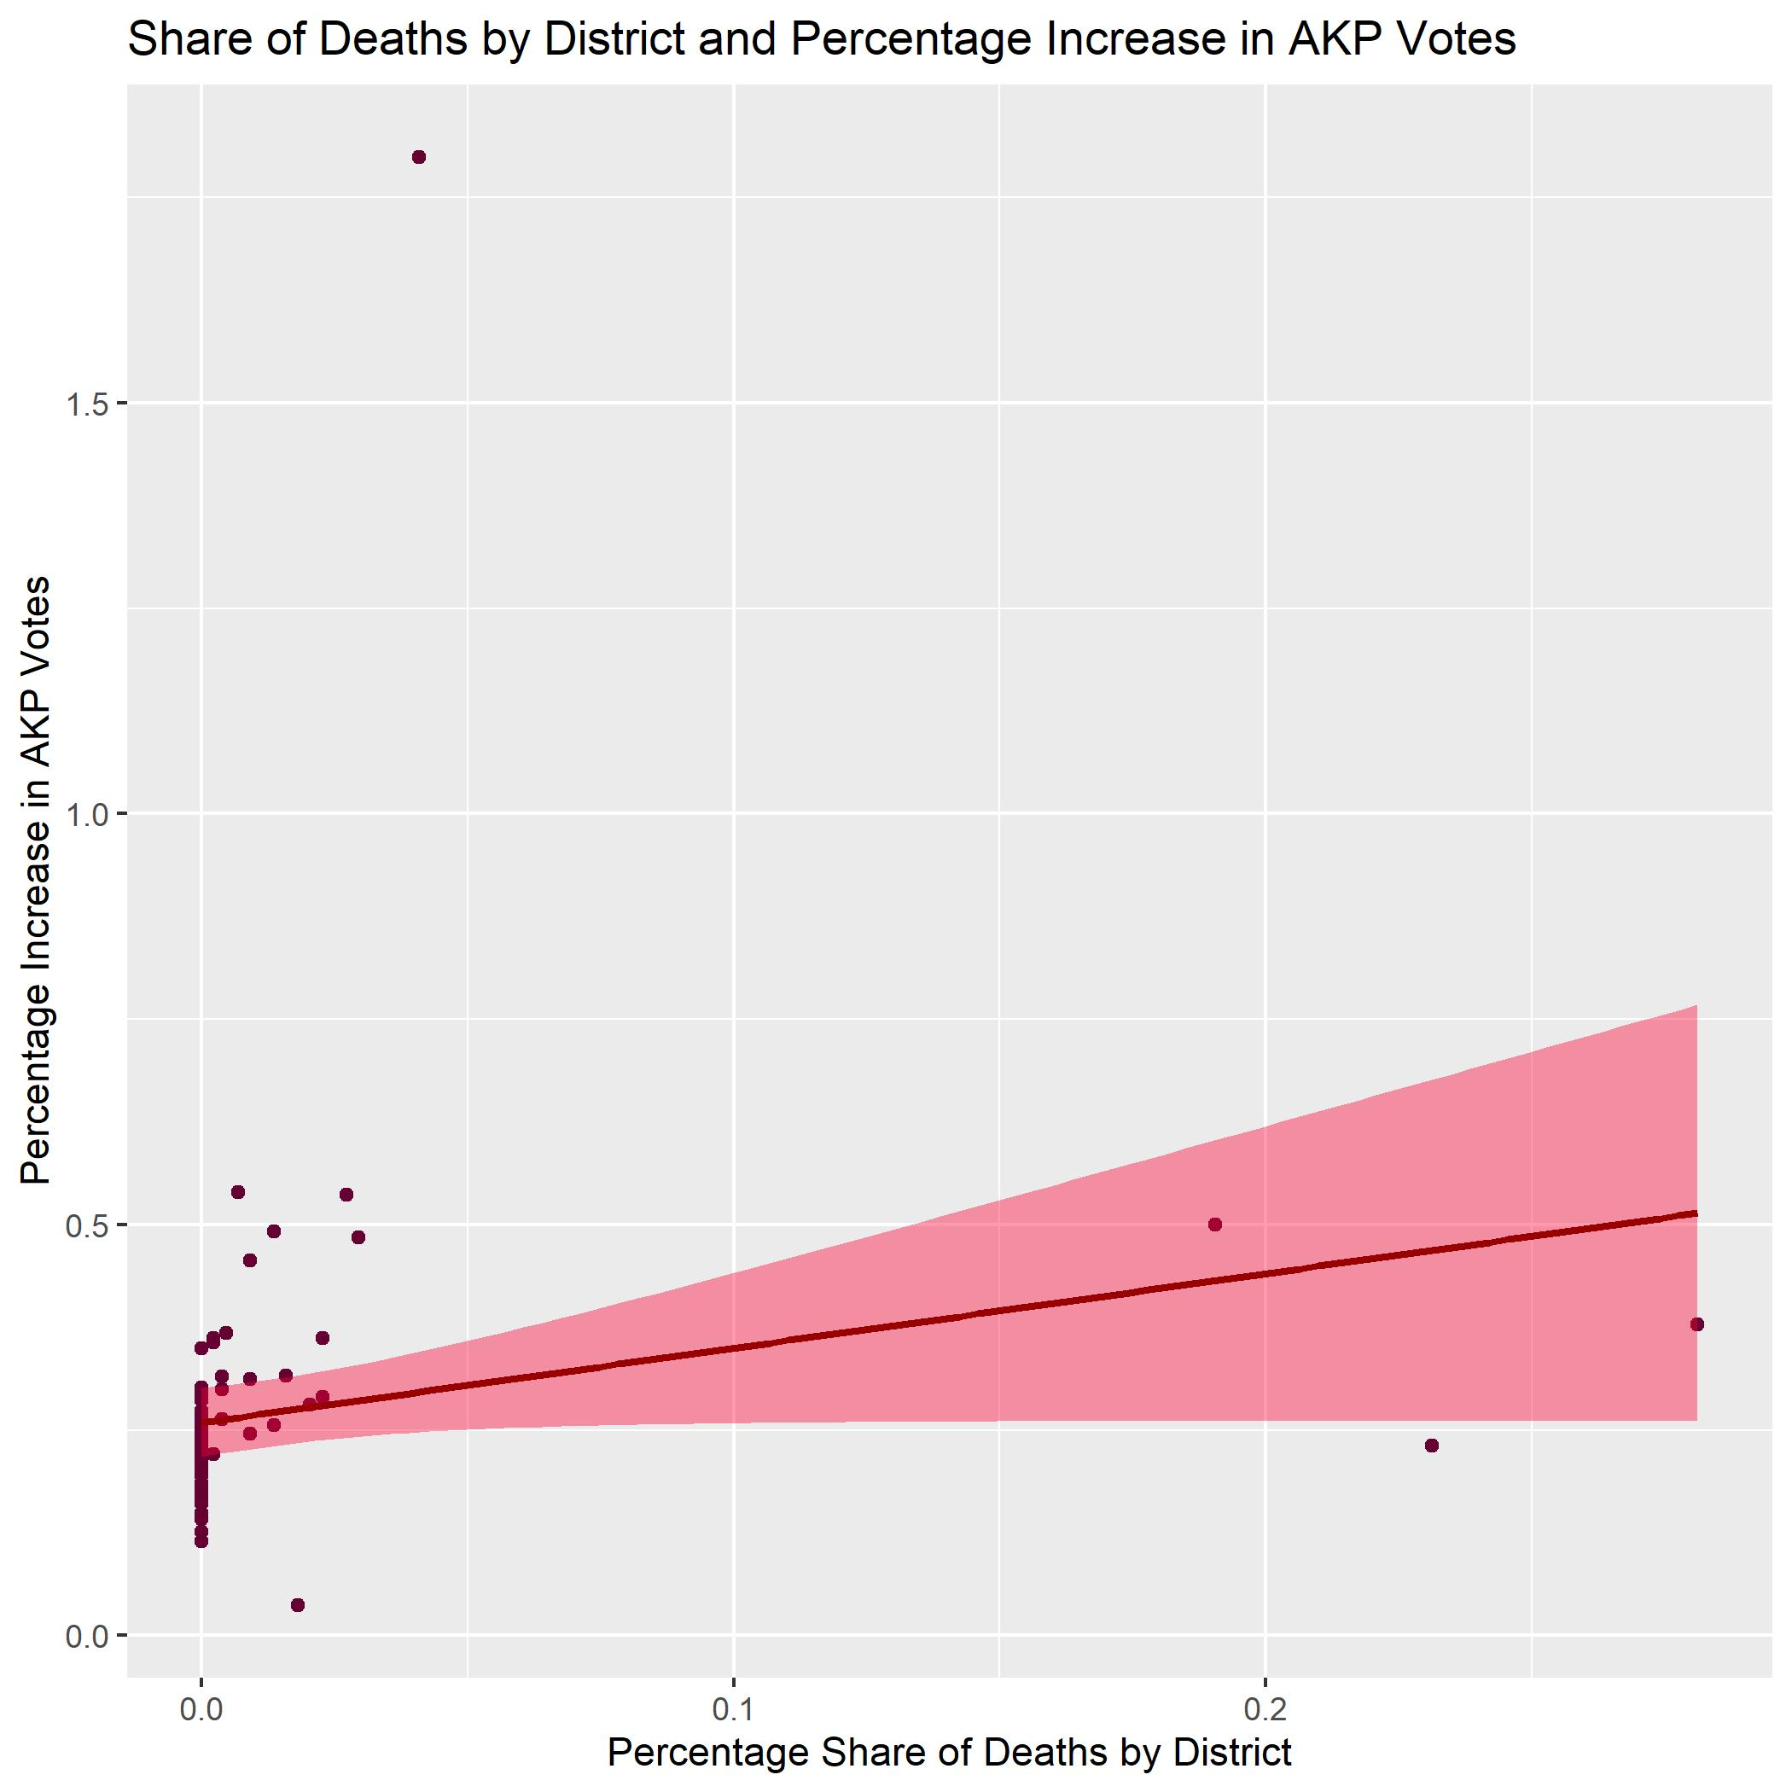
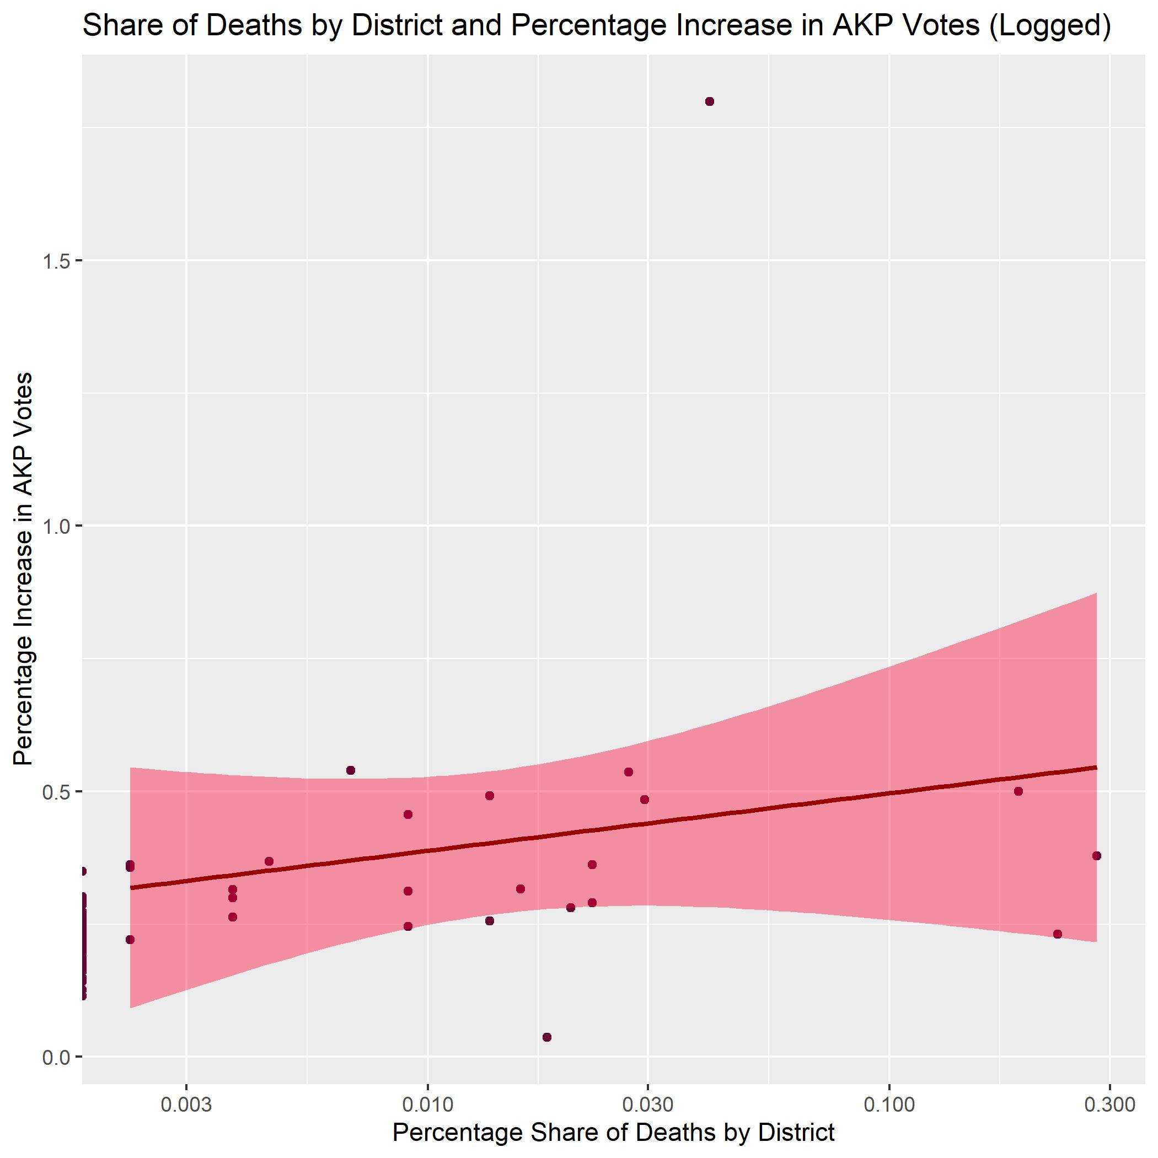
Results

Slide 8
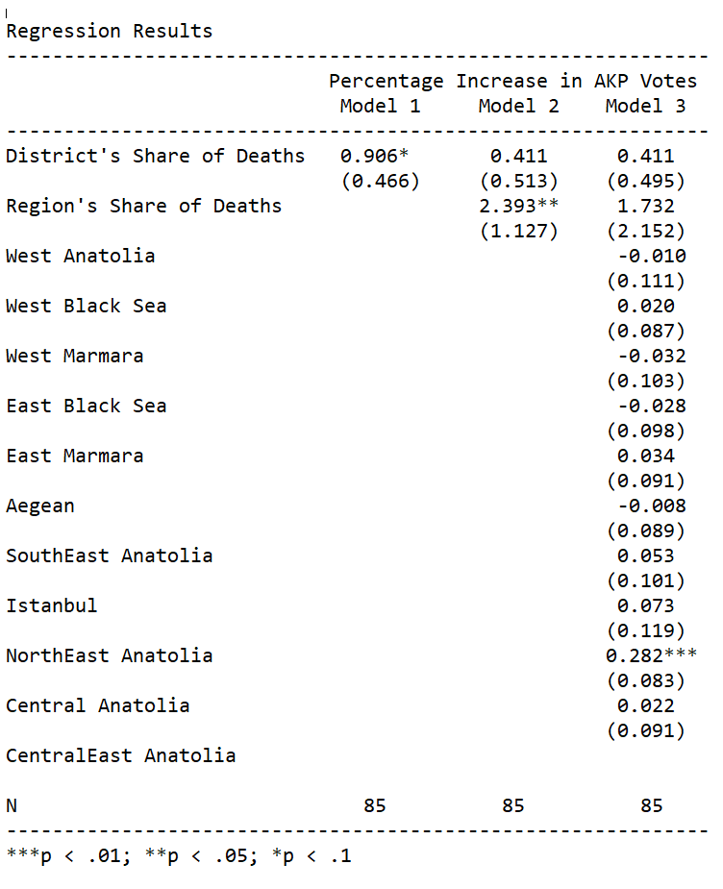
Results

