Slide 1
The Good, the Bad, and the Ugly (Charts)
CM Burch

Slide 2
On Charts

Slide 3
Charts Convey Information Quickly

Slide 4
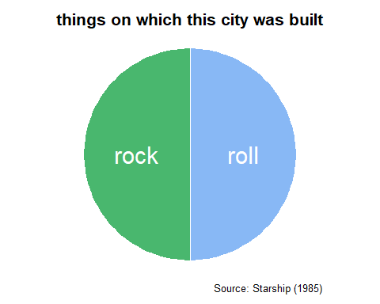
""

Slide 5
Why Do We Care About Junk Charts?

Slide 6
How To Identify Junk Charts

Slide 7
The Culprits

Slide 8
The Good

Slide 9
The Bad

Slide 10
The Ugly

Slide 11
Elements of Data Analytic Style
Less is More Colors encode data differences

Slide 12
Some Common Mistakes and How to Fix Them
Pie Charts
Pie chart problems Pie chart conventions

Slide 13
Slide with R Output

Slide 14
References
Fung, Kaiser. (2020)[1]. The Unspoken Rules of Visualisation (and when to break them). DataJournalism. https://datajournalism.com/read/longreads/the-unspoken-rules-of-visualisation-and-when-to-break-them
Fung, Kaiser. (2020)[2]. Junk Charts: Recycling Chartjunk as Junk Art. https://junkcharts.typepad.com
Harris, Robert L. (1999). Information Graphics: A Comprehensive Illustrated Reference. USA: Oxford University Press. ISBN 0-19-513532-6.
Leek, Jeff. (2014). The Elements of Data Analytic Style: A guide for people who want to analyze data.
Tufte, Edward R. (1983). The Visual Display of Quantitative Information. Cheshire, CT: Graphics Press.
Tufte, Edward R. (2006). Beautiful Evidence. Cheshire, CT: Graphics Press. ISBN 978-0961392178.
Wilke, Claus O. (2019). Fundamentals of Data Visualization: A Primer on Making Informative and Compelling Figures. Sebastopol, CA: O’Reilly Media, Inc. ISBN 978-1-492-03108-6

