Slide 1
MaxUMC - A Library For Unstructured Mesh Computation

Slide 2
Overview
MaxUMC is a domain specific language for generic physics problems on unstructured meshed.
The main target is explicit time integration of PDEs, or more generally, numerical methods of explicit and iterative type.
MaxUMC offloads the most compute intensive elements of the simulation from the CPU to the DataFlow Engine (DFE) achieving orders of magnitude speedup.

Slide 3
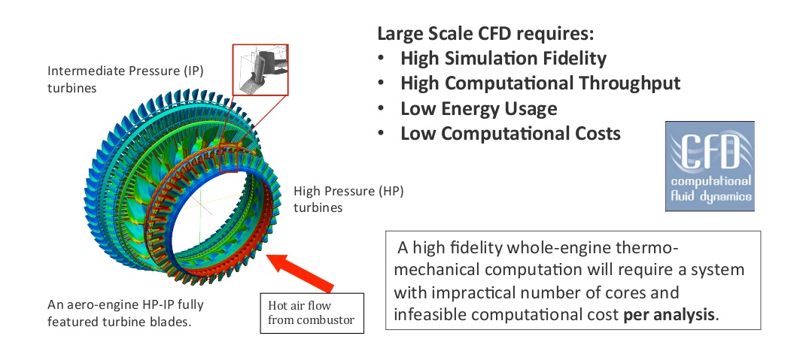
Example Use Case - CFD
Problem Features:
Complex geometry -> Unstructured Mesh
Massive Scale – Millions+ of Degrees of Freedom

Slide 4
Example Use Case - CFD
Problem Features:
Complex geometry -> Unstructured Mesh
Massive Scale – Millions+ of Degrees of Freedom

Slide 5
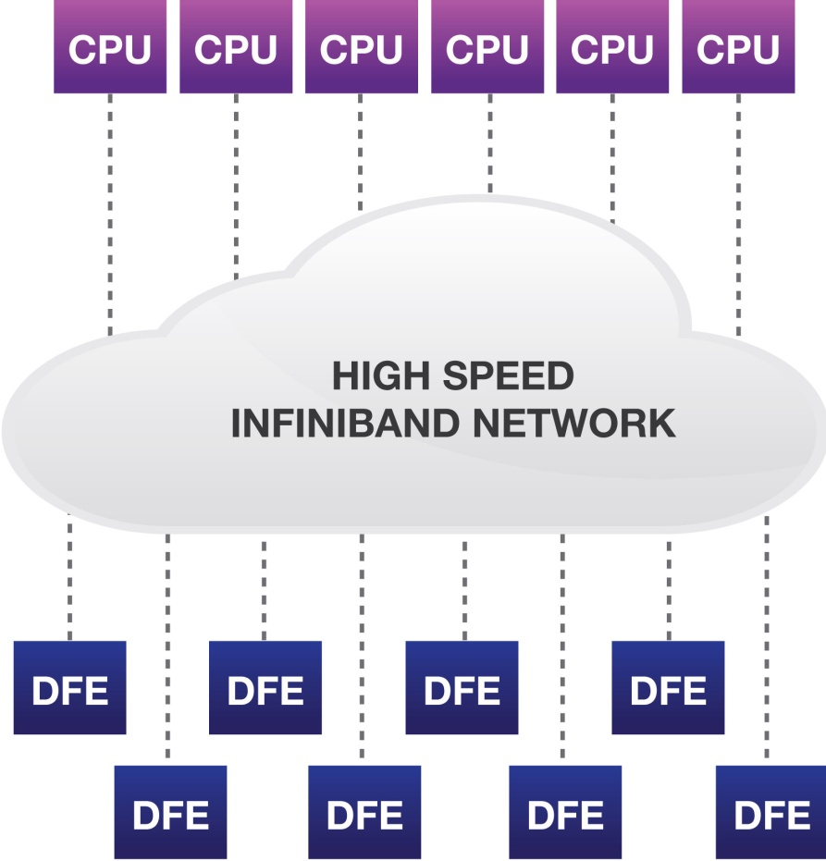
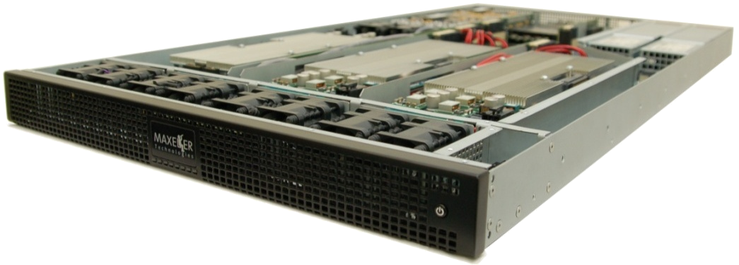
MaxUMC Can Be Executed on MPC-X Series
8 dataflow engines (384GB RAM)
High-speed MaxRing
Zero-copy RDMA between CPUs and DFEs over Infiniband
Dynamic CPU/DFE balancing
5

Slide 6
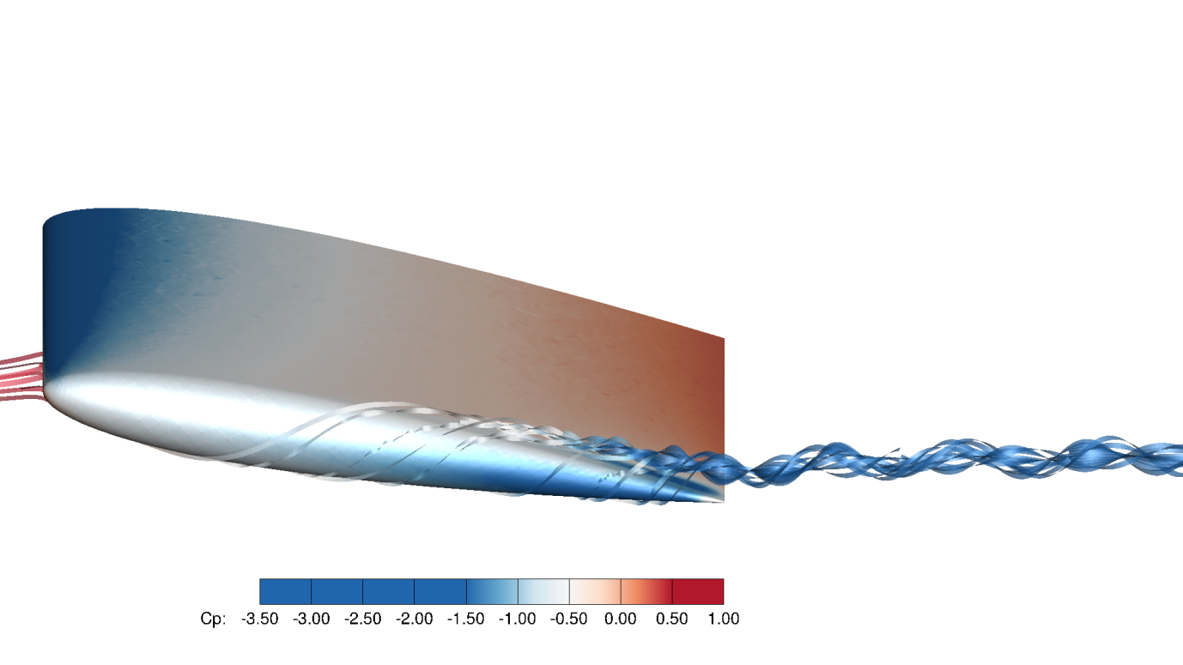
Prior Unstructured Mesh Performance on Maxeler Hardware
Developed in collaboration with Imperial College London.
Finite Element CFD solver.
6.4M Degrees Of Freedom.
13.8x speedup vs 1x CPU.
3x speedup vs 12x CPU.
Single DFE implementation only.

