Slide 1
MaxUMC - A Library For Unstructured Mesh Computation

Slide 2
Overview
MaxUMC is a library for generic physics problems on unstructured meshes.
The main target is explicit time integration of PDEs, or more generally, numerical methods of explicit and iterative type.
MaxUMC offloads the most compute intensive elements of the simulation from the CPU to the DataFlow Engine (DFE) achieving orders of magnitude speedup.

Slide 3
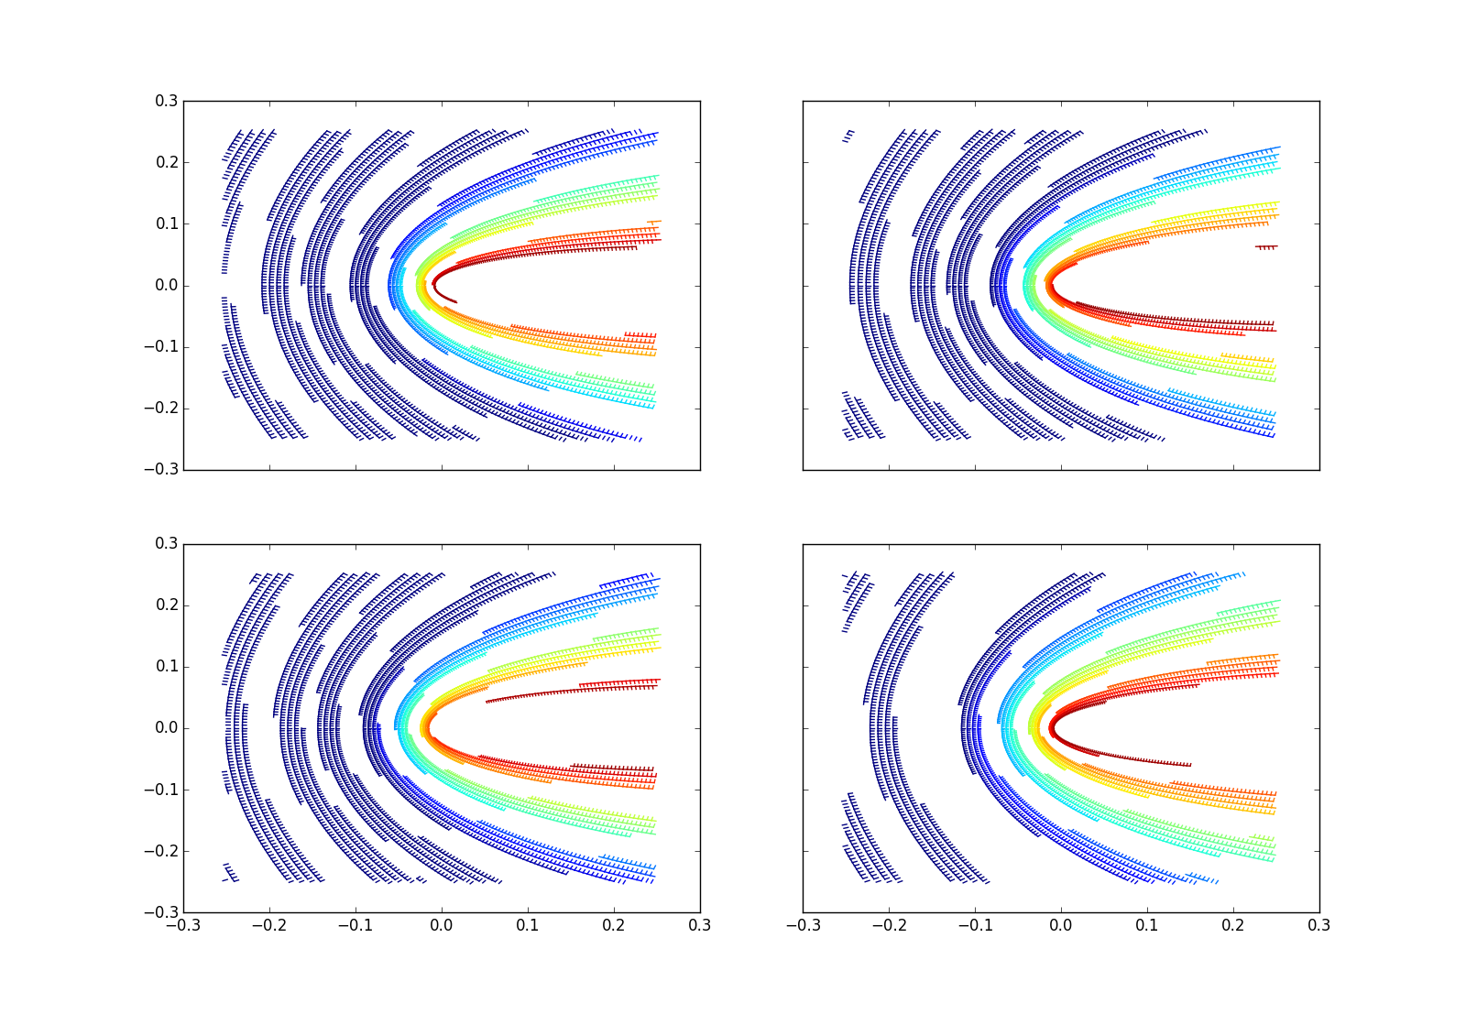
MaxUMC CPU Libraries
Automatic domain decomposition and colouring based on the mesh structure.
Run only once per mesh, reuse for different computational tasks.
Domain decomposition automatically scales over available hardware at runtime.

Slide 4
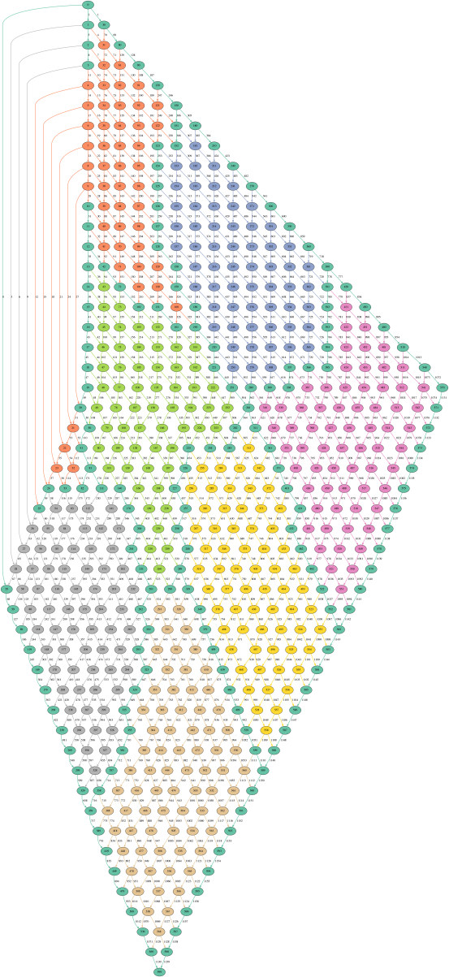
CPU/DFE Load Sharing
DFE handles bulk compute which dominates runtime.
CPU handles boundary compute and communication.
MaxGenUMC software libraries decompose the domain and re-order the compute automatically for maximum efficiency.

Slide 5
CPU -> DFE Communication
DRAM
Data
Variable
Input
Input
Buffer
Compute
Data
Mux
PCIE
Data
Variable
Input
MaxGenUMC libraries manage unstructured communication.
Bulk data from DRAM may be combined with boundary data from the host.
The choreography of this data is precomputed by MaxGenUMC software libraries.

Slide 6
DFE -> CPU Communication
Accum.
Buffer
Reorder
Buffer
Variable
Output
DRAM
Data
Computed
Data
DeMux
Variable
Output
PCIE
Data
MaxGenUMC libraries manage unstructured communication.
The host merges data from different DFE domains.
MaxGenUMC libraries performs unstructured reduction and reordering operations.
The choreography of this data is precomputed by MaxGenUMC software libraries.

Slide 7
Example – Airfoil (Finite Volume)
The Airfoil example is a Finite Volume CFD example.
It performs flux reconstruction to find a steady state flow using a predictor/corrector method.
The example is very heavily adapted from an example from the OP2 package, an open-source framework for the execution of unstructured grid applications, developed at Oxford University.

Slide 8
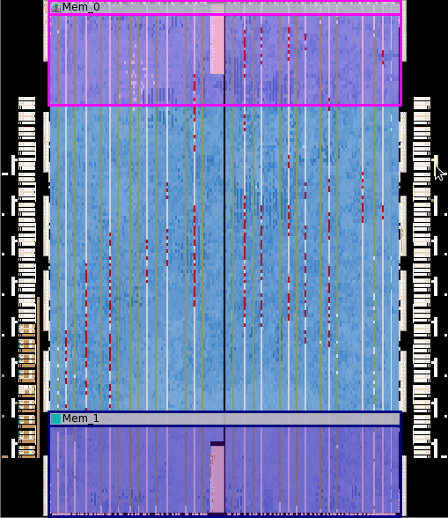
MAIA Performance
Double Precision
1.5*10^8 Mesh Nodes Per Second Per DFE
Logic Utilization = 94.81%
Multiplier Utilization = 18%
FMEM Utilization = 89%

Slide 9
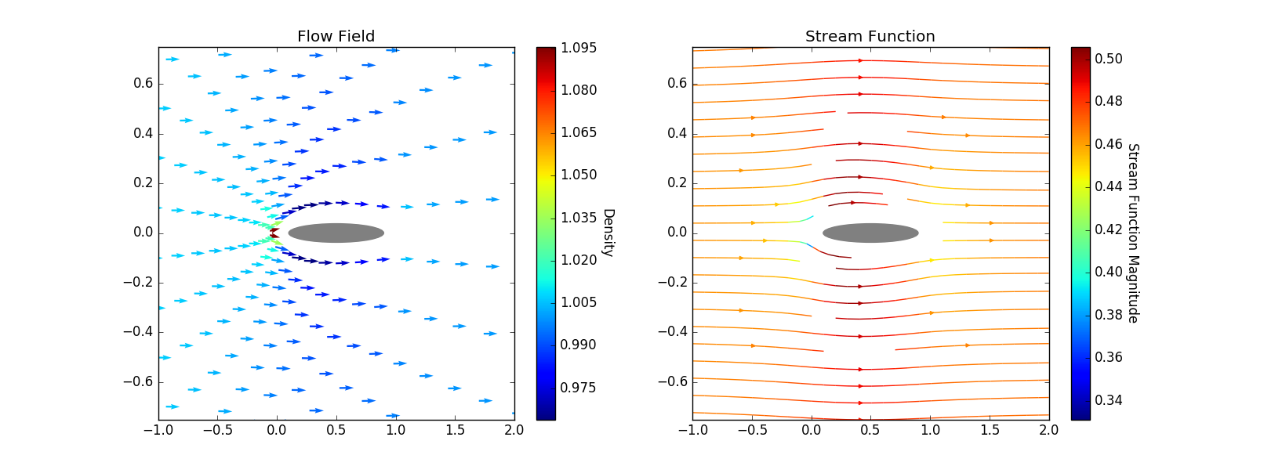
Airfoil Results
Unstructured Mesh, Computational Fluid Dynamics on Maxeler DFE Hardware.
Libraries adaptable to other unstructured problems (e.g. Spectral Element Method).

