Slide 1
转发面技术
速度与灵活之间的权衡

Slide 2
CONTENTS
目录
01
02
03
产业背景概述
市场调查分析
公司竞争优势
04
团队介绍

Slide 3
技术图谱
OVS
OVS kernel
OVS DPDK
OVS HW offload
OVS kernel offload using TC
OVS DPDK offload using rte_flow
eBPF
eBPF HW offload
P4 switch
DPDK SWX
DPU P4 eswitch
SR-IOV
legacy SR-IOV
SR-IOV & OVS-DPDK
virtio full HW offloading
vDPA
vDPA SIM
general vDPA
base kernel
base DPDK
Mellanox ASAP² vDPA
with OVS
with OVS DPDK
Base DPU

Slide 4
应用解决方案
VM networking
virtio-net/virtio-net
vhost-net/virito-net
vhost-user/virtio-pmd
virtio full HW offloading
vDPA
Container networking
xxxx
xxxx

Slide 5
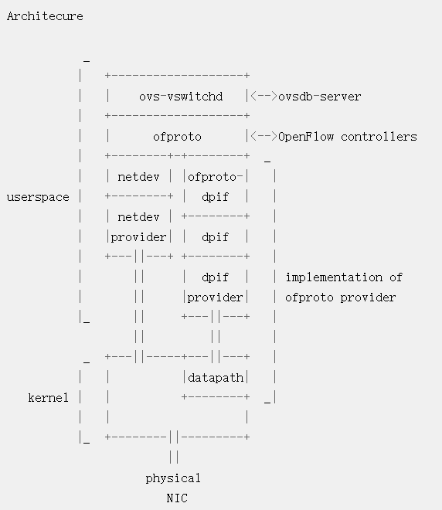
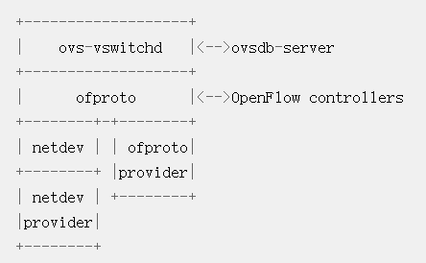
ovs架构

Slide 6
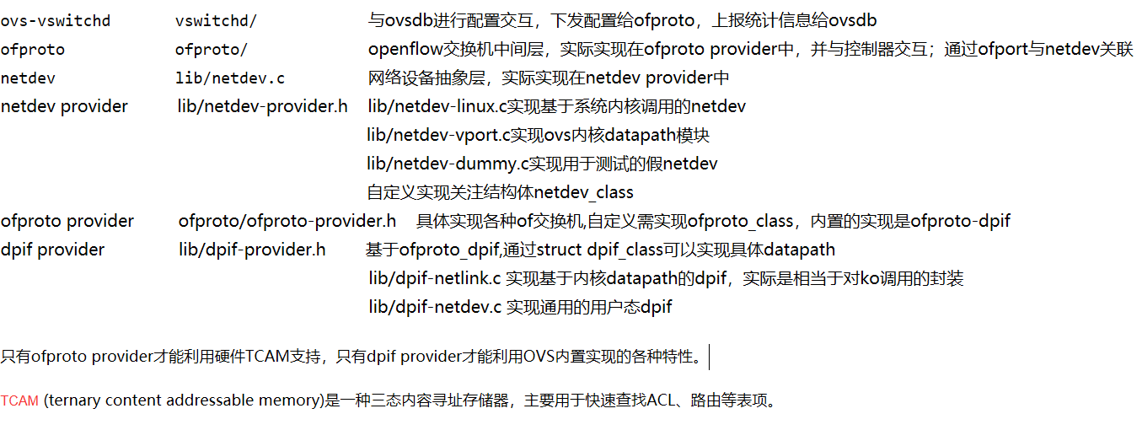
ovs架构

Slide 7
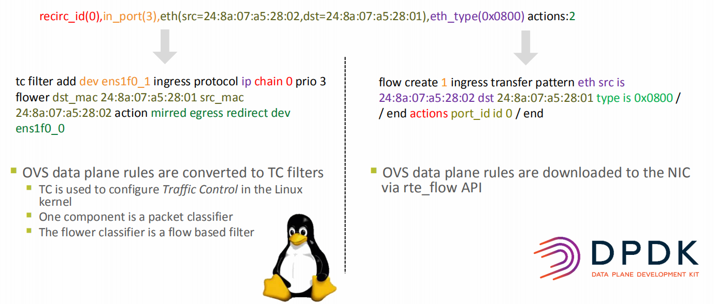
ovs HW offload
ovs-vsctl set Open_vSwitch . other_config:hw-offload=true
Flow add/delete/stats events are forwarded to HW offload thread
Kernel offload using TC
DPDK offload using rte_flow
HW offload control plane

Slide 8
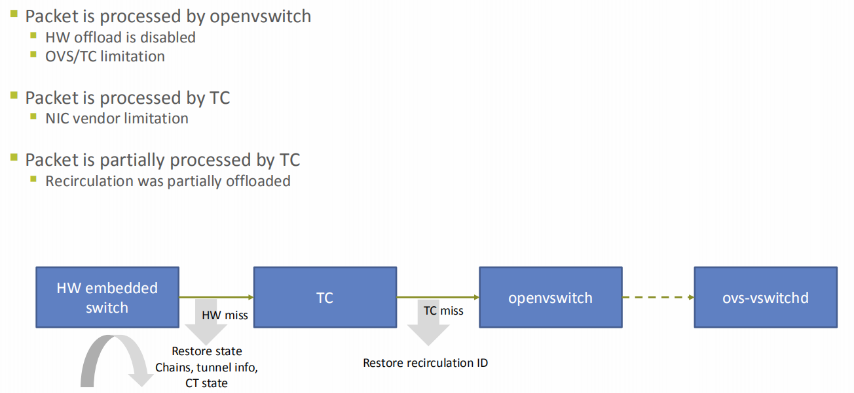
Netlink netdev data plane processing pipeline
TC filters are processed before openvswitch
The openvswitch kernel driver hooks to the rx_handler

Slide 9
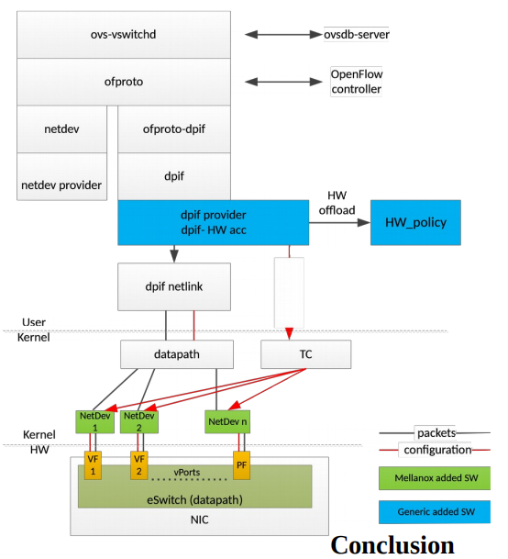
OVS use SR-IOV offload

Slide 10
ovs各种实现总览
native ovs
ovs with DPDK
native ovs HW offload
ovs-DPDK HW offload
ovs-vswitchd
ofproto
netdev
ofproto-dpif
netdev provider
dpif
dpif provider
dpif netlink
dpif netdev
DPDK datapath
TC
datapath
NIC eSwitch(datapath)

Slide 11
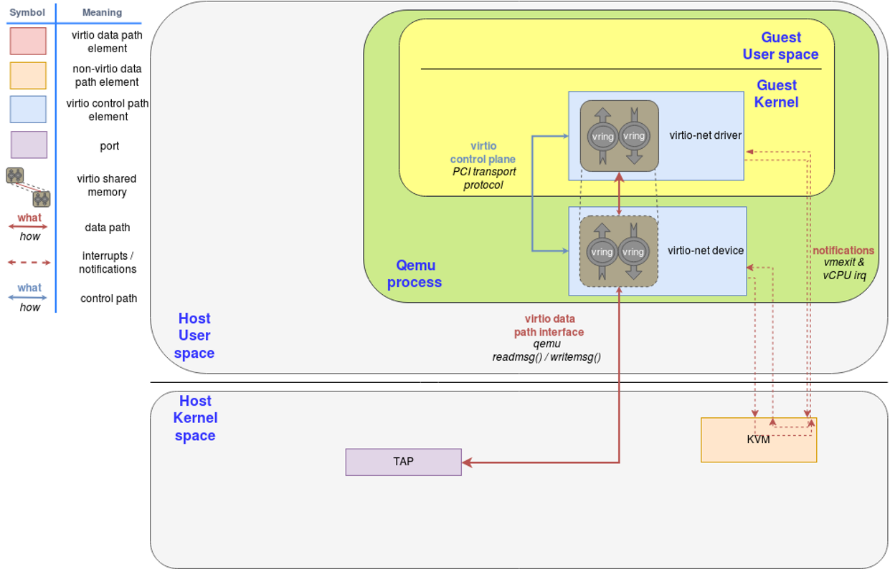
virtio-net on qemu

Slide 12
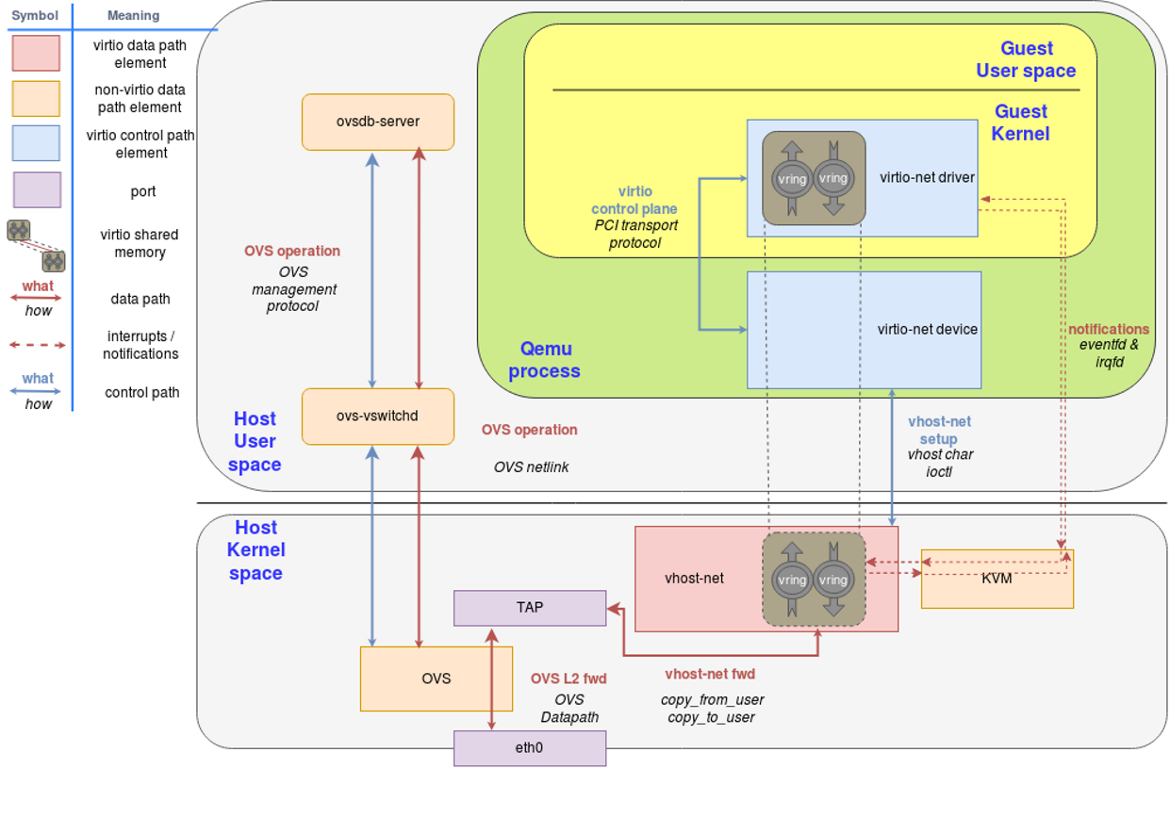
vhost-net/virtio-net 架构

Slide 13
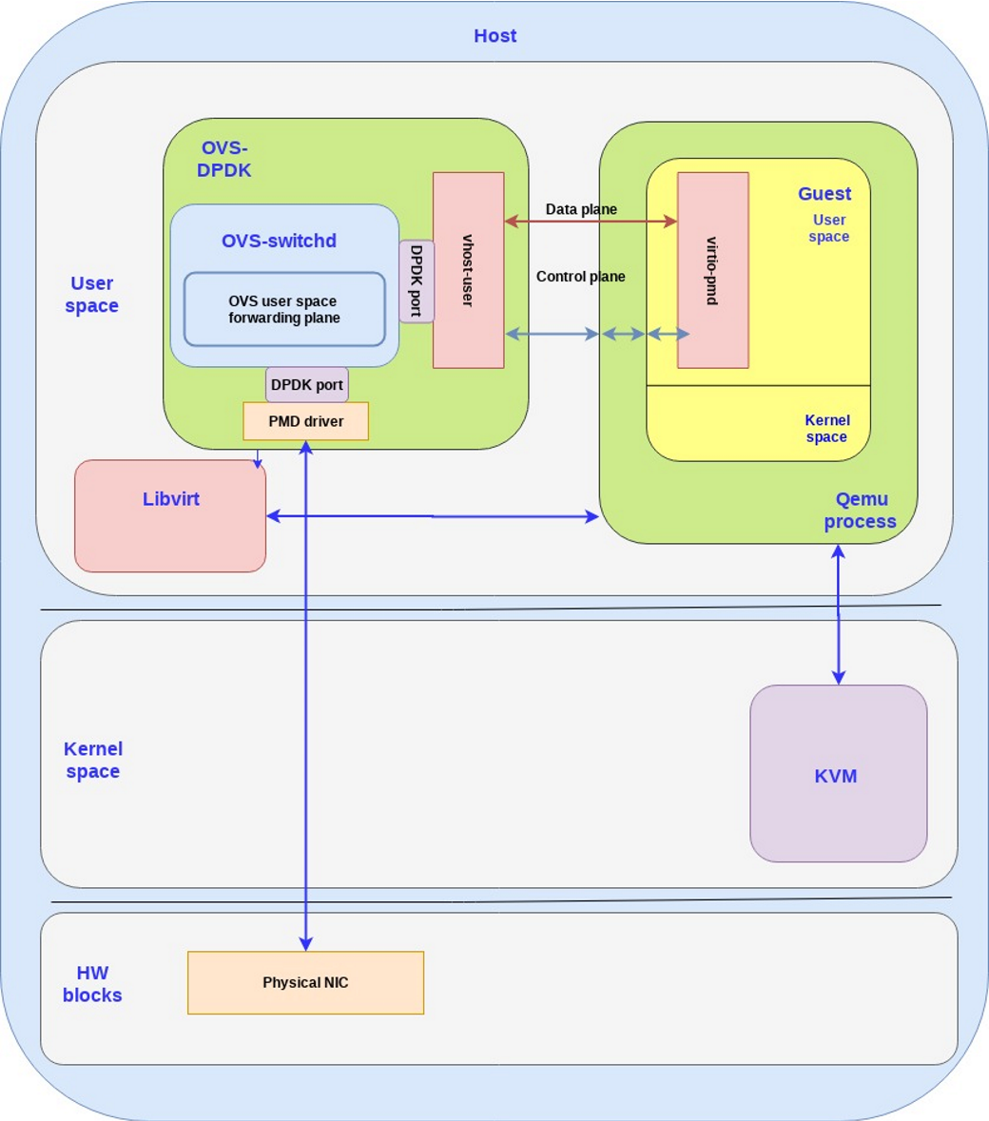
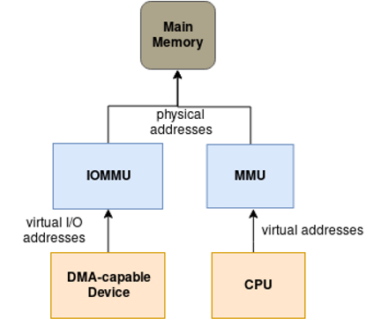
vhost-user/virtio-pmd 架构

Slide 14
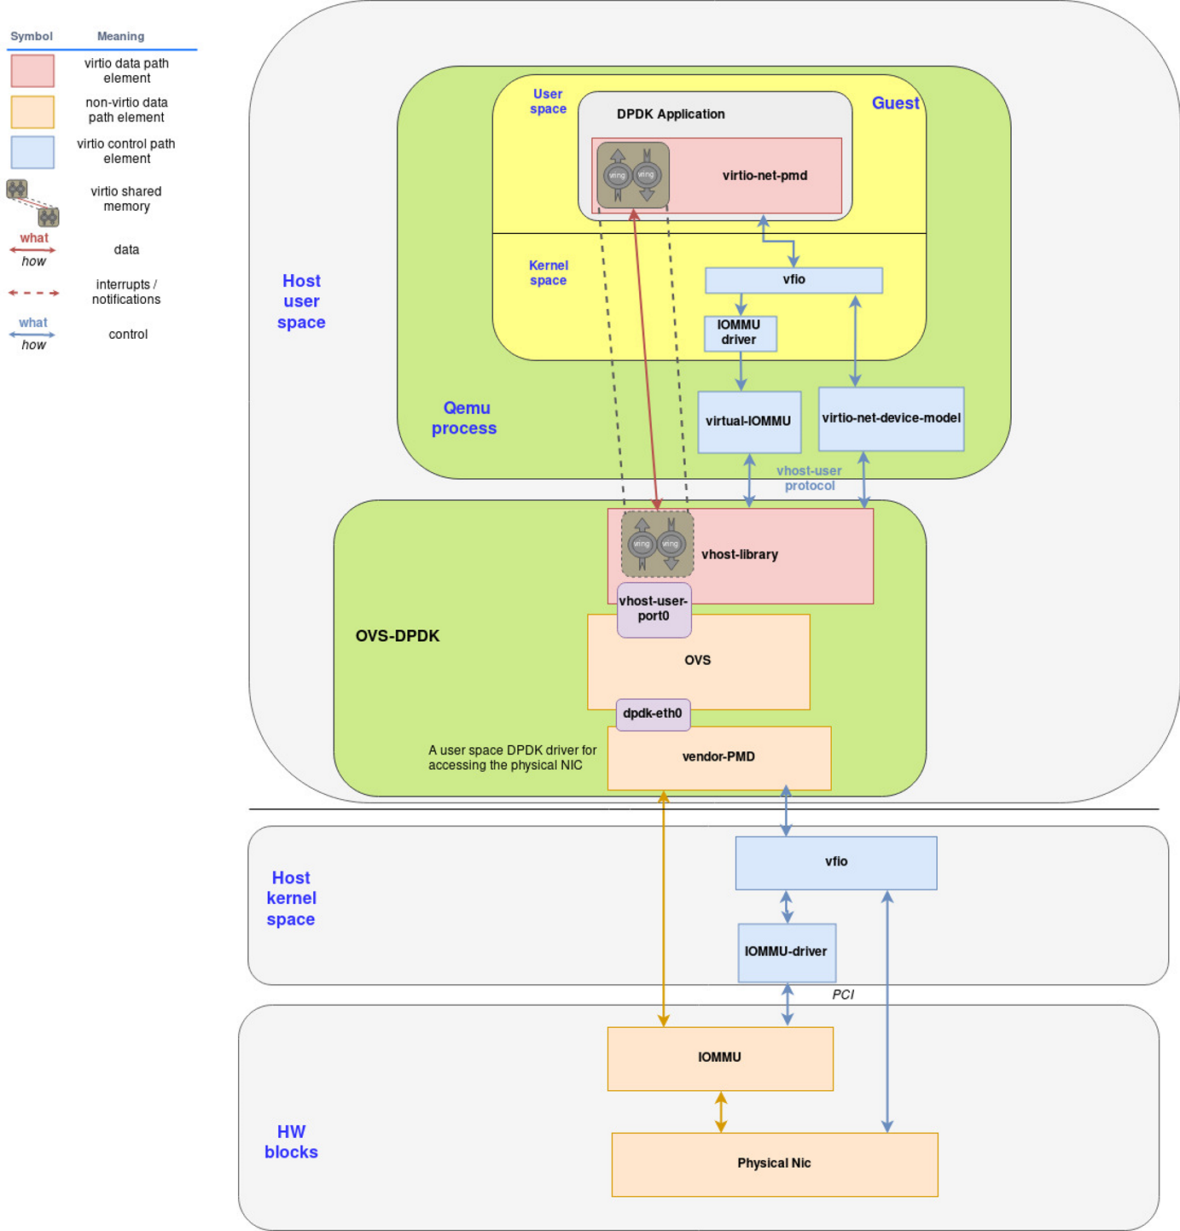
OVS-DPDK + vhost-user/virtio-pmd

Slide 15
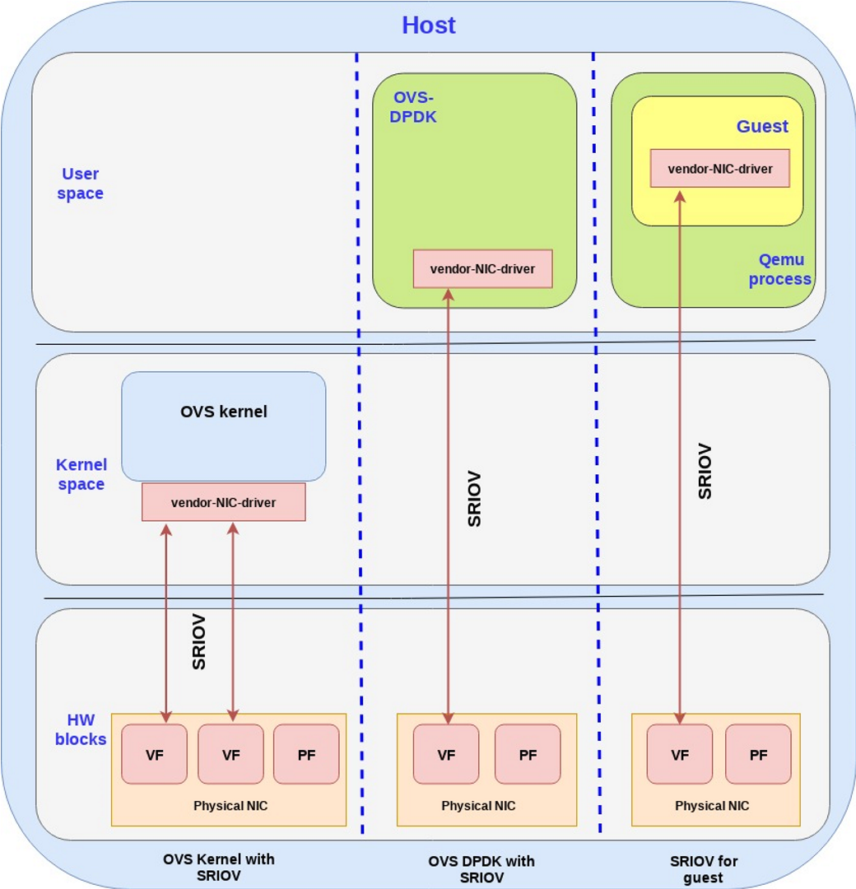
SR-IOV应用场景

Slide 16
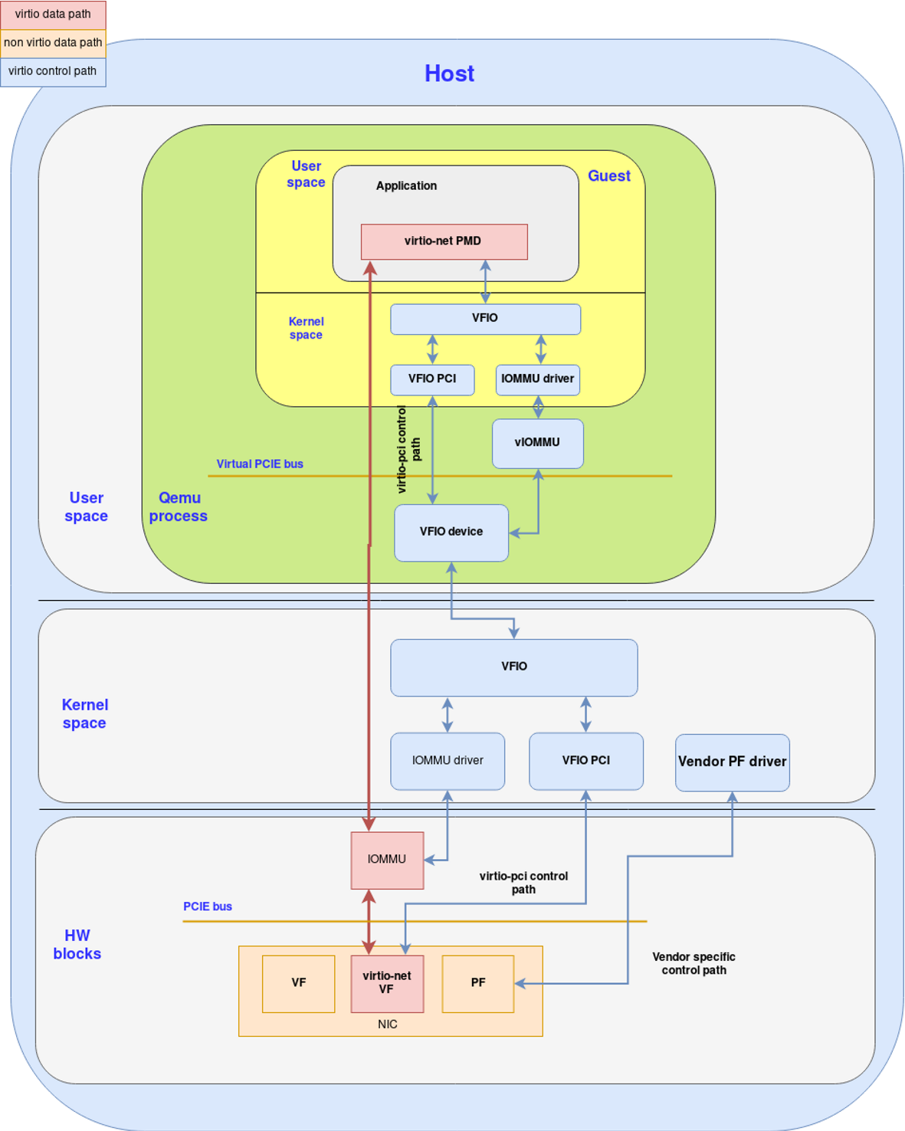
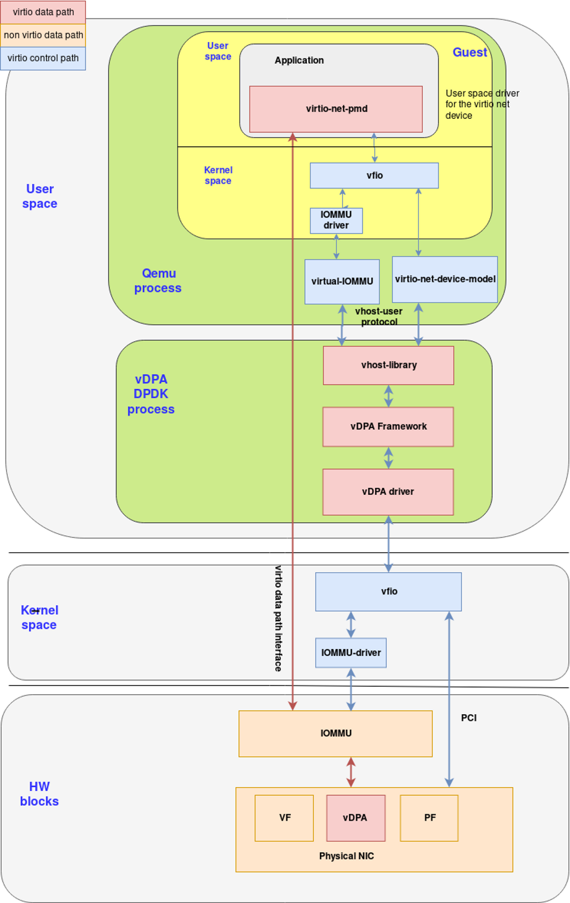
Virtio full HW offloading & vDPA base DPDK

Slide 17
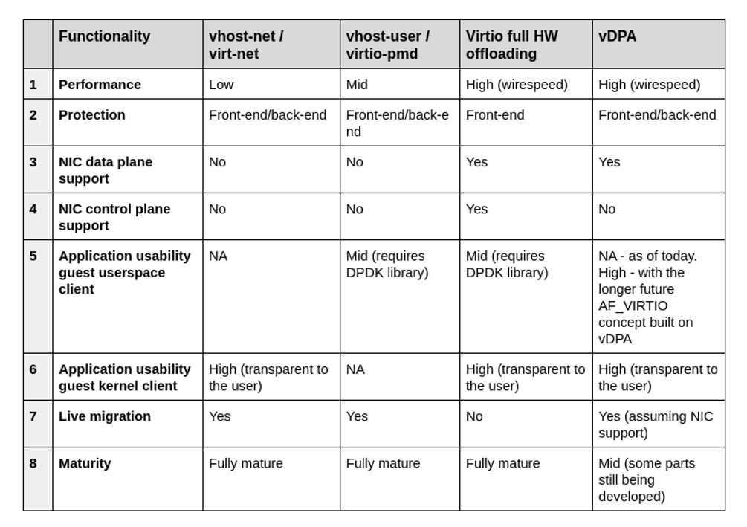
virtio networking 方案比较

Slide 18
Mellanox

