Slide 1

MMI 716 - Game Programming Patterns
Palette of Memories:
The Artist's Path to Remembrance
Project Phase III
Burcu Alakuş
2459410

Slide 2
Outline
Game Idea
Game Components
Design Patterns
Progress
Completion Evaluation

Slide 3
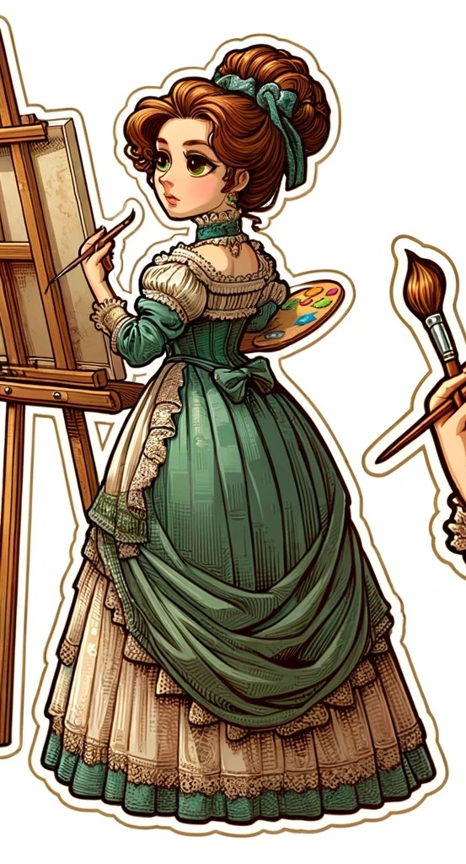
Game Idea
Palette of Memories: The Artist's Path to Remembrance
centred around a female painter who wakes up with no memory of her past
a journey through the mind and art of its protagonist
players will navigate through a series of rooms
specific items within the rooms that trigger fragments of her memories, piecing together her identity and history
offers a unique exploration of memory, identity, and creativity
Image created by DALL·E

Slide 4
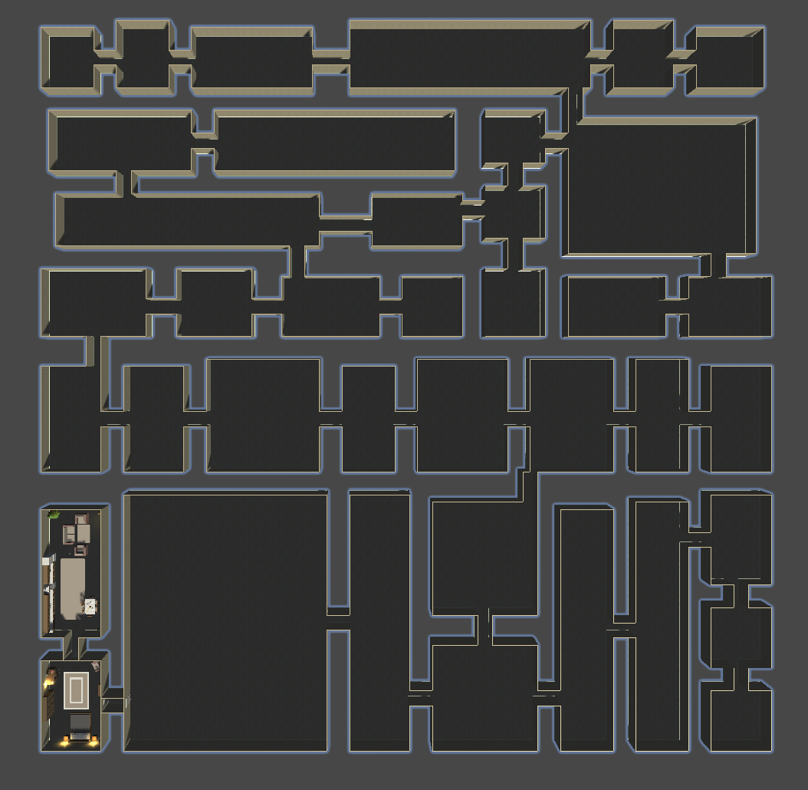
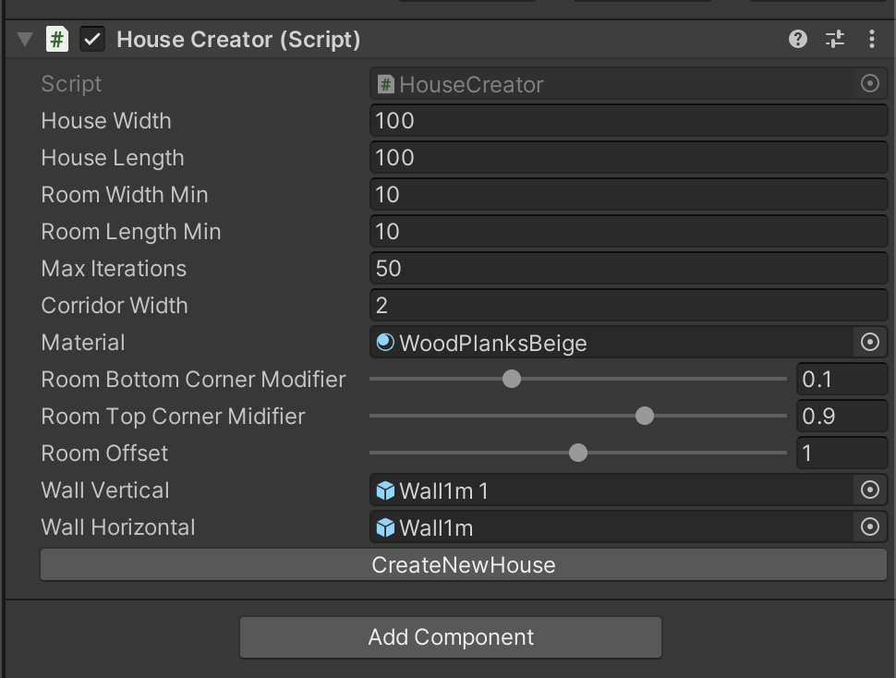
Game Components - House Creator

Slide 5
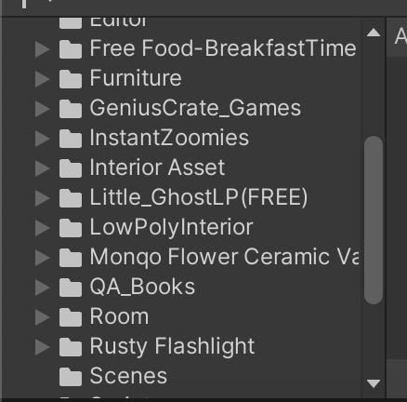
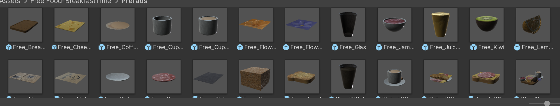
Game Components - Assets

Slide 6
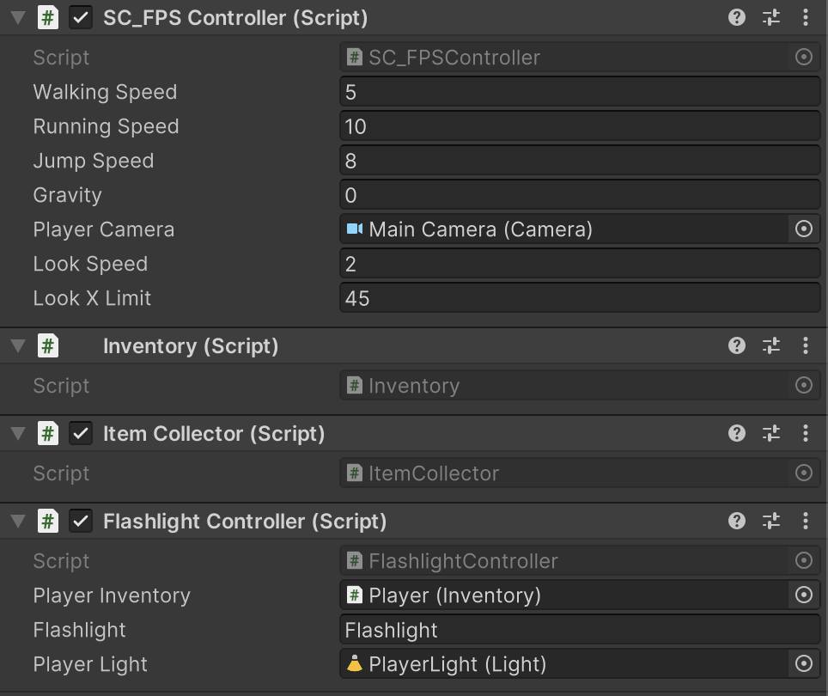
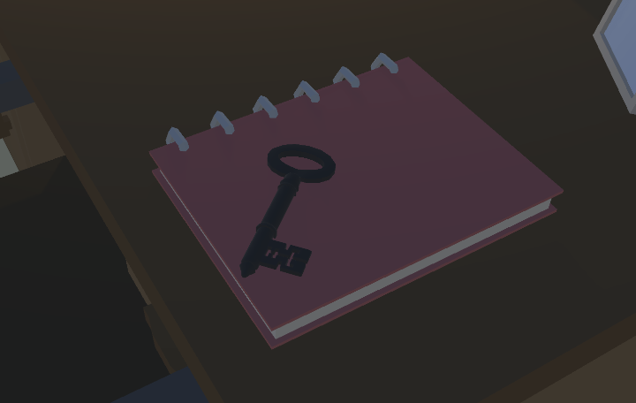

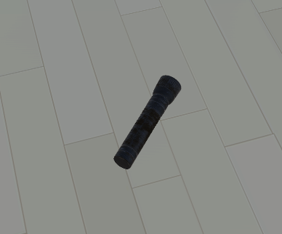
Game Components - Player
Some items with “collectable” tag

Slide 7
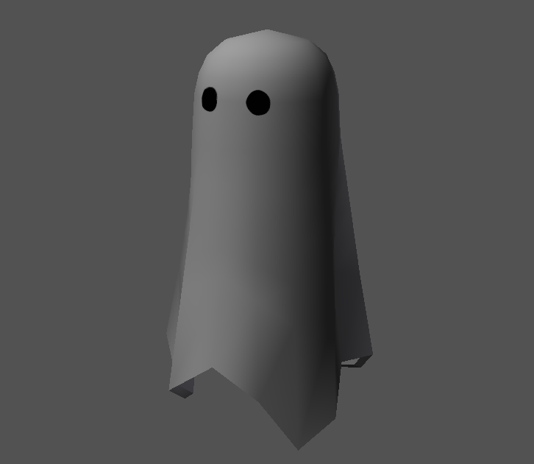
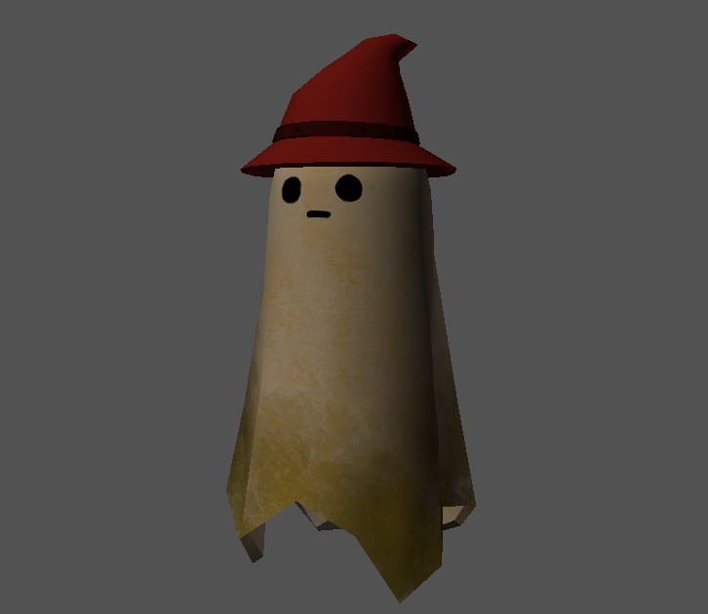
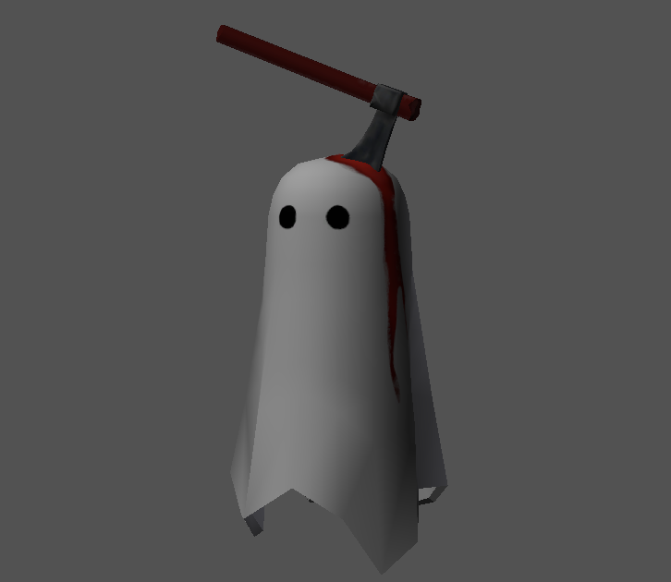
Game Components - Ghosts
Appear when specific items are collected
Chasing the player
Make creepy sounds
Disappear if the player gets far enough or after a certain period of time

Slide 8
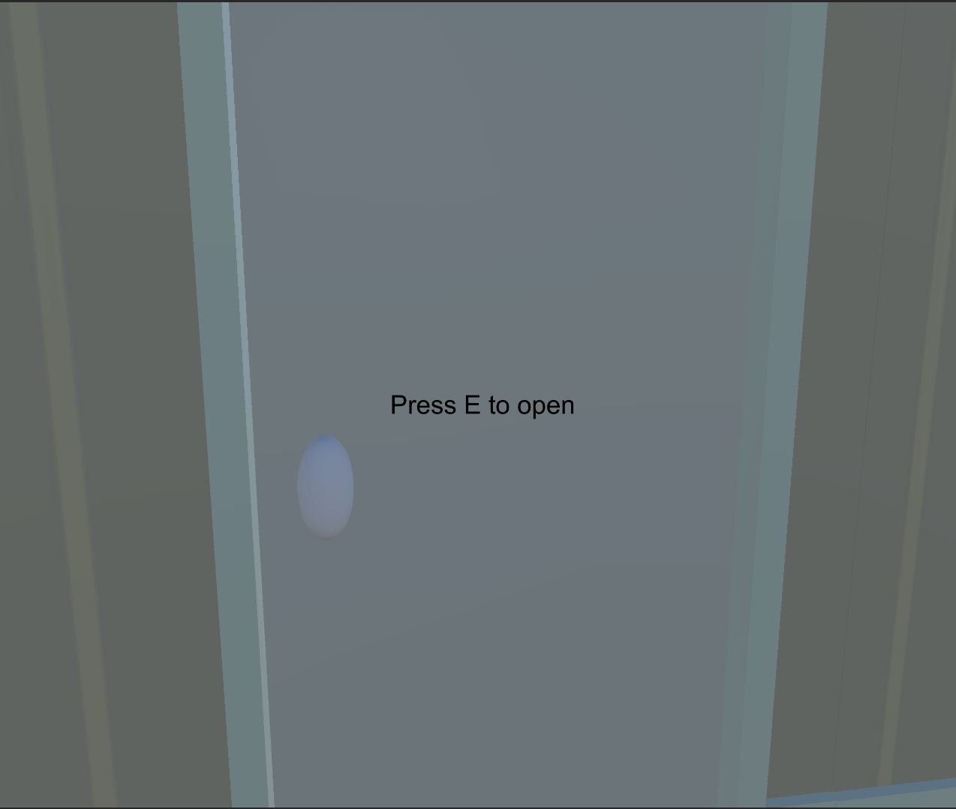
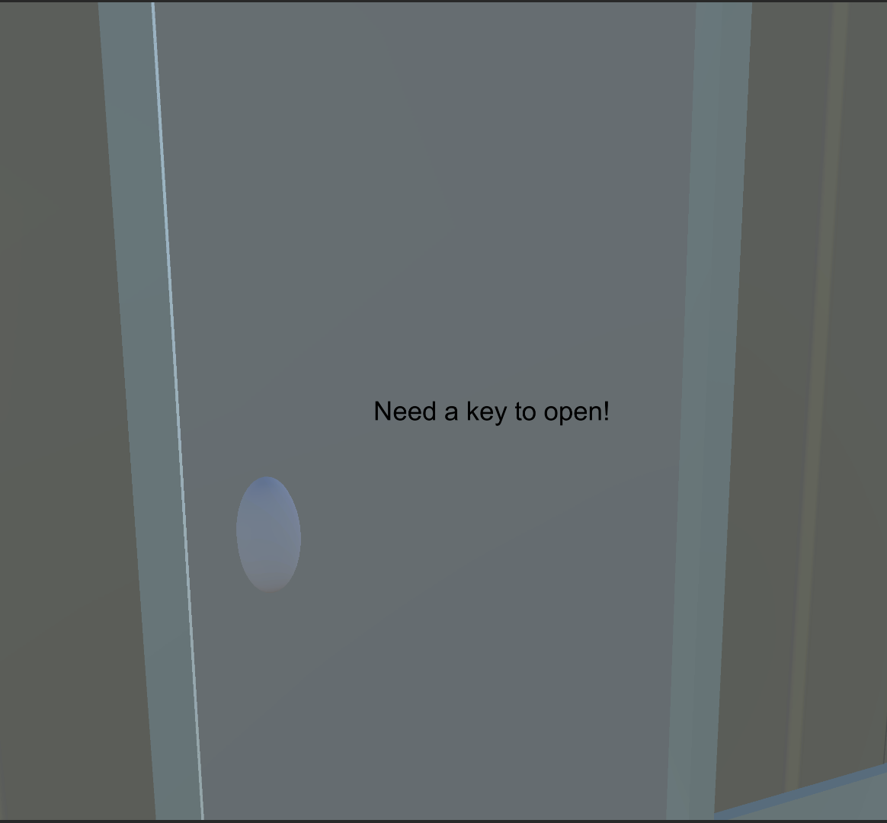
Game Components - Doors and Keys
Some rooms are locked
The player needs to find the keys

Slide 9
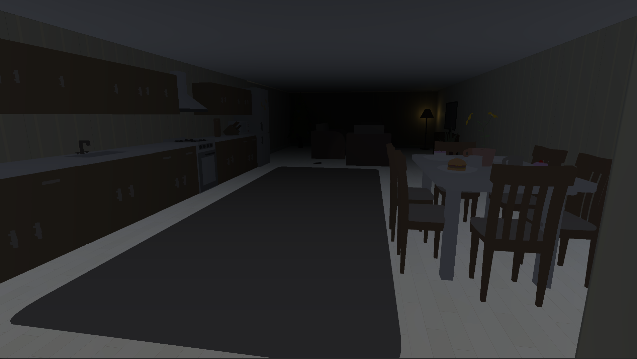
Game Components - Environment Lightning
No Skybox Material
Without skybox

Slide 10
Game Components - Fog
Foggy environment
With fog

Slide 11
Game Components – Audio & Animation
Door opening sound + animation
Ghost creepy sound + animation
Item collecting sound
Walking sound

Slide 12
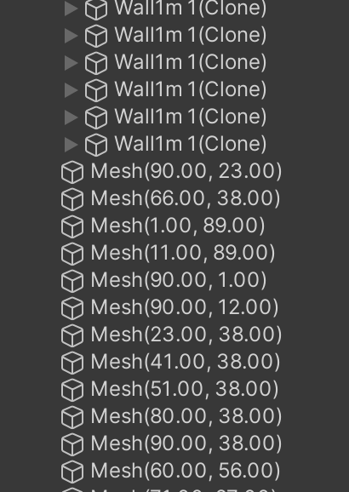
Design Patterns – Flyweight + Binary Space Partitioning
For house creation (walls, floors, etc.) that uses binary space partitioning to generate rooms and corridors within a house area based on given dimensions and constraints and cloning one prefab, only positions differ.
Binary Space Partitioner: recursively splits a given area into rooms until they cannot be divided according to minimum size constraints.

Slide 13
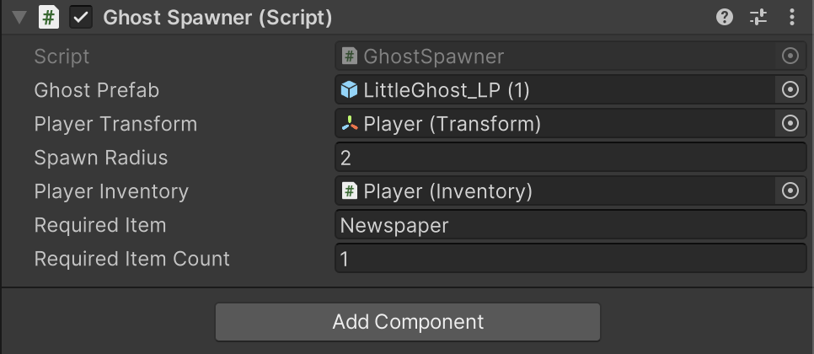
Design Patterns - Prototype
Ghost Spawner

Slide 14
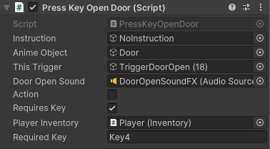
Design Patterns - State
Doors (opened/closed, need key/do not need key)

Slide 15
Progress
Technical parts partially completed
this version is playable and complete to explore the game but not in the desired state
menu, «how to play» are added,
settings tab is not activated, so, there is command pattern
several patterns implemented

Slide 16
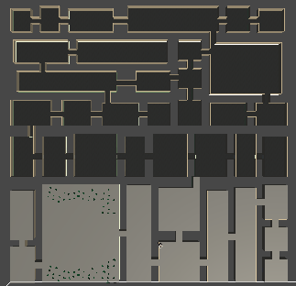
Progress
The interior of the rooms arranged but not completed
wanted at least 20 rooms but had 11 rooms finished
due to not saving time and losing some stuff and lack of assets
Finished part
Wanted to finish part

Slide 17
Completion Evaluation
Story is now complete but changed
Could not find painter's items
painter –> governess (influenced by Anne Brontë’s Agnes Grey)

Slide 18
Thank you for listening!

