Slide 1
Real Time Emotion Detection
Burcu ALPER
Atılım University, 2021
Course: CMPE462 – Artificial intelligence
INSTRUCTOR: CEMIL UZUN

Slide 2
Outline
CONCEPTS
DATASET
TRANSFER LEARNING
FACE RECOGNITION
DEMO

Slide 3
CONCEPTS
Implementation by:
Python
OPENCV
TensorFlow
Jupyter Notebook

Slide 4
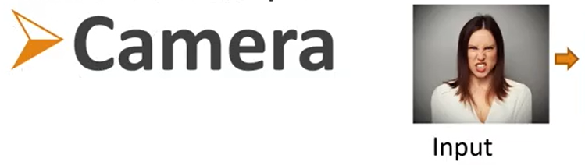
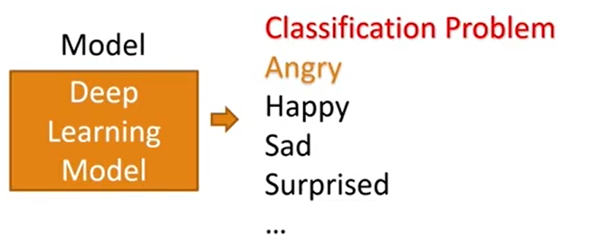
How to find Facial Expressions?
haarcascade_frontalface_default.xml

Slide 5
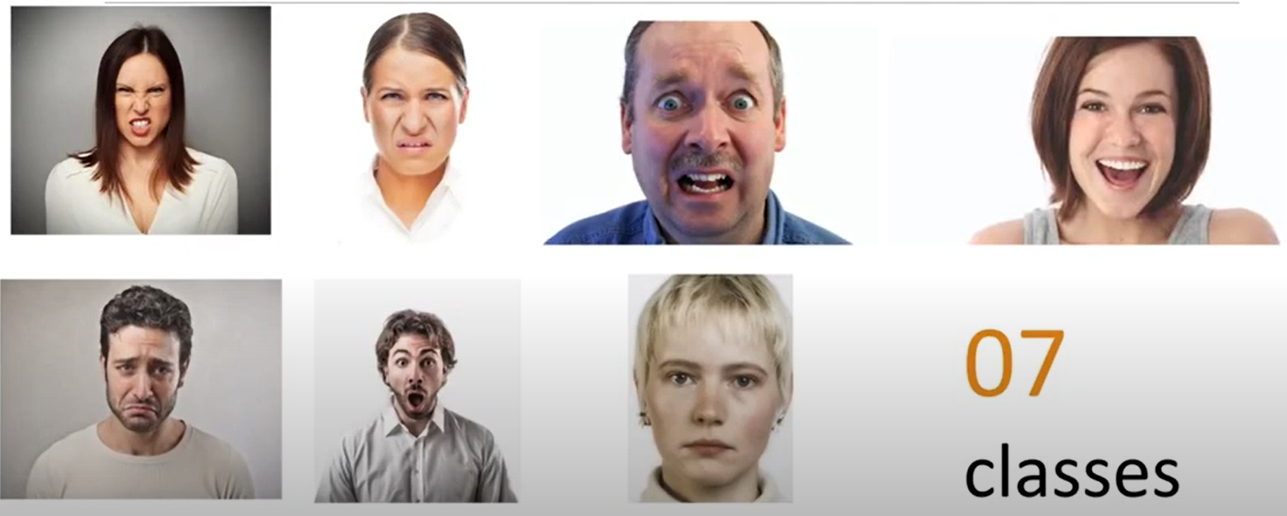
Types of Facial Expressions

Slide 6

Dataset
* https://www.kaggle.com/msambare/fer2013?select=test

Slide 7
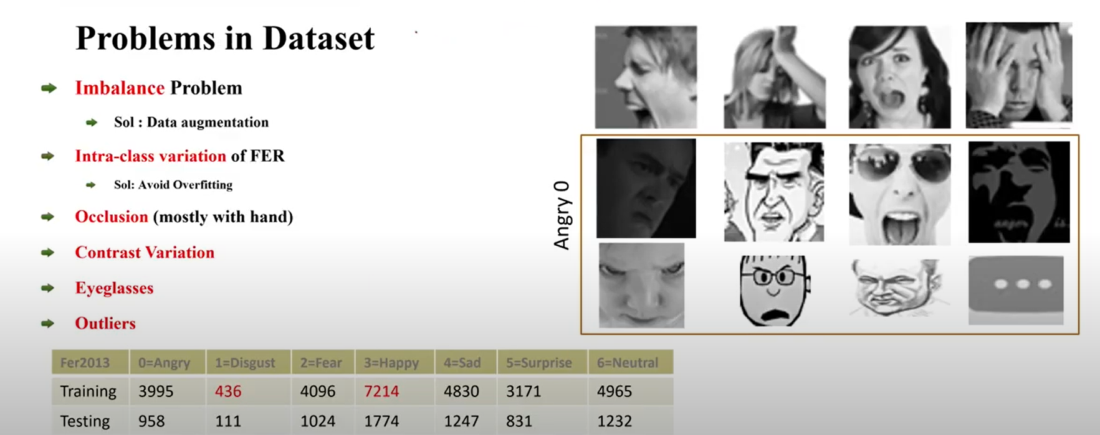
Dataset

Slide 8
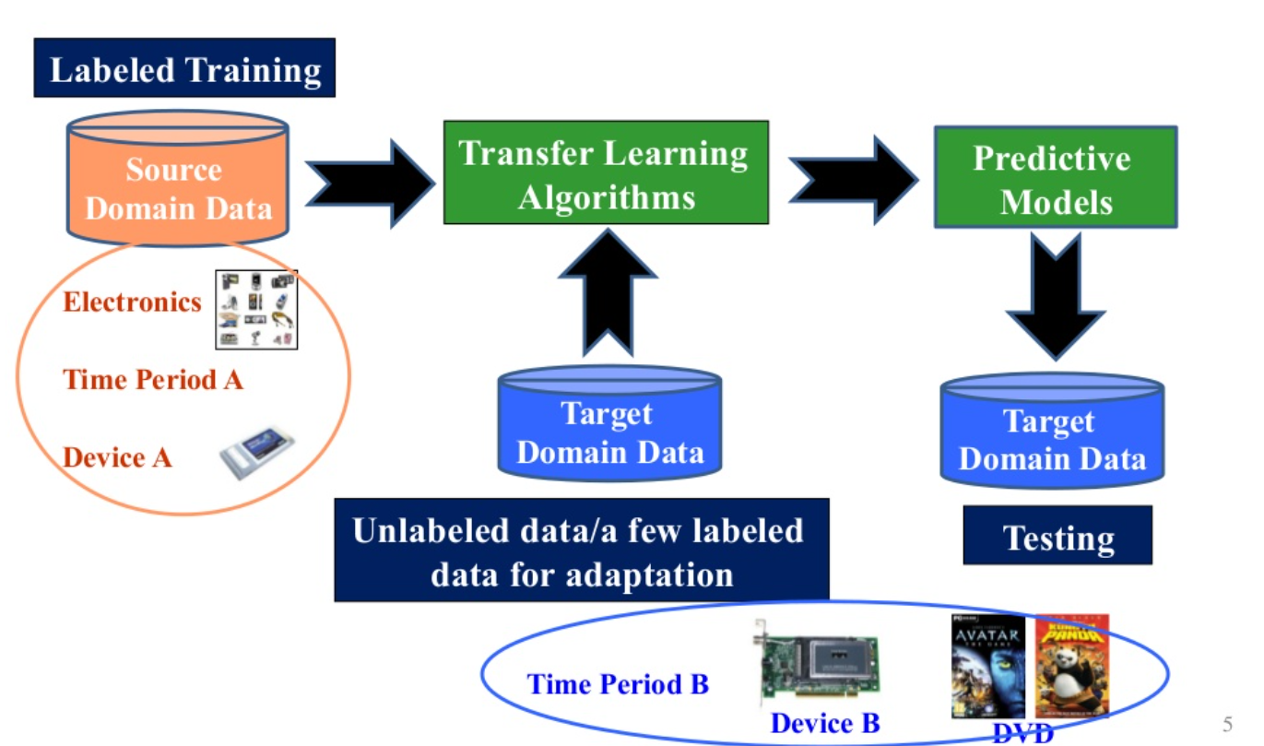
Transfer Learning

Slide 9
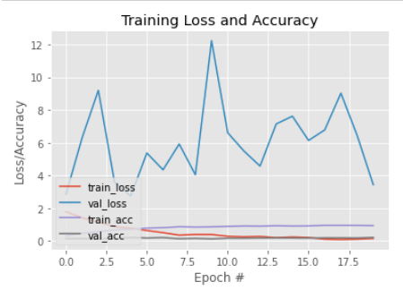
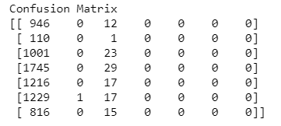
Face Recognition
Train the data
Open the webcam
Find the face
Use the model to predict
Display the result

Slide 10


