Slide 1
revenuegen
File created on: 8/19/2022 6:21:57 PM

Slide 2
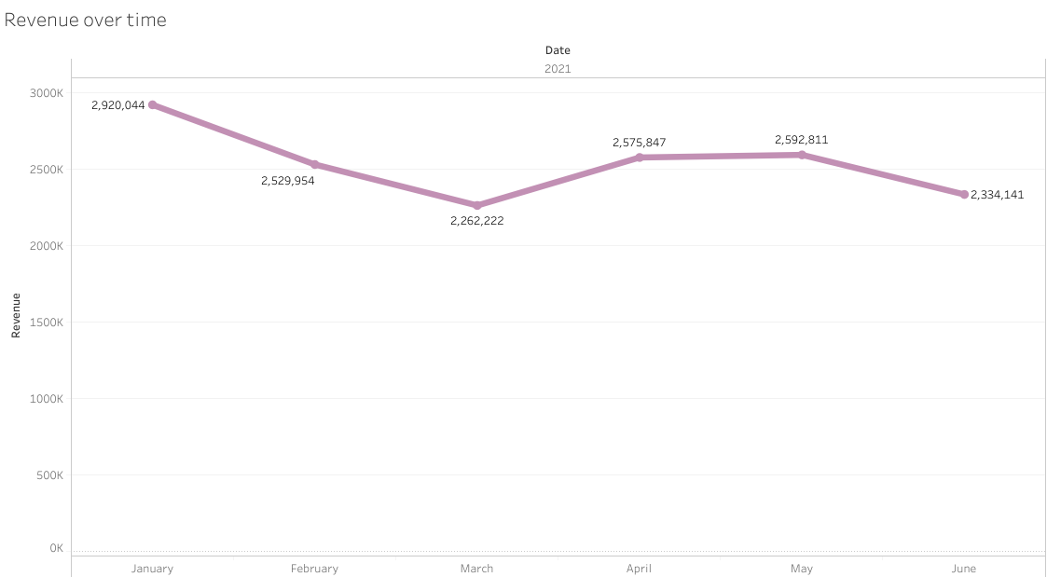

Slide 3
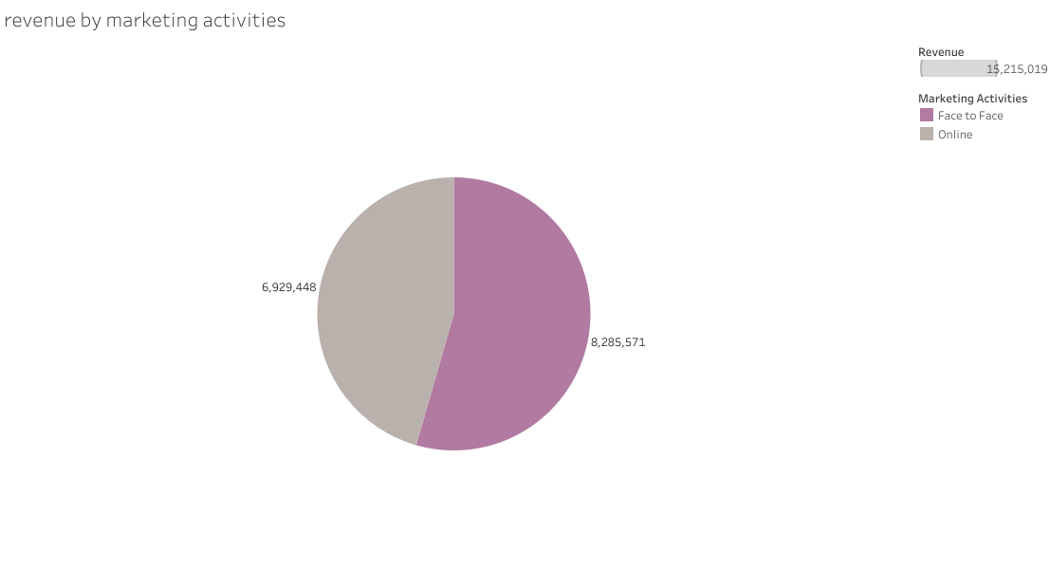

Slide 4


Slide 5
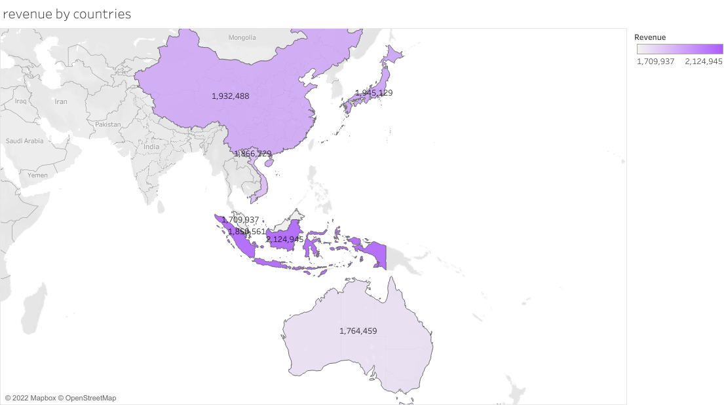

Slide 6
