Slide 1
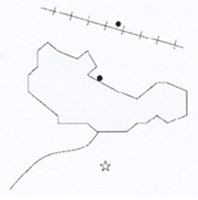
Group Activity: let’s label the map
Relocate the labels below on the map
Cooperton
Frantz Railway
Harriston
Lake Jones
Oldport
Jones river

