Slide 1
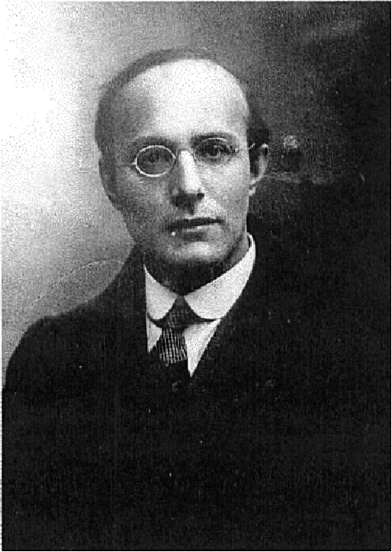
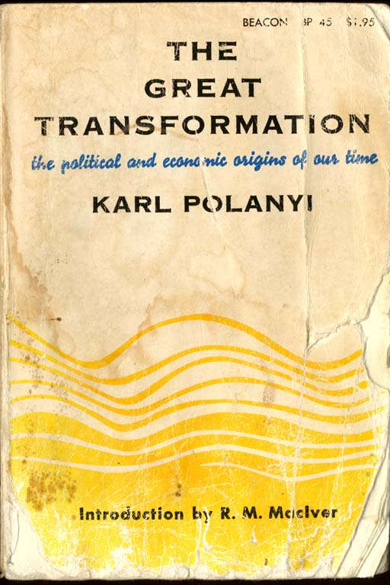
Karl Polanyi: Creating Contemporary Spaces

Slide 2
The Great Transformation
Polanyi: 1886-1964.
Politically (today) we would call him a social democrat.
Wrote the Great Transformation while at Bennington College, published in 1944.
Thesis: “Nineteenth Century Civilization has Collapsed. This book is concerned with the political and economic origins of the event as well as the great transformation which it ushered in.”
WWI, the interwar period, the Great Depression, fascism and WWII as the logical columniation of laissez-faire taken to an extreme.
No one had heretofore connected these events to the industrial revolution.

Slide 3
Critique of Liberalism
Polanyi’s critique of (Classical) Liberal economic theory challenges two core assumptions:
  That the market is a uniquely “natural” form of economic organization of society.
  That human economic behavior is naturally & inevitably motivated by the goal of maximizing profits.
Much of what Polanyi tried to explain in the Great Transformation was the uniqueness of the modern market society, and of “market fundamentalism,” and the horrific social consequences of self-regulated markets.
Block: Polanyi’s was a powerful critique of market liberalism (neolilberalism) and the idea that national societies and global economies can and should be organized through self-regulating markets.

Slide 4
Social Market vs Free Market
Polanyi argues there are three general types of economic systems prior to the rise of market societies: redistributive, reciprocity, and householding. Economic life in each was constrained by need to maintain social cohesion; activity was conducted in “social markets”
  Social markets are regulated, by social norms/values and governments, e.g., Scandinavia today.
  “The passing of market-economy can become the beginning of an era of unprecedented freedom…; regulation and control can achieve freedom not only for a few, but for all” pp. 256 [265]
The rise of the nation-state pushed changes in social structure ushering in a competitive capitalist economy & ultimately industrialization.
This created a new type of economy in which prices of all goods, including labor, changed without regard to effects on society; Self regulating markets operate independently of social needs.

Slide 5
Polanyi’s Basic Ideas
Embeddedness: The economy is (naturally) embedded (subordinated) to institutions (political, religious) and social relations especially trust). People’s economic activities are shaped by their networks & social relations. Markets are limited by institutions and social relations & networks that connect markets to the moral fabric of society.
Fictitious commodities: “Labor, Land and Money; “commodities” not originally meant (or “produced”) to be sold on a market.
Self-Regulating Market Society: a society dominated by an economy that is disembedded from the institutions and social norms of society; human beings and environment are fully commodified; where society is subordinated to the logic of the market.
Politics: The Nation-State developed long alongside the market economy: State policies commodified humans and the environment—Labor, Land and Money are fictitious commodities because they were not originally created for sale on the market—and set the rules of the game.
The Double-Movement: Polanyi's model of change; the evolving relationship between The State, Markets, and Society.

Slide 6
The Double Movement:
Change driven by two Movements: Polanyi argues that the commodification of land, labor & money (fictitious commodities) leads to social resistance.
Movement: Forces for the self-regulating market; subordinating society to the logic of the market.
Countermovement: Forces to protect society from the negative externalities of free markets; subordinating the economy to society.
Interaction: The two are in constant flux; The nature of the Self-regulating market gives rise to a specific form of countermovement.
Politics & Class Conflict: Class interest, politics and conflict are central to how the movement and countermovement(s) unfold.
Stability: Double Movement is necessary
  Strong Movement → economic collapse, e.g., 1920s (0r 2000s).
  Stalemate → fascism
  Strong Countermovement → self-regulating market subordinated to democratic institutions (e.g., Scandinavia)

Slide 7
Movement:
  Goal:
  Establishing the Self-Regulating Market (dis-embed market forces from social institutions); or towards marketization, the spread of market thinking, market-based forms of allocation.
  Forces/Proponents (today):
  Today the “neoliberals”; sectors of big business, finance, export-based firms, and their political allies. A planned attempt using the state to impose the self-regulating market on society; creating a “free market” from social institutions through deregulation, privatization;
  Principles:
  Laissez-faire; Individualism—maximize individual freedom.

Slide 8
Results of the Movement:
Market forces incompatible with sustainability—broadly defined
Polanyi argues that if left unprotected by social institutions, human beings will perish from the effects of social exposure; “they would die as the victims of acute social dislocation through vice, perversion, crime and starvation”
The objectification of humans and the environment: Free markets devastate the environment, democracy and the social fabric of society: diminishing accountability and transparency regarding political decisions, environmental degradation, income and wealth concentration, unemployment, fraying social cohesion.
Thus, the movement for markets creates disruptions that spark a countermovement consisting of groups affected by these dislocations, or what Polanyi calls society’s self-protection mechanism.

Slide 9
Countermovement:
Goal:
Conserve/protect humankind, the environment, and productive organization—the economy—from market forces; state-based social protection against marketization;
Forces/Proponents:
A reaction driven by those most affected by the expanding markets or the commodification of everything*:
  Generally a diverse “reaction” to the effects of free market—e.g.,—sectors of labor, business, environmental—including some who were supporters of free markets (e.g., Greenspan), and their political allies.
Principles:
Human rights, protection of the public and public resources necessary for a decent life via regulation and other policies.

Slide 10
Polanyi’s Argument: A self-regulating Economic System is a Myth (Utopia):
Free market economy – in which markets are entirely free from social or political control – is a myth even in the 19th century, during the era of laissez-faire--It was created by state coercion, and depended on power of governments to work.
Role of government and politics: all of the key inputs into the economy—land, labor, and money—are social constructions and sustained through government’s coercive power (Block, p. xxvi)
  The Financial organizations insist they should be free of regulations while depending on access to cheap credit from the Federal Reserve.
  Pharmaceutical firms resist government limits on their price-setting ability, yet rely on public R&D funding & government grants of monopolies through the patent system.
  Compliance of employees with the demands of employers is maintained by police, judges, and an elaborate structure of legal rules.
Regulation/Rules: Always necessary to create markets; it isn’t regulation versus deregulation; rather what kind of regulation: regulations to benefit wealth and capital, or to benefit the public and common good?

Slide 11
Summary:
Polanyi rejects the idea the state should (economic libertarians) or could (Marxists) could wither away.
“Laissez-faire was not a method to achieve a thing, it was the thing to be achieved.”
There is nothing nature about laissez-faire, or disembedded economies.
“Laissez-faire was planned; planning was not”
“Our thesis is that the idea of a self-adjusting market implied a stark utopia . . .” Block xxiv-xxv
“Labor, Land and Money are fictitious commodities because they were not originally produced to be sold on a market. Labor is simply the activity of human beings, land is subdivided nature, and the supply of money and credit in modern societies is necessarily shaped by governmental policies.”

Slide 12
The Central Paradox of our Time
Economic (neoliberal) globalization does not strengthen the current regime of global laissez-faire but works to undermine it
-and inevitably creates a political countermovement.
“The expansion of market forces would sooner or later be met by a countermovement aiming at conservation of man and nature as well as productive organization…and using protective legislation, restrictive associations, and other instruments of intervention as its methods”
--Karl Polanyi, The Great Transformation, pp. 132 [138]

Slide 13
Questions?

Slide 14
Commanding Heights Video
So how did we get here?
What is the basic story?
What are the central events, ideas and actors involved in the story?
How does the context (social and historical), space, place and “society” interact to create specific outcomes?
How are economic and politics linked?
Why do some ideas become “popular” while others don’t?

