Slide 1
Consumer Advocacy Networks & Movements.

Slide 2
Introduction
Today we return to a larger question: How to democratize a system characterized by an unequal distribution of power & where the traditional mechanisms via governmental regulation aren’t available?
What might we learn from Alinsky about building alternatives to the neoliberal model?
Decreasing the gap between the decision makers and the decision takers—a goal of the Alinsky model—is the essence of Certification Strategies.
Like LW & CBAs, these are attempts to alter corporate behavior by imposing a set of community defined standards for corporate behavior:
Based on global coalition building among labor, faith-based, community groups, students, environmental….
Using evidence, data and the media
Relying on market forces; unlike LW and CBAs which are legal contracts or policies.

Slide 3
Some Strategies to Alter Corporate Behavior
United Students Against Sweatshops (USAS)—the Second Anti-Sweat Campaign
Code of Conducts
Fair Trade and Product Certification

Slide 4
USAS
Beginnings:
The mid-1990s student-labor led anti-sweatshop movement pushing for product certification was one of the earliest sub-movements of the global justice movement.
The movement involved three aspects:
A) Disclosures: Public disclosures in the mid-1990s of the Gap in Central America, and Kathie Lee Gifford’s Wal-Mart clothing line in Honduras, Nike shoes in Indonesia and the El Monte Raid in 1997.
The National Labor Committee (NLC) exposed the child labor and sweatshop conditions in a factory manufacturing products under the Kathie Lee Gifford label and the testimony to congress of a 15 year old Honduran worker that she had made Kathie Lee clothing since she was 13 working from 10-12 hrs/day and sometimes overnight for cents/hour.
Global Exchange also arranged a U.S. tour by an Indonesian Nike worker—Nike’s stock plunged 39%—a new verb was coined by these campaigns to b Nike-ed is to have you labor practices questioned and you good name attacked.
https://www.youtube.com/watch?v=ZPmXiQKjRpw

Slide 5
B) Training: In 1997-8 a group of Students spent the summer at a Labor Organizing Program—called Union Summer with UNITE the garment workers union: Over the next year the Students, from Duke, Harvard, Illinois and Georgetown, organized the United Students Against Sweatshops.
C) Experience: In 1998 traveled to Central America to witness the conditions under which the apparel was produced. They produced videos to use in organizing chapters across the U.S. https://www.youtube.com/watch?v=1XtYhfcEZ9A
By 2001 there were campaigns on over 200 campuses. Still chapters on over 150 campuses
Goal: Establish Standards (the Collegiate Code of Conduct) for protecting workers’ rights engaged in the manufacturing of apparel with collegiate logos: This includes wages and working conditions, child labor, etc. in foreign factories that produce university apparel, as well as workers in the U.S.
The Workers Rights Consortium—labor-rights watchdog founded by USAS to monitor and expose abuses in the global commodity chain:
https://www.workersrights.org/mission/
Notes:
The Anti-Sweatshop movement would develop out of this Labor-Student Coalition.

Slide 6
Code of Conduct
Definition:
A formal statement of the values and business practices of a corporation.
As businesses became globalized, companies were pressured by community advocacy groups, labor orgs, educational institutions and others to adopt codes of conduct.
Third Way:
Codes are a third way approach to changing corporate behavior regarding working conditions, wage, the environment.
Codes to establish and protect workers’ rights, indigenous rights, the environment in situations where civil society, unions and governments are either too weak or nonexistent.
Codes, however, only specify appropriate behavior and have no formal enforcement mechanisms.

Slide 7
Enforcement:
How are Codes Enforced?
Credibility:
Credibility of any code of conduct depends on the extent to which it is taken seriously by industry, unions, consumers and governments.
Which depends on monitoring, enforcement and transparency:
Transparency: the extent to which foreign contractors and subcontractors, workers, the public, nongovernmental organizations and governments are aware of the code's existence and meaning. A code can be made transparent through its posting and dissemination and through training regarding its provisions. But this is often insufficient.
Monitoring: two forms
Internal: through a committee, ombudsman, regular reporting obligations, field visits, or hot lines; almost always fails
External: through an NGO, outside auditor, or consultant; (e.g., WRC).
Still, there are no formal mechanisms through which companies can be forced to comply to voluntary codes. So how is compliance enforced?
Brands & Public Shaming: Competition and the importance of corporate brands and logos. Naomi Klein

Slide 8
Certification Strategies
The weakness of the Code of Conduct movement led to a more sophisticated strategy called Product Certification
Product Certification is similar in many respects to the Code of Conduct strategy
But
Involves a Third Party that certifies products or services meet specific standards.
And Labels (Brand) the product as meeting those standards.

Slide 9
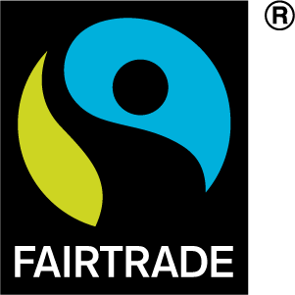
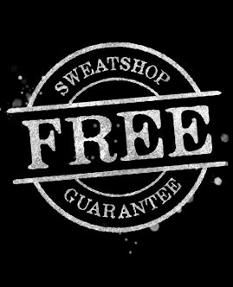

Certification Overview:
Certification: A certification system uses Logos to communicate to consumers that a 3rd party has certified that the product meets a set of standards
Certification is based on tests, inspections and audits of the company—this “party” is unrelated to the company

Slide 10
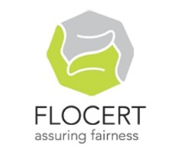
What is Fair Trade?
Fair trade is an organized social movement and market-based approach designed to promote local development by improving trading conditions and sustainability.
Establishes higher prices to producers as well as higher social and environmental standards.
Focuses on exports from developing countries to developed countries, e.g., handicrafts, coffee, cocoa, sugar, tea, bananas, honey, cotton, wine, fresh fruit, chocolate, flowers, sports balls.
Certification: To carry the Fair Trade Label, products are certified by a 3rd party (FLOCert).
Fair trade companies (Transfair) typically work as third
parties marketing products produced under
specific conditions. This betters working conditions
and ensures that producers get more for their
products, while providing access to global markets
for small companies and co-ops

Slide 11

What is FSC Certification?
Forest certification: A market-based, non-regulatory forest conservation mechanism designed to promote environmentally-responsible forestry through the verification of sustainable forest management practices and product labeling.
By certifying forest lands to FSC standards and tracking all wood fiber coming out of these certified forests, final products like paper, furniture, lumber, etc can be labeled & recognized by consumers who want to support sustainable forest management.
Forest Stewardship Council: FSC sets standards for sustainable forest management that include respect of indigenous rights, reduced use of chemicals, and protection of old-growth forests
SmartWood: Rainforest Alliance‘s SmartWood
program is a third party certifier that verifies
products as meeting environmental and
social standards.
Notes:
11

Slide 12

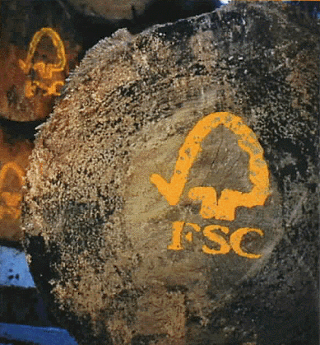


How Does FSC Certification Work?
FSC tracks products from forest to shelf.
Responsibly produced forest products are identified with the FSC logo.
1. Forest Management
certification
2. Chain of Custody
certification
3. Product Labeling
Notes:
There are two types of FSC certification, those for forests (called Forest Management certification) and those for manufacturers, distributors and traders (called Chain of Custody certification).
Once a forest is FSC-certified, all the wood coming from this forest can then be tracked through manufacturing and processing so that when a final wood or paper product carries the FSC logo, it can be guaranteed to have come from a responsible wood source. This means that all manufacturers, processors, distributors and traders within a supply chain must become Chain of Custody certified, so that FSC fibre can be tracked and the label used to identify FSC-certified products.
12

Slide 13
Goal and Strategy Of Product Certification
What’s the Goal:
To alter economic globalization by altering the behavior of corporations.
Certification strategies are like Code of Conduct strategies, but with more teeth to ensure that products are produced according to a set of agreed upon standards: e.g., environmental, social, economic…
What’s the strategy?
Market-based (consumer-driven) strategy: Based on the demand side of the equation; an economic market-based instrument that provides information and incentives to both consumers and producers.
The idea is to use the market as a means to shape corporate behavior by combining demand with certification; reward & punishment.
Can it work? What’s the Theory?
In the hyper-competitive global system producers will adopt any strategy that will increase its market share and hence its profits. Companies will adopt this strategy if it promises to expand its market share
What does the strategy rely on? What’s the Achilles Heel?

Slide 14
Summary
All these movements are attempting to alter globalization by nurturing alliances across groups and address a broader set of issues beyond the workplace.
Certification Campaigns: Based on the code of conduct strategy in that products are certified as meeting certain standards—these can theoretically be anything, from working conditions to environmental standards.
Strategy: “Third Way” strategies targeting companies directly rather than trying to control via governmental regulation.
Coalitions: Driven by global coalitions of organizations and activists & based on solidarity, trust, and commitment to justice.

Slide 15
What do these strategies suggest about globalization?
1) Power & Reform: These kinds of citizen-led advocacy groups are examples of the transnational groups pushing to Alter-globalization and address the power vacuum created as governments’ inability to regulate and control capital.
2) Spatial Organizing: Potentially creating the foundations for a more vibrant transnational civil society necessary to confront the global power of capital.
3) Successes? Have these campaigns proved successful? There is no easy answer but evidence shows an increase in consumer activism and value-influenced buying behavior throughout the world– and major corporations are active in using certified products; Trade discussion include sustainability.
Panacea: Transnational Advocacy Networks can use the market to address abuse along the commodity chain; but TANS can not be (nor should be) substitutes for local community-based organizations and the building of grass-roots power thru leadership development and capacity building.
See: Kuttner: Can Unions Save Lives
Notes:
Sister Ruth Rosenbaum, founder of the Center for Reflection, Education, and Action—an anti-poverty group based in Hartford, Connecticut—sums of the changes this way:
"When we first started working on codes of conduct back in the 1990s, this was kind of like way out there, now, it is absolutely normal for a company to have a code of conduct."

