Slide 1
Algorithm Design

Slide 2
Aims
Understand the principles of algorithm design with examples
Understand how to merge data from 2 files
Understand how to search a list
Understand recursion and its application to lists and to string reversal

Slide 3
Merging Data
Query File
Data File (could contain 000’s of entries)
205607_s_at
41329_at
220840_s_at
208438_s_at
213800_at
215388_s_at
210267_at
214579_at
205996_s_at
208967_s_at
203417_at
212175_s_at
209839_at
218223_s_at
203925_at
220295_x_at
212101_at
202194_at
212102_s_at
212103_at
219159_s_at
215776_at
212147_at
…
208644_at ENSG00000143799
221921_s_at ENSG00000162706
215388_s_at ENSG00000244414
208270_s_at ENSG00000176393
206446_s_at ENSG00000142615
202194_at ENSG00000117500
204418_x_at ENSG00000213366
208500_x_at ENSG00000187140
211050_x_at ENSG00000240618
215566_x_at ENSG00000011009
221831_at ENSG00000169641
201235_s_at ENSG00000159388
203872_at ENSG00000143632
203561_at ENSG00000244682
215728_s_at ENSG00000097021
217365_at ENSG00000232423
215388_s_at ENSG00000000971
200910_at ENSG00000163468
209839_at ENSG00000197959
218917_s_at ENSG00000117713
203417_at ENSG00000117122
212147_at ENSG00000117122
210923_at ENSG00000162383
…

Slide 4
Parsing Files – Possible Solution 1
out_file = open("id_matches.txt", "w")
with open("affy_ids.txt") as file:
for id in file:
with open("affy_genes.txt") as file2:
for line in file2:
gene_line = line.split()
if id.rstrip() == gene_line[0]:
out_file.write(line)

Slide 5
Solution 1 - Problems
File “affy_genes.txt” has to be opened for each affy ID in the "affy_ids.txt“
This could require the file to be opened and closed thousands of times
The “affy_genes.txt” file itself could contain hundreds of thousands of lines
Affy ids may be associated with more than one gene
Genes can also match more than one affy ID
So can’t exit “affy_genes.txt” file as soon as first match made
Have to parse entire file each time

Slide 6
Solution 2
ids = {}
with open("affy_ids.txt") as file:
for line in file:
ids[line.rstrip()] = 1
out_file = open("id_matches.txt", "w")
with open("affy_genes.txt") as file:
for line in file:
list = line.split()
if list[0] in ids:
out_file.write(line)
Both files are now only opened and parsed once

Slide 7
Searching a List
Consider a function that searches a list for a particular entry and returns the index position, if it is present
def search(num, vals):
# Variable num is the entry to be searched for
# and values is a list of values to be searched
# The function will return the index position
Example use:
>>> search(4, [7, 1, 4, 2, 5])
2
>>> search(7, [3, 1, 4, 2, 5])
-1

Slide 8
Searching Function
def search(num, vals):
for i in range(len(vals)):
if vals[i] == num: # item found, return the index value
return i
return -1 # loop finished, item was not in list

Slide 9
Linear Search
The Python “in” and “index” functions, as well as the “search” function all use linear searches
This means the function starts at index position 0 and works through the list until a match is found
In most instances this search strategy is adequate but with very large lists the efficiency starts to deteriorate
A better option for large lists would be a binary search

Slide 10
Binary Search
Requires an ordered list
Strategy is to start by checking the value in the middle of the list:
Match
Yes
No
Return number
< Value
Yes
No
Check value in middle
of lower half of list
Check value in middle of upper half of list
Match
Match
Return number
Etc …
Return number
Etc …
Notes:
Guess a number between 1 and 100. First guess 50. If told the value is higher, it is in the range 51-100. The next logical guess is 75.

Slide 11
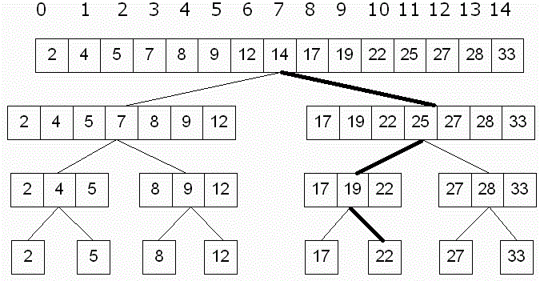
Binary Search Example
List = [2, 4, 5, 7, 8, 9, 12, 14, 17, 19, 22, 25, 27, 28, 33)
Search for ‘22’:
Maximum 4 steps to search for an entry

Slide 12
Python Binary Search Algorithm
Need two variables to keep track of position in the list – the low and high points
Initially low is set to the first index position and high to the last
Compare search value with value in the middle of the list
If lower then set high point to middle index position
If higher set low point to middle index
Repeat until value is found or there are no more indices to search

Slide 13
Python Binary Search Algorithm
def search(num, vals):
low = 0
high = len(vals) – 1
while low <= high: # There is a range to search
mid = (low + high) / 2 # Position of middle item
item = vals[mid]
if num == item: # Found it! Return the index
return mid
elif num < item: # x is in lower half of range
high = mid - 1 # move top marker down
else: # x is in upper half of range
low = mid + 1 # move bottom marker up
return -1 # No range left to search,
# x is not there

Slide 14
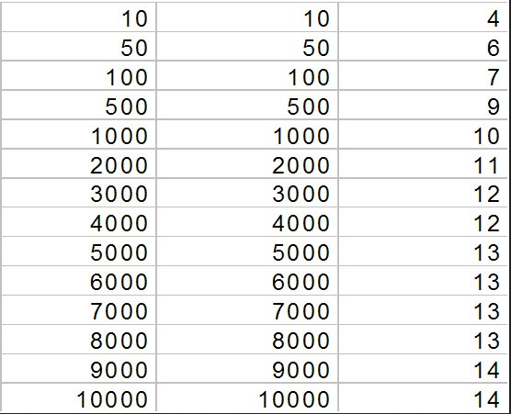
Python Binary Search Efficiency
Binary search is far more efficient than the linear search but do need to sort list first
Once sorted the best case performance is one comparison and the worst-case (value not in list) is log₂N, where N is the size of the array
List Size
Linear (N)
Binary (Log₂N)
Notes:
http://www.csit.parkland.edu/~mbrandyberry/CS1Java/Lessons/Lesson27/BinarySearchEfficiency.htm

Slide 15
Recursion
Recursion simply means applying a function as a part of the definition of that same function.
Essentially the function calls itself.
The key to making it work is that there must be a terminating condition such that the function branches to a non-recursive solution at some point.
Consider a function to calculate a factorial:
1! = 1
2! = 1 x 2 = 2
3! = 1 x 2 x 3 = 2! x 3 = 6
N! = 1 x 2 x 3 x .... (N-2) x (N-1) x N = (N-1)! x N

Slide 16
Factorial Function
def factorial(n):
if n == 1:
return 1
else:
return n * factorial(n-1)
Now because we decrement N each time and we test for N equal to 1 the function must complete.
There is a small bug in this definition however, if you try to call it with a number less than 1 it goes into an infinite loop! To fix that change the test to use "<=" instead of "==".
This goes to show how easy it is to make mistakes with terminating conditions, this is probably the single most common cause of bugs in recursive functions.
Make sure you test all the values around your terminating point to ensure correct operation.

Slide 17
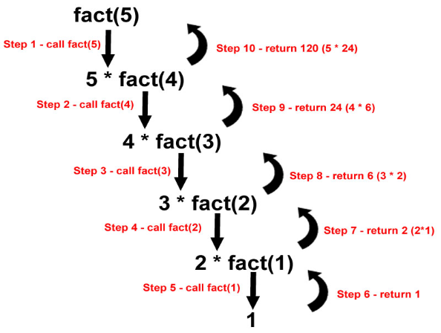
Factorial Function
How does the factorial function work?
The return statement returns n * (the result of the next factorial call) so the code is effectively doing:

Slide 18
Reversing a String
Have already seen one method for this:
s = “abcde”
s = s[::-1]
Strings can also be reversed with a recursive function:
def reverse(s):
if s == "":
return s
else:
return reverse(s[1:]) + s[0]

Slide 19
Recursion and Lists
Can use recursion to print a list
def printList(L):
if L:
print (L[0]) # Print the first item in the list
printList(L[1:]) # Uses slice to call printList on the # remainder of the list
nums = (1, 2, 3, 4, 5)
printList(nums)
Outputs:
1
2
3
4
5

Slide 20
Recursion and Lists
Recursion is of more use if printing a list that contains one or more lists.
This function uses the Python type() function to determine if an item is a list:
def printList(L):
# if its empty do nothing
if not L:
return
# if it's a list call printList on 1st element
if type(L[0]) == type([]):
printList(L[0])
else: # no list so just print
print (L[0])
# now process the rest of L
printList(L[1:])

Slide 21
Towers of Hanoi
There is an old legend about a temple with three poles, one of them filled with 64 gold disks.
The disks are of different sizes and they are put on top of each other such that each disk on the pole a little smaller than the one beneath it.
The priests have to move this stack from one of the three poles to another one, but a large disk can never be placed on top of a smaller one.
The legend says that when they have finished their work the temple would crumble into dust, and the world would end.
However, it would require 2⁶⁴ - 1 moves (18,446,744,073,709,551,615) to complete the task.
The legend and the game of towers of Hanoi was actually created in 1883 by the French mathematician Edouard Lucas.

Slide 22


Towers of Hanoi

Slide 23
Why Towers of Hanoi?
The factorial solution is the “hello word” example of a recursive function
Along with the list examples, they all demonstrate recursion but can also be solved using iterative code, even if often less efficiently
The towers of Hanoi is a problem that cannot easily be solved iteratively but can be solved with a relatively simple recursive function
To solve any problem recursively you need to first define the rules for solving the problem

Slide 24
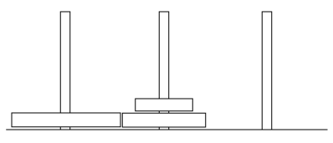
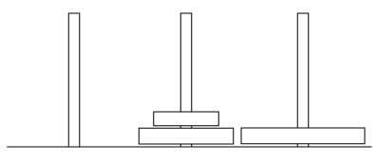
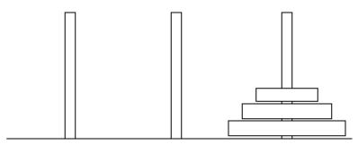
Towers of Hanoi Rules
The 3 pegs can be labelled “start”, “middle” and “end”.
The rules for the solution are then:
1: Move N-1 disks from the start peg to the middle peg
2: Move the Nth (largest) disk from the start peg to the end peg
3: Move N-1 disks from the middle peg to the final peg
Rule 3 calls rules 1 and 2 and the pegs change designation accordingly.
This is followed recursively until the disks are all moved to the end peg.

Slide 25
Towers of Hanoi Solution
def hanoi(disk, start, middle, end):
if disk > 0:
# 1: Move N-1 disks from the start pole to the middle peg
hanoi(disk - 1, start, end, middle)
print('Move disk' + str(disk) + ' from ' + start + ' to ' + end)
hanoi(disk - 1, middle, start, end)
# Call function with specified number of starting disks
hanoi(3, “Start”, “Middle”, “End”)

Slide 26
Towers of Hanoi Solution 1 Output
Move disk1 from Start to End
Move disk2 from Start to Middle
Move disk1 from End to Middle
Move disk3 from Start to End
Move disk1 from Middle to Start
Move disk2 from Middle to End
Move disk1 from Start to End

Slide 27
Code Explanation
# Set the terminating condition. No disks left so function just returns and
# cascades back
if disk > 0:
# 1: Move N-1 disks from the start pole to the middle peg
# The middle peg is now the target (end) and the end becomes the
# intermediary (middle)
hanoi(disk - 1, start, end, middle)
# 2: Move the Nth (largest) disk from the start pole to the end peg
print('Move disk' + str(disk) + ' from ' + start + ' to ' + end)
# 3: Move N-1 disks from the middle peg to the final pole
# The middle is now the starting position (start) and the start is the # intermediary (middle)
hanoi(disk - 1, middle, start, end)

Slide 28
Exponentiation
The iterative way to calculate a^{n} for any integer n is to multiply a by itself n times
This can be achieved with a simple loop:
def calcPower(a, n):
ans = 1
for i in range(n):
ans = ans * a
return ans
print (calcPower(2, 8))
This method requires n calculations, in this case 8.

Slide 29
Recursive Exponentiation
The basis of solving the problem using recursion is the principle of divide and conquer
The laws of exponents mean that 2⁸ = 2⁴(2⁴)
Therefore if 2⁴ is known then 2⁸ just needs one calculation multiplication.
Furthermore, 2⁴ = 2²(2²) and 2² = 2(2)
2(2) = 4, 4(4) = 16, 16(16) = 256 = 2⁸
The result is that 2⁸ can be calculated with only 3 multiplications, 2¹⁶ in 4 etc
For an even number a^{n} = a^{n//2}(a^{n//2})
For an odd number a^{n} = a^{n//2}(a^{n//2}) (a)

Slide 30
Recursive Exponentiation Solution
def calcPower(a, n):
# Set the terminating condition.
if n == 0:
return 1
else:
factor = calcPower(a, n//2)
if n%2 == 0: # Even
return factor * factor
else: # Odd
return factor * factor * a
print (calcPower(2, 8))

Slide 31
Recursion
There are similarities between looping and recursion
Anything that can be done with a loop can also be done with a recursive function
Some problems that are difficult to solve with loops (e.g. tree traversal)
are relatively simple to solve with recursion
Be aware when recursion can be used as it may improve the efficiency of your code
However, a loop may still be the best solution

Slide 32
Conclusions
Understanding how to program is just the first stage in writing code
Algorithm design is the core component of program design
When designing code consider the efficiency of the code
Remember that generally anything that can be done with a loop can be done with a simple recursive function
Unless the code is only going to be a short script then design it first

