Slide 1
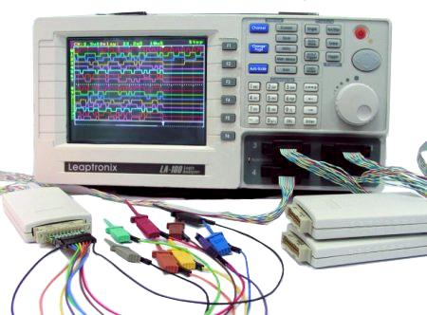


cross-platform browser instrumentation using JavaScript
jsprobes
Brian Burg (@brrian / burg@cs.uw.edu)

Slide 2



Background: browser research template
1
Become puzzled by a question
2
Get real data and analyze
3
Write paper with answers
images from www.phdcomics.com

Slide 3
Right now, this is the hard part
1
Become puzzled by a question
2
Get real data and analyze
3
Write paper with answers
images from www.phdcomics.com

Slide 4
Browser instrumentation wishlist
Cross-platform/architecture
Low/no performance overhead
Shareable/distributable
Runtime flexibility
Familiar programming model
Cross-language/cross-component

Slide 5

Existing approaches: browser addons/extensions
Advantages
Disadvantages
Somewhat familiar programming model
Easy to distribute
Cross-platform
Flexibility at runtime
Can’t access all parts of the stack
Bad for critical path instrumentation
Image: Mozilla Test Pilot (www.mozillalabs.com/testpilot/)

Slide 6


Existing approaches: platform instrumentation
ETW
Advantages
Disadvantages
Extremely low/no performance overhead
Can instrument any browser component
Runtime flexibility
Needs escalated (root) privileges/kernel mod
Platform-specific
Limited programming language/model
Cannot distribute
Images: dtrace.org, en.wikipedia.org/wiki/SystemTap

Slide 7
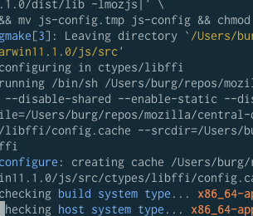
Existing approaches: modifying browser source
Advantages
Disadvantages
Can do anything!
(possible) low performance impact
Difficult to understand and modify
Easy to cause crashes
Hard to distribute/share/reuse
Very fragile vs. upstream changes

Slide 8
jsprobes: an experiment
A browser instrumentation framework…
With instrumentation written in JavaScript
Accessible via XPCOM to addons
Available on all platforms/architectures
Which encourages experimentation
That can gather many kinds of data
Fast enough to gather low-level data

Slide 9
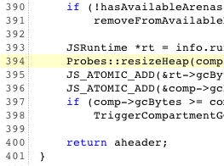
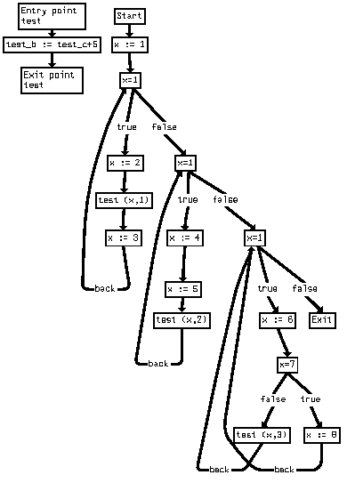
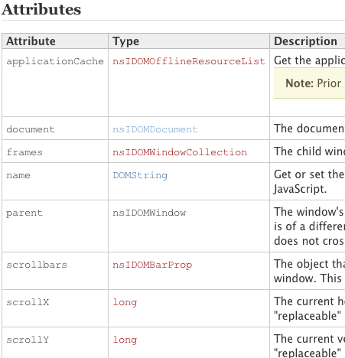
jsprobes terminology
probe point
Source location to instrument
probe handler
What to do at probe point
probe values
Data to record at probe point
images from www.phdcomics.com

Slide 10
jsprobes use case
1. Find an interesting probe point
probes.GC_DID_START
2. Decide which probe values to use
env.currentTimeMS,
runtime.heapSize
3. Write a probe handler for that point
pendingGC = [env.currentTimeMS, 0,
runtime.heapSize, 0];

Slide 11
jsprobes use case (2)
4. Write a matching handler to GC_WILL_END:
pendingGC[1] = env.currentTimeMS;
pendingGC[3] = runtime.heapSize;
data.push(pendingGC);
5. Register handlers with the probes service.
6. Periodically fetch data and do something, such as aggregate, graph, or report it.

Slide 12
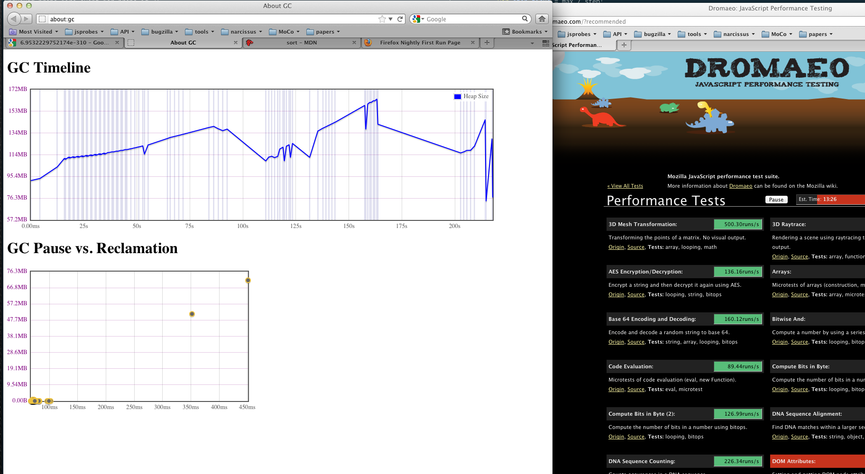
Demo! (source available at https://bitbucket.org/burg/aboutgc)

Slide 13
jsprobes architecture
Handler registry
Main browser
thread + heap
Probe handler
thread + heap

Slide 14
jsprobes architecture
Handler registry
probe handler code
probe handler code
probe handler code
Register probe handler with service
Main browser
thread + heap
Probe handler
thread + heap

Slide 15
jsprobes architecture
Probe point reached.
Handler registry
1
probe handler code
probe handler code
probe handler code
Register probe handler with service
Main browser
thread + heap
Probe handler
thread + heap

Slide 16
jsprobes architecture
Probe point reached.
Data gathered, serialized,
and enqueued
Handler registry
probe handler code
probe handler code
probe handler code
Register probe handler with service
Main browser
thread + heap
Probe handler
thread + heap

Slide 17

jsprobes architecture
Data gathered, serialized,
and enqueued
asynchronously deserialize data
and run handlers
Handler registry
probe handler code
probe handler code
probe handler code
Register probe handler with service
Main browser
thread + heap
Probe handler
thread + heap

Slide 18

jsprobes architecture
Data gathered, serialized,
and enqueued
asynchronously deserialize data
and run handlers
Handler registry
probe handler code
probe handler code
probe handler code
Register probe handler with service
Main browser
thread + heap
Probe handler
thread + heap
Post async messages back to main thread

Slide 19

jsprobes architecture
Data gathered, serialized,
and enqueued
asynchronously deserialize data
and run handlers
Handler registry
probe handler code
probe handler code
probe handler code
Register probe handler with service
Dispatch message to callbacks
Probe handler
thread + heap
Main browser
thread + heap
Post async messages back to main thread

Slide 20
Architecture implications
Probe points can fire at times unsafe for JS
Probe handlers have read-only access*
Handler must specify what data to collect
Probe data must be representable in JS
Probe data must be be serializable**
* Side-effects would complicate reasoning when multiple handlers are registered for the same probe point
** Probe data is marshalled using the HTML 5 structured cloning algorithm. This can be extended to support new data types.

Slide 21
jsprobes: current status
Cross-platform/architecture
Low/no performance overhead (TODO)
Shareable/distributable (TODO)
Runtime flexibility
Familiar programming model
Cross-language/cross-component
Current implementation available at https://bitbucket.org/burg/jsprobes-patches

Slide 22
Let’s fill in the research template…
1
2
3
3
Use jsprobes to
make an addon
that measures
per-site heap size
Implement better
heap size heuristics
based on real data
“Do websites have a typical heap size?”
images from www.phdcomics.com

Slide 23

Future work
More sophisticated implementation
No “probe effect” when probes inactive
Low performance impact when active
Add probe points to more components
Expose more types of data to probe handlers
Brian Burg – University of Washington
burg@cs.uw.edu www.brrian.net www.twitter.com/brrian
https://bitbucket.org/burg/ http://brrian.tumblr.com

