Slide 1
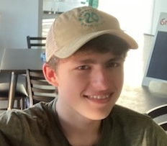



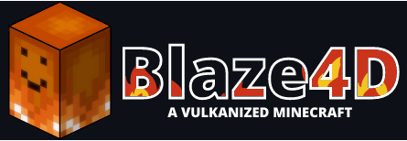
Hi, I’m Ryan
A computer science student passionate about graphics programming.
EMAIL
ryan.gehling@yahoo.com
My Projects
About Me
Sodium
Made with: Java, LWJGL, OpenGL
An optimization mod for Minecraft that reduces stuttering and increases frame rates by several times the base game. This mod rewrites the entire rendering engine from the ground up to use more modern OpenGL strategies, better culling algorithms, and more efficient CPU to GPU communication. I’ve worked with two other people to refactor large portions of the mod since I became a lead developer.
Hello! My name is Ryan and I enjoy programming!
One of my aspirations is to attend a university that allows me to enhance my self-taught computer programming skills for the development of AI applications and optimize computer graphics rendering for end-user performance.
Here are a few technologies I’ve been working with recently:
Java
Swing
LWJGL
Batch
JavaScript
OpenGL
Vulkan
GeoGebra
Made with: Java, GWT, WebGL
An online tool for students and educators to model mathematics, graph equations, analyze algebra, and more. I worked with two other lead developers to discuss potential rendering improvements and updating to newer rendering tools. I’ve begun work on efforts to make the 3D graphing calculator more performant by reducing and batching draw calls. I’ve also started work on adding more features to the existing 3D graphs.
Blaze4D
Made with: Java, LWJGL, Vulkan
A mod for Minecraft meant to replace the existing OpenGL rendering engine with one that uses Vulkan, maintaining compatibility with existing mods and adding additional features. There was a large demand for this conversion from the Minecraft community. I worked with 3 other developers, and together, we completed the conversion. We plan on expanding this further to add compatibility with Sodium and add additional features such as ray tracing.

