Slide 1
Persistence (I)
I/O and Files

Slide 2
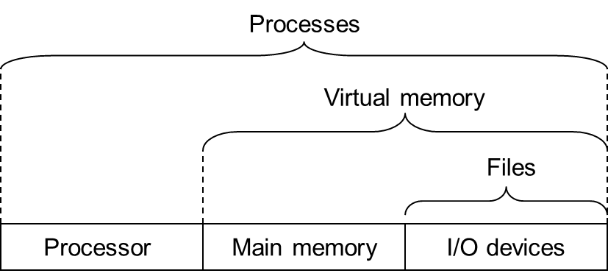
OS: Three Easy Pieces
虚拟化
持久化
并发

Slide 3
Outline
I/O Devices
Unix I/O
Reading File Metadata
Sharing Files & I/O redirection

Slide 4
I/O Devices
I/O: Input/Output
  持久化设备
    加载程序、数据
    保存状态
  CPU, Cache, RAM都无法保存状态
  新的挑战者
    非易失内存
      Non-Volatile Memory
      Storage Class Memory
      Persistent Memory

Slide 5
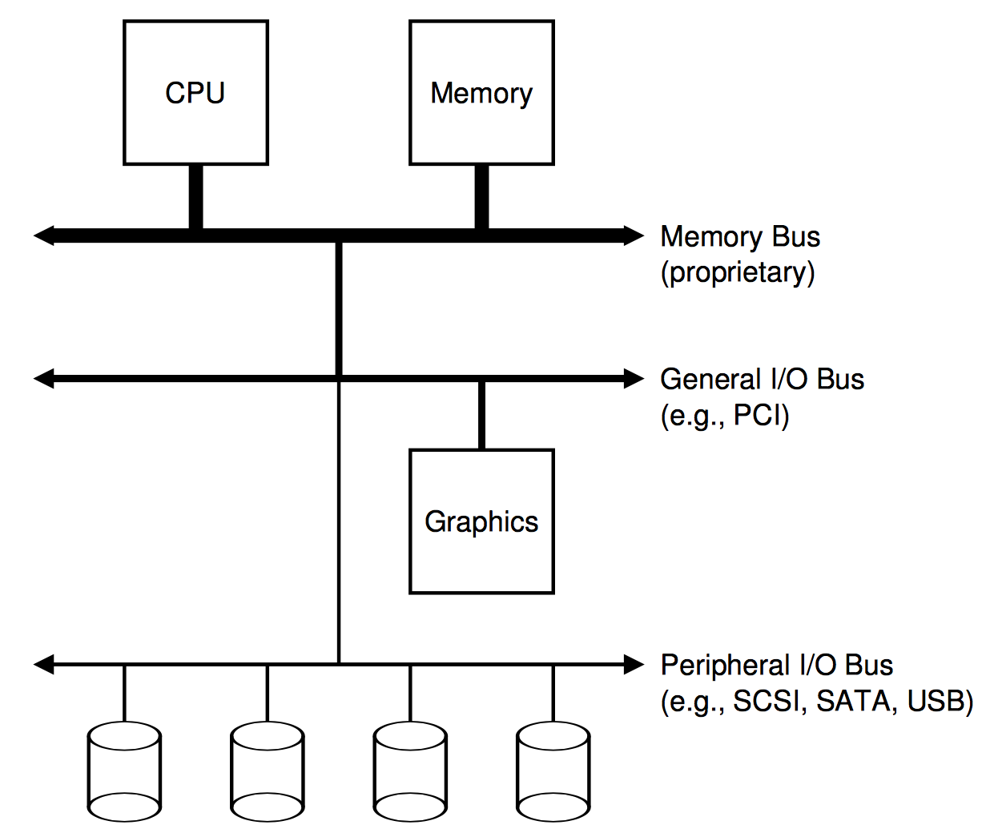
I/O Devices
System Architecture
  层次结构原因
    快速设备近
    慢速设备远

Slide 6
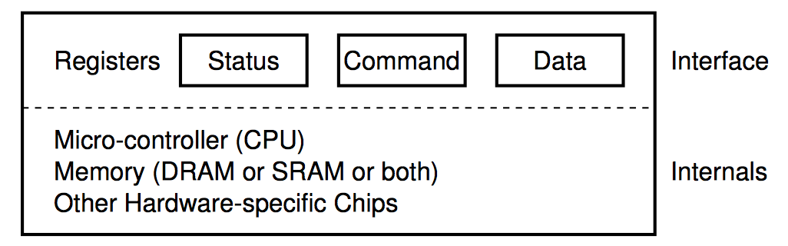
I/O Devices
I/O设备的通用结构
  Status
  Command
  Data

Slide 7
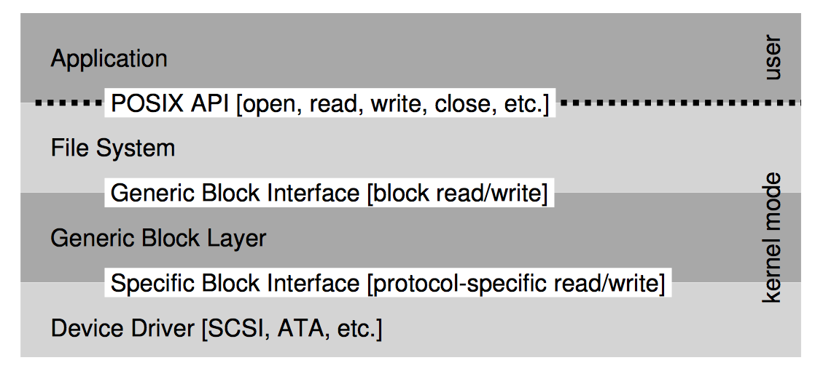
I/O Devices
File System Stack

Slide 8
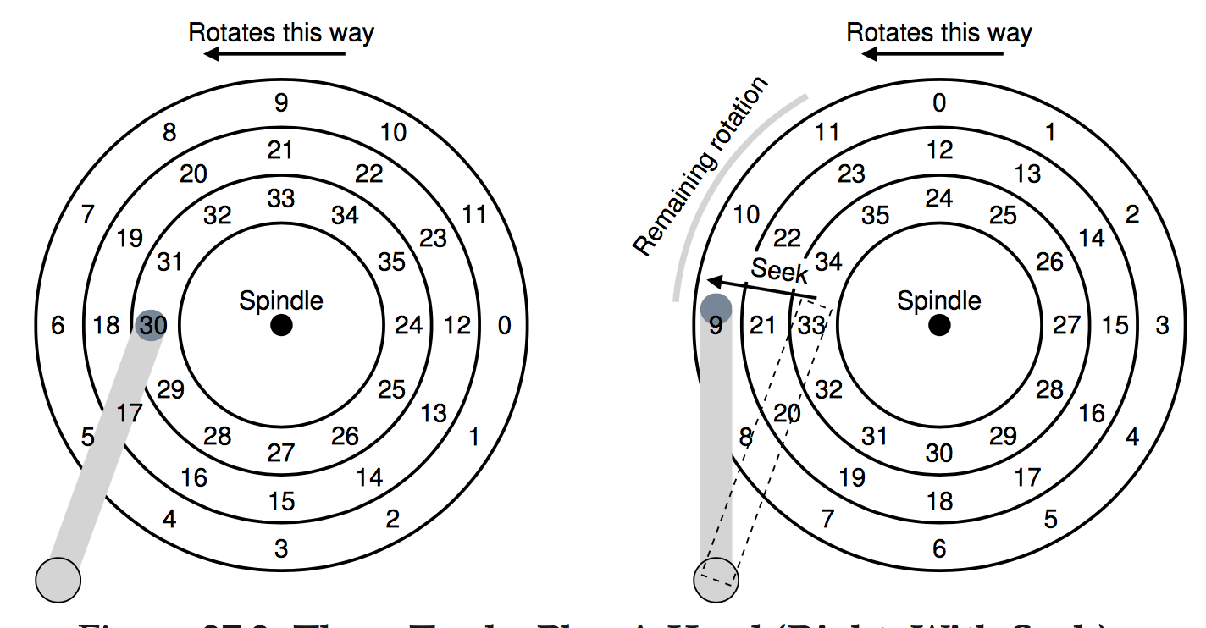
I/O Devices
磁盘
闪存

Slide 9
I/O Devices
磁盘调度
  : Shortest Seek Time First
    picking requests on the nearest track first
  问题
    饥饿
    陷入局部最优，达不到全局最优

Slide 10
I/O Devices
Elevator (a.k.a. SCAN or C-SCAN)
  外->内；内->外；外->内…
  F-SCAN
    Freeze the queue, 一个方向扫完之后才处理新来的请求
    避免饥饿
    效率问题：新来的附近请求
  C-SCAN (Circular SCAN)
    只是从外到内，再置位到最外道
    所有磁道更加公平，否则中间磁道访问的机会更多

Slide 11
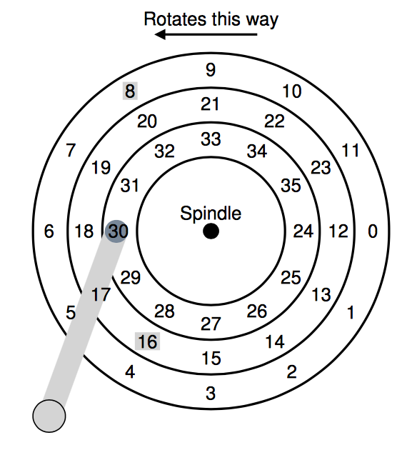
I/O Devices
SSTF和Elevator算法的通用问题
  没有考虑到旋转的影响
SPTF: Shortest Positioning Time First
  当前磁头在30
  下一步到16，还是8？
  It depends
  看Seek time和rotation
  delay哪个更大，最好在
  Disk controller里面实现

Slide 12
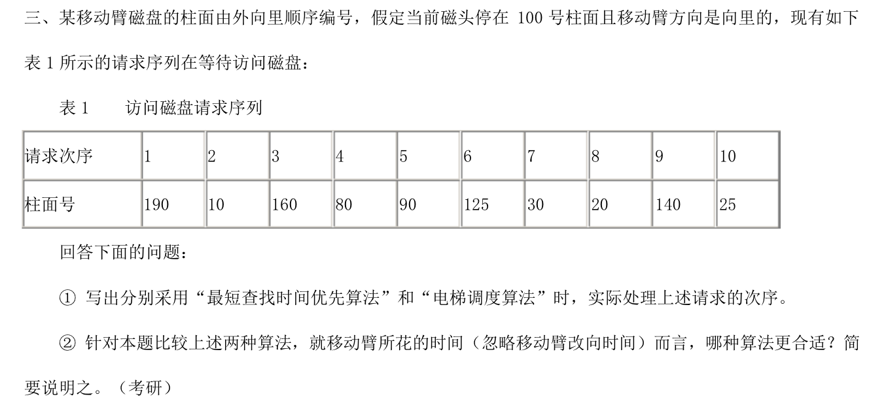
练习5-1
磁盘调度算法

Slide 13
练习5-1
最短查找时间优先
  100-90-80-125-140-160-190-30-20-10
  10+10+45+15+20+30+160+10+10 = 310
电梯算法（F-SCAN)
  100-90-80-30-20-10-125-140-160-190
  10+10+50+10+10+115+15+20+30 = 270

Slide 14
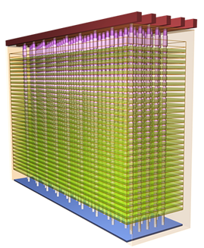
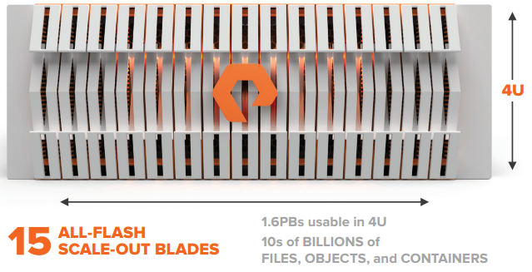
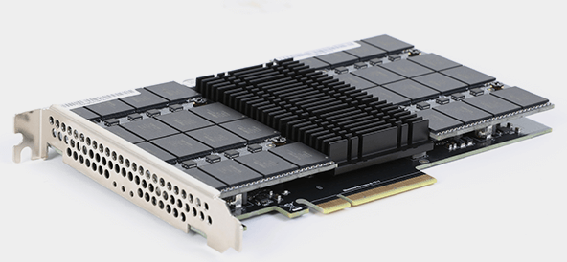
I/O Devices
Flash-based SSD
新型NVMe接口
B
A
3D NAND
快速、高并发
4KB随机读延迟 125μs
4KB 随机写延迟 15μs
4KB随机写IOPS 120K
超大容量，32-64层
单盘25TB（宝存）
闪存
Flash
C
全闪存阵列
局限性
D
在很多领域取代磁盘（每GB成本低于1美元）
Pure Storage Flash Blade: 15 GB/s
成本；耐久性、可靠性；
SSD RAID控制器成熟度

Slide 15
Outline
I/O Devices
Unix I/O
Reading File Metadata
Sharing Files & I/O redirection

Slide 16
Why Unix I/O
Input/Output
  A process of copying data between main memory and external devices
Standard I/O library
  User level or high level I/O functions
Unix I/O
  I/O functions provided by kernel
  Helps you understand other system concepts
    I/O vs. process
  Sometimes, it is the only choice

Slide 17
Unix I/O
A Unix file is a sequence of m bytes
  B₀, B₁, ……, B_{k}, ……, B_{m}
All I/O devices are modeled as files
  such as networks, disks, and terminals
  allows Unix to export a simple, low-level application interface, known as Unix I/O
All input and output is performed by reading and writing the appropriate files
  Enables all input and output to be performed in a uniform and consistent way.

Slide 18
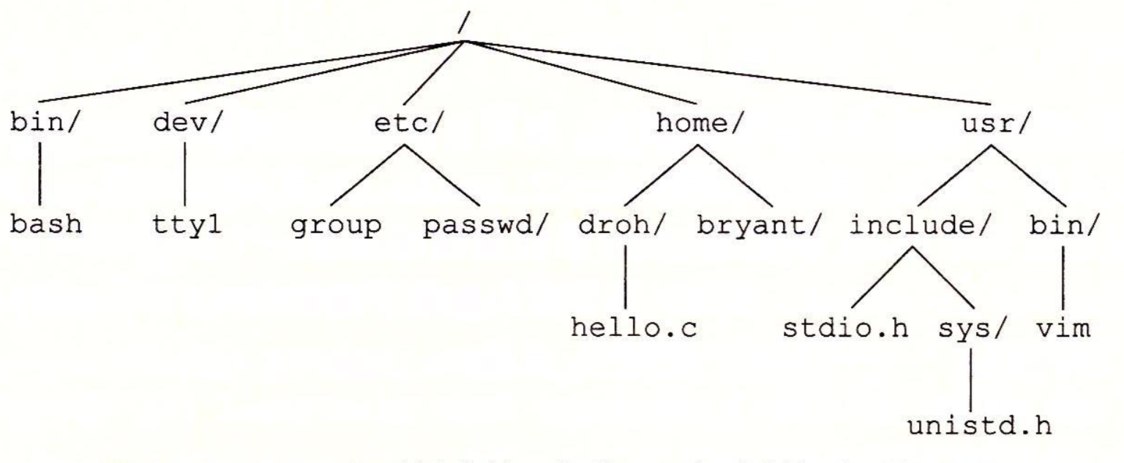
Unix I/O
Linux系统目录层次结构（部分）

Slide 19
Open Files
An application announces its intention to access an I/O device
  The kernel opens the corresponding file
  The kernel returns a small non-negative integer, descriptor
    Identifies the file in all subsequent operations on the file
  The kernel keeps track of all information about the open file
    Maintains a file position k, initially 0, for each open file

Slide 20
Kernel Data Structures for Files
open file table
(shared by all process)
V-node table
(shared by all processes)
file A
Descriptor table (one table per process)
file A
file pos
File access
refcnt = 1
File size
...
File type
fd0
fd1
…
fd2
fd3
fd4
fd5
fd6
fd7

Slide 21
Descriptor table
每个进程有自己独立的descriptor table
  每个文件描述符是一个非负数字，作为descriptor table的索引
    0：标准输入（默认已打开）
    1 ：标准输出（默认已打开）
    2 ：标准错误（默认已打开）
    其他打开的文件，从3开始编号
  每个打开的文件描述符指向一个file table中的一个entry

Slide 22
File table
The set of open files is represented by a file table
File table is shared by all processes
Each file table entry consists
  the current file position
  a reference count of the number of descriptor entries that currently point to it
  a pointer to an entry in the v-node table
  the kernel deletes a file table entry when its reference count becomes zero

Slide 23
V-node table
V-node table is shared by all processes
Each entry contains most of the information of a file

Slide 24
Kernel Data Structures for Files
open file table
(shared by all process)
V-node table
(shared by all processes)
file A
Descriptor table (one table per process)
file A
file pos
File access
refcnt = 1
File size
...
File type
fd0
fd1
file B
…
fd2
file B
fd3
fd4
file pos
File access
fd5
refcnt = 1
File size
fd6
File type
fd7
...
…

Slide 25
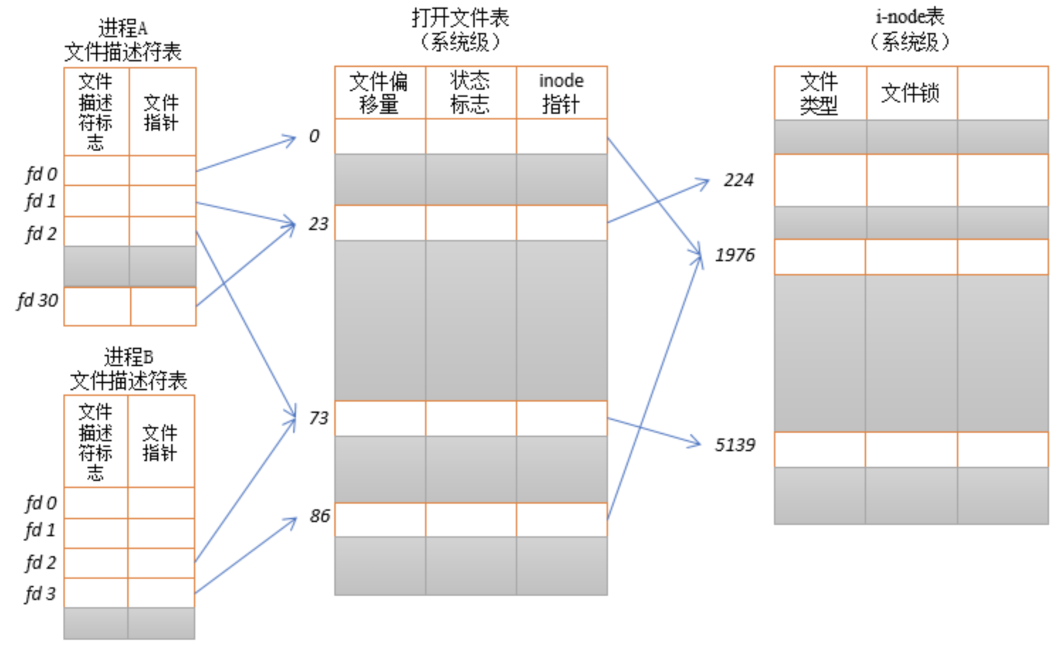
例子
可能一个进程多个fd对应打开同一个打开的文件(如dup2)
可能多个进程对应同一个打开文件(如fork)
可能多个进程对应不同打开文件，但是同一个文件

Slide 26
Open Files
An application announces its intention to access an I/O device
  应用程序只需要维护文件描述符，其他信息都在kernel数据结构中
  一个应用程序可以通过seek操作，显式的设置文件的当前访问位置
    Read/write操作都从当前位置开始向后进行

Slide 27
Open Files
#include <sys/types.h>
#include <sys/stat.h>
#include <fcntl.h>
int open(char *filename, int flags, mode_t mode);
Returns: new file descriptor if OK, -1 on error
flags
  O_RDONLY, O_WRONLY, O_RDWR (must have one)
  O_CREAT, O_TRUNC, O_APPEND (optional)
mode
  S_IRUSR, S_IWUSR, S_IXUSR
  S_IRGRP, S_IWGRP, S_IXGRP
  S_IROTH, S_IWOTH, S_IXOTH

Slide 28
Open Files
Flags:
  O_CREAT:如果文件不存在，就创建一个空文件
  O_TRUNC：如果文件已经存在，就截断它
    再写入时，从头写入，覆盖原来的内容
  O_APPEND:在每次写入操作钱，设置文件位置到文件的结尾处
Note: open集成了create file功能

Slide 29
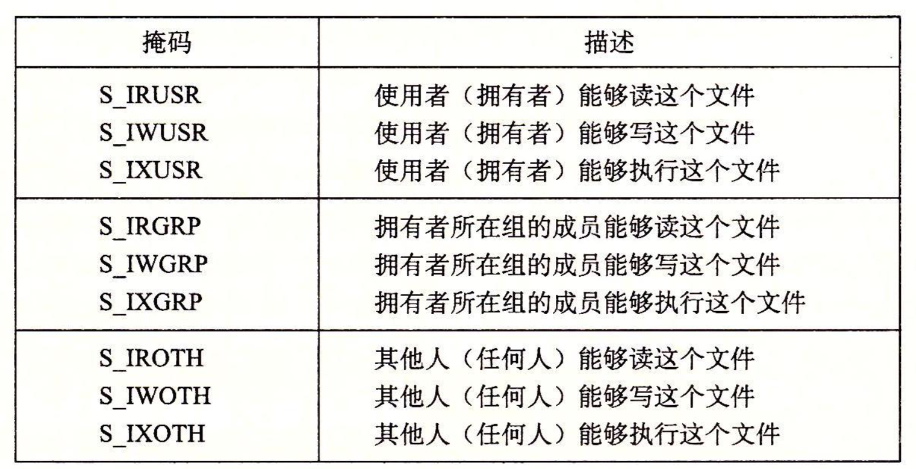
Open Files
Mode:

Slide 30
Open Files
umask(): set mask of process
利用umask命令可以指定哪些权限将在新文件的默认权限中被删除
#define DEF_MODE S_IRUSR | S_IWUSR | \
S_IRGRP | S_IWGRP | \
  S_IROTH | S_IWOTH
#define DEF_UMASK S_IWGRP | S_IWOTH
umask(DEF_UMASK);
fd = open (“foot.txt”,
O_CREAT|O_TRUNC|O_WRONLY, DEF_MODE);
/* permission: S_IRUSR|S_IWUSR|S_IRGRP|S_IROTH*/

Slide 31
Open Files
一个进程的文件描述符有上限
  超过了会报错：“Too many open files”
  单个进程的上限一般是1024
    可以通过ulimit –n查询
  系统的最大值：sysctl -a | grep fs.file-max

Slide 32
Open Files
#include "csapp.h"
2
3 int main()
4 {
5 int fd1, fd2;
6
7 fd1 = Open("foo.txt", O_RDONLY, 0);
8 Close(fd1);
9 fd2 = Open("baz.txt", O_RDONLY, 0);
10 printf("fd2 = %d\n", fd2);
11 exit(0);
12 }

Slide 33
Close Files
close the file
  Do not access the file
  The kernel action
    The kernel frees the structures it created when the file was opened
    The kernel restores the descriptor to a pool of available descriptors
      The next file that is opened is guaranteed to receive the smallest available descriptor in the pool

Slide 34
Close Files
close the file
  Default actions when terminate
    The kernel closes all open files
    The kernel frees their memory resources
#include <unistd.h>
int close(int fd) ;
Returns: zero if OK, -1 on error

Slide 35
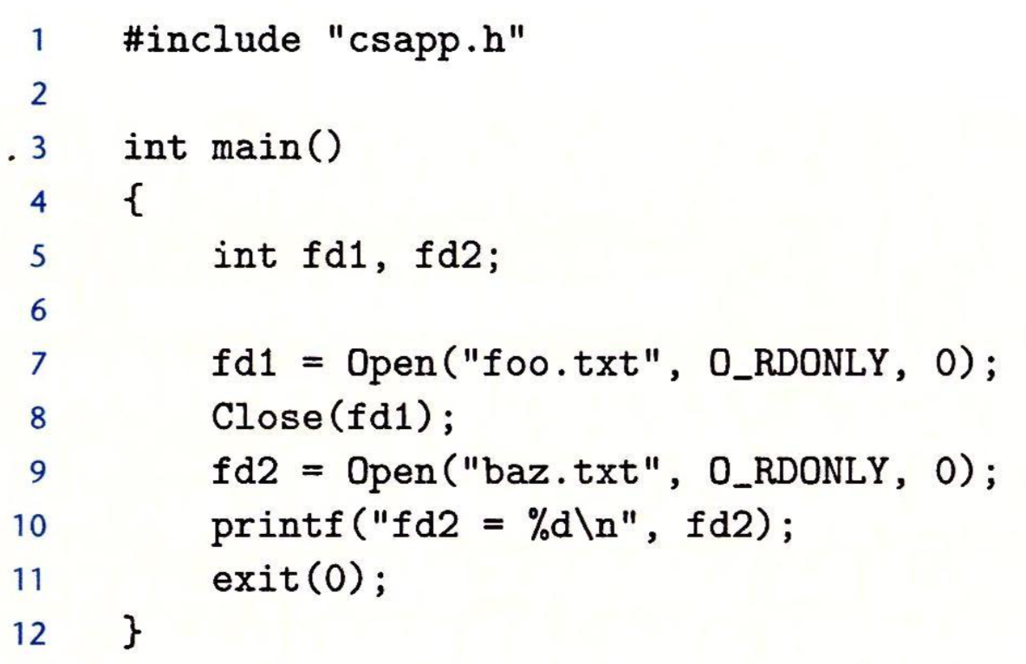
课堂练习
屏幕输出什么？
Notes:
3

Slide 36
Reading and Writing Files
#include <unistd.h>
ssize_t read(int fd, void *buf, size_t count);
returns: number of bytes read if OK,
0 on EOF, -1 on error
ssize_t write(int fd, const void *buf, size_t count);
returns: number of bytes written if OK,
-1 on error

Slide 37
Reading and Writing Files
A read operation
  Copies m > 0 bytes from the file to memory
    starting at the current file position k
    incrementing k by m
  If the total bytes from k to the end of file is less than m, it triggers a condition known as end-of-file (EOF)
    Can be detected by the application
    There is no explicit ”EOF character” at the end of a file

Slide 38
Reading and Writing Files
1 #include "csapp.h"
2
3 int main(void)
4 {
5 char c;
6
7 /* copy stdin to stdout, one byte at a time */
8 while(Read(STDIN_FILENO, &c, 1) != 0)
9 Write(STDOUT_FILENO, &c, 1);
10 exit(0);
11 }
STDIN_FILENO(0), STDOUT_FILENO(1), STDERR_FILENO(2)

Slide 39
Reading and Writing Files
ssize_t vs. size_t
  X86-64:
    ssize_t: signed long
    size_t: unsigned long
Short count
  Read and write transfer fewer bytes than the application requests
    Encounter EOF on reads
    Reading text lines from a terminal
    Reading and writing network sockets

Slide 40
Outline
I/O Devices
Unix I/O
Reading File Metadata
Sharing Files & I/O redirection

Slide 41
Reading File Metadata
#include <unistd.h>
#include <sys/stat.h>
int stat(const char *filename, struct stat *buf);
int fstat(int fd, struct stat *buf) ;
returns: 0 if OK, -1 on error

Slide 42
Reading File Metadata
/* file info returned by the stat function */
struct stat {
dev_t st_dev; /* device */
ino_t st_ino; /* inode */
mode_t st_mode; /* protection and file type */
nlink_t st_nlink; /* number of hard links */
uid_t st_uid; /* user ID of owner */
gid_t st_gid; /* group ID of owner */
dev_t st_rdev; /* device type (if inode device) */
off_t st_size; /* total size, in bytes */
unsigned long st_blksize; /* blocksize for filesystem I/O */
unsigned long st_blocks; /* number of blocks allocated */
time_t st_atime; /* time of last access */
time_t st_mtime; /* time of last modification */
time_t st_ctime; /* time of last change */
};

Slide 43
硬链接和软链接
解决文件共享使用问题
硬链接 (hard link)
  一个 inode 号对应多个文件名
  同一个文件使用了多个别名
  硬链接可由命令 link 或 ln 创建
  文件有相同的 inode 及 data block；
  只能对已存在的文件进行创建；
  不能交叉文件系统进行硬链接的创建；
  不能对目录进行创建，只可对文件创建；
  删除一个硬链接文件并不影响其他有相同 inode 号的文件

Slide 44
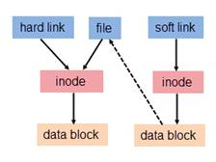
硬链接和软链接
软链接
  又称符号链接，即 soft link 或 symbolic link
  文件用户数据块中存放的内容是另一文件的路径名的指向，则该文件就是软连接
  软链接就是一个普通文件，只是数据块内容有点特殊。软链接有着自己的 inode 号以及用户数据块

Slide 45
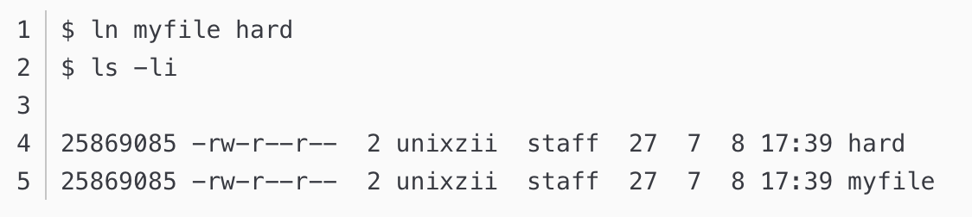
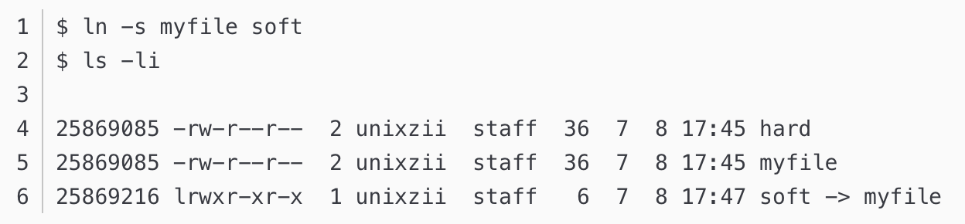
硬链接和软链接

Slide 46
int main(int argc, char **argv)
{
struct stat stat ;
char *type, *readok ;
Stat(argv[1], &stat) ;
if (S_ISREG(stat.st_mode)) /* Determine file type */
type = “regular” ;
else if (S_ISDIR(stat.st_mode))
type = “directory” ;
else
type = “other” ;
if ((stat.mode & S_IRUSR)) /* check read access */
readok = “yes”;
else
readok = “no”;
printf(“type: %s, read: %s\n”, type, readok) ;
exit(0) ;
}
S_ISREG() Is this a regular file?
S_ISDIR() Is this a directory file?

Slide 47
Reading Directory
#include <sys/types.h>
#include <dirent.h>
DIR *opendir (const char *name);
returns: 成功则返回处理的指针；若出错，则返回NULL
struct dirent *readdir (DIR *dirp);
returns: 成功则返回指向下一个目录项的指针；没有更多目录或出错则返回NULL

Slide 48
Reading Directory
目录项
  struct dirent {
  ino_t d_ino; /* inode number */
  char d_name[256]; /* filename */
  }
  有些linux版本包括更多内容

Slide 49
Reading Directory
#include <dirent.h>
DIR *closedir (DIR *dirp);
returns: 成功则返回0；若出错，则返回-1

Slide 50
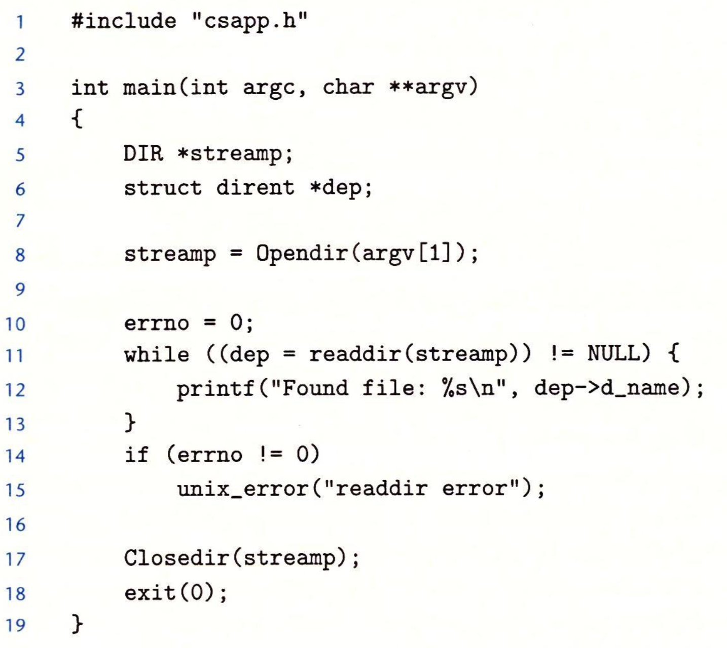
Reading Directory

Slide 51
Outline
I/O Devices
Unix I/O
Reading File Metadata
Sharing Files & I/O redirection

Slide 52
V-Node table
Shared by all processes
Each entry contains most of the information in the stat structure, such as
  st_mode
  st_size

Slide 53
Sharing Files
没有文件共享
的情况
open file table
(shared by all process)
V-node table
(shared by all processes)
file A
Descriptor table (one table per process)
file A
file pos
File access
refcnt = 1
File size
...
File type
fd0
fd1
file B
…
fd2
file B
fd3
fd4
file pos
File access
fd5
refcnt = 1
File size
fd6
File type
fd7
...
…

Slide 54
Sharing Files
open两次同一个
文件
open file table
(shared by all process)
V-node table
(shared by all processes)
file A
Descriptor table (one table per process)
file A
file pos
File access
refcnt = 1
File size
...
File type
fd0
fd1
file B
…
fd2
fd3
fd4
file pos
fd5
refcnt = 1
fd6
fd7
...

Slide 55
Sharing Files
foobar.txt
#include “csapp.h”
int main()
{
int fd1, fd2;
char c;
fd1 = open(“foobar.txt”, O_RDONLY, 0);
fd2 = open(“foobar.txt”, O_RDONLY, 0);
read(fd1, &c, 1);
read(fd2, &c, 1);
printf(“c = %c\n”, c);
exit(0)
}
foobar
屏幕输出什么？
Notes:
F，两个opened file独立，都从头开始读

Slide 56
Sharing Files between Parent and Child
Parent
open file table
(shared by all process)
fd0
V-node table
(shared by all processes)
fd1
fd2
file A
fd3
fd4
file A
fd5
file pos
fd6
File access
fd7
refcnt = 1
File size
...
File type
file B
…
file B
file pos
File access
refcnt = 1
File size
...
File type
…

Slide 57
Sharing Files between Parent and Child
Parent
open file table
(shared by all process)
fd0
V-node table
(shared by all processes)
fd1
fd2
file A
fd3
fd4
file A
fd5
file pos
fd6
File access
fd7
refcnt = 2
File size
Child
...
File type
fd0
fd1
file B
…
fd2
file B
fd3
fd4
file pos
File access
fd5
refcnt = 2
File size
fd6
File type
fd7
...
…

Slide 58
Sharing Files between Parent and Child
foobar.txt
#include “csapp.h”
int main()
{
int fd;
char c;
fd = open(“foobar.txt”, O_RDONLY, 0) ;
if (fork() == 0 ) {
read(fd, &c, 1) ;
exit(0) ;
}
wait(NULL) ;
read(fd, &c, 1) ;
printf(“c = %c\n”, c) ;
exit(0)
}
foobar
屏幕输出什么？
为什么？COW？
Notes:
o
父子进程共享同一个文件描述符，但是opened file是同一个，所以pos是同一个（COW针对fd,如果对fd的值进行修改）

Slide 59
I/O Redirction
unix > ls > foo.txt
  重定向操作，ls本来应该输出到屏幕（标准输出，1）
  但>将其改为foo.txt
  如何实现？
  将fd=1的指针修改，指向打开的foo.txt文件
  Dup2操作
  Ps. 与ls | grep xxx的区别

Slide 60
I/O Redirction
dup2 copies entries in the per-process file descriptor table.
dup2(oldfd, newfd) overwrites the entry in the per-process file table for newfd with the entry for oldfd.
#include <unistd.h>
int dup2(int oldfd, int newfd);
returns: nonnegative descriptor if OK,
-1 on error

Slide 61
Redirection
dup2(4,1)
open file table
(shared by all process)
V-node table
(shared by all processes)
file A
Descriptor table (one table per process)
file A
file pos
File access
refcnt = 1
File size
...
File type
fd0
fd1
file B
…
fd2
file B
fd3
fd4
file pos
File access
fd5
refcnt = 1
File size
fd6
File type
fd7
...
…

Slide 62
Redirection
dup2(4,1)
open file table
(shared by all process)
V-node table
(shared by all processes)
file A
Descriptor table (one table per process)
file A
file pos
File access
refcnt = 0
File size
...
File type
fd0
fd1
file B
…
fd2
file B
fd3
fd4
file pos
File access
fd5
refcnt = 2
File size
fd6
File type
fd7
...
…

Slide 63
Redirection
foobar.txt
#include “csapp.h”
int main()
{
int fd1, fd2;
char c;
fd1 = open(“foobar.txt”, O_RDONLY, 0) ;
fd2 = open(“foobar.txt”, O_RDONLY, 0) ;
read(fd2, &c, 1) ;
dup2(fd2, fd1) ;
read(fd1, &c, 1) ;
printf(“c = %c\n”, c) ;
exit(0)
}
foobar
屏幕输出什么？
Notes:
o

