Slide 1
程序的机器级表示
柴云鹏

Slide 2
Computer Architecture

Slide 3
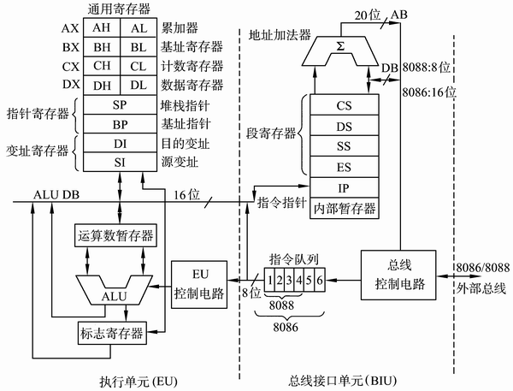
CPU Architecture
Intel 8086处理器的结构
  运算器
  控制器
  寄存器
  (Cache)

Slide 4
CPU Architecture
CPU工作流程
  While (1) {
    Fetch_an_instruction();
    Understand_the_instruction();
    Execute_the_instruction();
  }
  Instructions:
    移动数据(among register, memory, and I/O)
    算数、逻辑、位运算
    跳转类（指令跳转，函数调用等）
    ……

Slide 5
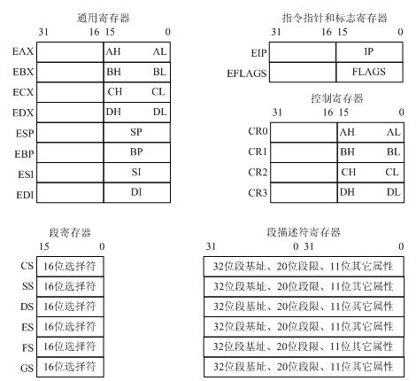
Register
80386的寄存器

Slide 6
Register
EAX、EBX、ECX、EDX
  通用寄存器
ESP, EBP, ESI, EDI
  32位通用寄存器
  各自的低16位可以独立使用：SP, BP, SI, DI
  ESP：系统栈的栈指针寄存器
  EBP：基址指针寄存器
  ESI、EDI：索引寄存器，从ESI指定位置拷贝到EDI指定位置

Slide 7
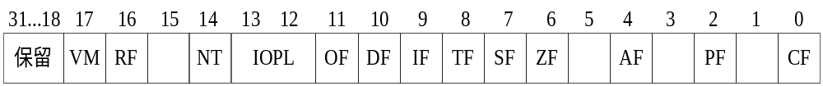
Register
标志寄存器EFLAGS
Bit Mnemonic Usage
0 CF carry flag
2 PF parity flag
6 ZF zero flag
7 SF sign flag
10 DF direction flag
11 OF overflow flag

Slide 8
Register
64位计算机
  X86-64指令集扩展了IA32的32位寄存器
    用’r’代替’e’，%eax->%rax, %esp->%rsp
  增加了8个寄存器
    %r8~%r15
  浮点数XMM寄存器
    %xmm0~%xmm15，128位，能放下4个float，或2个double

Slide 9
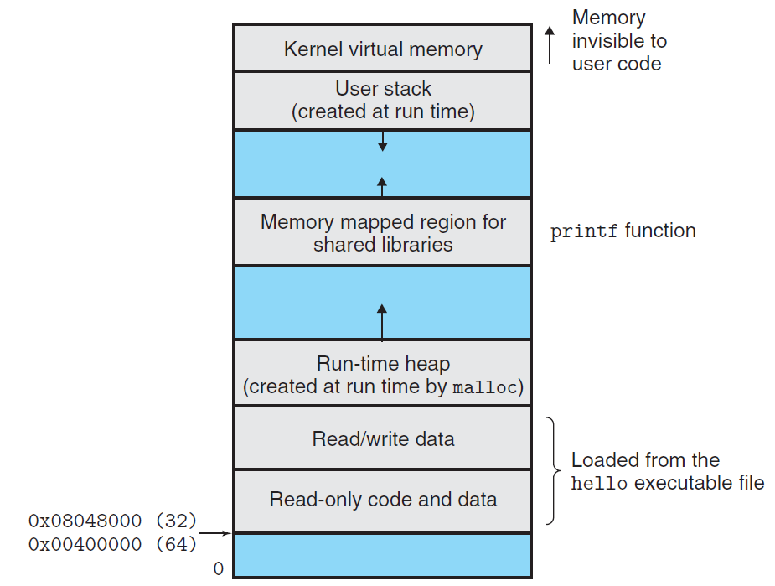
程序员可见状态
  寄存器
  %rax, %rbx, %rcx, %rdx, %rbp, %rsp, %rsi, %rdi
  %r8, %r9, %r10, %r11, %r12, %r13, %r14, %r15
  EFlags (SF, ZF, OF, CF, …)
  CS, DS, SS, ES, FS, GS
  PC (IP)
  Memory
    8086: 物理内存
    80386+: 虚拟内存地址

Slide 10
程序员可见状态
x86-64 Integer Registers
%rax
%r8
%eax
%r8d
%rbx
%r9
%ebx
%r9d
%rcx
%r10
%ecx
%r10d
%rdx
%r11
%edx
%r11d
%rsi
%r12
%esi
%r12d
%rdi
%r13
%edi
%r13d
%rsp
%r14
%esp
%r14d
%rbp
%r15
%ebp
%r15d
  Can reference low-order 4 bytes (also low-order 1 & 2 bytes)

Slide 11
Some History: IA32 Registers
Origin
(mostly obsolete)
%eax
%ax
%ah
%al
accumulate
%ecx
%cx
%ch
%cl
counter
%edx
%dx
%dh
%dl
data
general purpose
%ebx
%bx
%bh
%bl
base
%esi
source
index
%si
%edi
destination
index
%di
%esp
stack
pointer
%sp
%ebp
base
pointer
%bp
16-bit virtual registers (backwards compatibility)

Slide 12
C and Assembly Language

Slide 13
Turning C into Object Code
  Code in files p1.c p2.c
  Compile with command: gcc –Og p1.c p2.c -o p
    Use basic optimizations (-Og) [New to recent versions of GCC]
    Put resulting binary in file p
text
C program (p1.c p2.c)
Compiler (gcc –Og -S)
text
Asm program (p1.s p2.s)
Assembler (gcc or as)
Static libraries (.a)
binary
Object program (p1.o p2.o)
Linker (gcc or ld)
binary
Executable program (p)

Slide 14
Compiling Into Assembly
C Code (sum.c)
Generated x86-64 Assembly
long plus(long x, long y);
void sumstore(long x, long y,
long *dest)
{
long t = plus(x, y);
*dest = t;
}
sumstore:
pushq %rbx
movq %rdx, %rbx
call plus
movq %rax, (%rbx)
popq %rbx
ret
Obtain (on shark machine) with command
  gcc –Og –S sum.c
Produces file sum.s
Warning: Will get very different results on other machines (Andrew Linux, Mac OS-X, …) due to different versions of gcc and different compiler settings.

Slide 15
Disassembling Object Code
Disassembled
0000000000400595 <sumstore>:
400595: 53 push %rbx
400596: 48 89 d3 mov %rdx,%rbx
400599: e8 f2 ff ff ff callq 400590 <plus>
40059e: 48 89 03 mov %rax,(%rbx)
4005a1: 5b pop %rbx
4005a2: c3 retq
Disassembler
  objdump –d sum
  Useful tool for examining object code
  Analyzes bit pattern of series of instructions
  Produces approximate rendition of assembly code
  Can be run on either a.out (complete executable) or .o file

Slide 16
Alternate Disassembly
Object
Disassembled
0x0400595:
0x53
0x48
0x89
0xd3
0xe8
0xf2
0xff
0xff
0xff
0x48
0x89
0x03
0x5b
0xc3
Dump of assembler code for function sumstore:
0x0000000000400595 <+0>: push %rbx
0x0000000000400596 <+1>: mov %rdx,%rbx
0x0000000000400599 <+4>: callq 0x400590 <plus>
0x000000000040059e <+9>: mov %rax,(%rbx)
0x00000000004005a1 <+12>:pop %rbx
0x00000000004005a2 <+13>:retq
Within gdb Debugger
  gdb sum
  disassemble sumstore
  Disassemble procedure
  x/14xb sumstore
  Examine the 14 bytes starting at sumstore

Slide 17
Code Examples
//C code int accum = 0; int sum(int x, int y) { int t = x+y; accum += t; return t; }

Slide 18
Code Examples
instruction
//C code int accum = 0; int sum(int x, int y) { int t = x+y; accum += t; return t; } | _sum: pushl %ebp movl %esp,%ebp movl 12(%ebp),%eax addl 8(%ebp),%eax addl %eax, accum movl %ebp,%esp popl %ebp ret
Obtain with command gcc –O2 -S code.c Assembly file code.s
addl 8(%ebp),%eax

Slide 19
Addressing Mode（寻址方式）
Type | Form | Operand value | Name
Immediate | $Imm | Imm | Immediate
Register | E_{a} | R[E_{a}] | Register
Indexed | Imm | M[Imm] | Absolute
Indexed | (E_{a}) | M[R[E_{a}]] | Indirect
Indexed | Imm(E_{b}) | M[Imm+ R[E_{b}]] | Base+displacement
Indexed | (E_{b}, E_{i}) | M[R[E_{b}]+ R[E_{i}]] | Indexed
Indexed | Imm(E_{b}, E_{i}) | M[Imm+ R[E_{b}]+ R[E_{i}]] | Scaled indexed
Indexed | (, E_{i}, s) | M[R[E_{i}]*s] | Scaled indexed
Indexed | (E_{b}, E_{i}, s) | M[R[E_{b}]+ R[E_{i}]*s] | Scaled indexed
Indexed | Imm(E_{b}, E_{i}, s) | M[Imm+ R[E_{b}]+ R[E_{i}]*s] | Scaled indexed

Slide 20
Address | Value
0x100 | 0xFF
0x104 | 0xAB
0x108 | 0x13
0x10C | 0x11
Register | Value
%eax | 0x100
%ecx | 0x1
%edx | 0x3
Operand
Value
%eax
0x100
(%eax)
0xFF
$0x108
0x108
0x108
0x13
260(%ecx,%edx)
(0x108)0x13
(%eax,%edx,4)
(0x10C)0x11

Slide 21
Understanding Machine Execution

Slide 22
Outline
Machine states
Machine execution
Virtual Memory Layout

Slide 23
Assembly Programmer’s View
Memory
FFFFFFFF
%eax
Addresses
%edx
%ecx
C0000000
BFFFFFFF
Stack
%ebx
Data
%esi
80000000
Heap
%edi
Instructions
7FFFFFFF
%esp
%ebp
40000000
DLLs
CPU
3FFFFFFF
Heap
%eip
%eflag
Data
08000000
Text
00000000

Slide 24
Programmer-Visible States
Program Counter(%eip)
  Address of the next instruction
Register File
  Heavily used program data
  Integer and floating-point

Slide 25
Programmer-Visible States
Conditional code register (%eflags)
  Hold status information about the most recently executed instruction
  Implement conditional changes in the control flow
Virtual Memory

Slide 26
Operations in Assembly Instructions
Instruction
  Performs only a very elementary operation
Program
  is a sequence of instructions
Sequential execution mode
  Normally one by one in sequential
  Conditionally branch to a new instruction address
Typically operates data stored in registers
Transfers data between memory and a register
_sum: pushl %ebp movl %esp,%ebp movl 12(%ebp),%eax addl 8(%ebp),%eax addl %eax, accum movl %ebp,%esp popl %ebp ret

Slide 27
Understanding Machine Execution
Where the sequence of instructions are stored?
  In virtual memory
  Code area
How the instructions are executed?
  %eip stores an address of memory,
  from the address, machine can read a whole instruction once
  then execute it
  increase %eip
    %eip is also called program counter (PC)
55 89 e5 8b 45 0c 03 45 08 01 05 00 00 00 00 89 ec 5d c3 | Obtain with command gcc –O2 -c code.c Relocatable object file code.o

Slide 28
Code Layout
0xffffffff
memory invisible to
user code
kernel virtual memory
0xc0000000
Linux/x86
process
memory
image
Read/write data
Read only data
Read only code
%eip
0x08048000
forbidden

Slide 29
Sequential execution
f()
{
int i = 3 ;
}
kernel virtual memory
08048390 <_f>:
90: 55 push %ebp
91: 89 e5 mov %esp,%ebp
93: 83 ec 14 sub $0x14,%esp
96: c7 45 fc movl $03, -0x4(%ebp)
03 00 00 00
9d: c9 leave
9e: c3 ret
Read/write data
Read only data
Read only code
%eip
0x08048000
forbidden
Notes:
LEAVE指令是将栈指针指向帧指针，然后POP备份的原帧指针到%EBP

Slide 30
Sequential execution
PC
08 04 83 9e
 | c3 | ret
 | c9 | leave
9c | 00
 | 00
 | 00
 | 03
98 | fc
 | 45
 | c7 | movl $0x3,-0x4(%ebp)
 | 14
94 | ec
 | 83 | sub $0x14,%esp
 | e5
 | 89 | mov %esp,%ebp
90 | 55 | push %ebp
00000000 <_f>:
0: 55 push %ebp
1: 89 e5 mov %esp,%ebp
3: 83 ec 14 sub $0x14,%esp
6: c7 45 fc 03 00 00 00
movl $0x3,-0x4(%ebp)
d: c9 leave
e: c3 ret
PC
08 04 83 9d
PC
08 04 83 96
PC
08 04 83 93
PC
08 04 83 91
PC
08 04 83 90

Slide 31
Code Layout
0xffffffff
memory invisible to
user code
kernel virtual memory
0xc0000000
Linux/x86
process
memory
image
Read/write data
Read only data
Read only code
%eip
0x08048000
forbidden

Slide 32
Data layout
Object model in assembly
  A large, byte-addressable array
  No distinctions even between signed or unsigned integers
  Code, user data, OS data
  Run-time stack for managing procedure call and return
  Blocks of memory allocated by user

Slide 33
Data Layout
0xffffffff
memory invisible to
user code
kernel virtual memory
0xc0000000
Stack
Downward growth
%esp
Read/write data
Linux/x86 process
memory image
Read only data
Read only code
%eip
0x08048000
forbidden

Slide 34
Example (C Code)
#include <stdio.h>
int accum = 0;
int sum(int x, int y)
{
int t = x + y;
accum += t;
return t;
}
int main()
{
int s;
s = sum(4,3);
printf(" %d %d \n", s, accum);
return 0;
}

Slide 35
Example (object Code)
08048360 <sum>:
8048360: 55 push %ebp
8048361: 89 e5 mov %esp,%ebp
8048363: 8b 45 0c mov 0xc(%ebp),%eax
8048366: 8b 55 08 mov 0x8(%ebp),%edx
8048369: 5d pop %ebp
804836a: 01 d0 add %edx,%eax
804836c: 01 05 f0 95 04 08 add %eax, 0x80495f0
8048372: c3 ret

Slide 36
Example (object Code)
08048360 <sum>:
8048360: 55 push %ebp
8048361: 89 e5 mov %esp,%ebp
8048363: 8b 45 0c mov 0xc(%ebp),%eax
8048366: 8b 55 08 mov 0x8(%ebp),%edx
8048369: 5d pop %ebp
804836a: 01 d0 add %edx,%eax
804836c: 01 05 f0 95 04 08 add %eax, 0x80495f0
8048372: c3 ret

Slide 37
Example (object Code)
08048360 <sum>:
8048360: 55 push %ebp
8048361: 89 e5 mov %esp,%ebp
8048363: 8b 45 0c mov 0xc(%ebp),%eax
8048366: 8b 55 08 mov 0x8(%ebp),%edx
8048369: 5d pop %ebp
804836a: 01 d0 add %edx,%eax
804836c: 01 05 f0 95 04 08 add %eax, 0x80495f0
8048372: c3 ret

Slide 38
Organization of an Assembly Program

Slide 39
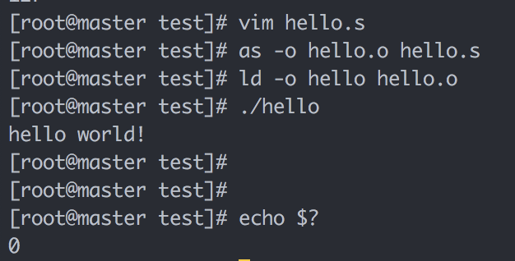
Example 1
$ as hello.s -o hello.o
$ ld hello.o -o hello
$ ./hello
$ echo $? #打印返回值
.data
msg : .string "hello world!\n"
len = . – msg
.text
.global _start
_start:
movq $len, %rdx ;第4个参数，字符串长度
movq $msg, %rcx ;第3个参数，字符串地址
movq $1, %rbx ;第2个参数，1指定标准输出（0-标准输入）
movq $4, %rax ;第1个参数，4为系统调用号：sys_write
int $0x80 ;80中断，系统调用
movl $0, %ebx ;参数1，退出代码，指定的返回值
movl $1, %eax ;1号系统调用：sys_exit
int $0x80

Slide 40
语法
X86汇编
  AT&T格式
    寄存器%
    常量、变量$
    寄存器参数：src, dst (→)
    Len = . - msg
  Intel格式
    寄存器参数： dst, src (←)
    Len equ $ - msg
    Len = $ - msg
  gcc –O1 –S –masm=intel code.c，可以生成intel风格的汇编代码
加长度后缀
  movb传送字节
  movw传送字
  movl传送双字(long word)
  movq传送四字

Slide 41
语法
.data 数据段
  全局变量
  常量
.text 程序段
.stack 堆栈段

Slide 42
常量vs变量
符号常量
  符号常量使用标识符表达一个数值
  Len = . – msg
  在变为机器代码时会直接替换为对应的值
变量
  本质是(临时)拥有一段内存，变量即内存的地址
  在变为机器代码时会直接替换为对应内存段的首地址
  .ascii 字符串
  .short 短整型 16位2字节
  .int .long 长整型 32位4字节 (同一平台C语言中long 为8字节）
  .byte 一个字节
  .float 浮点单精度
  .double 浮点双精度

Slide 43
工具
汇编器
  as, gcc依赖的汇编器
链接器
  ld
调试器
  Gdb

Slide 44
Control

Slide 45
Outline
Jump instructions
  PC-relative Address
Translate Control constructs in C to assembly
  Goto、Branch、Loop

Slide 46
Control
Two of the most important parts of program execution
  Data flow (Accessing and operating data)
  Control flow (control the sequence of operations)

Slide 47
Control
Sequential execution is default
  the instructions are executed in the order they appear in the program
Chang the control flow
  Jump instructions
  分支语句对性能有一定影响，分支预测失败会有较大的惩罚（根源在于内存访问速度远低于CPU运算速度）

Slide 48
Jump Instructions
1 xorl %eax, %eax Set %eax to 0
2 jmp .L1 Goto .L1
3 movl (%eax), %edx Null pointer dereference
4 .L1:
5 popl %edx

Slide 49
Unconditional jump
Jumps unconditionally
Direct jump: jmp label
  jmp .L
Indirect jump: jmp *Operand
  jmp *%eax
  jmp *(%eax)

Slide 50
Conditional jump
或者跳转，或者继续顺序执行
  取决于一定的condition codes
  Jz(je), jnz(jne)
  Js, jns
  有符号数：jl(jnge), jg(jnle), jle(jng), jge(jnl)
  无符号数：ja(jnbe), je(jnae), jae(jnb), jbe(jna)
都是direct jump类型

Slide 51
Jump Instructions
jle .L2
.L5:
movl %edx, %eax
sarl $1, %eax
subl %eax, %edx
Leal (%edx, %edx, 2), %edx
testl %edx, %edx
jg .L5
9 .L2:
10 movl %edx, %eax
这个结构的程序
是在做什么？

Slide 52
Jump Targets in Binary
Two forms to represent a jump target
PC-relative (direct jump)
  实质上是在指令中记录下来：跳转的目标地址（标号所在地址）与当前指令下一条指令的差值（可正可负）
  由于硬件每执行完一条指令，都会自动将Pc执行当前指令的下一条指令。如果决定跳转，只需要PC += 指令中的offset即可
Absolute address (indirect jump)
  Jump target is an absolute address

Slide 53
Example
jle .L2
.L5:
movl %edx, %eax
sarl $1, %eax
subl %eax, %edx
Leal (%edx, %edx, 2), %edx
testl %edx, %edx
jg .L5
9 .L2:
10 movl %edx, %eax

Slide 54
PC-relative in the Relocatable Object
8: 7e 0d jle 17<silly+0x17>
a: 89 d0 mov %edx, %eax dest1:
3 c: c1 f8 sar %eax
e: 29 c2 sub %eax, %edx
10: 8d 14 52 lea (%edx, %edx, 2), %edx
6 13: 85 d2 test %edx, %edx
15: 7f f3 jg a<silly+0x10>
17: 89 d0 movl %edx, %eax dest2:
d+a = 17
17+f3(-d) =a

Slide 55
PC-relative in the Executable Object
804839: 7e 0d jle 17<silly+0x17>
804839e: 89 d0 mov %edx, %eax dest1:
3 80483a0: c1 f8 sar %eax
80483a2: 29 c2 sub %eax, %edx
80483a4: 8d 14 52 lea (%edx, %edx, 2), %edx
6 80483a7: 85 d2 test %edx, %edx
80483a9: 7f f3 jg a<silly+0x10>
80483ab: 89 d0 movl %edx, %eax dest2:
d+804849e = 80483ab
80483ab+f3(-d) = 804839e

Slide 56
课堂练习
下列XXXX的值是什么？
  1)
    0x804828f: 74 05 je XXXX
    0x8048291: e8 1e 00 00 00 call 80482b4
  2)
    0x8048357: 72 e7 jb XXXX
    0x8048359: c6 05 10 a0 04 08 01 movb $0x1, 0x804a010
8048296
8048340
Notes:
8048296
8048340

Slide 57
课堂练习
3)
  XXXX: 74 12 je 8048391
  XXXX: b8 00 00 00 00 mov $0x0, %eax
4)
  80482bf: e9 e0 ff ff ff jmp XXXX
  80482c4: 90 nop
3. 804837d, 804837f
4. 80482a4
Notes:
3. 804837d, 804837f
4. 80482a4

Slide 58
Outline
Jump instructions
Translate Control constructs in C to assembly
  Goto, Branch, Loops

Slide 59
Control Constructs in C
Gotos
  goto L
  break
  continue
Branch
  if () { } else if () { } else { }
  switch () {case }

Slide 60
Control Constructs in C
Loop
  while () { }
  do { } while ()
  for (init; test; incr) { }

Slide 61
Translating Conditional Branches
t = test-expr ;
if ( t )
goto true ;
else-statement
goto done
true:
then-statement
done:
if ( test-expr )
then-statement
else
else-statement

Slide 62
Translating Conditional Branches
int absdiff(int x, int y)
{
if (x < y)
return y – x;
else
return x – y;
}
int absdiff(int x, int y)
{
int rval ;
if (x < y)
goto less
rval = x – y ;
goto done;
less:
rval = y – x;
done:
return rval;
}

Slide 63
Jump Instructions
movl 8(%ebp), %edx # get x
movl 12(%ebp), %eax # get y
cmpl %eax, %edx # cal x - y
jl .L3 # if x < y goto less
subl %eax, %edx # compute x - y
movl %edx, %eax # set return val
jmp .L5 # goto done
.L3: # less:
subl %edx, %eax # compute y – x
.L5: # done: Begin Completion code

Slide 64
Do-while Translation
do
body-statement
while (test-expr)
loop:
body-statement
t = test-expr;
if ( t )
goto loop ;

Slide 65
Do-while Translation
.L6:
lea (%ebx, %edx), %eax
movl %edx, %ebx
movl %eax, %edx
incl %ecx
cmpl %esi, %ecx
jl .L6
movl %ebx, %eax
int fib_dw(int n)
{
int i = 0;
int val = 0 ;
int nval = 1 ;
do {
int t = val + nval ;
val = nval ;
nval = t ;
i++;
} while ( i<n) ;
return val ;
}
register | value | initially
%ecx | i | 0
%esi | n | n
%ebx | val | 0
%edx | nval | 1
%eax | t | -

Slide 66
While Loop Translation
while (test-expr)
body-statement
loop: if ( !test-expr)
t = test-expr goto done;
if ( !t ) do
goto done; body-statement
body-statement while(test-expr)
goto loop; done:
done:

Slide 67
While Loop Translation
int fib_w_goto(int n)
{
int val=1;
int nval=1;
int nmi, t ;
if ( val >= n )
goto done ;
nmi = n-1;
loop:
t=val+nval ;
val = nval ;
nval = t ;
nmi--;
if ( nmi )
goto loop
done:
return val
}
int fib_w(int n)
{
int i=1;
int val=1;
int nval=1;
while ( i<n ) {
int t=val+nval ;
val = nval ;
nval = t ;
i++;
}
return val ;
}

Slide 68
While Loop Translation
Register usage
movl 8(%ebp), %eax
movl $1, %ebx
movl $1, %ecx
cmpl %eax, ebx
jge .L9
lea –1(%eax), %edx
.L10:
lea (%ecx, %ebx), %eax
movl %ecx, %ebx
movl %eax, %ecx
decl %edx
jnz .L10
.L9:
Register
Variable
Initially
%edx
nmi
n-1
%ebx
val
1
%ecx
nval
1

Slide 69
For Loop Translation
For Version
for (Init; Test; Update )
Body
While Version
Init;
while (Test ) {
Body
Update;
}

Slide 70
“For” Loop Do-While Conversion
C Code
Goto Version
long pcount_for_goto_dw
(unsigned long x) {
size_t i;
long result = 0;
i = 0;
if (!(i < WSIZE))
goto done;
loop:
{
unsigned bit =
(x >> i) & 0x1;
result += bit;
}
i++;
if (i < WSIZE)
goto loop;
done:
return result;
}
long pcount_for
(unsigned long x)
{
size_t i;
long result = 0;
for (i = 0; i < WSIZE; i++)
{
unsigned bit =
(x >> i) & 0x1;
result += bit;
}
return result;
}
Init
!Test
Body
Update
Test
Initial test can be optimized away

Slide 71
Procedure Call

Slide 72
Outline
Procedure call
Stack frame
Calling conventions

Slide 73
Procedure/Function call
Another type of unconditional JUMP
  SAME:
    Control from one part to another
  DIFF:
    Return：往返 vs. 单程
    Passing data (arguments, return values)
    Local variable
    Registers：保存离开时的状态

Slide 74
Basic Concept
Terminology
  Caller
  Callee
f()
call-1
g()
call-2
h()
call-1
  Caller: f
  Callee: g
call-2
  Caller: g
  Callee: h

Slide 75
Basic Concept
Terminology
  Caller: g
  Callee: f
Control Flow
  e.g. int g() { return 1 ; }
  int f() { return g() ; }
  int main() { g(); return f(); }
g()
call
f()
main()
g()
f()
g()

Slide 76
Procedure/Function Implementation
  Invoke callee
  Return to caller
  Passing data
  Registers
  Local variable

Slide 77
Procedure/Function Implementation
  Invoke callee: call (new instructions)
  Return to caller
  Passing data
  Registers
  Local variable

Slide 78
Invoke Callee
Instruction
  call label (direct)
  call *operand (indirect)
Behavior description (by hardware)
  Save return address in the stack (call下一条指令)
  Jump to the entry of callee
call = push + jmp
  push retaddr
  jmp callee

Slide 79
Execution of call and ret
//beginning of function sum
08048394 <sum>:
8048394: 55 push %ebp
. . .
80483a4: ret
. . .
//call to sum from main
80483dc: e8 b3 ff ff ff call 8048394<sum>
80483e1: 83 c4 14 add $0x14, %esp
Executing call
After call
%eip | 0x080483dc
%esp | 0xff9bc960
ret | -
%eip | 0x08048394
%esp | 0xff9bc95c
ret | 0x080483e1

Slide 80
Procedure/Function Implementation
  Invoke callee: call (new instructions)
  Return to caller: ret (new instructions)
  Passing data
  Registers
  Local variable

Slide 81
Return to Caller
Instruction
  ret
Behavior description (by hardware)
  Pop return address from stack
  Jump to return address in caller
ret = pop + jmp
  pop retaddr
  jmp retaddr

Slide 82
Execution of call and ret
//beginning of function sum
08048394 <sum>:
8048394: 55 push %ebp
. . .
80483a4: ret
. . .
//call to sum from main
80483dc: e8 b3 ff ff ff call 8048394<sum>
80483e1: 83 c4 14 add $0x14, %esp
executing ret
After ret
%eip | 0x080483a4
%esp | 0xff9bc95c
ret | 0x080483e1
%eip | 0x080483e1
%esp | 0xff9bc960
ret | -

Slide 83
Procedure/Function Implementation
  Invoke callee: call (new instructions)
  Return to caller: ret (new instructions)
  Passing data: stack, register
  Registers
  Local variable

Slide 84
课堂练习
下面的代码片段经常出现在库函数的编译版本中：
call next
next:
popl %eax
Eax被设置成什么值？
解释为什么这个调用没有与之匹配的ret指令
这段代码完成了什么功能？
Notes:
Eax被设置为popl指令的地址
不是真的过程调用
这是IA32中将程序计数器（IP）的值放入通用寄存器的唯一方法（*）

Slide 85
Stack Frame Structure
The portion of stack allocated for a procedure
A stack frame is delimited by
  The frame pointer %ebp
  The stack pointer %esp
The stack pointer can move when the procedure is executing (dynamic)
The frame pointer is static (%ebp)
%ebp
Frame
%esp

Slide 86
Stack Frame Structure
主函数、子函数共享同一个system stack
call: save return address in the stack
ret: pop return address from stack
  The end of caller’s stack frame
Caller Frame
retaddr
%ebp
Callee Frame
%esp

Slide 87
Frame Chain
Pointers (%ebp/%esp) only delimit topmost frame
%ebp
%esp

Slide 88
Frame Chain
Pointers (%ebp/%esp) only delimit topmost frame
Frames are chained
  1. call callee
%ebp
%esp

Slide 89
Frame Chain
Pointers (%ebp/%esp) only delimit topmost frame
Frames are chained
  1. call callee
  callee:
  2. push %ebp
  3. mov %esp, %ebp
retaddr
%ebp
%esp

Slide 90
Frame Chain
Pointers (%ebp/%esp) only delimit topmost frame
Frames are chained
  1. call callee
  callee:
  2. push %ebp
  3. mov %esp, %ebp
retaddr
%ebp
%ebp
%esp

Slide 91
Frame Chain
Pointers (%ebp/%esp) only delimit topmost frame
Frames are chained
  1. call callee
  callee:
  2. push %ebp
  3. mov %esp, %ebp
retaddr
old %ebp
%ebp
%esp

Slide 92
Frame Chain
Pointers (%ebp/%esp) only delimit topmost frame
Frames are chained
  1. call callee
  callee:
  2. push %ebp
  3. mov %esp, %ebp
  . . .
  n-2. mov %ebp, %esp
  n-1. pop %ebp
  n. ret
retaddr
old %ebp
%ebp
%esp

Slide 93
Frame Chain
Pointers (%ebp/%esp) only delimit topmost frame
Frames are chained
  1. call callee
  callee:
  2. push %ebp
  3. mov %esp, %ebp
  . . .
  n-2. mov %ebp, %esp
  n-1. pop %ebp
  n. ret
retaddr
old %ebp
%ebp
%esp

Slide 94
Frame Chain
Pointers (%ebp/%esp) only delimit topmost frame
Frames are chained
  1. call callee
  callee:
  2. push %ebp
  3. mov %esp, %ebp
  . . .
  n-2. mov %ebp, %esp
  n-1. pop %ebp
  n. ret
retaddr
old %ebp
%ebp
%esp

Slide 95
Frame Chain
Pointers (%ebp/%esp) only delimit topmost frame
Frames are chained
  1. call callee
  callee:
  2. push %ebp
  3. mov %esp, %ebp
  . . .
  n-2. mov %ebp, %esp
  n-1. pop %ebp
  n. ret
retaddr
old %ebp
%ebp
%esp

Slide 96
Frame Chain
old %ebp
old %ebp
old %ebp
Pointers (%ebp/%esp) only delimit topmost frame
Frames are chained
%ebp
%esp

Slide 97
Restore Caller %ebp
Instruction
  leave
Behavior description (by hardware)
  Adjust %esp to callee %ebp
  Pop caller %ebp from stack
leave = mov + pop
  mov %ebp, %esp
  pop %ebp

Slide 98
Execution of call and ret
//beginning of function sum
08048394 <sum>:
8048394: 55 push %ebp
. . .
80483a4: ret
. . .
//call to sum from main
80483dc: e8 b3 ff ff ff call 8048394<sum>
80483e1: 83 c4 14 add $0x14, %esp
Executing call
After call
After ret
%eip | 0x080483dc
%esp | 0xff9bc960
ret | -
%eip | 0x08048394
%esp | 0xff9bc95c
ret | 0x080483e1
%eip | 0x080483e1
%esp | 0xff9bc960
ret | -

Slide 99
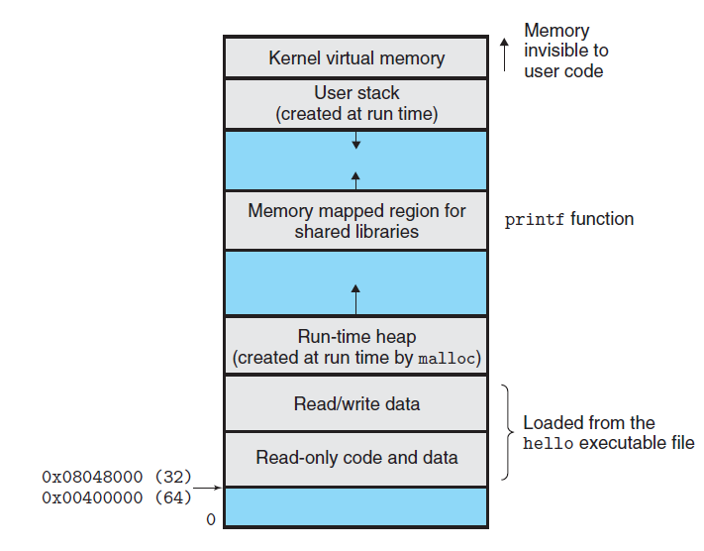
Memory Layout
User stack

Slide 100
Passing Data: Arguments
Pushed by Caller
  Saved in caller frame
  Just upon of return address
  From Nth to 1st (from right to left)
Used by Callee
  Relative to %ebp
  Offset: 8 + 4*i + %ebp
Caller Frame
argument N
. . . . . .
argument 1
retaddr
old %ebp
%ebp
Callee Frame
%esp

Slide 101
Passing Data: Arguments
%ebp
push argument N
Caller Frame
%esp
argument N

Slide 102
Passing Data: Arguments
%ebp
push argument N
. . .
push argument 1
Caller Frame
argument N
. . . . . .
%esp
argument 1

Slide 103
Passing Data: Arguments
push argument N
. . .
push argument 1
call callee
%ebp
Caller Frame
argument N
. . . . . .
argument 1
%esp
retaddr

Slide 104
Passing Data: Arguments
push argument N
. . .
push argument 1
call callee
push %ebp
%ebp
Caller Frame
argument N
. . . . . .
argument 1
retaddr
%ebp
Callee Frame
%esp

Slide 105
Passing Data: Arguments
push argument N
. . .
push argument 1
call callee
push %ebp
mov %esp, %ebp
. . .
Caller Frame
argument N
. . . . . .
argument 1
retaddr
old %ebp
%esp /
%ebp
Callee Frame

Slide 106
Passing Data: Arguments
X86 64位，传参数先用寄存器
  %rdi，%rsi，%rdx，%rcx，%r8，%r9 用作函数参数，依次对应第1参数，第2参数….第6个参数（从左到右）
  剩余参数还和以前的算法一样，从右往左依次入栈
  例如func(p1, p2, p3, p4, p5, p6, p7, p8)
    p1: %rdi, p2: %rsi, p3: %rdx, p4: %rcx, p5: %r8, p6: %r9
    栈：(低地址）←ret addr, p7, p8←（高地址）

Slide 107
Passing Data: Return Value
Specific register to keep the return value
  %eax / %rax is used to pass the result of callee to caller

Slide 108
Procedure/Function Implementation
  Invoke callee: call (new instructions)
  Return to caller: ret (new instructions)
  Passing data: stack, register
  Registers: calling convention
  Local variable

Slide 109
Calling Convention
Registers act as a single resource shared by all of the procedures
  Only 1 procedure can be active
  Partition registers between caller and callee (必须遵守惯例)
    Caller-save register
    Callee-save register
  Only consider the registers used by the procedure

Slide 110
Calling Convention
%rbx
%r12
Callee-saved
Temporaries
Callee-save registers
  %rbx, %rbp, %r12~%r14
  Saved by callee
  Caller can use these registers freely
  Callee must save them before using
  Callee must restore them before return
%r13
%r14
%rbp
Special
%rsp

Slide 111
Callee-save Registers
call callee
push %ebp
mov %esp, %ebp
push %ebx
. . .
retaddr
Old %ebp
%ebp
Callee Frame
%esp
Saved %ebx

Slide 112
Calling Convention
Caller-save registers
  所有其他寄存器（除了%rsp不需要保存）
  Saved by caller
  Callee can use these registers freely
  The contents in these registers may be changed after return
  Caller must restore them if it tries to use them after calling

Slide 113
Caller-save Registers
push %eax
push argument N
. . .
push argument 1
call callee
%ebp
Caller Frame
Saved %eax
argument N
. . . . . .
argument 1
retaddr
%esp

Slide 114
Procedure/Function Implementation
  Invoke callee: call (new instructions)
  Return to caller: ret (new instructions)
  Passing data: stack, register
  Registers: calling convention
  Local variable: stack

Slide 115
Local Variable
Why not store local variables in registers ?
  No enough registers
  Array and structures (e.g., a[2])
  Need address (e.g., &a)

Slide 116
Local Variable
Allocation
  Below saved regs or old %ebp
  move/sub %esp, (e.g., subl $4, %esp)
De-allocation
  move/add %esp, (e.g., addl $4, %esp)
Usage
  Relative to %esp/%ebp, (e.g., movl %eax, 8(%esp))
retaddr
Old %ebp
%ebp
Callee Frame
Saved regs
Local variable
%esp

Slide 117
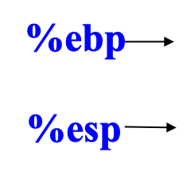
Put it Together
Caller Frame

Slide 118
Put it Together
%ebp
Caller Frame
caller-save registers
1. Save caller-save registers
(%rbx, %rbp, %r12~15, %rsp以外的寄存器)
%esp

Slide 119
Put it Together
%ebp
Caller Frame
caller-save registers
1. Save caller-save registers
2. Push actual arguments
from right to left
arguments (n~1)
%esp

Slide 120
Put it Together
%ebp
Caller Frame
caller-save registers
1. Save caller-save registers
2. Push actual arguments
from right to left
3. Call instruction
  Save return address
  Transfer control to callee
arguments (n~1)
retaddr
%esp

Slide 121
Put it Together
%ebp
Caller Frame
caller-save registers
4. Save caller %ebp
arguments (n~1)
retaddr
%esp
%ebp

Slide 122
Put it Together
Caller Frame
caller-save registers
4. Save caller %ebp
5. Set callee %ebp
arguments (n~1)
retaddr
old %ebp
%esp /
%ebp

Slide 123
Put it Together
Caller Frame
caller-save registers
4. Save caller %ebp
5. Set callee %ebp
6. Save callee-save registers
(%rbx, %rbp, %r12~15)
arguments (n~1)
retaddr
%ebp
old %ebp
callee-save registers
%esp

Slide 124
Put it Together
Caller Frame
caller-save registers
4. Save caller %ebp
5. Set callee %ebp
6. Save callee-save registers
(%rbx, %rbp, %r12~15)
7. Allocate space for local
variable
arguments (n~1)
retaddr
%ebp
old %ebp
callee-save registers
local variables
%esp

Slide 125
Put it Together
Caller Frame
caller-save registers
. . .
n-4. save return value in %eax
arguments (n~1)
retaddr
%ebp
old %ebp
callee-save registers
local variables
%esp

Slide 126
Put it Together
Caller Frame
caller-save registers
. . .
n-4. save return value in %eax
n-3. de-allocate local variable
arguments (n~1)
retaddr
%ebp
old %ebp
callee-save registers
%esp
local variables

Slide 127
Put it Together
Caller Frame
caller-save registers
. . .
n-4. save return value in %eax
n-3. de-allocate local variable
n-2. Restore callee-save registers
arguments (n~1)
retaddr
old %ebp
%esp /
%ebp
callee-save registers
local variables

Slide 128
Put it Together
Caller Frame
%ebp
caller-save registers
. . .
n-4. save return value in %eax
n-3. de-allocate local variable
n-2. Restore callee-save registers
n-1. Restore caller %ebp
arguments (n~1)
retaddr
%esp
old %ebp
callee-save registers
local variables

Slide 129
Put it Together
%ebp
Caller Frame
caller-save registers
. . .
n-4. save return value in %eax
n-3. de-allocate local variable
n-2. Restore callee-save registers
n-1. Restore caller %ebp
n. Ret instruction
  pop return address
  Transfer control to caller
arguments (n~1)
%esp
retaddr
old %ebp
callee-save registers
local variables

Slide 130
Example
1 int swap_add(int *xp, int *yp)
2 {
3 int x = *xp;
4 int y = *yp;
5
6 *xp = y;
7 *yp = x;
8 return x + y;
9 }
10

Slide 131
Example
11 int caller()
12 {
13 int arg1 = 534;
14 int arg2 = 1057;
15 int sum = swap_add(&arg1, &arg2);
16 int diff = arg1 - arg2;
17
18 return sum * diff;
19 }

Slide 132
Example
Before
int sum = swap_add(&arg1, &arg2);
Stack frame for caller
0 | Saved %ebp
-4 | 1057(arg2)
-8 | 534(arg1)
-12
%ebp
%esp

Slide 133
Parameter Passing
1 leal -4(%ebp),%eax
Compute &arg2
2 pushl %eax
Push &arg2
Stack frame for caller
0 | Saved %ebp
-4 | 1057(arg2)
-8 | 534(arg1)
-12 | &arg2
%ebp
%esp

Slide 134
Parameter Passing
1 leal -4(%ebp),%eax
Compute &arg2
2 pushl %eax
Push &arg2
3 leal -8(%ebp),%eax
Compute &arg1
4 pushl %eax
Push &arg1
Stack frame for caller
0 | Saved %ebp
-4 | 1057(arg2)
-8 | 534(arg1)
-12 | &arg2
-16 | &arg1
%ebp
%esp

Slide 135
Call Instruction
1 leal -4(%ebp),%eax
Compute &arg2
2 pushl %eax
Push &arg2
3 leal -8(%ebp),%eax
Compute &arg1
4 pushl %eax
Push &arg1
5 call swap_add
Call the swap_add function
Stack frame for caller
0 | Saved %ebp
-4 | 1057(arg2)
-8 | 534(arg1)
-12 | &arg2
-16 | &arg1
-20 | Return Addr
%ebp
%esp

Slide 136
Setup code in swap_add
swap_add:
1 pushl %ebp Save old %ebp
Stack frame for caller
0 | Saved %ebp
-4 | 1057(arg2)
-8 | 534(arg1)
-12 | yp(&arg2)
-16 | xp(&arg1)
-20 | Return Addr
-24 | Saved %ebp
%ebp
%esp

Slide 137
Setup code in swap_add
swap_add:
1 pushl %ebp Save old %ebp
2 movl %esp,%ebp
Set %ebp as frame pointer
Stack frame for caller
24 | Saved %ebp
20 | 1057(arg2)
16 | 534(arg1)
12 | yp(&arg2)
8 | xp(&arg1)
4 | Return Addr
0 | Saved %ebp
%ebp
%esp
Stack frame for swap_add

Slide 138
Setup code in swap_add
swap_add:
1 pushl %ebp Save old %ebp
2 movl %esp,%ebp
Set %ebp as frame pointer
3 pushl %ebx
Save %ebx
Stack frame for caller
24 | Saved %ebp
20 | 1057(arg2)
16 | 534(arg1)
12 | yp(&arg2)
8 | xp(&arg1)
4 | Return Addr
0 | Saved %ebp
-4 | Saved %ebx
%ebp
%esp
Stack frame for swap_add

Slide 139
Body code in swap_add
5 movl 8(%ebp),%edx Get xp
Stack frame for caller
24 | Saved %ebp
20 | 1057(arg2)
16 | 534(arg1)
12 | yp(&arg2)
8 | xp(&arg1)
4 | Return Addr
0 | Saved %ebp
-4 | Saved %ebx
%edx
%ebp
xp(=&arg1=%ebp+16)
%esp
Stack frame for swap_add

Slide 140
Body code in swap_add
5 movl 8(%ebp),%edx Get xp
6 movl 12(%ebp),%ecx Get yp
Stack frame for caller
24 | Saved %ebp
20 | 1057(arg2)
16 | 534(arg1)
12 | yp(&arg2)
8 | xp(&arg1)
4 | Return Addr
0 | Saved %ebp
-4 | Saved %ebx
%edx
%ebp
xp(=&arg1=%ebp+16)
%ecx
yp(=&arg2=%ebp+20)
%esp
Stack frame for swap_add

Slide 141
Body code in swap_add
5 movl 8(%ebp),%edx Get xp
6 movl 12(%ebp),%ecx Get yp
7 movl (%edx),%ebx Get x
8 movl (%ecx),%eax Get y
Stack frame for caller
24 | Saved %ebp
20 | 1057(arg2)
16 | 534(arg1)
12 | yp(&arg2)
8 | xp(&arg1)
4 | Return Addr
0 | Saved %ebp
-4 | Saved %ebx
%edx
%ebp
xp(=&arg1=%ebp+16)
%ecx
yp(=&arg2=%ebp+20)
%esp
Stack frame for swap_add
%ebx
534
%eax
1057

Slide 142
Body code in swap_add
9 movl %eax, (%edx) Store y at *xp
Stack frame for caller
24 | Saved %ebp
20 | 1057(arg2)
16 | 1057(arg1)
12 | yp(&arg2)
8 | xp(&arg1)
4 | Return Addr
0 | Saved %ebp
-4 | Saved %ebx
%edx
%ebp
xp(=&arg1=%ebp+16)
%ecx
yp(=&arg2=%ebp+20)
%esp
Stack frame for swap_add
%ebx
534
%eax
1057

Slide 143
Body code in swap_add
9 movl %eax, (%edx) Store y at *xp
10 movl %ebx, (%ecx) Store x at *yp
Stack frame for caller
24 | Saved %ebp
20 | 534(arg2)
16 | 1057(arg1)
12 | yp(&arg2)
8 | xp(&arg1)
4 | Return Addr
0 | Saved %ebp
-4 | Saved %ebx
%edx
%ebp
xp(=&arg1=%ebp+16)
%ecx
yp(=&arg2=%ebp+20)
%esp
Stack frame for swap_add
%ebx
534
%eax
1057

Slide 144
Body code in swap_add
9 movl %eax, (%edx) Store y at *xp
10 movl %ebx, (%ecx) Store x at *yp
11 addl %ebx,%eax Set return value = x+y
Stack frame for caller
24 | Saved %ebp
20 | 534(arg2)
16 | 1057(arg1)
12 | yp(&arg2)
8 | xp(&arg1)
4 | Return Addr
0 | Saved %ebp
-4 | Saved %ebx
%edx
%ebp
xp(=&arg1=%ebp+16)
%ecx
yp(=&arg2=%ebp+20)
%esp
Stack frame for swap_add
%ebx
534
%eax
1591

Slide 145
Finishing code in swap_add
12 popl %ebx Restore %ebx
Stack frame for caller
24 | Saved %ebp
20 | 534(arg2)
16 | 1057(arg1)
12 | yp(&arg2)
8 | xp(&arg1)
4 | Return Addr
0 | Saved %ebp
-4 | Saved %ebx
%edx
%ebp
xp(=&arg1=%ebp+16)
%ecx
yp(=&arg2=%ebp+20)
%esp
Stack frame for swap_add
%ebx
original value
%eax
1591

Slide 146
Finishing code in swap_add
12 popl %ebx Restore %ebx
13 movl %ebp, %esp Restore %esp
Stack frame for caller
24 | Saved %ebp
20 | 534(arg2)
16 | 1057(arg1)
12 | yp(&arg2)
8 | xp(&arg1)
4 | Return Addr
0 | Saved %ebp
-4 | Saved %ebx
%edx
%ebp
xp(=&arg1=%ebp+16)
%ecx
yp(=&arg2=%ebp+20)
%esp
Stack frame for swap_add
%ebx
original value
%eax
1591

Slide 147
Finishing code in swap_add
12 popl %ebx Restore %ebx
13 movl %ebp, %esp Restore %esp
14 popl %ebp Restore %ebp
Stack frame for caller
0 | Saved %ebp
-4 | 534(arg2)
-8 | 1057(arg1)
-12 | yp(&arg2)
-16 | xp(&arg1)
-20 | Return Addr
 | Saved %ebp
 | Saved %ebx
%ebp
%esp
%edx
xp(=&arg1=%ebp+16)
%ecx
yp(=&arg2=%ebp+20)
%ebx
original value
%eax
1591

Slide 148
Finishing code in swap_add
12 popl %ebx Restore %ebx
13 movl %ebp, %esp Restore %esp
14 popl %ebp Restore %ebp
15 ret Return to caller
Call by value
Stack frame for caller
0 | Saved %ebp
-4 | 534(arg2)
-8 | 1057(arg1)
-12 | yp(&arg2)
-16 | xp(&arg1)
-20 | Return Addr
 | Saved %ebp
 | Saved %ebx
%ebp
%esp
%edx
xp(=&arg1=%ebp+16)
%ecx
yp(=&arg2=%ebp+20)
%ebx
original value
%eax
1591

