Slide 1
Exceptional Control Flow III
(Signal)

Slide 2
Outline
Signal Terminology
Sending Signals
Receiving Signals
Signal Handling Issues

Slide 3
Signals
Unix signal
  用于进程之间的通信
  A higher-level software form of exception
  That allows processes and the kernel to interrupt other processes

Slide 4
The kill Program
Kill program
  is located in directory /bin/
  sends an arbitrary signal to another process (不一定是杀死进程，可以是其他类型的信号)
e.g. unix> kill -9 15213
  sends signal 9 (SIGKILL) to process 15213.

Slide 5
Signals Type
Signal是通知一个进程的一个消息：
  系统中发生了某个类型的事件
每种signal type对应系统事件的某个类型
  低层次的硬件异常
    一般是由kernel的exception handler处理，正常用户进程看不到
    Signal提供了一种机制，把这种exception的发生告知用户进程
  高层次的软件事件
    来自kernel
    或来自其他用户进程

Slide 6
Hardware Events
SIGFPE signal (number 8)
  If a process attempts to divide by zero, then the kernel sends it a SIGFPE signal
SIGILL signal (number 4)
  If a process executes an illegal instruction, the kernel sends it a SIGILL signal.
SIGSEGV signal (number 11)
  If a process makes an illegal memory reference, the kernel sends it a SIGSEGV signal.

Slide 7
Software Events
SIGINT signal (number 2)
  While a process is running in the foreground
  if you type a ctrl-c
  then the kernel sends a SIGINT signal to the process
SIGKILL signal (number 9)
  A process can forcibly terminate another process
  by sending it a SIGKILL signal
SIGCHLD signal (number 17)
  When a child process terminates or stops,
  the kernel sends a SIGCHLD signal to the parent.

Slide 8
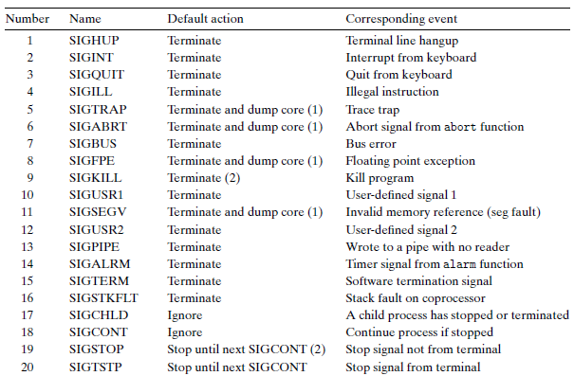
Linux Signals
> man signal

Slide 9
Linux Signals
Linux系统共定义了64种信号
  不可靠信号： 也称为非实时信号，standard signal
    不支持排队，信号可能会丢失, 比如发送多次相同的信号, 进程只能收到一次
    信号值取值区间为1~31
  可靠信号： 也称为实时信号，real-time signal
    支持排队, 信号不会丢失, 发多少次, 就可以收到多少次
    信号值取值区间为32~64

Slide 10
Linux Signals
kill –l可以查看所有信号
取值 | 名称 | 解释 | 默认动作
1 | SIGHUP | 挂起
2 | SIGINT | 中断
3 | SIGQUIT | 退出
4 | SIGILL | 非法指令
5 | SIGTRAP | 断点或陷阱指令
6 | SIGABRT | abort发出的信号
7 | SIGBUS | 非法内存访问
8 | SIGFPE | 浮点异常
9 | SIGKILL | kill信号 | 不能被忽略、处理和阻塞
10 | SIGUSR1 | 用户信号1
11 | SIGSEGV | 无效内存访问
12 | SIGUSR2 | 用户信号2
13 | SIGPIPE | 管道破损，没有读端的管道写数据
14 | SIGALRM | alarm发出的信号
15 | SIGTERM | 终止信号
16 | SIGSTKFLT | 栈溢出

Slide 11
Linux Signals
取值 | 名称 | 解释 | 默认动作
17 | SIGCHLD | 子进程退出 | 默认忽略
18 | SIGCONT | 进程继续
19 | SIGSTOP | 进程停止 | 不能被忽略、处理和阻塞
20 | SIGTSTP | 进程停止
21 | SIGTTIN | 进程停止，后台进程从终端读数据时
22 | SIGTTOU | 进程停止，后台进程想终端写数据时
23 | SIGURG | I/O有紧急数据到达当前进程 | 默认忽略
24 | SIGXCPU | 进程的CPU时间片到期
25 | SIGXFSZ | 文件大小的超出上限
26 | SIGVTALRM | 虚拟时钟超时
27 | SIGPROF | profile时钟超时
28 | SIGWINCH | 窗口大小改变 | 默认忽略
29 | SIGIO | I/O相关
30 | SIGPWR | 关机 | 默认忽略
31 | SIGSYS | 系统调用异常

Slide 12
Signal Terminology
Two steps to transfer a signal to a destination process
  Sending a signal
  Receiving a signal

Slide 13
Sending a signal
The kernel
  发送（传送）信号到目标进程
    在目标进程的上下文中的某些状态进行设置
信号产生的原因：
  硬件原因
    如敲键盘（Ctrl+C）
  内核检测到某个系统事件
    例如除以0，子进程终止等
  进程调用了某些系统调用（如kill）
    kill()，raise()，sigqueue()，alarm()，setitimer()，abort()
    让内核给目标进程发信号
    进程可以发送信号给自己

Slide 14
Sending a signal
kill()：用于向进程或进程组发送信号；
sigqueue()：只能向一个进程发送信号，不能像进程组发送信号；主要针对实时信号提出，与sigaction()组合使用，当然也支持非实时信号的发送；
alarm()：用于调用进程指定时间后发出SIGALARM信号；
setitimer()：设置定时器，计时达到后给进程发送SIGALRM信号，功能比alarm更强大；
abort()：向进程发送SIGABORT信号，默认进程会异常退出。
raise()：用于向进程自身发送信号；

Slide 15
Receiving a signal
目标进程接收信号
  时机：当进程从内核态刚切换到用户态时；
  因为信号都是内核发送的，所以这时可以处理之前发送给该进程的所有信号（从小到大处理）；
  该进程工作在用户态期间，不会产生新的信号（因为要先进入内核态，才能产生信号；kill是系统调用）
  在内核态，signal信号不起作用；
  在用户态，signal所有未被屏蔽的信号都处理完毕；

Slide 16
Receiving a signal
对于收到的信号，进程可以有3种处理方式：
  Ignore the signal
  Terminate
  Catch the signal
    by executing a user-level function called a signal handler

Slide 17
Pending Signal
Pending signal
  已经发送，但还没有接受的信号，叫做pending signal
Only one
  At any point in time,
  there can be at most one pending signal of a particular type
Not queued
  If a process has a pending signal of type k
  then any subsequent signals of type k sent to that process are not queued
  they are simply discarded.
A pending signal is received at most once.

Slide 18
Blocking a Signal
进程可以选择性block特定信号的接收
当一个信号被block时
  可以发送
  但是pending signal不会被接受
  直到该进程unblock这种signal

Slide 19
Internal Data Structures
For each process, the kernel maintains
  the set of pending signals in the pending bit vector
  the set of blocked signals in the blocked bit vector
The kernel sets bit k in pending
  whenever a signal of type k is delivered
The kernel clears bit k in pending
  whenever a signal of type k is received.

Slide 20
Process Groups
可以发送信号给一些进程
  Unix系统提供一些发送信号给多个进程的机制
  这些机制都依赖于进程组（process group，pg）
每个进程仅属于一个进程组
  进程组由一个非负数标记（进程组ID，pgid）
默认情况下，自己和自己的父进程属于同一个进程组

Slide 21
Process Groups
  #include <unistd.h>
  pid_t getpgrp(void);
  returns: process group ID of calling process
  #include <unistd.h>
  pid_t setpgid(pid_t pid, pid_t pgid);
  returns: 0 on success, -1 on error
setpgid
  把进程pid的进程组设置为pgid
  如果pid=0, 那就是指当前进程
  如果pgid=0，那就是用pid作为进程组ID
  “自立门户”

Slide 22
setgpid Function
e.g. setpgid(0, 0);
  Suppose process 15213 is the calling process,
  then this function call
    creates a new process group whose process group ID is 15213
    adds process 15213 to this new group.

Slide 23
The kill Program
Kill program
  is located in directory /bin/
  sends an arbitrary signal to another process
e.g. unix> kill -9 15213
  sends signal 9 (SIGKILL) to process 15213.

Slide 24
The kill Program
Sending signals to process group by kill
  Using a negative PID
  Which causes the signal to be sent to every process in process group PID
e.g. unix> kill -9 -15213
  sends a SIGKILL signal to every process in process group 15213.
linux> ./forks 16
Child1: pid=24818 pgrp=24817
Child2: pid=24819 pgrp=24817
linux> ps
PID TTY TIME CMD
24788 pts/2 00:00:00 tcsh
24818 pts/2 00:00:02 forks
24819 pts/2 00:00:02 forks
24820 pts/2 00:00:00 ps
linux> /bin/kill -9 -24817
linux> ps
PID TTY TIME CMD
24788 pts/2 00:00:00 tcsh
24823 pts/2 00:00:00 ps
linux>

Slide 25
Sending Signals from the Keyboard
Job
  An abstraction used by Unix shells
  To represent the processes
    that are created as a result of evaluating a single cmdline
  At any point, there is at most one foreground job and zero or more background jobs
  e.g. unix> ls | sort
  a foreground job consisting of two processes connected by a pipe

Slide 26
Sending Signals from the Keyboard
The shell creates a separate process group for each job
  Typically, the process group ID is taken from one of the parent processes in the job

Slide 27
Sending Signals from the Keyboard
Shell
pid=10
pgid=10
pid=20
pgid=20
Fore-
ground
job
Back-
ground
job #1
Back-
ground
job #2
pid=32
pgid=32
pid=40
pgid=40
Background
process group 32
Background
process group 40
Child
Child
pid=21
pgid=20
pid=22
pgid=20
Foreground
process group 20

Slide 28
Sending Signals from the Keyboard
Typing ctrl-c at the keyboard
  causes a SIGINT signal to be sent to the shell
  The shell catches the signal
  Then sends a SIGINT to every process in the foreground process group
  The result is to terminate the foreground job (default)

Slide 29
Sending Signals from the Keyboard
Typing crtl-z
  sends a SIGTSTP signal to the shell
  The shell catches the signal
  Sends a SIGTSTP signal to every process in the foreground process group
  The result is to stop (suspend) the foreground job (default)

Slide 30
Example of ctrl-c and ctrl-z
bluefish> ./forks 17
Child: pid=28108 pgrp=28107
Parent: pid=28107 pgrp=28107
<types ctrl-z>
Suspended
bluefish> ps w
PID TTY STAT TIME COMMAND
27699 pts/8 Ss 0:00 -tcsh
28107 pts/8 T 0:01 ./forks 17
28108 pts/8 T 0:01 ./forks 17
28109 pts/8 R+ 0:00 ps w
bluefish> fg
./forks 17
<types ctrl-c>
bluefish> ps w
PID TTY STAT TIME COMMAND
27699 pts/8 Ss 0:00 -tcsh
28110 pts/8 R+ 0:00 ps w
STAT (process state) Legend:
First letter:
S: sleeping
T: stopped
R: running
Second letter:
s: session leader
+: foreground proc group
See “man ps” for more
details
Fg: resume the most recently suspended or backgrounded job

Slide 31
Sending Signals with kill Function
#include <sys/types.h> #include <signal.h> int kill(pid_t pid, int sig); returns: 0 if OK, -1 on error
If pid is greater than zero,
  then the kill function sends signal number sig to process pid
If pid is less than zero
  then kill sends signal sig to every process in process group abs(pid)

Slide 32
1 #include "csapp.h"
2
3 int main()
4 {
5 pid_t pid;
6
7 /* child sleeps until SIGKILL signal received */
8 if ((pid = Fork()) == 0) {
9 Pause(); /* wait for a signal to arrive */
10 printf("control should never reach here!\n");
11 exit(0);
12 }
13
14 /* parent sends a SIGKILL signal to a child */
15 Kill(pid, SIGKILL);
16 exit(0);
17 }

Slide 33
Receiving a Signal
先决条件：
  当内核从一个exception handler中返回，
  而且正准备将控制权传给进程p时
Process A
Process B
user code
kernel code
context switch
Time
user code
kernel code
context switch
user code

Slide 34
Receiving a Signal
Actions
  kernel checks the set of unblocked pending signals (pending & ˜blocked)
  If this set is empty (the usual case)
    then the kernel passes control to the next instruction (I_{next})in the logical control flow of p.
  However, if the set is nonempty
    then the kernel chooses some signal k in the set (typically the smallest k)
    and forces p to receive signal k.
注意：发信号一定是在内核态，发完信号从内核态转为用户态时，就触发上述检测和信号处理行为

Slide 35
Receiving a Signal
The receipt of the signal triggers some action by the process.
Once the process completes the action, then control passes back to the next instruction (I_{next}) in the logical control flow of p.
(1) Signal received by process
(2) Control passes
to signal handler
I_{curr}
I_{next}
(3) Signal handler runs
(4) Signal handler
returns to
next instruction

Slide 36
Nested Signal Handlers
Handlers can be interrupted by other handlers
  不能是同一个handler!
Main program
Handler S
Handler T
(2) Control passes to handler S
(1) Program catches signal s
I_{curr}
(4) Control passes to handler T
(3) Program catches signal t
(7) Main program resumes
I_{next}
(6) Handler S
returns to main program
(5) Handler T
returns to handler S

Slide 37
Receiving a Signal
Each signal type has a predefined default action, which is one of the following:
  The process terminates.
  The process terminates and dumps core.
  The process stops until restarted by a SIGCONT signal.
  The process ignores the signal.

Slide 38
Receiving a Signal
SIGKILL
  The default action is to terminate the receiving process
SIGCHLD
  The default action is to ignore the signal.
  如果父进程调用wait()，则会监听和处理这个信号

Slide 39
Receiving a Signal
A process can modify the default action associated with a signal
  by using the signal function
  The only exceptions are SIGSTOP and SIGKILL, whose default actions cannot be changed.

Slide 40
Signal Function
#include <signal.h> typedef void (*signalhandler_t)(int); signalhandler_t signal(int signum, signalhandler_t *handler) returns: ptr to previous handler if OK, SIG_ERR on error (does not set errno)
此处typedef作用是定义一种函数指针类型signalhandler_t
Three ways to change default actions:
  If handler is SIG_IGN, then signals of type signum are ignored.
  If handler is SIG_DFL, then the action for signals of type signum reverts to the default action.
  Otherwise, change action to handler (called signal handler)

Slide 41
Signal Function
Installing the handler
  Changing the default action by passing the address of a handler to the signal function
Catching the signal
  The invocation of the handler
Handling the signal
  The execution of the handler

Slide 42
1 #include "csapp.h"
2
3 void handler(int sig) /* SIGINT handler */
4 {
5 printf("Caught SIGINT\n");
6 exit(1);
7 }
8
9 int main()
10 {
11 /* Install the SIGINT handler */
12 if (signal(SIGINT, handler) == SIG_ERR)
13 unix_error("signal error");
14
15 pause(); /* wait for the receipt of a signal */
16
17 exit(0);
18 }
最终exit状态是0还是1呢？

Slide 43
Signal Function
Handling the signal
  当进程捕获了一个类型为k的信号
  K对应的handler函数被激活
    K作为handler的参数传进去
  当handler执行到它的return语句时
    控制权传递回正常的程序控制流
      通常会返回被signal接收中断的位置

Slide 44
Signal Function
同一个handler函数可以用于捕获不同类型的信号
  所以才需要signal类型作为参数传进去

Slide 45
Sending Signals With the alarm Function
#include <unistd.h> unsigned int alarm(unsigned int secs); returns: remaining secs of previous alarm, or 0 if no previous alarm
Arranges for the kernel to send a SIGALRM signal to the calling process in secs seconds.
If secs is zero
  then no new alarm is scheduled.
The call to alarm
  取消掉任何待处理的（pending）闹钟
  返回之前pending alarm还剩余的秒数
  如果没有pending alarm，返回0

Slide 46
1 #include "csapp.h"
2 void handler(int sig)
3 {
4 static int beeps = 0;
5 printf("BEEP\n");
6 if (++beeps < 5)
7 Alarm(1); /* next SIGALRM will be delivered in 1s */
8 else {
9 printf("BOOM!\n");
10 exit(0);
11 }
12 }
13 int main()
14 {
15 Signal(SIGALRM, handler); /* install SIGALRM handler */
16 Alarm(1); /* next SIGALRM will be delivered in 1s */
17
18 /* signal handler returns control here each time */
19 while (1);
20 exit(0);
21 }

Slide 47
linux> ./alarm
BEEP
BEEP
BEEP
BEEP
BEEP
BOOM!

Slide 48
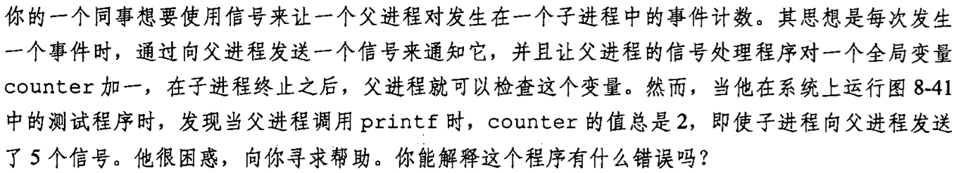
课堂练习

Slide 49
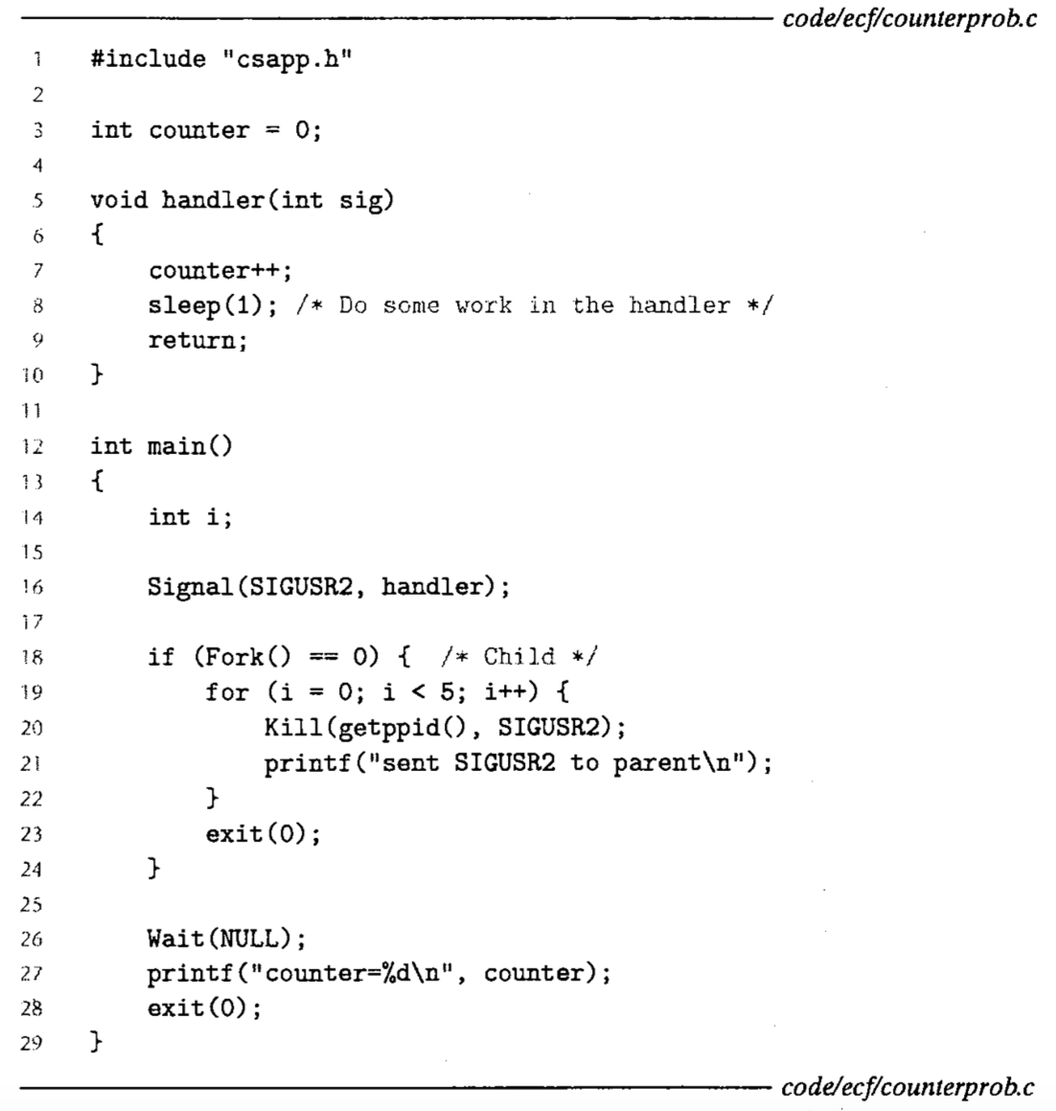
练习
Notes:
要点1：进程进入阻塞（blocked）状态，还是可能会被信号唤醒，切换到handler处理信号的。
要点2：同一个信号的handler再返回前不可再次调用，也就是进入信号处理handler的条件是之前同类信息信号的handler必须返回，才能再次进入handler。比如SIGUSR1的handler调用SIGUSR2的handler，在后者处理过程中再来SIGUSR1,是不能进入的，只是记录下来信号到达。必须等第一个SIGUSR1彻底返回，才会再次进入SIGUSR1的handler。
流程：不论先调度父进程，还是先调度子进程，第一个SIGUSR2信号很快会发出，handler处理，count++，然后进入sleep(1)。
然后再收到第二个SIGUSR2信号时，由于对第一个SIGUSR2信号的handler还没有返回，所以不能重入，信号记录，但是不会处理。
然后在sleep的1秒之内，后续的4个信号都会发出，但会叠加在一起，等从sleep(1)中返回后，处理时被当作一个信号了。

Slide 50
Signal Handling Issues
Pending signals can be blocked
  Unix signal handler一般会屏蔽当前正在处理信号同一类型的pending signals
Pending signals are not queued
  在数据结构上，每一种信号类型之对应一个bit，所以只能记录有/无信号，无法记录来了几个信号
  第二个及以后到达的pending signal只是被简单地丢弃了

Slide 51
Signal Handling Issues
System calls can be interrupted
  Slow system calls
    read, wait, and accept
  On some systems
    当一些slow system call被信号中断后，signal handler捕获了一个信号并进行处理和返回后，system call就不继续执行了
    而是立刻返回用户程序，并设置全局变量errno来报错
    例如前面提到的sleep，可能提前返回

Slide 52
14 int main()
15 {
16 int i, n; char buf[MAXBUF];
17 if (signal(SIGCHLD, handler1) == SIG_ERR)
18 unix_error("signal error");
19
20 /* parent creates children */
21 for (i = 0; i < 3; i++) {
22 if (Fork() == 0) {
23 printf("Hello from child %d\n", (int)getpid());
24 Sleep(1);
25 exit(0);
26 }
27 }
28 /* parent waits for term. input and then processes it */
29 if ((n = read(STDIN_FILENO, buf, sizeof(buf))) < 0)
30 unix_error("read");
31
32 printf("Parent processing input\n");
33 while (1) ;
34
35 exit(0);
36 }

Slide 53
1 #include "csapp.h"
2
3 void handler1(int sig)
4 {
5 pid_t pid;
6
7 if ((pid = waitpid(-1, NULL, 0)) < 0)
8 unix_error("waitpid error");
9 printf("Handler reaped child %d\n", (int)pid);
10 Sleep(2);
11 return;
12 }
13

Slide 54
linux> ./signal1
Hello from child 10320
Hello from child 10321
Hello from child 10322
Handler reaped child 10320
Handler reaped child 10322
<cr>
Parent processing input
<ctrl-z>
Suspended
linux> ps
PID TTY STAT TIME COMMAND
...
10319 p5 T 0:03 signal1
10321 p5 Z 0:00 signal1 <zombie>
10323 p5 R 0:00 ps

Slide 55
1 #include "csapp.h"
2
3 void handler2(int sig)
4 {
5 pid_t pid;
6
7 while ((pid = waitpid(-1, NULL, 0)) > 0)
8 printf("Handler reaped child %d\n", (int)pid);
9 if (errno != ECHILD)
10 unix_error("waitpid error");
11 Sleep(2);
12 return;
13 }

Slide 56
linux> ./signal2
Hello from child 10378
Hello from child 10379
Hello from child 10380
Handler reaped child 10379
Handler reaped child 10378
Handler reaped child 10380
<cr>
Parent processing input
Notes:
Reap 18906后sleep(2);
然后再次调用handler时应该while循环回收18908和18907。

Slide 57
Signal Function
一旦通过signal函数注册信号对应的处理函数，只有当再次调用signal函数，并将handler指定为SIG_IGN或SIG_DFL才能取消
  SIG_IGN：忽略信号
  SIG_DFL：恢复默认处理方式

Slide 58
课堂练习
下列程序的输出是？
pid_t pid;
int counter = 2;
void handler1(int sig) {
counter = counter - 1;
printf("%d", counter);
fflush(stdout);
exit(0);
}
int main() {
signal(SIGUSR1, handler1);
printf("%d", counter);
fflush(stdout);
if ((pid = fork()) == 0) {
while(1) {};
}
kill(pid, SIGUSR1);
waitpid(-1, NULL, 0);
counter = counter + 1;
printf("%d", counter);
exit(0);
}
Notes:
2，1，3

Slide 59
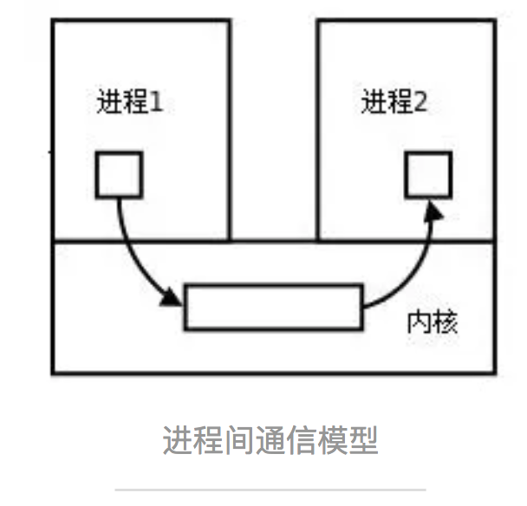
进程间通信
Inter Process Communication (IPC)

Slide 60
进程间通信
进程间通信目的：
  数据传输
    一个进程需要将它的数据发送给另一个进程，发送的数据量在一个字节到几M字节之间
  共享数据
    多个进程想要操作共享数据，一个进程对共享数据
  通知事件
    一个进程需要向另一个或一组进程发送消息，通知它（它们）发生了某种事件（如进程终止时要通知父进程）。

Slide 61
进程间通信
进程间通信（IPC）目的：
  资源共享
    多个进程之间共享同样的资源。为了作到这一点，需要内核提供锁和同步机制。
  进程控制
    有些进程希望完全控制另一个进程的执行（如Debug进程），此时控制进程希望能够拦截另一个进程的所有陷入和异常，并能够及时知道它的状态改变。

Slide 62
进程间通信
Linux进程间通信来源（Unix）
  AT&T
    对Unix早期的进程间通信手段进行了系统的改进和扩充，形成了“system V IPC”，通信进程局限在单个计算机内
  BSD（加州大学伯克利分校的伯克利软件发布中心）
    跳过了单机的限制，形成了基于套接口（socket）的进程间通信机制

Slide 63
进程间通信
UNIX进程间通信方式包括：
  管道、FIFO、信号
System V进程间通信方式包括：
  System V消息队列、System V信号灯、System V共享内存
POSIX进程间通信包括：
  posix消息队列、posix信号灯、posix共享内存
由于Unix版本的多样性，电子电气工程协会（IEEE）开发了一个独立的Unix标准，这个新的ANSI Unix标准被称为计算机环境的可移植性操作系统界面（PSOIX）。现有大部分Unix和流行版本都是遵循POSIX标准的，而Linux从一开始就遵循POSIX标准

Slide 64
进程间通信
Linux继承了这些通信方式，包括：
  #1. 管道（pipe）
  #2. 流管道(s_pipe)
  #3. 有名管道（FIFO）
  #4. 信号（signal）
  #5. 消息队列
  #6. 共享内存
  #7. 信号量
  #8. 套接字（socket)

