Slide 1
Virtual Memory (I)
Introduction

Slide 2
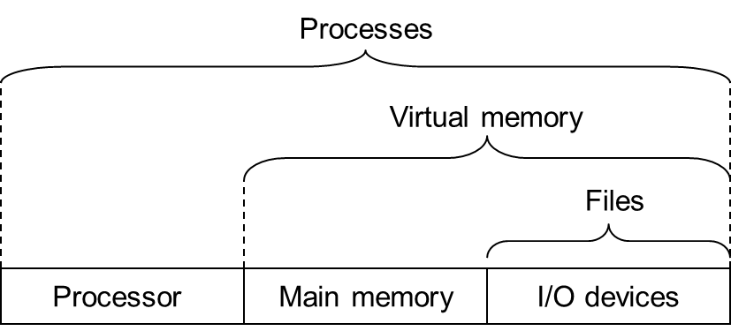
OS: Three Easy Pieces
虚拟化
持久化
并发

Slide 3
Virtualization
计算机主要硬件
  CPU（运算器/控制器）
    进程
  内存（存储器）
    虚拟内存
  外存（输入输出）
    文件系统

Slide 4
Outline
VM History
VM Overview
Memory API

Slide 5
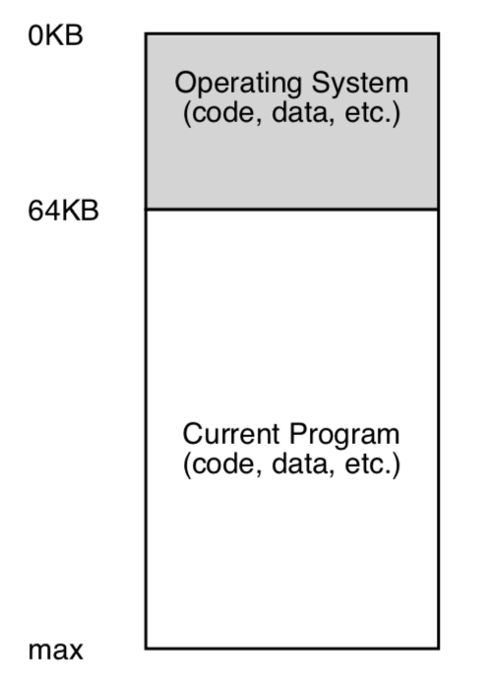
Early Systems
直接使用物理地址，没有抽象
OS还只是一些库，放在内存地址0开始的一段地址空间
用户程序从某个地址开始（如64K），使用剩余的全部内存
用户程序都要自己搞定，对OS没有多少期待

Slide 6
Multiprogramming and Time Sharing
Multiprogramming
  多个程序并发（不并行），当有程序在进行Io操作时，其他进程可以利用CPU，提高CPU利用率
Time Sharing
  Batch processing的反应太慢，用户感受不好
    例如debug过程反馈时间很长
  让用户感觉自己独享整个计算机
    用户的interactivity开始重要

Slide 7
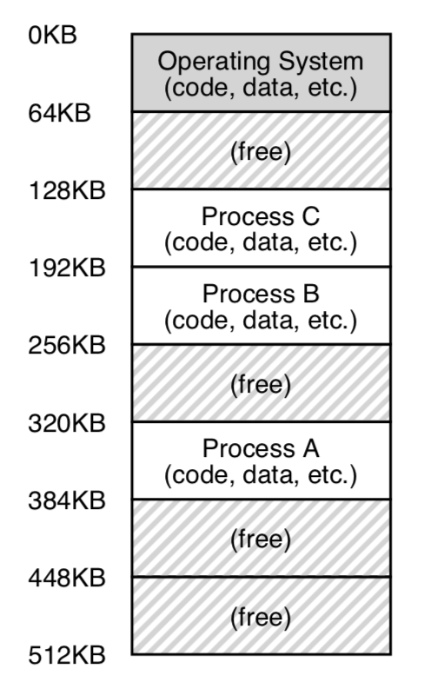
Time Sharing Implementation
Method 1. 每次一个程序独占全部内存
  好处：内存更大，程序执行更快
  缺点：切换任务时，需要有大量的I/O，因此性能很差
Method 2. 每个程序都留在内存中
  各占用一部分内存
三个进程共享内存

Slide 8
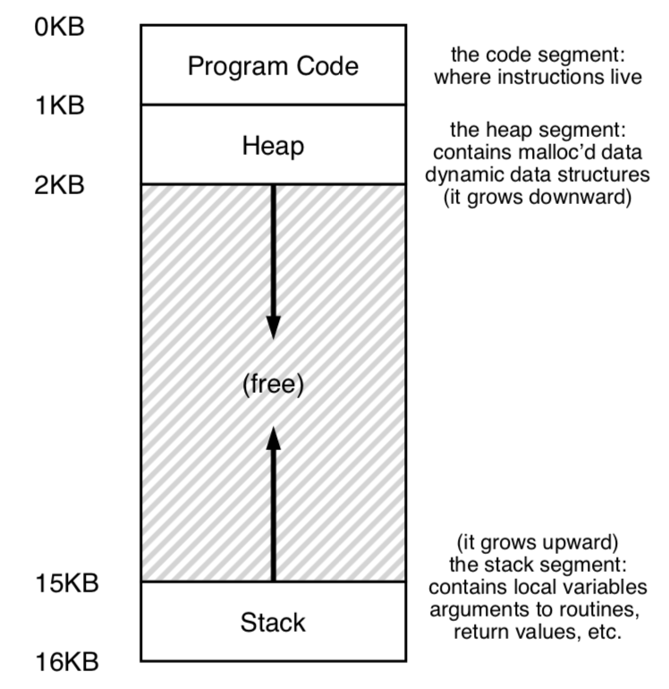
Multi-program -> Protection
为了不让进程之间互相访(po)问(huai)对方的内存
  Abstraction: address space
    每个进程应该只能看到属于自己的内存空间
    那么就不能把物理地址直接给用户
    建立虚拟地址空间，以及虚拟地址和物理地址间的映射

Slide 9
Multi-program -> Protection
Address space
  Code区域
  Stack区域
  Heap区域
  看不到其他进程的内存空间
  也看不到内核程序的内存空间

Slide 10
VM Overview

Slide 11
Virtual Memory
Abstraction
  假的，但是方便使用
Transparent
  用户程序感知不到，以为是真的
  在物理地址和虚拟地址上都能跑
Efficient
  否则用户不太能接受VM机制（性能是前提
Protection / Isolation
  进程无法访问其他进程、内核的地址空间
  任意一条指令执行时，不能访问到自己空间以外的地方

Slide 12
Virtual Memory
Addresses
  Virtual address
  Logical address
  Physical address

Slide 13
Physical Addressing
Attributes of the main memory
  Organized as an array of M contiguous byte-sized cells
  Each byte has a unique physical address (PA) started from 0
physical addressing
  A CPU use physical addresses to access memory
Examples
  Early PCs, DSP, embedded microcontrollers, and Cray supercomputers

Slide 14
A System Using Physical Addressing
Main memory
0:
1:
Physical address
(PA)
2:
CPU
3:
4:
4
5:
6:
7:
8:
...
M-1:
Data word
Used in “simple” systems like embedded microcontrollers in devices like cars, elevators, and digital picture frames

Slide 15
Virtual Addressing
Virtual addressing
  the Program accesses main memory by a virtual address (VA)
    The virtual address is converted to the appropriate physical address by hardware

Slide 16
Virtual Addressing
Address translation
  Converting a virtual address to a physical address
  Requires close cooperation between the CPU hardware and the operating system
    HW: the memory management unit (MMU)
      Dedicated hardware on the CPU chip to translate virtual addresses on the fly
    SW: A look-up table (MMU可以访问)
      Stored in main memory
      Contents are managed by the operating system

Slide 17
A System Using Virtual Addressing
Main memory
0:
CPU Chip
1:
Virtual address
(VA)
Physical address
(PA)
2:
CPU
MMU
3:
4:
4100
4
5:
6:
7:
8:
...
M-1:
Data word
Used in all modern servers, desktops, and laptops
One of the great ideas in computer science

Slide 18
Address Space
Address Space
  An ordered set of nonnegative integer addresses
Linear Space
  The integers in the address space are consecutive
Linear address space: Ordered set of contiguous non-negative integer addresses:
{0, 1, 2, 3 … }

Slide 19
Address Space
N-bit Address Space
  Virtual address space:
    Set of N = 2^{n} virtual addresses {0, 1, 2, 3, …, N-1}
  Physical address space:
    Set of M = 2^{m} physical addresses {0, 1, 2, 3, …, M-1}
Each object can now have multiple addresses
  one physical address, one (or more) virtual addresses

Slide 20
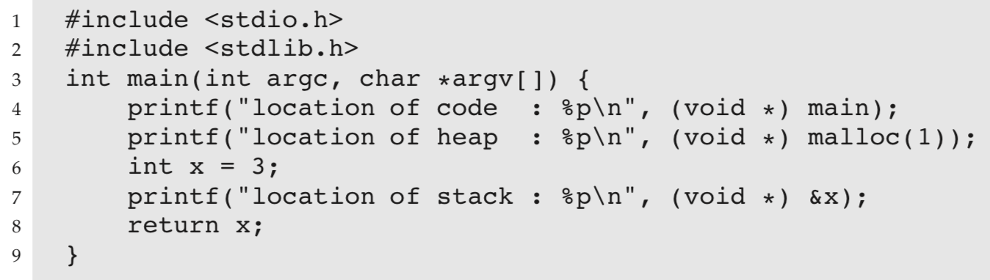
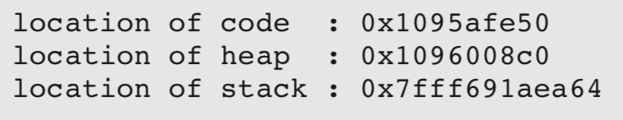
Virtual Memory
打印程序中各部分地址
  打印出来的都是virtual address
64-bit Mac OS：
  先是code，然后是heap，再是stack

Slide 21
练习4-1
填写下表中的空格和?
K=2¹⁰(Kilo), M=2²⁰(Mega), G=2³⁰(Giga), T=2⁴⁰(Tera), P=2⁵⁰(Peta), E=2⁶⁰(Exa)
#virtual address bits (n) | #virtual address (N) | Largest possible virtual address
8
 | 64K
 | 2?=256T
64
2³²-1=?G-1

Slide 22
练习4-1答案
K=2¹⁰(Kilo), M=2²⁰(Mega), G=2³⁰(Giga), T=2⁴⁰(Tera), P=2⁵⁰(Peta), E=2⁶⁰(Exa)
#virtual address bits (n) | #virtual address (N) | Largest possible virtual address
8
 | 64K
32
 | 256T
64
256
255
16
64K-1
4G
4G-1
48
256T-1
16E
16E-1

Slide 23
Memory API

Slide 24
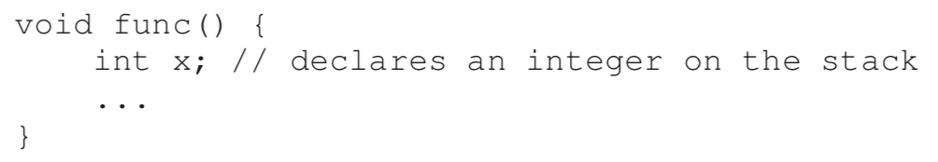
Memory API
Stack:
  申请局部变量
全局变量区
  全局变量，静态变量

Slide 25
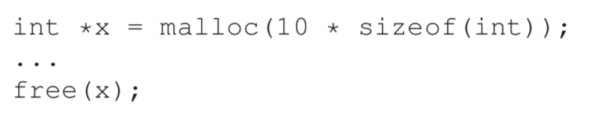
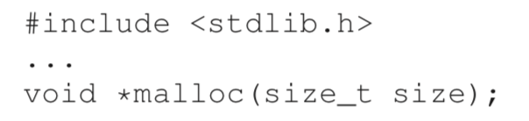
Memory API
Heap：
  Malloc(), free()

Slide 26
Memory API
Malloc(), free()不是system call
  只是library call
  调用其他system call：brk, mmap
系统调用通常提供一种最小功能，而库函数通常提供比较复杂的功能。
brk
  改变heap区大小的system call，修改heap end指针
  不要直接调用，一般都是内存分配的库函数调用
此外还用到了mmap系统调用
  后面详细介绍

Slide 27
Memory API
Calloc()
  Malloc() + 初始化为0
Realloc()
  重新分配空间，扩充分配空间
  具体操作是找到一个更大的空间，然后把旧的数据复制过去，返回新空间的指针

Slide 28
Fork Revisited

Slide 29
Sharing Revisited: Shared Objects
Process 1
virtual memory
Physical
memory
Process 2
virtual memory
Process 1 maps the shared object
Shared
object

Slide 30
Sharing Revisited: Shared Objects
Process 1
virtual memory
Physical
memory
Process 2
virtual memory
Process 2 maps the shared object
Notice how the virtual addresses can be different
Shared
object

Slide 31
Sharing Revisited: Private COW Objects
Process 1
virtual memory
Physical
memory
Process 2
virtual memory
Private
copy-on-write
area
Private
copy-on-write object

Slide 32
Sharing Revisited: Private COW Objects
Process 1
virtual memory
Physical
memory
Process 2
virtual memory
Copy-on-write
Write to private
copy-on-write
page
Private
copy-on-write object

