Slide 1
Virtual Memory (II)
Address Translation

Slide 2
Outline
Overview
Paging: Introduction
Paging: Faster Translations (TLBs)
Paging: Smaller Tables

Slide 3
Overview
Address Translation
  Process看到、使用的地址都是virtual address
  真正访问硬件前，需要转化为physical address

Slide 4
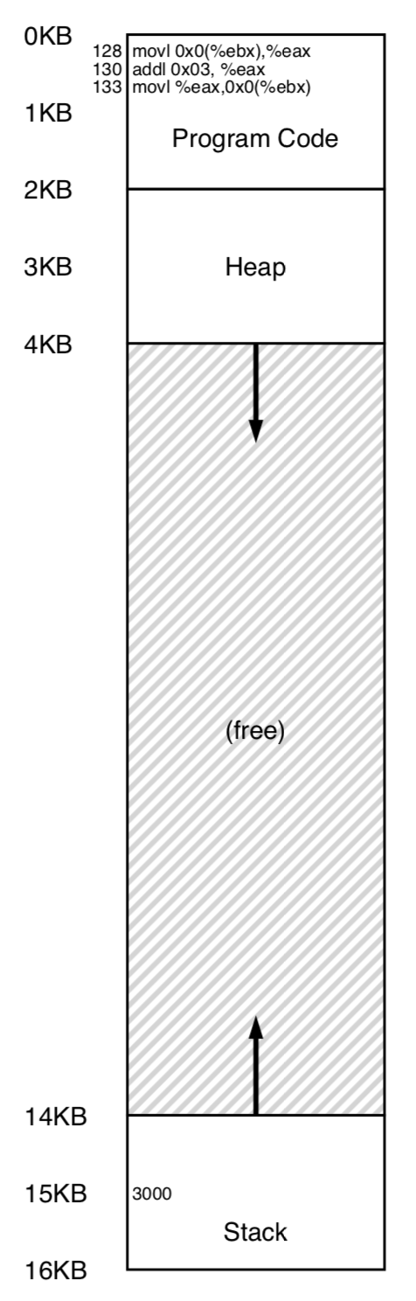
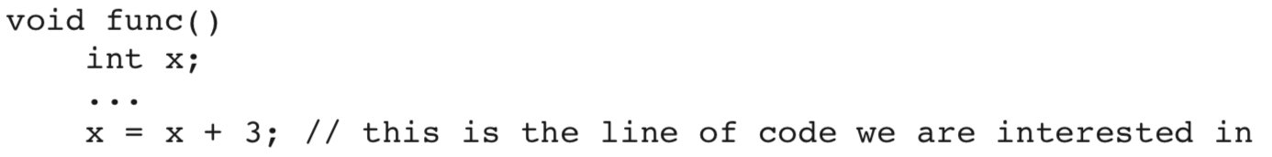
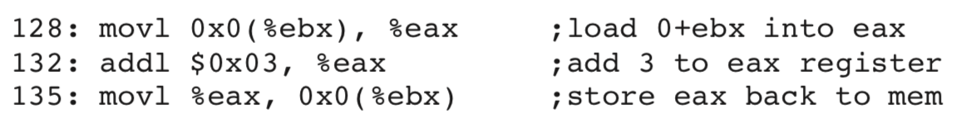
Overview
An Example

Slide 5
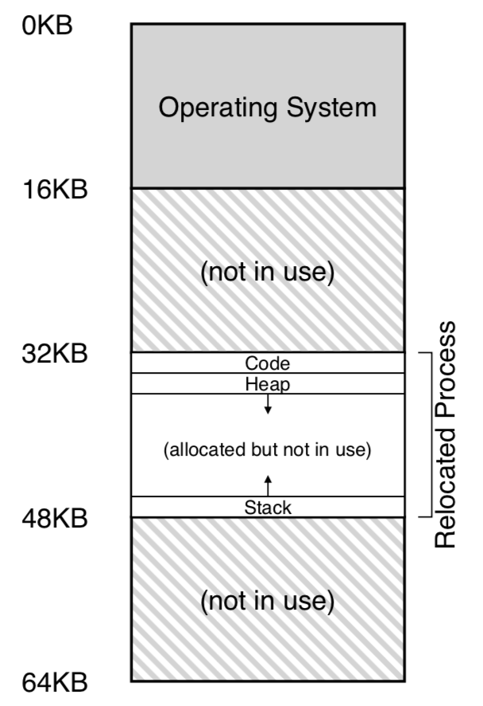
Overview
进程看到的地址不是真实的
Physical
Address
Virtual
Address

Slide 6
Overview
Address Translation背后的操作是什么？
  Transparent
    程序操作的地址，当作va或pa都能运行
  Efficient
    速度要很快，因为访存是个很常见的操作
  所以，要借用快速的硬件
    MMU：Memory Management Unit
    Load/store指令时，CPU利用MMU去做address translation
    但OS软件也有参与，因为MMU做地址翻译的元数据要放在内存里，这块内存空间是OS管理和提供的（MMU是CPU的一部分）
  进程没有权限访问PA，但也不是借用system call陷入内核态获取权限（因为太慢），而是CPU直接用硬件解决

Slide 7
Overview
具体的硬件解决方案
  1950’s：base and bounds/dynamic relocation
  需要两个硬件寄存器：
    Base
    Bounds
  因此，能够找到对应的物理内存，而且限制用户只能访问自己的内存空间（bound之内）

Slide 8

Overview
An example
  PC=128
  取指令：VA=PC+base = 128+32K = 32896
  硬件按照VA去取指令，放到CPU里的指令寄存器
  CPU执行该指令
  取数字的地址=0+%ebx+base
  …

Slide 9
Overview
对于其中的bounds
  硬件在访问内存前，首先检查是否越界
  如果不越界，正常访问
  如果越界，则CPU会抛出exception，然后进入exception handler的代码
  一般该进程会被终止

Slide 10
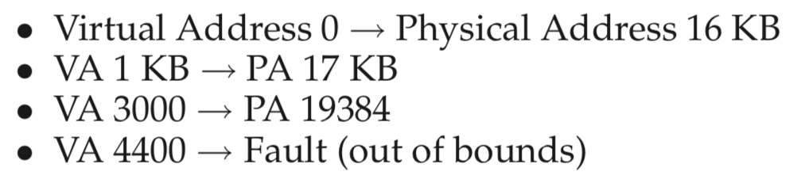
Overview
Example Translations
  process的地址空间是4KB
  位于物理地址16KB

Slide 11
Paging: Introduction

Slide 12
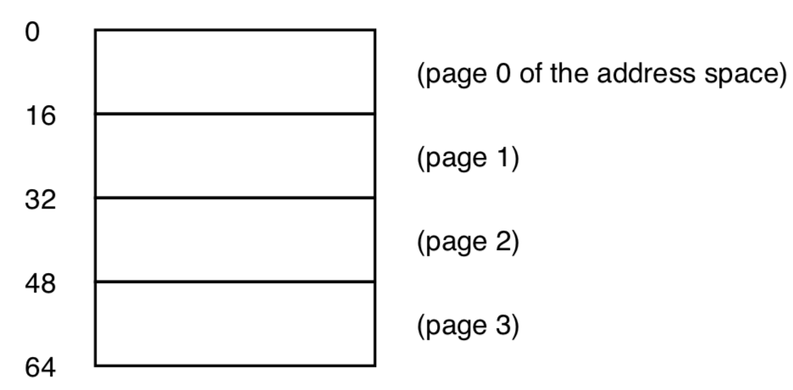
Paging
VA->PA的另一种方式（segmentation之外）
Paging: 固定大小，映射的单位
早期计算机Atlas（1962）
  e.g., 64B的地址空间，page大小为16B

Slide 13
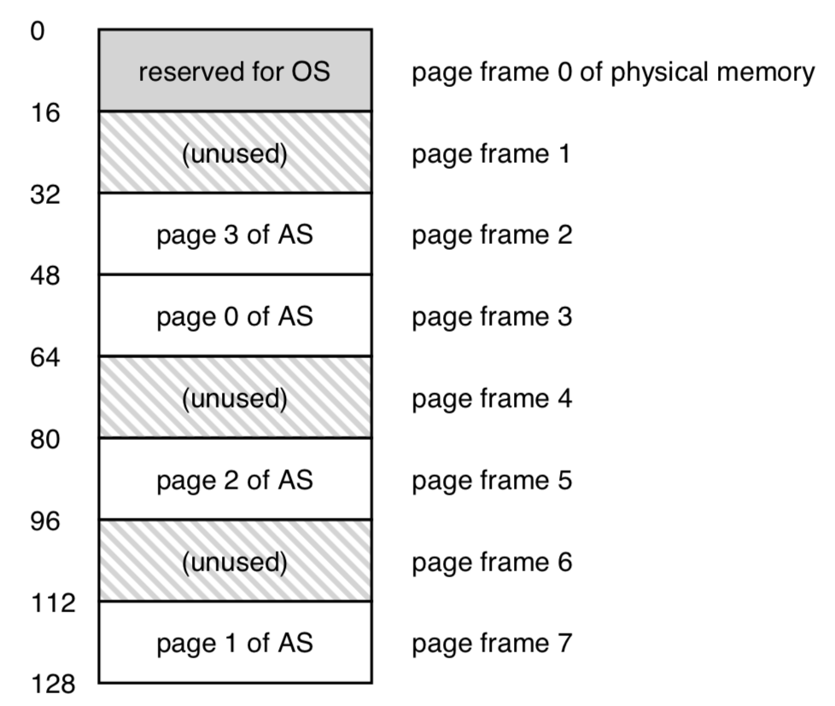
Paging
Va空间64B，Pa空间128B

Slide 14
Paging
Paging的优点：
  #1. Flexibility
    能够应对大块稀疏空间的问题（解决segmentation的问题）
  #2. simplicity (free-space management)
    对齐
    连续的VA不需要对应连续的PA
    所以，只需要维护所有的free page，都可以分配出去，不需要凑成大块的连续空间（compaction）

Slide 15
Paging
Paging的缺点
  VA->Pa映射信息比较多（比segmentation多很多）
  Page Table
    (Virtual Page 0 → Physical Frame 3)
    (VP 1 → PF 7)
    (VP 2 → PF 5)
    (VP 3 → PF 2).

Slide 16
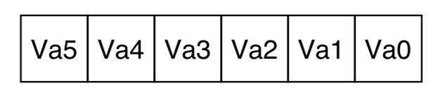
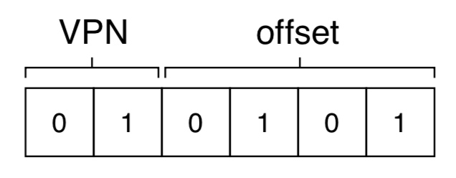
Paging
Page Table
  每个进程一个
  一个数组，index为VPN，content为PA（linear page table）
  VPN: virtual page number
    E.g., VA空间64 bytes，VA 6位
    Page大小16B，offset 4位
    VPN：2位，一共4个

Slide 17
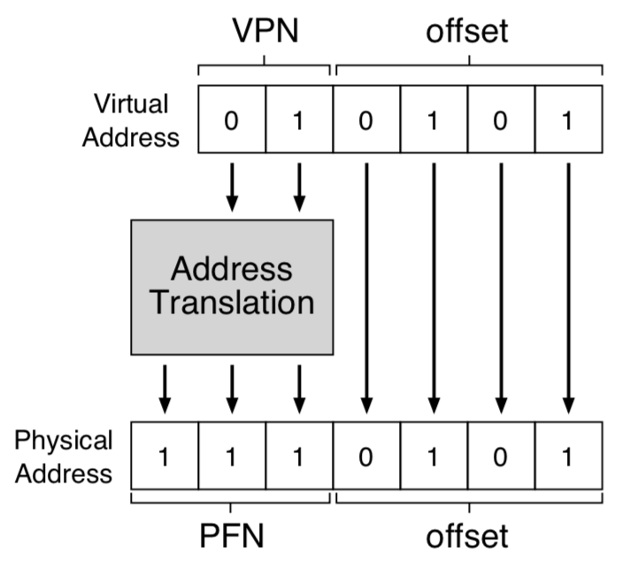
Paging
Address translation
  VPN -> PFN (physical frame number)
  Offset不变

Slide 18
Address Translation
V = {0, 1, . . . , N–1} virtual address space
P = {0, 1, . . . , M–1} physical address space
N > M
Address Translation
MAP: V → P U {∅} address mapping function
MAP(a) = a' if data at virtual address a is
present at physical address a' in P
= ∅ if data at virtual address a is not
present in P (invalid or on disk)

Slide 19
Address Translation
page fault
fault
handler
Processor
∅
Hardware
Addr Trans
Mechanism
Main
Memory
Secondary memory
a
a'
virtual address
OS performs
this transfer
(only if miss)
physical address
part of the
on-chip
memory mgmt unit (MMU)

Slide 20
Address Translation
Basic Parameters
  N = 2^{n} = Virtual address limit
  M = 2^{m} = Physical address limit
  P = 2^{p} = page size (bytes).

Slide 21
Address Translation
n–1
p
p–1
0
virtual page number
page offset
virtual address
address translation
m–1
p
p–1
0
physical page number
page offset
physical address
Notice that the page offset bits don't change as a result of translation

Slide 22
Address Translation
Basic Parameters
  N = 2^{n} = Virtual address limit
  M = 2^{m} = Physical address limit
  P = 2^{p} = page size (bytes).
Components of the virtual address (VA)
  VPO: Virtual page offset
  VPN: Virtual page number
Components of the physical address (PA)
  PPO: Physical page offset (same as VPO)
  PPN: Physical page number

Slide 23
Address Translation via Page Table
page table base register
(PTBR)
virtual address
n–1
p
p–1
0
VPN acts as
table index
virtual page number (VPN)
page offset
valid
access
physical page number (PPN)
if valid=0
then page
not in memory
m–1
p
p–1
0
physical page number (PPN)
page offset
physical address

Slide 24
Simple Memory System Example
Addressing
  14-bit virtual addresses
  12-bit physical address
  Page size = 64 bits (6-bit)
13
12
11
10
9
8
7
6
5
4
3
2
1
0
VPN
VPO
(Virtual Page Number)
(Virtual Page Offset)
11
10
9
8
7
6
5
4
3
2
1
0
PPN
PPO
(Physical Page Number)
(Physical Page Offset)

Slide 25
Simple Memory System Page Table
Only show first 16 entries
 | PPN | Valid
00 | 28 | 1
01 | – | 0
02 | 33 | 1
03 | 02 | 1
04 | – | 0
05 | 16 | 1
06 | – | 0
07 | – | 0
 | PPN | Valid
08 | 13 | 1
09 | 17 | 1
0A | 09 | 1
0B | – | 0
0C | – | 0
0D | 2D | 1
0E | 11 | 1
0F | 0D | 1

Slide 26
练习4-2：Address Translation
Virtual Address: 0x03D4
13
12
11
10
9
8
7
6
5
4
3
2
1
0
VPN
VPO
VPN: VPO: Page Fault? d
11
10
9
8
7
6
5
4
3
2
1
0
PPN
PPO
PPN: PPO: PA:

Slide 27
练习4-2答案
Virtual Address: 0x03D4
13
12
11
10
9
8
7
6
5
4
3
2
1
0
0
0
0
0
1
1
1
1
0
1
0
1
0
0
VPN
VPO
VPN: 0x0f VPO: 0x14 Page Fault? No d
11
10
9
8
7
6
5
4
3
2
1
0
0
0
1
1
0
1
0
1
0
1
0
0
PPN
PPO
PPN: 0x0D VPO: 0x14 PA: 0x354

Slide 28
Simple Memory System Page Table
Only show first 16 entries
 | PPN | Valid
00 | 28 | 1
01 | – | 0
02 | 33 | 1
03 | 02 | 1
04 | – | 0
05 | 16 | 1
06 | – | 0
07 | – | 0
 | PPN | Valid
08 | 13 | 1
09 | 17 | 1
0A | 09 | 1
0B | – | 0
0C | – | 0
0D | 2D | 1
0E | 11 | 1
0F | 0D | 1

Slide 29
练习4-3
给定一个32位的虚拟地址空间和一个24位的物理地址，当页面大小P分为别1KB，2KB，4KB，8KB时，请确定VPN、VPO、PPN、PPO的位数。

Slide 30
练习4-3答案
P=1KB
  VPN=22; VPO=10; PPN=14; PPO=10
P=2KB
    VPN=21; VPO=11; PPN=13; PPO=11
P=4KB
    VPN=20; VPO=12; PPN=12; PPO=12
P=8KB
    VPN=19; VPO=13; PPN=11; PPO=13

Slide 31
Page Hit
VA: virtual address
PTEA: page table entry address
PTE: page table entry
PA: physical address
CPU Chip
2
Cache/
Memory
MMU
PTEA
1
PTE
CPU
VA
3
PA
4
Data
5
1) Processor sends virtual address to MMU
2-3) MMU fetches PTE from page table in memory
4) MMU sends physical address to cache/memory
5) Cache/memory sends data word to processor

Slide 32
Page Faults
Exception
Page fault handler
4
CPU Chip
2
Cache/
Memory
Disk
MMU
PTEA
Victim page
1
5
CPU
VA
PTE
7
3
New page
6
1) Processor sends virtual address to MMU
2-3) MMU fetches PTE from page table in memory
4) Valid bit is zero, so MMU triggers page fault exception
5) Handler identifies victim (and, if dirty, pages it out to disk)
6) Handler pages in new page and updates PTE in memory
7) Handler returns to original process, restarting faulting instruction

Slide 33
Integrating Caches and VM
VA
PA
miss
Trans-
lation
Cache
Main
Memory
CPU
hit
data

Slide 34
Integrating Caches and VM
Most Caches “Physically Addressed”
  Accessed by physical addresses
  Allows multiple processes to have blocks in cache at same time (如果cache用VA呢？)
  Allows multiple processes to share pages
    Cache Coherence
  Cache doesn’t need to be concerned with protection issues
    Access rights checked as part of address translation

Slide 35
Integrating Caches and VM
Perform Address Translation Before Cache Lookup
  But this could involve a memory access itself
  (of the PTE)
  Of course, page table entries can also become cached

Slide 36
Integrating Caches and VM
PTE
CPU Chip
PTE
MMU
PTEA
hit
Memory
PTEA
PTEA
miss
PTEA
CPU
VA
PA
miss
PA
PA
PA
hit
Data
L1
cache
Data
实际系统，有TLB专门作为page table的缓存（后续介绍）

Slide 37
Paging
Page table开销计算
  例如32位计算机，page大小为4KB
  所以VPN 20位，offset 12位
  每个page table entry (PTE)是4B
  假设有100个进程同时在运行
  则page table总大小为100*4B*2²⁰=400MB
  非常庞大！

Slide 38
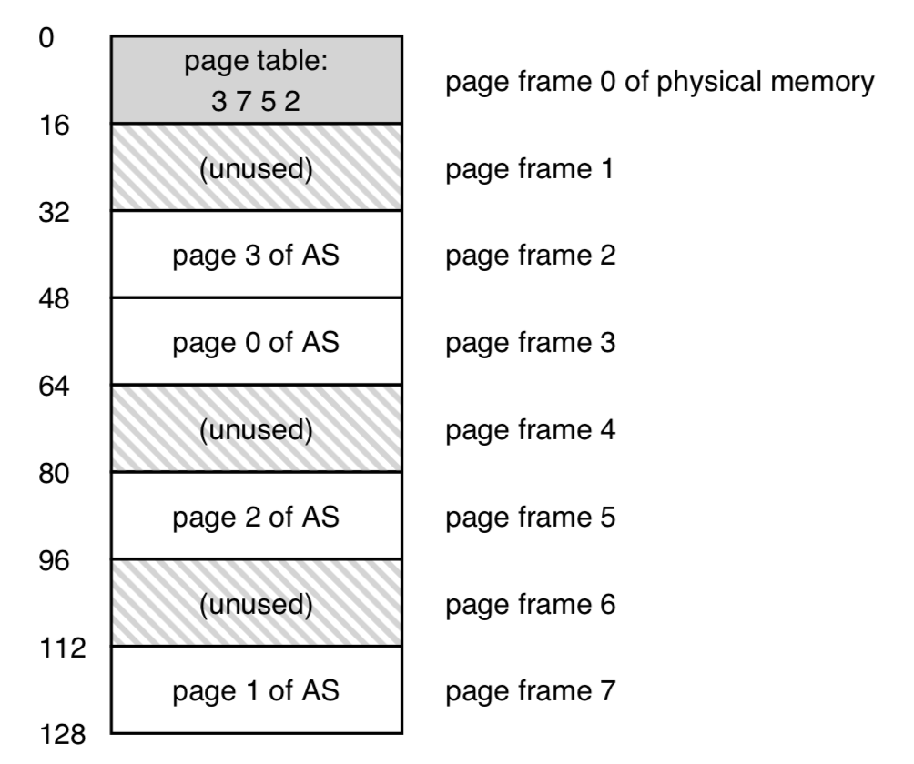
Paging
  Page Table
    没办法在MMU硬件上存储，只能放在main memory中

Slide 39
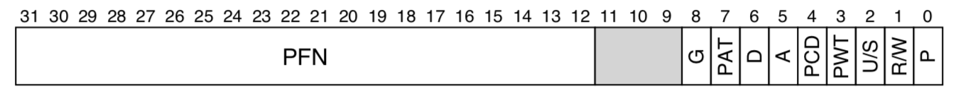
Paging
真实的page table entry (PTE)
  valid bit
  protection bits (R/W) （r/w/e权限）
  present bit (P) （on disk/ in physical memory）
  dirty bit (D)（与disk版本是否一致）
  reference bit/accessed bit (A)（体现page的流行度，与replacement有关）
  U/S: user/supervisor，用户态是否可以访问
  PAT/PWT/PCD/G: 与硬件cache相关

Slide 40
Paging
地址翻译实例
  Movl 21, %eax（直接寻址21）
  假设有page-table base register，存储当前进程page table首地址
  获取PTE地址
    VPN_MASK = 0x30 (hex 30, or binary 110000)
    SHIFT = 4
    （虚存空间64B）

Slide 41
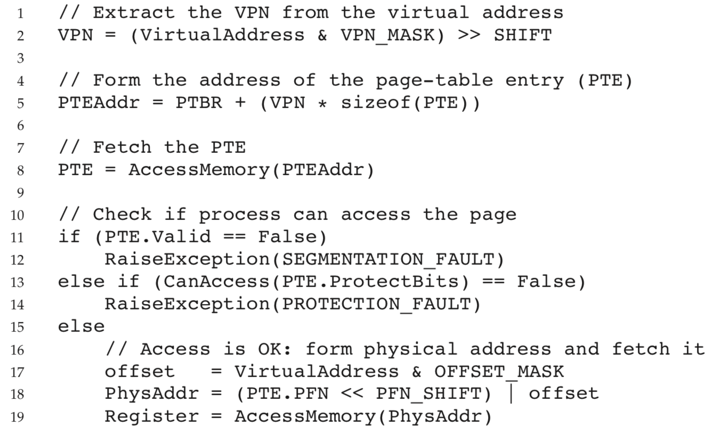
Paging
地址翻译实例

Slide 42
Paging
Page table的两个没有解决的问题：
  运行太慢（两次访问内存）
  占用内存空间太大

Slide 43
Paging: Faster Translations (TLBs)

Slide 44
Paging: Faster Translations (TLBs)
目标：
  怎么加速paging方案的内存访问？
思考：
  用什么思路来加速？
  需要hardware提供什么支持？
  需要OS提供什么支持？

Slide 45
Paging: Faster Translations (TLBs)
Translation-Lookaside Buffer (TLB)
  Hardware support (old friend of OS)
  Part of memory-management unit (MMU)
  hardware cache of popular virtual-to-physical address translations (VPN->PPN) (address-translation cache)
  没有TLB，paging的virtual address方案就是不实用的

Slide 46
TLB Hit
CPU Chip
TLB
2
PTE
VPN
3
Cache/
Memory
1
MMU
CPU
VA
PA
4
Data
5
A TLB hit eliminates a memory access

Slide 47
TLB Miss
CPU Chip
TLB
4
2
PTE
VPN
Cache/
Memory
1
MMU
3
CPU
VA
PTEA
PA
5
Data
6
A TLB miss incurs an additional memory access (PTE)
Fortunately, TLB misses are rare. Why?

Slide 48
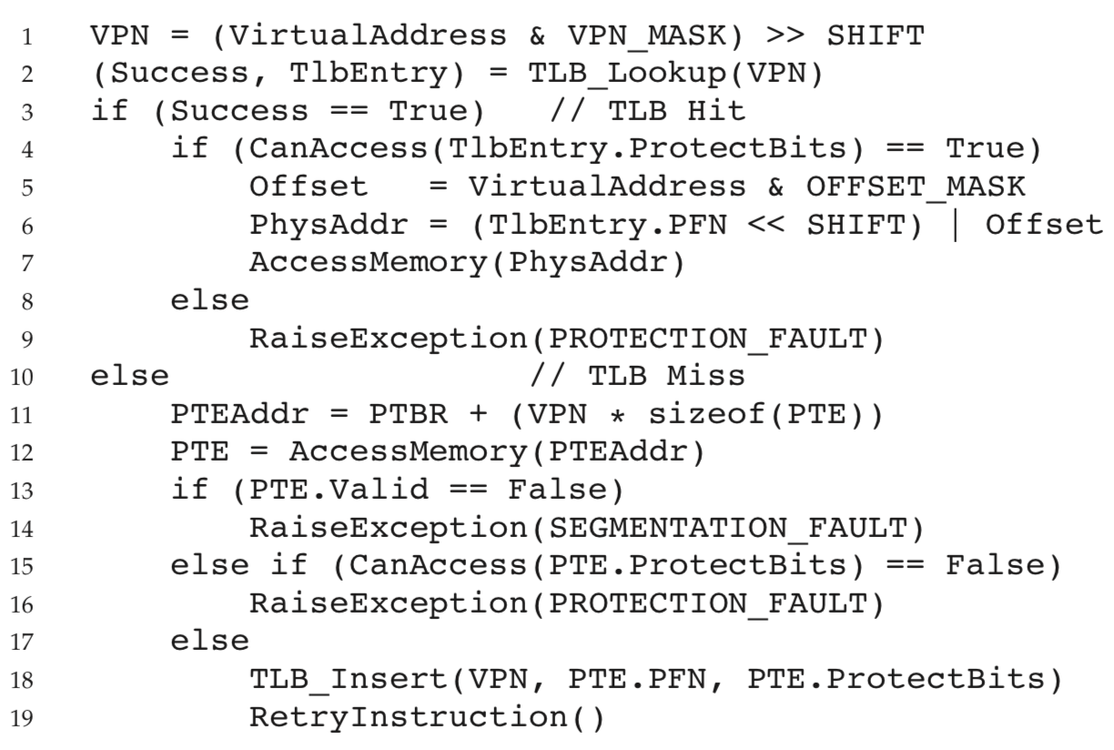
Paging: Faster Translations (TLBs)
TLB Control Flow Algorithm
  hardware-managed TLB, linear page table
重试指令，总会TLB hit

Slide 49
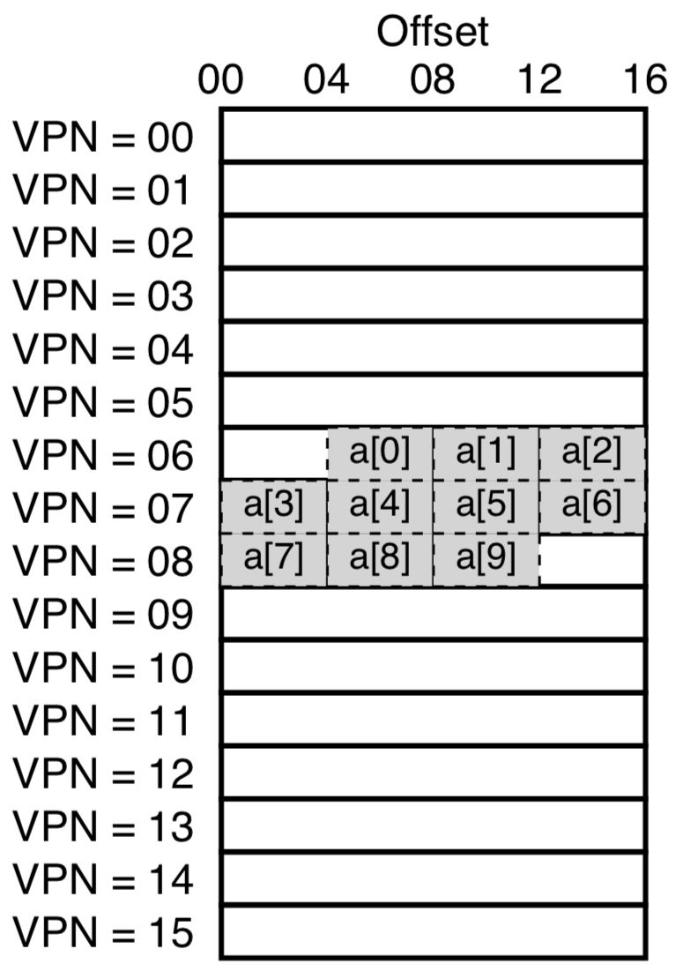
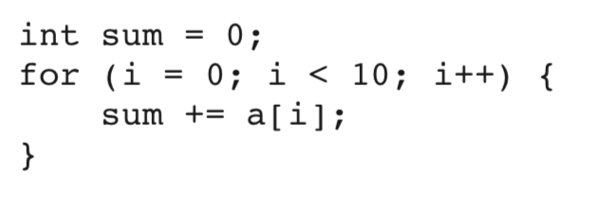
Paging: Faster Translations (TLBs)
Tiny Address Space Example
  VA space: 8-bit, one page: 16B
  Array: starting at VA=100 (VPN=6)
  VPN: 4-bit, VPO: 4-bit
  计算下列代码的TLB命中率：

Slide 50
Paging: Faster Translations (TLBs)
Tiny Address Space Example
  VA space: 8-bit, one page: 16B
  Array: starting at VA=100 (VPN=6)
  VPN: 4-bit, VPO: 4-bit
  计算下列代码的TLB命中率：
a[0], a[3], a[7] miss;
其余hit。命中率=70%
即使TLB大小为1
(Spatial locality)
Page增大，命中率进一步提升

Slide 51
Paging: Faster Translations (TLBs)
Who Handles The TLB Miss?
  Hardware, or OS?
  早期，都是hardware处理（不信任OS），TLB需要知道page table的物理地址
    E.g., intel x86 architecture
  现代，software-managed TLB
    当TLB miss时，抛出一个exception
    陷入kernel mode，在handler处理TLB miss
    之后回到原指令流，重试指令，TLB hit
    E.g., MIPS R10k, Sun SPARK v9 (RISC)

Slide 52
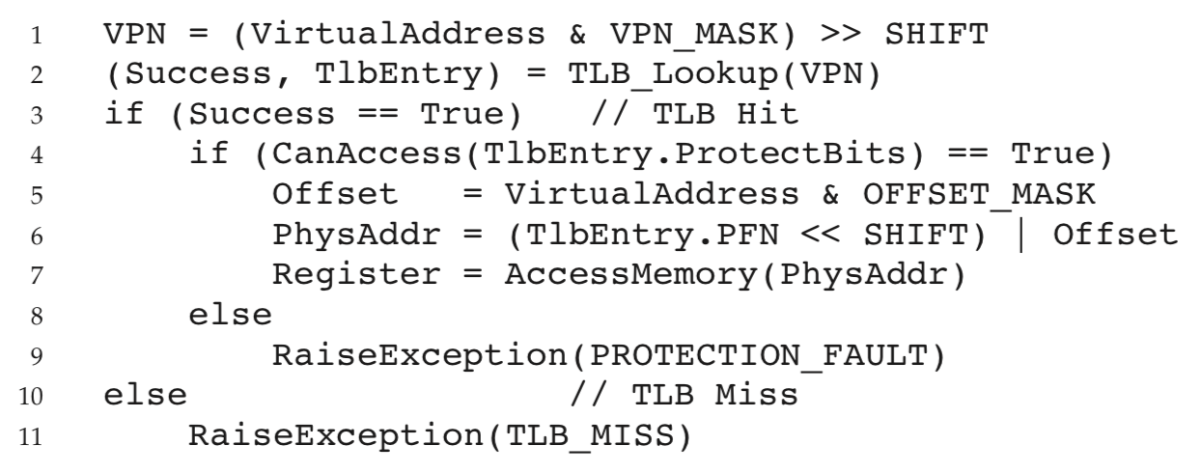
Paging: Faster Translations (TLBs)
TLB Control Flow Algorithm (OS Handled)

Slide 53
Paging: Faster Translations (TLBs)
软件处理TLB miss方式的优点：
  Flexibility: OS can use any data structure it wants to implement the page table, without necessitating hardware change.
  Simplicity: hardware doesn’t have to do much on a miss

Slide 54
Paging: Faster Translations (TLBs)
TLB Contents: What’s In There?
  典型TLB：32, 64或128 entries，fully associative (全相连)
  格式：
    VPN | PFN | other bits
  Other bits:
    A Valid bit: 该entry是否为有效的地址翻译
    Protection bits
    A Dirty bit

Slide 55
Paging: Faster Translations (TLBs)
n–1
p
p–1
0
virtual page number
page offset
virtual address
TLBT (tag)
TLBI (index)
组相连TLB：
TLBT为组编号
address translation
m–1
p
p–1
0
physical page number
page offset
physical address
Cache tag
Cache index
Cache offset

Slide 56
Address Translation
Components of the virtual address (VA)
  VPO: Virtual page offset
  VPN: Virtual page number
  TLBI: TLB index
  TLBT: TLB tag
Components of the physical address (PA)
  PPO: Physical page offset (same as VPO)
  PPN: Physical page number
  CO: Byte offset within cache line
  CI: Cache index
  CT: Cache tag

Slide 57
Paging: Faster Translations (TLBs)
n–1
p
p–1
0
virtual page number
page offset
virtual address
valid
tag
physical page number
.
.
.
TLB
=
TLB hit
physical page number
page offset
physical address
tag
index
valid
tag
data
Cache
=
data
cache hit

Slide 58
Simple Memory System TLB
TLB
  16 entries
  4-way associative (2-bit)
Addressing
  14-bit virtual addresses
  12-bit physical address
  Page size = 64 B (6-bit)
TLBT
TLBI
13
12
11
10
9
8
7
6
5
4
3
2
1
0
VPN
VPO
 | Tag | PPN | Valid | Tag | PPN | Valid | Tag | PPN | Valid | Tag | PPN | Valid
0 | 03 | – | 0 | 09 | 0D | 1 | 00 | – | 0 | 07 | 02 | 1
1 | 03 | 2D | 1 | 02 | – | 0 | 04 | – | 0 | 0A | – | 0
2 | 02 | – | 0 | 08 | – | 0 | 06 | – | 0 | 03 | – | 0
3 | 07 | – | 0 | 03 | 0D | 1 | 0A | 34 | 1 | 02 | – | 0

Slide 59
练习2-4
Virtual Address 0x03D4
13
12
11
10
9
8
7
6
5
4
3
2
1
0
0
0
0
0
1
1
1
1
0
1
0
1
0
0
VPN
VPO
VPN: TLBI: TLBT: TLB Hit? Page Fault? O
11
10
9
8
7
6
5
4
3
2
1
0
0
0
1
1
0
1
0
1
0
1
0
0
PPN
PPO
PPN: PPO: PA:

Slide 60
练习2-4答案
Virtual Address 0x03D4
13
12
11
10
9
8
7
6
5
4
3
2
1
0
0
0
0
0
1
1
1
1
0
1
0
1
0
0
VPN
VPO
VPN: 0x0f TLBI: 0x03 TLBT: 0x03 TLB Hit? Page Fault? O
11
10
9
8
7
6
5
4
3
2
1
0
0
0
1
1
0
1
0
1
0
1
0
0
PPN
PPO
PPN: PPO: PA:

Slide 61
练习2-4答案
TLB
  16 entries
  4-way associative (2-bit)
    四路指每组(set)四项，并发查找
    16/4 = 4 (一共四组，所以TLBI 2-bit)
Addressing
  14-bit virtual addresses
  12-bit physical address
  Page size = 64 B (6-bit)
TLBT
TLBI
13
12
11
10
9
8
7
6
5
4
3
2
1
0
VPN
VPO
 | Tag | PPN | Valid | Tag | PPN | Valid | Tag | PPN | Valid | Tag | PPN | Valid
0 | 03 | – | 0 | 09 | 0D | 1 | 00 | – | 0 | 07 | 02 | 1
1 | 03 | 2D | 1 | 02 | – | 0 | 04 | – | 0 | 0A | – | 0
2 | 02 | – | 0 | 08 | – | 0 | 06 | – | 0 | 03 | – | 0
3 | 07 | – | 0 | 03 | 0D | 1 | 0A | 34 | 1 | 02 | – | 0

Slide 62
练习2-4答案
Virtual Address 0x03D4
13
12
11
10
9
8
7
6
5
4
3
2
1
0
0
0
0
0
1
1
1
1
0
1
0
1
0
0
VPN
VPO
VPN: 0x0f TLBI: 0x03 TLBT: 0x03 TLB Hit? Yes Page Fault? No
11
10
9
8
7
6
5
4
3
2
1
0
0
0
1
1
0
1
0
1
0
1
0
0
PPN
PPO
PPN: 0x0D PPO: 0x14 PA: 0x354

Slide 63
Simple Memory System Cache
Cache
  16 lines
  4-byte line size
  Direct mapped
CT
CI
CO
11
10
9
8
7
6
5
4
3
2
1
0
PPN
PPO
Idx | Tag | Valid | B0 | B1 | B2 | B3 | Idx | Tag | Valid | B0 | B1 | B2 | B3
0 | 19 | 1 | 99 | 11 | 23 | 11 | 8 | 24 | 1 | 3A | 00 | 51 | 89
1 | 15 | 0 | – | – | – | – | 9 | 2D | 0 | – | – | – | –
2 | 1B | 1 | 00 | 02 | 04 | 08 | A | 2D | 1 | 93 | 15 | DA | 3B
3 | 36 | 0 | – | – | – | – | B | 0B | 0 | – | – | – | –
4 | 32 | 1 | 43 | 6D | 8F | 09 | C | 12 | 0 | – | – | – | –
5 | 0D | 1 | 36 | 72 | F0 | 1D | D | 16 | 1 | 04 | 96 | 34 | 15
6 | 31 | 0 | – | – | – | – | E | 13 | 1 | 83 | 77 | 1B | D3
7 | 16 | 1 | 11 | C2 | DF | 03 | F | 14 | 0 | – | – | – | –

Slide 64
练习2-5
PA: 0x354
CT
CI
CO
11
10
9
8
7
6
5
4
3
2
1
0
0
0
1
1
0
1
0
1
0
1
0
0
PPN
PPO
  Offset: CI: CT: Hit? Byte: 6

Slide 65
练习2-5答案
PA: 0x354
CT
CI
CO
11
10
9
8
7
6
5
4
3
2
1
0
0
0
1
1
0
1
0
1
0
1
0
0
PPN
PPO
  Offset: 0x0 CI: 0x05 CT: 0x0D Hit? Byte: 0x 6

Slide 66
Simple Memory System Cache
Cache
  16 lines
  4-byte line size
  Direct mapped
CT
CI
CO
11
10
9
8
7
6
5
4
3
2
1
0
PPN
PPO
 | Tag | Valid | B0 | B1 | B2 | B3 |  | Tag | Valid | B0 | B1 | B2 | B3
0 | 19 | 1 | 99 | 11 | 23 | 11 | 8 | 24 | 1 | 3A | 00 | 51 | 89
1 | 15 | 0 | – | – | – | – | 9 | 2D | 0 | – | – | – | –
2 | 1B | 1 | 00 | 02 | 04 | 08 | A | 2D | 1 | 93 | 15 | DA | 3B
3 | 36 | 0 | – | – | – | – | B | 0B | 0 | – | – | – | –
4 | 32 | 1 | 43 | 6D | 8F | 09 | C | 12 | 0 | – | – | – | –
5 | 0D | 1 | 36 | 72 | F0 | 1D | D | 16 | 1 | 04 | 96 | 34 | 15
6 | 31 | 0 | – | – | – | – | E | 13 | 1 | 83 | 77 | 1B | D3
7 | 16 | 1 | 11 | C2 | DF | 03 | F | 14 | 0 | – | – | – | –

Slide 67
Address Translation Example
PA: 0x354
CT
CI
CO
11
10
9
8
7
6
5
4
3
2
1
0
0
0
1
1
0
1
0
1
0
1
0
0
PPN
PPO
  Offset: 0x0 CI: 0x05 CT: 0x0D Hit? Yes Byte: 0x36

Slide 68
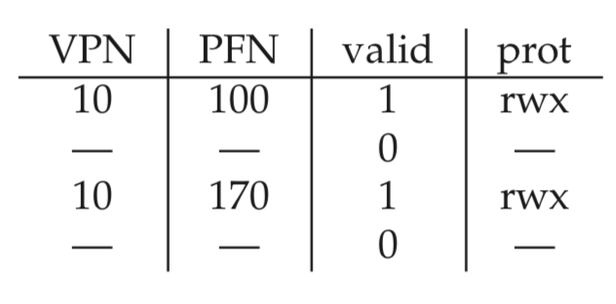
Paging: Faster Translations (TLBs)
TLB Issue: Context Switches
  TLB中存储的是当前process的page table
  当发生context switch的时候，旧的缓存项可能干扰
  E.g., 进程从P1切换到P2，VPN=10可能有两个entry
  具体应该如何在context switch时处理TLB？

Slide 69
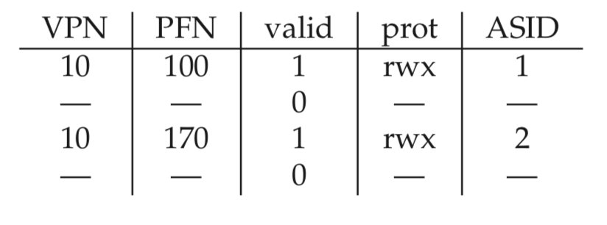
Paging: Faster Translations (TLBs)
TLB Issue: Context Switches
  #1. 简单地清空TLB，重新开始
    OS：利用特权指令来控制硬件
    硬件：直接将TLB所有位清零
    问题：TLB命中率回到0，性能较差
  #2. address space identifier (ASID)
    可以按照PID来理解
    可以区分不同VA空间，不必清空TLB，也不会发生错误

Slide 70
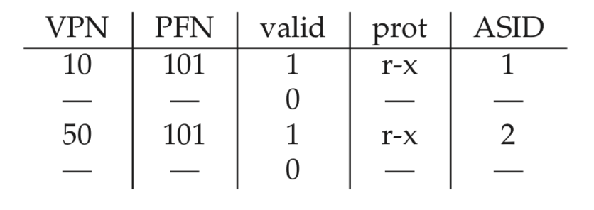
Paging: Faster Translations (TLBs)
TLB Issue: Context Switches
  两个VPN指向同一个PFN (PPN)
  合理，因为两个进程进行了内存共享
    Fork
    进程间通信->共享内存

Slide 71
Paging: Faster Translations (TLBs)
Issue: Replacement Policy
  least-recently-used (LRU)
  random
  LRU未必命中率比random高
    例如进程间规律switch，LRU导致每个进程初始命中率很低

Slide 72
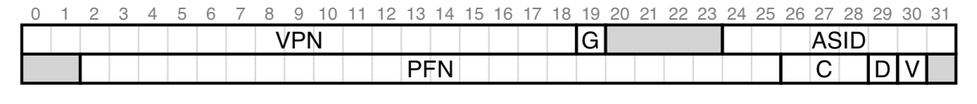
Paging: Faster Translations (TLBs)
A Real TLB Entry
  MIPS R4000: 32-bit address space, 4KB pages
  Software-managed TLB
  A TLB entry: 64 bits
  VPN: 20-bit, offset: 12-bit
  实际VPN 19位，因为用户只能用一半，另一半留给kernel
  PFN: 24-bit，物理内存支持到64GB (2²⁴B)

Slide 73
Paging: Faster Translations (TLBs)
A Real TLB Entry
  ASID: 8-bit，最多256个进程
  A global bit (G): 全局共享给所有进程，如果设置，ASID被忽略
  Coherence bit (C): 硬件cache相关
  Dirty bit (D)
  Valid bit (V)
  一般有32或64个entry，少量预留给OS

Slide 74
Paging: Faster Translations (TLBs)
A Real TLB Entry
  特权指令，操作TLB
    TLBP: 看TLB中是否存在一个特定的translation
    TLBR: 将一个TLB entry读到寄存器
    TLBWI: 写入一个TLB entry
    TLBWR: 随机替换一个TLB entry

Slide 75
Paging: Faster Translations (TLBs)
RAM ISN’T ALWAYS RAM (CULLER’S LAW)
  Random-access memory (RAM)，理论上访问各地址的速度一样
  但实际上因为有cache、TLB的存在，访问不同地址的速度差距可能很大
  所以，RAM isn’t always RAM

Slide 76
进程与地址翻译
(Linux)每个进程有自己的虚拟地址空间
  两个进程可能同一个虚拟地址
页表
  每个进程自己独立的页表（不同的内存区域）
  MMU要知道进程号(PID)，才能找到对应的页表
  所以MMU是硬件加速页表的访问，但页表内存需要OS去管理，因为进程是OS下才有的概念（对于MMU只是ID->页表这样多个页表的行为模式，不需要知道进程的概念）

Slide 77
进程与地址翻译
TLB
  两个进程可能在有冲突：Va->Pa, Va->Pb（不同进程的虚拟地址都是Va，但对应的物理地址不同）
  没问题，但性能不佳的方案
    进程B切到进程A，invalidate TLB中所有条目，从头开始
    再换回B，没有cache，实际映射关系不变
  ASID（Address Space ID）
    每个进程一个ASID，真的索引信息是ASID+VPN

Slide 78
Paging: Smaller Tables

Slide 79
Paging: Smaller Tables
回顾Paging方案的两个问题：
  速度慢（TLB加速）
  占用内存空间大（？）
    32-bit address space, 4KB pages, 4-byte page-table entry
    一个进程：1M*4B=4MB
    100个并发进程：400MB

Slide 80
Paging: Smaller Tables
Given:
  X86: 32-bit address space
  4KB (2¹²) page size, 4-byte PTE
  X86-64: 48-bit address space
  4KB (2¹²) page size, 8-byte PTE
Problem:
  X86: Would need a 4 MB page table!
    2²⁰ *4 bytes (20bit = 32bit – 12bit)
  X86-64: Would need a 512 GB page table!
    2³⁶ *8 bytes (36bit = 48bit – 12bit)

Slide 81
Paging: Smaller Tables
Simple Solution : Bigger Pages
  Page size: 4KB -> 16KB
  一个进程：2³²/2¹⁴ = 2¹⁸ = 256K个entry，1MB空间
  100个进程：100MB
  问题：internal fragmentation
    用户至少分配一个page，但可能只用了其中的一小部分，浪费空间
    Page变大，削弱paging方案的flexibility优势

Slide 82
Paging: Smaller Tables
Hybrid Approach: Paging and Segments
  Paging: 细粒度，空间开销大，适合稠密地址空间
  Segment：粗粒度，空间开销小，适合稀疏地址空间
  Hybrid: 利用二者优势
  最早是multics作者之一Jack Dennis提出

Slide 83
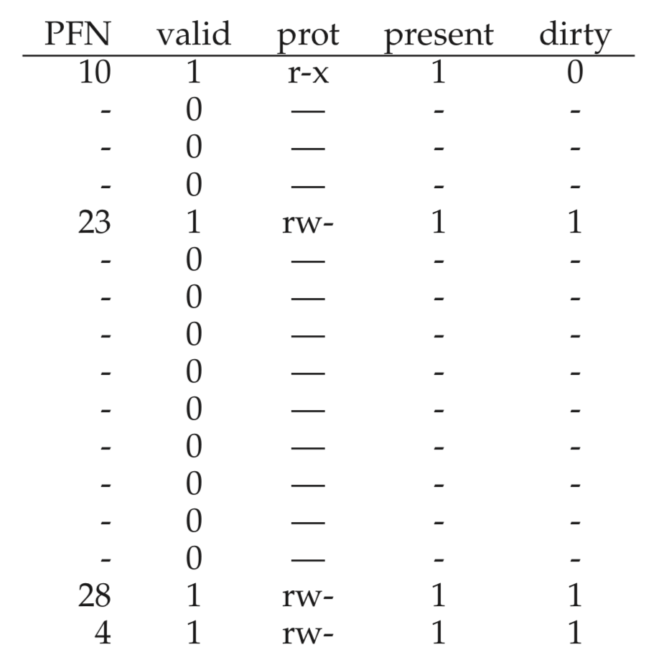
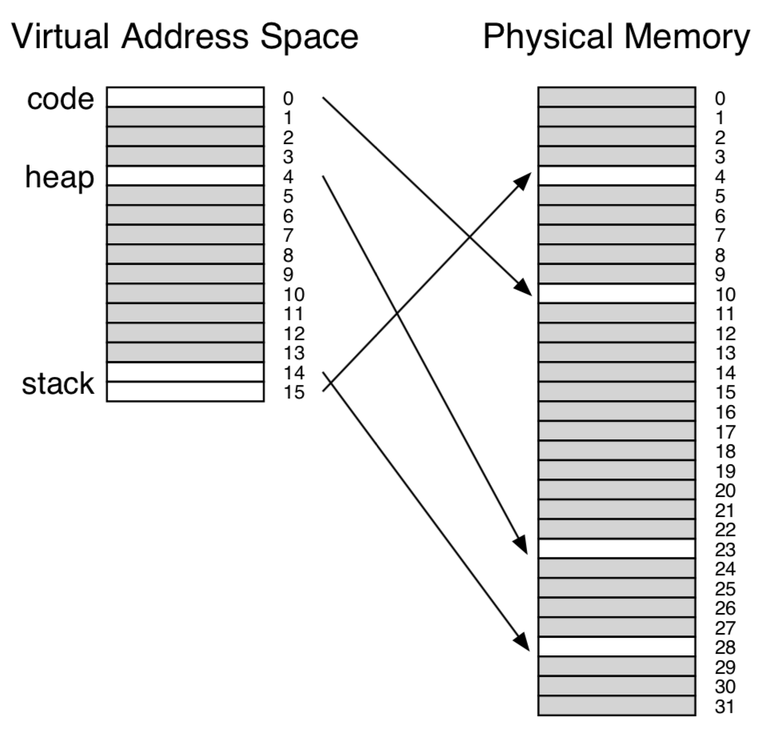
Paging: Smaller Tables
Hybrid Approach: Paging and Segments
  E.g., 16KB address space, 1KB pages

Slide 84
Paging: Smaller Tables
Hybrid Approach: Paging and Segments
  Segmentation: base+bound，放在专门的寄存器中
    Code, heap, stack三个segment，因此有三对base+bound寄存器
    存放当前活跃进程的三个segment信息
  每个segment建立一张页表，bound为段内已使用的最大内存
    后面没有分配的空间不计入page table，可以节省空间
    假设code segment只使用了前三个page (0, 1, 2)，那么code segment page table只记录三个entry，bound=3

Slide 85
Paging: Smaller Tables
Hybrid Approach: Paging and Segments
  段页式内存管理
  也存在问题：
    如果空间稀疏（内部空，而不是后面空），效率也不高
    两种方式，导致额外的fragmentation

Slide 86
Paging: Smaller Tables
为什么Page Table占用空间会大？
  每个VPN都需要一个entry
  但实际上多数进程并没有真正利用多少VPN，占用多少PPN
  i.e., Page Table往往是稀疏的，有很多entry是空的，却占用了大量空间
  Solution: 多级页表，压缩空白entry所占的空间

Slide 87
Paging: Smaller Tables
Common solution
  multi-level page tables
  e.g., 2-level page table
    Level 1 table: 1024 entries, each of which points to a Level 2 page table.
    Level 2 table: 1024 entries, each of which points to a page
Level 2
Tables
Level 1
Table
...

Slide 88
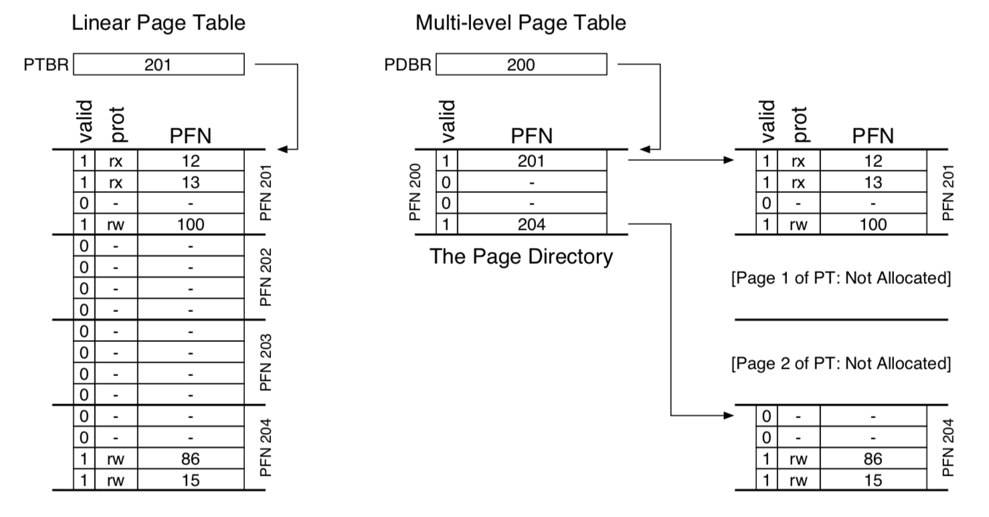
Paging: Smaller Tables
Multi-level Page Tables

Slide 89
Multi-Level Page Tables: 中间可以有空洞
Level 1
page table
Level 2
page tables
Virtual memory
0
VP 0
PTE 0
...
PTE 0
...
VP 1023
2K allocated VM pages
for code and data
PTE 1
PTE 1023
VP 1024
PTE 2 (null)
...
PTE 3 (null)
VP 2047
PTE 4 (null)
PTE 0
Gap
PTE 5 (null)
...
PTE 6 (null)
PTE 1023
PTE 7 (null)
6K unallocated VM pages
PTE 8
1023 null
PTEs
(1K - 9)
null PTEs
PTE 1023
1023
unallocated
pages
1023 unallocated pages
32 bit addresses, 4KB pages, 4-byte PTEs
VP 9215
1 allocated VM page
for the stack
...

Slide 90
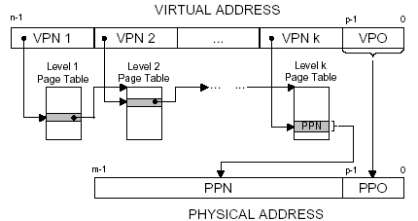
Paging: Smaller Tables

Slide 91
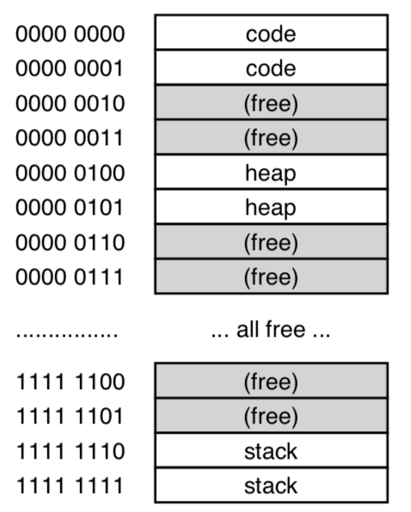
Paging: Smaller Tables
A Detailed Multi-Level Example
  14-bit virtual address space
  8-bit for VPN, 6-bit for offset
  4-byte PTE
  A linear page table: 256 entries
  Page table: 1KB (256*4B)
  Page 0, 1 -> code
  Page 4, 5 -> heap
  Page 254, 255 -> stack

Slide 92
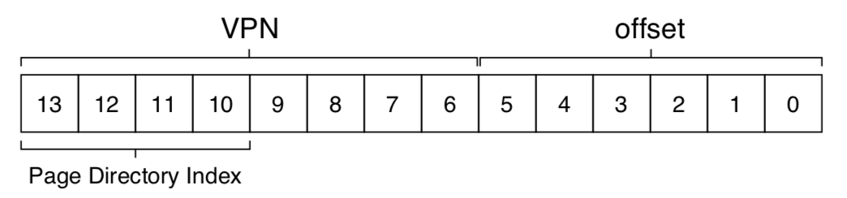
Paging: Smaller Tables
A Detailed Multi-Level Example
  一个page是64B，能放16个PTE
  所以一级页表是16个entry，各负责16(=256/16)个VPN
  Page-directory index (PDIndex)为VPN的前4位，用来定位是属于一级页表中的哪个entry

Slide 93
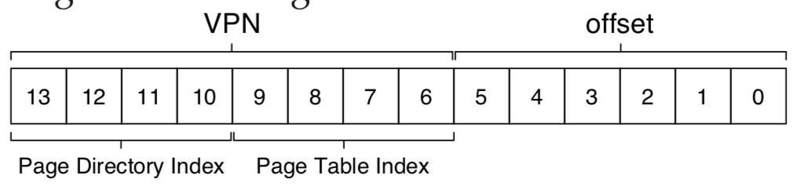
Paging: Smaller Tables
Page table index (PTIndex)
  VPN的后四位，是二级页表的index

Slide 94
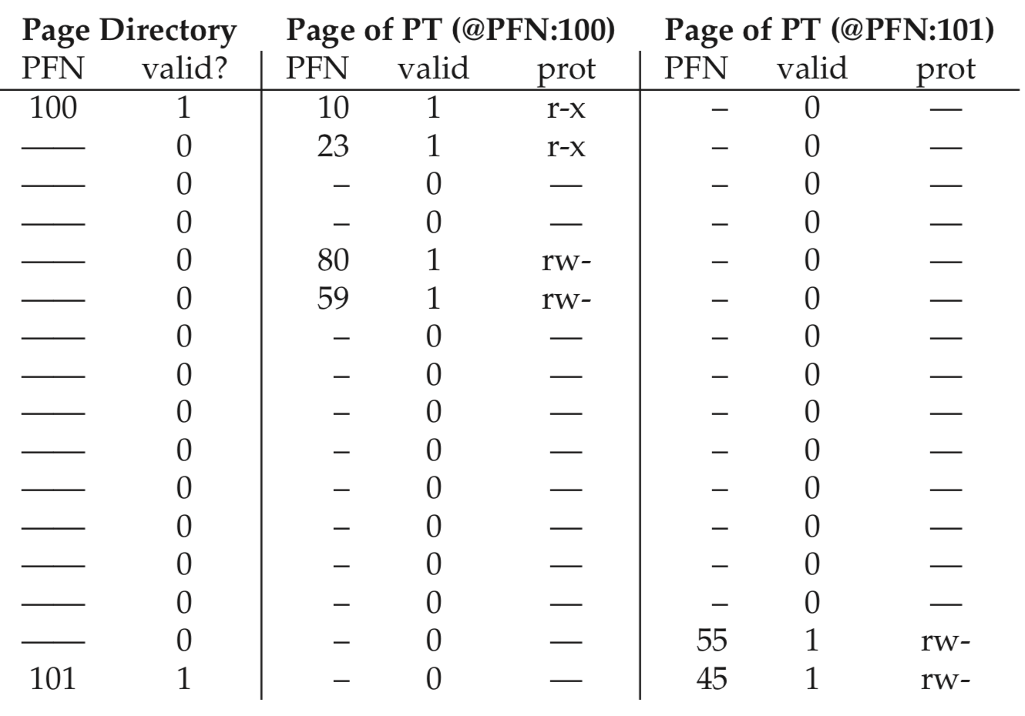
Paging: Smaller Tables
二级页表结果

Slide 95
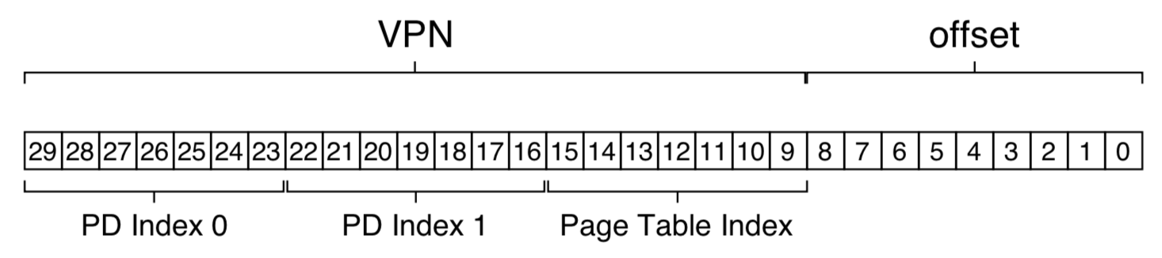
Paging: Smaller Tables
More Than Two Levels
  在VPN前面划分多个PD Index

Slide 96
Paging: Smaller Tables
Inverted Page Tables
  VPN -> PPN，比较稀疏，多个进程=>空间开销大
  但Pa有效，利用率高，比较稠密=>
  Inverted page tables (PPN->VPN)
  缺点是用户需求是VPN->PPN的查找
  线性搜索开销太大，所以需要有额外的结构来加速搜索，例如hash结构
    e.g., IBM PowerPC
  Page table are just data structure. You can do lots of crazy things on it.

Slide 97
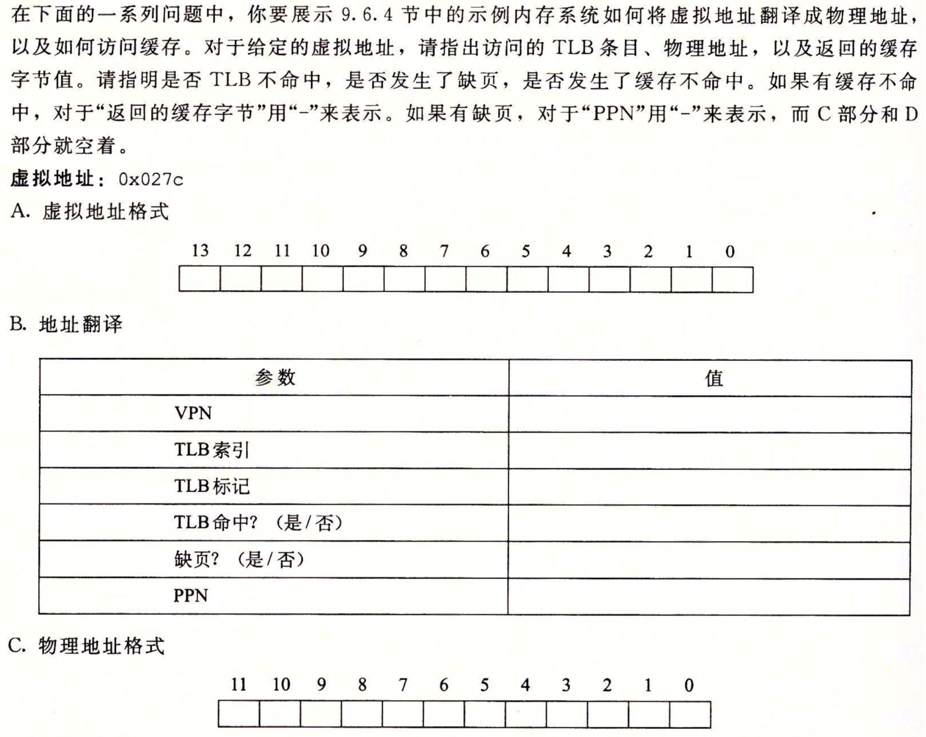
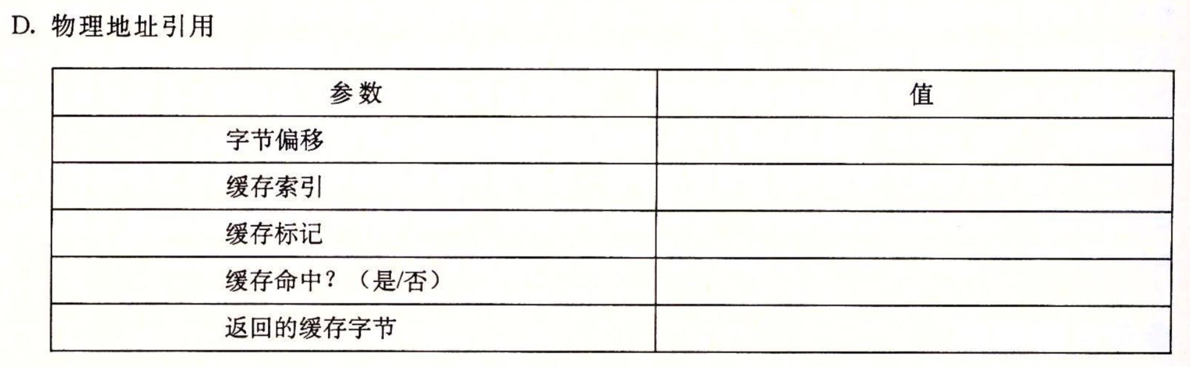
课堂练习
Page:64B
VA:14-bit
PA:12-bit
TLB:四路组
相连，16 items
Cache:直接映射，
16个组，cacheline
4B

Slide 98
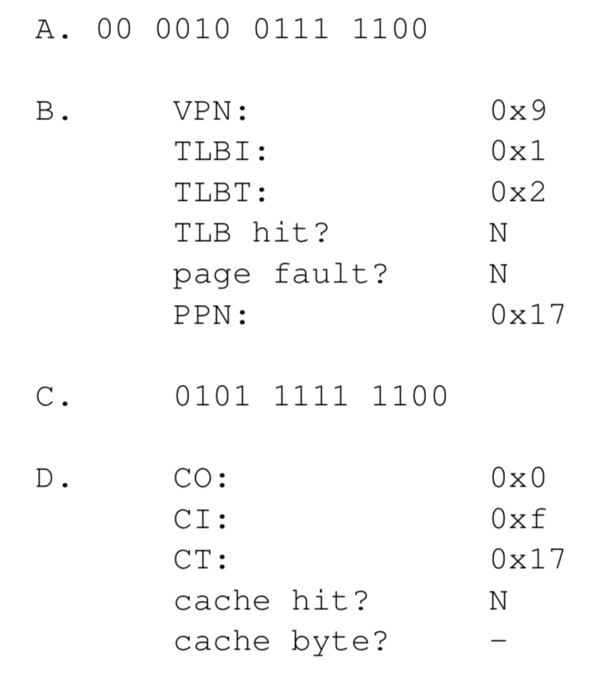
练习答案

Slide 99
Intel Core i7 Memory System
Processor package
Core x4
Registers
Instruction
fetch
MMU
(addr translation)
L1 d-cache
32 KB, 8-way
L1 i-cache
32 KB, 8-way
L1 d-TLB
64 entries, 4-way
L1 i-TLB
128 entries, 4-way
L2 unified cache
256 KB, 8-way
L2 unified TLB
512 entries, 4-way
To other
cores
QuickPath interconnect
4 links @ 25.6 GB/s each
To I/O
bridge
L3 unified cache
8 MB, 16-way
(shared by all cores)
DDR3 Memory controller
3 x 64 bit @ 10.66 GB/s
32 GB/s total (shared by all cores)
Main memory

Slide 100
Review of Symbols
Basic Parameters
  N = 2^{n} : Number of addresses in virtual address space
  M = 2^{m} : Number of addresses in physical address space
  P = 2^{p} : Page size (bytes)
Components of the virtual address (VA)
  TLBI: TLB index
  TLBT: TLB tag
  VPO: Virtual page offset
  VPN: Virtual page number
Components of the physical address (PA)
  PPO: Physical page offset (same as VPO)
  PPN: Physical page number
  CO: Byte offset within cache line
  CI: Cache index
  CT: Cache tag

Slide 101
End-to-end Core i7 Address Translation
CPU
32/64
L2, L3, and
main memory
Result
Virtual address (VA)
36
12
VPN
VPO
L1
hit
L1
miss
32
4
TLBT
TLBI
L1 d-cache
(64 sets, 8 lines/set)
TLB
hit
TLB
miss
...
...
L1 TLB (16 sets, 4 entries/set)
9
9
9
9
40
12
40
6
6
VPN1
VPN2
VPN3
VPN4
PPN
PPO
CT
CI
CO
Physical
address
(PA)
CR3
PTE
PTE
PTE
PTE
Page tables

Slide 102
Core i7 Level 4 Page Table Entries
63
62
52
51
12
11
9
8
7
6
5
4
3
2
1
0
XD
Unused
Page physical base address
Unused
G
D
A
CD
WT
U/S
R/W
P=1
Available for OS (page location on disk)
P=0
Each entry references a 4K child page. Significant fields:
P: Child page is present in memory (1) or not (0)
R/W: Read-only or read-write access permission for child page
U/S: User or supervisor mode access
WT: Write-through or write-back cache policy for this page
A: Reference bit (set by MMU on reads and writes, cleared by software)
D: Dirty bit (set by MMU on writes, cleared by software)
Page physical base address: 40 most significant bits of physical page address (forces pages to be 4KB aligned)
XD: Disable or enable instruction fetches from this page.

Slide 103
Core i7 Page Table Translation
9
9
9
9
12
Virtual
address
VPN 1
VPN 2
VPN 3
VPN 4
VPO
L1 PT
Page global
directory
L2 PT
Page upper
directory
L3 PT
Page middle
directory
L4 PT
Page
table
40
40
40
40
CR3
/
/
/
/
Physical
address
of L1 PT
Offset into
physical and
virtual page
/
12
L1 PTE
L2 PTE
L3 PTE
L4 PTE
Physical
address
of page
512 GB
region
per entry
1 GB
region
per entry
2 MB
region
per entry
4 KB
region
per entry
40
/
40
12
Physical
address
PPN
PPO

Slide 104
Cute Trick for Speeding Up L1 Access
Tag Check
CT
40
6
6
Physical
address
(PA)
CT
CI
CO
PPN
PPO
Address
Translation
No
Change
Virtual
address
(VA)
CI
VPN
VPO
L1 Cache
36
12
Observation
  Bits that determine CI identical in virtual and physical address
  Can index into cache while address translation taking place
  Generally we hit in TLB, so PPN bits (CT bits) available next
  “Virtually indexed, physically tagged”
  Cache carefully sized to make this possible

Slide 105
Linux Virtual Memory System
Process-specific data structures
(e.g. task and mm structs,
page tables, kernel stack)
Different for
each process
Kernel
virtual
memory
Physical memory
Identical for
each process
Kernel code and data
User stack
%esp
Memory mapped region
for shared libraries
Process
virtual
memory
brk
Run-time heap (via malloc)
Uninitialized data (.bss)
Initialized data (.data)
Program text (.text)
x08048000 (32)
x40000000 (64)

Slide 106
Linux organizes VM as a collection of “areas”
vm_area_struct
process virtual memory
task_struct
mm_struct
vm_end
mm
pgd
vm_start
vm_prot
mmap
vm_flags
shared libraries
vm_next
0x40000000
pgd:
  page directory address (will be loaded to CR3)
vm_prot:
  read/write permissions for this area
vm_end
vm_start
data
vm_prot
vm_flags
0x0804a020
vm_next
text
vm_end
vm_start
0x08048000
vm_prot
vm_flags
vm_next
0

Slide 107
Linux organizes VM as a collection of “areas”
vm_area_struct
process virtual memory
task_struct
mm_struct
vm_end
mm
pgd
vm_start
vm_prot
mmap
vm_flags
shared libraries
vm_next
0x40000000
vm_flags
  shared with other processes or private to this process
vm_end
vm_start
data
vm_prot
vm_flags
0x0804a020
vm_next
text
vm_end
vm_start
0x08048000
vm_prot
vm_flags
vm_next
0

Slide 108
Linux page fault handling
process virtual memory
Is the VA legal?
  i.e. is it in an area defined by a vm_area_struct?
  if not then signal segmentation violation (e.g. (1))
vm_area_struct
vm_end
vm_start
r/o
shared libraries
vm_next
1
read
vm_end
vm_start
data
3
r/w
read
vm_next
2
text
write
vm_end
vm_start
r/o
vm_next
0

Slide 109
Linux page fault handling
process virtual memory
Is the operation legal?
  i.e., can the process read/write this area?
  if not then signal protection violation (e.g., (2))
If OK, handle fault
  e.g., (3)
vm_area_struct
vm_end
vm_start
r/o
shared libraries
vm_next
1
read
vm_end
vm_start
data
3
r/w
read
vm_next
2
text
write
vm_end
vm_start
r/o
vm_next
0

