Slide 1
Virtual Memory (IV)
Dynamic Memory Allocation

Slide 2
Outline
Basic concepts
Implicit free lists

Slide 3
Dynamic Memory Allocation
Programmers use dynamic memory allocators (such as malloc) to acquire VM at run time.
  尤其是一些数据结构，只能在运行时才能知道其大小
Dynamic memory allocators manage an area of process virtual memory known as the heap.
Application
Dynamic Memory Allocator
Heap
User stack
Top of heap
(brk ptr)
Heap (via malloc)
Uninitialized data (.bss)
Initialized data (.data)
Program text (.text)
0

Slide 4
Dynamic Memory Allocation
Heap：
  一段连续空间（虚存空间，有page table时，物理未必连续）
  Allocator把heap当作一组可变大小的blocks，blocks或者是allocated状态，或者是free状态
  与数据结构“堆”(heap)没有关系，这里是堆积、大量的意思
Types of allocators
  Explicit allocator: application allocates and frees space
    E.g., malloc and free in C
  Implicit allocator: application allocates, but does not free space
    E.g. garbage collection in Java, ML, and Lisp
Will discuss simple explicit memory allocation today

Slide 5
The malloc Package
#include <stdlib.h>
void *malloc(size_t size)
  Successful:
    Returns a pointer to a memory block of at least size bytes
    aligned to an 8-byte (x86) or 16-byte (x86-64) boundary
    If size == 0, returns NULL
    (如果需要更严格的对其，例如4K对齐，需要用memalign函数)
  Unsuccessful: returns NULL (0) and sets errno

Slide 6
The malloc Package
void free(void *p)
  Returns the block pointed at by p to pool of available memory
  p must come from a previous call to malloc or realloc
Other functions
  calloc: Version of malloc that initializes allocated block to zero.
  realloc: Changes the size of a previously allocated block.
  sbrk: Used internally by allocators to grow or shrink the heap

Slide 7
malloc Example
#include <stdio.h>
#include <stdlib.h>
void foo(int n) {
int i, *p;
/* Allocate a block of n ints */
p = (int *) malloc(n * sizeof(int));
if (p == NULL) {
perror("malloc");
exit(0);
}
/* Initialize allocated block */
for (i=0; i<n; i++)
p[i] = i;
/* Return allocated block to the heap */
free(p);
}

Slide 8
Assumptions Made in This Lecture
Memory is word addressed (each word can hold a pointer)
Allocated block
(4 words)
Free block
(3 words)
Free word
Allocated word

Slide 9
Allocation Example
p1 = malloc(4)
p2 = malloc(5)
p3 = malloc(6)
free(p2)
p4 = malloc(2)

Slide 10
Constraints
Applications
  可以任意调用malloc和free请求，形成任意顺序的malloc和free序列
  Free请求必须针对一个已经malloc过的block（也要避免double free）
Allocators
  不能控制分配blocks的数量或大小（由application决定）
  必须立刻响应malloc请求
    不能通过reorder或buffer请求来优化性能
  必须从free空间中分配blocks
    不能覆盖已有内容
  必须对齐分配的blocks，满足对齐要求
    8-byte (x86) or 16-byte (x86-64) alignment on Linux boxes
  只能操作和修改空闲内存
  不能移动已经分配的blocks
    例如，不同做compaction操作（为了不影响性能）

Slide 11
Performance Goal: Throughput
Given some sequence of malloc and free requests:
  R₀, R₁, ..., R_{k}, ... , R_{n-1}
Goals: maximize throughput and peak memory utilization
  These goals are often conflicting
Throughput:
  Number of completed requests per unit time
  Example:
    5,000 malloc calls and 5,000 free calls in 10 seconds
    Throughput is 1,000 operations/second

Slide 12
Performance Goal: Peak Memory Utilization
Given some sequence of malloc and free requests:
  R₀, R₁, ..., R_{k}, ... , R_{n-1}
Def: 聚集有效负载（aggregate payload） P_{k}
  malloc(p) results in a block with a payload of p bytes
  After request R_{k} has completed, the aggregate payload P_{k} is the sum of currently allocated payloads
Def: Current heap size H_{k}
  Assume H_{k} is monotonically nondecreasing（不变或增长）
    i.e., heap only grows when allocator uses sbrk
Def: 峰值利用率（Peak memory utilization） after k+1 requests
  U_{k} = ( max_{i<=k} P_{i} ) / H_{k}
  的最大能

Slide 13
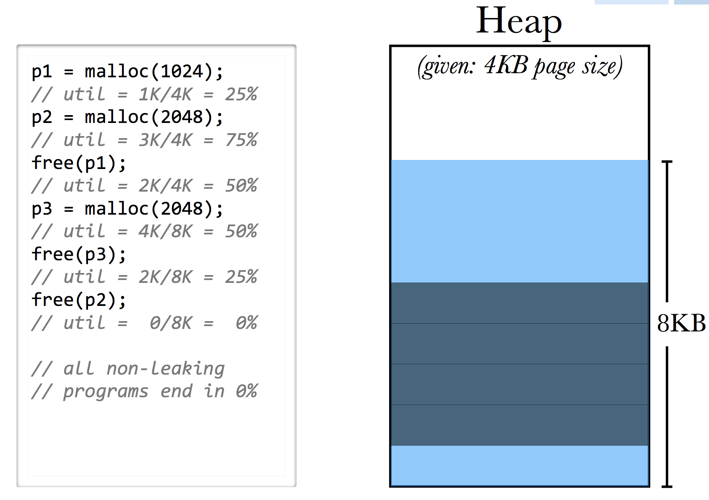
Performance Goal: Peak Memory Utilization
峰值利用率（Peak memory utilization）例子
实时
利用率
峰值
利用率
25%(4k)
75%(4k)
75%(4k)
50%(8k)
50%(8k)
50%(8k)

Slide 14
Fragmentation
Poor memory utilization caused by fragmentation
  internal fragmentation
  external fragmentation

Slide 15
Internal Fragmentation
For a given block, internal fragmentation occurs if payload is smaller than block size
Caused by
  Overhead of maintaining heap data structures (e.g., pointers)
  Padding for alignment purposes
  Explicit policy decisions
  (e.g., to return a big block to satisfy a small request)
Depends only on the pattern of previous requests
  Thus, easy to measure
Block
Internal
fragmentation
Payload
Internal
fragmentation

Slide 16
External Fragmentation
Occurs when there is enough aggregate heap memory, but no single free block is large enough
Depends on the pattern of future requests
  Thus, difficult to measure (以上情况可能是碎片，也可能不是)
p1 = malloc(4)
p2 = malloc(5)
p3 = malloc(6)
free(p2)
p4 = malloc(6)
Oops! (what would happen now?)

Slide 17
Implementation Issues
如何知道free一个指针时，需要释放多少内存空间？
如何组织管理空闲块？
当我们分配的数据结构比一个free block小时，如何处理额外的空间？
我们如何从free blocks中选择一个用来分配？可能有很多个符合条件的
如何插入被释放的块？

Slide 18
Knowing How Much to Free
Standard method
  Keep the length of a block in the word preceding the block.
    This word is often called the header field or header
  Requires an extra word for every allocated block
p0
p0 = malloc(4)
5
block size
payload
free(p0)

Slide 19
Keeping Track of Free Blocks
Method 1: Implicit list using length—links all blocks
Method 2: Explicit list among the free blocks using pointers
Method 3: Segregated free list
  Different free lists for different size classes
Method 4: Blocks sorted by size
  Can use a balanced tree (e.g. Red-Black tree) with pointers within each free block, and the length used as a key
5
4
6
2
5
4
6
2

Slide 20
Outline
Basic concepts
Implicit free lists

Slide 21
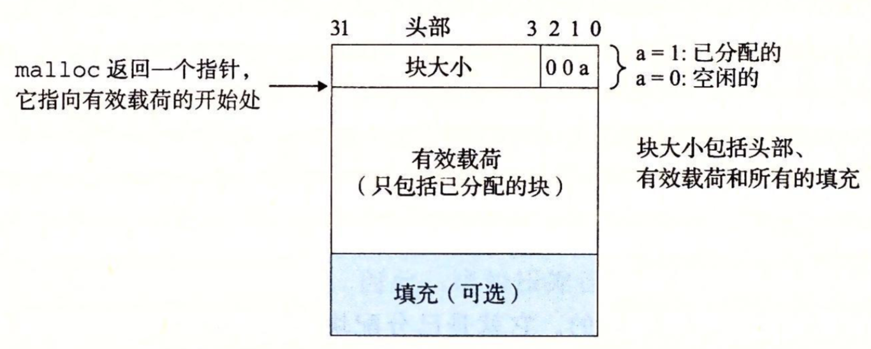
Method 1: Implicit List
For each block we need both size and allocation status
  Could store this information in two words: wasteful!
Standard trick
  If blocks are aligned, some low-order address bits are always 0 (例如，双字对齐，则块大小是8的倍数，块大小最后三位一点是0)
  Instead of storing an always-0 bit, use it as a allocated/free flag
  When reading size word, must mask out this bit

Slide 22
Method 1: Implicit List
块大小为24（0x18）字节，已分配块，头部将是
  0x00000018 | 0x1 = 0x00000019
块大小为40（0x28）字节，未分配块，头部将是
  0x00000028 | 0x0 = 0x00000028

Slide 23
Detailed Implicit Free List Example
Start
of
heap
Unused
8/0
16/1
32/0
16/1
0/1
Double-word
aligned
Allocated blocks: shaded
Free blocks: unshaded
Headers: labeled with size in bytes/allocated bit
32位机器，一个word是32位（4字节）

Slide 24
Detailed Implicit Free List Example
Implicit Free List
  优点：简单
  缺点：任何操作的开销都很大，线性复杂度

Slide 25
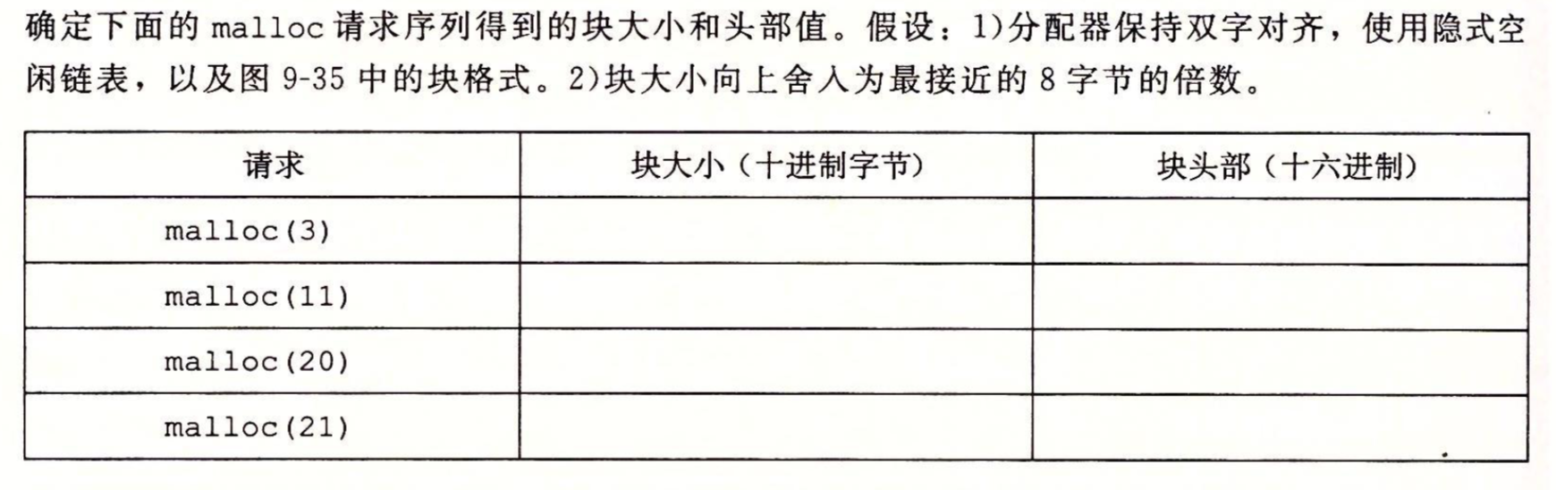
课堂练习

Slide 26
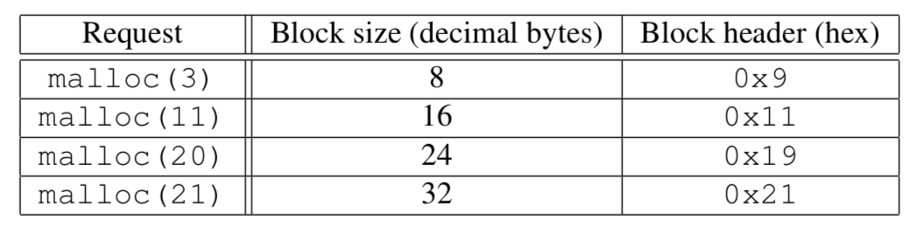
练习答案

Slide 27
Implicit List: Finding a Free Block
First fit:
  从头搜索list，选择第一个符合要求的free block
  线性复杂度，与总块数（包括allocated和free blocks）一个数量级
  实际操作中，可能在list开始的部分导致很多碎片
Next fit:
  操作类似于first fit，只是从上一次搜索结束的地方开始下一次搜索
  均匀使用整个list
  可能比first fit更快（因为后面有一些较的空闲块，而first fit开头部分很难满足，实际上总在搜索一些unhelpful blocks）
  有一些研究说，其碎片化现象更严重
p = start;
while ((p < end) && \\ not passed end
((*p & 1) || \\ already allocated
(*p <= len))) \\ too small
p = p + (*p & -2); \\ goto next block (word addressed)

Slide 28
Implicit List: Finding a Free Block
Best fit:
  搜索整个list，找到所有符合条件的free blocks，然后选择最小的一个
  尽可能保留大的free blocks，一般能够提高内存空间利用率
  搜索整个list，所以会比first fit更慢一些（不会提前结束
Worst fit:
  与Best fit操作类似，但策略正相反，返回最大的free block
  能够避免best fit带来的小碎片
  但一般表现很差，碎片化严重
  性能与best fit类似

Slide 29
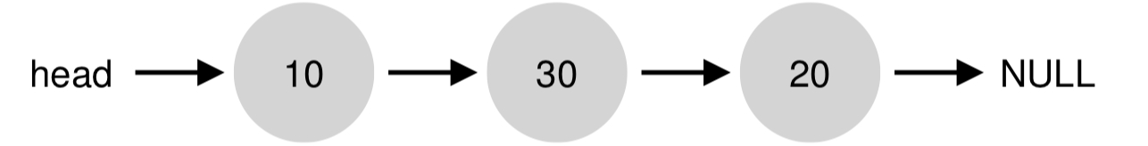
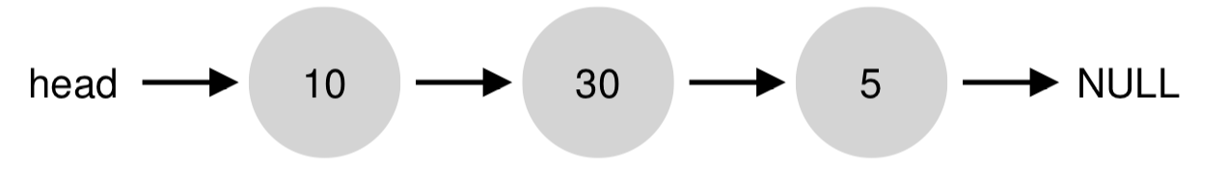
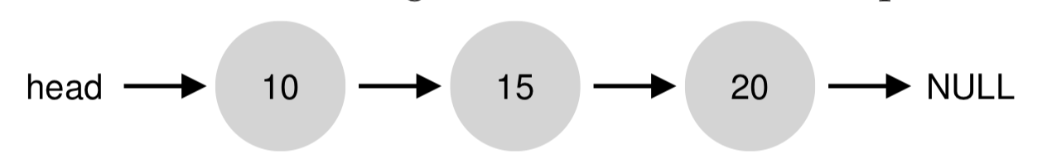
Implicit List: Finding a Free Block
例子
  分配15，best fit，在20中分配（缺点是5有点小，可能不满足后续分配需求）
  如果选择worst fit，结果如下：

Slide 30
Implicit List: Finding a Free Block
如果无法找到合适的free block
  即使总的空闲空间够用（由于碎片
    Fail，返回NULL
    调用sbrk()系统调用申请增大heap区，增加新的物理内存，映射到新扩大的heap区VA

Slide 31
Implicit List: Allocating in Free Block
Allocating in a free block: splitting
  Since allocated space might be smaller than free space, we might want to split the block
4
4
6
2
p
addblock(p, 4)
4
4
4
2
2
E.g., len=4;
Len=3;
Len=5
void addblock(ptr p, int len) {
int newsize = ((len + 1) >> 1) << 1; // round up to even
int oldsize = *p & -2; // mask out low bit
*p = newsize | 1; // set new length
if (newsize < oldsize)
*(p+newsize) = oldsize - newsize; // set length in remaining
} // part of block

Slide 32
Implicit List: Freeing a Block
Simplest implementation:
  Need only clear the “allocated” flag
    void free_block(ptr p) { *p = *p & -2 }
  But can lead to “false fragmentation”
4
4
4
2
2
free(p)
p
4
4
4
2
2
malloc(5)
Oops!
  There is enough free space, but the allocator won’t be able to find it

Slide 33
Implicit List: Coalescing（合并）
Join (coalesce) with next/previous blocks, if they are free
  Coalescing with next block
  But how do we coalesce with previous block?
4
4
4
2
2
logically
gone
free(p)
p
4
4
6
2
2
void free_block(ptr p) {
*p = *p & -2; // clear allocated flag
next = p + *p; // find next block
if ((*next & 1) == 0)
*p = *p + *next; // add to this block if
} // not allocated

Slide 34
Implicit List: Bidirectional Coalescing
Boundary tags [Knuth73]
  Replicate size/allocated word at “bottom” (end) of free blocks
  Allows us to traverse the “list” backwards, but requires extra space
  Important and general technique!
4
4
4
4
6
6
4
4
Header
Size
a
a = 1: Allocated block
a = 0: Free block
Size: Total block size
Payload: Application data
(allocated blocks only)
Format of
allocated and
free blocks
Payload and
padding
Boundary tag
(footer)
Size
a

Slide 35
Constant Time Coalescing (Case 1)
m1
1
m1
1
m1
1
m1
1
n
1
n
0
n
1
n
0
m2
1
m2
1
m2
1
m2
1

Slide 36
Constant Time Coalescing (Case 2)
m1
1
m1
1
m1
1
m1
1
n
1
n+m2
0
n
1
m2
0
m2
0
n+m2
0

Slide 37
Constant Time Coalescing (Case 3)
m1
0
n+m1
0
m1
0
n
1
n
1
n+m1
0
m2
1
m2
1
m2
1
m2
1

Slide 38
Constant Time Coalescing (Case 4)
m1
0
n+m1+m2
0
m1
0
n
1
n
1
m2
0
m2
0
n+m1+m2
0

Slide 39
Disadvantages of Boundary Tags
Internal fragmentation
Can it be optimized?
  Which blocks need the footer tag?
    前面块是空闲块才需要footer
  What does that mean?
    Header空闲位增加记录前一块是空闲，还是占用
    空闲块还是有footer，不浪费
    占用块不需要footer
    占用块释放时，除了看下一个块的header，可以往回看上一个块的footer

Slide 40
Summary of Key Allocator Policies
Placement policy:
  First-fit, next-fit, best-fit, etc.
  Trades off lower throughput for less fragmentation
Splitting policy:
  When do we go ahead and split free blocks?
  How much internal fragmentation are we willing to tolerate?
Coalescing policy:
  Immediate coalescing: coalesce each time free is called
  Deferred coalescing: try to improve performance of free by deferring coalescing until needed. Examples:
    Coalesce as you scan the free list for malloc
    Coalesce when the amount of external fragmentation reaches some threshold

Slide 41
Implicit Lists: Summary
Implementation: very simple
Allocate cost:
  linear time worst case
Free cost:
  constant time worst case
  even with coalescing
Memory usage:
  will depend on placement policy
  First-fit, next-fit or best-fit
Not used in practice for malloc/free because of linear-time allocation
  used in many special purpose applications
However, the concepts of splitting and boundary tag coalescing are general to all allocators

Slide 42
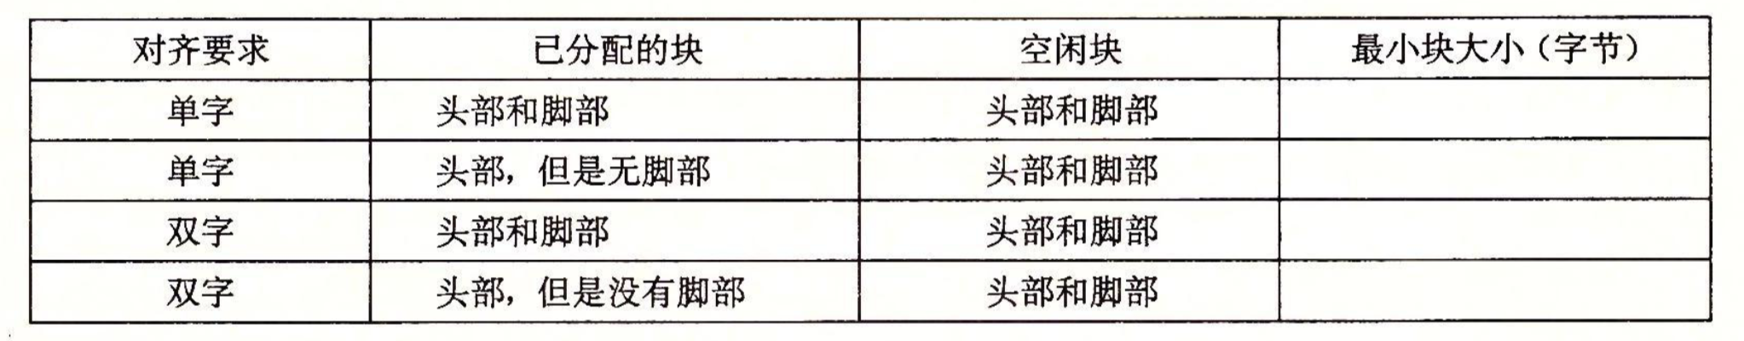
课堂练习
隐式空闲链表，不允许有效负载为0，头部和脚部都是4字节。
  对齐：指整个块大小，包括head, footer在内

Slide 43
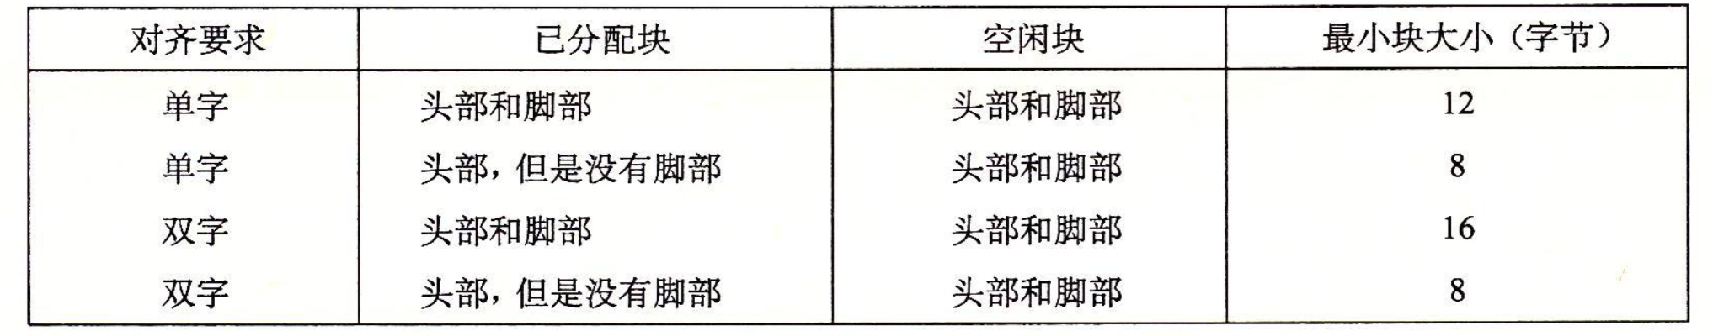
练习答案

Slide 44
Dynamic Memory Allocation:
Advanced Concepts

Slide 45
Outline
Explicit free lists
Segregated free lists

Slide 46
Keeping Track of Free Blocks
Method 1: Implicit free list using length—links all blocks
Method 2: Explicit free list among the free blocks using pointers
Method 3: Segregated free list
  Different free lists for different size classes
Method 4: Blocks sorted by size
  Can use a balanced tree (e.g. Red-Black tree) with pointers within each free block, and the length used as a key
5
4
6
2
5
4
6
2

Slide 47
Explicit Free Lists
Allocated (as before)
Free
Size
a
Size
a
Payload and
padding
Next
Prev
Size
a
Size
a
Maintain list(s) of free blocks, not all blocks
  “next” free block可能在任何地方
    不像之前implicit list中，next是在相邻的内存
    所以必须有forward/backward pointers，不能只是记录size
  仍然需要boundary tag，用于合并
  幸运的是，以上需求只针对free block，所以不需要占用有效内存空间

Slide 48
Explicit Free Lists
Logically:
Physically: blocks can be in any order
A
B
C
Forward (next) links
A
B
4
4
4
4
6
6
4
4
4
4
C
Back (prev) links

Slide 49
Allocating From Explicit Free Lists
conceptual graphic
Before
After
(with splitting)
= malloc(…)

Slide 50
Freeing With Explicit Free Lists
Insertion policy: Where in the free list do you put a newly freed block?
LIFO (last-in-first-out) policy
  Insert freed block at the beginning of the free list
  Pro: simple and constant time
  Con: studies suggest fragmentation is worse than address ordered
Address-ordered policy
  Insert freed blocks so that free list blocks are always in address order:
  addr(prev) < addr(curr) < addr(next)
  Con: requires search
  Pro: studies suggest fragmentation is lower than LIFO

Slide 51
Freeing With a LIFO Policy (Case 1)
conceptual graphic
Before
free( )
Root
Insert the freed block at the root of the list
After
Root

Slide 52
Freeing With a LIFO Policy (Case 2)
conceptual graphic
Before
free( )
Root
如果新插入的free block能够和其他free block合并，那么合并后的新块会放在队首（root指针指向的位置）
After
Root

Slide 53
Freeing With a LIFO Policy (Case 3)
conceptual graphic
Before
free( )
Root
向后合并，同样的处理方式
After
Root

Slide 54
Freeing With a LIFO Policy (Case 4)
conceptual graphic
Before
free( )
Root
同时向前、向后3个free blocks合并，同样的处理方式
After
Root

Slide 55
Explicit List Summary
与implicit list比较:
  分配的时间开销与free blocks数量线性相关，而不是与所有blocks
    当内存占用比较满的情况下，时间复杂度低很多
  释放块的复杂度略有增加，因为要遍历寻找合并目标
  链接需要一些额外的空间 (2 extra words needed for each block)
    会增加internal fragmentation吗?
这种方面一般是作为segregated free lists中每个独立队列的解决方案（很少独立使用）
  每个size范围的块用一个explicit free list进行管理

Slide 56
Today
Explicit free lists
Segregated free lists

Slide 57
Keeping Track of Free Blocks
Method 1: Implicit list using length—links all blocks
Method 2: Explicit list among the free blocks using pointers
Method 3: Segregated free list
  Different free lists for different size classes
Method 4: Blocks sorted by size
  Can use a balanced tree (e.g. Red-Black tree) with pointers within each free block, and the length used as a key
5
4
6
2
5
4
6
2

Slide 58
Segregated List (Seglist) Allocators
Each size class of blocks has its own free list
Often have separate classes for each small size
For larger sizes: One class for each two-power size
e.g., Memcached (slab)
1-2
3
4
5-8
9-inf

Slide 59
Segregated List (Seglist) Allocators
#1. 简单分离存储（Simple Segregated Storage）
#2. 分离适配（Segregated Fit）
#3. 伙伴系统（Buddy System）

Slide 60
Segregated List (Seglist) Allocators
#1. 简单分离存储（Simple segregated storage）
  每个大小类的空闲链表包含大小相等的块
    如{17~32}类，所有块的大小都是32
  按照目标大小选择对应的类，从中分配一个块，空闲空间就浪费（内部碎片）
    如目标大小是20，则分配一个32的块
    如果该类中没有空间，就向OS申请一个这样大小的内存
  优点：
    分配和释放都很快速，常数时间
    操作简单，不分割，不合并
    已分配块不需要头尾（因为大小从类别中可知，也不合并）
    分配和释放都在free list头部进行，所以只需要单项链表
  缺点：内部碎片和外部碎片（因为不合并）

Slide 61
Segregated List (Seglist) Allocators
#2. 分离适配（Segregated Fit）
  每个free list中是一个空间范围的free blocks
  To allocate a block of size n:
    搜索free list，直到找到合适的block (m > n)
    如果找到了一个合适的block:
      按照实际大小n分割块
      剩下的部分放到合适的队列中（optional）
    如果找不到块，就尝试下一级更大的队列
    不断重复，直到找到合适的free block
  If no block is found:
    向OS申请额外的heap memory (using sbrk())
    从新内存中分配n bytes
    把剩下的部分放到合适的队列中

Slide 62
Seglist Allocator (cont.)
To free a block:
  Coalesce and place on appropriate list
Advantages of seglist allocators
  Higher throughput
    log time for power-of-two size classes
    2^{n}，粗粒度，但简单高效（抓住主要矛盾
  Better memory utilization
    First-fit search of segregated free list approximates a best-fit search of entire heap.
    Extreme case: Giving each block its own size class is equivalent to best-fit.
C标准库中的GNU malloc采用

Slide 63
Buddy System
伙伴系统，是分离适配的一个特例
  每个大小类都是2的整数幂
堆空间共2^{m}，组织为2^{k}大小的一组块（0<=k<=m）
  最开始只有一个2^{m}大小的块
为了分配2^{k}大小的块，分配我们找到的第一个2^{j}大小的可用块（k<=j<=m）
  如果j=k，那么分配完成
  如果j>k，就递归二分这个块，直到j=k
  每次剩下的半块（即伙伴）被放到相应的free list中
当释放一个2^{k}的块，就找到其伙伴进行合并，递归进行，直到遇到已分配的伙伴为止

Slide 64
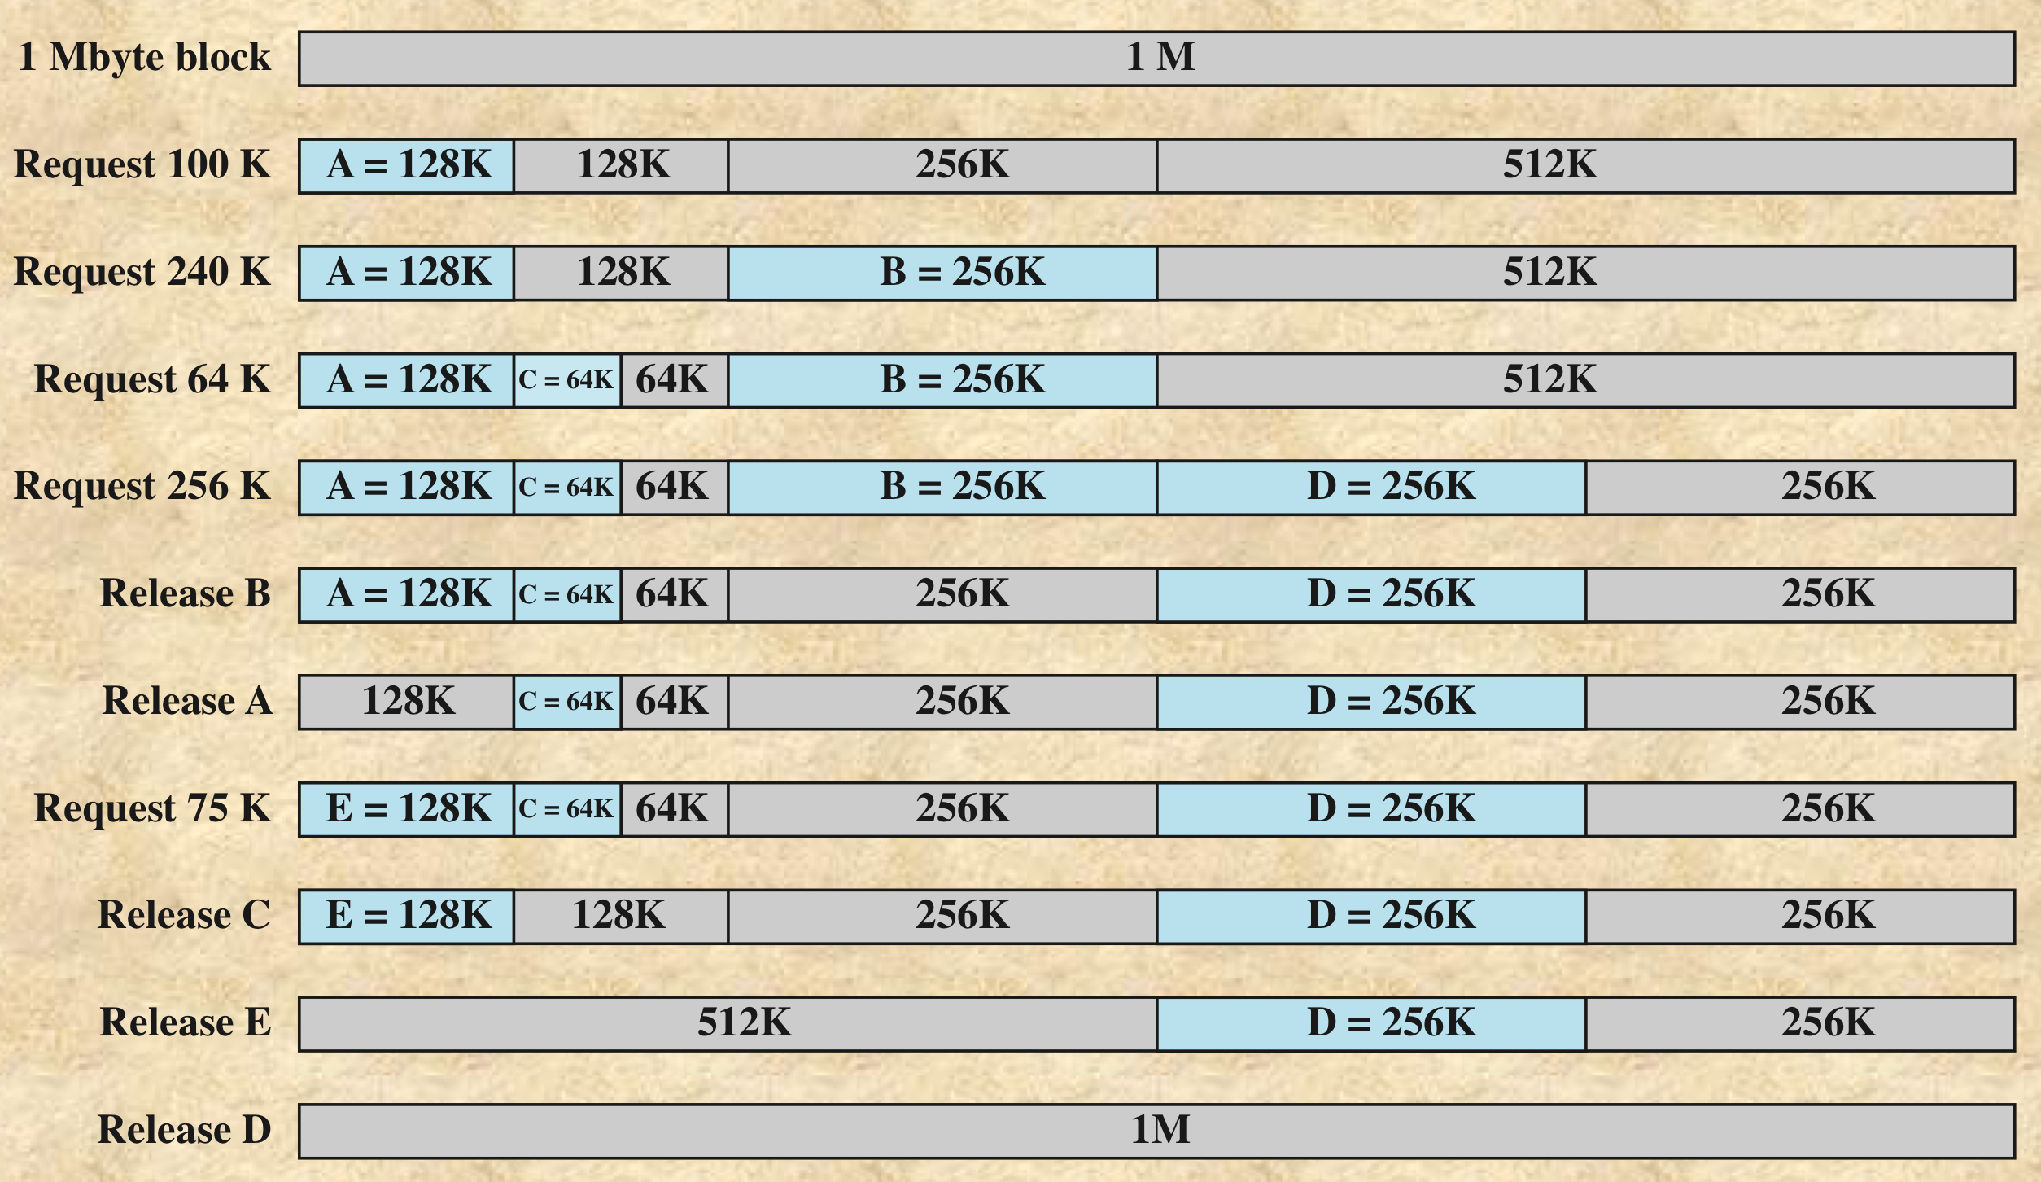
Buddy System
例子，总空间是1MB（2²⁰）

Slide 65
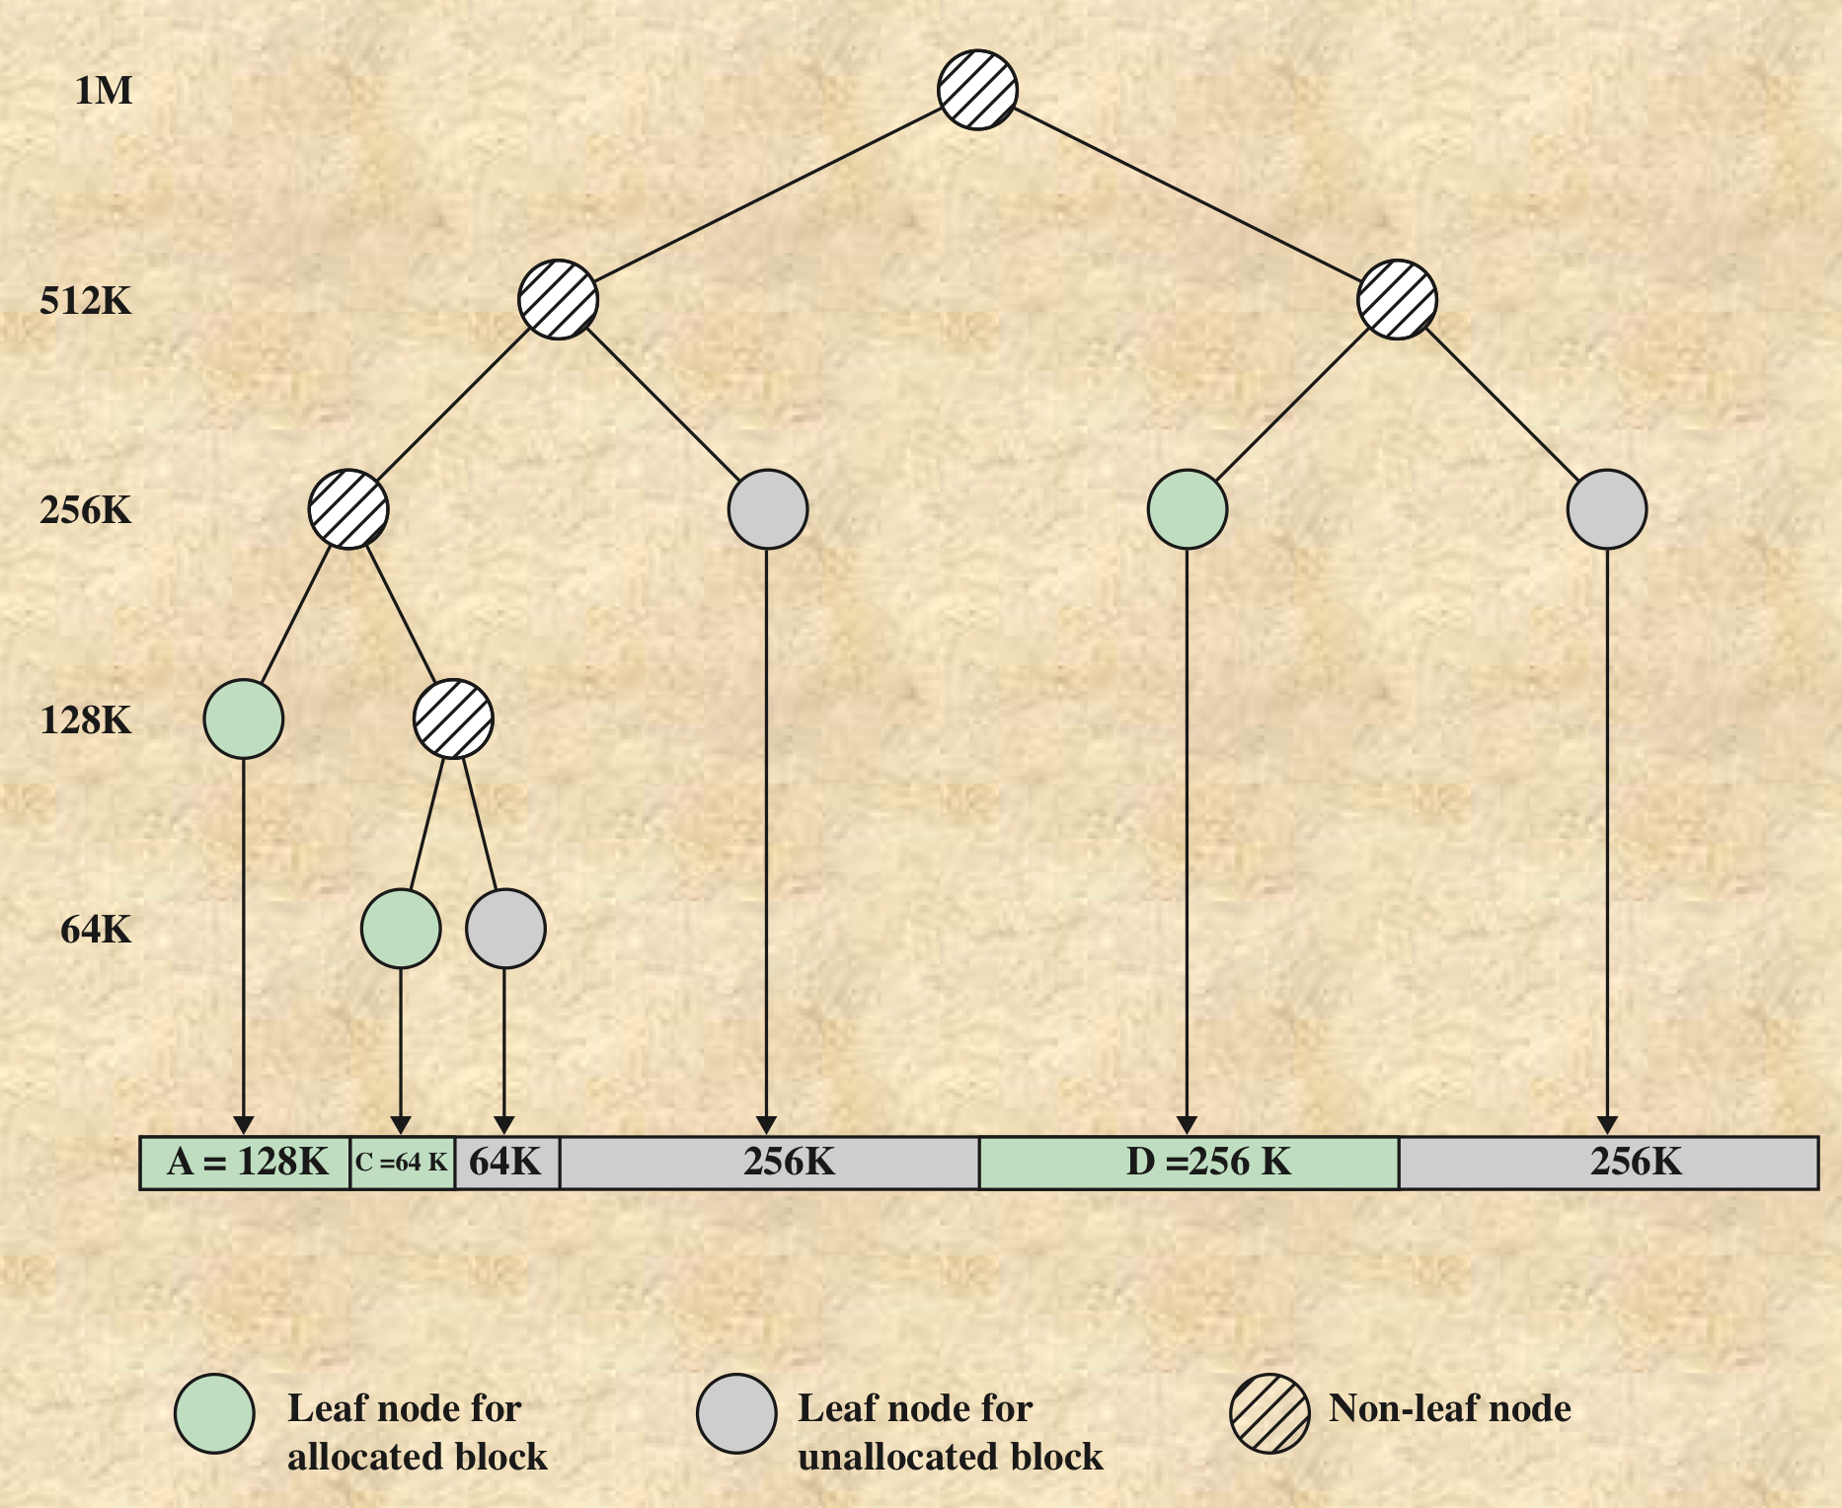
Buddy System
Tree Representation of Buddy System

Slide 66
Buddy System
如何找到伙伴？
  给定一个块的地址和大小，很容易计算其伙伴的地址
  如一个4B的块，地址为
    xxx…x000
  则它的伙伴地址为
    xxx…x100
  只有一位不同

Slide 67
Buddy System
优点：
  整齐，快速搜索和快速合并（美感
缺点：
  整齐，产生内部碎片
不适合通用目的的分配器，如果应用的分配单位以2的整数幂为主，则很适合

Slide 68
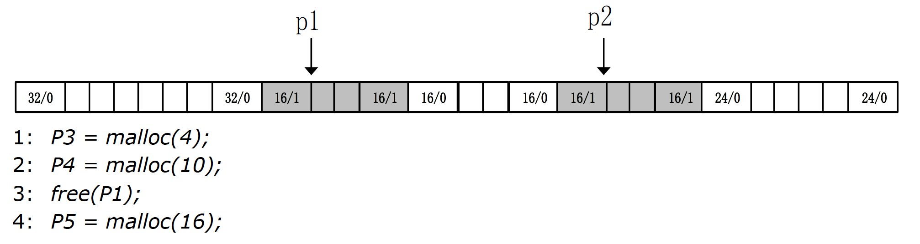
课堂练习
给出当前时间的heap状态，灰色表示allocated blocks，白色是free blocks，每个块是4 bytes。分配器保持double word alignment。运行给出代码。
请画出在first fit和best fit两种模式下，执行每条语句后的内存分布，并且计算峰值利用率

Slide 69
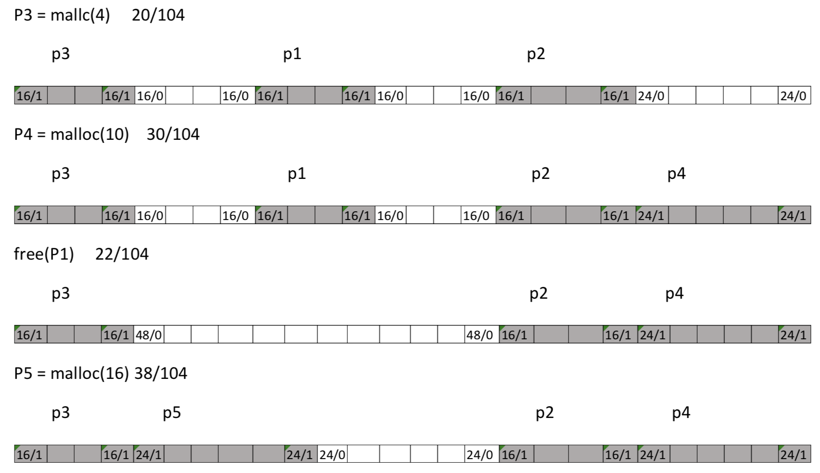
练习答案
First-fit

Slide 70
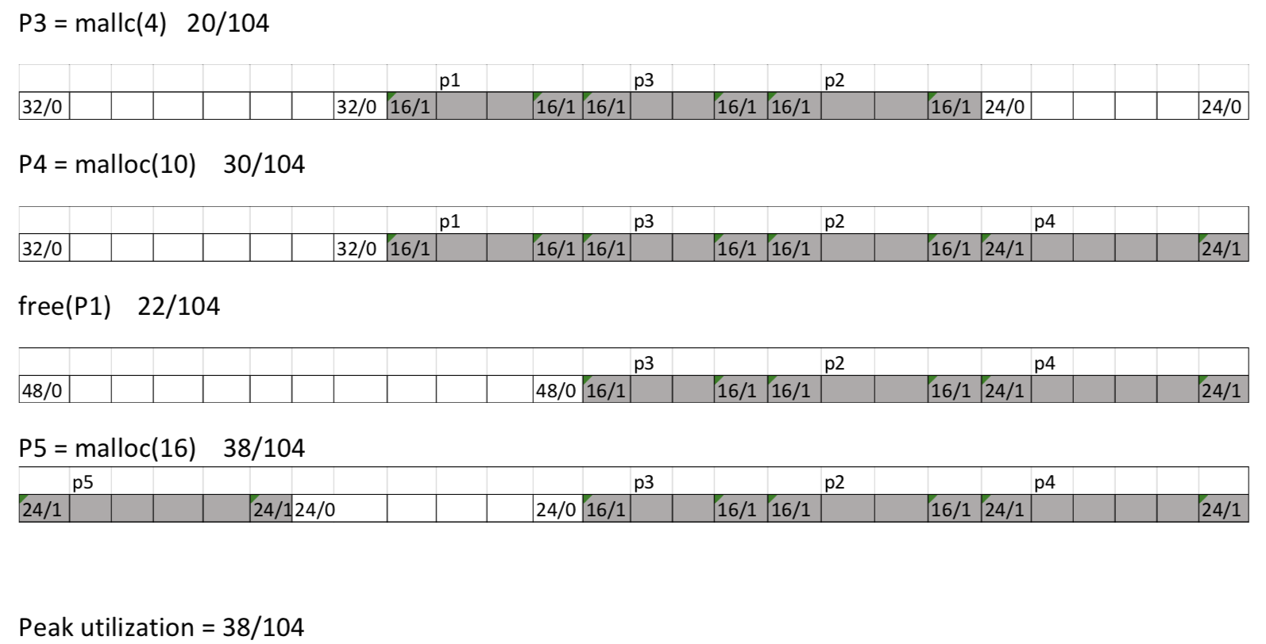
练习答案
best-fit

