Slide 1
wikitext-2 dataset training via RNN/LSTM & Transformer
姓名 | 宋志麒
学号 | 221017000226

Slide 2
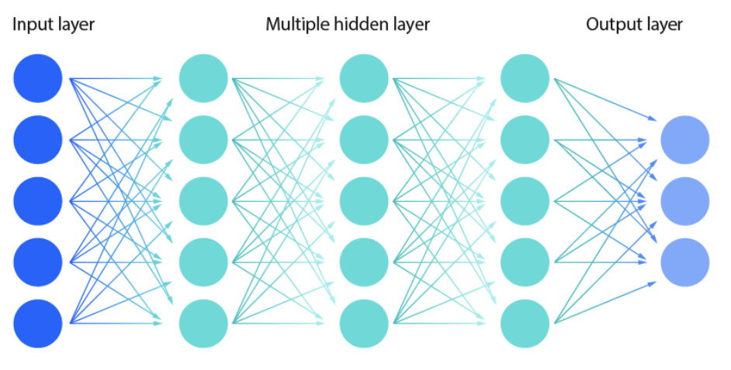
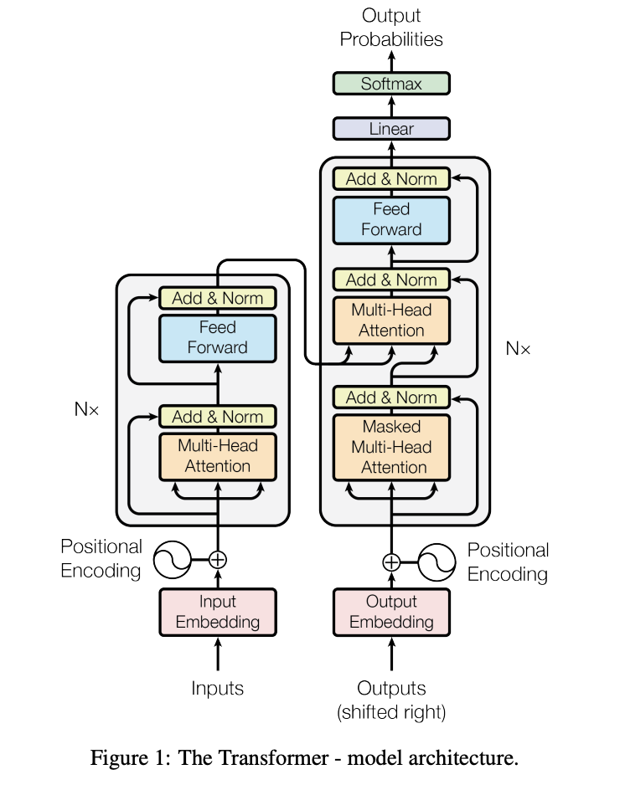
Background | Dataset | DL Model | Training | Save Model | Generate Text
https://arxiv.org/pdf/1706.03762.pdf
illustrates the process of training a multi-layer RNN/LSTM, Transformer DL model
Generate new text base on trained model
Original version from PrTorch Examples(Word-Level Modeling using RNN and Transformer)
Limited knowledge of AI/ML/DL/NPL

Slide 3
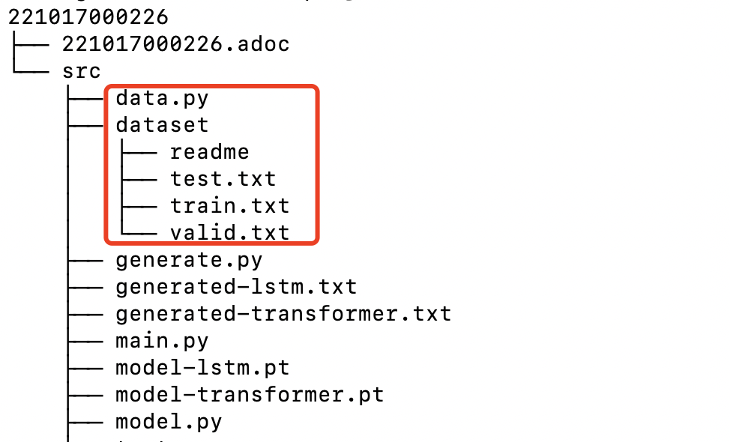
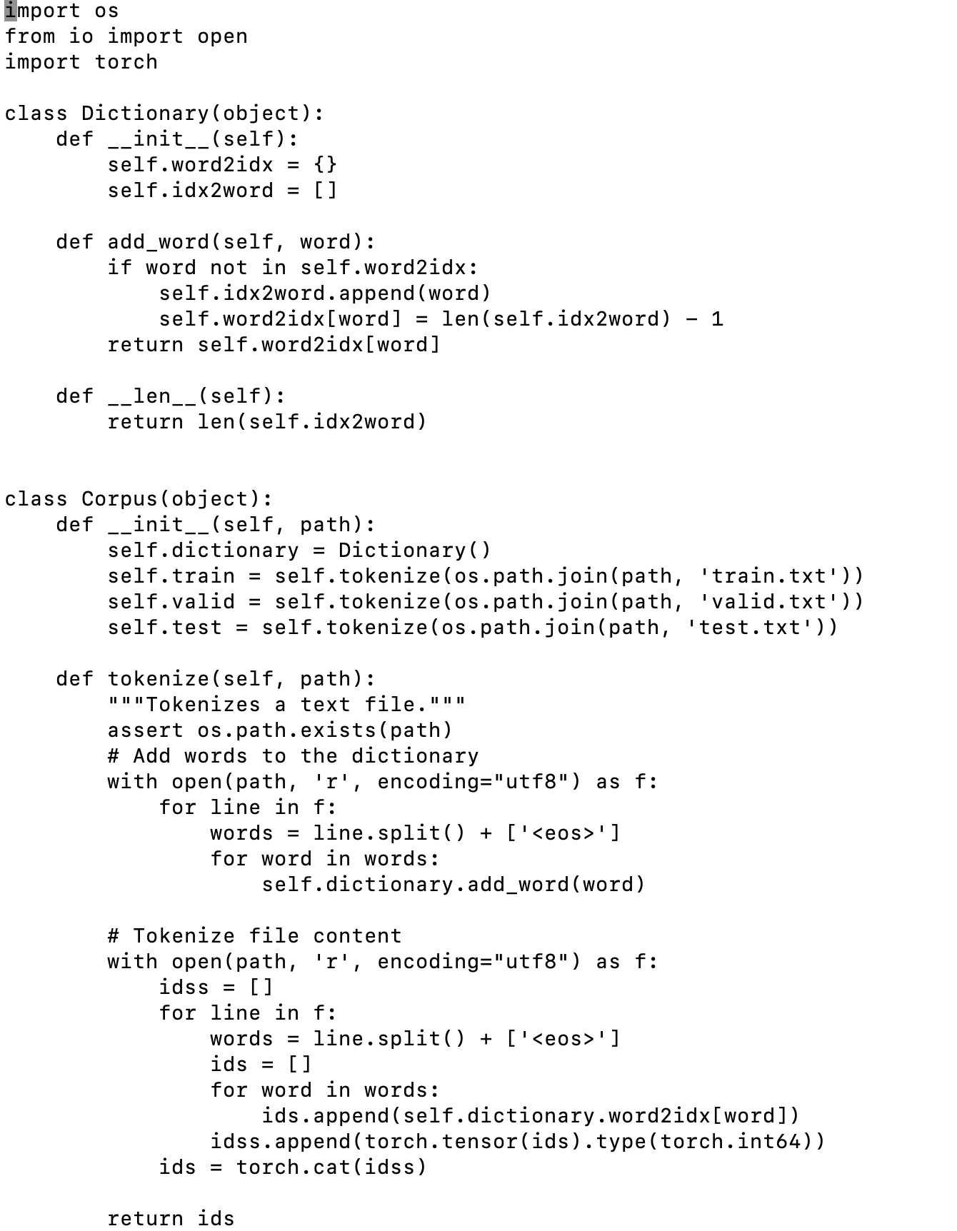
Background | Dataset | DL Model | Training | Save Model | Generate Text
The Wikitext-2 dataset is a collection of text data extracted from Wikipedia. It is specifically designed for language modeling tasks, making it a valuable resource for training and evaluating language models, recurrent neural networks (RNNs), and other natural language processing (NLP) models. Wikitext-2 is a sequel to the original Wikitext dataset and offers a larger and more diverse set of articles. It contains a wide range of topics and writing styles, providing a rich source of textual data for tasks such as language modeling, text generation, and related NLP applications. Download: https://s3.amazonaws.com/research.metamind.io/wikitext/wikitext-2-raw-v1.zip

Slide 4
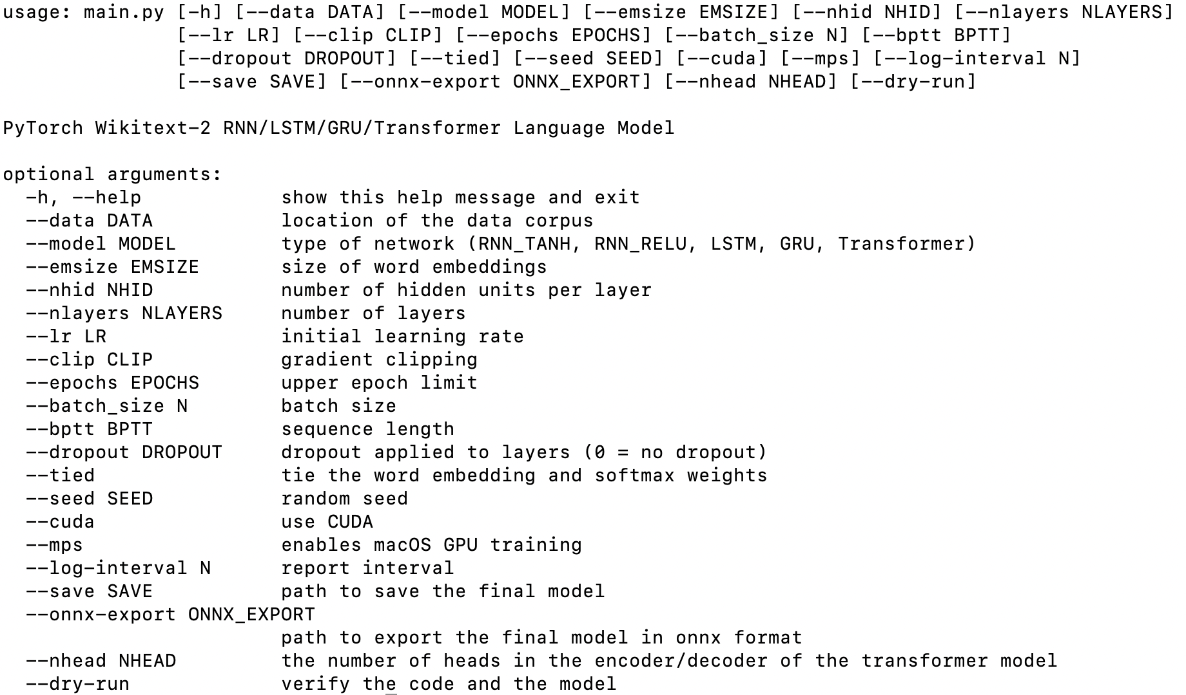
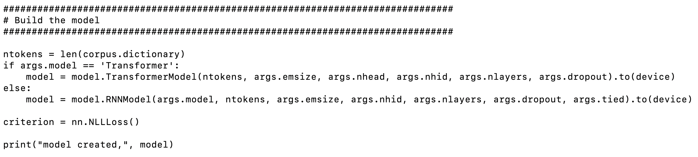
Background | Dataset | DL Model | Training | Save Model | Generate Text

Slide 5
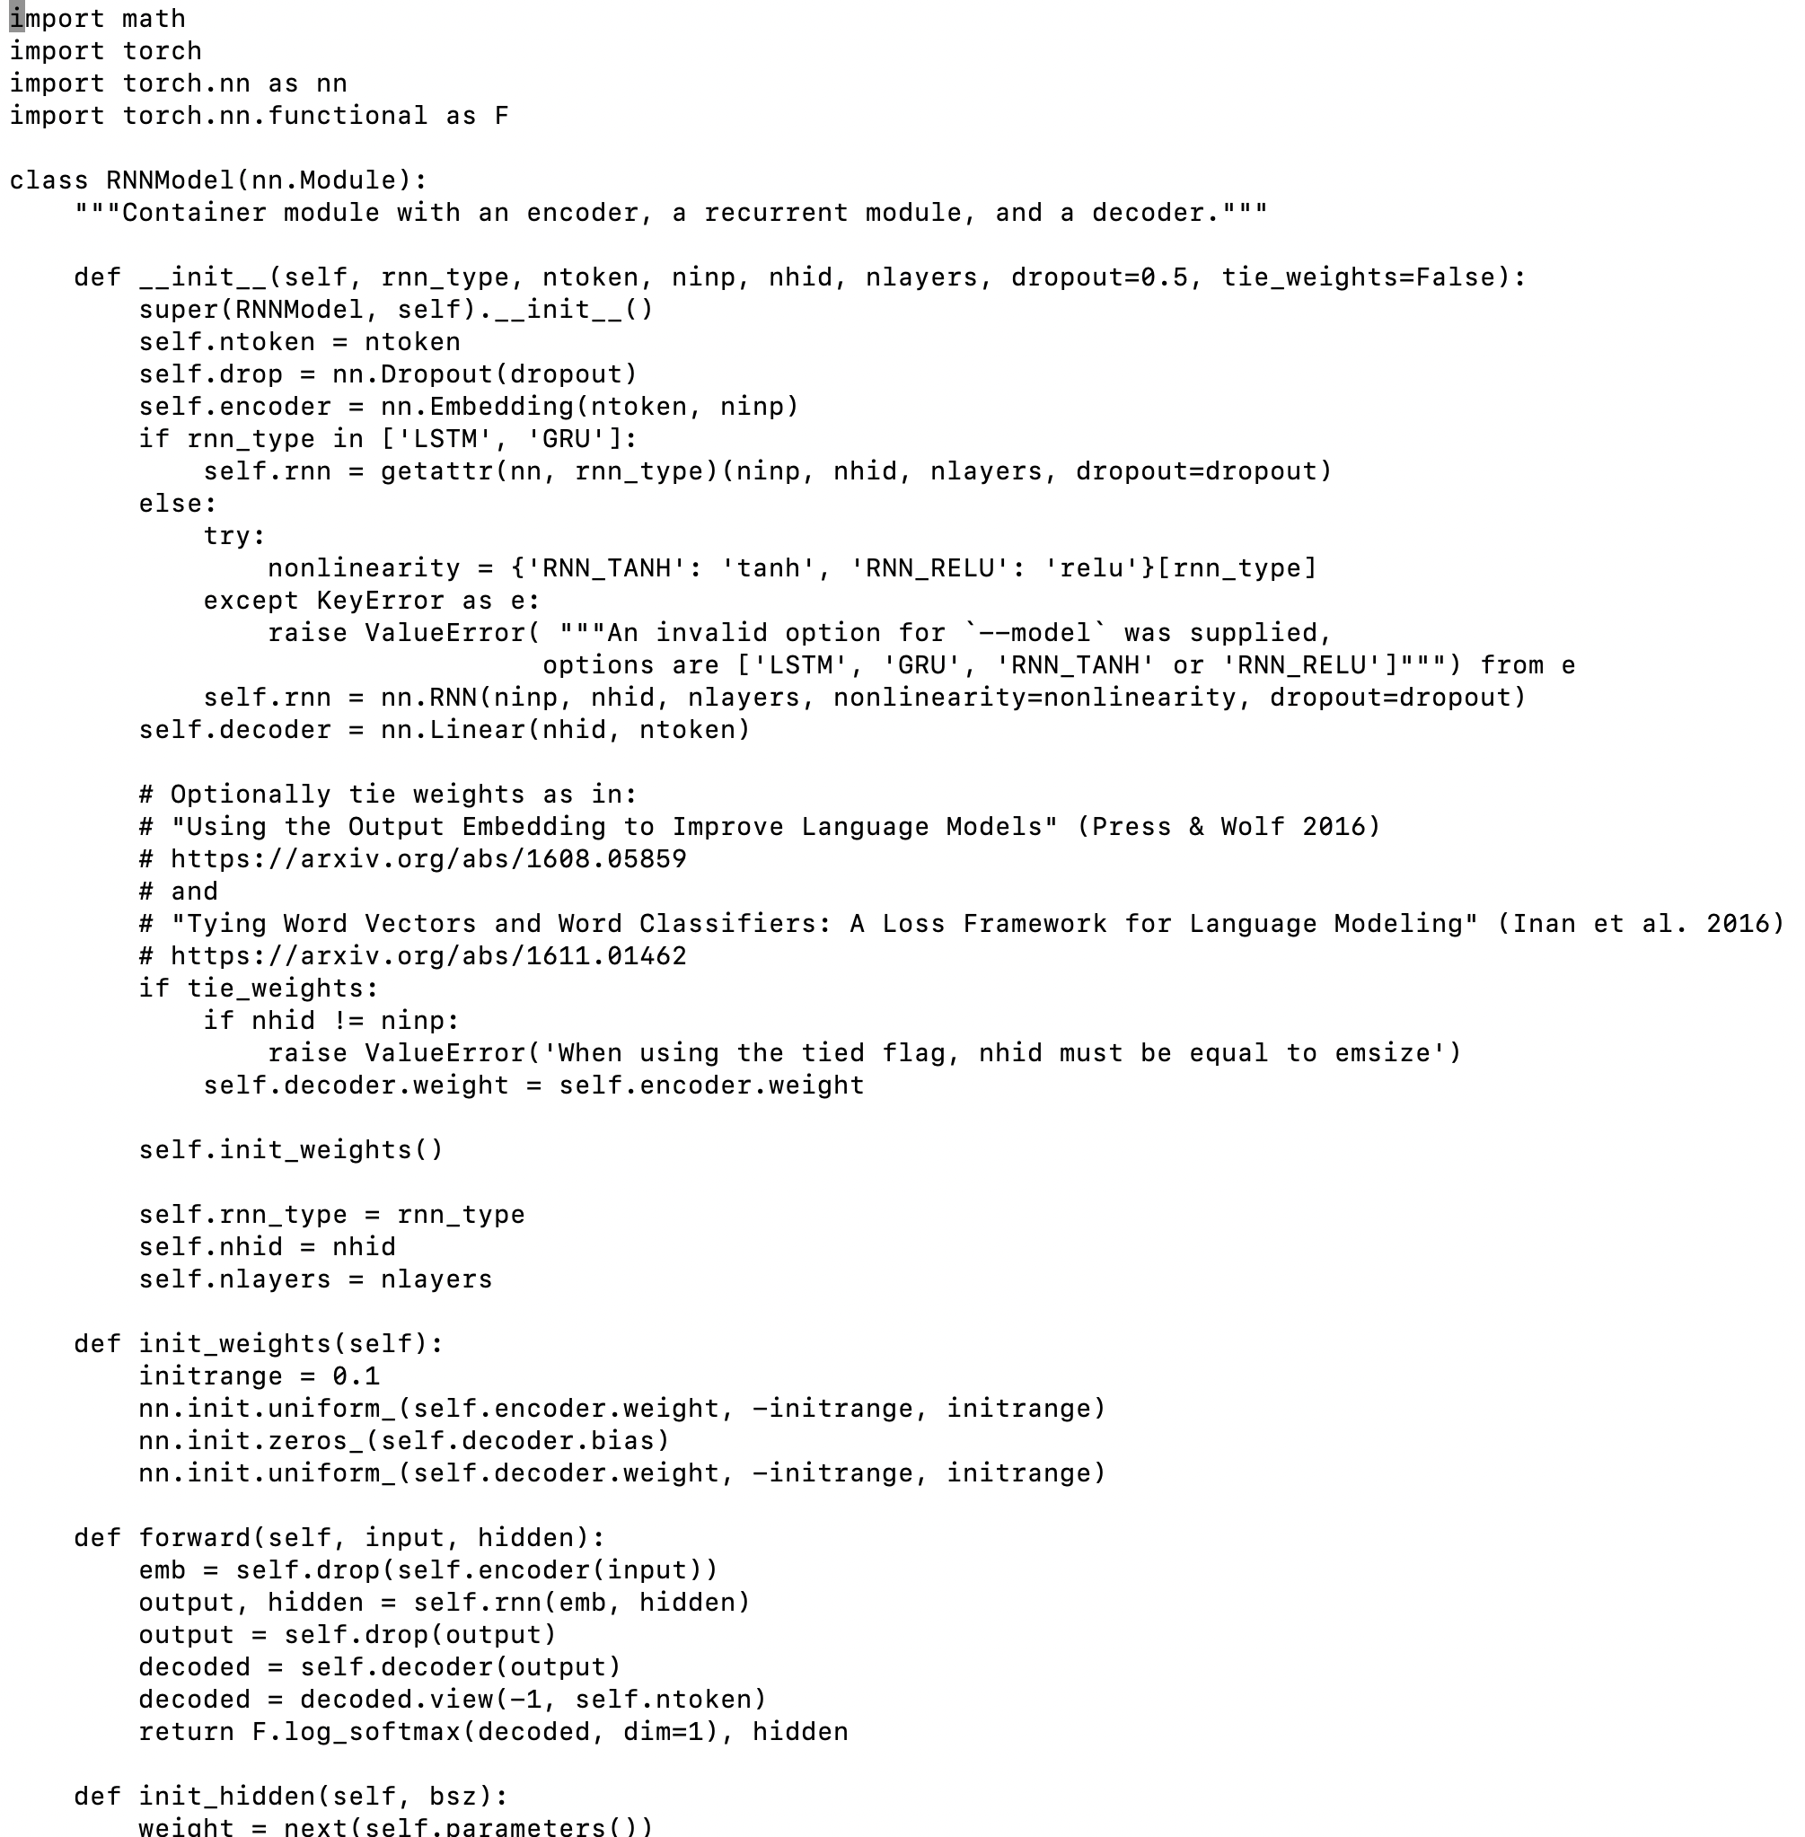
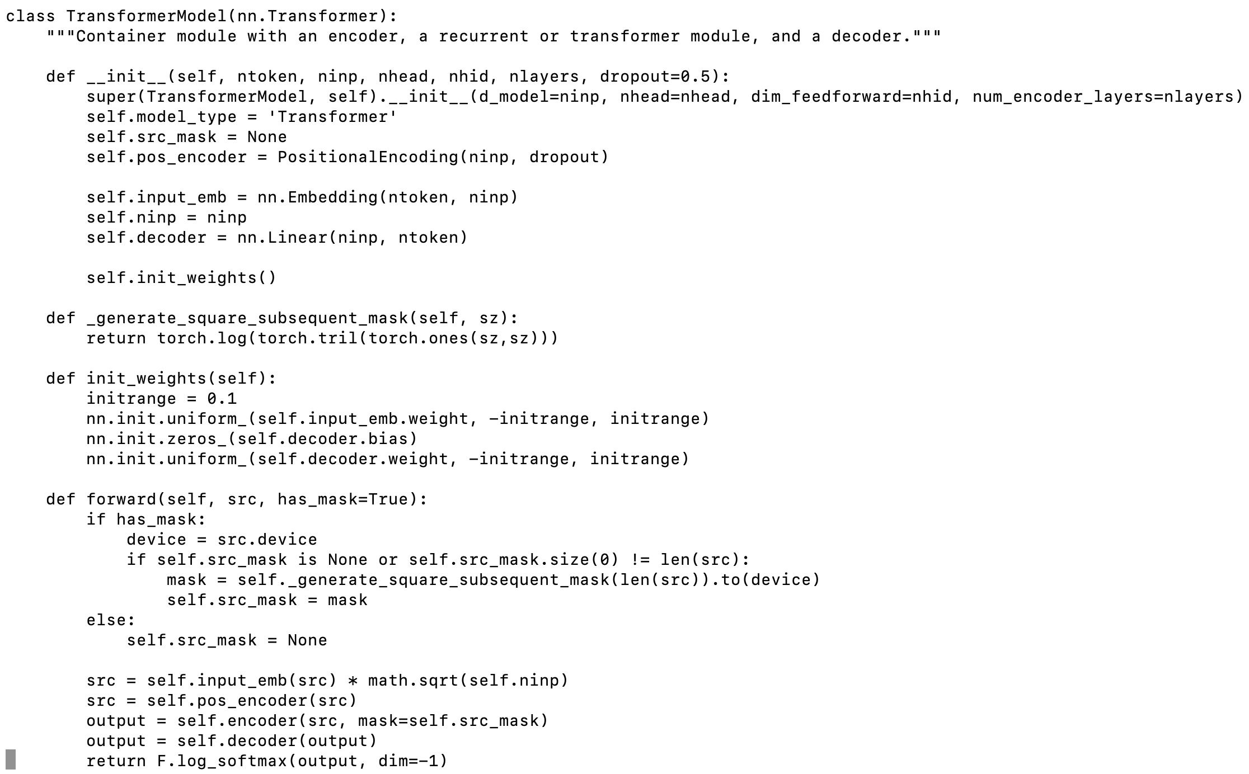
Background | Dataset | DL Model | Training | Save Model | Generate Text

Slide 6
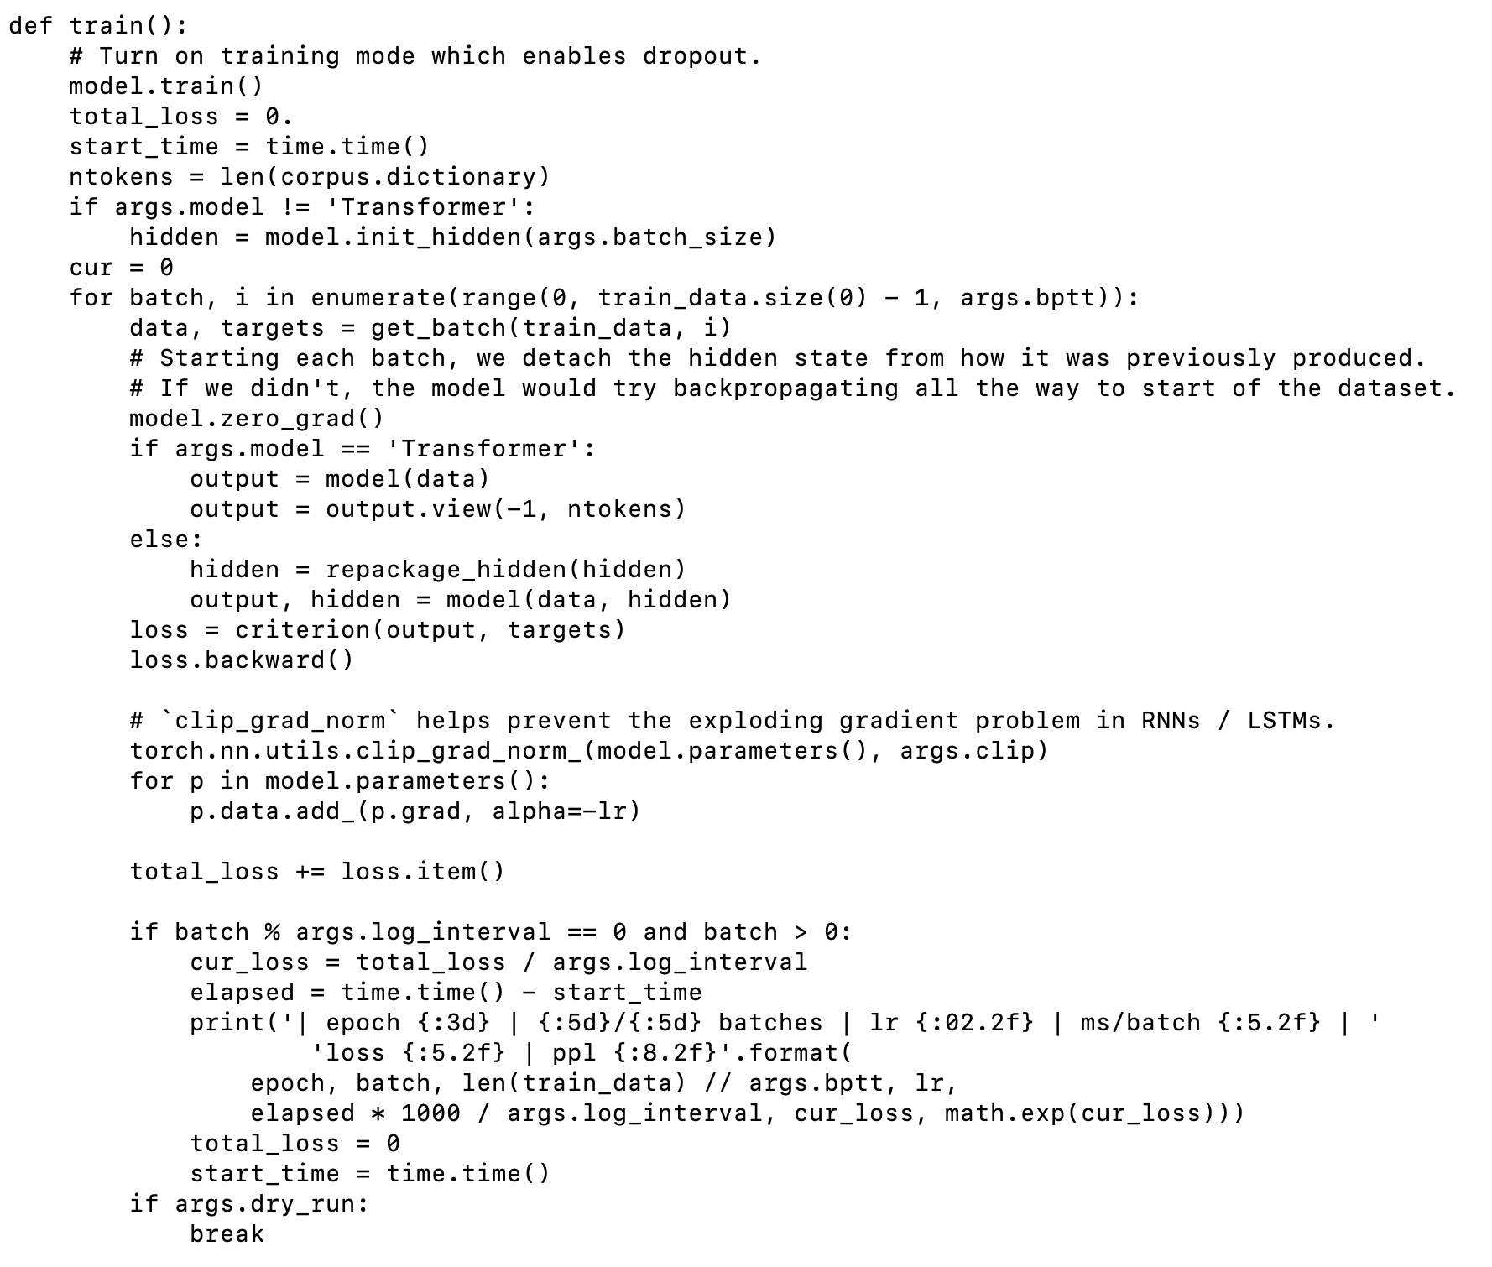
Background | Dataset | DL Model | Training | Save Model | Generate Text

Slide 7
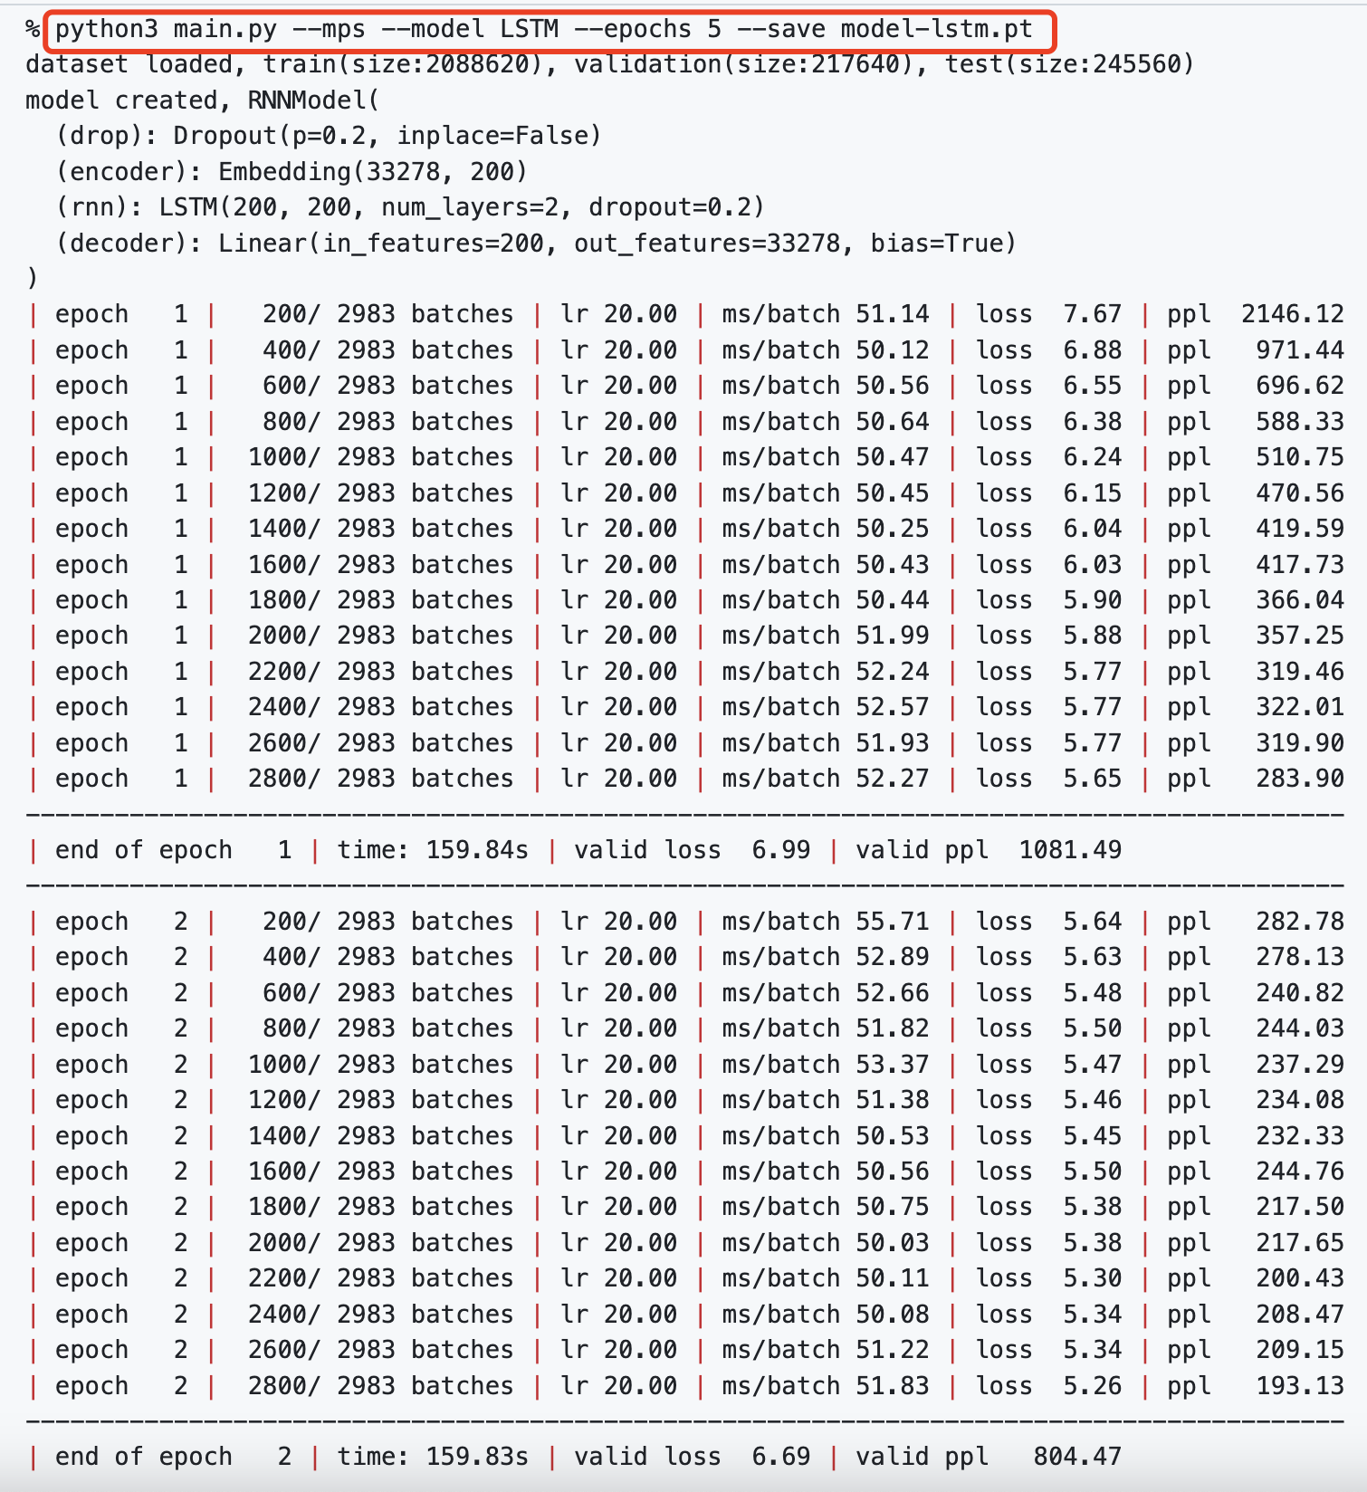
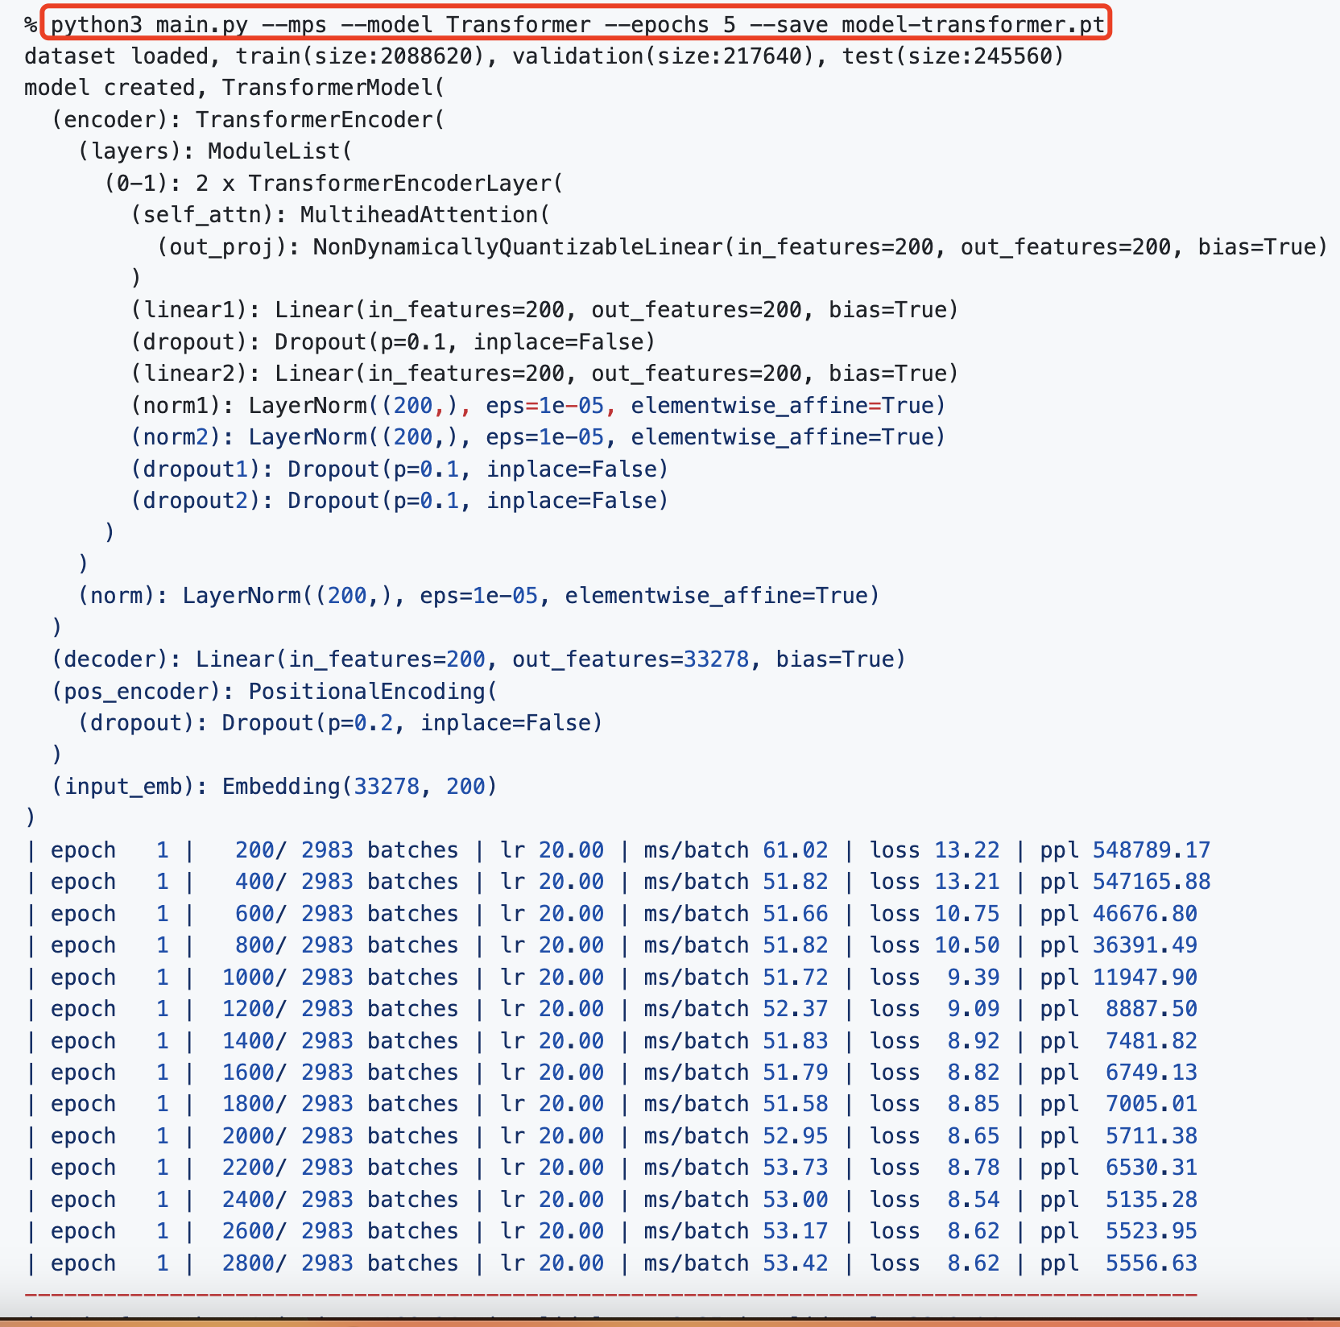
Background | Dataset | DL Model | Training | Save Model | Generate Text

Slide 8
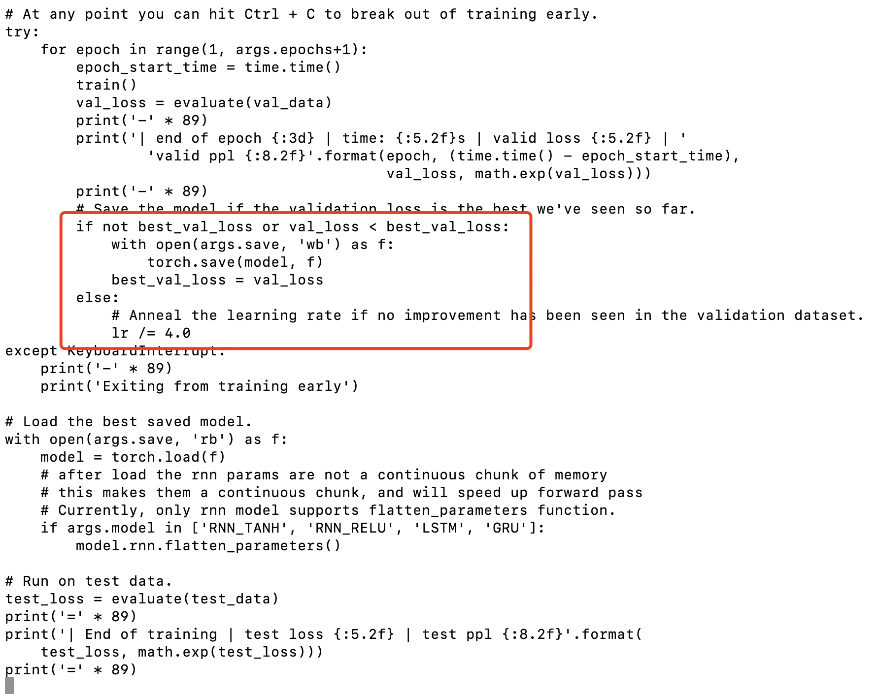
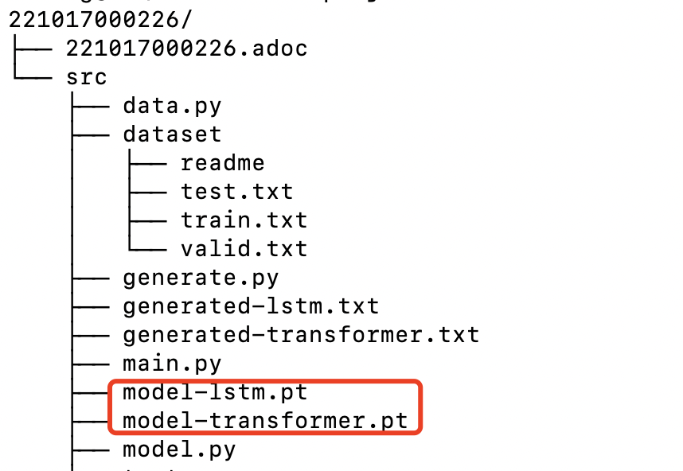
Background | Dataset | DL Model | Training | Save Model | Generate Text

Slide 9
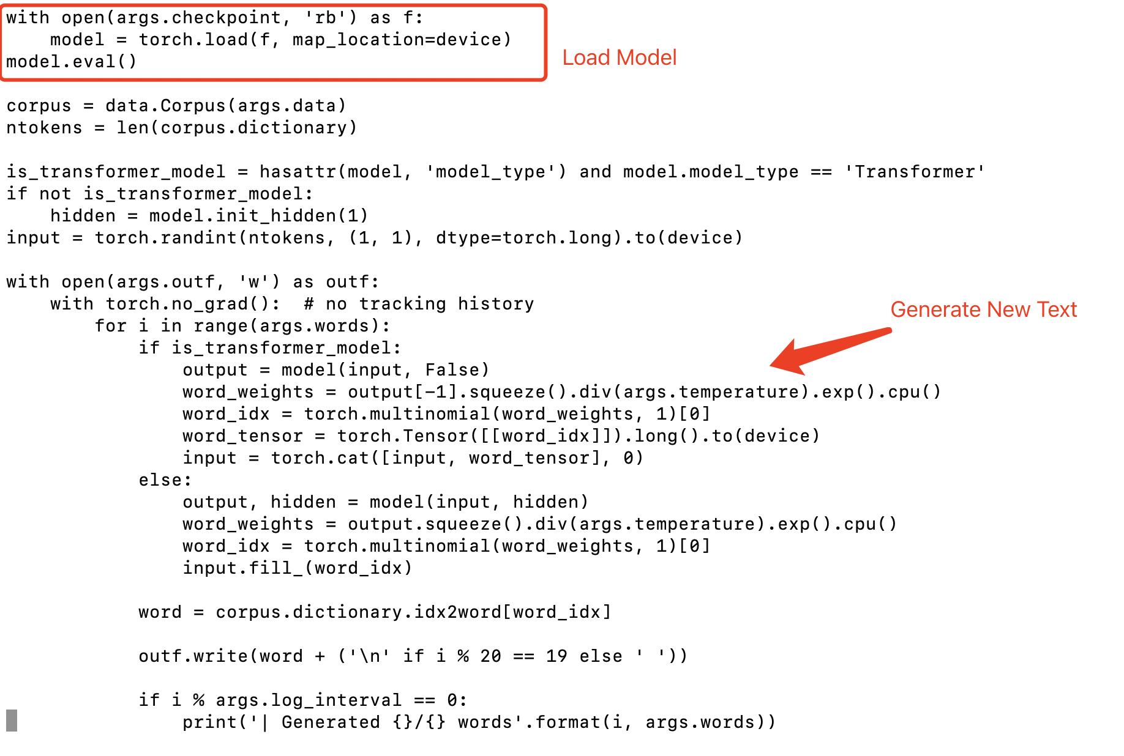
Background | Dataset | DL Model | Training | Save Model | Generate Text

Slide 10
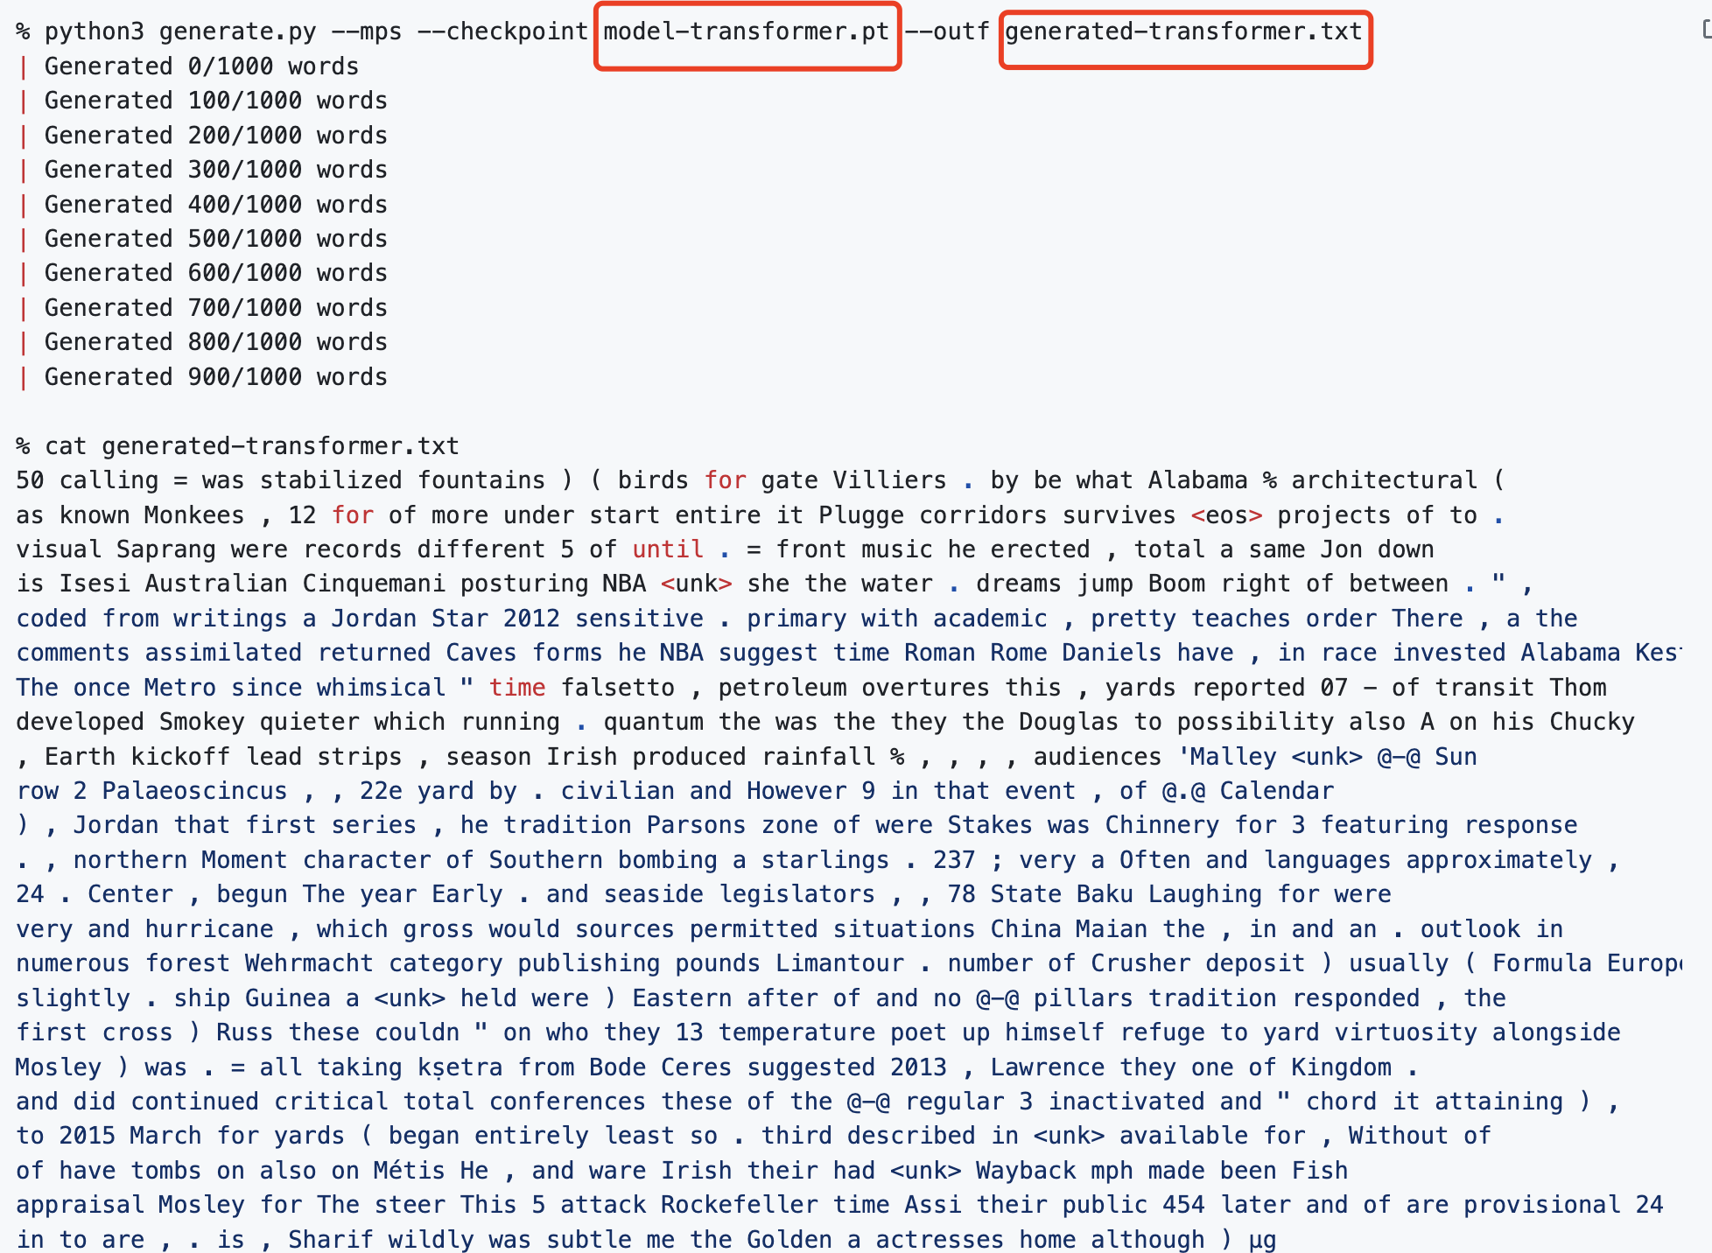
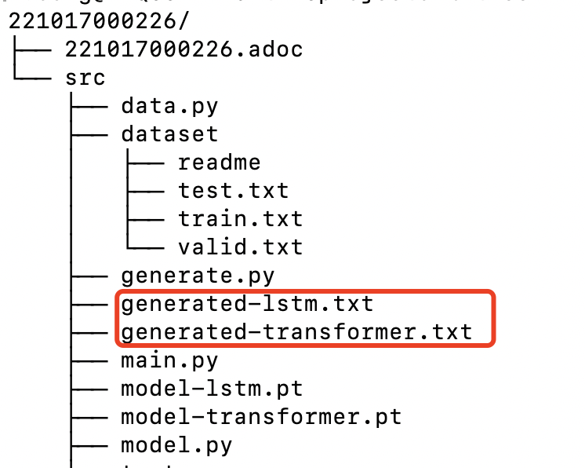
Background | Dataset | DL Model | Training | Save Model | Generate Text

Slide 11
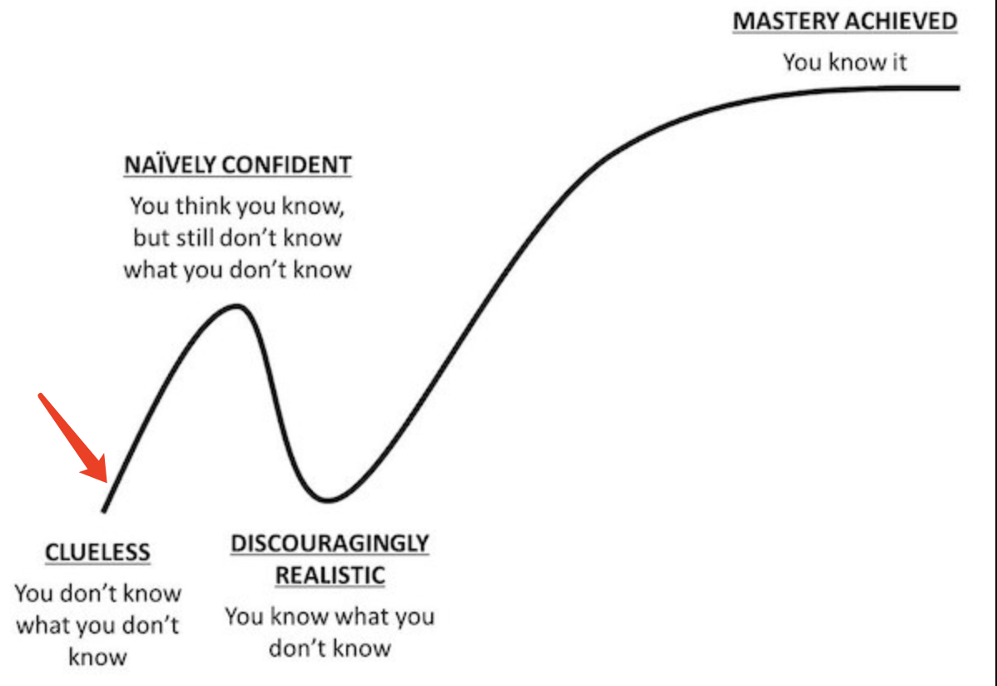
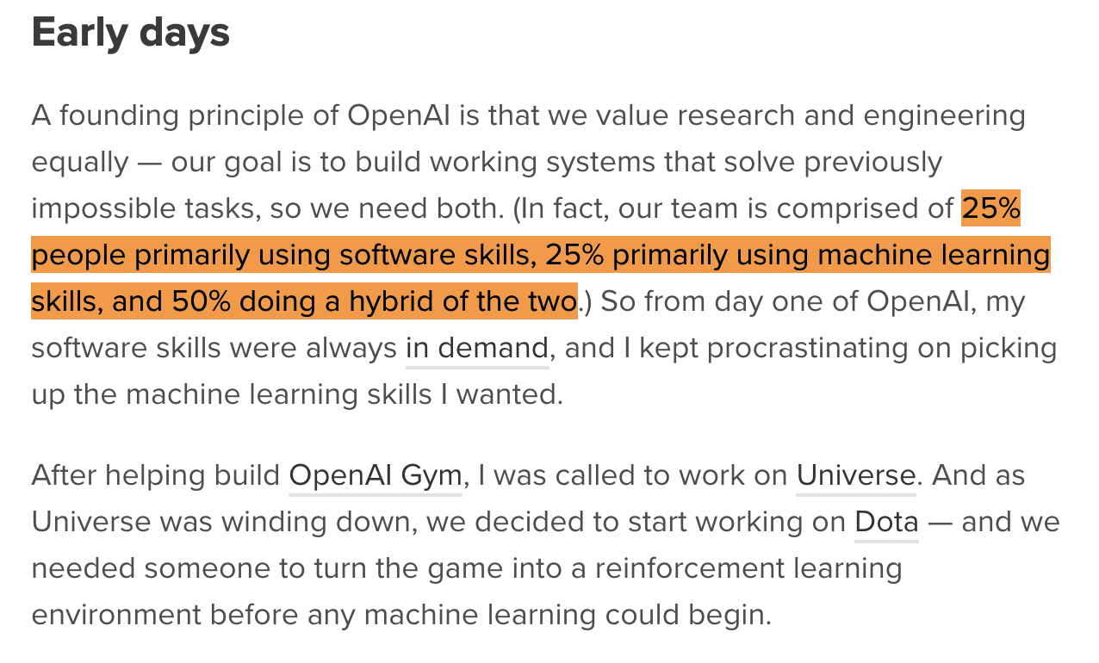

Sum up
Learning curve
https://blog.gregbrockman.com/how-i-became-a-machine-learning-practitioner
https://github.com/info-ruc/tm23projects/pull/1

Slide 12
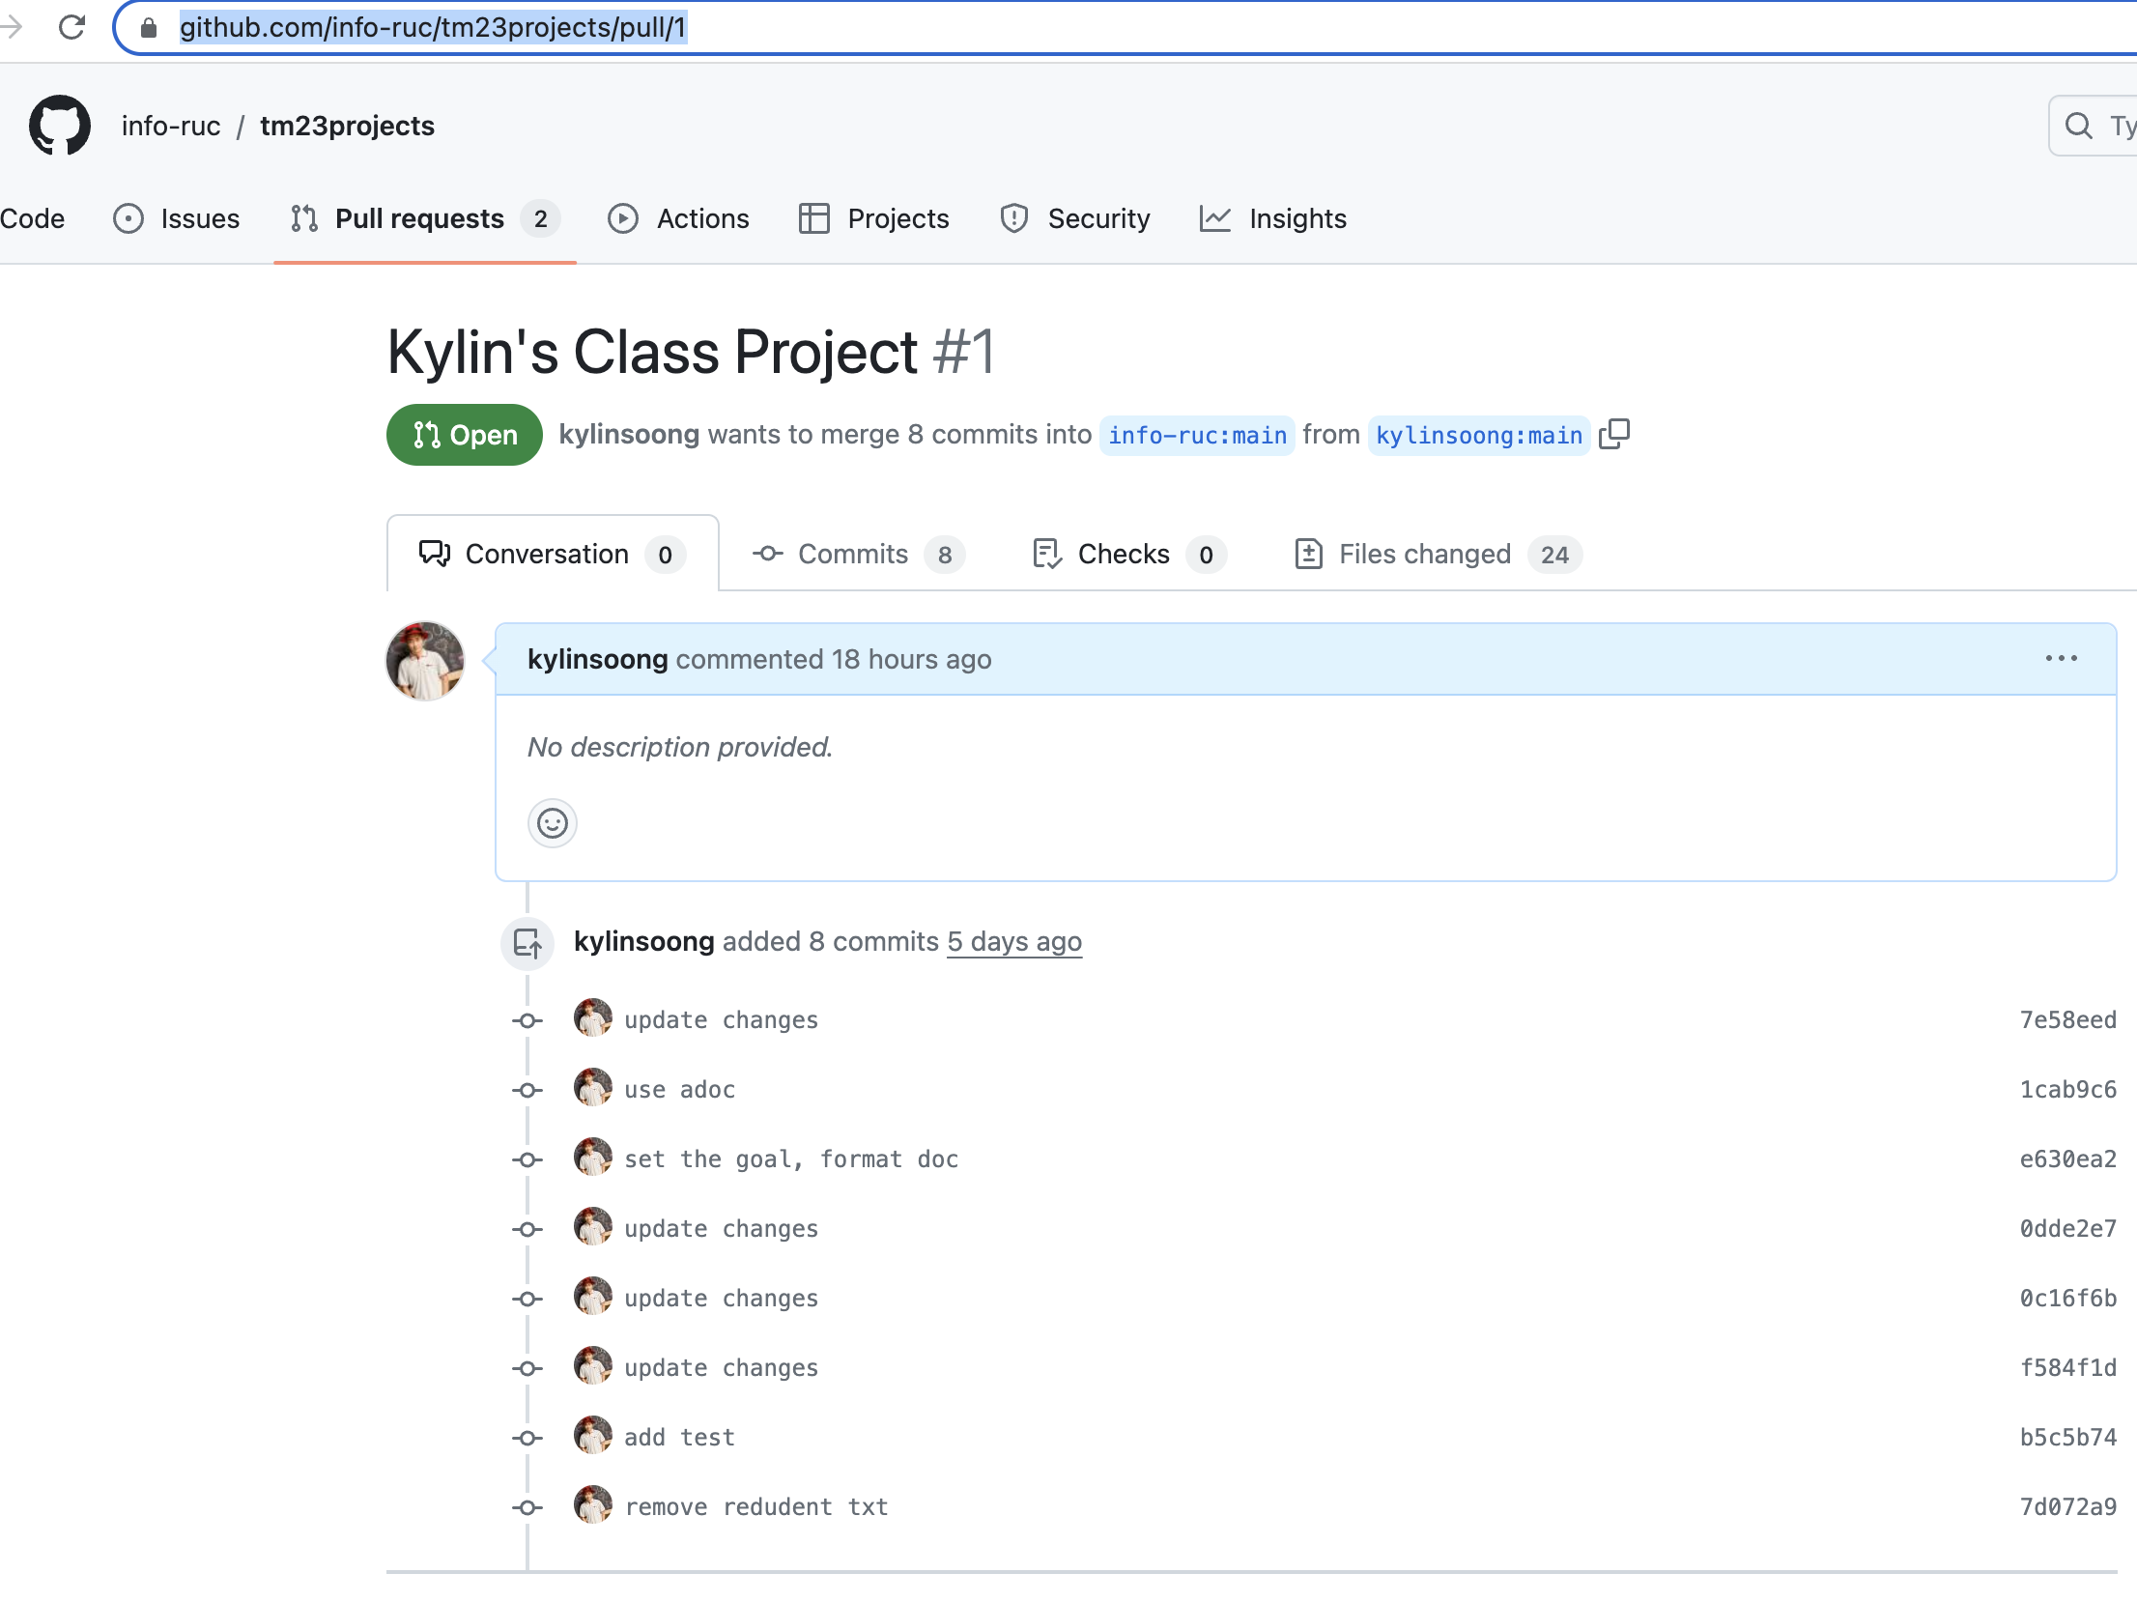
Sum up
https://github.com/info-ruc/tm23projects/pull/1

