Slide 1
CIMC
CARVANA IMAGE MASKING CHALLENGE
BHAVYA(1401063), DEVAL(1401060)
KARAN(140113), PARTH(1401054)

Slide 2
Motivation
Problem proposed by a successful start-up-"Carvana", hence a relevant issue in the industry.
Looking to solve the problem with minimal computational power, hence the same issue when encountered by new ventures can also be tackled.

Slide 3
Problem Statement
Accurately segment the car from the given set of images with 16 different angles.

Slide 4
Result Generation Norms
320 images i.e. 16 different automobiles ranging from Sedan, SUV to Hatchback were taken in consideration.
Results generated by WaterShed Algorithm uses Meyer’s approach.
For comparison we have considered OTSU in Global Thresholding technique.

Slide 5
Meyer’s WaterShed
A set of markers, pixels where the flooding shall start, are chosen. Each is given a different label.
The neighboring pixels of each marked area are inserted into a priority queue with a priority level corresponding to the gradient magnitude of the pixel.
The pixel with the lowest priority level is extracted from the priority queue. If the neighbors of the extracted pixel that have already been labeled all have the same label, then the pixel is labeled with their label. All non-marked neighbors that are not yet in the priority queue are put into the priority queue.
Redo step 3 until the priority queue is empty.

Slide 6
Results
By Watershed Algorithm

Slide 7
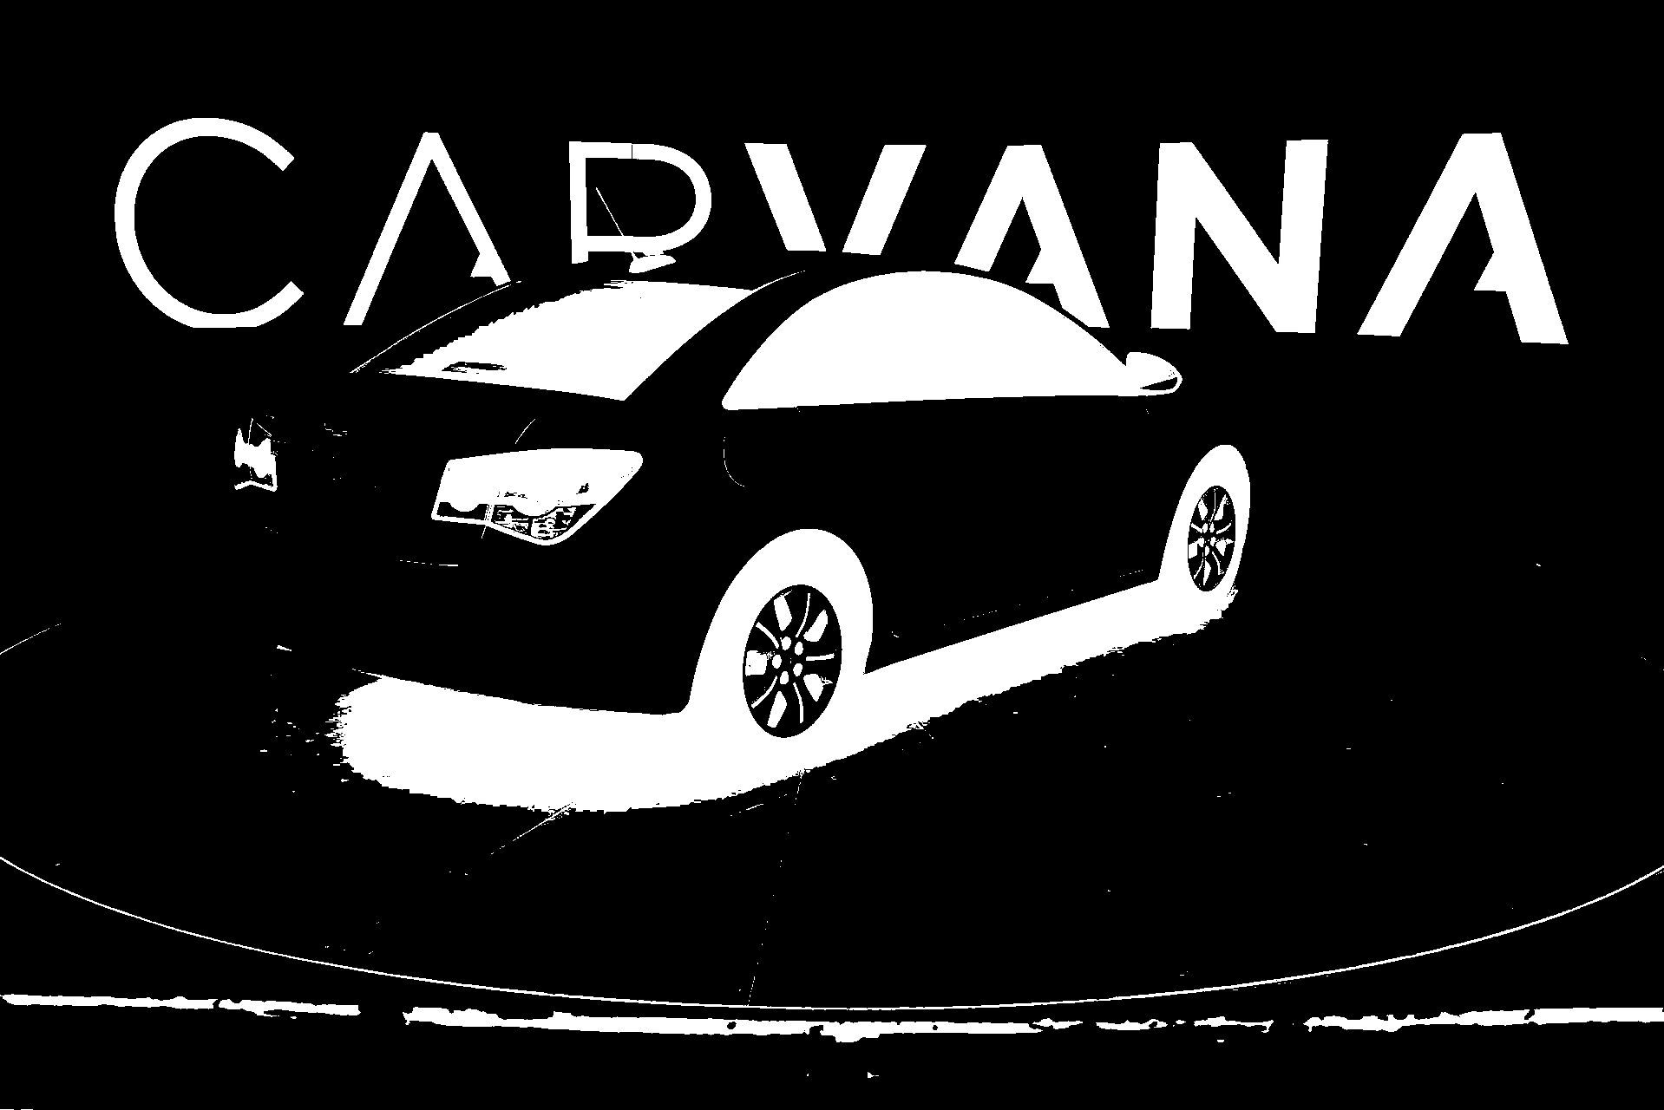

Slide 8
Global Thresholding
Global Thresholding by mean gave fairly good result for camera angle 2,5,9 and 14.
But as we need to consider a generalized approach we considered OTSU thresholding technique giving decent results for almost all camera angle.
OTSU simply reduces intra-class variance and maximizes inter-class variance.

Slide 9
Results
Generated by Thresholding Techniques

Slide 10
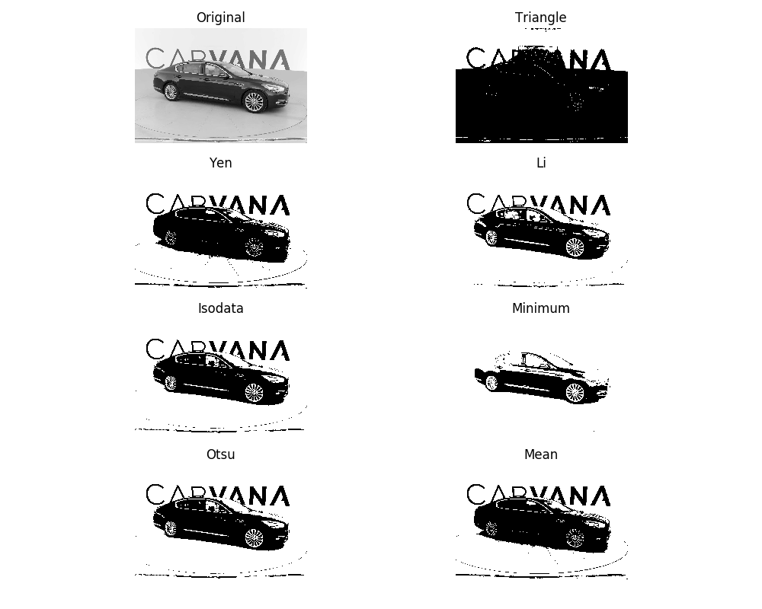

Slide 11
Results
Integration of Multiple Cues

Slide 12
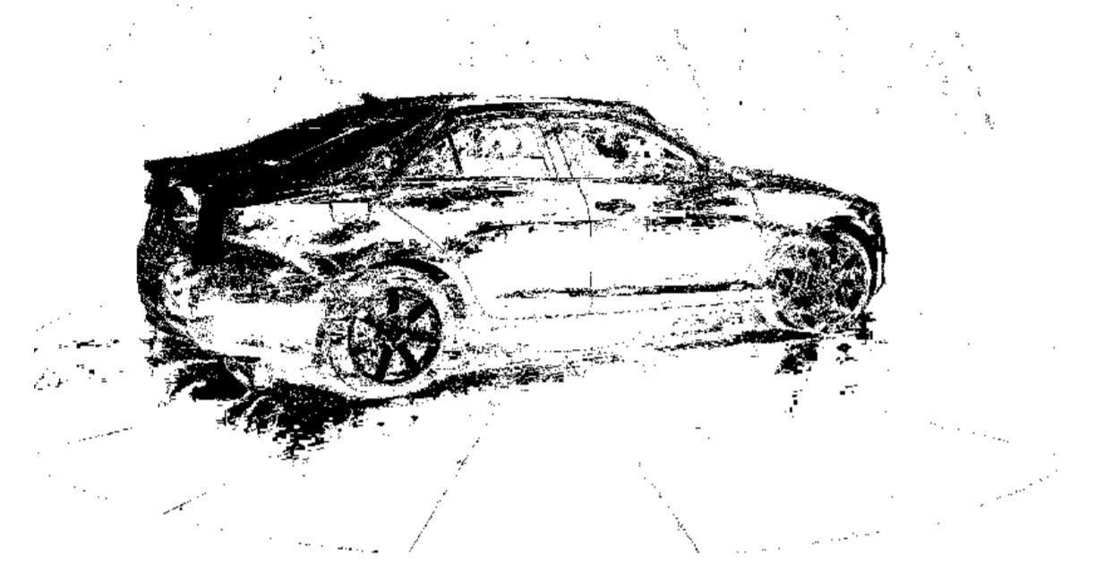

Slide 13
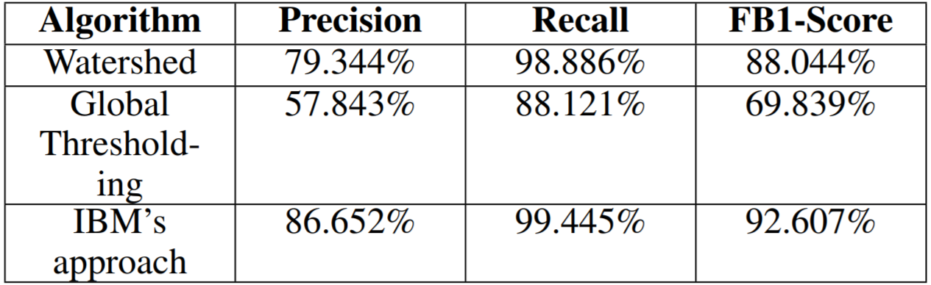
Accuracy

Slide 14
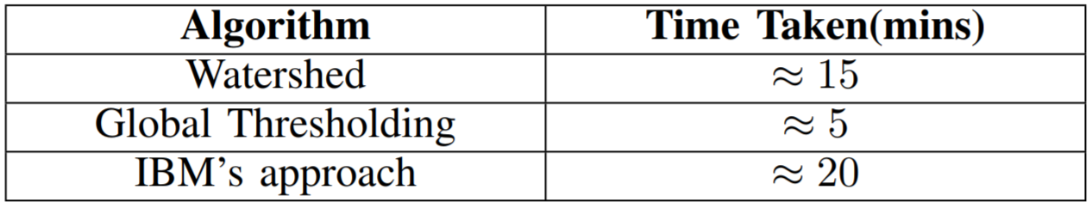
Efficiency

Slide 15
Observations and Conclusion
Estimated FB1 score for FSN (fast segmentation Neural Nets) as Kaggle considers is 99.23%.
Computational Cost for the same is approx 160 mins (nearly 3 hours) to train the model.
Nearly half hour is required to generate results for 320 images by the same FSNs.
These FSN’s are not an online version scalable.

Slide 16
Observations and Conclusion
IBM’s Segmentation Technique manages a high 92.6% FB1 score with only 20 min time for 320 images.
As it is an unsupervised technique, it scales without additional efforts.
Segmentation is still considered a revered problem among computer vision community.

Slide 17
SEGMENTATION IS STILL NOT COMPLETED !!
WE ARE THOUGH

Slide 18
Reference
MDL-Implementation
https://github.com/hlin117/mdlp-discretization
https://github.com/zhixuhao/unet
Paper-Implementation
http://ieeexplore.ieee.org/document/529692/
http://ieeexplore.ieee.org/abstract/document/5995597/?reload=true
https://en.wikipedia.org/wiki/Watershed_(image_processing)
Kaggle-Competition Guidance
https://github.com/malhotraa/carvana-image-masking-challenge

