Slide 1
Pulse Rate Estimation - A CV approach
Computer Vision Project
JAR

Slide 2
Motivation
Computer-vision-assisted non contact-based PR estimation has evolved significantly due to the limitations of contact-based techniques.
Non-clinical purposes
Absence of the patient - virtual PR Estimation.

Slide 3
Problem Statement
Given a facial video recording, the task is to estimate pulse rate using non contact techniques. The concepts include computer vision, facial recognition and detection and signal processing techniques.
The method is based on automatic face tracking along with blind source separation of the color channels into independent components

Slide 4
Literature Review
Our solution for PR Estimation is based on the following two papers:
M. Poh, D. McDuff, and R. Picard, “Non contact, automated cardiac pulse measurements using video imaging and blind source separation,” 2010
“Real-time Quantifying Heart Beat Rate from Facial Video Recording on a Smartphone using Kalman Filters”, Wen Jun Jiang,, Shi Chao Gao, Peter Wittek and Li Zhao, 2014
Both the papers make use of Video-based monitoring methods which are largely suitable for nonclinical purposes. The common method is to extract PPG signal by analyzing the periodic changes in skin color.

Slide 5
Literature Review
For both papers, the general algorithm is :
Input facial video
Face detection and tracking
ROI detection
Raw Feature Vector Extraction
Statistical Analysis
Estimated Pulse Rate
Frequency domain analysis
Bandpass Filtering
BVP signal extraction

Slide 6
PhotoPlethysmoGraphy (PPG)
The underlying process of these methods of non-contact estimation is PPG, a non-invasive optical technique of determining pulse rate by sensing the cardiovascular pulse wave or the blood volume pulse (BVP) through variations in transmitted or reflected light from the skin.
According to the Beer-Lambert law, the change of blood volume in the tissue is reversely proportional to the intensity of the light reflected or transmitted from skin. This is hardly seen by the naked eye, but it can be captured by the commercial camera.
Nowadays, the transmitted mode is often used in measuring PPG signal from the fingertip which is less susceptible to noise.

Slide 7
Implementation
INPUT FACIAL VIDEO
Input video length = 16 seconds
Frame rate =15 fps
Total frames processed = 240
FACE DETECTION
Done using Haar Feature-based Cascade Classifiers (Viola Jones’ method) in each frame

Slide 8
Implementation
ROI DETECTION
Using three different kinds of ROI for comparison: Full face, Forehead and Cheek
Full face -> central 60% width of bounding box
Forehead -> central 60% width and top 20% length
Cheek -> 30% width on each side of bounding box, bottom 50% length
RAW FEATURE VECTOR EXTRACTION
Extracting ‘traces’ as the average of R, G and B components across ROI of each frame
The traces would hence be of the length equal to the number of frames taken
Three correlated signals, each containing vital information

Slide 9
Implementation
PRE-PROCESSING
In order to remove small, high frequency motion artifacts we use a moving average window. By trial and error, we found the ideal moving average window length to be 4.
Normalized the three traces
STATISTICAL ANALYSIS
Decorrelating the three traces (assuming them to be linear combinations of three separate sources) using ICA
The independent components found are not ordered

Slide 10
Implementation
BVP SIGNAL EXTRACTION
Out of the three independent signals obtained, we observed that typically the second source has the highest SNR ratio and gives clear peak. Hence, we proceed taking the second signal every time
BANDPASS FILTERING
The measurements contain noise due to motion artifacts present in the video, hence we get a mixture of frequencies in the source signal
We set our operational range to [0.75 - 4] Hz as it corresponds to 45 to 240 bpm, taking into account even extreme cases of human pulse rates. The filtered signal is taken as measured BVP
Practically, the signal is filtered using a bandpass filter of the passband [0.75/fps-4/fps] Hz

Slide 11
Implementation
FFT and PSD
The Fourier transform if the BVP signal gives us frequencies present in the signal
Computing Power Spectral Density of the FFT of the correct BVP gives us peaks at the pulse rate (measured in Hz).
The peak value in Hz is then converted to bpm by multiplying it with 60.

Slide 12
Validation
We used 4 subjects with varying facial features and skin tones to test our method.
The illumination for these videos is also varying
The subjects were asked to remain normal (blinking, breathing and small twitching was allowed) but avoid big movements
Results gave an error range of +/- 4 bpm

Slide 13
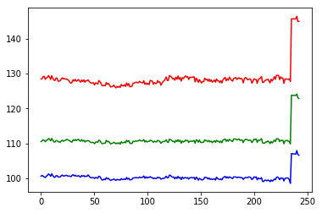
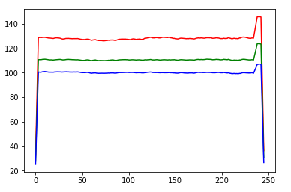
Results & Observations
For 102 bpm, 15 fps, 16 second (848x480p ) video
Raw R, G, B data (raw, unprocessed) After smoothing using moving
average window (of length 4)

Slide 14
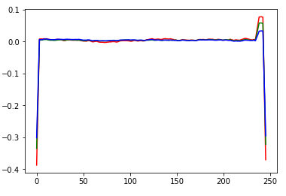
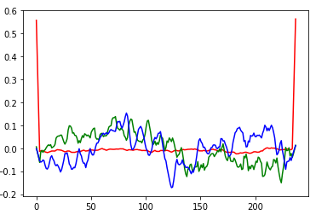
Results & Observations
For 102 bpm, 15 fps, 16 second (848x480p ) video
After normalization S₁, S₂ and S₃ after ICA (we select S₂ every time)

Slide 15
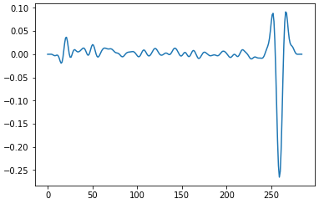
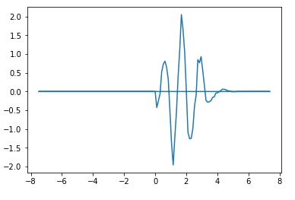
Results & Observations
For 102 bpm, 15 fps, 16 second (848x480p ) video
Bandpass Filtering Fast Fourier Transform

Slide 16
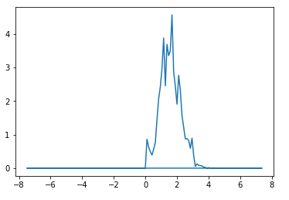
Results & Observations
For 102 bpm, 15 fps, 16 second (848x480p ) video
PSD : we can clearly see the peak at 1.7 here, which corresponds to 101 bpm

Slide 17
ROI Comparison results
Original bpm | Full face | Cheek | Forehead
102 | 101 | 98 | 104
78 | 82 | 82 | 74
75 (beard) | 76 | 95 | 76
73 (beard) | 69 | 72 | 72
77 (high movement) | 83 | 96 | 83

Slide 18
Conclusion
Here is a non-contact video based technique to measure heart rates. On comparing different parts of the face as ROI, we found that the full face works best in most cases.
However, it depends on the amount of skin in the image as well, so people with facial hair (beards) and prominent foreheads will give better/similar results in forehead. Also, people with prominent cheeks and small foreheads will give better results in cheek.
The idea to define a ROI which has more skin was to remove motion artifacts caused by blinking or movement of the lips. But we see that the movement has mostly been taken care of by smoothing the signal and bandpass filtering.

Slide 19
Future work
We can use video tracking instead of frame by frame processing as it would computationally less expensive.
Better segmentation techniques can be used to detect Region of Interest such as forehead or cheeks.
Ambient Noise Removal in the range of 0.75 to 4 Hz

Slide 20
References
M. Poh, D. McDuff, and R. Picard, Non contact, automated cardiac pulse measurements using video imaging and blind source separation, 2010
Real-time Quantifying Heart Beat Rate from Facial Video Recording on a Smartphone using Kalman Filters, Wen Jun Jiang,, Shi Chao Gao, Peter Wittek and Li Zhao, 2014
Viola Jones https://en.wikipedia.org/wiki/Viola
ICA https://www.cs.helsinki.fi/u/ahyvarin/whatisica.shtml
http://iopscience.iop.org/article/10.1088/0967-3334/28/3/R01/meta
http://neurosky.com/2015/01/ecg-vs-ppg-for-heart-rate-monitoring-which-is-best/

