Slide 1
Faculty Record Management System
Team Members-
Burhanuddin Bootwala ( EN18CS301071)
Dev Ramchandani (EN18CS301078)
Gurneet Chahbra (EN18CS301092)

Slide 2
Problem Domain
The "Faculty Management System" has been developed to override the problems prevailing in the practicing manual system. This software is supported to eliminate and, in some cases, reduce the hardships faced by this existing system. Moreover, this system is designed for the particular need of the company to carry out operations in a smooth and effective manner.
The application is reduced as much as possible to avoid errors while entering the data. It also provides error message while entering invalid data. No formal knowledge is needed for the user to use this system. Thus, by this all it proves it is user-friendly. Faculty Management System, as described above, can lead to error free, secure, reliable and fast management system. It can assist the user to concentrate on their other activities rather to concentrate on the record keeping. Thus, it will help organization in better utilization of resources.
Every organization, whether big or small, has challenges to overcome and managing the information of Students, Faculty, Courses, Managing Sessions, Lectures. Every Faculty Management System has different Faculty needs; therefore, we design exclusive employee management systems that are adapted to your managerial requirements. This is designed to assist in strategic planning, and will help you ensure that your organization is equipped with the right level of information and details for your future goals. Also, for those busy executives who are always on the go, our systems come with remote access features, which will allow you to manage your workforce anytime, at all times.
These systems will ultimately allow you to better manage resources.

Slide 3
Technology Used
Frontend – CSS, HTML, JS.
Backend - Python.
Framework – Django.
For Database - MySQL

Slide 4
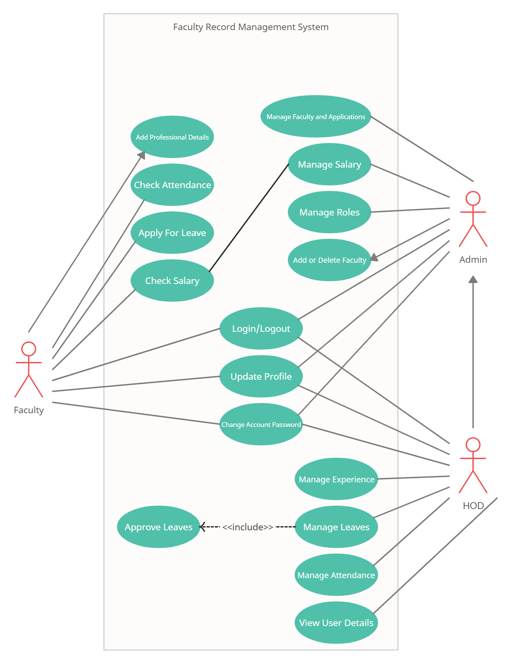
Use Case Diagram

Slide 5
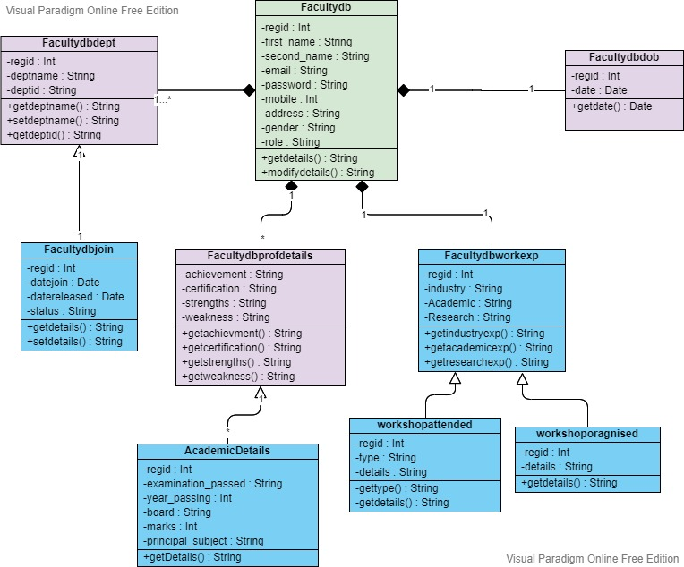
Class Diagram

Slide 6
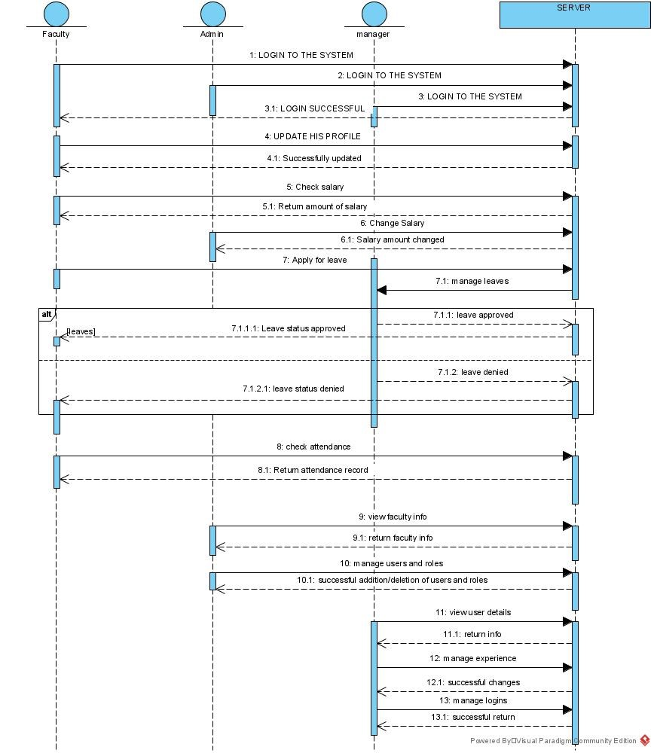
Sequence Diagram

Slide 7
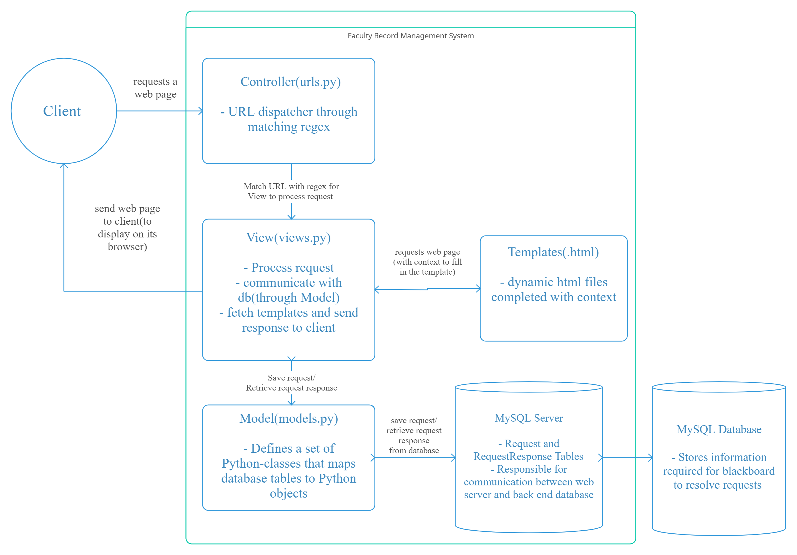
Deployment Diagram

Slide 8
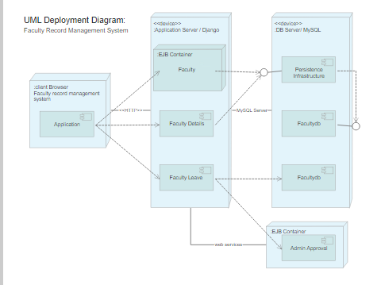
Deployment Diagram

Slide 9
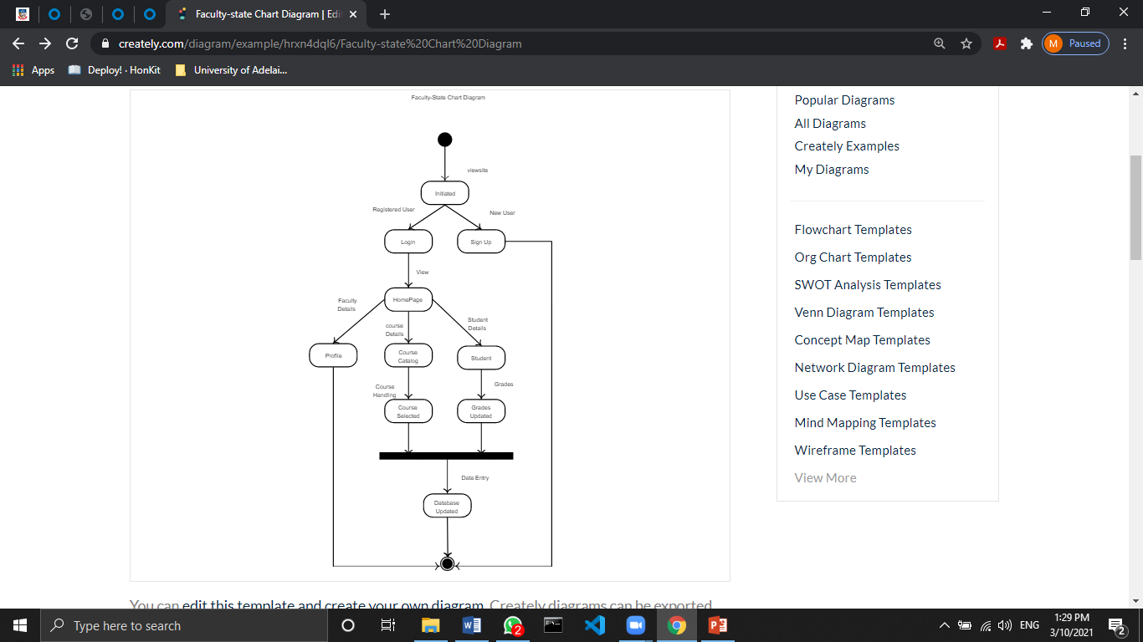
State Chart Diagram

Slide 10
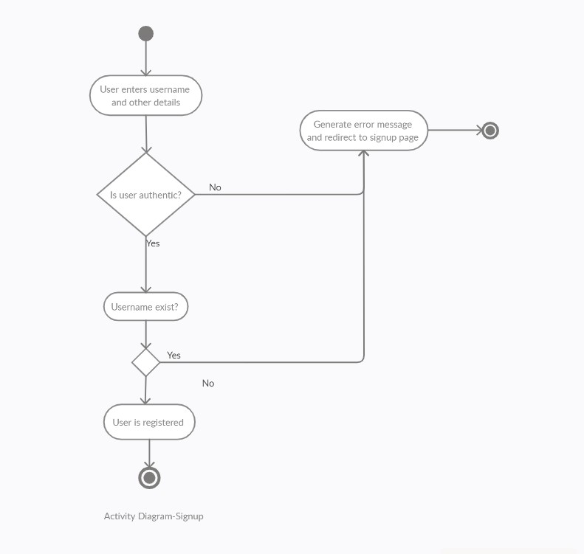
Activity Diagram

Slide 11
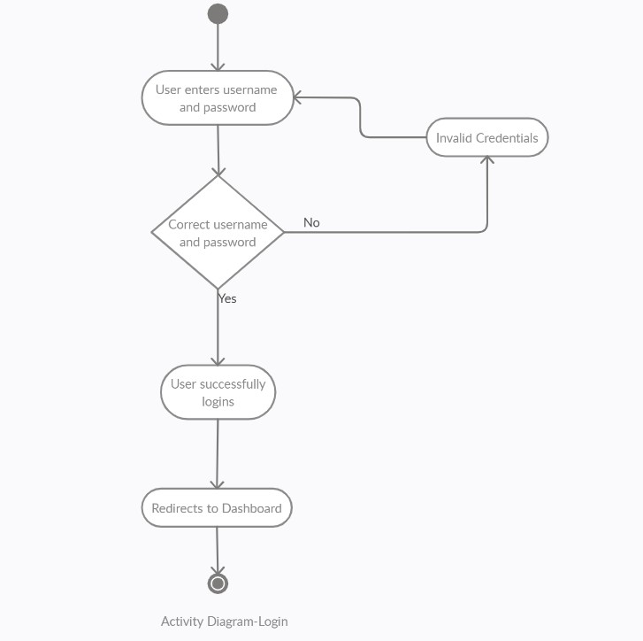
Activity Diagram

Slide 12
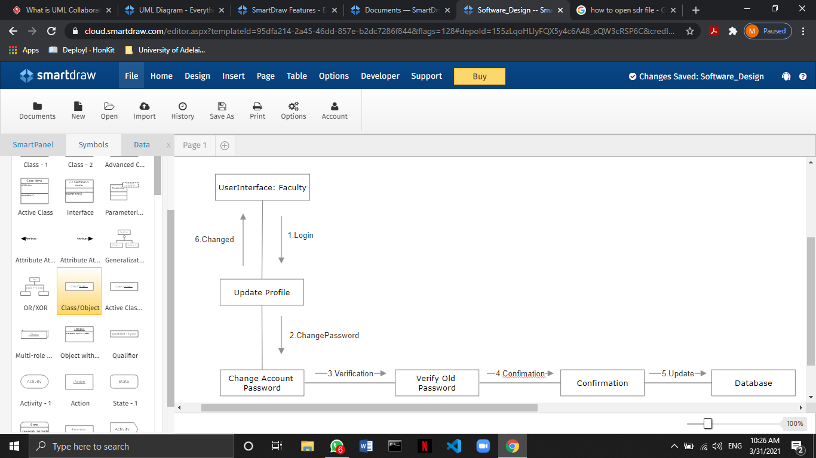
Collaboration Diagram

Slide 13
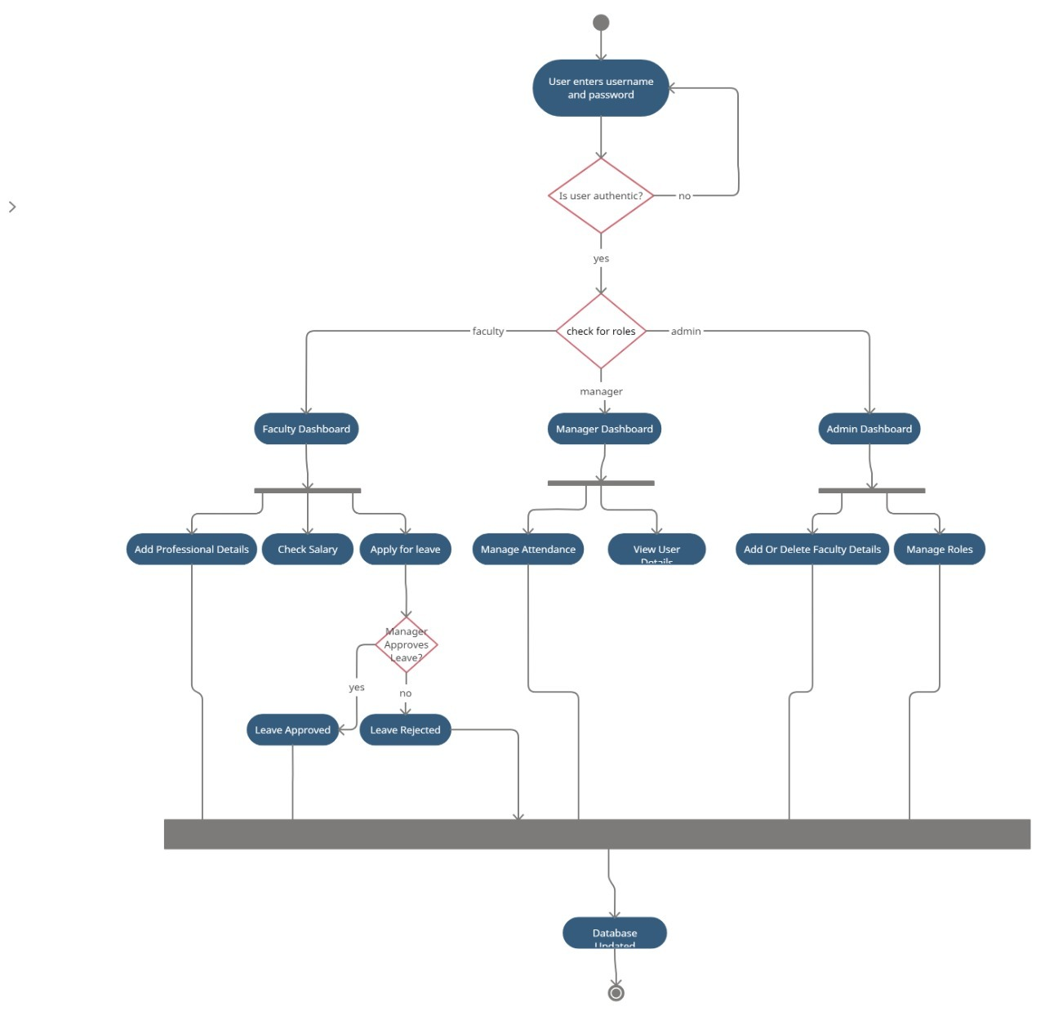
Activity Diagram

